Slide 1

The Course of Atmospheric Thermodynamics
MUSTANSIRIYAH UNIVERSITY
COLLEGE OF SCIENCES
ATMOSPHERIC SCIENCES DEPARTMENT
2020-2021
Dr. Sama Khalid Mohammed
SECOND STAGE
Lecture 5

Slide 2

THIS LECTURE INCLUDING THE FOLLOWING ITEMS
CONDENSATION LEVEL.
FREE CONVECTION LEVEL.
THERMODYNAMIC DIAGRAMS.

Slide 3
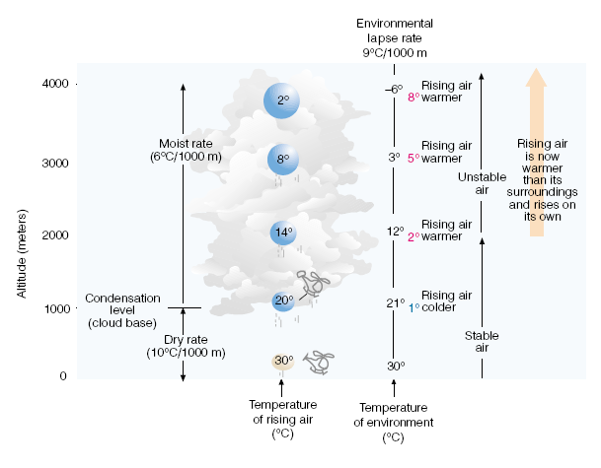
CONDENSATION LEVEL
Suppose an unsaturated (but humid) air parcel is somehow forced to rise from the surface, as the parcel rises, it expands, and cools at the dry adiabatic rate until its air temperature cools to its dew point. At this level, the air is saturated; the relative humidity is 100 percent, and furthers lifting results in condensation and the formation of a cloud.

Slide 4
CONDENSATION LEVEL
The elevation above the surface where the cloud first forms is called the condensation level (for example 1 km) , notice that above the condensation level, the rising saturated air cools at the moist adiabatic rate. Notice also that from the surface up to a level near 2 km, the rising; lifted air is colder than the air surrounding it. The atmosphere up to this level is stable.

Slide 5
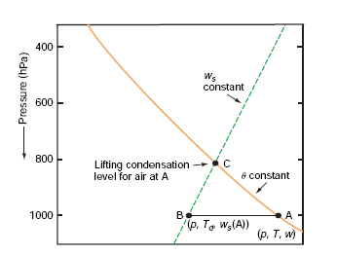
CONDENSATION LEVEL
During lifting the mixing ratio w and potential temperature of the air parcel remain constant, but the saturation mixing ratio w_{s} decreases until it becomes equal to w at the LCL. Therefore, the LCL is located at the intersection of the potential temperature line passing through the temperature T and pressure p of the air parcel, and the w_{s} line that passes through the pressure p and dew point T_{d} of the parcel

Slide 6
FREE CONVECTION LEVEL
Due to the release of latent heat, the rising air near 2 km has actually become warmer than the air around it. Since the lifted air can rise on its own accord, the atmosphere is now unstable. The level in the atmosphere where the air parcel, after being lifted, becomes warmer than the air surrounding it, is called the level of free convection.

Slide 7
Why We Use Thermodynamic Diagrams?
They are used to graphically display the relation between two of the thermodynamic variables T, V, and p, Process lines represent on the diagram. This is done through processes lines which represent specific thermodynamic processes, and each chart contains five sets of lines including: Isotherms , Isobars , Adiabats, Pseudoadiabats(moist adabats), Saturation moisture lines.
We used them for basic calculation such as condensation level, temperature of free convection.

Slide 8
Why We Use Thermodynamic Diagrams?
When an air parcel undergoes a reversible process, the succession of states is represented on the thermodynamic diagram by a curve.
A cyclic process is represented by a closed curve.
On some charts the area so enclosed is directly proportional to the work done in the process.

Slide 9
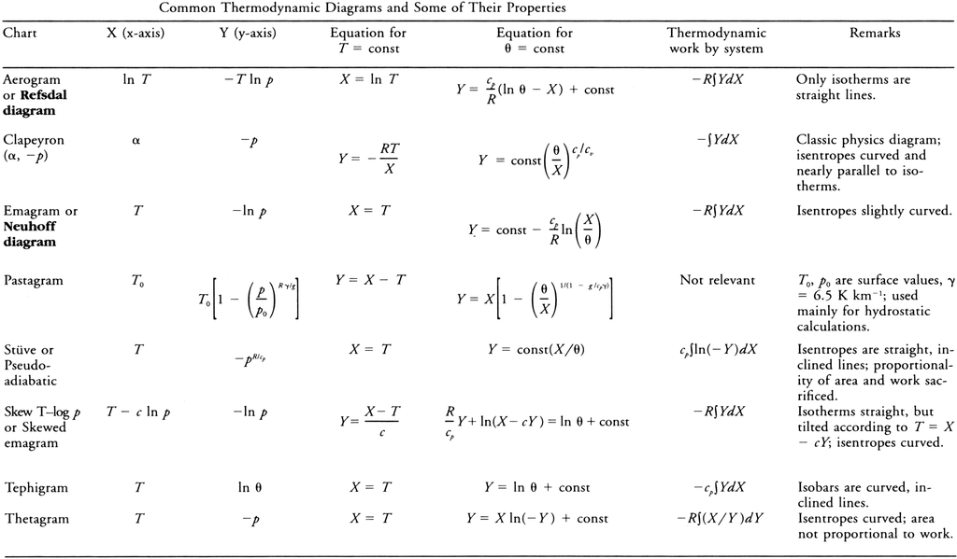
FYI: Thermodynamic Diagrams Info.

Slide 10
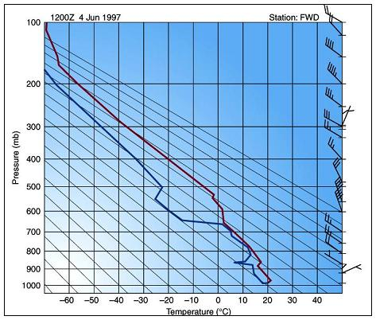
Isobars and Isotherms in a Thermodynamic Diagrams
The pressure and temperature uniquely define the thermodynamic state of a dry air parcel of unit mass at any time. The horizontal lines represent isobars and the vertical lines describe isotherms.

Slide 11
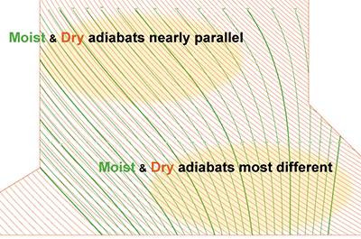
Dry Adiabats and Moist or Pseudo Adiabats
Dry Adiabats lines represent the change in temperature that an unsaturated air parcel would undergo if moved up and down in the atmosphere.
Pseudo or moist Adiabatic Lines usually curves portray the temperature changes that occur upon a saturated air parcel when vertically displaced. Saturation adiabats appear on the thermodynamic diagram as a set of curves with slopes ranging from 0.2C°/100 m in warm air near the surface to that approaching the dry adiabats (1C°/100 m) in cold air aloft, why?

Slide 12
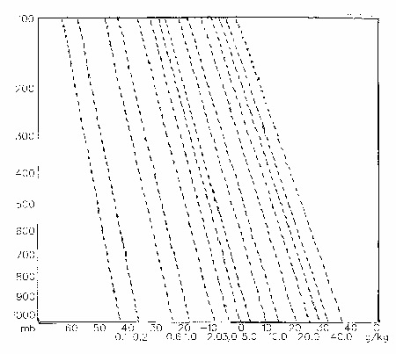
Isohume – Mixing Ratio Lines
These lines (also called saturation mixing ratio lines or isopleths) uniquely define the maximum amount of water vapor that could be held in the atmosphere (saturation mixing ratio) for each combination of temperature and pressure. These lines can be used to determine whether the parcel were saturated or not.

Slide 13
What are the properties of a Useful Thermodynamic Diagrams?
The diagrams are such that equal area represents equal energy on any point on the diagram.
A useful thermodynamic diagram should have the following general properties
The area enclosed by a cyclic process should be proportional to the work done during the process.
As many of the process lines as possible should be straight.
The angle between the isotherms and adiabats should be as close to 90 as possible.

Slide 14
FYI: How to create a diagram?
We can create a diagram with area proportional to work using the p-α diagram.
Since work per unit mass is defined as dw = - p dα , the area on a p- α diagram is proportional to work.
But this diagram is not very useful for meteorologists because
The angle between isotherms and adiabats is very small
Process lines aren’t very straight
Volume is not a convenient thermodynamic variable for meteorology.

Slide 15
How to create a Useful diagram for Meteorologist?
By using (T and p ) as the thermodynamic variables, but we have to find a way of setting up the axes of our diagram so that area will be proportional to work.
What are the True thermodynamic diagram?
Because equal area represents equal energy on any point on the diagram, a true thermodynamic diagram has an Area and Energy

Slide 16
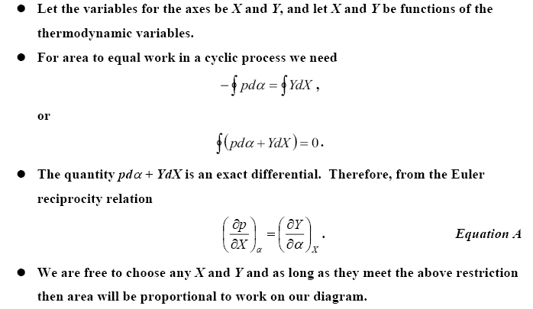
FYI: How to create a Useful diagram for Meteorologist?

Slide 17
What are the Types of Diagrams?
Some of the types of the Thermodynamic Diagrams are:
Emagram
Tephigram
SkewT/Log P diagram (modified emagram)
Psuedoadiabatic (or Stüve) diagram

Slide 18
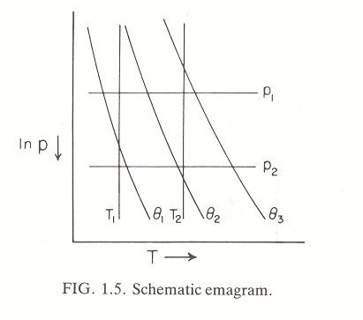
What is The EMAGRAM? What are the Properties of its Lines?
The emagram (energy-per-unit-mass diagram) is created by letting X = T, and by using the equation of state for dry air with some mathematical processes we get the diagram axes: X=T , Y= - R_{d} ln P
The properties of the lines in Emagram are:
Dry Adiabats are slightly curved, concave upward, Pseudoadiabats are curved convex upward, Isotherm – adiabat angle varies with axis scale, but is usually about 45°.
Area denotes total work done in a cyclic process ∮ w = -R_{d}∮ T dlnP, and this it represent a true thermodynamic diagram.
isotherms
R_{d} lnP
isobars
T

Slide 19
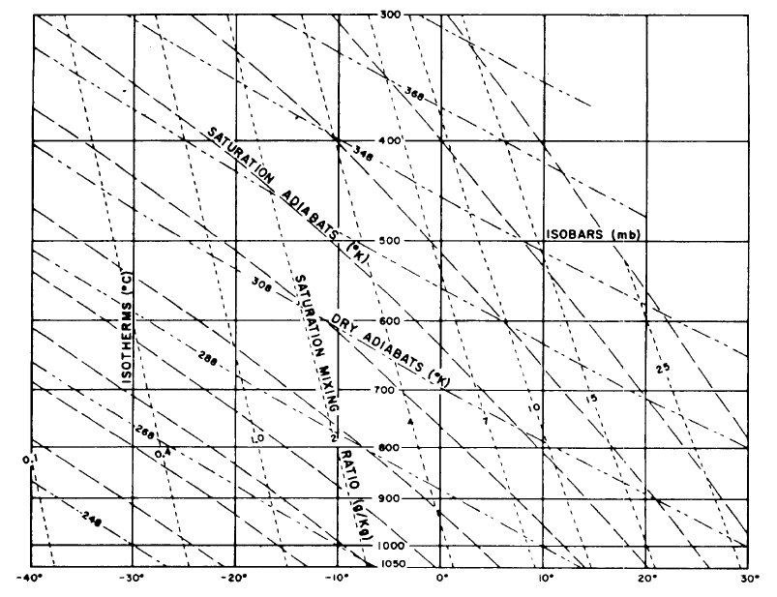
EMAGRAM

Slide 20
‘Pseudo-adiabatic’ chart
we can look at the following equation of potential temperature graphically, then we will get e.g., the ‘Pseudo-adiabatic’ chart
Re-arrange:
So if you plot: p^{0.286} on y-axis, T on x-axis
For a constant θ, (p₀^{0.286}/θ) is also a constant, so the graph yields a straight line with gradient given by (p₀^{0.286}/θ), and passing through T=0 and p=0

Slide 21
‘Pseudo-adiabatic’ chart
Earth’s
atmosphere
y-axis is linear for p^{0.286}
also linear for ln(p)

Slide 22
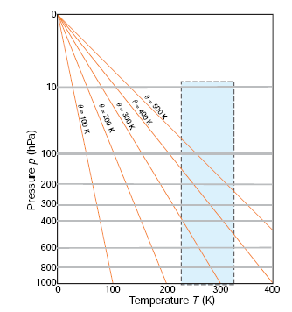
‘Pseudo-adiabatic’ chart
isotherms are vertical and dry adiabats (constant θ) are oriented at an acute angle relative to isotherms.
Because changes in temperature with height in the atmosphere generally lie between isothermal and dry adiabatic, most temperature soundings lie within a narrow range of angles when plotted on a pseudo-adiabatic chart.
Advantage:
we can follow each line and determine graphically temperature at any pressure, assuming adiabatic expansion / compression.
Disadvantage:
Everything happens in small region of the chart.

Slide 23
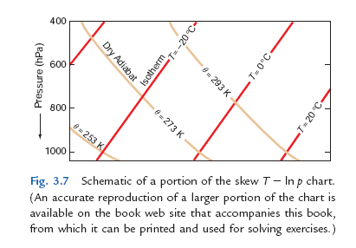
‘Skew T – ln P ’ chart
This restriction is overcome in the so-called skew T -ln p chart, in which the ordinate (y) is ln p and the abscissa (x) is x=T+(constant)y = T-(constant)ln p
So y=(x−T)/(constant)
and for an isotherm T is constant, the relationship between y and x for an isotherm is of the form y = mx + c, where m is the same for all isotherms
and c is a different constant for each isotherm. Therefore, on the skew T - ln p chart, isotherms are straight parallel lines that slope upward from left to right.
y = -RlnP
x = T + klnP

Slide 24
‘Skew T – ln P ’ chart
The scale for the x axis is generally chosen to make the angle between the isotherms and the isobars about 45°, as depicted schematically in Fig. Note that the isotherms on a skew T - ln p chart are intentionally “skewed” by about 45° from their vertical orientation in the pseudoadiabatic chart (hence the name skew T ln p chart).

Slide 25
‘Skew T – ln P ’ chart
From (eq 1), the equation for a dry adiabat (θ constant) is –ln P = (constant) ln T + constant
Hence, on a ln p versus ln T chart, dry adiabats would be straight lines. Since ln p is the ordinate on the skew T – ln p chart, but the abscissa is not ln T, dry adiabats on this chart are slightly curved lines that run from the lower right to the upper left. The angle between the isotherms and the dry adiabats on a skew T ln p chart is approximately 90° .
Therefore, when atmospheric temperature soundings are plotted on this chart, small differences in slope are more apparent than they are on the pseudoadiabatic chart.
y = -RlnP
x = T + klnP

Slide 26
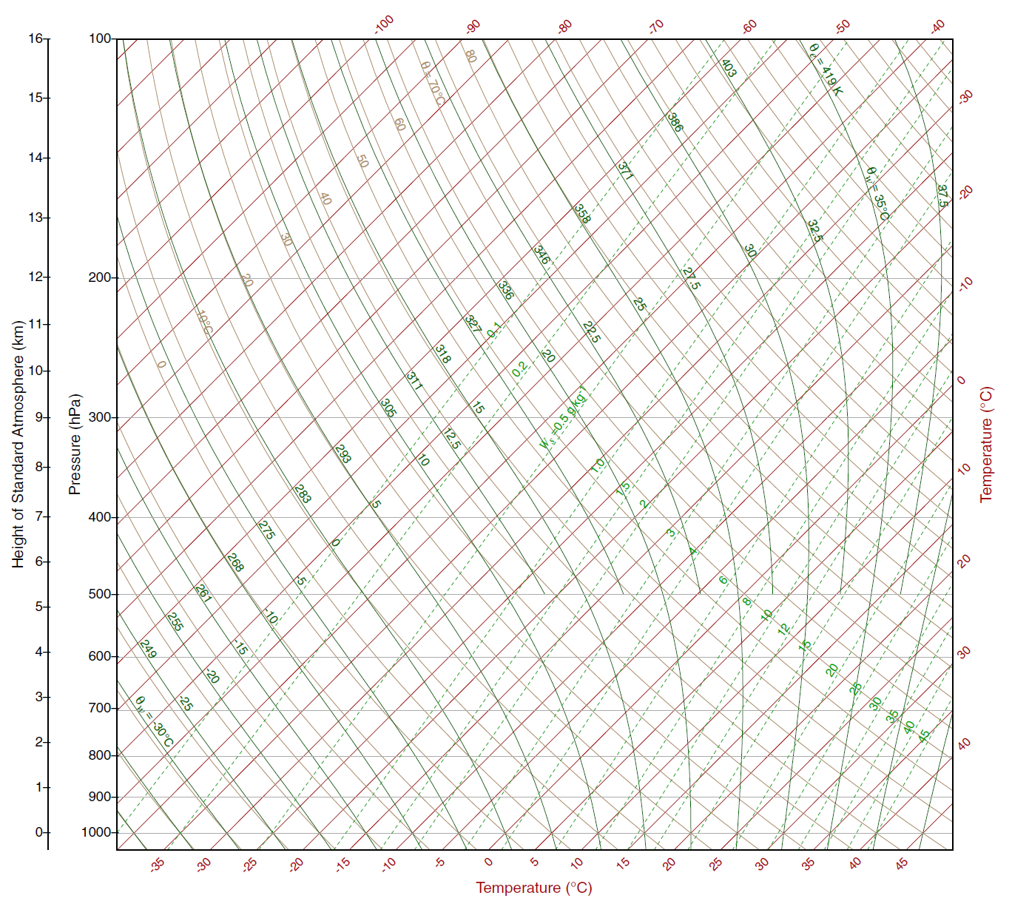
What are all the
lines on the skew T-ln p chart?
isobar
isotherm
dry
adiabat
saturated
adiabat
saturation
mixing
ratio

Slide 27
CHECK OUT THIS SITE FOR
SKEW T- ln P CHART
https://www.weather.gov/jetstream/skewt

