Slide 1

Eddy Flux
Basim ALknani

Slide 2
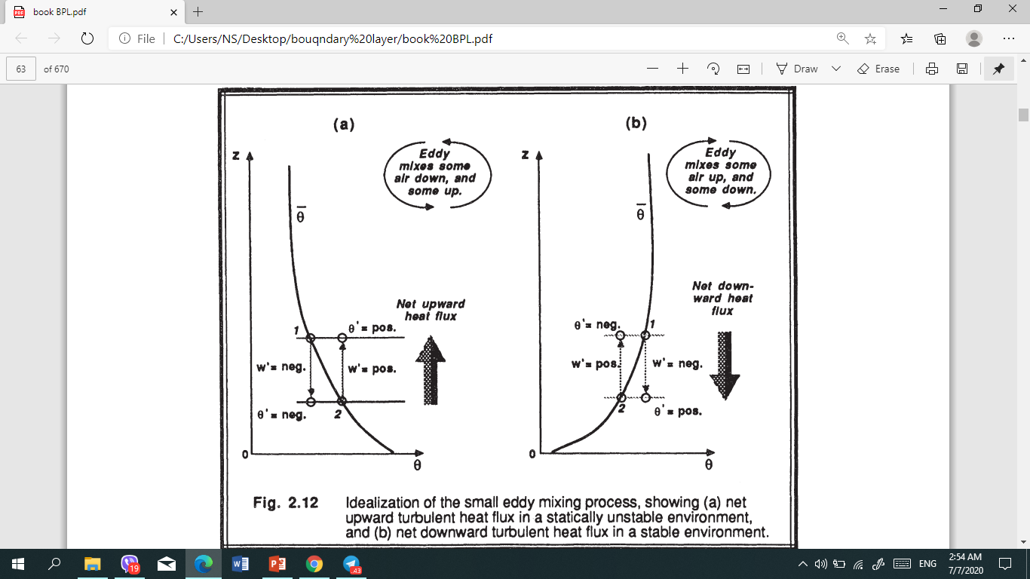
Eddy Flux
If turbulence is completely random, then a positive w' ϴ' one instant might cancel a negative w' ϴ' at some later instant, resulting in a near-zero value for the average turbulent heat flux. ​As is shown below, however, there are situations where the average turbulent flux might be significantly different from zero.
a small idealized eddy near the ground on a hot summer day
(see Fig 2.12a). The average potential temperature profile is usually superadiabatic in such surface layers. If the eddy is a swirling motion, then some of the air from position 1 will be mixed downward (i.e., w' is negative) , while some air from position 2 will mix up (i.e., w' is positive) to take its place.
The average motion caused by turbulence is w' = 0
The downward moving air parcel (negative w') ends up being cooler than its surroundings (negative ϴ' ), resulting in an instantaneous product )w'ϴ'( that is positive. The upward moving air (positive w') is warmer than its surroundings (positive ϴ' ), also resulting in a positive instantaneous product )w'ϴ'(. Both the upward and downward moving air contribute positively to the flux, )w'ϴ'(; thus, the average kinematic eddy heat flux )w'ϴ'( is positive for this small-eddy mixing process. Turbulent eddies transport heat upward in this case, tending to make the lapse rate more adiabatic.

Slide 3
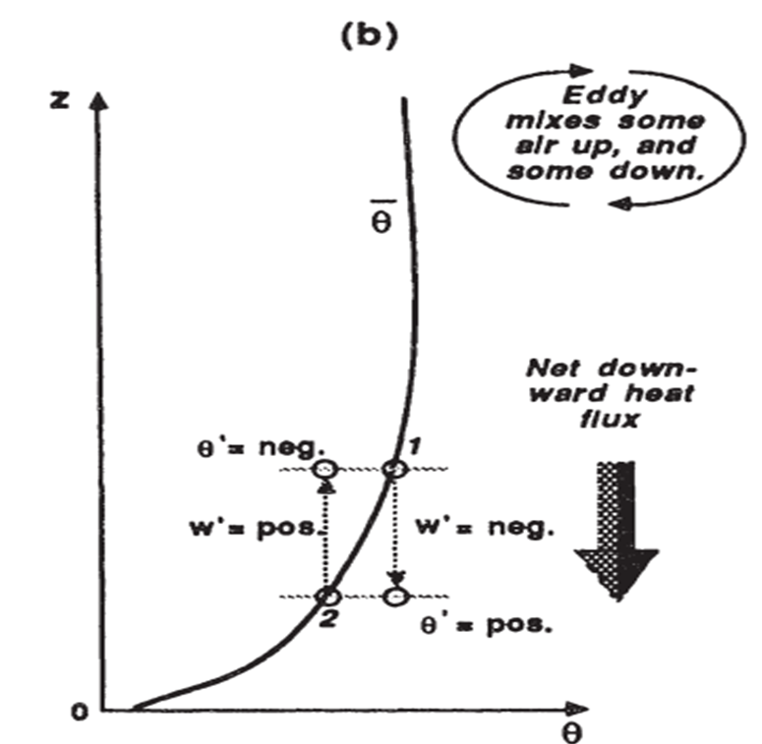
night where a statically stable lapse rate is present (Fig 2.12b). Again, picture a small eddy moving some air up and some back down. An upward moving parcel ends up cooler than its surrounding (negative w'ϴ'( , while a downward moving parcel is warmer (negative w'ϴ'). The net effect of the small eddy is to cause a negative w'ϴ' meaning a downward transport of heat.

