Slide 1
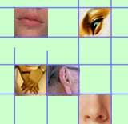
Introduction to Multimedia
By
Dr. Hadi AL Saadi

Slide 2
What is multimedia?
Multi: more than one
Medium (singular): middle, intermediary, mean
Media (plural): means for conveying information
Media in the press, newspaper, radio and TV context - mass media
Media in communications: cables, satellite, network – transmission media
Media in computer storage: floppy, CD, DVD, HD, USB – storage media
Media in HCI context: text, image, audio, video, CG – interaction media
Multimedia is a presentation of a computer application
incorporating media elements such as text, graphics, animations
, audio, and video.

Slide 3
What is Multimedia in terms of Computing
Computing: Computer-based technologies and applications
→ What computers? →Various forms of computers/devices!
In terms of computing, four fundamental multimedia attributes:
Digitized: All media including audio/video are represented in digital format
Distributed: The information conveyed is remote, either pre-produced and stored or produced in real-time, distributed over networks
Interactive: When the user is given the option of controlling the elements of the multimedia project .
Integrated: The media are treated in a uniform way, presented in an orchestrated way, but are possible to manipulate independently
Definition of Multimedia:
Computer-based techniques of text, images, audio, video, graphics, animation, and any other medium where every type of information can be represented, processed, stored, transmitted, produced and presented digitally.

Slide 4

Multimedia can be classified
LINEAR
A Multimedia Project is identified as Linear when:
  It is not interactive
  User have no control over the content that is being showed to them.
Example:
  A movie
  A non-interactive lecture / demo show
NON-LINEAR
A Multimedia Project is identified as Non-Linear when:
  It is interactive , users have control over the content that is being showed to them.
  Users are given navigational control
Example:
  Games
  Courseware
  Interactive CD

Slide 5
Benefits of Multimedia
10% of what they read
20% of what they hear
30% of what they see
50% of what they hear and see
80% of what they hear, see and say
90% of what they hear, see, say and touch

Slide 6
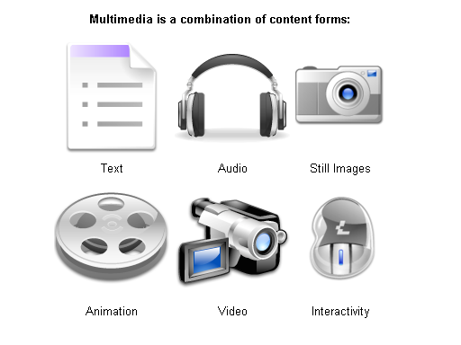
What are the media components?
Text - ASCII/Unicode, HTML, Postscript, PDF
Audio – Sound, music, speech, structured audio (e.g. MIDI)
Still Image - Facsimile, photo, scanned image
Video (Moving Images) – Movie, a sequence of pictures
Graphics – Computer produced image
Animation – A sequence of graphics images

Slide 7
Classification of media types
Time/Space nature
Sound
Video
Animation
Continuous
or time-based
Photo
Text
Graphics
Discrete
or space-based
Origin
Captured
from real world
Synthesized
by computer

Slide 8
Captured Versus Synthesized Media
Captured media refers to information types captured from the real world (e.g. Still pictures, moving pictures, and sound).
Synthesized media refers to information types synthesized by the computers (e.g. Text, graphics and computer animation).
Discrete Versus Continuous Media
Discrete media refers to media involving space dimension only (e.g. Still images, text and graphics). Discrete media is also referred to as static media or non-time-based media or non-temporal media or space-based media.
Continuous (time based) media refers to time-based media (e.g. Sound, moving images, and animation). Continuous media is also referred to as dynamic media or time-based media or temporal media.

Slide 9
Characteristics of Multimedia System
They must be computer-controlled.
User is able to view, hear, and see using a Multimedia PC System.
They are integrated.
At least one discrete and one continuous media combined for information presentation
design sharing
The information they handle must be represented digitally.
Consists of various form of media i.e. text, graphics, audio, video, and animations; created, stored, processed, and transmitted DIGITALLY.
The interface to the final user may permit interactivity.
User is able to navigate, interact, create, and communicate.

Slide 10
General Overview of a Multimedia System

Slide 11
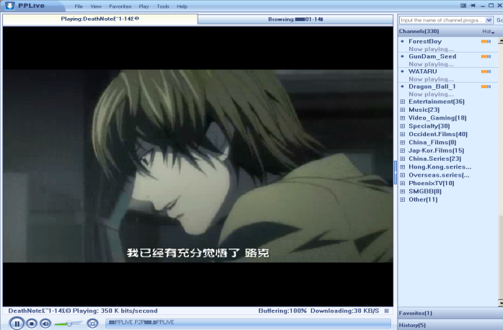
Benefits of using multimedia in software
Ease of use
  User friendly, increase user’s effectiveness
Intuitive Interface
  Allows user to determine functions of an application by their own intuition
Immersive Experience
- Software application takes over the entire computer screen, allows user to focus on application

Slide 12
Benefits of using multimedia in software
Self-paced interaction and better retention
- allows information processing at one’s own pace
Better understanding
- simultaneous presentation of different media provides richer & broader range of information.
Cost effectiveness
- less training, less technical support

Slide 13
Problems with Multimedia
Investment costs
- multimedia involves high volume of content
- expensive copyright and royalty
Technical barriers (accessibility issues)
- upgrade IT and PC infrastructure
Socio psychological barriers
  - Generation gap
  - Learning rates
  - Learning in group/individual
  - Importance of teacher
Legal problems
  - Copyright

Slide 14

Where to use multimedia ?
Business
Government
Education
Broadcasting and Entertainment
Research and Development
Health

Slide 15

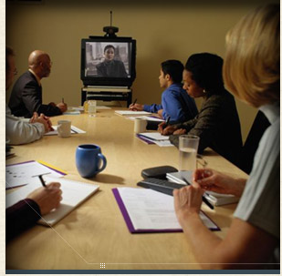
Business
Interactive Multimedia Merchandising
  Online-shopping Kiosks
  Virtual shopping / home shopping
  http://www.thevirtualmall.co.uk/
Desktop Videoconferencing
  Due to the high cost of transportation and the large amount of employee time spent traveling to meetings, videoconferencing is on the rise.

Slide 16
…continued
Multimedia Travel Systems
  These systems enable the travel agents to show their customers about where they will travel, what will be their accommodation like, and what they will be able to do at their destinations.
  www.visitmalaysia.com.my
Real Estate
  Multimedia systems enable buyers to visit hundreds of properties virtually, view on screen photos of homes, inspect floor plans, see street maps, and study neighborhood demographics.
  www.penangtimessquare.com

Slide 17
…continued
Corporate Training
  Many corporations have used multimedia to reduce training cost and improve employee productivity.
Advertising and Electronics Brochures
  The electronic brochure is an advertising and marketing tool that usually consists of single diskette or CD-ROM sent to targeted audiences. Corporations are also beginning to offer shareholders annual reports on CD-ROM.
www.porsche.com

Slide 18
Government
Public Service Kiosks
  Multimedia kiosks convey public service information such as jobs and employment opportunities.
  City-info kiosks offer to citizens and travelers the ability to find information on addresses, points of interest, shops, restaurants, public transportation, hours of opening, guided tours, city transport info.

Slide 19
…continued
Politics
  Multimedia in general and internet in particular are playing a big role in politics and virtual campaigning where every political candidate contesting in an election has a web site.
Consumer Information
  Multimedia based CD-ROMs are available which contains government information on a wide variety of topics: government forms, list of government offices in each state, tax preparation etc.

Slide 20

Education
Computer Aided Learning
To assist student through simulation for better understanding such as volcano eruption, corrosion, language pronunciation, etc.
www.quiz-tree.com
Virtual Campus
Learning takes place in a virtual classroom using video conferencing and online lecture so that students all around the world can attend.

Slide 21
Broadcasting and Entertainment
Electronic catalogue
Product features and descriptions are advertised through web, CD and mobile devices.
Interactive Movie
Viewers can decide the direction of the plot of the movie and camera angle.
On-demand News or movies
News, movies and TV series can be watched on demand through web and mobile devices.
http://soccernet.espn.go.com

Slide 22

…continued
3D or animated movies
Movies created through advance 3D technology and animation techniques.
Video Games
Advances in the field of multimedia have led to more attractive video and computer games being available now in the consumer market.

Slide 23
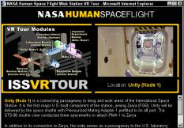
…continued
Virtual Reality
Virtual Reality refers to the use of a computer to immerse the user into a simulated experience that it seems real. Virtual reality systems often use special hardware to enhance the experience, including visual displays.
Cyber Sports
Cyber Sports is the use of virtual reality to provide computer users with a realistic sports experience. Two new interactive virtual reality devices let you “Swing” and “Hit” balls at your PC.

Slide 24
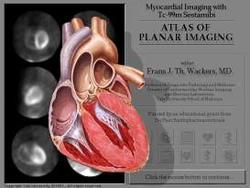
Medicine
Virtual Surgery
Virtual surgery authoring system has been created for producing surgical training simulation.
Surgeons can use 3-D images created from magnetic resonance imaging (MRI) scans of the human body to practice complicated procedures such as brain tumor removal and reconstructive surgery.

Slide 25
…continued
Video Conferencing and Image Retrieval
The use of imaging techniques (X-Rays, CT, MRI etc) is growing in health care. The collection, maintenance, processing and distribution of these records can be significantly improved by using computer based storage and multimedia networking. Once these records are integrated with the on-line patient information and easily shared by both local and remote physicians, it results in a large number of benefits like reduced cost and improved care.

Slide 26
Multimedia Products
Briefing
eg: corporate presentation, sales presentation and educational lectures.
Reference
eg: encyclopedias, dictionaries
Database
eg: library system, phone directory

Slide 27
…continued
Education and Training
eg: - Instructor support products – Resource materials for instructors
  - Standalone or self-paced products – Learning bmaterials for students to study at their own pace
Kiosk
eg: bank machines, mall information centers.
Entertainment and Games
eg: computer games and movies.

Slide 28

Text Book
Text Books
1) Ze-Nian Li & Mark S. Drew, "Fundamentals of Multimedia",
Pearson Education, 2004

