Slide 1
The RNA Viruses That Infect Humans
Lec 10

Slide 3
Nonenveloped Nonsegmented ssRNA Viruses: Picornaviruses
Picornaviruses represent a very large virus family “pico” referring to small size and “rna” referring to its core of ribonucleic (RNA).They include two major groups of human pathogens: Enteroviruses and Rhinoviruses. Enteroviruses are transient inhabitants of the human alimentary tract and may be isolated from the throat or lower intestine. Rhinoviruses are associated with the respiratory tract and isolated chiefly from the nose and throat. Less common picornaviruses associated with human illness include hepatitis A virus and cardiovirus.

Slide 4
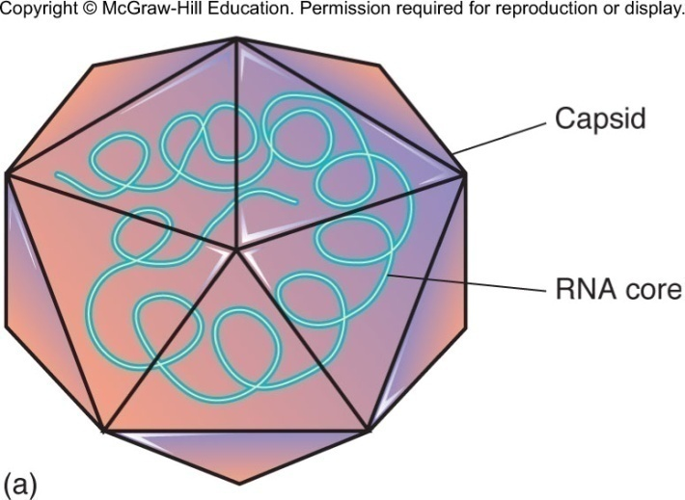
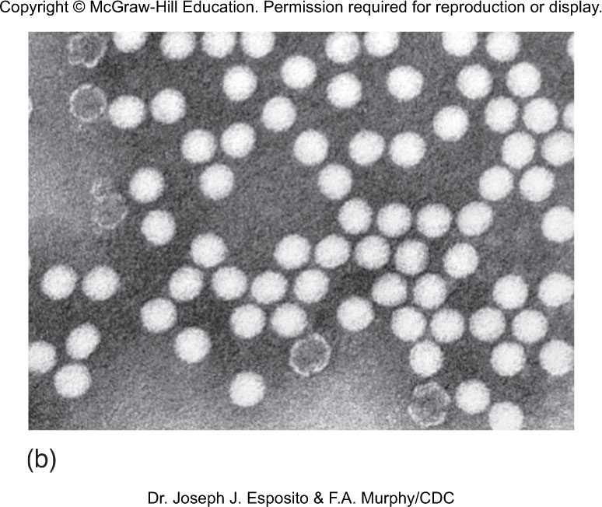
Nonenveloped Nonsegmented ssRNA Viruses: Picornaviruses
Picornaviruses
Enterovirus – poliovirus, HAV
Rhinovirus – rhinovirus
Cardiovirus – infects heart and brain

Slide 5
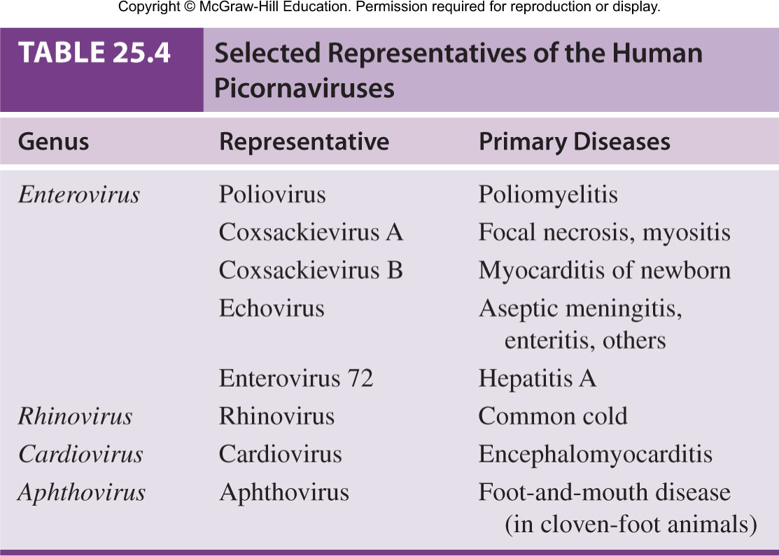
Picornaviruses

Slide 6
Poliovirus and Poliomyelitis
Poliovirus – Single-stranded RNA, linear, positive sense, naked icosahedral symmetry Size: 22-30nm, Shape: spherical; resistant to acid, bile, and detergents; can survive stomach acids when ingested.
Poliovirus can survive for 4-6 months in cold water.
Worldwide vaccination programs have reduced the number of cases; eradication is expected.
Poliomyelitis (polio) – acute enteroviral infection of the spinal cord that can cause neuromuscular paralysis.

Slide 7
Pathogenesis of Poliomyelitis
⇒ Mode of Transmission: Polio virus is transmitted primarily by Fecal-Oral route through ingestion, other routes includes Inhalation & conjunctiva. Polioviruses adhere to receptors of mucosal cells in oropharynx, and intestine multiply in number and shed in throat and feces, some leak into blood
Initially virus multiplies in epithelial cells of GIT &
Lymphatic tissues, from the tonsils
⇓
Spreads to regional lymph nodes- enters bloodstream. Most infections are short-term, mild viremia
⇓
Carried to the spinal cord & brain.
⇓
In CNS, virus multiplies in neurons & destroys them .
⇓
Lesions are mostly in anterior horn of spinal cord, cause paralysis.

Slide 8
Pathogenesis of Poliomyelitis
Some develop mild nonspecific symptoms of fever, headache, nausea, sore throat, and myalgia
If viremia persists, virus spreads to spinal cord and brain.
Invasion of motor neurons causes flaccid paralysis.
Decades later post-polio syndrome (PPS) –progressive muscle deterioration; occurs in 25-50% of patients infected with polioviruses in childhood.
Copyright © McGraw-Hill Education. Permission required for reproduction or display.
Asymptomatic
Minor non-CNS illness
Aseptic meningitis
Paralytic
0
20
40
60
80
100
Percent

Slide 9
LABORATORY DIAGNOSIS OF POLIOVIRUS
⇒ Specimen : Blood, CSF, Throat swab and Feces; autopsy specimen includes brain & spinal cord.
⇒ Direct demonstration of virus : virus can be demonstrated in feces by direct electron microscopy ⇒ Isolation of virus : specimens are inoculated into HeLa and Hep-2 cell line, virus growth indicated by typical cytopathic effect seen in cells within 2-3 days.
⇒ Serology : neutralization test can be used for serotyping of poliovirus.

Slide 10
Treatment and Prevention
Treatment is largely supportive for pain and suffering; respiratory failure may require artificial ventilation; physical therapy may be needed
Prevention is vaccination:
Active immunization by vaccination is effective against poliovirus; two types of vaccines
Inactivated polio vaccine (IPV) Salk vaccine is given by deep subcutaneous or intramuscular injection, induces only systemic antibody response but do not provide intestinal or mucosal immunity.
Oral polio vaccine (OPV) Sabin vaccine, attenuated virus induces both local secretory IgA antibodies in the intestine or mucosa and also Humoral antibodies (IgM & IgG).no longer recommended in the U.S.
Worldwide eradication is being attempted.

Slide 11
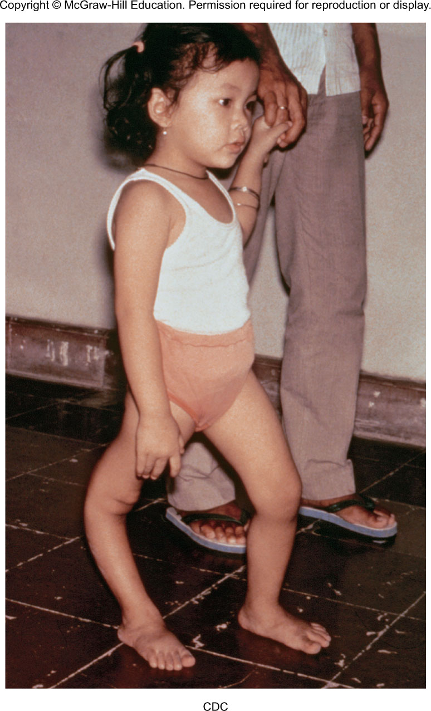
Images of Polio

Slide 12
Nonpolio Enteroviruses
Most common
Coxsackieviruses A and B
Echoviruses
Nonpolioenteroviruses
Similar to poliovirus in epidemiological and infectious characteristics but less virulent
Responsible for respiratory infections, conjunctivitis, and hand-foot-mouth disease
Rare cases of coxsackievirus and echovirus paralysis, aseptic meningitis, and encephalitis

Slide 13
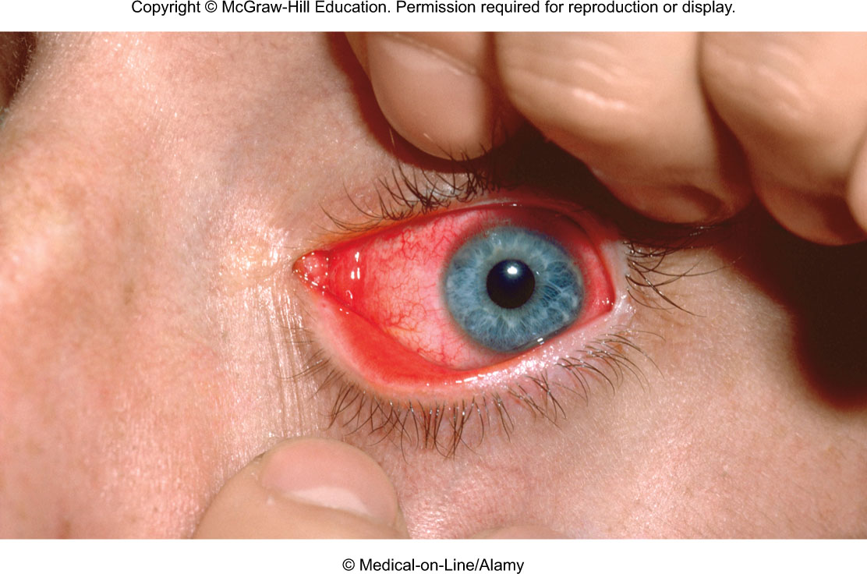
NonPolio – coxsackievirus
Acute hemorrhagic conjunctivitis

Slide 14
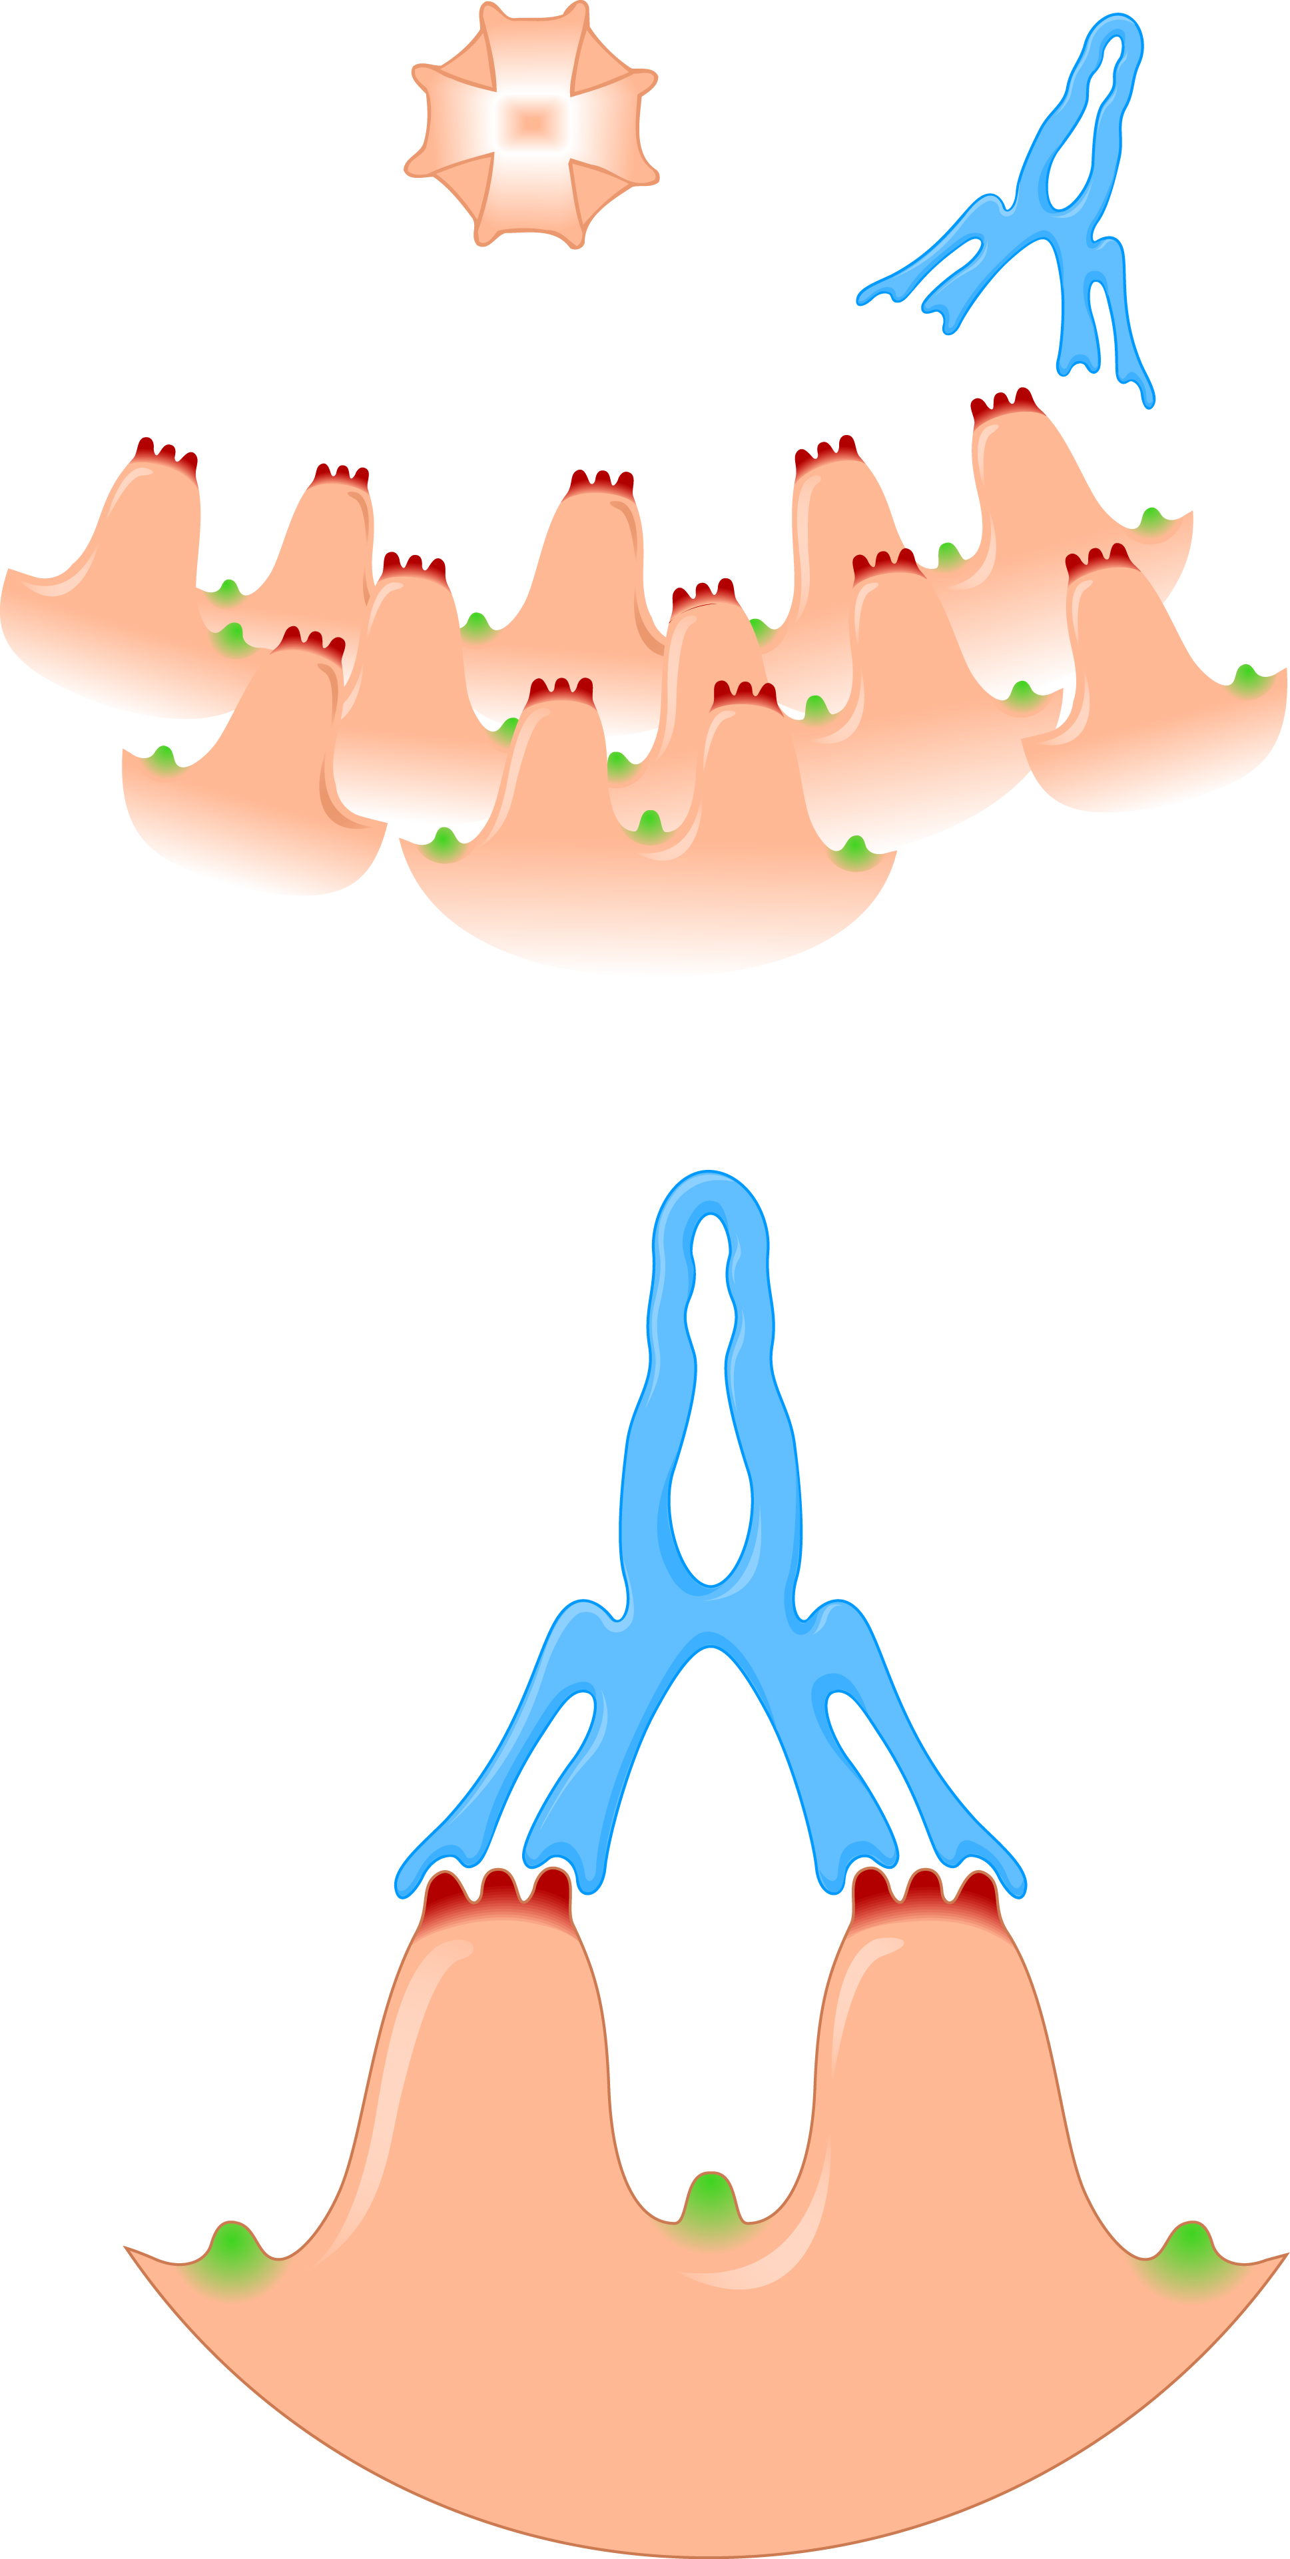
Human Rhinovirus (HRV)
Rhino” comes from the Greek word for “nose” which is a typical way for the virus to get into the body.
More than 110 serotypes associated with the common cold.
Unique molecular surface makes development of a vaccine unlikely.
Many strains circulating in the population at one time; acquired from contaminated hands and fomites
Copyright © McGraw-Hill Education. Permission required for reproduction or display.
Rhinovirus
particle
Antibody
Knob antigen
Pocket antigen
(a)
(b)

Slide 15
Human Rhinovirus (HRV)
Sensitive to acidic environments; optimum temperature is 33ºC
Headache, chills, fatigue, sore throat, cough, nasal drainage
Treat the symptoms
Handwashing and care in handling nasal secretions

Slide 16
Caliciviruses
They are a group of non-enveloped, single-stranded RNA viruses.
Noroviruses were previously called Norwalk; believed to cause 1/3rd of all viral acute gastroenteritis cases
Transmitted by fecal-oral route
Infection in all ages at any time of year
Acute onset, nausea, vomiting, cramps, diarrhea, chills
Rapid and complete recovery
No vaccine

Slide 17
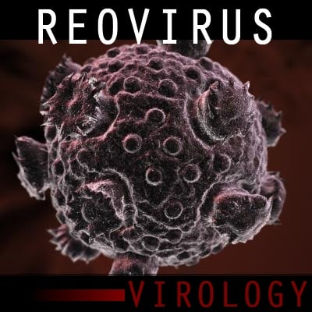
Nonenveloped Segmented dsRNA Viruses: Reoviruses
Unusual double-stranded RNA genome
Two best known:
Reovirus – nonenveloped viruses that contain a genome of 10 segments of double-stranded RNA.
cold-like upper respiratory infection, enteritis
(a)
(b)

Slide 18
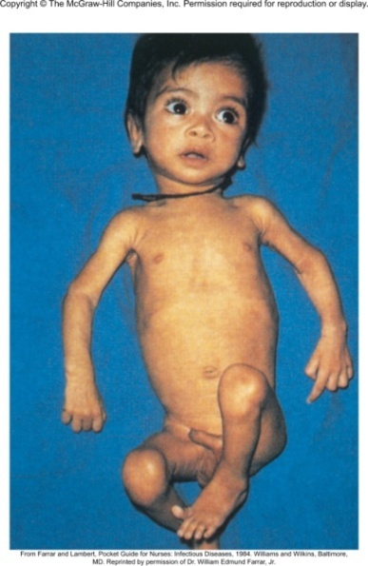
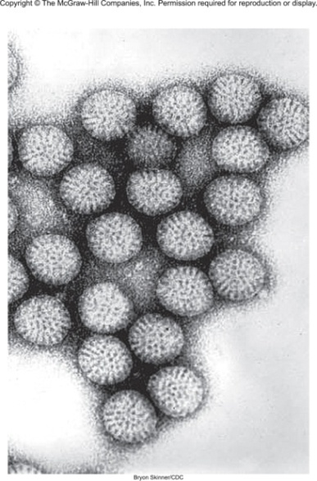
Nonenveloped Segmented dsRNA Viruses: Rotaviruses
Rotavirus –is a virus that causes diarrhea and other intestinal symptoms. It’s very contagious and is the most common cause of diarrhea in infants and young children worldwide. If you look at a rotavirus through a microscope, it has a round shape. The Latin word for wheel is “rota,” which explains how the virus got its name.
Oral-fecal transmission.
Cause inflammation in the the stomach and intestine. It can cause severe diarrhea, vomiting, fever, belly pain and dehydration in infants, young children, and some adults.
Good hygiene, such as washing your hands regularly, is important. But vaccination is the best way to prevent rotavirus infection.
Bryon Skinner/CDC
From Farrar and Lambert, Pocket Guide for
Nurses: Infectious Diseases, 1984. Williams
and Wilkins, Baltimore, MD. Reprinted by
permission of Dr. William Edmund Farrar, Jr.

