Slide 1
The RNA Viruses That Infect Humans

Slide 2
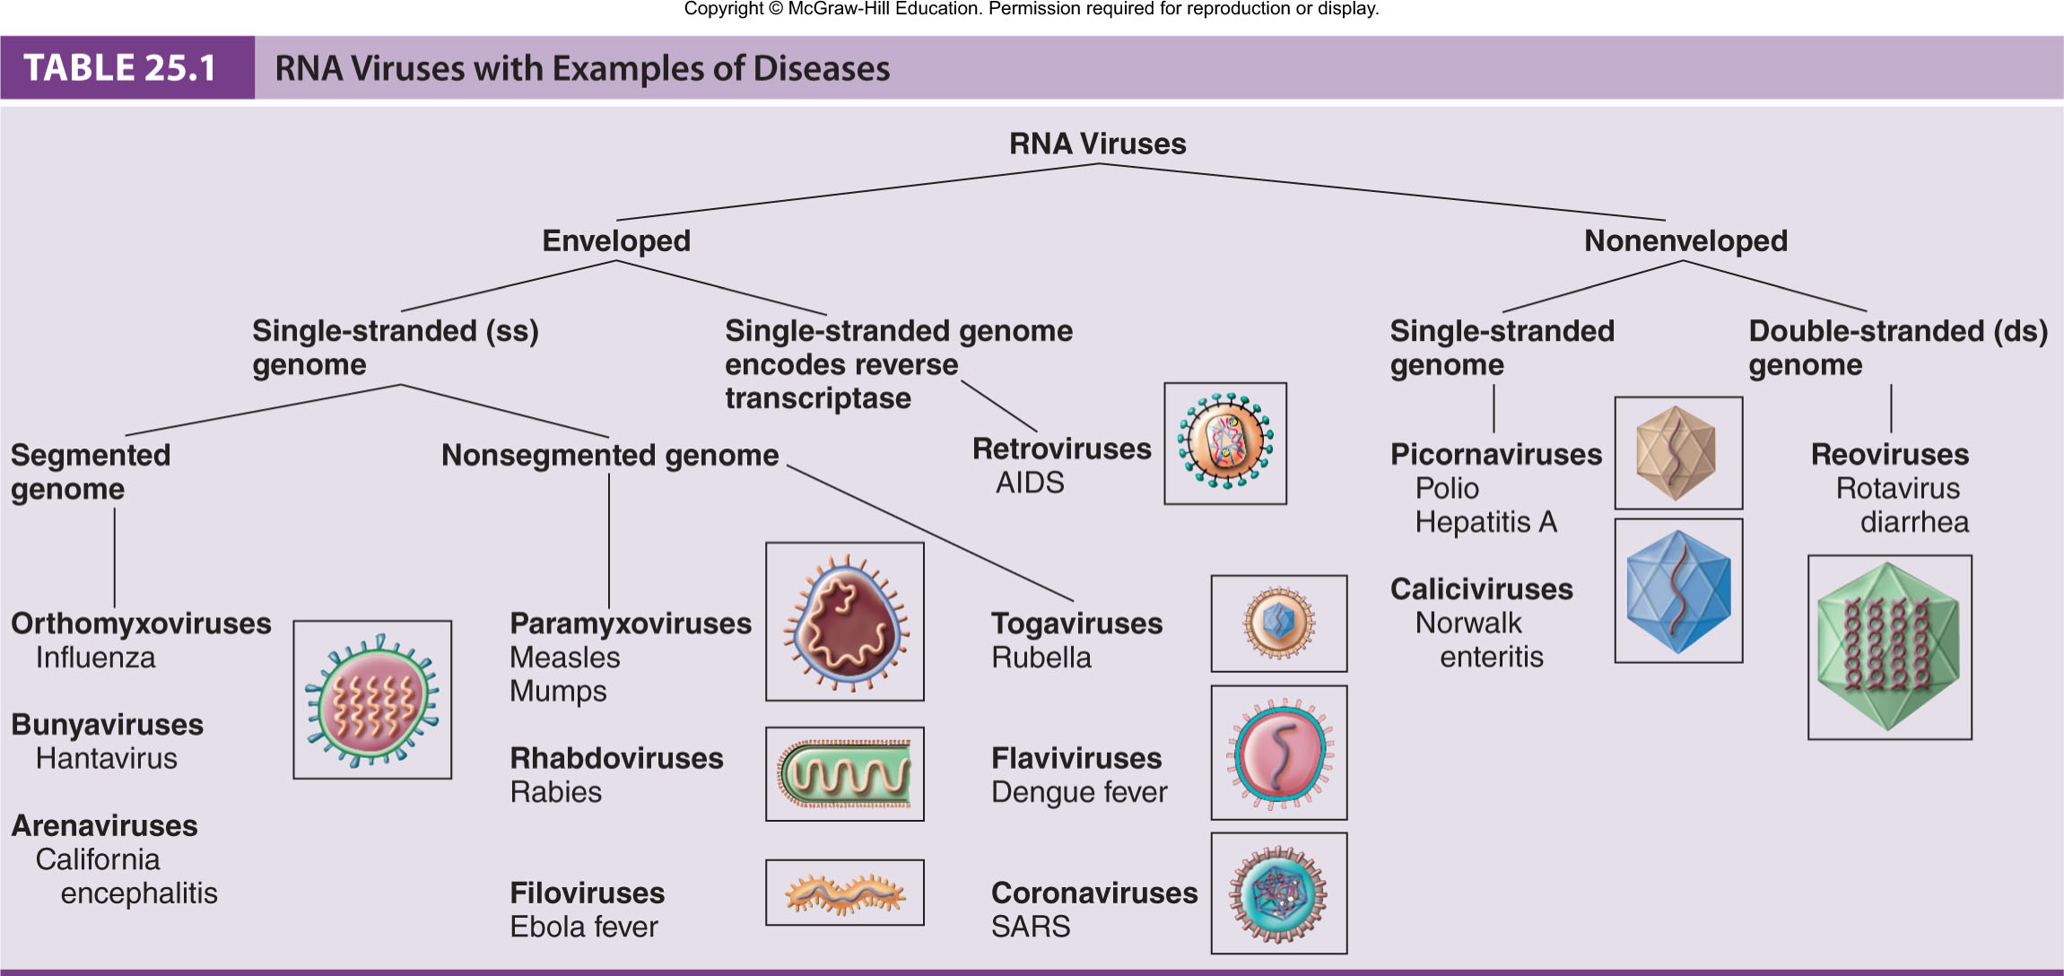
RNA Viruses
Diverse group of microbes
Assigned to one of 12 families based on envelope, capsid, and nature of RNA genome

Slide 3
Enveloped Segmented Single-Stranded RNA Viruses
Orthomyxoviruses
Bunyaviruses
Arenaviruses
A segmented genome enables the virus to generate reassortants. In this process, the RNA molecules of different virus strains are mixed or reshuffled in doubly infected cells during replication and morphogenesis. In this way, progeny viruses can obtain new combinations of RNA segments and thus gain novel properties.

Slide 4
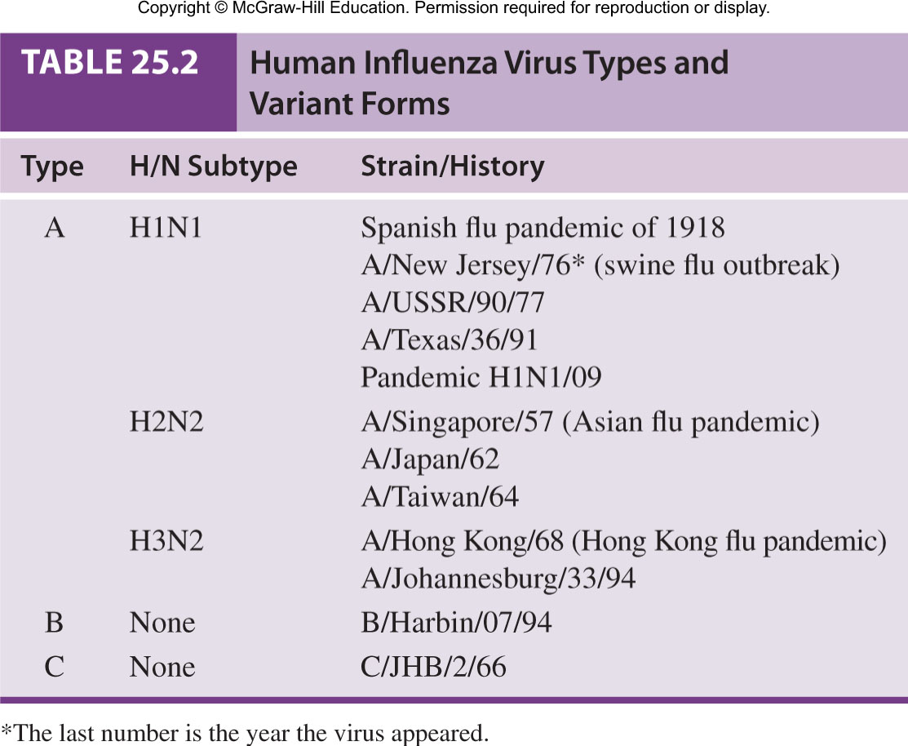
The Biology of Orthomyxoviruses: Influenza
3 distinct influenza virus types: A, B, C; Type A causes most infections

Slide 5
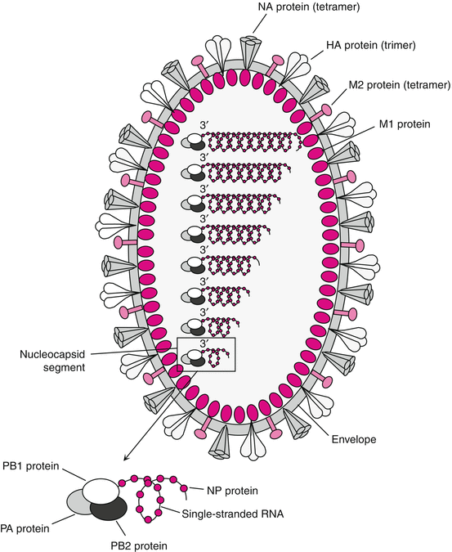
Influenza Infection
Virus attaches and multiplies in the cells of the respiratory tract .sneezes or coughs more than half a million virus particles can be spread to those close by. In otherwise ,the time during which a person might be infectious to another person peaks on day 2 and persists for an average total
duration of 5 days but can persist
as long as 9 days.

Slide 6
Influenza Glycoproteins
Key to influenza are glycoprotein spikes –
  Hemagglutinin (H) – 16 different subtypes; most important virulence factor; binds to host cells
  Neuraminidase (N) – 9 subtypes – hydrolyzes mucus and assists viral budding and release
Both glycoproteins frequently undergo genetic changes decreasing the effectiveness of the host immune response
Copyright © McGraw-Hill Education. Permission required for reproduction or display.
Binding sites used to anchor virus to host cell receptors (low rate of mutation)
Site for antibody binding
(high rate of mutation)
Viral envelope

Slide 7
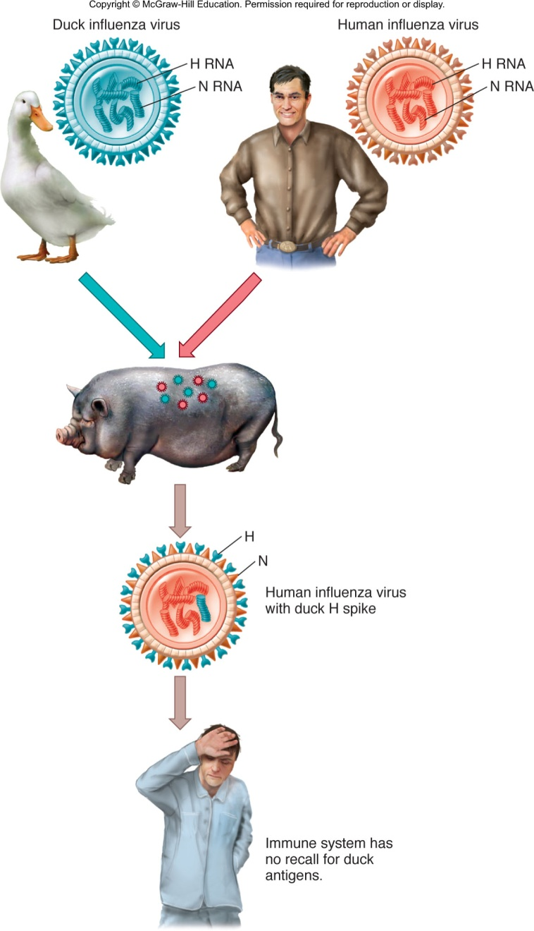
Influenza Mutation
Constant mutation is called antigenic drift – gradually change their amino acid composition
Antigenic shift – one of the genes or RNA strands is substituted with a gene or strand from another influenza virus from a different animal host
  Genome of virus consists of 10 genes encoded on 8 separate RNA strands

Slide 8
Influenza A
Acute, highly contagious respiratory illness
Seasonal, pandemics; most commonly among elderly and small children
Binds to ciliated cells of respiratory mucosa
Causes rapid shedding of cells, stripping the respiratory epithelium; severe inflammation
Fever, headache, myalgia, pharyngeal pain, shortness of breath, coughing
Weakened host defenses predispose patients to secondary bacterial infections, especially pneumonia

Slide 9
Influenza Strains
Influenza B
Only undergo antigenic drift
Not known to undergo antigenic shift
Influenza C
Known to cause only minor respiratory disease; probably not involved in epidemics

Slide 10
Diagnosis, Treatment, Prevention
Rapid immunofluorescence tests to detect antigens in a pharyngeal specimen; serological testing to screen for antibody titer
Treatment: control symptoms; amantadine, rimantadine, zanamivir (Relenza), and oseltamivir (Tamiflu)
Flu virus has developed high rate of resistance to amantadine and rimantadine
Annual trivalent vaccine recommended

Slide 11
Bunyaviruses and Arenaviruses
Transmitted zoonotically; cause periodic epidemics; extremely dangerous; biosafety level 4 viruses
Bunyaviruses –forms three nucleocapsid segments
- transmitted by insects and ticks
  California encephalitis, Rift Valley fever, Korean hemorrhagic fever
  flu -like symptoms high fever, lung edema, and pulmonary failure; 33% mortality rate
  Carried by deer and harvest mice; transmitted via airborne dried animal waste
Arenaviruses
Lassa fever, Argentine hemorrhagic fever, Bolivian hemorrhagic fever, and Lymphocytic choriomeningitis
Closely associated with rodent host
Transmission through aerosols and contact

Slide 12
Enveloped Nonsegmented ssRNA Viruses
Paramyxoviruses
Rhabdoviruses
Filoviruses
Togaviruses
Flaviviruses(Hepatitis C Virus (HCV)Lec. 6
Coronaviruses

Slide 13
Paramyxoviruses
Paramyxoviruses (parainfluenza, mumps virus)
Morbillivirus (measles virus)
Pneumovirus (respiratory syncytial virus)
Respiratory transmission
Envelope has glycoprotein and F spikes that initiate cell-to-cell fusion
Fusion with neighboring cells – syncytium or multinucleate giant cells form
Copyright © McGraw-Hill Education. Permission required for reproduction or display.
Paramyxovirus
Uncoating
Host cell₁
Host cell₂
Host cell₃
Point of cell fusion

Slide 14
Parainfluenza
Widespread as influenza but more benign
Respiratory transmission
Seen mostly in children
Minor cold, bronchitis, bronchopneumonia, croup
No specific treatment available; supportive therapy

Slide 15
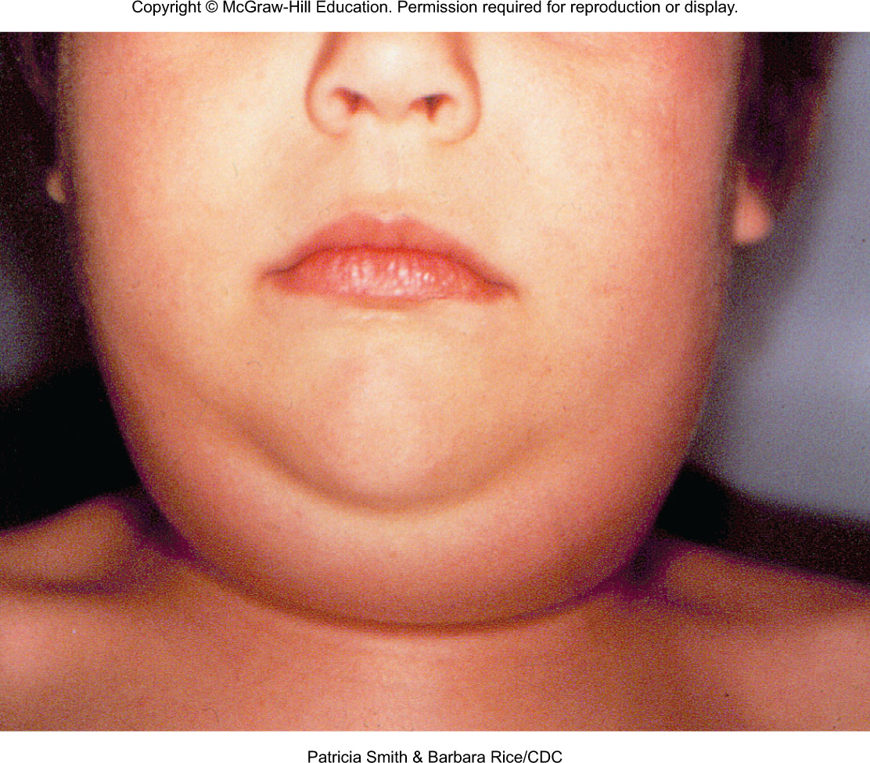
Mumps
Epidemic parotitis; self-limited, associated with painful swelling of parotid salivary glands

Slide 16
Mumps
Humans are the only reservoir
40% of infections are subclinical; long-term immunity
Incubation 2-3 weeks fever, muscle pain and malaise, classic swelling of one or both cheeks
Usually uncomplicated invasion of other organs; in 20-30% of infected adult males, epididymis and testes become infected; sterility is rare
Symptomatic treatment
Live attenuated vaccine MMR
16
Notes:
16

Slide 17
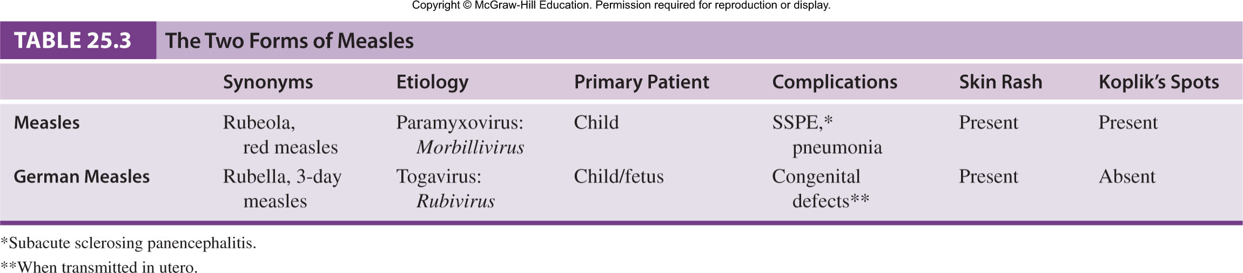
Measles
Caused by Morbillivirus
Also known as red measles and rubeola
Different from German measles
Very contagious; transmitted by respiratory aerosols
Humans are the only reservoir
. frequent cause of death worldwide

Slide 18
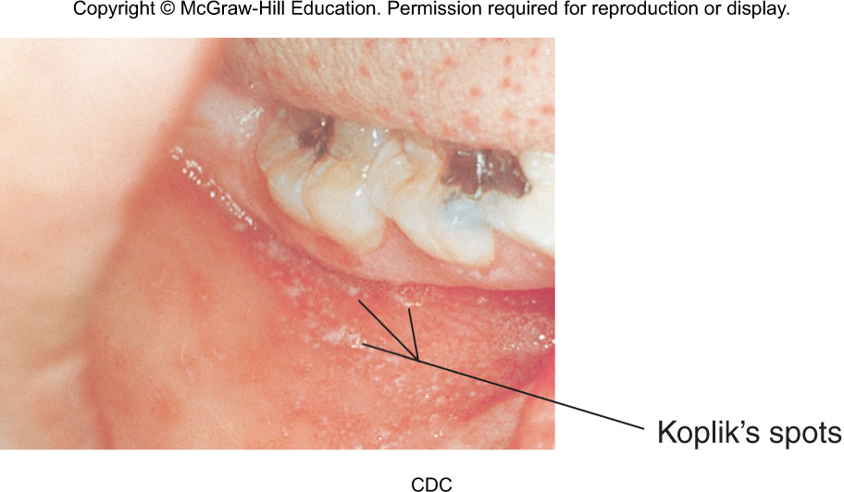
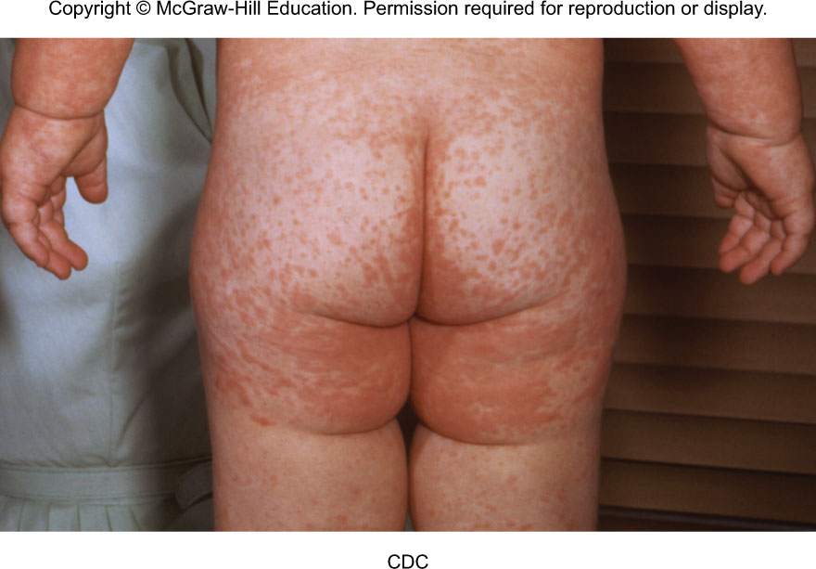
Measles
Virus invades respiratory tract
Sore throat, dry cough, headache, conjunctivitis, lymphadenitis, fever, Koplikʻs spots – oral lesions(viral exanthema of measles manifesting two to three days before the measles rash itself).
18
Notes:
18

Slide 19
Measles
Most serious complication is subacute sclerosing panencephalitis (SSPE), a progressive neurological degeneration of the cerebral cortex, white matter, and brain stem
  1 case in a million infections
  Involves a defective virus spreading through the brain by cell fusion and destroys cells
  Leads to coma and death in months or years
Attenuated viral vaccine MMR

Slide 20
Respiratory Syncytial Virus (RSV)
Also called Pneumovirus
Infects upper respiratory tract
It’s a common childhood illness that can affect adults too
Epithelia of nose and eye portal of entry; replicates in nasopharynx
cold-like symptoms. Severe infection leads to pneumonia and bronchiolitis ,Fever, rhinitis, pharyngitis, otitis
Treatment: synagis, a monoclonal antibody that blocks attachment, ribavirin
Washing your hands and other common good hygiene practices help prevent spreading RSV.

Slide 21
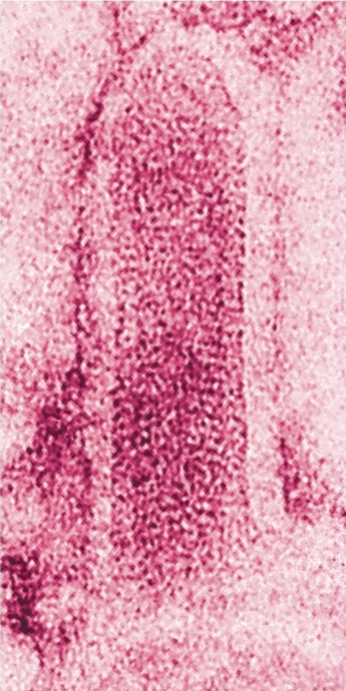
Rhabdovirus
Rabies :Enveloped, bullet-shaped virions
Slow, progressive zoonotic disease
Primary reservoirs are wild mammals; it can be spread by both wild and domestic mammals by bites, scratches, and inhalation of droplets
Copyright © McGraw-Hill Education. Permission required for reproduction or display.
Glycoprotein spikes
Matrix protein
Nucleocapsid
(a)
CDC
(b)

Slide 22
Rabies
Virus enters through bite, grows at trauma site for a week and multiplies, then enters nerve endings and advances toward the ganglia, spinal cord and brain
Infection cycle completed when virus replicates in the salivary glands
Clinical phases of rabies:
Prodromal phase – fever, nausea, vomiting, headache, fatigue; some experience pain, burning, tingling sensations at site of wound
Furious phase – agitation, disorientation, seizures, twitching, hydrophobia
Dumb phase – paralyzed, disoriented, stuporous
Progress to coma phase, resulting in death

Slide 23
Rabies
Often diagnosed at autopsy – intracellular inclusions (Negri bodies) in nervous tissue
Bite from wild or stray animals demands assessment of the animal, meticulous wound care, and specific treatment
Preventive therapy initiated if signs of rabies appear
Treatment – passive and active postexposure immunization
  Infuse the wound with human rabies immune globulin (HRIG) and globulin; vaccination with human diploid cell vaccine (HDCV), an inactivated vaccine given in 6 doses with 2 boosters
Control – vaccination of domestic animals, elimination of strays, and strict quarantine practices
  Live oral vaccine incorporated into bait for wild animals

Slide 24
Togavirus
Rubella Caused by Rubivirus, a ssRNA with a loose envelope
German measles
Endemic disease
Most cases reported are adolescents and young adults
Transmitted through contact with respiratory secretions
Diagnosis based on serological testing
No specific treatment available
Attenuated viral vaccine MMR

Slide 25
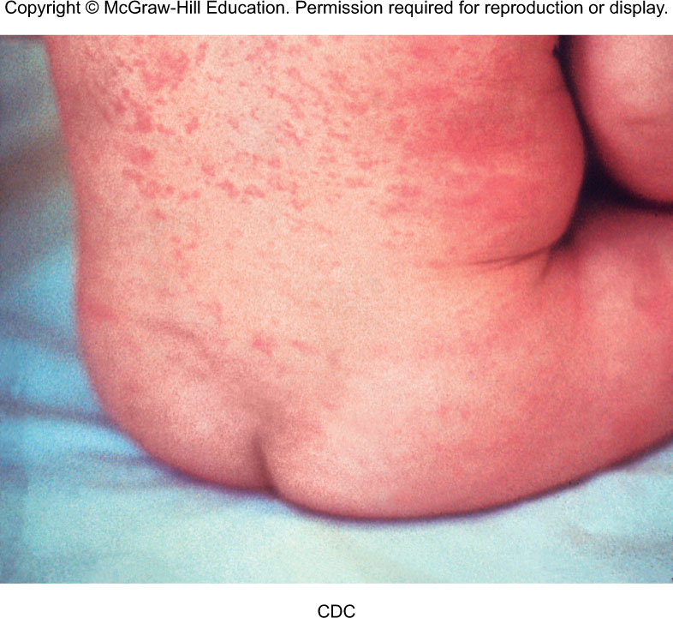
Rubella
Two clinical forms:
Postnatal rubella – malaise, fever, sore throat, lymphadenopathy, rash, generally mild, lasting about 3 days
Congenital rubella – infection during 1st trimester most likely to induce miscarriage or multiple defects such as cardiac abnormalities, ocular lesions, deafness, mental and physical retardation

Slide 26
Arboviruses: Viruses Spread by Arthropod Vectors
Mosquitoes, ticks, flies
400 viruses
Togaviruses, flaviviruses, some bunyaviruses and reoviruses
Most illnesses caused by these viruses are mild fevers; some may cause severe encephalitis, and life-threatening hemorrhagic fever

Slide 27
The Influence of the Vector
Vectors and viruses tend to be clustered in the tropics and subtropics; many temperate zones have periodic epidemics
Arbovirus life cycles are closely tied to the ecology of the vectors
Infections show a peak incidence when the arthropod is actively feeding and reproducing
Humans can serve as dead-end, accidental hosts or they can be a maintenance reservoir
Controlling the vector controls the disease

Slide 28
General Characteristics of
Arbovirus Infections
Arboviruses= Arthropod-born viruses
Acute arbovirus infection may result in undifferentiated mild fever with rash; no long-term effects; prominent symptoms are fever, headache, myalgia, joint stiffness, rash
Viral encephalitis – brain, meninges, and spinal cord are involved; convulsions, tremor, paralysis, loss of coordination, memory deficits, changes in speech and personality, coma; survivors may have permanent brain damage

Slide 29
Hemorrhagic Fevers
Yellow fever – eliminated in U.S.
Two patterns of transmission:
  Urban cycle – Yellow fever is spread by the bite of infected Aedes aegypti mosquitoes. A mosquito becomes infected when it bites a person who has yellow fever in his or her blood. Direct spread of yellow fever from one person to another does not occur. About 15% of people who get yellow fever develop serious illness that can lead to bleeding, shock, organ failure, and sometimes death.
  Sylvan cycle – forest monkeys and mosquitoes; South America
Acute fever, headache, muscle pain; may progress to oral hemorrhage, nosebleed, vomiting, jaundice, and liver and kidney damage; significant mortality rate
Dengue fever – flavivirus carried by Aedes mosquito; not in U.S.; usually mild infection
  Dengue hemorrhagic shock syndrome, breakbone fever – extreme muscle and joint pain; can be fatal

