Slide 1
Enveloped and
Non-enveloped DNA viruses
Lec: 4

Slide 2
Non-enveloped DNA Viruses
Non-enveloped viruses are surrounded by a protein coating, commonly referred to as a capsid. The capsid does the job of attaching to host cells.
Non-enveloped viruses are difficult to sterilize.
They display excellent heat-resistant properties, and moreover, can easily withstand a dry and acidic environment, also, more powerful and proliferates rapidly in an acidic environment. They can survive in some disinfection processes.

Slide 3
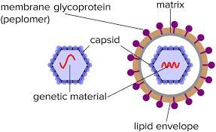

Slide 4
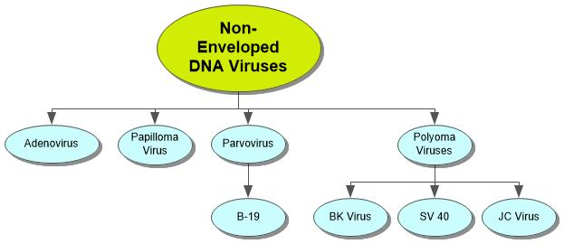
Non enveloped DNA viruses include many viruses as show below:

Slide 5
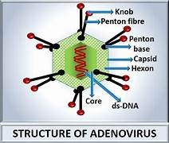
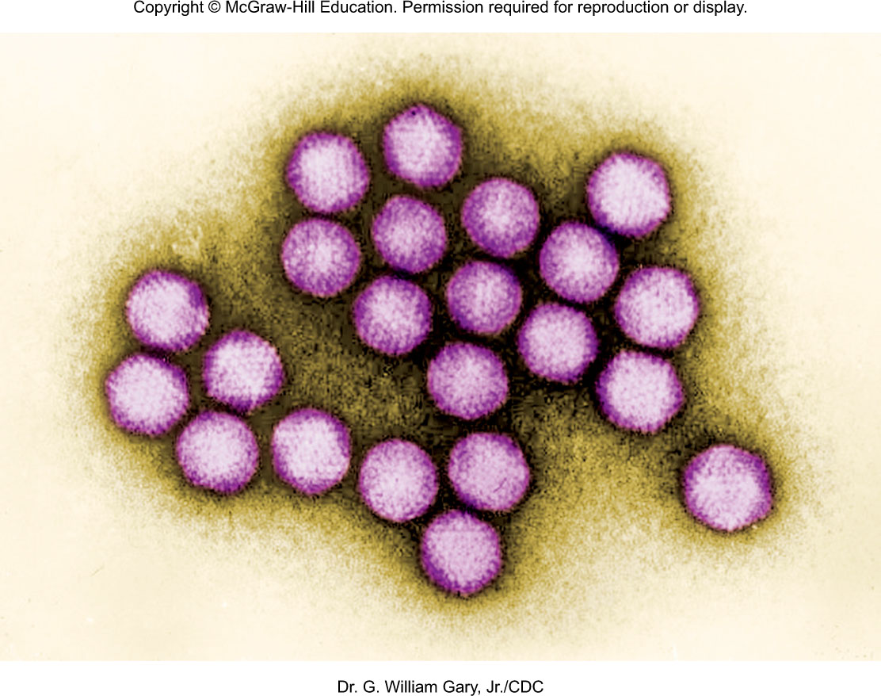
The Adenoviruses
Nonenveloped, dsDNA
49 types associated with human disease

Slide 6
The Adenoviruses
Adenoviruses are a group of viruses that are transmissible via a variety of methods:
Close contact, such as touching or shaking hands
coughing and sneezing
Touching an infected object or surface, then touching the mouth, nose, or eyes without washing the hands first
Adenoviruses can also spread through infected stools — for example, during a diaper change.
Some adenoviruses are contagious in water.

Slide 7
The Adenoviruses
Infect lymphoid tissue, respiratory and intestinal epithelia and conjunctiva
Spread by respiratory and ocular secretions
Causes colds, pharyngitis, conjunctivitis, keratoconjunctivitis, acute hemorrhagic cystitis
Severe cases treated with interferon
Inactivated polyvalent vaccine
Adenovirus infections can be identified using antigen detection, polymerase chain reaction (PCR), virus isolation, and serology.
Notes:
7

Slide 8
Papilloma and Polyoma Viruses
Small, nonenveloped dsDNA
Circular DNA
Cause persistent infections and tumors

Slide 9
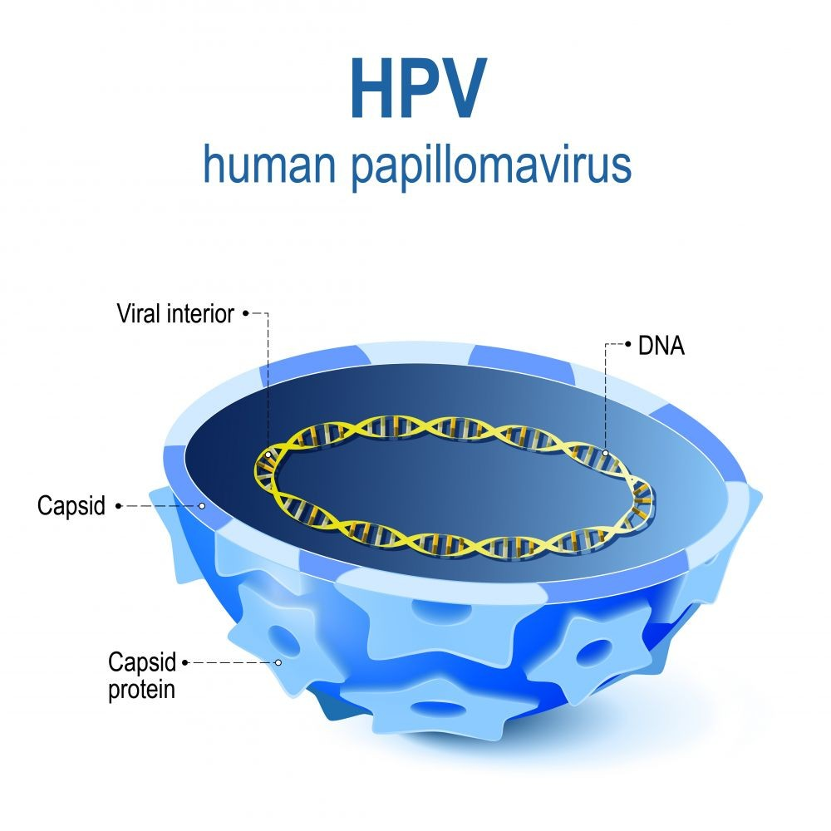
Human Papillomavirus
Papillomaviruses are small,
dsDNA,non-enveloped, icosahedral DNA viruses that have a diameter of 52–55 nm.
There are more than 100 types of HPV, of which at least 13 are cancer-causing (also known as high risk type). Two HPV types (16 and 18) cause 70% of cervical cancers and precancerous cervical lesions.
It takes 15 to 20 years for cervical cancer to develop in women with normal immune systems. It can take only 5 to 10 years in women with weakened immune systems, such as those with untreated HIV infection.

Slide 10
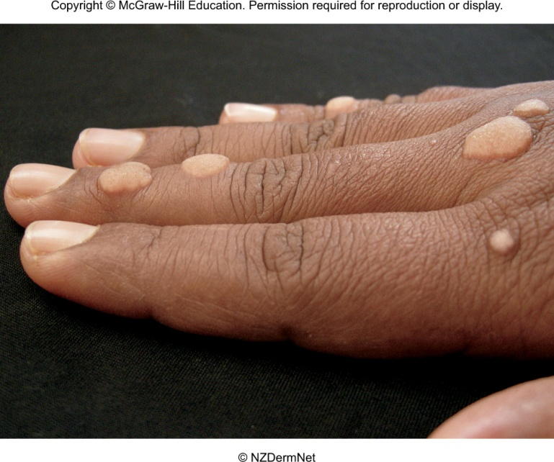
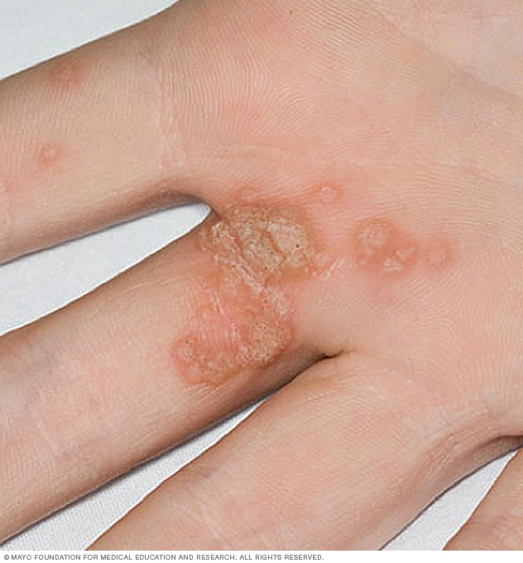
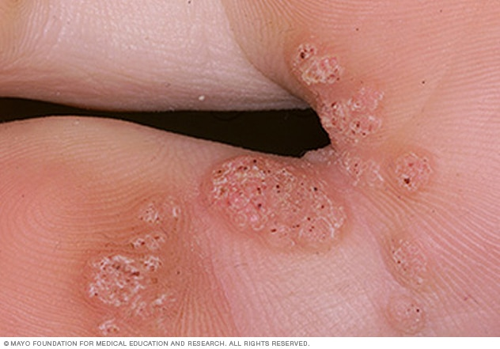
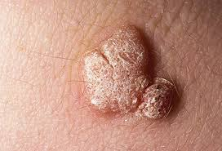
Human Papillomavirus
Common seed warts – painless, elevated, rough growth; on fingers, etc.
Plantar warts – deep, painful; on soles of feet
Genital warts -morphology ranges from tiny, flat, inconspicuous bumps to extensive, branching, cauliflower-like masses

Slide 11
Transmissible through direct contact or contaminated fomites; incubation – 2 weeks to more than a year
Most common warts regress over time; they can be removed by direct chemical application of Prescription cream and physical removal by cauterization(burning), freezing, or laser surgery
Warts can recur
Human Papillomavirus

Slide 12
Human Papillomavirus
Diagnosis of Papilloma
-Pap smear
Early detection through inspection of genitals, women Pap smear to screen for abnormal cervical cells.
-PCR
Two effective HPV vaccines. Gardasil 9, and Cervarix. The vaccines do not prevent other sexually transmitted diseases, nor do they treat existing HPV infections or HPV-caused disease.

Slide 13
Polyoma Viruses
Are unenveloped double stranded DNA viruses with circular genome isocahedral in shape.
In immunocompetent hosts, the viruses remain latent after primary infection.
Illnesses associated with these viruses occur in times of immune compromise, especially in conditions that bring about T cell deficiency.
Their occurrence in individuals was mainly confirmed by PCR and the presence of virus-specific antibodies.

Slide 14
Polyoma Viruses
BKV are known to cause, hemorrhagic cystitis in recipients of bone marrow transplantation
Many people who are infected with this virus are asymptomatic.
It is not known how this virus is transmitted. It is known, however, that the virus is spread from person to person, and not from an animal source. It has been suggested that this virus may be transmitted through respiratory fluids or urine.

Slide 15
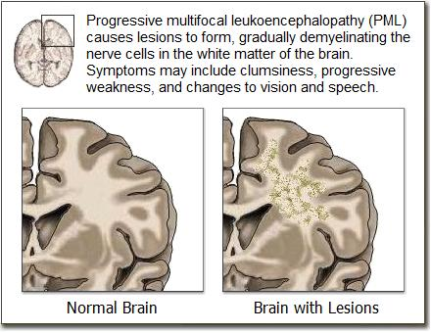
Polyoma Viruses
JC-Virus
cause(PML)progressive multifocal leukoencephalopathy in immunocompromised patients. the initial site of infection may be the tonsils, or possibly the gastrointestinal tract.
The virus then remains latent in the gastrointestinal tract and can also infect the tubular epithelial cells in the kidneys, where it continues to reproduce, shedding virus particles in the urine.

Slide 16
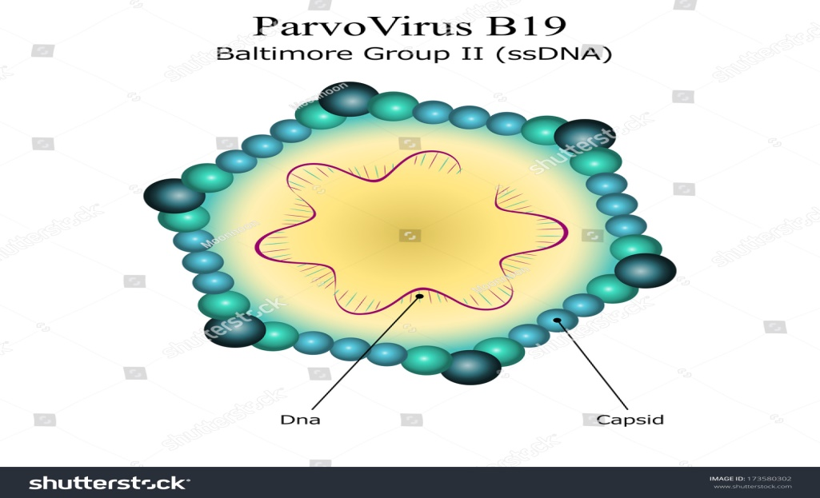
Parvoviruses
Nonenveloped, ssDNA
Small diameter and genome size
Causes distemper in cats, enteric disease in dogs, fatal cardiac infection in puppies
Few cause infections in humans

Slide 17
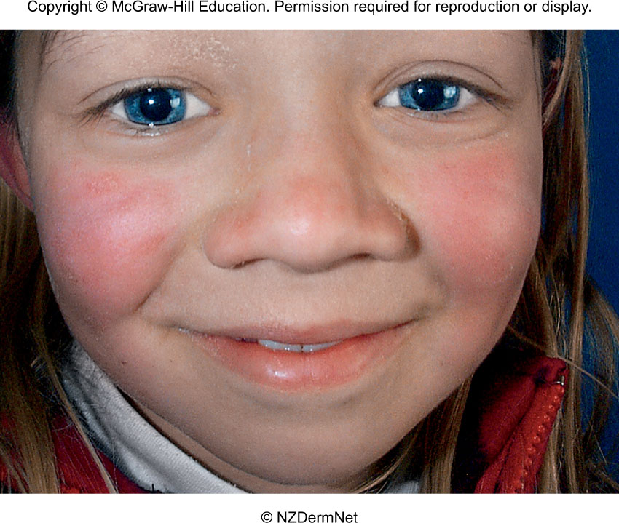
Human Parvoviruses
B19 erythroparvovirus
cause of erythema infectiosum (fifth disease); rash of childhood
Children may have fever and rash on cheeks
Severe fatal anemia can result if pregnant woman transmits virus to fetus
Adeno-associated virus (AAV) is a defective virus; it cannot replicate in host cell without adenovirus
Diagnosis by:
1- Serology
2- Isolation
3- PCR
Notes:
17

Slide 18
Enveloped DNA viruses
Viruses that have a lipid membrane. Many enveloped viruses, such as HBV, Herpesviruses and Poxviruses are pathogenic to humans and of clinical importance. The lipid envelope of these viruses is relatively sensitive and thus can be destroyed by alcohols such as ethanol or 2-propanol. Enveloped viruses can be killed by disinfectants that are virucidal against enveloped viruses.

Slide 20
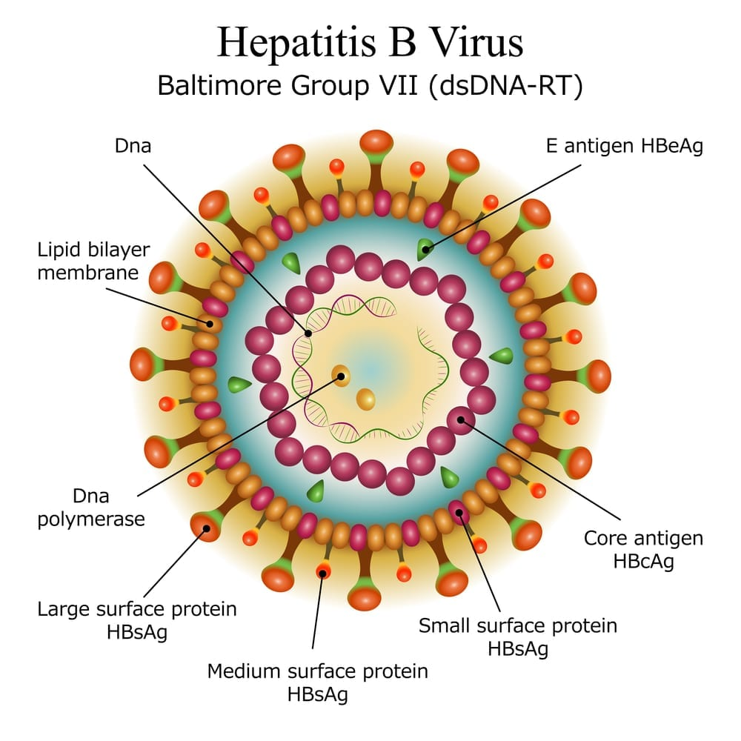
Hepatitis B Virus infection
Hepatitis B is a viral infection that attacks the liver and can cause both acute and chronic disease.
The virus is most commonly transmitted
from mother to child during birth and delivery
through contact with blood or other body fluids, including sex with an infected partner
injection-drug use that involves sharing needles, syringes, or drug-preparation equipment and needle sticks
-exposures to sharp instruments.
Increases risk of liver cancer
– hepatocellular carcinoma

Slide 21
Pathogenesis of Hepatitis B Virus
Virus enters through break in skin or mucous membrane or by injection into bloodstream
Reaches liver cells, multiplies, and releases viruses into blood; average 7 week incubation Most exhibit few overt symptoms and eventually develop HBV immunity.
Some experience malaise, fever, chills, anorexia, abdominal discomfort, and diarrhea.
Fever, jaundice, rash, and arthritis in more severe disease cases.
Small number of patients develop chronic liver disease – Necrosis and cirrhosis.

Slide 22
Diagnosis and Management of Hepatitis B
Diagnosis based on examination of risk factors, serological tests to detect viral antibodies or antigen; radioimmunoassay and ELISA tests for surface antigens
Screening of blood for transfusion, semen for sperm banks, organs for transplant, and routine prenatal testing of all pregnant women
Mild cases managed by treatment of symptoms and supportive care; chronic infections treated with interferon

Slide 23
Prevention of Hepatitis B
Passive immunization with HBIG for persons exposed, or possibly exposed, including neonates born to infected mothers
Primary prevention is vaccination for high risk individuals and encouraged for all newborns and infants
Vaccines derived from surface antigen from cloned yeast – 3 doses with boosters
Vaccine derived from purified sterile antigen extracted from carrier blood; mainly for people who have yeast allergies

