Slide 1
Enveloped DNA viruses
Lec 5

Slide 2
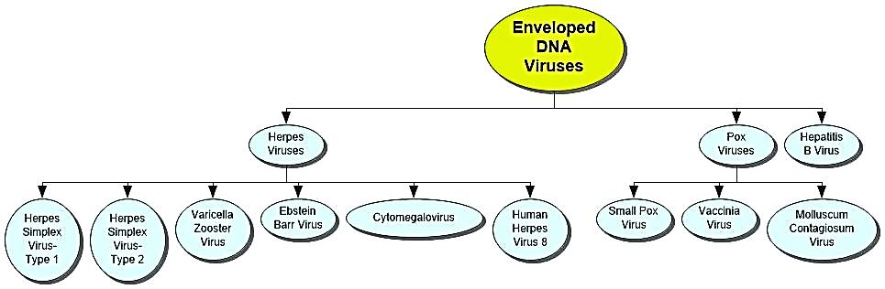
Enveloped DNA viruses

Slide 3
Herpesvirida
Largest family of DNA viruses that affects humans
Infections are very common viruses are
ubiquitous
Icosahedral capsid enclosed in lipoprotein
envelope
Tegument amorphous proteinaceous material lying
between envelope and capsid
Contains virus-coded enzymes and transcription
factors
Genome single molecule of linear, ds-DNA

Slide 4
Herpesvirus subfamily types
Alphaherpesvirinae: are fast- growing, cytolytic viruses that tend to establish latent infections in neurons; HSV (genus Simplexvirus) and varicella-zoster virus (genus Varicellovirus) are members.
Herpes simplex virus 1 | Human herpesvirus 1 | facial, labial and ocular lesions
Herpes simplex virus 2 | Human herpesvirus 2 | genital lesions
Varicella-zoster virus | Human herpesvirus 3 | chickenpox and shingles

Slide 5
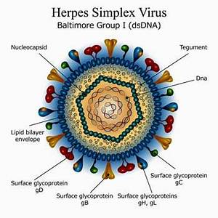
Herpes simplex virus 1
Herpes labialis – fever blisters, cold sores; most common recurrent HSV-1 infection; vesicles occur on mucocutaneous junction of lips or adjacent skin; itching and tingling prior to vesicle formation; lesion crusts over in 2-3 days and heals.
Herpetic gingivostomatitis – infection of oropharynx in young children; fever, sore throat, swollen lymph nodes.
Herpetic keratitis – ocular herpes – inflammation of eye; gritty feeling in the eye, conjunctivitis, sharp pain, and sensitivity to light

Slide 6
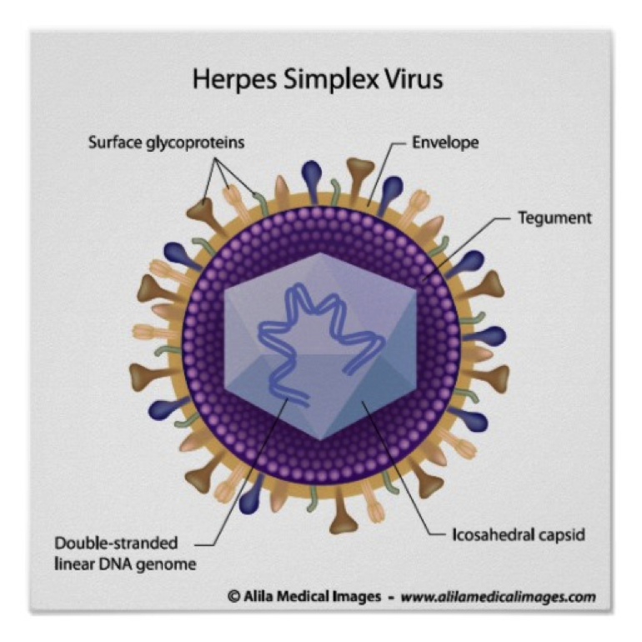
Herpes simplex virus 2
Genital herpes – herpes genitalia – starts with malaise, anorexia, fever, clusters of sensitive vesicles on the genitalia, urethritis, painful urination, cervicitis, itching; vesicles ulcerate.
CDC

Slide 7
Diagnosis, Treatment, and Control of Herpes Simplex
Vesicles and exudate are typical diagnostic symptoms, scrapings from base of lesions showing giant cells, culture and specific tests for diagnosing severe or disseminated HSV; direct fluorescent antibody tests
Treatment: acyclovir, famciclovir, valacyclovir; topical medications

Slide 8
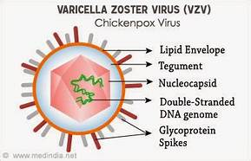
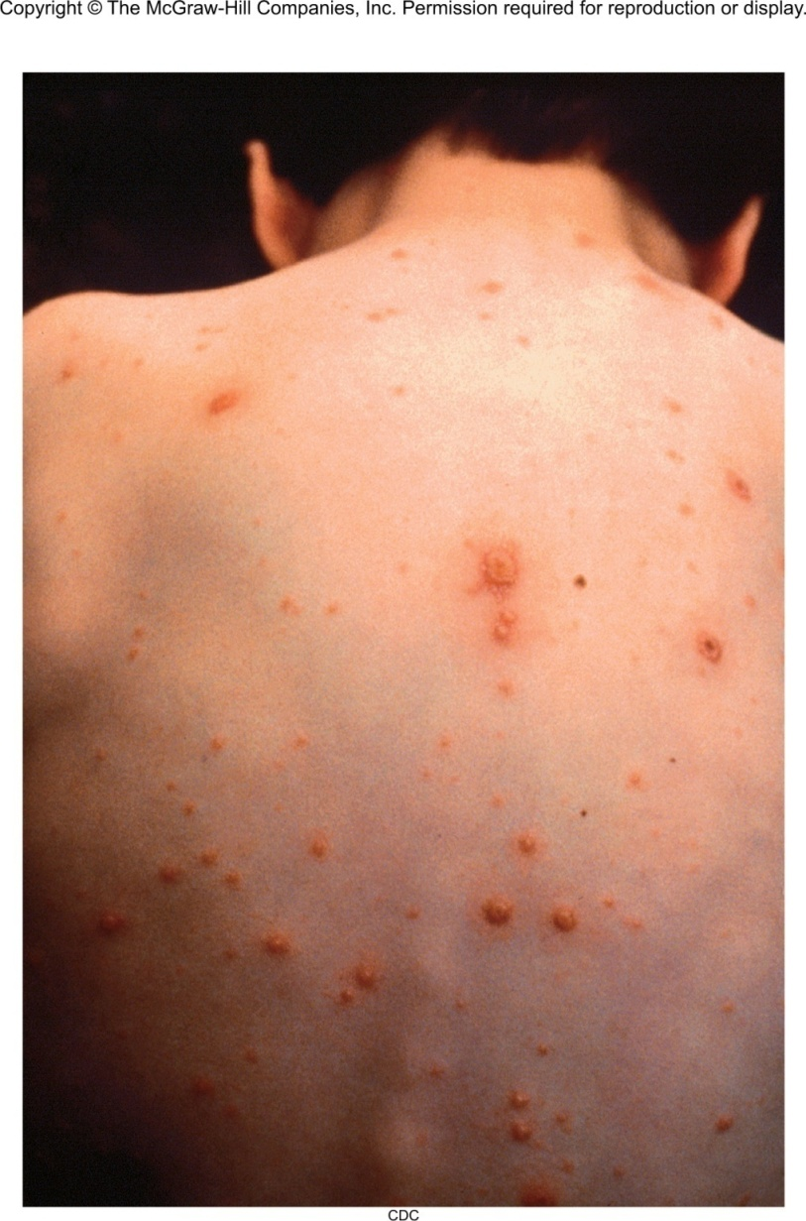
Varicella-Zoster Virus (VZV)
Causes chickenpox and shingles
Humans only natural host
Transmitted by respiratory droplets and contact
Primary infection – chickenpox – characteristic vesicles
Virus enters neurons and remains latent
(a)
CDC

Slide 9
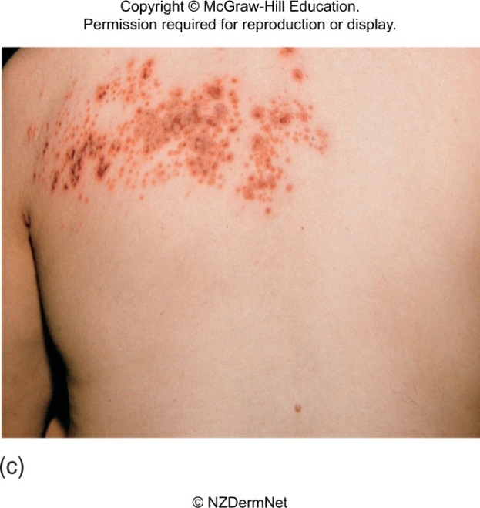
Varicella-Zoster Virus (VZV)
Later, reactivation of the virus
results in shingles with vesicles
localized to distinctive areas,
dermatomes
More common in older patients
Treatment: treat symptoms in uncomplicated infections; acyclovir, famciclovir, interferon for systemic disease
Live attenuated vaccine for chickenpox and shingles
Notes:
9

Slide 10
Betaherpesvirinae: are slow-growing and may be cytomegalic (massive enlargements of infected cells) and become latent in secretory glands and kidneys; cytomegalovirus (Human herpesvirus 5) is classified in the Cytomegalovirus genus. Also included here, in the genus Roseolovirus, are human herpesviruses 6 and 7.

Slide 11
Cytomegalovirus
Cytomegaloviruses – CMV
Produce giant cells with nuclear and cytoplasmic inclusions
Transmitted in saliva, respiratory mucus, breast milk, urine, semen, cervical secretions
Commonly latent in various tissues.
Copyright © McGraw-Hill Education. Permission required for reproduction or display.
Normal
lung cell
Insert Fig 24.13
Nucleus
with large
inclusion
Infected lung cell
Dr. Edwin P. Ewing, Jr./CDC
Most infections are asymptomatic.
3 groups develop a more virulent form of disease: fetuses, newborns, immunodeficiency adults.

Slide 12
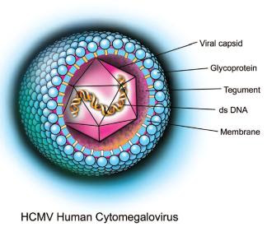
Cytomegalovirus
Newborns may exhibit enlarged liver
and spleen, jaundice, capillary bleeding,
microcephaly, and ocular inflammation; may be fatal.
  Babies who survive develop neurological sequelae, hearing, visual disturbances and mental retardation
Perinatal CMV infection – mostly asymptomatic, or pneumonitis, and a mononucleosis-like syndrome
AIDS patients – CMV mononucleosis, disseminated CMV, retinitis
Transplant patients – pneumonitis, hepatitis, myocarditis, meningoencephalitis.
Treatment reserved for immunocompromised – ganciclovir, foscarnet.

Slide 13
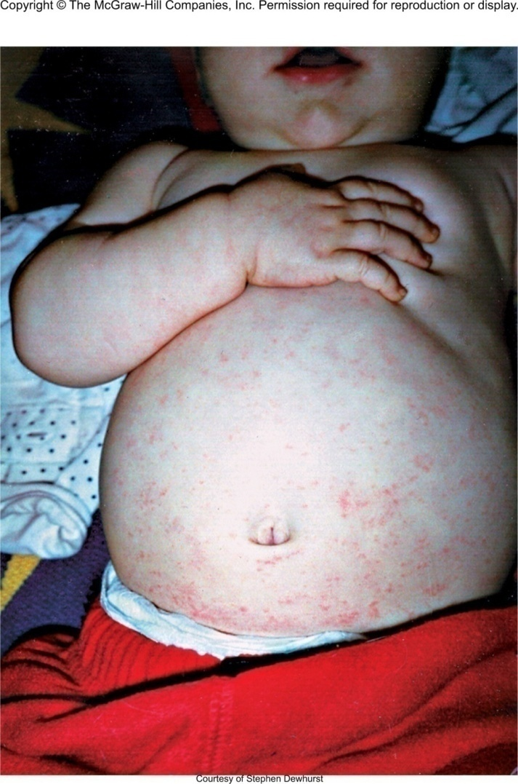
Human herpes virus 6 (HHV-6)-human B-lymphotropic virus
Transmitted by close contact with saliva and other secretions; very common.
Causes roseola, an acute febrile disease in babies 2-12 months; begins with fever, followed by a faint maculopapular rash; usually self-limited.
Copyright © McGraw-Hill Education. Permission required for reproduction or display.
Insert Fig 24.17
Courtesy of Stephen Dewhurst

Slide 14
Human herpes virus 6 (HHV-6)-human B-lymphotropic virus
Adults may get mono-like symptoms, lymphadenopathy and hepatitis
Over 70% of Multiple Sclerosis patients show signs of infection
Significant relationship between HHV-6 and Hodgkin’s lymphoma, oral carcinoma, certain T-cell leukemias
Notes:
14

Slide 15
HHV-7 is closely related to HHV-6 and causes similar diseases
Kaposi’s sarcoma-associated virus or HHV-8 is linked with common tumor of AIDS patients; also may be involved in multiple myeloma

Slide 16
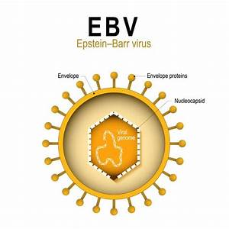
Gammaherpesvirinae: exemplified by EBV (Epstein- Barr Virus): infect and become latent in lymphoid cells. KSHV (Kaposis sarcoma –associated herpesvirus) designated as human herpesvirus 8, is classified in the Rhadinovirus genus.

Slide 17
Epstein-Barr Virus (EBV)
Ubiquitous virus; infects lymphoid tissue and salivary glands
Transmission – direct, oral contact and contamination with saliva
By mid-life, 90-95% of all people are infected
Anyone with an immune deficiency is highly susceptible to EBV

Slide 18
Epstein-Barr Virus (EBV)
Infectious mononucleosis – sore throat, high fever, cervical lymphadenopathy; develop after 30-50 day incubation
Dormancy in B cells; reactivated; may be asymptomatic
Tumors and Other Complications Associated with EBV:
Burkitt lymphoma – B cell malignancy;
Nasopharyngeal carcinoma – malignancy of epithelial cells; occurs in older Chinese and African men.
Tonsil
Exudate
Inflammation
Notes:
18

Slide 19
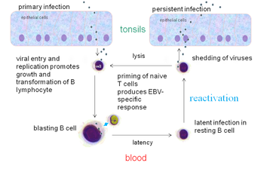
The EBV replication cycle

Slide 20
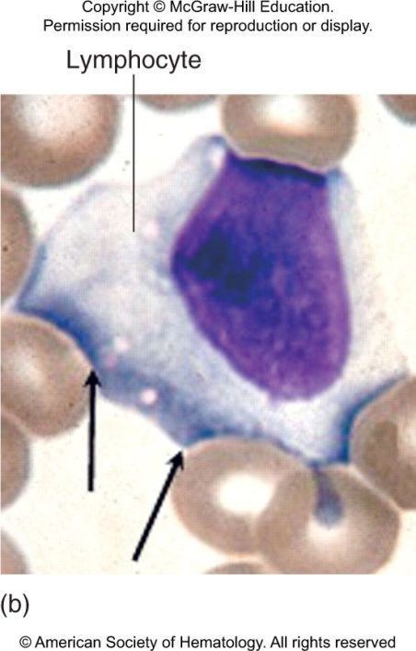
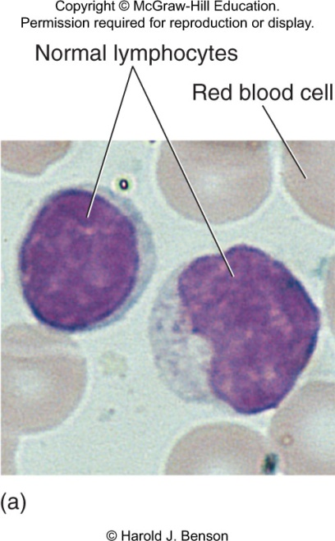
Diagnosis, Treatment, and Prevention
Differential blood count shows lymphocytosis, neutropenia, and large atypical lymphocytes; serological assays to detect antibodies and antigen.
Treatment directed at relief of symptoms of fever and sore throat.
Disseminated disease may be treated with IV gamma globulin, interferon, acyclovir, and monoclonal antibodies.

Slide 21
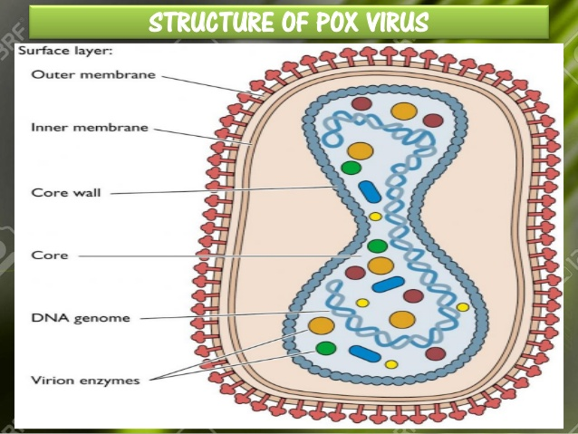
Pox viruses:
Smallpox(variola virus)
Poxviruses (members of the Poxviridae family) can infect both humans and
animals,
include smallpox (variola),
monkeypox, vaccinia.
Before smallpox was eradicated, it was a serious infectious disease caused by the variola virus. It was contagious—meaning, it spread from one person to another.

Slide 22
Smallpox infection generally resulted in acute onset fever and malaise, followed by a distinctive skin rash (i.e., raised firm lesions with umbilication) mainly occurring on the face, arms, and legs.
It was mainly transmitted between humans through the respiratory route (i.e., via saliva droplets); however, transmission from direct contact with infected bodily fluids was also reported. The incubation period of Variola virus was 7 to 17 days with rash typically appearing 4 to 7 days later; the most infectious period was during the first week of illness.

Slide 23
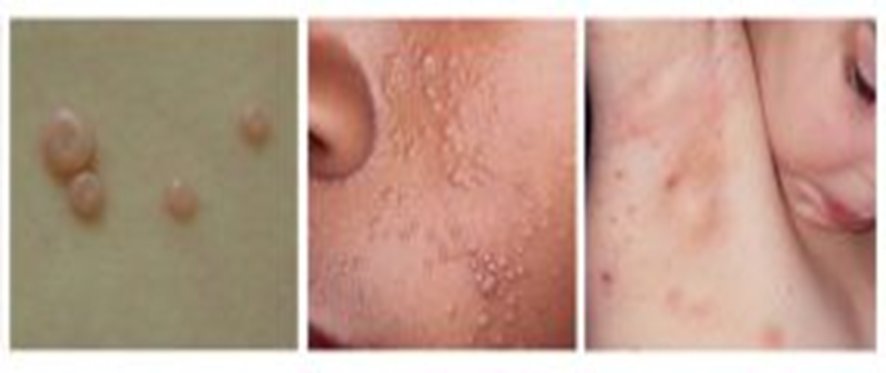
Molluscum contagiosum
Molluscum contagiosum is an infection caused by a poxvirus (molluscum contagiosum virus). The result of the infection is usually a benign, mild skin disease characterized by lesions (growths) that may appear anywhere on the body. Within 6-12 months, Molluscum contagiosum typically resolves without scarring but may take as long as 4 years.

Slide 24
Prevention and treatment
Currently, the smallpox vaccine is not recommended for the general public because smallpox has been eradicated. If there were a smallpox outbreak, health officials would use a smallpox vaccine to control it. While some antiviral drugs may help treat smallpox disease, there is no treatment for smallpox that has been tested in people who are sick with the disease and proven effective.
Smallpox vaccine
The vaccine is made from a virus called vaccinia, which is a poxvirus similar to smallpox, but less harmful.

