Slide 1
VIRAL GENETICS

Slide 2
Viruses grow rapidly, there are usually a large number of progeny virions per cell. There is, therefore, more chance of mutations occurring over a short time period. The nature of the viral genome (RNA or DNA; segmented or non-segmented) plays an important role in the genetics of the virus.
Viruses may change genetically due to mutation or recombination.
MUTANTS: Origin
Spontaneous mutations
These arise naturally during viral replication: e.g. due to errors by the genome-replicating
polymerase or a a result of the incorporation of tautomeric forms of the bases. (Tautomers are isomers of a compound which differ only in the position of the protons and electrons. The carbon skeleton of the compound is unchanged. A reaction which involves simple proton transfer in an intramolecular fashion is called a tautomerism)
DNA viruses tend to more genetically stable than RNA viruses. There are error correction
mechanisms in the host cell for DNA repair, but probably not for RNA.
Some RNA viruses are remarkably invariant in nature. Probably these viruses have the same
high mutation rate as other RNA viruses, but are so precisely adapted for transmission and
replication that fairly minor changes result in failure to compete successfully with
parental (wild-type, wt) virus.

Slide 3
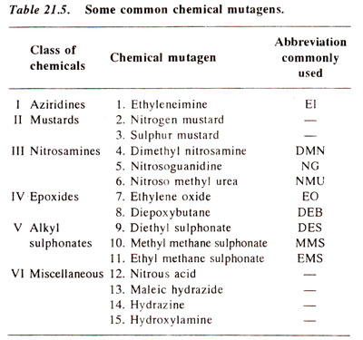
Mutations that are induced by physical or chemical means
Chemical:
Agents acting directly on bases, e.g. nitrous acid
Agents acting indirectly, e.g. base analogs which mispair more frequently than normal bases , thus generating mutations
Physical: Agents such as UV light or X-rays

Slide 4
Types of mutation
Mutants can be point mutants (one base replaced by another) or insertion/deletion mutants.
Examples of the kinds of phenotypic changes seen in virus mutants:
(phenotype = the observed properties of an organism)
1- Conditional lethal mutants
These mutants multiply under some conditions but not others (whereas the wild-type virus grows under both sets of conditions)
e.g. temperature sensitive (ts) mutants - These will grow at low temperature e.g. 31 degrees C but not at e.g. 39 degrees C, wild type grows at 31 and 39 degrees C. It appears that the reason for this is often that the altered protein cannot maintain a functional conformation at the elevated temperature.
e.g. host range - These mutants will only grow in a subset of the cell types in which the wild type virus will grow - such mutants provide a means to investigate the role of the host cell in viral infection
Plaque size: Plaques may be larger or smaller than in the wild type virus, sometimes such mutants show altered pathogenicity
Drug resistance: This is important in the development of antiviral agents - the possibility of drug resistant mutants arising must always be considered

Slide 5
2- Enzyme-deficient mutants
Some viral enzymes are not always essential and so we can isolate viable enzyme-deficient mutants; e.g. herpes simplex virus thymidine kinase is usually not required in tissue culture but it is important in infection of neuronal cells
3- "Hot" mutants
These grow better at elevated temperatures than the wild type virus. They may be more virulent since host fever may have little effect on the mutants but may slow down the replication of wild type virions
4- Attenuated mutants
Many viral mutants cause much milder symptoms (or no symptoms) compared to the parental virus - these are said to be attenuated. These have a potential role in vaccine development and they also are useful tools in determining why the parental virus is harmful

Slide 6
EXCHANGE OF GENETIC MATERIAL Recombination Exchange of genetic information between two genomes. "Classic" recombination This involves breaking of covalent bonds within the nucleic acid, exchange of genetic information, and reforming of covalent bonds. This kind of break/join recombination is common in DNA viruses or those RNA viruses which have a DNA phase (retroviruses). The host cell has recombination systems for DNA. Recombination of this type is very rare in RNA viruses (there are probably no host enzymes for RNA recombination). Picornaviruses show a form of very low efficiency recombination. The mechanism is not identical to the standard DNA mechanism, and is probably a "copy choice" kind of mechanism (figure 1) in which the polymerase switches templates while copying the RNA.
Recombination is also common in the coronaviruses - again the mechanism is different from the situation with DNA and probably is a consequence of the unusual way in which RNA is synthesized in this virus. So far, there is no evidence for recombination in the negative stranded RNA viruses giving rise to viable viruses (In these viruses, the genomic RNA is packaged in nucleocapsids and is not readily available for base pairing).

Slide 7
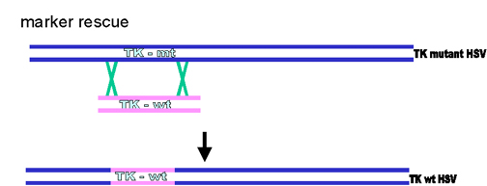
Various uses for recombination techniques
a) Mapping genomes (the further apart two genes are, the more likely it is that there will be a recombination event between them).
b) Marker rescue - DNA fragments from wild type virus can recombine with mutant virus to generate wild type virus - this provides a means to assign a gene function to a particular region of the genome. This also provides a means to insert foreign material into a gene (figure 2).
Recombination enables a virus to pick up genetic information from viruses of the same type and occasionally from unrelated viruses or even the host genome (as occurs in some retroviruse.
Figure 2: Marker rescue

Slide 8
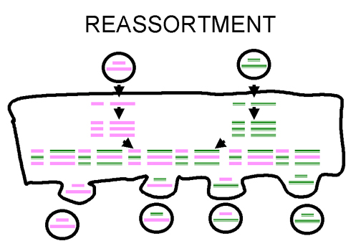
Reassortment
If a virus has a segmented genome and if two variants of that virus infect a single cell, progeny virions can result with some segments from one parent, some from the other.
This is an efficient process - but is limited to viruses with segmented genomes - so far the only human viruses characterized with segmented genomes are RNA viruses e.g. orthomyxoviruses, reoviruses, arenaviruses, bunya viruses.
Reassortment may play an important role in nature in generating novel reassortants and has also been useful in laboratory experiments (figure 3). It has also been exploited in assigning functions to different segments of the genome. For example, in a reassorted virus if one segment comes from virus A and the rest from virus B, we can see which properties resemble virus A and which virus B.
Reassortment is a non-classical kind of recombination
Figure 3 Reassortment of virus genome in segmented viruses

Slide 9
Applied genetics
There is vaccine called Flumist (LAIV, approved June 2003) for influenza virus which involves some of the principles discussed above. The vaccine is trivalent – it contains 3 strains of influenza virus:
The viruses are cold adapted strains which can grow well at 25 degrees C and so grow in the upper respiratory tract where it is cooler. The viruses are temperature-sensitive and grow poorly in the warmer lower respiratory tract. The viruses are attenuated strains and much less pathogenic than wild-type virus. This is due to multiple changes in the various genome segments.
Antibodies to the influenza virus surface proteins (HA - hemagglutinin and NA - neuraminidase) are important in protection against infection. The HA and NA change from year to year. The vaccine technology uses reassortment to generate reassortant viruses which have six gene segments from the attenuated, cold-adapted virus and the HA and NA coding segments from the virus which is likely to be a problem in the up-coming influenza season. This vaccine is a live vaccine and is given intranasally as a spray and can induce mucosal and systemic immunity. A live, attenuated reassortant vaccine has been approved for rotaviruses (RotaTeq from Merke).

Slide 10
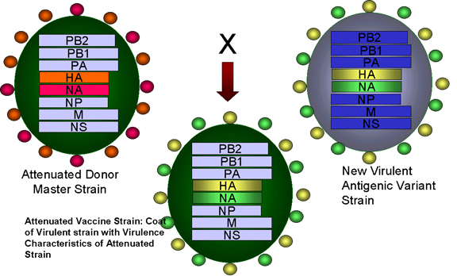

Slide 11
Multiplicity reactivation
If double stranded DNA viruses are inactivated using ultraviolet irradiation, we often see reactivation if we infect cells with the inactivated virus at a very high multiplicity of infection (i.e. a lot of virus particles per cell) - this is because inactivated viruses cooperate in some way. Probably complementation allows viruses to grow initially, as genes inactivated in one virion may still be active in one of the others. As the number of genomes present increases due to replication, recombination can occur, resulting in new genotypes, and sometimes regenerating the wild type virus
Complementation
Interaction at a functional level NOT at the nucleic acid level. For example, if we take two mutants with a ts (temperature-sensitive) lesion in different genes, neither can grow at a high (non-permissive) temperature. If we infect the same cell with both mutants, each mutant can provide the missing function of the other and therefore they can replicate (nevertheless, the progeny virions will still contain ts mutant genomes and be temperature-sensitive).
We can use complementation to group ts mutants, since ts mutants in the same gene will usually not be able to complement each other. This is a basic tool in genetics to determine if mutations are in the same or a different gene and to determine the minimum number genes affecting a function.

Slide 12
Defective viruses
Defective viruses lack the full complement of genes necessary for a complete infectious cycle (many are deletion mutants) - and so they need another virus to provide the missing functions - this second virus is called a helper virus. Defective viruses must provide the necessary signals for a polymerase to replicate their genome and for their genome to be packaged but need provide no more. Some defective viruses do more for themselves.
Some examples of defective viruses:
Some retroviruses have picked up host cell sequences but have lost some viral functions. These need a closely related virus which retains these functions as a helper.
Some defective viruses can use unrelated viruses as a helper: For example, hepatitis delta virus (an RNA virus) does not code for its own envelope proteins but uses the envelope of hepatitis B virus (a DNA virus).
Defective interfering particles
The replication of the helper virus may be less effective than if the defective virus (particle) was not there. This is because the defective particle is competing with the helper for the functions that the helper provides. This phenomenon is known as interference, and defective particles which cause this phenomenon are known as "defective interfering" (DI) particles. Not all defective viruses interfere, but many do.
Note that it is possible that defective interfering particles could modulate natural infections.

Slide 13
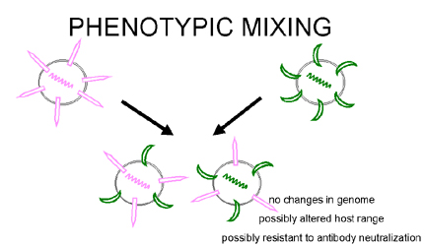
Phenotypic mixing
If two different viruses infect a cell, progeny viruses may contain coat components derived from both parents and so they will have coat properties of both parents. This is called phenotypic mixing (figure 5). IT INVOLVES NO ALTERATION IN GENETIC MATERIAL, the progeny of such virions will be determined by which parental genome is packaged and not by the nature of the envelope.
Phenotypic mixing may occur between related viruses, e.g. different members of the Picornavirus family, or between genetically unrelated viruses, e.g. Rhabdo- and Paramyxo- viruses. In the latter case the two viruses involved are usually enveloped since it seems there are fewer restraints on packaging nucleocapsids in other viruses' envelopes than on packaging nucleic acids in other viruses' icosahedral capsids.
Figure 5 Phenotypic mixing between two different viruses infecting the same cell

Slide 14
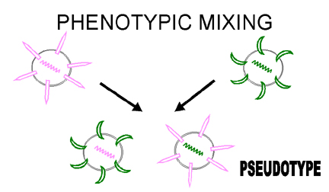
We can also get the situation where a coat is entirely that of another virus, e.g. a retrovirus nucleocapsid in a rhabdovirus envelope. This kind of phenotypic mixing is sometimes referred to as pseudotype (pseudovirion) formation (figure 6). The pseudotype described above will show the adsorption-penetration-surface antigenicity characteristics of the rhabdovirus and will then, upon infection, behave as a retrovirus and produce progeny retroviruses. This results in pseudotypes having an altered host range/tissue tropism on a temporary basis
Figure 6 Phenotypic mixing to form a pseudotype

