Slide 1
Boundary Layer Characteristics
The earth's surface is a boundary on the domain of the atmosphere. Transport processes at this boundary modify the lowest 100 to 3000 m of the atmosphere, creating what is called the boundary layer .
The remainder of the air in the troposphere is loosely called the free atmosphere.
The troposphere extends from the ground up to an average altitude of 11 km,
define the boundary layer as that part of the troposphere that is directly influenced by the presence of the earth's surface and responds to surface forcing with a timescale of about an hour or less. These forcings include frictional drag, evaporation and transpiration, heat transfer, pollutant emission, and terrain. The boundary layer thickness is quite variable in time and space. Its maximum height can reach 3 km over deserts, dry fields and boreal forests. Over wetter surfaces the PBL reaches about 1 to 2 km.
Two types of clouds are often included in boundary-layer studies. One is the fair-weather cumulus cloud and the other type is the stratocumulus cloud.

Slide 3
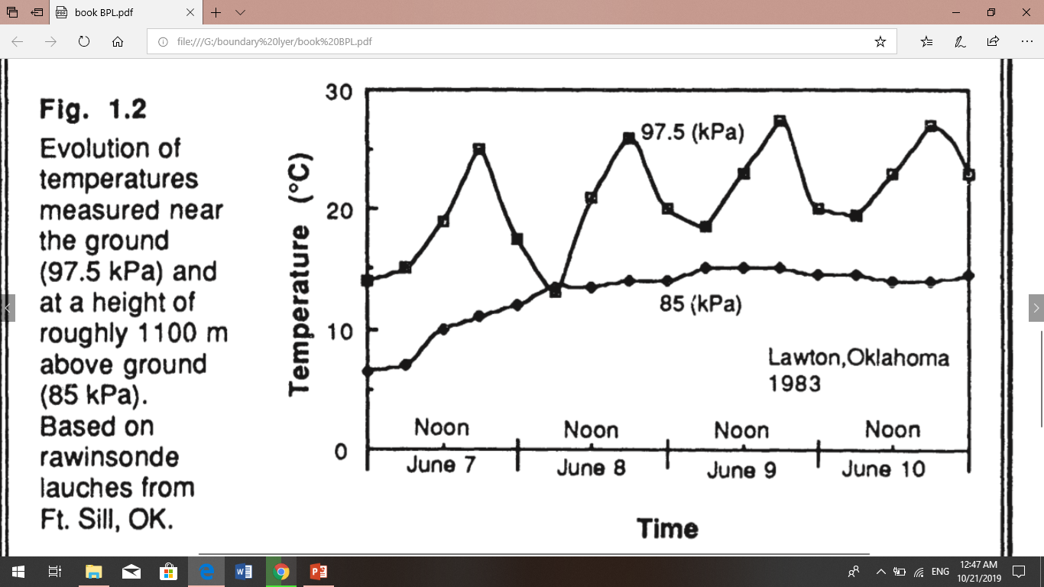
For example of temperature variations in the lower troposphere is shown in Fig 1.2. These time-histories were constructed from radiosonde soundings made every several hours near Lawton, Oklahoma. shows a diurnal variation of temperature near the ground that is not evident at greater altitudes. Such diurnal variation is one of the key characteristics of the boundary layer over land. The free atmosphere shows little diurnal variation.
This diurnal variation is not caused by direct forcing of solar radiation on the boundary layer. Little solar radiation is absorbed in the boundary layer; most are transmitted to the ground where typical absorptivities on the order of 90% result in absorption of much of the solar energy. It is the ground that warms and cools in response to the radiation, which in turn forces changes in the boundary layer via transport processes. Turbulence is one of the important transport processes, and is sometimes also used to define the boundary layer.

Slide 5
Wind and Flow
Air flow, or wind. can be divided into three broad categories: mean wind, turbulence, and waves (Fig 1.3).
Each can exist separately, or in the presence of any of the others. Each can exist in the boundary layer, where transport of quantities such as moisture, heat, momentum. and pollutants is dominated in the horizontal by the mean wind, and in the vertical by turbulence.
Mean wind is responsible for very rapid horizontal transport, or advection. Friction causes the mean wind speed to be slowest near the ground. Vertical mean winds are much smaller, usually on the order of millimeters to centimeters per second.
Waves, which are frequently observed in the nighttime boundary layer, transport little heat, humidity, and other scalars such as pollutants. They are, however, effective at transporting momentum and energy. These waves can be generated locally by mean-wind shears and by mean flow over obstacles. Thus, wave phenomena can be associated with the turbulent transport of heat and pollutants, although waves without turbulence would not be as effective.
Turbulence high frequency of occurrence of turbulence near the ground is one of the characteristics that makes the boundary layer different from the rest of the atmosphere. Outside of the boundary layer, turbulence is primarily found in convective clouds, and near the jet stream where strong wind shears can create clear air turbulence (CAT).
The frequent lack of turbulence above the boundary layer means that the rest of the free atmosphere cannot respond to surface changes.

Slide 6
Sources of turbulence:
Thermal forcing (thermals: buoyant eddies forced by solar heating of the surface)
Vertical wind shear (due to frictional drag by the surface on geostrophic flow aloft
Horizontal wind shear (due to flow of wind around obstacles: trees and mountains)
The surface-air interaction occurs in two primary forms: mechanical and thermal.
Much of the boundary layer turbulence is generated by forcings from the ground. For example, solar heating of the ground during sunny days causes thermals of warmer air to rise. These thermals are just large eddies.
Frictional drag on the air flowing over the ground causes wind shears to develop, which frequently become turbulent. Obstacles like trees and buildings deflect the flow, causing turbulent wakes adjacent to, and downwind of the obstacle.
The largest boundary layer eddies scale to the depth of the boundary layer; that is, 100 to 3000 m in diameter.
Turbulence is several orders of magnitude more effective at transporting quantities than is molecular diffusivity.
The frequent lack of turbulence above the boundary layer means that the rest of the free atmosphere cannot respond to surface changes.

Slide 8
Characteristics of ABL
The boundary layer ,dynamically distinct sublayers
Interfacial sublayer - in which molecular viscosity/diffusivity dominate vertical fluxes
Inertial layer - in which turbulent fluid motions dominate the vertical fluxes, but the dominant scales of motion are still much less than the boundary layer depth. This is the layer in which most surface wind measurements are made. • Layers (i) + (ii) comprise the surface layer.
iii) Outer layer - turbulent fluid motions (‘large eddies’).
• At the top of the outer layer, the BL is often capped by an entrainment zone in which turbulent BL eddies are entraining non-turbulent free-atmospheric air. This entrainment zone is often associated with a stable layer or inversion.

Slide 9
Applications and Relevance of BLM
The boundary layer is the part of the atmosphere in which we live and carry out most human activities.
Furthermore, almost all exchange of heat, moisture, momentum, aerosols, gasses, and pollutants occurs through the BL
Specific applications
Climate simulation and NWP - parameterization of surface characteristics, air-surface exchange, BL thermodynamics fluxes and friction, and cloud. No climate model can succeed without some consideration of the boundary layer. In NWP models, a good boundary layer is critical to proper prediction of the diurnal cycle, of low-level winds and convergence, of effects of complex terrain, and of timing and location of convection. Coupling of atmospheric models to ocean, ice, land-surface models occurs through BL processes.
Air Pollution and Urban Meteorology - Pollutant dispersal, interaction of BL with mesoscale circulations. Urban heat island effects. Visibility.
Agricultural meteorology - Prediction of frost, dew, evapotranspiration, soil temperature.
Aviation - Prediction of fog formation and dissipation, dangerous wind-shear conditions.
Remote Sensing - Satellite-based measurements of surface winds, temperature, etc.
Military – electromagnetic wave transmission, visibility.

Slide 10
Boundary Layer Depth and Structure :-
Over oceans the boundary layer depth varies relatively slowly in space and time. The sea surface temperature changes little over a diurnal cycle because of the tremendous mixing within the top of the ocean. Also, water has a large heat capacity, meaning that it can absorb large amounts of heat from the sun with relatively little temperature change. Thus, a slowly varying sea surface temperature means a slowly varying forcing into the bottom of the boundary layer. Most changes in boundary layer depth over oceans are caused by synoptic and mesoscale processes of vertical motion and advection a of different air masses over the sea surface.
Over both land and oceans,
the general nature of the boundary layer is to be thinner in high-pressure regions than in low-pressure regions
(Fig 1.6). The subsidence and low-level horizontal divergence associated with synoptic high-pressure move boundary layer air out of the high towards lower pressure regions. The shallower depths are often associated with cloud-free regions.
In low-pressure regions the upward motions carry boundary-layer air away from the ground to large altitudes throughout the troposphere. It is difficult to define a boundary layer top for these situations.

Slide 11
Over land surfaces in high pressure regions the boundary layer has a well defined structure that evolves with the diurnal cycle (Fig 1.7). The three major components of this structure are the mixed layer, the residual layer, and the stable boundary layer. When clouds are present in the mixed layer, it is further subdivided into a cloud layer ' and a sub cloud layer.
The surface layer is the region at the bottom of the boundary layer where this layer, typically 100 m thick
(or 10% of the depth of the ABL), the winds, temperature and humidity vary rapidly with altitude, and the characteristics of turbulence are affected by the surface. Vertical fluxes of heat and momentum are approximately constant. a thin layer called a microlayer or interfacial layer has been identified in the lowest few centimeters of air, where molecular transport dominates over turbulent transport.
At the sunset, the deep surface cooling creates a stable (nocturnal) boundary layer, above which is a residual layer, basically the leftover part of the daytime mixed layer· It mixing is caused by wind friction. The thickness of this layer depends on the prevailing wind velocity as well as on the roughness of the surface, but it rarely exceeds 500 m.
When the sun rises, the atmosphere begins to be heated from below and convective motions quickly overtake wind shear turbulence. Penetrative convection follows, gradually eroding upward the stratified layer created during the night and replacing it by the convective boundary layer (CBL). Wind-induced turbulence is much weaker than convection-induced turbulence, except at the base of the CBL where both have equal intensity. The suppression of heat input from the surface at sunset halts convection, and what used to be the CBL becomes an unagitated mixed layer, called the residual layer.

Slide 12
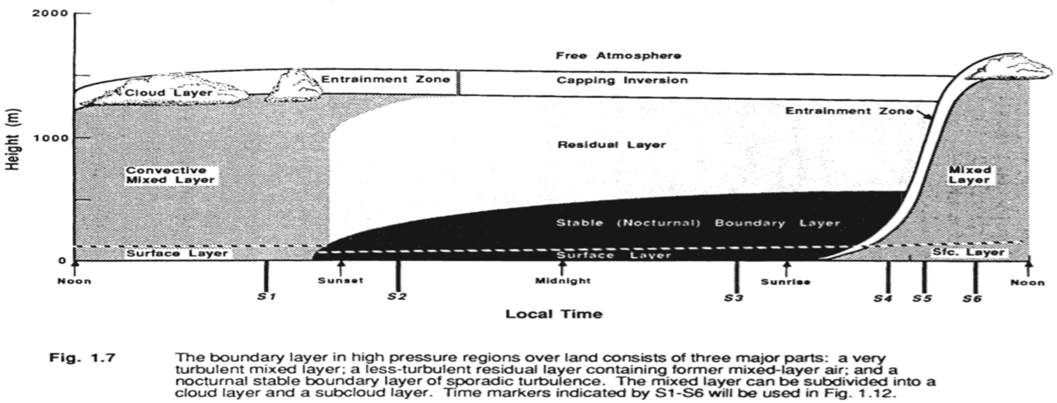

Slide 13
The following shorthand notation is often used for the various parts of the boundary layer.

Slide 14
Boundary Layer : extends from the surface to between 500 and 3,000 m altitude. Located within troposphere
Surface Layer : comprises the bottom 10% of the Boundary Layer.
Mixed Layer : area of upward and downward motion of air resulting in a very well mixed layer of air.
Very unstable
Entrainment Zone : area between the boundary layer and the free atmosphere.
Free Atmosphere : area above the boundary layer.
Cloud Layer : region within the boundary layer where clouds appear.
Subcloud Layer : region underneath the cloud layer
Nocturnal Boundary layer : portion of mixed layer that loses its buoyancy at night. Very stable.
Residual layer : the remaining portion of the mixed layer at night

Slide 15
Boundary layers are classified as unstable if the air moving upward in turbulent motions near the surface tends to be buoyant ( less dense) than in the downdrafts, and stable if the reverse is true.
If there is negligible buoyancy transport within the BL, it is called neutral.

