Slide 1
The Course of Fundamentals of Thermodynamics
MUSTANSIRIYAH UNIVERSITY
COLLEGE OF SCIENCES
DEPARTMENT OF ATMOSPHERIC SCIENCES
2020-2021
Dr. Sama Khalid Mohammed
SECOND STAGE
Lecture 8

Slide 2
Welcome Students In The New Course
And In The eighth Lecture ☺

Slide 3
This lecture including the following items
Overview of the Earth’s Atmosphere
Composition of the Atmosphere
Vertical Structure of the Atmosphere
Pressure (hydrostatic eq. )
Temperature
Pressure decrease in an isothermal atmosphere
Density
Geopotential and Geopotential Height
Thickness and the hypsometric equation

Slide 4
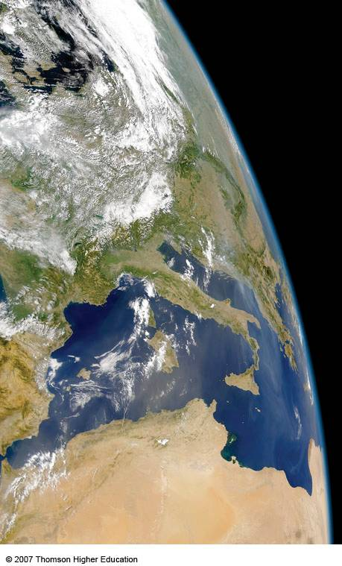
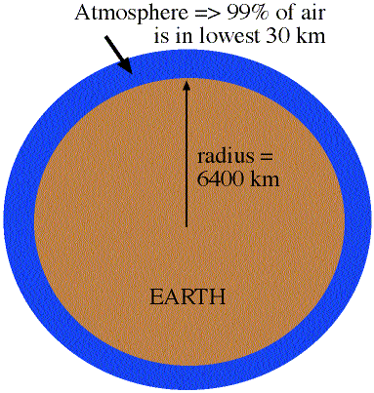
Overview of the Earth’s Atmosphere
The Atmosphere is really a thin envelope surrounding the earth
99% of atmosphere is in lowest 30 km
earth's radius is about 6400 km
So, the atmospheric depth is 30 km/6400 km= 0.5% of earth's radius

Slide 5
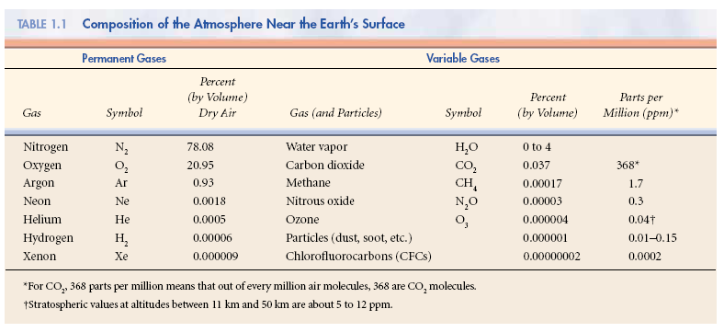
Composition of the Atmosphere
The earth’s atmosphere is a thin, gaseous envelope comprised mostly of nitrogen (N₂) and oxygen (O₂), with small amounts of other gases, such as water vapor (H₂O) and carbon dioxide (CO₂). Nested in the atmosphere are clouds of liquid water and ice crystals.

Slide 6
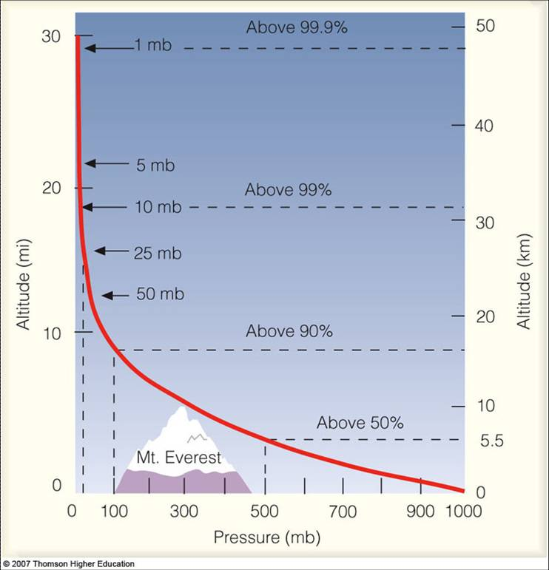
Vertical Structure of the Atmosphere
Vertical Profile of Pressure
Atmospheric Pressure decreases with height.... in a similar manner as density, WHY?

Slide 7
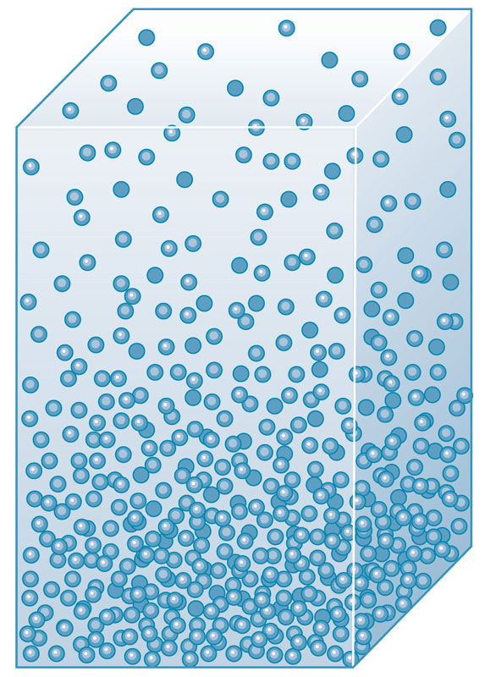
The Hydrostatic Equation
Air pressure at any height in the atmosphere is due to the force per unit area exerted against a surface by the weight of the air molecules above that surface. This “weight” results from the pull of gravity
That explains why pressure decreases with increasing height above the ground
P2
P1 > P2
However, pressure gradients cause a force that points from regions with high pressure towards regions with low pressure (vertical Gradient Pressure).
That explains why the atmosphere does not collapses on the ground and does not escape to the space
P1

Slide 8
The Hydrostatic Equation
Consider “g” the gravity acceleration (m/s²)
Consider that δp is negative ( that is, z increases p decreases)
Vertical Gradient Acceleration=Force/mass
In a hydrostatic equilibrium, and considering the limit as δz → 0
or:
pressure p + δp
pressure p
δz
Z
Gravity acceleration
Hydrostatic Equation

Slide 9
Vertical Structure of the Atmosphere
There are two types of pressure:
Hydrostatic pressure, which is just due to the weight of the air above you.
Dynamic pressure, which is due to the motion of the air.
In meteorology, dynamic pressure is usually very small, and we will assume for now that atmospheric pressure is solely due to hydrostatic pressure.
To find how pressure changes with height we start with the hydrostatic equation

Slide 10
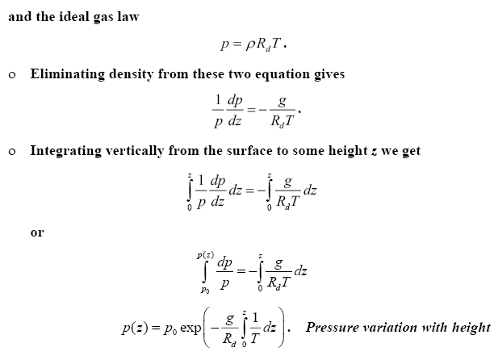
Vertical Structure of the Atmosphere
This Equation is used to obtain a relationship between pressure and height, used by altimeters to measure pressure and calculate altitude above sea level, in which Aircraft altimeters are essentially barometers that are calibrated to read altitude above mean sea level

Slide 11
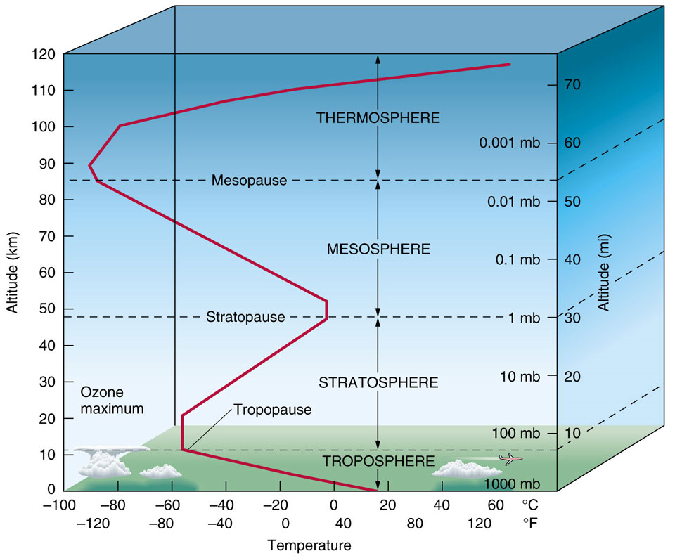
Vertical Structure of the Atmosphere
Vertical Profile of Temperature
There are distinct layers in the atmosphere where the temperature either increases or decreases with height.

Slide 12
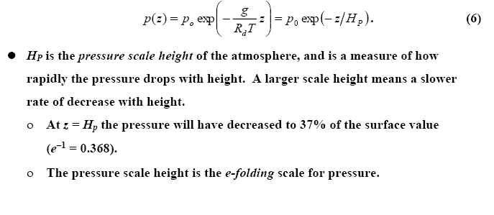
Vertical Structure of the Atmosphere
Pressure decrease in an isothermal atmosphere
Absolute temperature varies by only 20% or so through the troposphere, so we can get an idea how pressure changes with height by assuming a constant temperature (isothermal atmosphere). If this is done, the expression for the pressure profile becomes
Notes:
Scale height is a general way to describe how a value fades away and it is commonly used to describe the atmosphere of a planet. It is the vertical distance over which the density and pressure fall by a factor of 1/e. These values fall by an additional factor of 1/e for each additional scale height H. Thus, it describes the degree to which the atmosphere “hugs” the planet.
Scale height is extremely useful for making “back of the envelope calculations”.

Slide 13
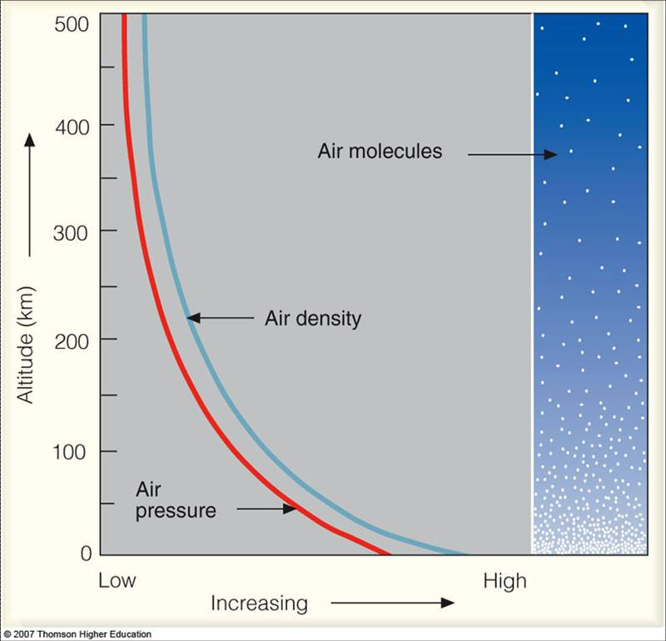
Vertical Structure of the Atmosphere
Vertical Profile of Density
The density of air is computed by determining the mass of air in a given volume.
The density of air decreases with height.
Riddles: Why are there more air molecules near the ground than higher in the atmosphere?
Notes:
http://apollo.lsc.vsc.edu/classes/met130/index.html

Slide 14
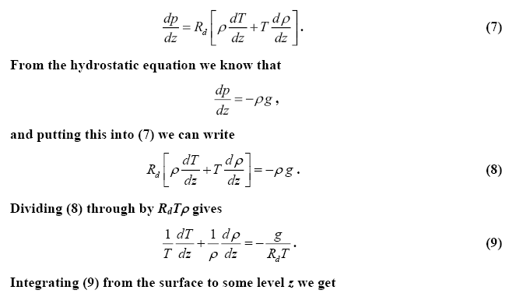
Vertical Structure of the Atmosphere
Vertical Profile of Density
We can also use the hydrostatic equation and the equation of state to find how density changes with height. We first start by differentiating the ideal gas law with respect to height to get
p=ρR_{d} T
Notes:
http://apollo.lsc.vsc.edu/classes/met130/index.html

Slide 15
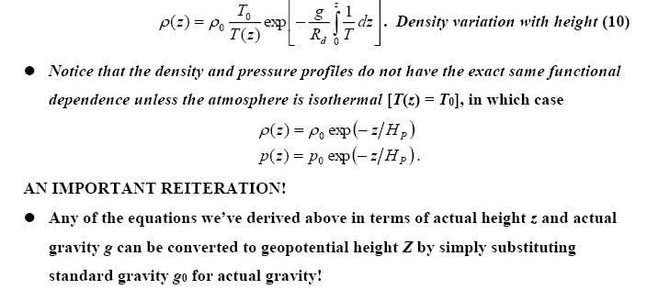
Vertical Structure of the Atmosphere
Notes:
http://apollo.lsc.vsc.edu/classes/met130/index.html

Slide 16
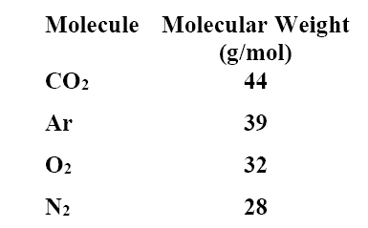
IS THE UPPER ATMOSPHERE WELL MIXED?
The atmosphere is a mixture of several different gases. The most abundant are N2, O2, Ar, and CO2.
In order of molecular weight we have
Notes:
http://apollo.lsc.vsc.edu/classes/met130/index.html

Slide 17
IS THE UPPER ATMOSPHERE WELL MIXED?
You would think that the atmosphere would stratify according to weight, with the heaviest molecules having the greatest concentration near the surface. Therefore, we would expect most of the CO2 and Ar to be found near the surface.
Without turbulence, molecular diffusion would dominate any vertical transport processes.
Molecular diffusion favors lighter molecules over heavier ones. Therefore, the lighter molecules would be better mixed through a layer than would the heavier molecules, which would remain near the bottom due to gravity.
Molecular diffusion is characterized by the mean free path, which is the average distance between collisions.
Notes:
http://apollo.lsc.vsc.edu/classes/met130/index.html

Slide 18
IS THE UPPER ATMOSPHERE WELL MIXED?
The shorter the mean free path, the less effective molecular diffusion becomes.
Mean free path increases as pressure (and density) decrease.
If turbulence is present, mixing is accomplished very efficiently.
Turbulent mixing does not discriminate based on mass. All molecules are mixed just as effectively.
Turbulent mixing is characterized by the mixing length, which is the average length that an air parcel can travel and still retain its identity.
If the mixing length is greater than the mean free path, turbulent mixing will dominate and all molecules will be well mixed.
Notes:
http://apollo.lsc.vsc.edu/classes/met130/index.html

Slide 19
IS THE UPPER ATMOSPHERE WELL MIXED?
If the mean free path is greater than the mixing length, molecular diffusion will dominate and the heavier molecules will be found toward the bottom.
Up to about 80 km or so, the mixing length is larger than the mean free path, so that turbulent mixing dominates and the atmosphere is well mixed.
Above 80 km the mean free path becomes larger than the mixing length (because density is decreasing with altitude). Therefore, above 80 km molecular diffusion dominates and the atmosphere is no longer well mixed. Instead, it becomes stratifies with the heavier molecules concentrated at the bottom.
The well-mixed region is called the homosphere.
The stratified region is called the heterosphere.
The transition layer between the two is called the turbopause.
Notes:
http://apollo.lsc.vsc.edu/classes/met130/index.html

