Slide 1
family: vibrionaceae
Genus: Vibrio

Slide 3
General characteristics
They are curved G -ve (comma shape) ,aerobic rods, motile with single polar flagellum, found in single or in cluster forming S shape, non spore former, on prolong cultivation Vibrio may become straight rods. Vibrio found in nature mostly in water, fishes and food.
Culture: Vibrio produce convex ,smooth round colonies, opaque and granular in transmitted light,
they are oxidase +ve,
most Vibrio grow well at 37 °C on media containing mineral salt and amino acids (Aspargin, Arginine, Lysine) as a source of carbon and nitrogen.
These organisms grow at alkaline pH(8.5-9.5) but they are rapidly killed by acid and heating at 55 0C for 15 min.,culture containing carbohydrates become sterile after few days. Vibrio cholera grows well on TCBS (Thiosulfate citrate bile sucrose) media.

Slide 4
General characteristics
These organisms grow at alkaline
pH(8.5-9.5) but they are rapidly killed by acid and heating at 55 0C for 15 min.
Vibrio cholera grows well on TCBS (Thiosulfate citrate bile sucrose) media.

Slide 5
Vibrio cholera (V.C.): 01,0139
Non vibrio cholera (N.V.C.):02-0138
V. parahaemolyticus (food- asscciated diarrhea disease)
V. vulnificis(wound infection)
V. alginolyticus (otitis externa,wound infection)

Slide 6
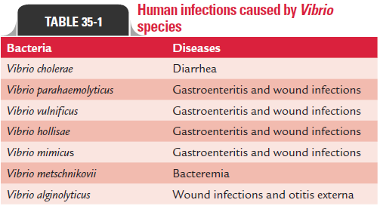

Slide 7
Eltor | Classical
Hemolytic | Non Hemolytic
Polymixin B (resistant) | Polymixin B (sensitive)
VP. +ve | VP. - ve
Cause heme agglutination of sheep RBC | dose not

Slide 8
Laboratory Diagnostic tests:
1-Gram stain.
2- TCBS (Na-citrate,Na-thiosulfate,bile salt,sucrose,bromothymolblue,pH:8)
3- Peptone water Nacl 7%, 0%
4- IMVIC
5- Motility
6- Nitrate reduction test.
7-TSI test
8- OF media.
9- Mannitol fermentation.
10 - Catalase and oxidase test.

Slide 9
11 - String test : When an isolated colony (18-24 hour growth) of a suspected bacterium is emulsified in Sodium deoxycholate or Sodium taurocholate (commonly known as bile salt), it lyses the cell wall of the bacterium releasing the DNA . Take a clean grease free slide and put a drop of (0 .5% bile salt). Emulsify an isolated colony of the bacterium using an inoculating loop. Keep on rubbing the loop vigorously for 2-3 min. until it appears viscous. Gently, pull the loop upwards from the slide. Formation of a thread like mucoid string indicates a positive test.

Slide 10
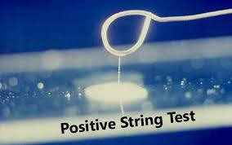

Slide 11
12- Cholera red test. Tryptophane + cone. H2SO4 ----+ nitrosoindole (red color +ve )
{Reagent :Sulphuric acid (1-3) drops}
Media : peptone water(18-24)h.
13- Oxidase test (4,5 tetramethyl paraphenyl diamine dihydro chloride),The oxidase test is based on the bacterial production of an oxidase enzyme. Transfer 1 colony (not from blood agar) to filter paper by loop then add 1 drop of ( 4,5 tetramethyl paraphenyl diamine dihydro chloride) +ve dark violet,,,,,,,, - ve no change in color

Slide 18
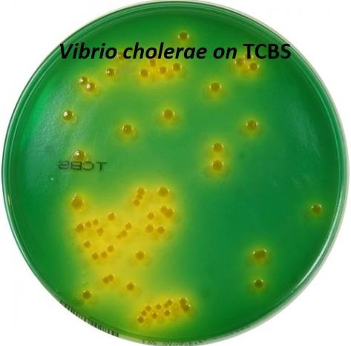

Slide 19
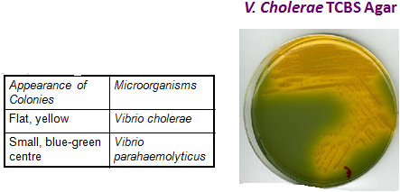

Slide 20
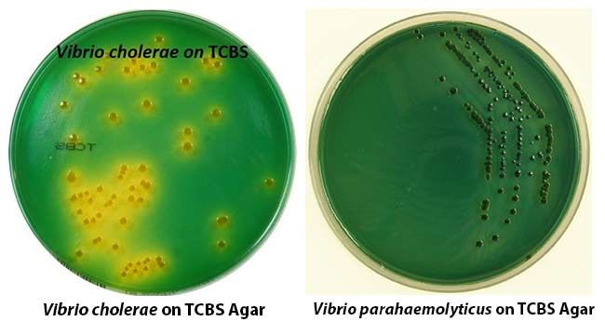

Slide 21
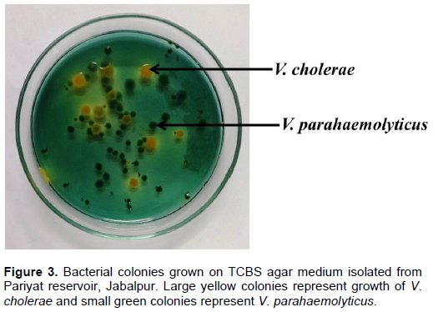

Slide 22
Test | Vibrio cholera | Vibrio parahaemolyticus
Catalase and oxidase | + | +
NO2 reduction | + | +
Indol | + | +
MR | +weak
VP | - | -
SC | V | V
Peptone water 7% NaCl | - | +
Peptone water 0% NaCl | + | -
TSI | A\A ,_,_ | K\A,_,_
Motility | + | +
Cholera red | + | -
Mannitol | +weak | +weak
String test | + | +
OF media | Oxidation and fermentation | Oxidation

Slide 24
