Slide 1
LAB:8 Shigella & Salmonella

Slide 2
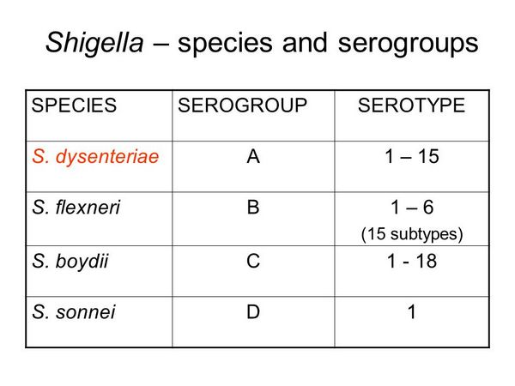

Slide 3
General characteristics
1-Gram negative
2-Rod shape
3- Facultative anaerobes
4-Non spore forming
5- Non motile
6-Uncapsulated
7- Non lactose fermenter(Pale colonies or Colorless colonies).except Sh. Sonnei( Late lactose ferm )
8-H2S –ve

Slide 4
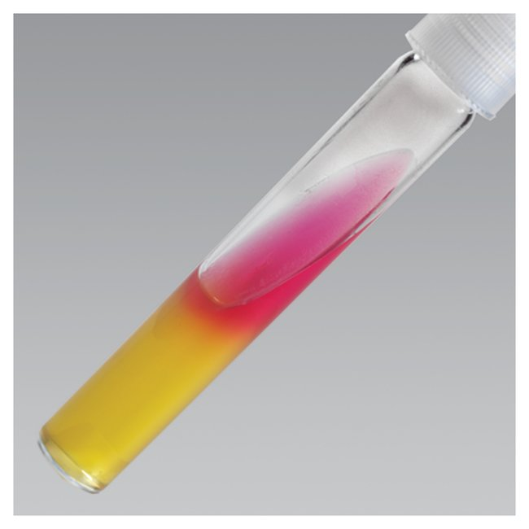

9-Catalase +ve ,,,Oxidase –ve
10-IMViC test : V,+,-, - except Sh. sonnei indol –ve
11-TSI test : K\A , CO2 –ve, H2S –ve
12-Glucose ferm except Sh. Flexneri
13-Mannitol ferm except Sh. dysenteriae

Slide 5
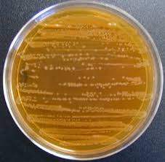
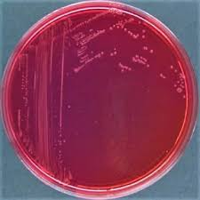

Slide 6
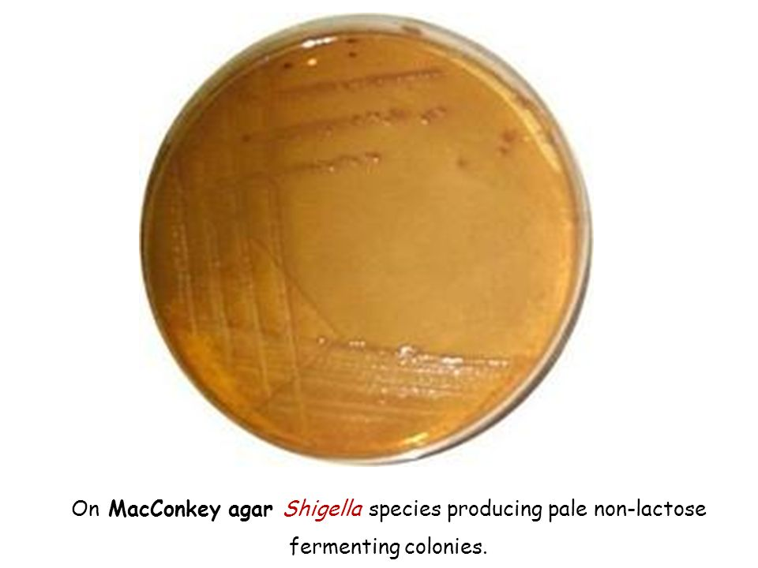
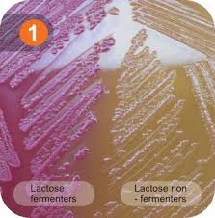

Slide 7
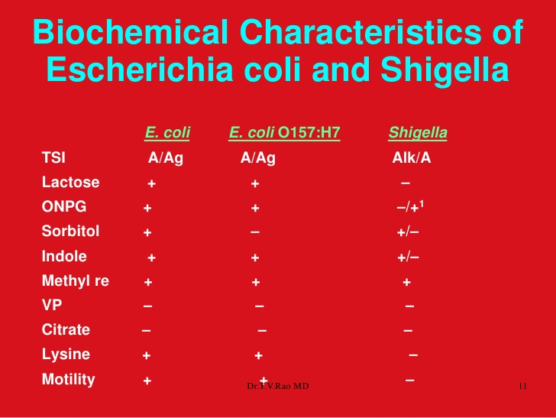

Slide 8
Test | S. dysenteriae | S. flexneri | S. boydii | S .sonnei
Indole | V | V | V | -
M | + | + | + | +
V | - | - | - | -
C | - | - | - | -
TSI | K\A,-,- | K\A,-,- | K\A,-,- | A\A,-,-
Motility | - | - | - | -
Glucose | + | - | + | +
Lactose | LNF | LNF | LNF | LF
Mannitol | - | + | + | +
Urease | - | - | - | -
Gelatinase | - | - | - | -
MacConkey agar | Pale colonies | Pale colonies | Pale colonies | Pink colonies
S-S agar | Pale colonies | Pale colonies | Pale colonies | Pink colonies
Xylose | - | - | - | -

Slide 9
Genus : Salmonella
General characteristics
1-Gram negative
2-Rod shape
3- Facultative anaerobes
4-Non spore forming
5- Motile +ve except S.gallinarium
6-Uncapsulated except S.typhi
7- Non lactose fermenter(Pale colonies or Colorless colonies) on MacConkey agar .
8-H2S +ve except S.typhi

Slide 10
9-Catalase +ve ,,,Oxidase –ve
10-IMViC test :-,+,-, + except S. typhi citrate –ve
11-TSI test : K\A , CO2 +ve, H2S +ve , except S. typhi H2S-ve
12-Glucose ferm
13-Mannitol ferm+ve

Slide 11
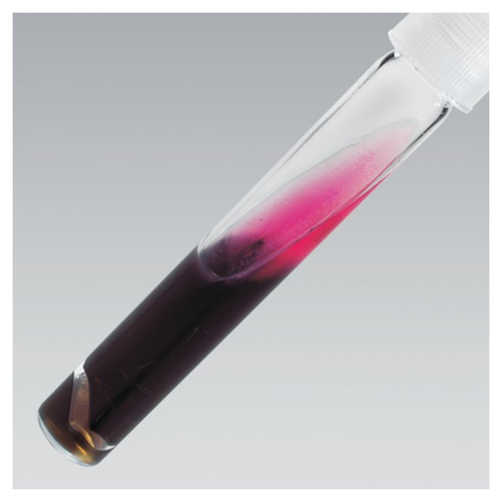

Slide 12
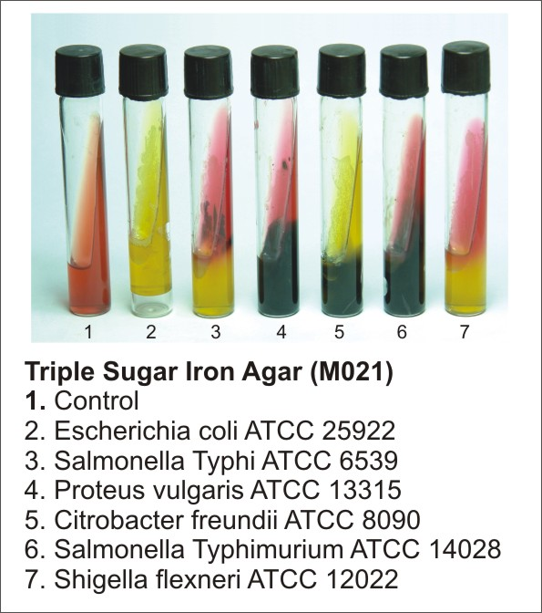

Slide 13
Test | S. typhi | S. Typhimurium
Indole | - | -
M | + | +
V | - | -
C | - | +
TSI | K\A,co2 +, H2S - | K\A, C02 +, H2S +
Motility | + | +
Glucose | + | +
Lactose | LNF | LNF
Mannitol | +with gas | +with gas
Xylose | + | +
Urease | - | -
XLD agar | Yellow colonies | Yellow colonies With black center
MacConkey agar | Pale colonies | Pale colonies
S-S agar | Pale colonies | Pale colonies with black center

Slide 14
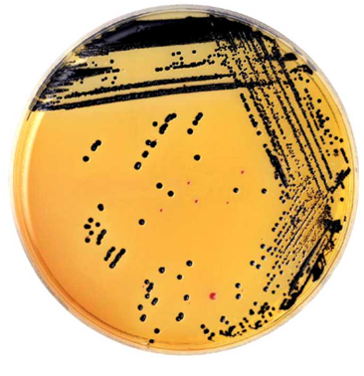

Slide 15
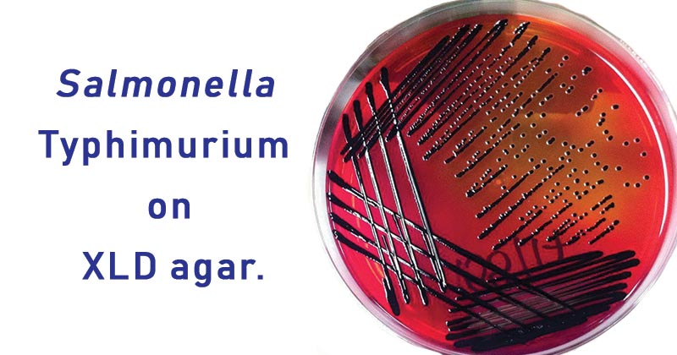

Slide 16
