Slide 1
LAB:6 Enterobacteriaceae

Slide 2
Enterobacteriaceae is a large family of Gram-negative bacteria. It was first proposed by Rahn in 1936, and now includes over 30 genera and more than 120 species.
Enterobacteriaceae includes, along with many harmless symbionts, many of the more familiar pathogens, such as Salmonella, Escherichia coli, Klebsiella, and Shigella. Other disease-causing bacteria in this family include Enterobacter and Citrobacter. Members of the Enterobacteriaceae can be referred to as enterobacteria or "enteric bacteria",

Slide 3
Members of the Enterobacteriaceae are bacilli (rod-shaped), and are typically 1–5 μm in length. They typically appear as medium to large-sized grey colonies on blood agar, although some can express pigments.
Most have many flagella used to move about, but a few genera are nonmotile. Most members of Enterobacteriaceae have peritrichous, type I fimbriae involved in the adhesion of the bacterial cells to their hosts.
They are not spore-forming

Slide 4
Citrobacter, Enterobacter, Escherichia, Hafnia, Morganella, Providencia , Klebsiella , Proteus , Salmonella , Shigella and Serratia.

Slide 5
General characteristics
1- Gram negative
2- Coccobacilli
3- facultative anaerobes
4- Non spore forming
5- capsule \ + or –
6- motile \ + or –
7- Catalase +
8- Oxidase –

Slide 6
Identification
To identify different genera of Enterobacteriaceae, a microbiologist may run a series of tests in the lab. These include:
Phenol red
Tryptone broth
Phenylalanine agar for detection of production of deaminase, which converts phenylalanine to phenyl pyruvic acid
Methyl red or Voges-Proskauer tests depend on the digestion of glucose. The methyl red tests for acid end products. The Voges Proskauer tests for the production of acetylmethylcarbinol.
Catalase test on nutrient agar tests for the production of enzyme catalase, which splits hydrogen peroxide and releases oxygen gas.
Oxidase test on nutrient agar tests for the production of the enzyme oxidase, which reacts with an aromatic amine to produce a purple color.
Nutrient gelatin tests to detect activity of the enzyme gelatinase.

Slide 7
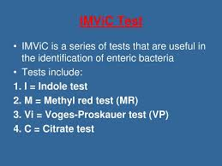

Slide 8
Indole test
Media culture :peptone water
Reagent ;kovacs
Enzymes: Tryptophanase
Substrate :Tryptophan
Positive result: red ring
Negative result :no change

Slide 9
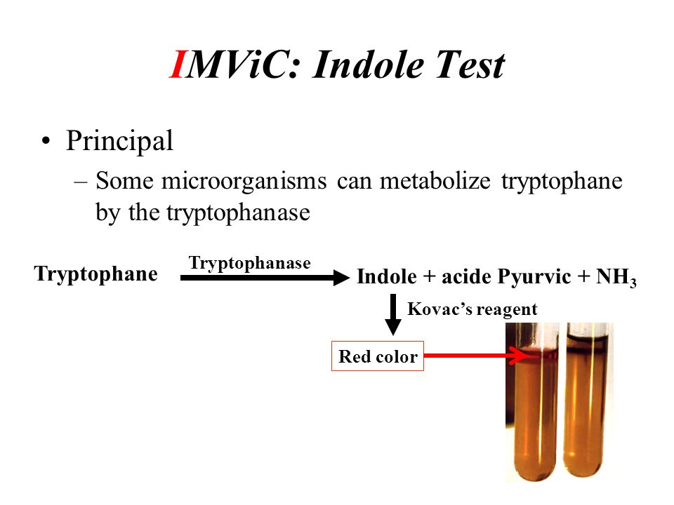

Slide 10
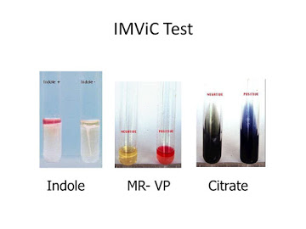

Slide 11
Methyl red – Voges proskauer test
Media culture :Glucose phosphate
Reagent : Methyl red& Barrits
Enzymes:
Substrate : Glucose
Positive result :M=red color ..V=pink color
Negative result :yellow color

Slide 12
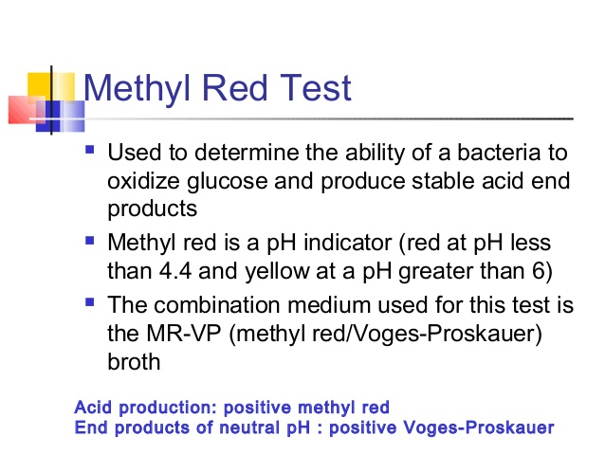

Slide 13
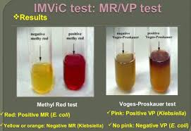

Slide 14
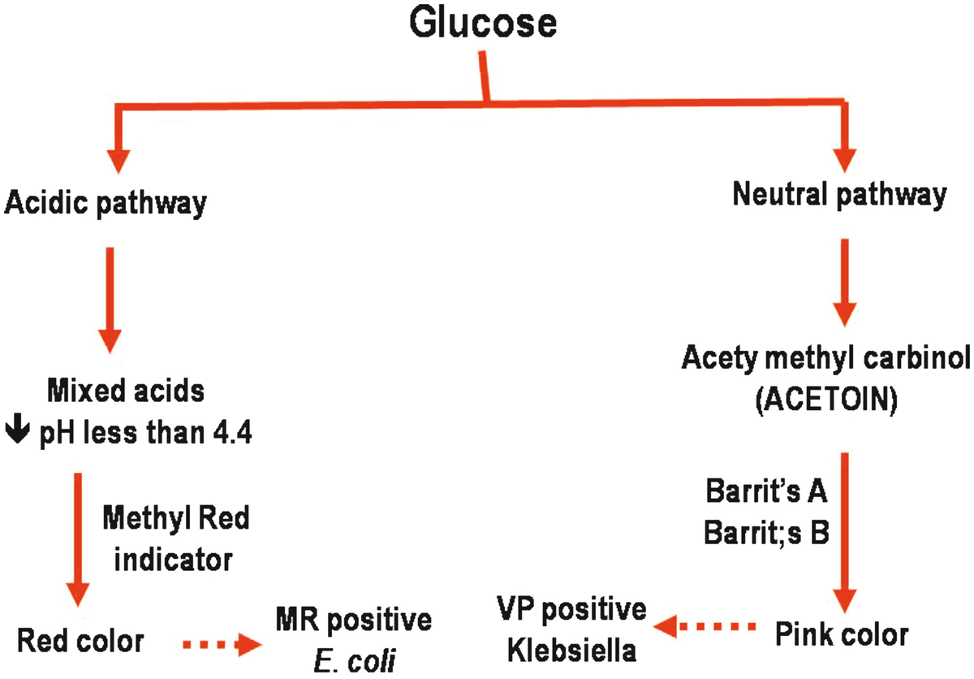

Slide 15
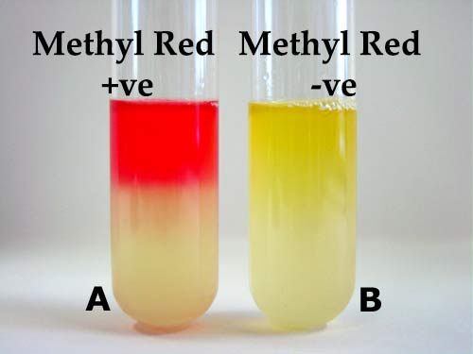

Slide 16
Citrate utilization test
Media culture :Simmon citrate agar
PH indicator :Bromothymol blue
Enzymes: Citrase
Substrate :Na-citrate
Positive result : Blue color
Negative result :NO growth

Slide 17
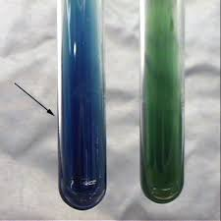

Slide 18
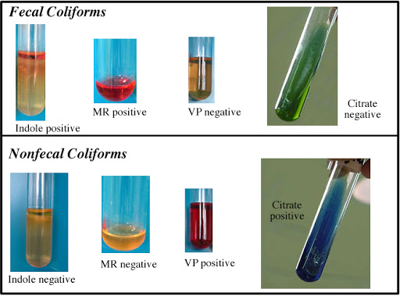

Slide 19
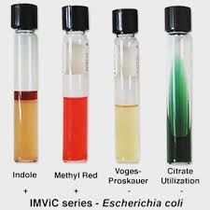

Slide 20
