Slide 1
LAB2:culture Media

Slide 2
Microorganisms, like all other living organisms, require basic nutrients for sustaining their life. All microorganisms have the same basic requirements but they are diverging in inorganic and organic compounds needs. By providing environmental and nutritional factors it is often possible to provide the appropriate conditions for their cultivation. On this basis we can define the
Culture media as a fellow: An artificial environment simulating natural conditions that necessary for bacteria to grow in laboratory.

Slide 3
Components of the Typical Culture Medium:
1- Energy source
2- Carbon source
3- Nitrogen source
4- Salts like phosphate, chlorides, sodium carbonates, potassium, magnesium, ferric, calcium and trace element like copper.
5- Source of different minerals e.g. iron, magnesium, sodium, potassium and traces of zinc and manganese. Note: Some microorganisms may need a source of vitamins and amino acids which are important in building cellular components of microorganisms

Slide 4
Culture Media Importance:
1-Isolation and preservation of microorganisms.
2-Reproducing a microorganism and studying its characteristics.
3-Encouragement and induction of the microorganisms to produce materials that have industrial importance like antibiotics and some organic acids.

Slide 5
Classification of Culture Media:
A) Depending on its consistency:
1- Liquid media or broth: these are media that do not contain any solidifying agent like agar. Liquid media are suitable to grow bacteria when the numbers in the inoculum is suspected to be low, also they are usually used in the extraction of active compounds produced by microorganisms (e.g. toxins).
2- Solid media: these are media that contain (1.5 – 2 %) agar. Solid medium they are important for isolation of microorganisms in pure form especially when there is more than one species in one sample.
3) Semisolid media: it contains less than 1% (about 0.7 - 0.8) % of agar. Such media are soft and are useful in demonstrating bacterial motility and separating motile from non-motile strains, also their requirements for O2 to know if these microorganisms are aerobic, anaerobic, micro aerobic, or facultative anaerobic.

Slide 6
B) Depending on its nature or components or contents:
1)Natural media: these are media that contain natural materials e.g. plant or animal tissues, milk, blood, fruit and vegetables juice and meat extract. The components of these media are accurately unknown.
2)Artificial media: these are divided into:
a) Synthetic or defined media: these are media which contain chemical substances that we know their composition and their concentration accurately. These media are used for a wide variety of physiological studies.

Slide 7
b) Semi synthetic or complex media: these are synthetic media supplemented with natural components of unknown chemical composition like the addition of meat extract, yeast extract, peptone or serum. Complex media are usually used for cultivation of bacterial pathogens and other fastidious bacteria.
3) Living media: these are media in which living cells are used as culture media like using chicken embryo and Hela cell for cultivation of viruses.

Slide 8
C) Depending on the purpose of uses
1)General purpose media: these are media in which many are grown. They are used for many purposes e.g. nutrient broth.
2)Selective media: these are media that are used for the cultivation and isolation of certain species of microorganisms from a mixture of different species. These media are divided into two kinds:
A) Suppressive selective media: Selective media contain a component that helps to grow of a microorganism and suppresses the growth of other undesirable (un wanted) species.

Slide 9
B)Enrichment selective media:
these are media which are used for the selection of the desirable species of microorganisms by induction their growth rather than other species which are grown in the same medium, this done by adding stimulatory materials which enrich the media like blood to nutrient agar medium to form blood agar medium. These media are used for the cultivation of fastidious bacteria.
3)Differential media: these are media which differentiate between two different groups of microorganisms and allow to diagnosis of microorganisms depending on its biological characters. Differential media contain certain material allows to detection of certain microorganisms depending on their metabolic activity.

Slide 10
There are several ways to suppress microorganisms like:
1- Addition of some suppressive materials to the medium like:
*The addition of certain dyes e.g. crystal violet, methylene blue, basic fuchsine which inhibit the growth of G +ve bacteria without affecting the G -ve growth. *The addition of certain antibiotics e.g. cycloheximide which inhibits the growth of saprophytic fungi and allows the growth of fungi that have medical important like the Dermatophytes when it is added to Sabouraud agar.
2- By manipulation of certain growth conditions according to the growth conditions of the desirable species e.g. temperature, aeriation, and pH.

Slide 11
4)Maintenance media: These media are used for maintenance and storage of microorganisms for long time by adding materials in a certain ratio. These materials maintain the persistence and viability of microorganisms for a longer time e.g. glycerol or tween-80 which leads to the slow growth rate of microorganisms (fast growth is followed by fast death). Maintenance media is preserved in the freezer. e.g. nutrient broth, brain-heart infusion broth.

Slide 12
5)Transport medium: Transport media are special media formulated to preserve a specimen and minimize bacterial overgrowth from the time of collection (human, soil, water, etc.) to the time it is received at the laboratory to be processed. Depending on the type of organisms suspected in the sample, transport media may vary. However, in general, transport media are classified based on physical state as semi solid and liquid and in basis of their utility as bacterial or viral transport media. Transport media contain only buffers and salt and doesn’t contain any nutritional ingredients such as carbon, nitrogen, and organic growth factors to prevent microbial multiplication.

Slide 13
Example of transport medium:
Stuarts medium: Commonly used for transporting specimens suspected of having gonococci. Also used for transporting Throat, vaginal, wound and skin swabs that may contain fastidious organisms
Cary and Blair Medium: semi-solid, white colored transport medium for faeces that may contain Salmonella, Shigella, Vibrio or Campylobacter.

Slide 14
5)Assay media: these media are used for performing assay like the medium that used for performing antibiotic sensitivity test which called Muller- Hinton agar.
6)Stimulatory media: these are media that stimulate the production of certain materials or structures inside the microorganism’s cell like: toxins, pigments and endospores.

Slide 15
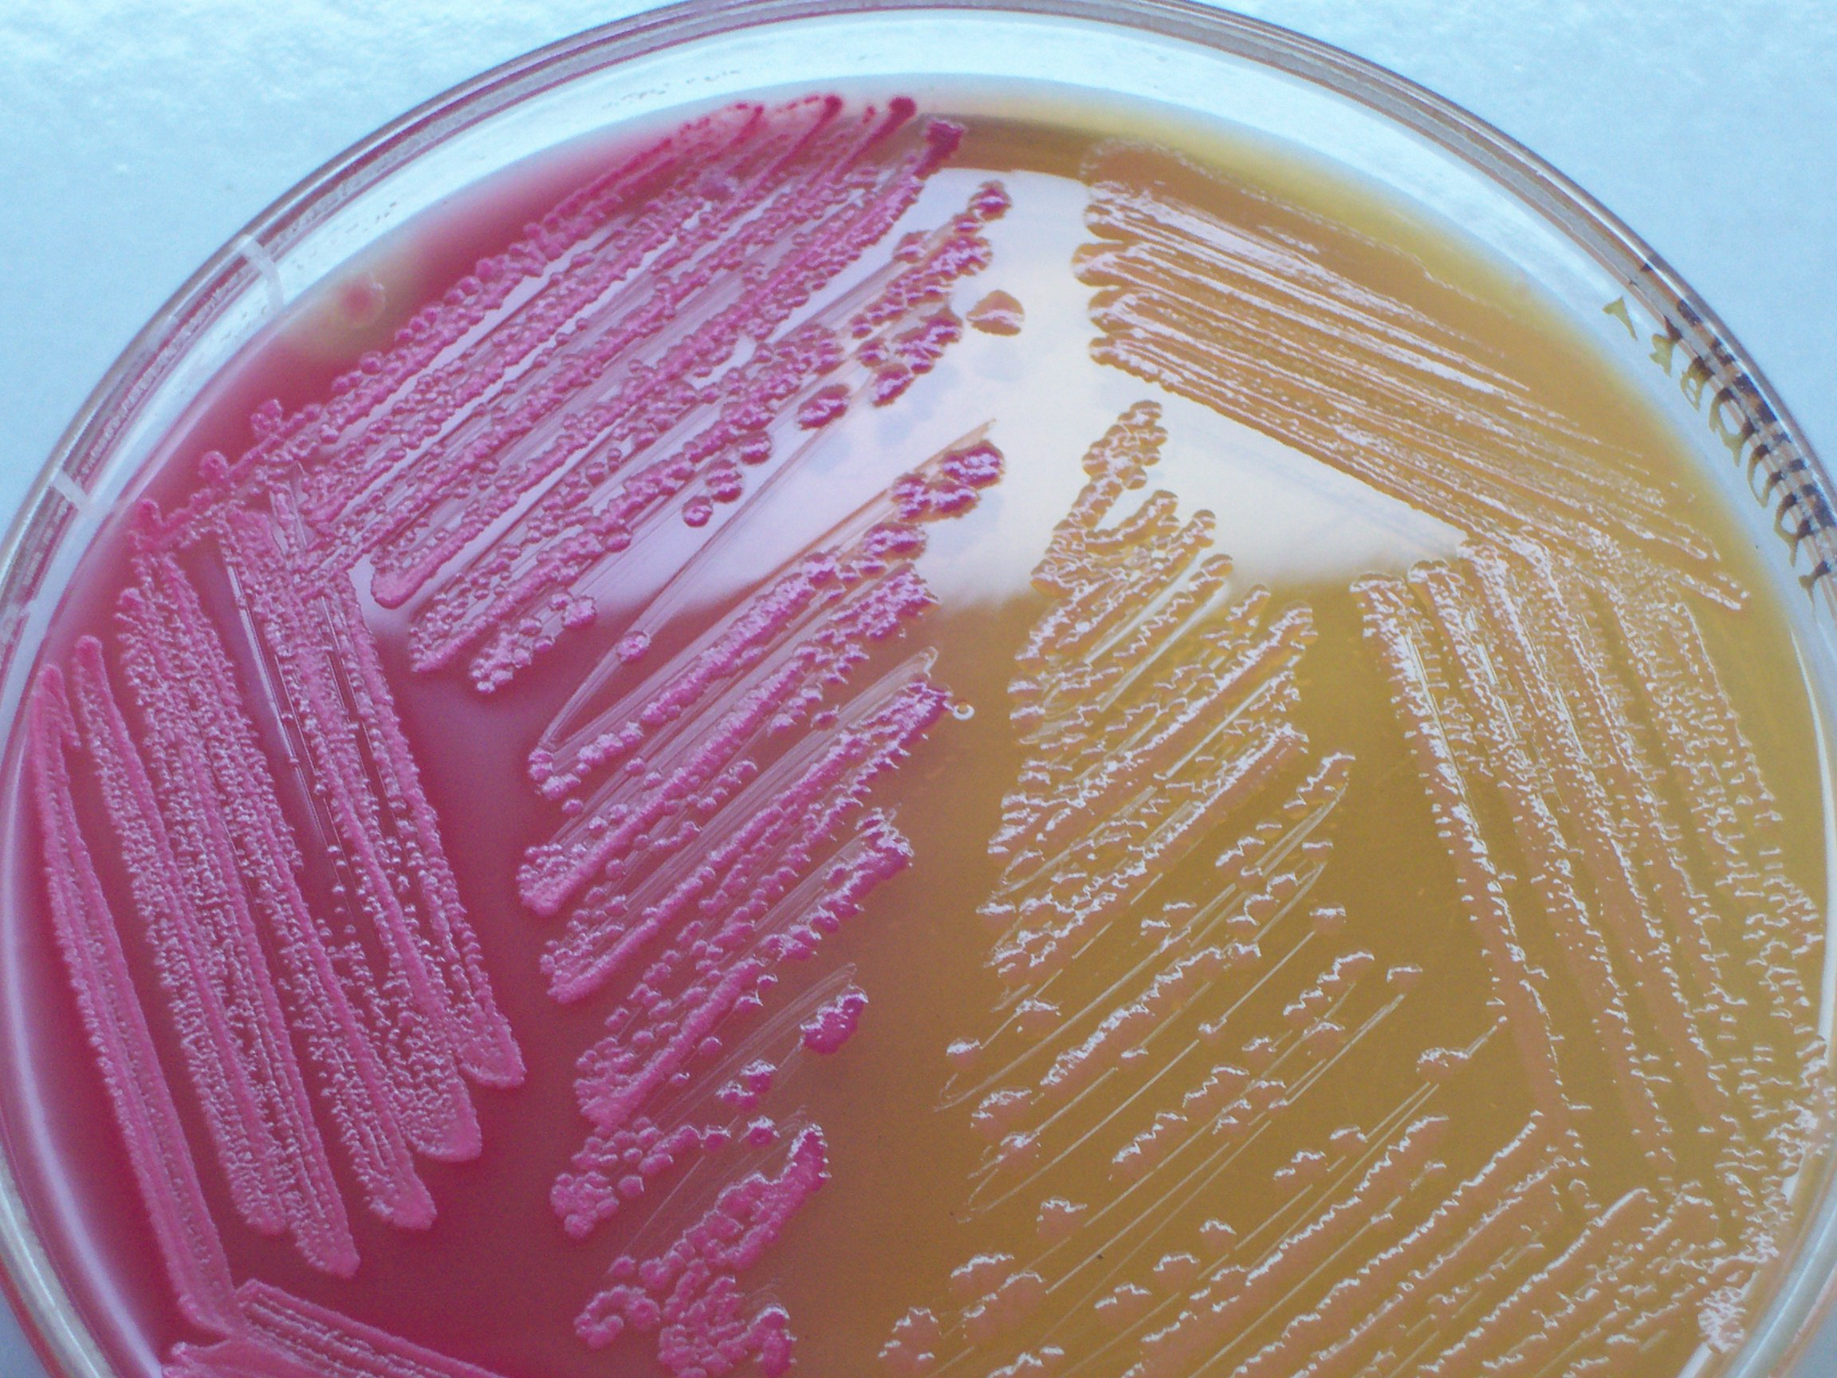

Slide 16
MacConkey agar (selective differential media for gram negative bacteria )
Sugar : Lactose
PH-indicator: Neutral red
The inhibitor for gram positive bacteria : crystal violet
The inhibitor for enterococci : bile salt
Lactose fermenter = pink colony
Lactose non fermenter = pale colony

Slide 17
Principle of MacConkey Agar: MacConkey agar is considered as a suppressive selective medium it permits the growth of Gr-ve enteric bacteria and inhibits the growth of Gr+ve non-enteric bacteria. The selective action of this medium is attributed to the (crystal violet) which inhibits the Gr+ve bacteria, also the medium contains (bile salts) that inhibit non-enteric bacteria and both (crystal violet and bile salts) do not affect the growth of enteric Gr-ve bacteria because these bacteria is adaptable to live with the presence of bile salts in the intestine.
Note: - Many reagents or indicators are added to differential media to differentiate between different bacterial species that grow on same media. Usually, these reagents are dyes which detect the changes in the media acidity that result from microbial metabolic activity, the changing in acidity manifested by changes in the dye color. Thus, these reagents or dyes are called as pH-indicators.

Slide 18
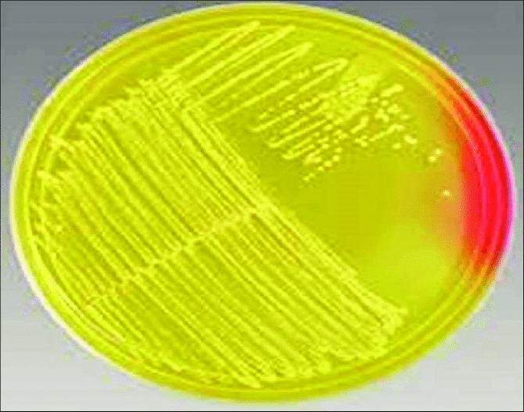
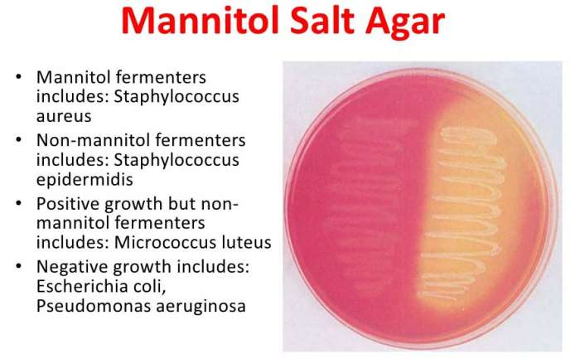

Slide 19
Mannitol salt agar (selective differential media for gram positive bacteria :Staphylococcus spp)
Sugar: Mannitol
The inhibitor for gram positive & negative bacteria = Nacl 7.5%
PH-indicator: phenol red
Mannitol fermenter = yellow colony
Mannitol non fermenter = red colony

Slide 20
XLD agar ( Xylose Lysine Deoxycholate ) selective differential media for Shigella
And Salmonella
Sugar : Xylose
PH-indicator: phenol red
H2S indicator : Na - thiosulphate
Gram positive & gram negative inhibitor = Na- Deoxycholate
Shigella non fermenter Xylose = red colony
Salmonella fermenter Xylose = yellow colony with black center

Slide 21
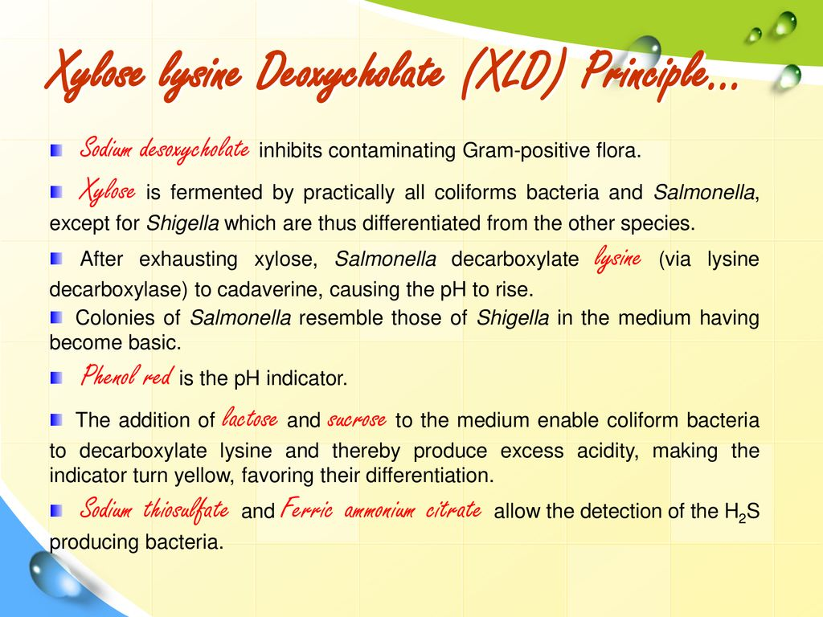

Slide 22
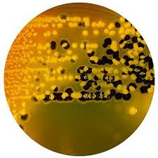
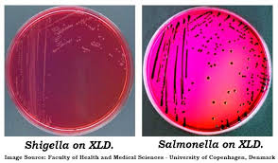

Slide 23
S-S agar ( Shigella Salmonella agar )
Sugar : lactose
PH-indicator : Neutral red
H2S indicator : Na - thiosulphate
Gram positive & gram negative inhibitor = Brilliant green
Shigella non fermenter lactose = pale colony
Salmonella non fermenter lactose = pale colony with black center

Slide 24
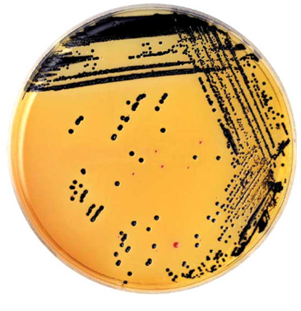
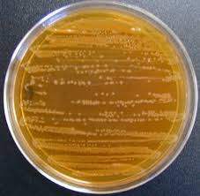

Slide 25
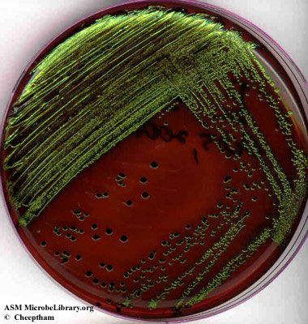
Eosin methylene blue

Slide 26
Eosin-methylene blue agar: is selective for gram-negative bacteria against gram-positive bacteria .In addition, EMB agar is useful in isolation and differentiation of the various gram-negative bacilli and enteric bacilli, generally known as coliforms and fecal coliforms respectively The bacteria which ferment lactose in the medium form colored colonies, while those that do not ferment lactose appear as colorless colonies EMB agar is used in water quality tests to distinguish coliforms and fecal coliforms that signal possible pathogenic microorganism contamination in water samples .EMB agar is also used to differentiate the organisms in the colon-typhoid-dysentery group:Escherichia coli colonies grow with a green metallic sheen with a dark center.

Slide 27
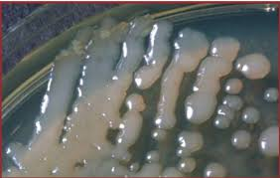

Slide 28
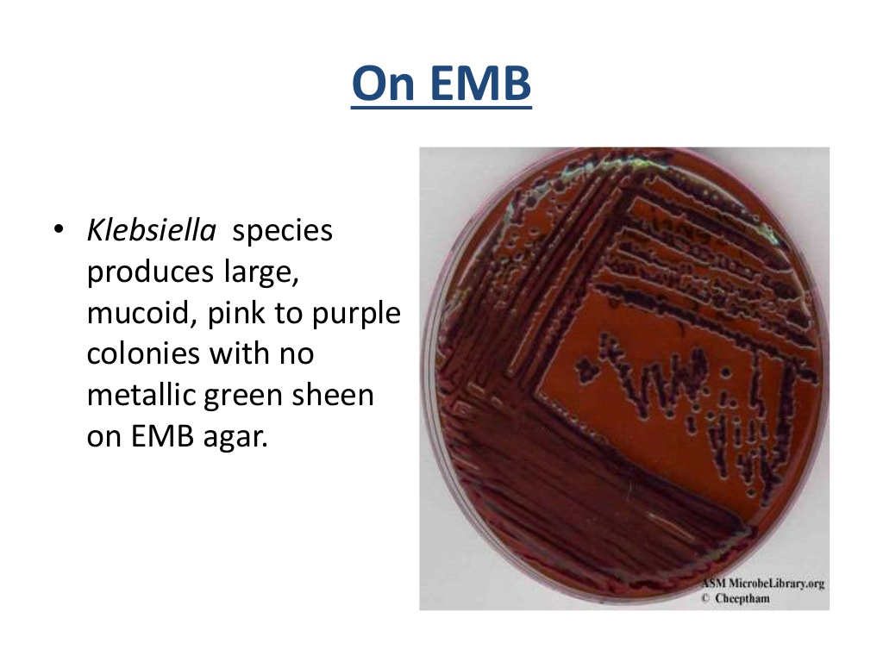

Slide 29
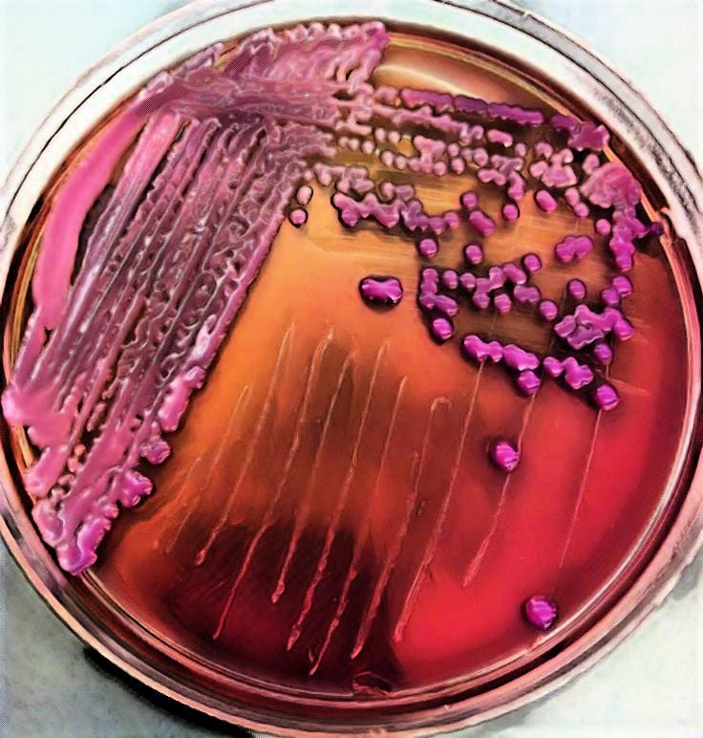

Slide 30
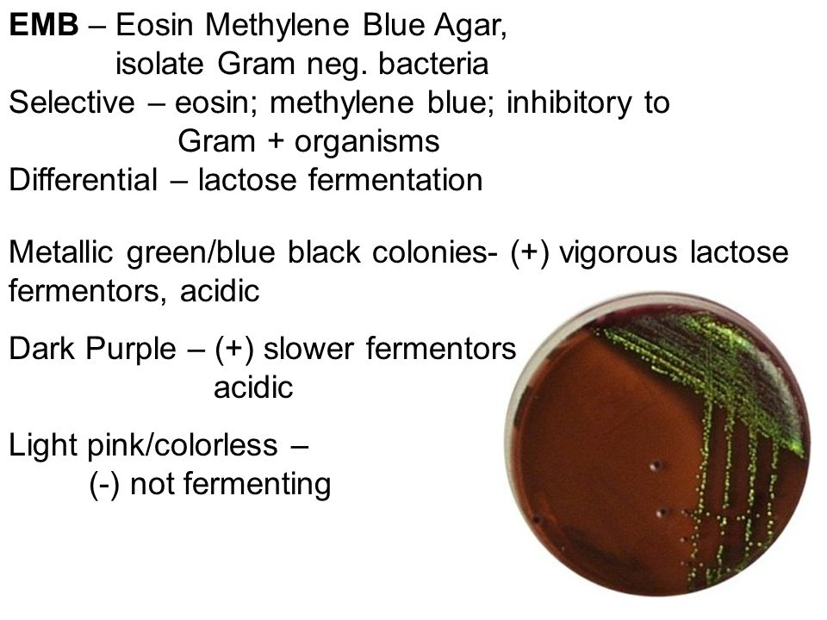

Slide 31
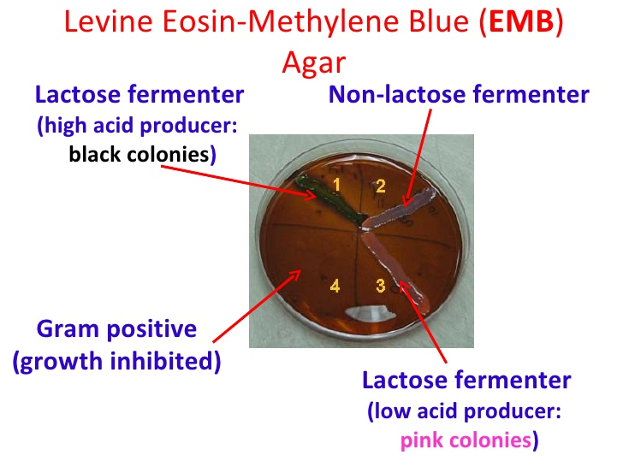

Slide 32
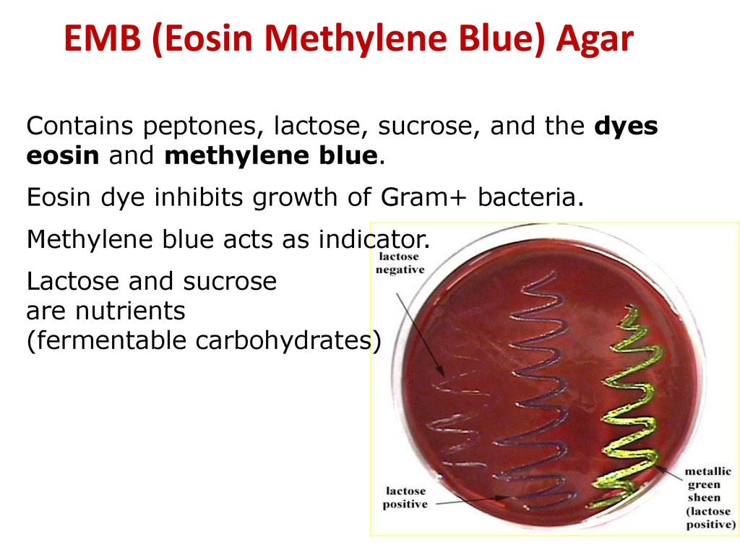

Slide 33
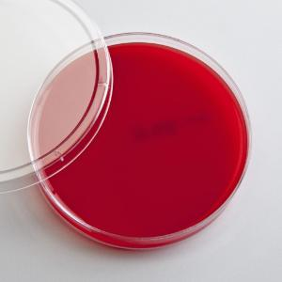
Blood agar ( Enrichment differential media )
Enrichment : for fastidious bacteria
Differential : alpha hemolysis & beta hemolysis
Add 5 ml blood \100 ml base of blood agar

Slide 34
