Slide 1
The center of pressure is defined:
Just like the center of gravity, but using the pressure distribution around the body instead of the weight distribution.
The amount of lift generated by an object depends on how much the flow is turned, which depends on the shape of the greater the flow turning, the greater the lift .

Slide 2
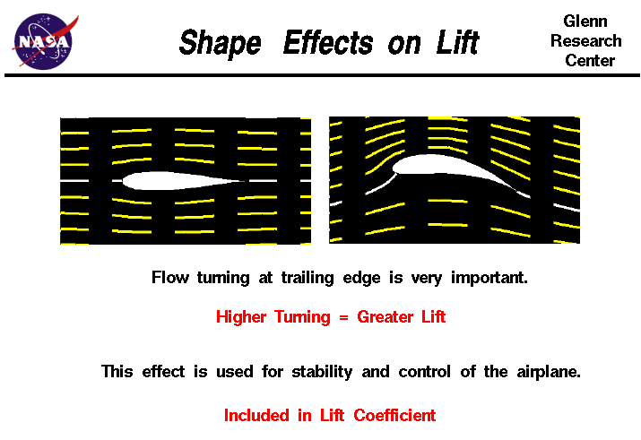

Slide 3
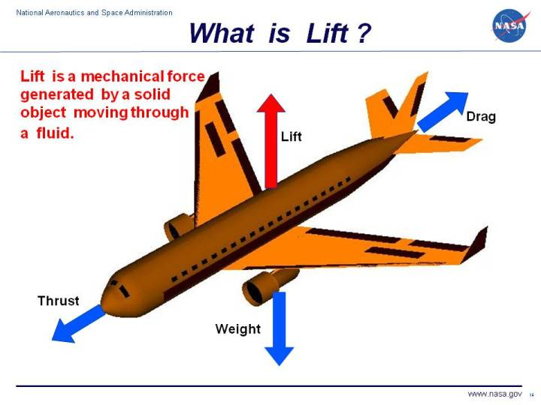

Slide 4
HOW IS LIFT GENERATED?
Lift occurs when a moving flow of gas is turned by a solid object.
The flow is turned in one direction, and the lift is generated in the opposite direction, according to Newton's Third Law of action and reaction.
Because air is a gas and the molecules are free to move about, any solid surface can deflect a flow.

Slide 5
For an aircraft wing, both the upper and lower surfaces contribute to the flow turning.
Why we can’t neglecting upper surface's part?
Neglecting the upper surface's part in turning the flow leads to an incorrect theory of lift.

Slide 6
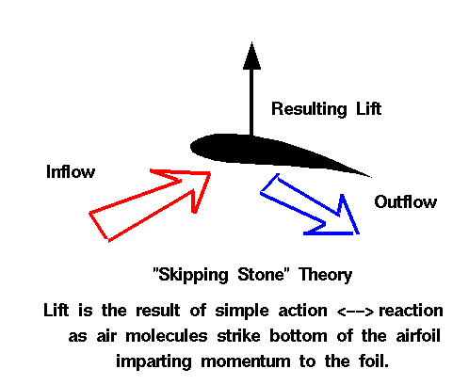

Slide 7
NO FLUID, NO LIFT
Lift is a mechanical force It is generated by:
The interaction and contact of a solid body with a fluid (liquid or gas).
It is not generated by a force field, in the sense of a gravitational field , or an electromagnetic field,
where one object can affect another object without being in physical contact.

Slide 8
For lift to be generated,
The solid body must be in contact with the fluid: no fluid, no lift.
The Space Shuttle does not stay in space because of lift from its wings but because of orbital mechanics related to its speed.
Space is nearly a vacuum. Without air, there is no lift generated by the wings.

Slide 9
NO MOTION, NO LIFT
Lift is generated by the difference in velocity between the solid object and the fluid.
There must be motion between the object and the fluid: no motion, no lift.
It makes no difference whether the object moves through a static fluid, or the fluid moves past a static solid object.
Lift acts perpendicular to the motion.

Slide 10
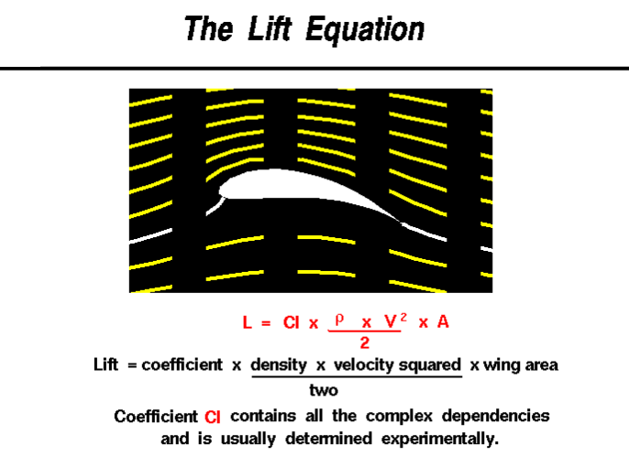

Slide 11
Lift depends on
The density of the air.
The square of the velocity.
The air's viscosity and compressibility.
The surface area over which the air flows.
The shape of the body,
The body's inclination to the flow.

Slide 12
In general,
The dependence on body
shape,
inclination,
air viscosity,
compressibility
Is very complex.
One way to deal with complex dependencies is to characterize the dependence by a single variable.

Slide 13
For lift, this variable is called:
The lift coefficient designated "Cl."
This allows us to collect all the effects, simple and complex, into a single equation.

Slide 14
The lift equation states that lift L
is equal to the lift coefficient Cl times the density ρ times half of the velocity V squared times the wing area A.
L = Cl x A x 0.5 x ρ x V ²

Slide 15
The lift coefficient:
Is a number that aerodynamicists use to model all of the complex dependencies of
Shape.
Inclination.
Some flow conditions on lift.
This equation is simply a rearrangement of the lift equation where we solve for the lift coefficient in terms of the other variables.

Slide 16
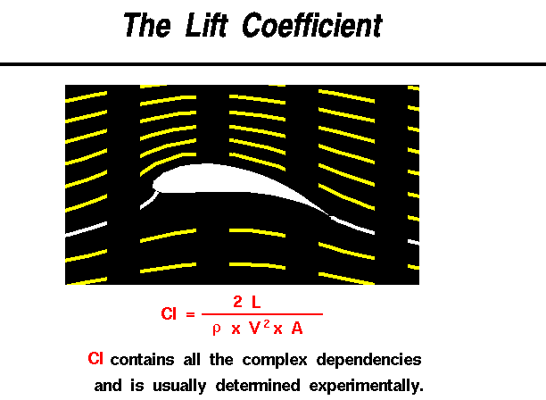

Slide 17
The lift coefficient Cl is equal to
the lift L divided by the quantity: density ρ times half the velocity V squared times the wing area A.
Cl = L / (A x 0 .5 x ρ x V ²)

Slide 18
The quantity :
One half the density times the velocity squared is called the dynamic pressure q.
So Cl = L / (q x A)
The lift coefficient then expresses the ratio of the lift force to the force produced by the dynamic pressure times the area.

Slide 19
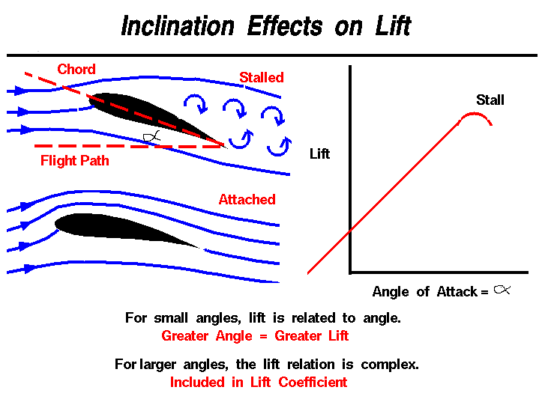

Slide 20
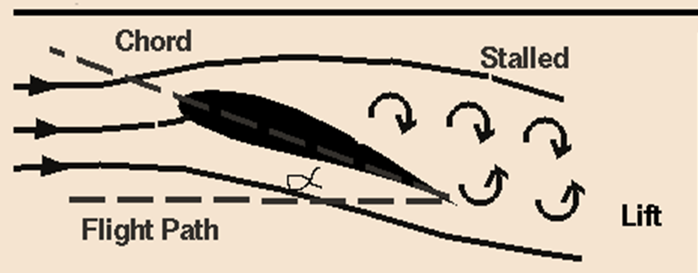

Slide 21
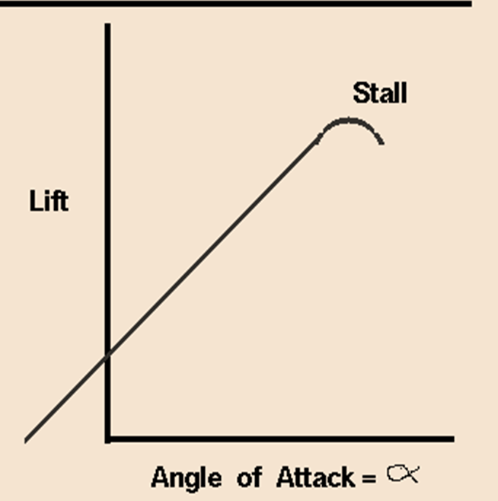

Slide 22
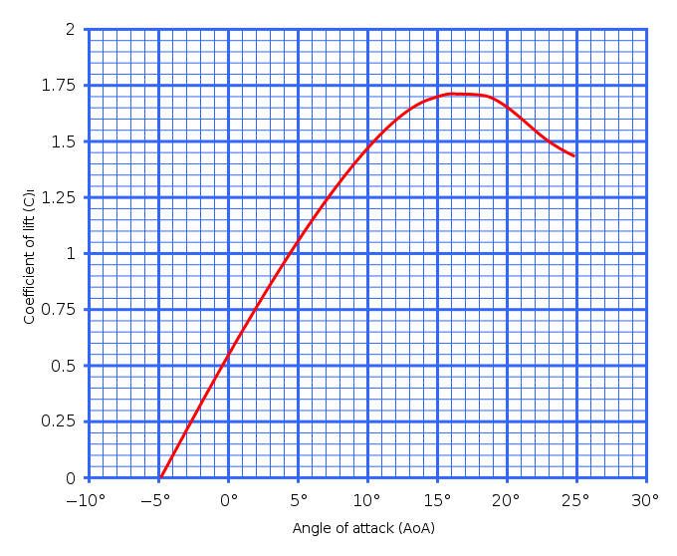

Slide 23
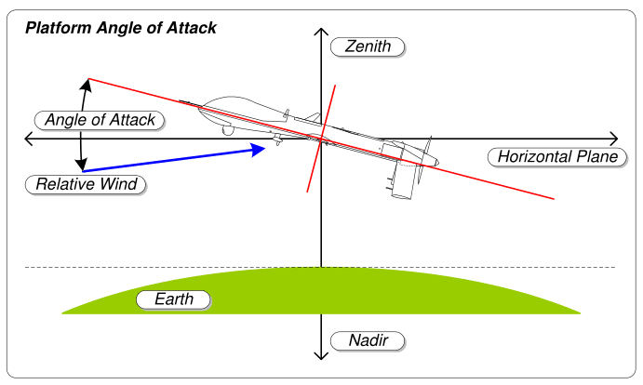

Slide 24
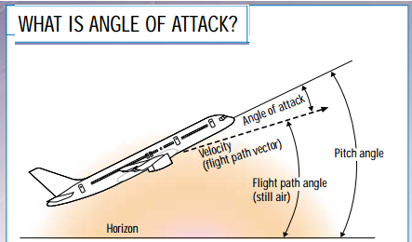

Slide 25
As a wing moves through the air, the wing is inclined to the flight direction at some angle.
The angle between the chord line and the flight direction is called:
Angle of Attack which has a large effect on the lift generated by a wing.

Slide 26
But just before lifting off, the pilot "rotates" the aircraft.
The nose of the airplane rises, increasing the angle of attack and producing the increased lift needed for takeoff.

Slide 27
The magnitude of the lift generated by an object depends on the shape of the object and how it moves through the air.
For thin airf oils, the lift is directly proportional to the angle of attack for small angles (within +/- 10 degrees).
For higher angles, however, the dependence is quite complex.

Slide 29
As an object moves through the air, air molecules stick to the surface.
This creates a layer of air near the surface called a boundary layer that, in effect, changes the shape of the object.
The flow turning reacts to the edge of the boundary layer just as it would to the physical surface of the object.

Slide 30
To make things more confusing ,the boundary layer may lift off or "separate" from the body and create an effective shape much different from the physical shape.
The separation of the boundary layer explains why aircraft wings will abruptly lose lift at high angles to the flow.
This condition is called a wing stall.

