Slide 1

The Course of Fundamentals of Thermodynamics
MUSTANSIRIYAH UNIVERSITY
COLLEGE OF SCIENCES
DEPARTMENT OF ATMOSPHERIC SCIENCES
2020-2021
Dr. Sama Khalid Mohammed
SECOND STAGE
Lecture 2

Slide 2

Welcome Students In The New Course
And In The Second Lecture ☺

Slide 3
This lecture including the following items
Extensive versus Intensive Variables
Transformations
Reversible and Irreversible Processes.
Cyclic Processes
Thermodynamic variables

Slide 4
Properties of System
Any characteristic of a System is known as its PROPERTY, ex. Pressure (P), Volume (V), Temperature (T), mass (m), etc.
In Thermodynamics, two property of a system is considered: Intensive and Extensive.
An intensive property is one that does not depend on how much substance is present. Temperature is an example of an intensive property. If two identical masses are at the same temperature and are added together, the temperature remains the same even though the mass is doubled.
An extensive property depends on how much substance is present. Internal energy is an example of an extensive property. If the two identical masses are added together there is twice as much internal energy.
If you cut a system in half and re-measure its properties, intensive properties remain unchanged, while extensive properties are cut in half.

Slide 5
Properties of System
There are two ways to convert an extensive property into an intensive property:
Divide by the mass. The result is a property that is normalized by the mass. We add the term specific to indicate that we’ve divided by the mass. For example, the specific internal energy u is defined as U/m.
Divide by the number of moles. The result is a property that is normalized by the number of moles present. We add the term molar specific to indicate we’ve divided by the number of moles. For example, the molar specific internal energy, um, is defined as U/n.
In general, extensive properties are denoted using upper-case letters, while intensive properties are denoted using lower-case letters. However, there are exceptions, including ONE NOTABLE EXCEPTION: Temperature is denoted using upper-case T, even though it is an intensive property.

Slide 6
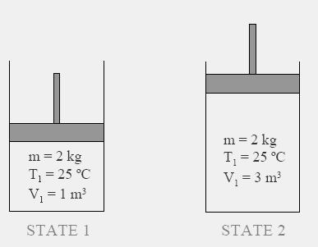
State and Equilibrium
Assume a System NOT undergoing any change.
Set of macroscopic properties to completely describe the condition of the system is known as its STATE or (State: condition described by observable macroscopic properties (state variable)) as we defined it in Lecture 1.
EQUILIBRIUM is a State of Balance

Slide 7
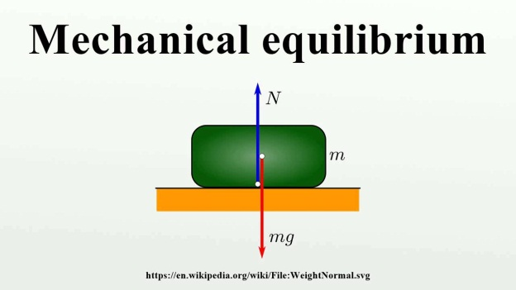
Thermodynamic Equilibrium State
It is a state in which the system’s properties, so long as the external conditions (surroundings) remain unchanged, do not change in time (no spontaneous changes). For example, a gas enclosed in a container of constant volume is in equilibrium if its pressure is constant throughout and its temperature is equal to that of the surroundings. There are three types of equilibrium:
Mechanical equilibrium – This means there are no unbalanced forces, so that neither the system, nor any part of the system, undergoes accelerations. This also implies that there is no turbulence within the system.
Material equilibrium – This means that there is no net transfer of matter from one phase or component of the system to another. The concentrations of chemical species and their phases are constant with time ( i.e. phase and chemical equilibrium).

Slide 8
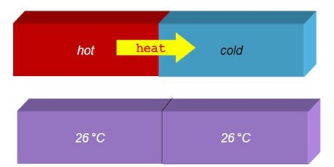
Thermodynamic Equilibrium
Thermal equilibrium – Means that the individual parts or pieces of the system would remain in the same state whether or not they were connected by a thermally conducting wall. In practicality, this means that there are no temperature gradients in the system.
A system is in thermodynamic equilibrium only if it is in mechanical, material, and thermal equilibrium.

Slide 9
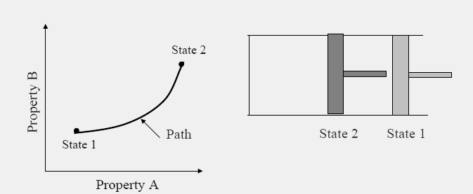
TRANSFORMATIONS
Any change a system undergoes from one equilibrium state to another is known as PROCESS
Series of states through which system passes during the process is known as its PATH, and it can be drawn based on the thermodynamic coordinates.
Notes:
Note that only equilibrium states of a closed system can be represented on a 2-dimensional thermodynamic diagram. Why is this?

Slide 10
TRANSFORMATIONS
There are an infinite number of paths on the diagram by which the system can be transformed from one equilibrium state to another. However, regardless of which path is taken, the change in the state variables will be the same between the two points.
Process proceeds in such a manner that system remains infinitesimally close to equilibrium conditions at all times is known as QUASI-STATIC or QUASI-EQUILIBRIUM Process.
Notes:
Note that only equilibrium states of a closed system can be represented on a 2-dimensional thermodynamic diagram. Why is this?

Slide 11


TRANSFORMATIONS
We can express the property of state variables mathematically in two ways:
  The change in any of the state variables (say U) doesn’t depend on the path of the system on a thermodynamic diagram. It only depends on the endpoints.
  The integral of a state variable around a closed path is zero.
Mathematically, this means that differentials of state variables are exact differentials.
  In order to be a state variable, the differential of the variable must be exact.
Notes:
Note that only equilibrium states of a closed system can be represented on a 2-dimensional thermodynamic diagram. Why is this?

Slide 12
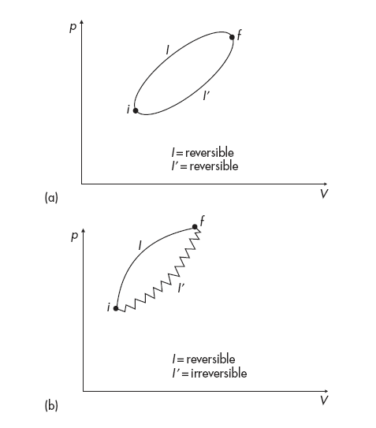
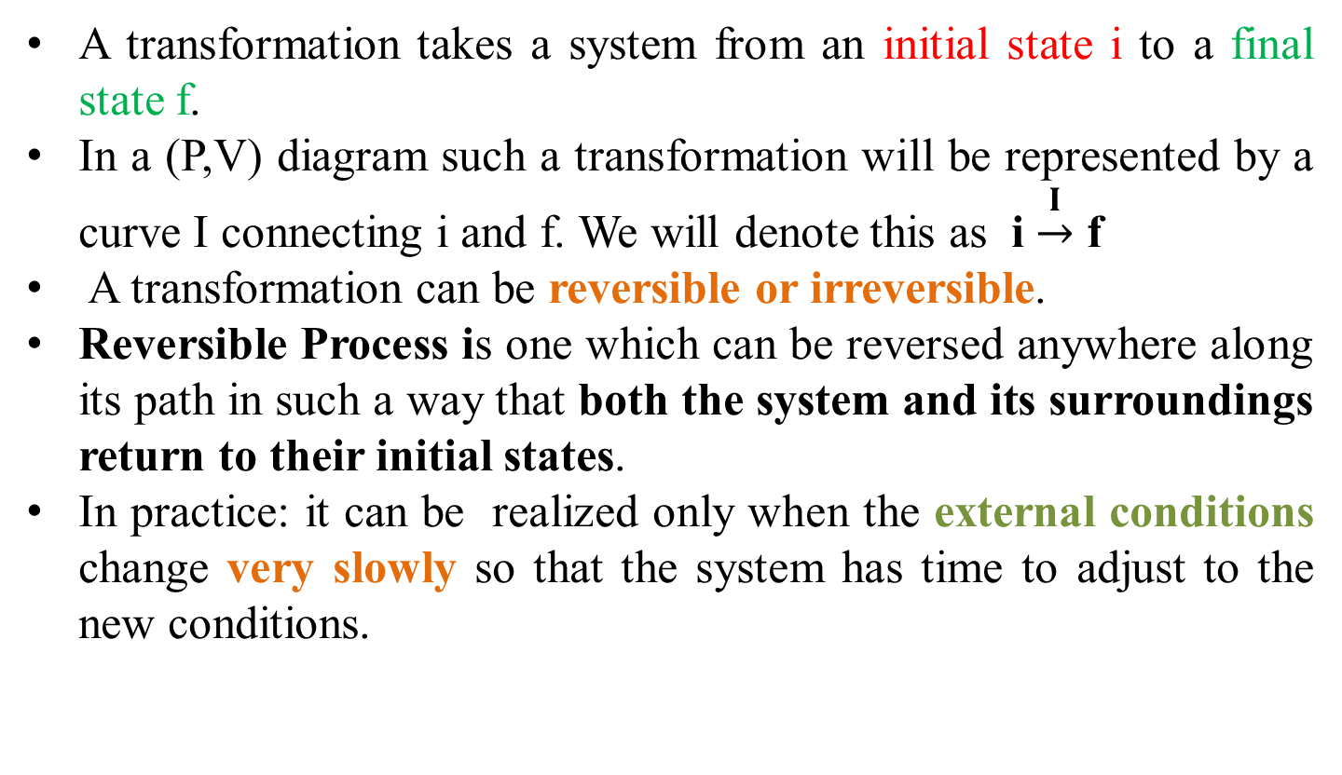
Reversible and Irreversible Process
A transformation takes a system from an initial state i to a final state f.
In a (P,V) diagram such a transformation will be represented by a curve I connecting i and f. We will denote this as i $\underset{→}{I}$ f
A transformation can be reversible or irreversible.
Reversible Process is one which can be reversed anywhere along its path in such a way that both the system and its surroundings return to their initial states.
In practice: it can be realized only when the external conditions change very slowly so that the system has time to adjust to the new conditions.

Slide 13
Reversible and Irreversible Process
Reversible Process can be reversed without leaving any trace on the
Surroundings. This is only possible when net Heat and net Work Exchange between the system and the surroundings is ZERO for the Process.
ex., assume that our system is a gas enclosed in a container with a movable piston. As long as the piston moves from i to f very slowly the system adjusts and all intermediate states are equilibrium states.
If a system goes from i to f reversibly, then it could go from f to i again reversibly if the same steps were followed backwards.

Slide 14

Irreversible Process
If the same steps cannot be followed exactly, then this transformation is represented by another curve I in the (P,V) diagram (i.e. f $\underset{→}{I′}$ i) and may or may not be reversible.
In other words the system may return to its initial state but the surroundings may not.
Examples (Free expansion of a gas, Mixing of two gasses.
Riddles
It follows that turbulent mixing in the atmosphere is a source of irreversibility, why?

Slide 15
Reversible and Irreversible Process
????????
P1
Water at –5°C
Ice at –5°C
Water at 0°C
Ice at 0°C
P2
Heat
?????????
Cool
Water at –5°C
Ice at –5°C

Slide 16
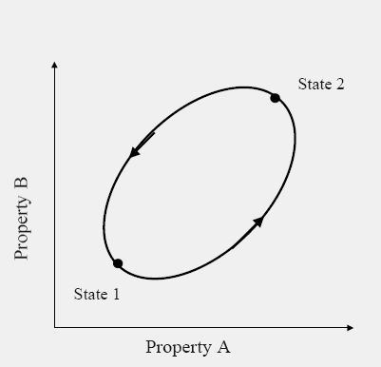
Cyclic Process
A system is said to have undergone a cycle if it returns to its ORIGINAL state at the end of the process. Hence, for a CYCLE, the
INITIAL and the FINAL states are identical.
Any transformation i → f → i is called a cyclic transformation, the cycle is a thermodynamic “round trip.”
we can have cyclic transformations which are reversible or irreversible.
Most of the Processes in nature are IRREVERSIBLE.

Slide 17
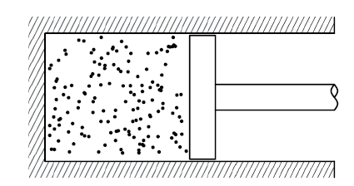
THERMODYNAMIC VARIABLES
Consider a volume of gas in a closed cylinder with a piston, in this way we can control certain properties of the gas, such as its volume or temperature, and perform experiments on it.
At the macroscopic level, the gas has some familiar properties:
volume V (units: m³)
mass M (units: kg)
density = M/V (units: kgm⁻³)
temperature T (units: K, Kelvin)
pressure p (units: Pa = Nm⁻², Pascal)
The gas is made up of molecules with individual mass M₁, so the total mass of gas M is equal to M = n µ, where
n is the number of moles
µ is the molar mass , µ = N_{A} M_{1,}
N_{A} is Avogadro number

Slide 18
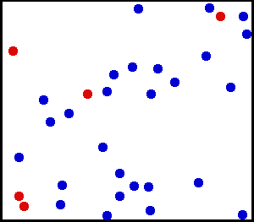
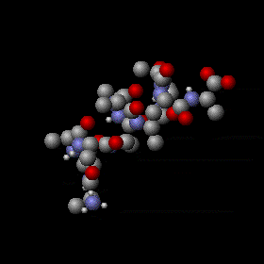
Temperature
In microscopic level, temperature measures the average kinetic energy of its atoms as they move.
In macroscopic level, it a physical property of a system that underlies the common notions of hot and cold.

Slide 19
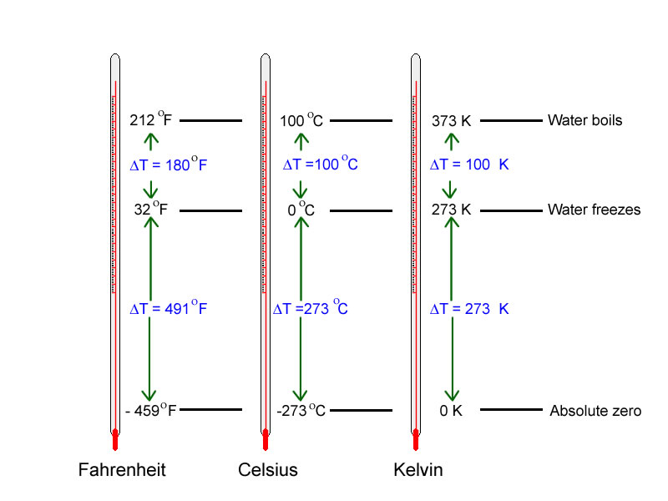
Temperature scales
 | boiling water | mixture of water and ice
Celsius (Centigrade) | 100 ° C | 0 ° C
Fahrenheit | 212 ° F | 32 ° F
Fahrenheit temperature (F)
Absolute temperature (Kelvin)

Slide 20
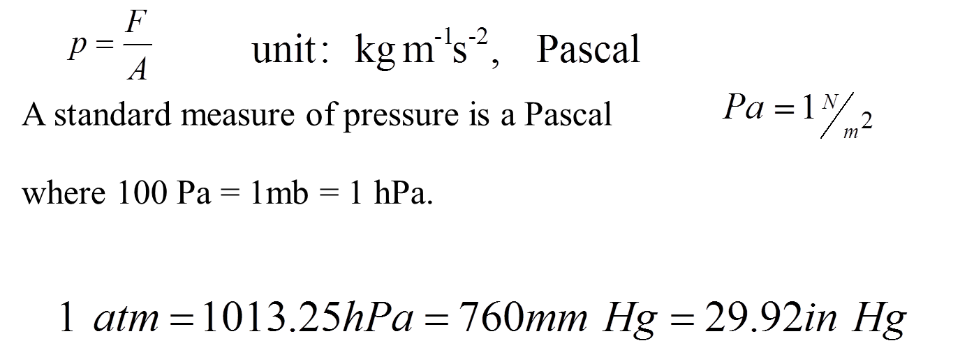
Pressure
Force F acting on unit area due to the weight of the atmosphere
Pressure is the force a gas exerts on its bounding walls per unit area. This does not mean that gas only has a pressure defined at the bounding walls: the internal pressure of a gas can in principle be measured by inserting some probe and measuring the force per unit area on the probe.
Wall of a container
Pressure and temperature do not correspond to a property of individual molecules. They are bulk properties that can only be defined as a statistical property of a large number of molecules.

Slide 21
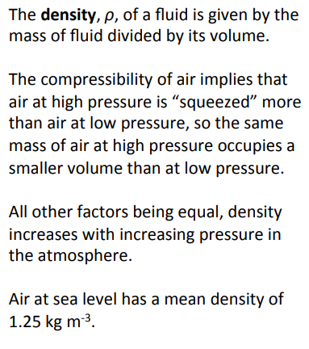
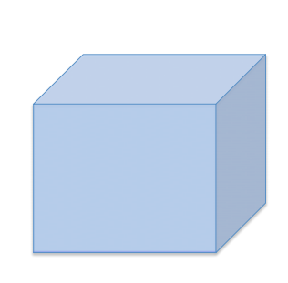
Density

Slide 22
THE END OF LECTURE TWO

