Slide 1
Connective and Supportive tissues:-
Type of body tissues specialized to physically support and connect other tissues and maintain water required for metabolite diffusion to and from cells.
Function of con. T. :
Mechanical: ex- cartilage, bone and tendon.
Nutrition: ex – blood.
Protection: ex – WBCs, Macrophages.
Repair: ex – fibroblast, osteocytes.

Slide 2
General Con. T. composed of:
First: Fibers of con. T.:
Fiber: - Elongated structures formed from proteins.
Types of fiber are:-
Collagen (white) fiber: Fibers sheets and networks extremely strong and resistance to normal tearing forces.
Elastic (yellow) fibers: thin single fibers form a network with ability of elasticity.
Reticular fibers: small fibers appeared black in color.

Slide 3
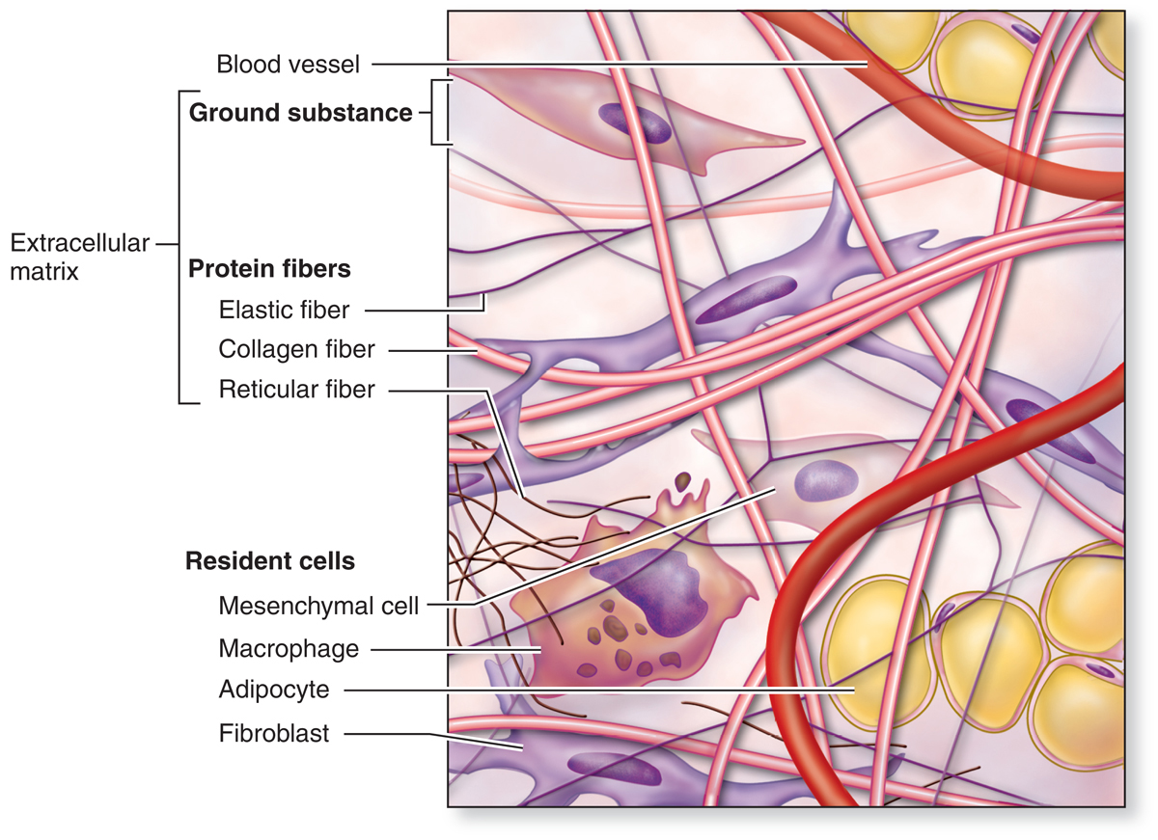
Notes:
Cellular and extracellular components of connective tissue.
Connective tissue is composed of fibroblasts and other cells and an extracellular matrix (ECM) of various protein fibers, all of which are surrounded by watery ground substance. In all types of connective tissue the extracellular volume exceeds that of the cells.

Slide 4
Second : cells of con. T. :
Mesenchyme cells ------- common cells, produce fibers and interstitial material.
Adiposities ----- store fat.
Plasma cells -----antibody producing cells.
Macrophages ------- phagocytosis.
Mast cells ---------- release histamine and cytokines.
White blood cells (WBC).
Pigment cells ---- in skin.

Slide 5
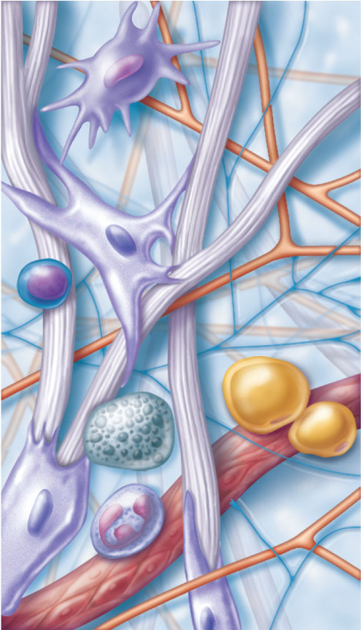
Cell types
Extracellular
matrix
Ground substance
Macrophage
Fibers
• Collagen fiber
• Elastic fiber
• Reticular fiber
Fibroblast
Lymphocyte
Fat cell
Capillary
Mast cell
Neutrophil

Slide 6
Third: ground substance.
Watery unstained extracellular material contains water, polysaccharide mucouprotein and protein such as albumin, glycoprotein, and globulin.
Classification of con. T. :
First type of con. T.: General con . T. :
Loose (areolar) con. T.:- many cells and little collagen, randomly distributed, thick layer beneath the epithelial in the digestive system.

Slide 7
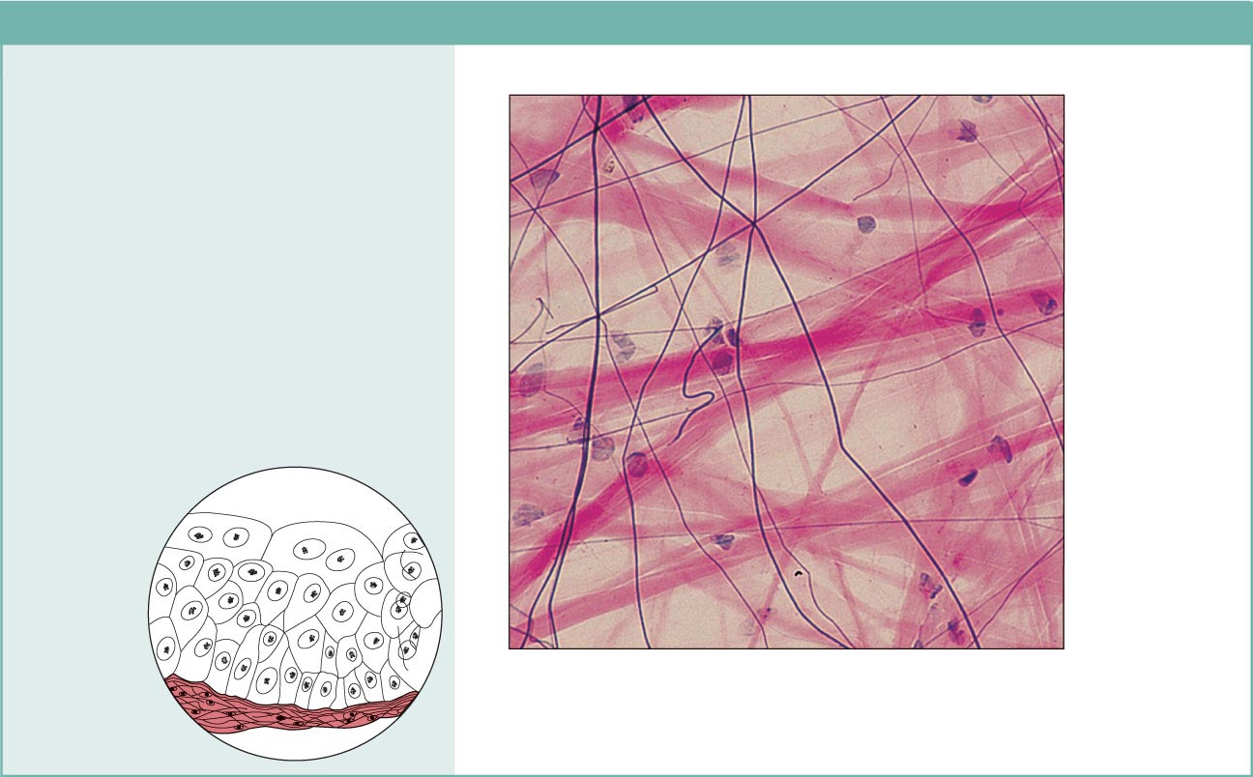
Figure 4.8a Connective tissues.
(a) Connective tissue proper: loose connective tissue, areolar
Description: Gel-like matrix with all
three fiber types; cells: fibroblasts,
macrophages, mast cells, and some
white blood cells.
Elastic
fibers
Function: Wraps and cushions
organs; its macrophages phagocytize
bacteria; plays important role in
inflammation; holds and conveys
tissue fluid.
Collagen
fibers
Location: Widely distributed under
epithelia of body, e.g., forms lamina
propria of mucous membranes;
packages organs; surrounds
capillaries.
Fibroblast
nuclei
Epithelium
Photomicrograph: Areolar connective tissue, a
soft packaging tissue of the body (300x).
Lamina
propria

Slide 8
Reticular tissue : specialized con. T. consist of collagen fiber produced by reticular cells .this tissue form a delicate network supports various type of cells and lymphocytes in most lymphoid organs (spleen) .
●Dense con. T. :
less flexible.
more resistance than loose con. T. ,
adopted to offer stress resistance and protection ..

Slide 9
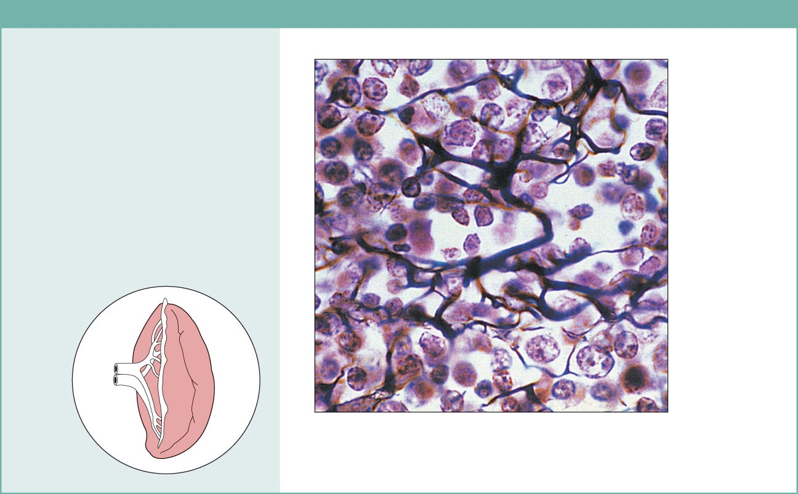
Figure 4.8c Connective tissues.
(c) Connective tissue proper: loose connective tissue, reticular
Description: Network of reticular
fibers in a typical loose ground
substance; reticular cells lie on the
network.
Function: Fibers form a soft internal
skeleton (stroma) that supports other
cell types including white blood cells,
mast cells, and macrophages.
White blood
cell
(lymphocyte)
Location: Lymphoid organs (lymph
nodes, bone marrow, and spleen).
Reticular
fibers
Spleen
Photomicrograph: Dark-staining network of reticular
connective tissue fibers forming the internal skeleton
of the spleen (350x).

Slide 10
Classified according to fiber arrangement to
Dense regular con. T :-
  consists of bundles of collagen fibers and fibroblasts
  forms tendons, ligaments and aponeuroses ( flat sheet of dense fibrous).
  Function : provide strong attachment between various structures

Slide 11
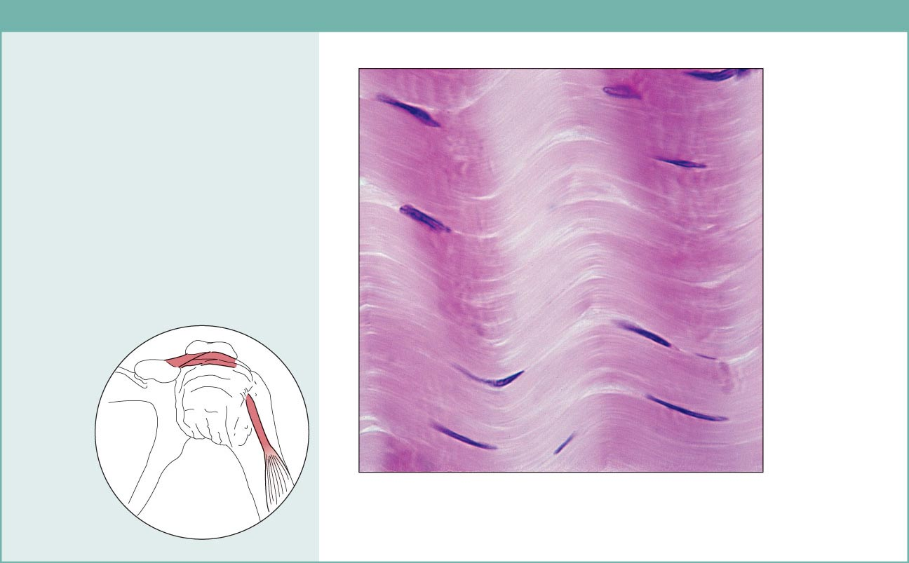
Figure 4.8d Connective tissues.
(d) Connective tissue proper: dense connective tissue, dense regular
Description: Primarily parallel
collagen fibers; a few elastic fibers;
major cell type is the fibroblast.
Collagen
fibers
Function: Attaches muscles to
bones or to muscles; attaches bones
to bones; withstands great tensile
stress when pulling force is applied
in one direction.
Location: Tendons, most
ligaments, aponeuroses.
Nuclei of
fibroblasts
Shoulder
joint
Ligament
Tendon
Photomicrograph: Dense regular connective
tissue from a tendon (500x).

Slide 12
  Dense irregular con. T . :-
  Few cells much collagen fibers randomly arranged.
  Providing resistance to stress from all direction.
  ex – Dermis of the skin and sub mucosa of digestive system.

Slide 13
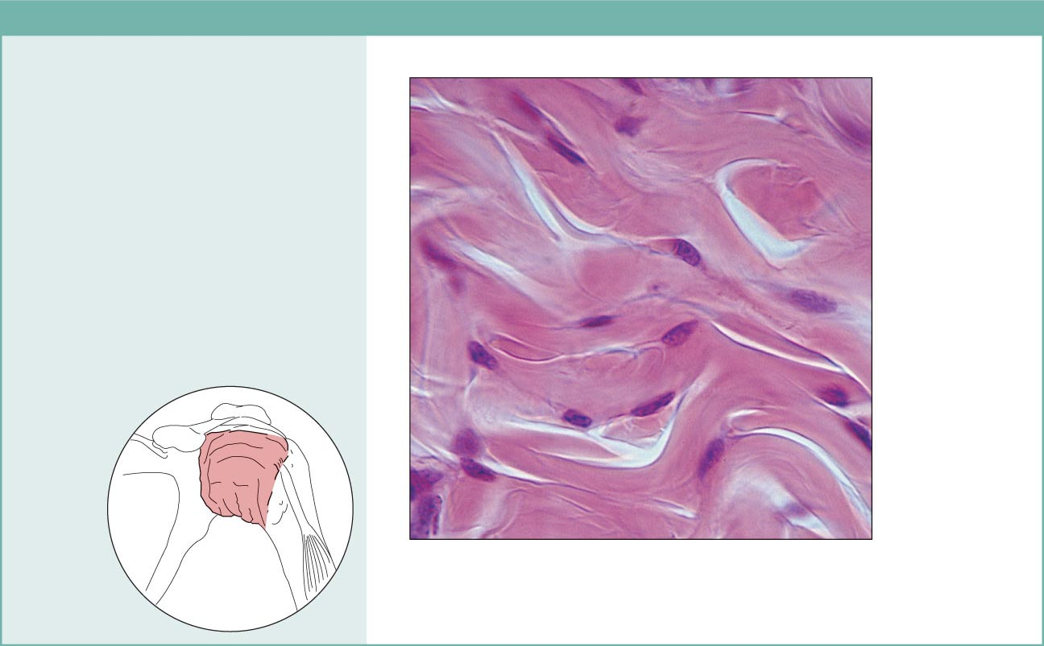
Figure 4.8e Connective tissues.
(e) Connective tissue proper: dense connective tissue, dense irregular
Description: Primarily
irregularly arranged collagen
fibers; some elastic fibers;
major cell type is the fibroblast.
Nuclei of
fibroblasts
Function: Able to withstand
tension exerted in many
directions; provides structural
strength.
Location: Fibrous capsules of
organs and of joints; dermis of
the skin; submucosa of
digestive tract.
Collagen
fibers
Fibrous
joint
capsule
Photomicrograph: Dense irregular
connective tissue from the dermis of the
skin (400x).

Slide 14
Second type of con. T. :- Embryonic con. T. :
Mesenchyme :- Con. Tissue developing mainly from mesoderm in embryo.
Composition:
Ground substance.
Sparse collagen fibers, reticular fibers.
Mesenchyme cells
Function:
secretion of ground substance, fibers
proliferation and differentiation into different connective tissue cell types, smooth muscle cells, blood cells.

Slide 15
Mucoid (mucous) con. T.
Location: umbilical cord
Composition:
Ground substance rich in hialuronic acid
Collagen fibers
Mucocytes (fibroblasts)
Function: secretion of ground substance, fibers.

Slide 16
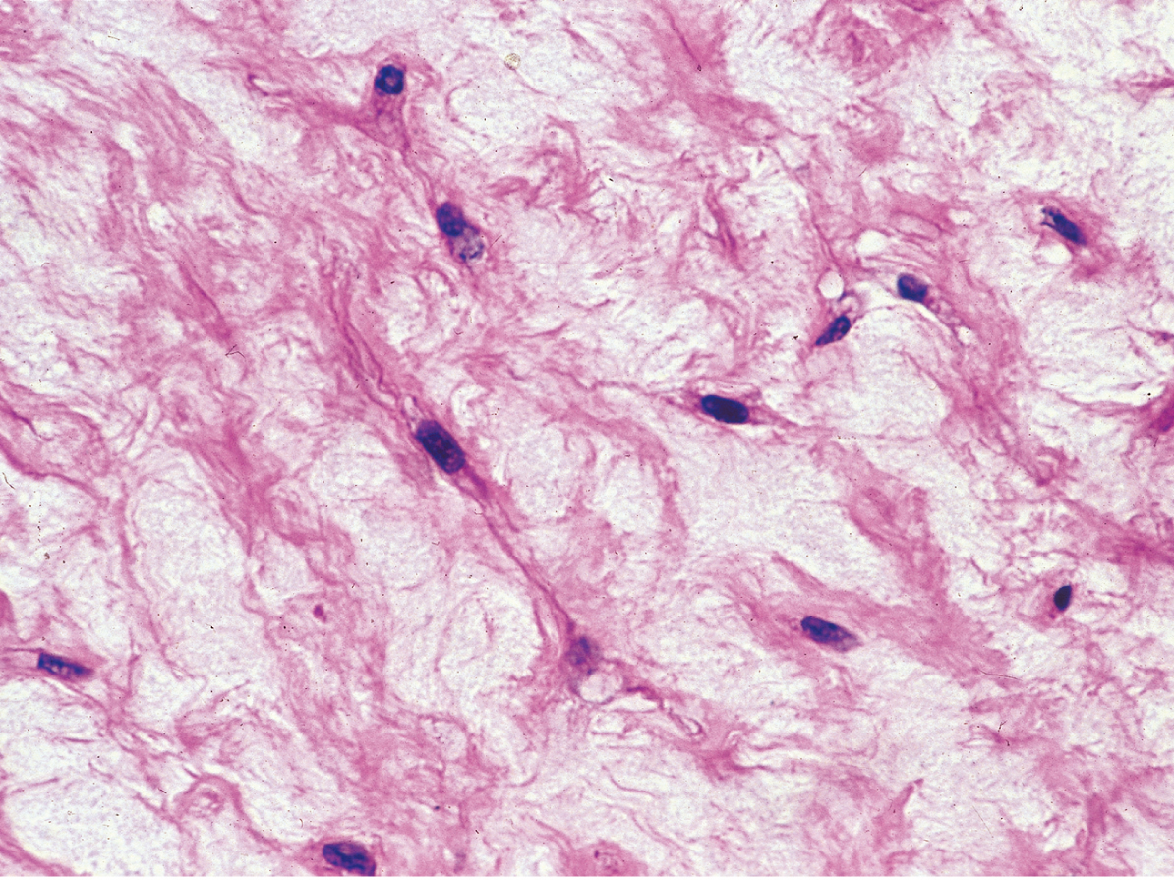
Notes:
Mucoid tissue.
A section of umbilical cord shows large fibroblasts surrounded by a large amount of very loose ECM containing mainly ground substances very rich in hyaluronan, with wisps of collagen. Histologically mucoid (or mucous) connective tissue resembles embryonic mesenchyme in many respects and is rarely found in adult organs. X200. H&E

