Slide 1
Epithelia Tissue
Epithelia can be divided into two main groups:
Covering (or lining).
Secretory(glandular) epithelia.
  1. Covering or lining Epithelia
  Cells of covering epithelia are organized into one or more layers that cover the external surface or line the cavities of an organ.
  Such epithelia are classified according to number of cell layers and the cell morphology in the surface layer.
  Simple epithelia : Contain one cell layer .
  Stratified epithelia: Contain two or more layers.

Slide 2
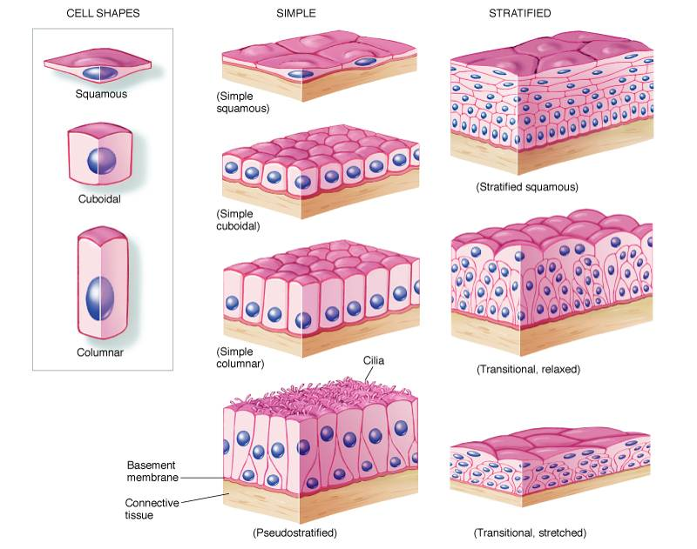
Classification of Epithelial Tissues

Slide 3
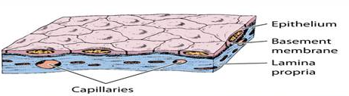
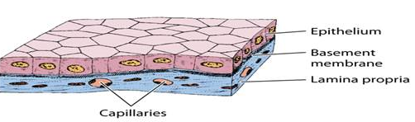
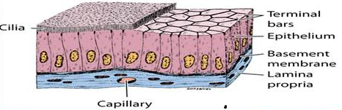
Based on cell shape, simple epithelia are classified as:
Squamous (thin cells).
Cuboidal (cell width and thickness roughly similar).
Columnar (cell taller than they are wide).
(A) | (B) | (C)

Slide 4
Cell Form | Examples | Main Function
Squamous | Lining of vessels (endothelium). Lining of cavities : pericardium , pleura , peritoneum (mesothelium). | Facilitates the movement of the viscera (mesothelium). Active transport by pinocytosis (mesothelium & endothelium). Secretion of biologically active molecules (mesothelium).
Cuboidal | Covering the ovary , thyroid. | Covering. Secretion.
Columnar | Lining of intestine , gallbladder. | Protection. Lubrication. Absorption. Secretion.

Slide 5
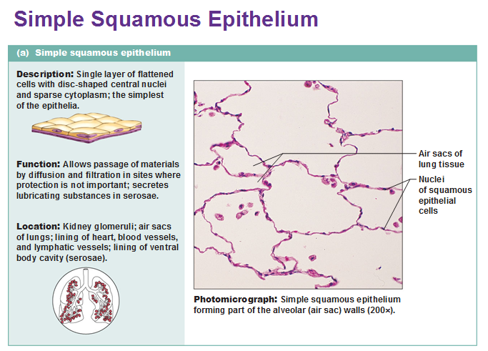

Slide 6
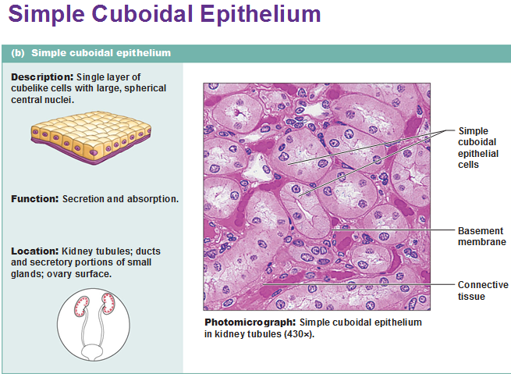

Slide 7
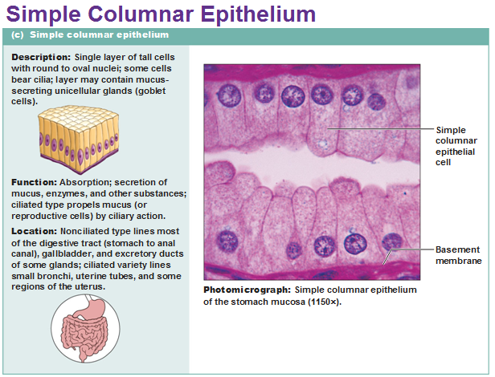

Slide 8
Apical structures of epithelial cells
1. Cilia : are highly motile surface modifications in cells that line the respiratory organs , oviducts or uterine tubes and different ducts in the testes. its Function is to sweep or move fluids ,cells ,or particulate matter across cell surfaces.

Slide 9
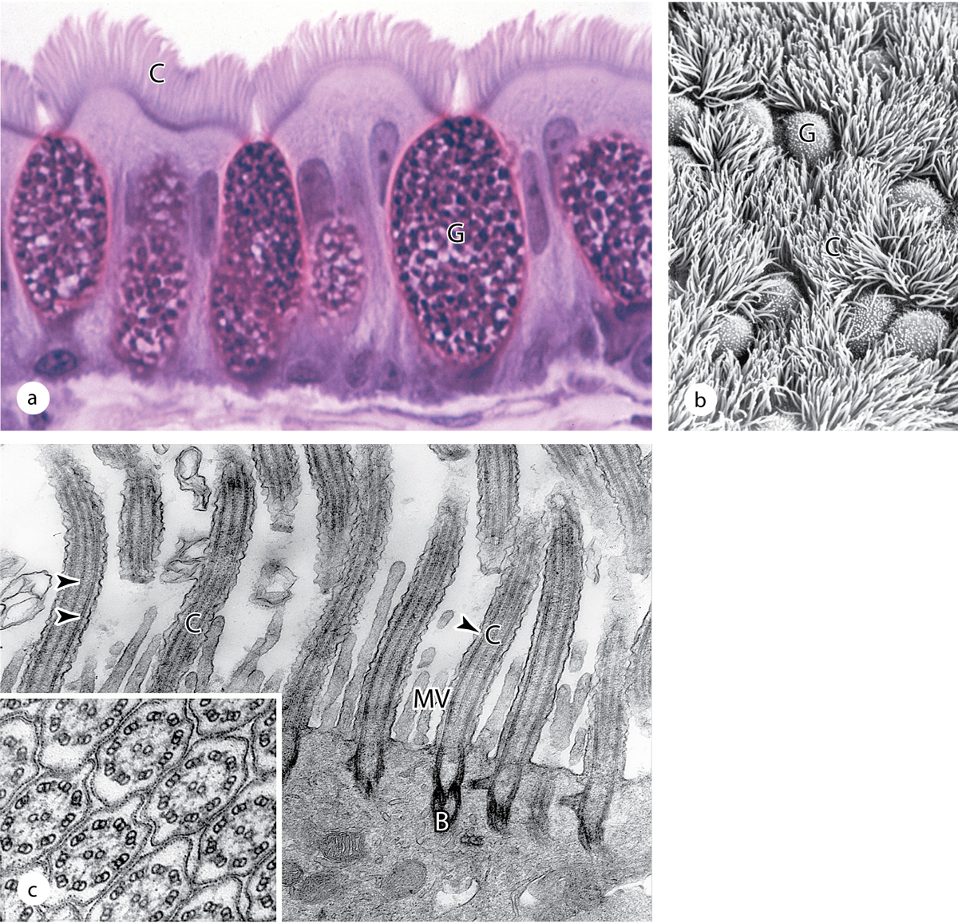
Ali Alsamawi
Notes:
Figure 4 Cilia.
Epithelial cells lining the respiratory tract have many very well-developed cilia. (a) By light microscopy cilia (C) on the columnar cells appear as a wave of long projections, interrupted by nonciliated, mucus-secreting goblet cells (G). X400. Toluidine blue. (b) SEM of the apical surfaces of this epithelium shows the density of the cilia (C) and the scattered goblet cells (G). X300.
(c) TEM of cilia (C) sectioned longitudinally reveals the central and peripheral microtubules of the axonemes, with cross sections (inset) clearly showing the 9 + 2 array of the microtubule doublets. At the base of each cilium is a basal body (B) anchoring the axoneme to the apical cytoplasm. Much shorter microvilli (MV) can be seen between the cilia. X59,000. Inset: X80,000.

Slide 10
Microvilli : are non-motile , highly developed on the apical surfaces of the epithelial cells of small intestine and kidney. Its Function is to absorb nutrients from the digestive tract of the small intestine or the glomerular filtrate in the kidney.
In cells such as those lining the small intestine ,apical surfaces are densely covered with uniform microvilli, which are visible as a brush or striated border on these cells.

Slide 11
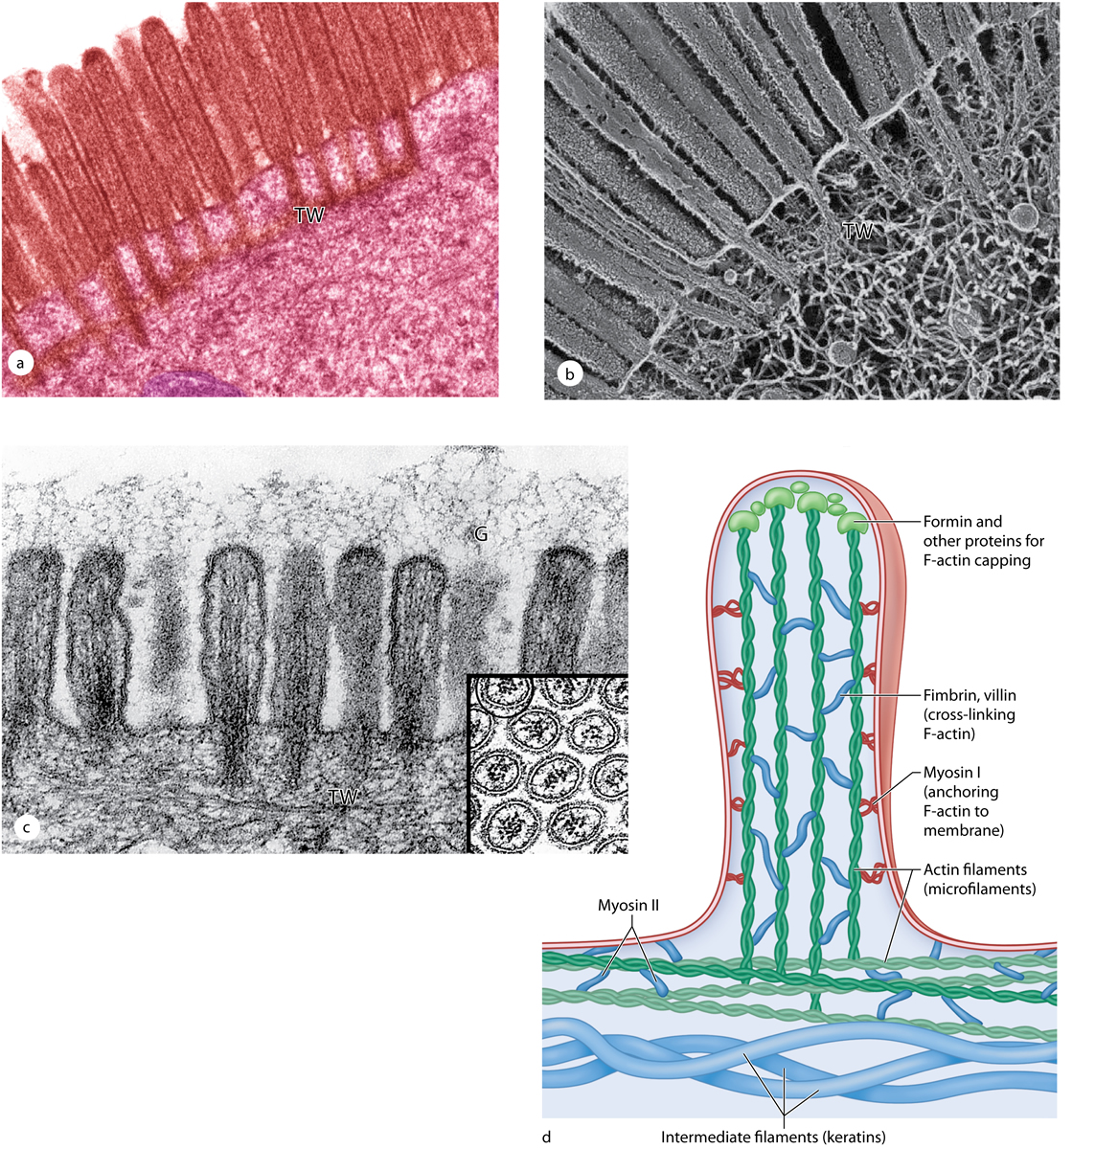
Ali Alsamawi
Notes:
Figure 5 Microvilli.
Absorptive cells lining the small intestine demonstrate the highly uniform microvilli of a striated or brush border particularly well. (a) A high-magnification light microscope shows many parallel microvilli and their connections to the terminal web (TW) in the underlying cytoplasm. X6500. (b) SEM of a sectioned epithelial cell shows both the internal and surface structure of individual microvilli and the association with actin filaments and intermediate filaments of the terminal web (TW). X7000. (c) TEM of microvilli sectioned longitudinally and transversely (inset) reveals the microfilament arrays that form the core of these projections. The terminal web (TW) of the cytoskeleton is also seen. The glycocalyx (G) extending from glycoproteins and glycolipids of the microvilli plasmalemma contains certain enzymes for late stages of macromolecule digestion. X15,000.
(d) The diagram shows a few microfilaments in a microvillus, with various actin-binding proteins important for F-actin assembly, capping, cross-linking, and movement. Like microfilaments in other regions of the cytoskeleton, those of microvilli are highly dynamic, with treadmilling and various myosin-based interactions. Myosin motors import various -microvilli components along the actin filaments. (Figure 4–8b, with permission, from Dr John Heuser, Washington University School of Medicine, St. Louis, MO.)

Slide 12
Stereocilia : are long microvilli with specialized mechanosensory function in cells of the inner ear and for absorption in tissues of the male reproductive tract.

Slide 13
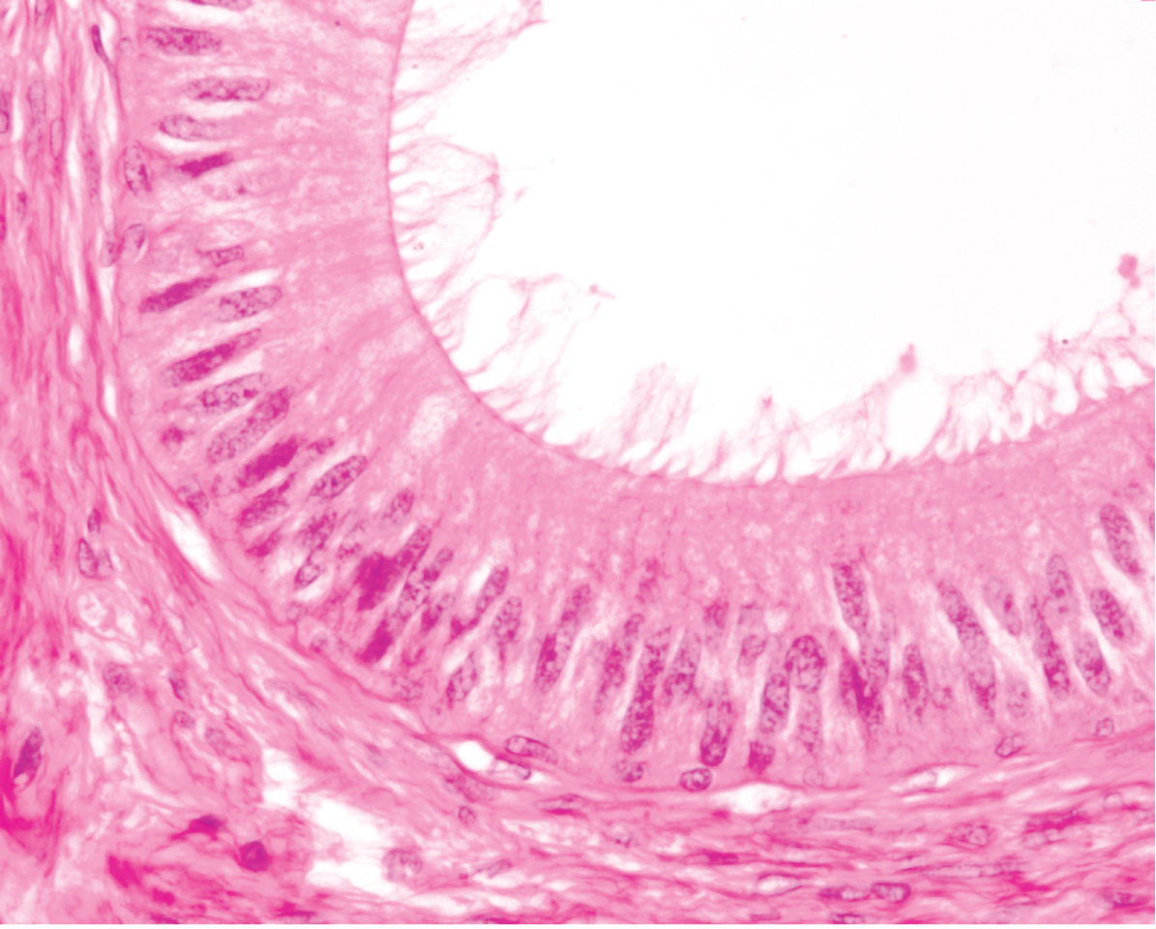
Ali Alsamawi
Notes:
Figure 6 Stereocilia.
At the apical ends of the tall epithelial cells lining organs such as the epididymis (shown here) are numerous very long stereocilia, which increase the surface area available for absorption. Stereocilia are much longer than microvilli and often have distal branching. X400. H&E.

Slide 14
Pseudostratified Columnar epithelium
Tall , irregular cells.
All are attached to the basement membrane but their nuclei are at different levels and not all cells are extend to the free surface.
Good example is the in the lining of the upper respiratory tract , where the cells are also heavily ciliated.

Slide 15
