Slide 1
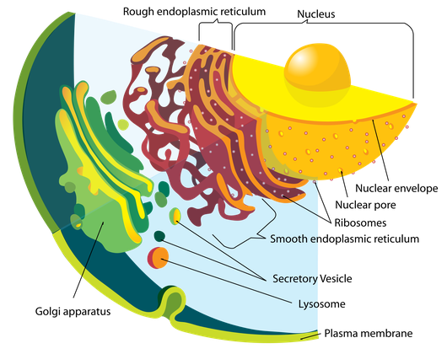
The Endomembrane system
The Endomembrane system (endo =within ) is a group of membranes and organelles in eukaryotic cells that works together to modify ,package and transport
Lipids and proteins. It includes the ,nuclear envelope , endoplasmic reticulum, , Golgi apparatus, lysosome ,vacuoles, vesicles, endosomes,
plasma membrane ,
the endomembrane system
doesn’t include the membrane of either
mitochondria and chloroplast .

Slide 2
the ER are different from cells to cell , a cell´s function determine the size and structure of the ER. for example , some cells ,such as sperm cells and red blood cells ,do not have an ER of any kind. Cells that synthesis and release a lot of protein would need a large amount of ER .The pancreas or liver for good examples of cells with large ER structure.
Endoplasmic reticulum has two types:
-Rough endoplasmic reticulum (studded with membrane -bound ribosomes.
-Smooth endoplasmic reticulum (Lacks ribosomes).
all these structure (tubules and sacs)are held in their place by the cytoskeleton

Slide 3
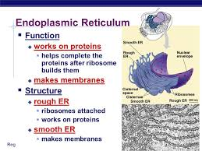
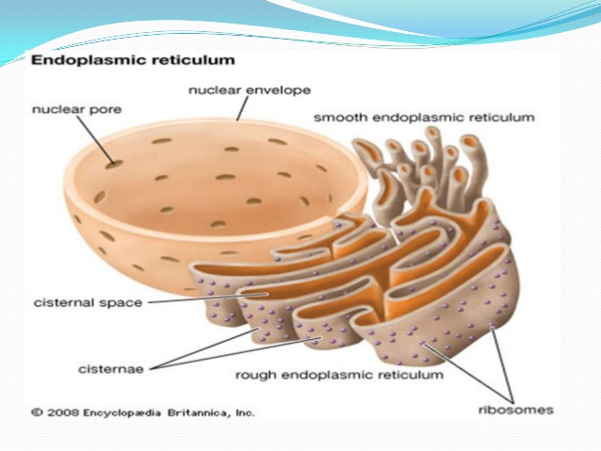
The endoplasmic reticulum
Another organelles in the cell is the endoplasmic reticulum (ER).the endoplasmic reticulum acts as an Intracellular circulatory or transporting system .the ER function as a manufacturing and packaging system .it works closely with the Golgi apparatus ,ribosomes ,mRNA and t RNA

Slide 4

Common function of RER and SER
1- Gives mechanical support to the cytoplasmic
2- The exchange of molecules by the process of Osmosis ,diffusion and active transport.
3- Contain many enzymes which perform various synthetic and metabolic active and provides increased surface for various enzymatic reactions.
4- It is transferred various of products from endoplasmic reticulum to other organelles as follows ; RER - SER- Ggolgi membrane-lysosomes-transport vesicles.
.

Slide 5
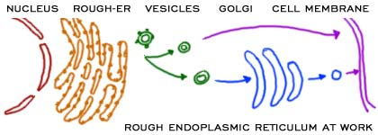

Slide 6
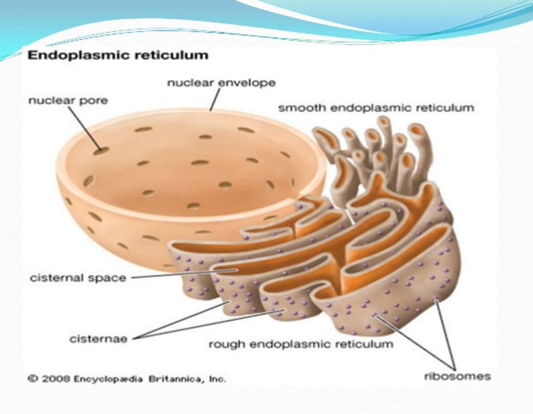

Slide 7
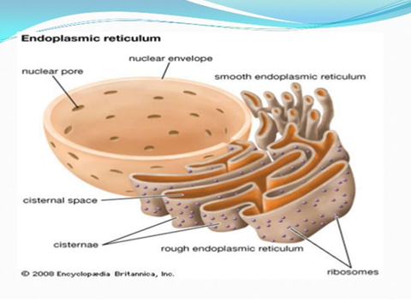
Structurally of the endoplasmic reticulum, is a network of membranes and flattened, membrane tube-like structures, Inside the membrane a fluid-filled space which is known as cisternae space or lumen that is continuous with nuclear envelope.

Slide 8
Rough endoplasmic reticulum (RER)
the major function of RER The synthesis and packaging of protein ,ribosomes are attached to the membrane of the ER ,making it (rough). A and nether function makes phospholipids for cellular membrane
. the process of protein synthesis are:
mRNA move from the nucleus to a ribosomes on the surface of RER.
the ribosomes builds the peptide chain
the chain is pushed in to cisternae space of the RER .
when the proteins are complete they collect and the RER pinches off a vesicle .
that vesicle (a small membrane bubble) can move to the cell membrane or the Golgi apparatus .
the proteins either used in the cell or sent out cell.

Slide 9
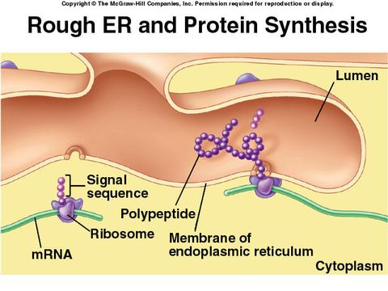

Slide 10
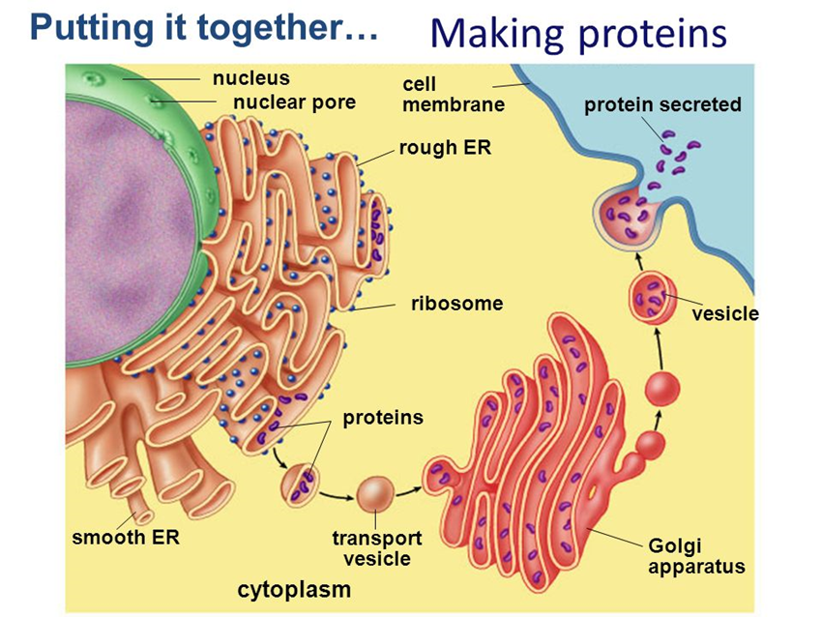

Slide 11
Smooth endoplasmic reticulum (SER)
The smooth endoplasmic reticulum is continuous with the RER but has no ribosomes . function of the SER include synthesis of carbohydrate , lipids and steroids hormones , detoxification of medication and poison .
Sarcoplasmic reticulum
In muscle cell ,as specialized SER called the sarcoplasmic reticulum is responsible for storage of the calcium ions, lead to coordinated contraction of the muscles cells. The sarcoplasmic reticulum plays a role in releasing calcium when the muscle is stimulated and actively transporting calcium back into the sarcoplasmic reticulum when the stimulation stops and the muscle must be relaxed.

Slide 12
Functions of SER
Carbohydrate an lipid synthesis : the synthesis of carbohydrate and lipids also produces cholesterol and phospholipids membrane. also responsible for repair of membranes .in the liver SER facilitates the conversion of stored glycogen to glucose.
Transportation of Proteins: It regulates the transfer of proteins that act as a transition to different locations.
Detoxification :One of the most important functions of SER is to detoxify the body from metabolic wastes and drugs.

Slide 13
The origin of the Endoplasmic Reticulum
1. ER possibility of formation of the wall of the nucleus
2. Another possibility is attributable to the type of replication which gets the ER Network.

Slide 14
The Golgi Apparatus
It is a station of Modifying, Sorting and packaging of the synthesized protein to be exported outside the cell or to be used inside the cell .It is also called Golgi-body .It consists of 3 structures:
1. Flattened curved cisternae that are differentiated into:
Cis-cisternae. The convex face or the immature face of Golgi complex. They are consisted of a network of interconnected cisternae called Cis-Golgi network (CGN). They are sit of protein phosphorylation.

Slide 15
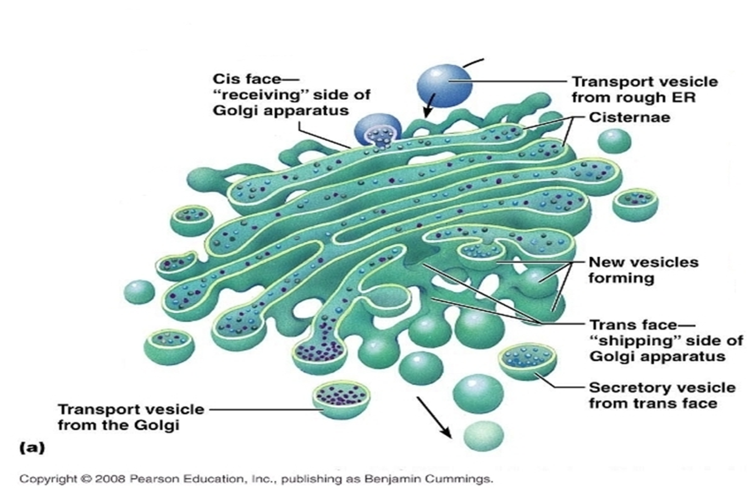
Trans-cisternae.: the concave or mature surface of Golgi, from it arise secretory vesicles which carry the modified or mature proteins. They consist of interconnected network called Trans-Golgi Network (TGN). They are the site of protein glycosylation .
Middle cisternae .
They are located between
Cis – and trans- Golgi
cisternae. They are connected
with them by transport vesicles.

Slide 16


Slide 17
2. Micro vesicles or transport vesicles: They are smaller in size and carry immature protein synthesized in RER , and fuse in Cis-Golgi network (CGN).
3. Secretory vesicles: They are larger in size than transport vesicle and carry mature protein that has been modified in Golgi Cisternae. They arise from Trans-Golgi Network (TGN )and fuse with plasma membrane to release their content outside the cell.

Slide 18
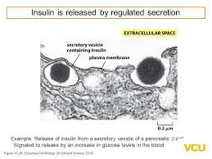
Secretory vesicles is vesicles contain proteins destined for extracellular release. After packaging, the vesicles bud off and are stored in the cell until a signal is given for their release. When the signal is received they move toward the membrane and fuse to release their contents. This process is known as regulated secretion.

Slide 19
Functions of Golgi apparatus:
1. Modification of protein: Golgi Complex contain different sets of enzymes that are able to modify the received newly synthesized immature protein. The processes of protein modification include:
•Glycosylation : It is the process of addition of sugar molecule and takes place in middle and trans-cisternae. It results in formation of glycoprotein .
•Phosphorylation : It is the process of addition of phosphate group and occurs in Cis-cisternae.
•Sulfation: It is the process of addition of sulfate group into amino acids of protein.

Slide 20
2- Processing and packaging of proteins
3- Sorting of proteins: In Golgi apparatus proteins are sorted according to which target they are synthesized. Golgi adds a sorting signal (carbohydrate )to direct the protein towards specific organelle.
In plant cells, the Golgi apparatus has the additional role of synthesizing polysaccharides ,Some of which are incorporated into the cell wall

Slide 21
The origin of the Golgi apparatus :
Vesicles dis­patched from the endoplasmic reticulum
2. The probability of the nuclear membranes .
3. Golgi apparatus resulted in break and rebuild flat bags again.
4. Believed to be the Golgi apparatus that may arise from a complex multiplication or divide Golgi Apparatus
5. Vesicles formed by invaginations of the plasma membrane.

Slide 22


