Slide 1
Importance of water
Water (H2O) is one of the most abundant chemical compounds on earth, covering 70% of the earth's surface, and is essential to all life. water is the most substance to sustaining life.
For example humans are made up of over 70% water, with the brain being composed of over 80% water.
The properties are largely the result of the extensive hydrogen bonds between molecules in water.
water is made up of atoms. Atoms linked by hydrogen bond, Two hydrogen atoms (have positive charge )and one oxygen atom (has negative charge) form a water molecule.
(Figure 1).
Chemistry of the cell

Slide 2
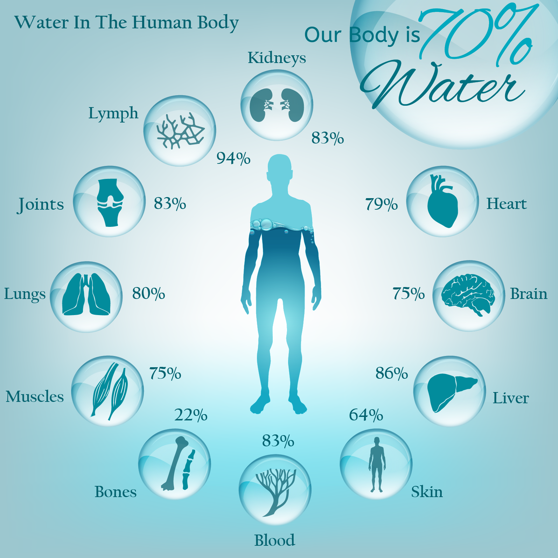

Slide 3
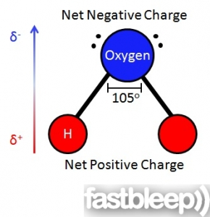

Slide 4
Properties of water
1-Water is the Universal solvent and facilitates Chemical reactions
a universal solvent for its ability to dissolve a wide range of substance (i.e. salt or sugar dissolving in water) .
-why water good solvent due to the polar nature of the water molecules, which allow water molecules to be attracted to each other.
- type of molecule that interacts with water ,such as polar molecules, which dissolve in water or form hydrogen bonds with water molecules are called hydrophilic ex. milk, soap, wool, hair, and cellulose,
-but a type of molecule that does not interacts with water ,such as nonpolar molecules, which do not dissolve in water or form hydrogen bonds with water molecules are called Molecules called hydrophobic (or water-hating) ex. oil, waxes, fats, all fatty acids.

Slide 5
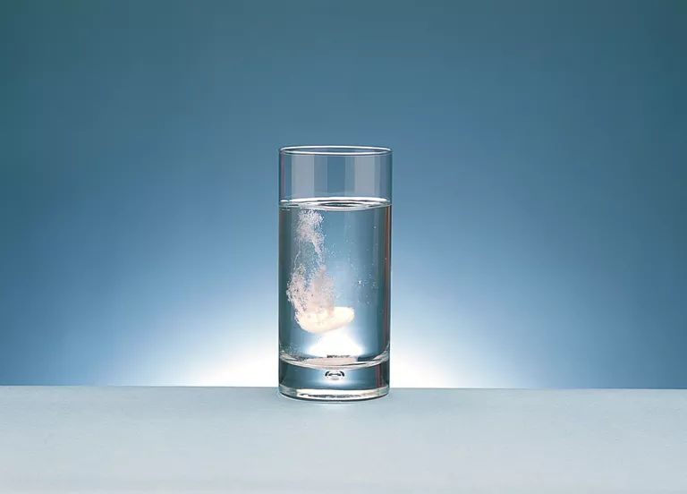
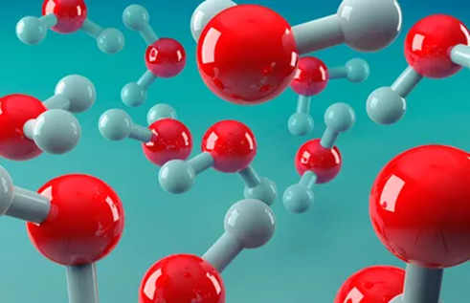

Slide 6
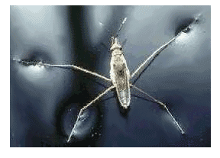
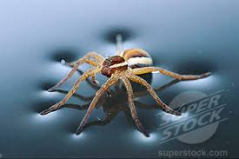
2-Water molecules are cohesive and adhesive
Cohesion is the attraction between water molecules. Cohesive attractive forces are responsible for the characteristic surface tension of water. This allows insects to run across the waters surface without breaking the surface.

Slide 7
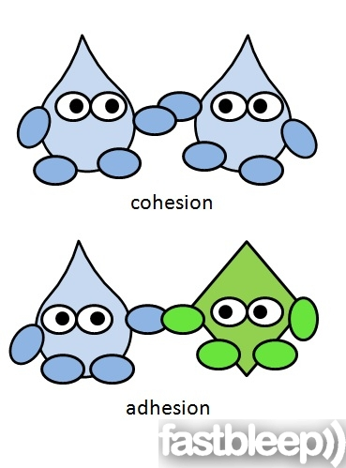
Adhesion is the attraction between molecules of water and molecules of another substance. Adhesive forces when combined with surface tension can result in a phenomenon known as capillary action. This action results in the movement of water up a narrow tube, against the force of gravity for example in the xylem vessels of plants. For these reason, water is an excellent transport system both outside of and within living organisms.

Slide 8
3-The temperature of liquid water rises and falls more slowly than that of most other liquids
water has a high heat capacity, so it requires a lot of energy to heat up; requires 1 cal to raise 1 gram of water by 1 degree °C. the many hydrogen bonds that link water molecules help water absorb heat without a change in temperature then temperature falls more slowly .this property of water is important for all living organisms ,water protects organisms from rapid temperature changes and helps them maintain their normal internal temperatures

Slide 9
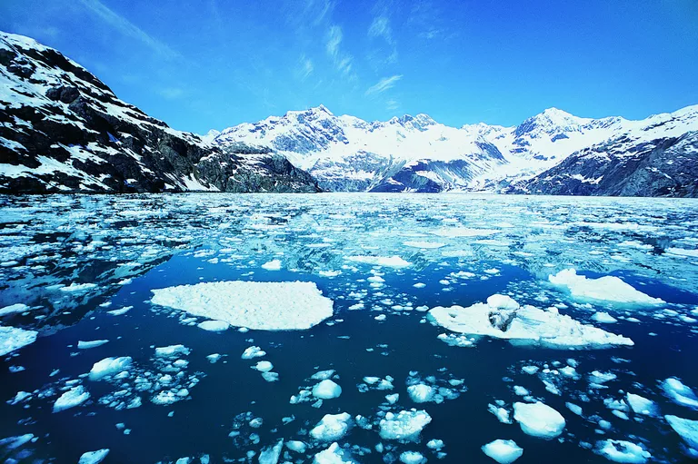
4- Water tends to remain a liquid
It does not readily change to ice or steam, this property of water helps moderate the earth´s temperature so that it promotes the continuance of life.
5-Solid water(ice) is less dense than liquid water
The density of most substances increases when a liquid becomes a solid, It is for this reason that ice floats. The fact that ice floats is essential for the survival of many aquatic ecosystems and ultimately life on Earth.

Slide 10
Properties of water
properties | chemistry | Result
Universal solvent | polarity | Facilitates chemical reactions
Adheres and cohesive | Polarity ; hydrogen bonding | Serves as transport medium
Resists changes in temperature | hydrogen bonding | Helps keep body temperatures constant
Resists change of state (from liquid to ice and from liquid to steam) | hydrogen bonding | Moderates earth s temperature ,Evaporation helps bodies remain cool
Less dense as ice than as liquid water | hydrogen bonding changes | Ice floats on water

Slide 11
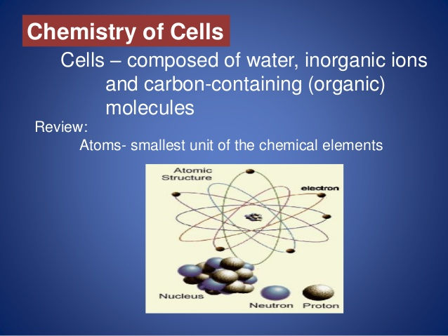

Slide 12
Chemistry of the cell
1-Small organic molecules
Carbon chain make up the skeleton of organism molecules .the small organic molecules in living things—sugars, fatty acids ,amino acid, and nucleotides all have a carbon backboned
,
2-Large organic molecules (Macromolecules)
Each of the small organic molecules can be subunit of a large organic molecule, often called a macromolecules .a subunit is called a monomer ,and the macromolecule is called a polymer.
The word monomer comes from mono- (one) and -mer (part). Monomers are small molecules which may be joined together in a repeating fashion to form more complex molecules called polymers.
-monosaccharide are the monomers within polysaccharide
-fatty acids and glycerol are the monomers within a lipid
-amino acids are the monomers for proteins
- nucleotides are the subunits of nucleic acids

Slide 13
Macromolecules | Monomer
polysaccharide | monosaccharide
lipid | glycerol and fatty acid
protein | amino acid
nucleic acid | nucleotide

Slide 14
The four major classes of organic molecules include carbohydrates, proteins, lipids and nucleic acids.
​Carbohydrate
Carbohydrate is a large macromolecule, consisting of carbon (C),hydrogen (H), and oxygen (O) atoms, usually with a hydrogen: oxygen atom ratio of 2:1 in other words, the formula (CH₂O)_{n} .
The carbohydrates are divided into four chemical groups:
monosaccharides, disaccharides, oligosaccharides, and polysaccharides.
In general, the monosaccharide and disaccharides, which are smaller (lower molecular weight) carbohydrates, the names of the monosaccharide and disaccharides very often end in the suffix–ose.
For example,
Grape sugar is the monosaccharide glucose
Cane sugar is the disaccharide sucrose
Milk sugar is the disaccharide lactose
Properties: Crystalline ; Soluble in water ; Sweet-tasting
(see illustration).

Slide 15
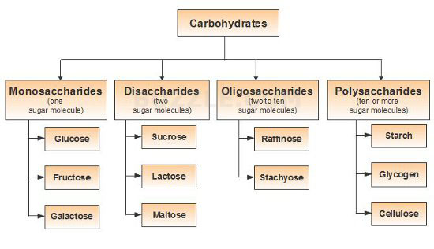

Slide 16
2-Disaccharides
Disaccharides contain two sugar molecules. Common disaccharides are sucrose, lactose, maltose
Properties; Crystalline; Water-soluble; Sweet-tasting; Sticky
3- Oligosaccharides
Oligosaccharides contain between tow and ten basic units
Their main role in the body is to store glucose. Common oligosaccharides are Raffinose and stachyose which consist of repetitive chains of Fructose, Galactose, and Glucose.
Properties : Crystalline ; Water-soluble
4-Polysaccharides
Polysaccharides have a high molecular weight. They are divided into:
Homopolysaccharides contain the same monosaccharides, include starch, cellulose and glycogen
Heteropolysaccharides contain more than one type of monosaccharides.
Include Pectin, hemicellulose and gums.
Properties: Not water-soluble ; Not crystalline ; Not sweet ; Form colloidal suspensions

Slide 17
The functions of carbohydrates
the storage of energy (e.g. starch and glycogen).
Structural components (e.g. Cellulose in plants and chitin in arthropods).
Important component of coenzymes (e.g. ATP,FAD, and NAD).
Backbone of the genetic molecule known as RNA. The related deoxyribose is a component of DNA.
Play importing roles in the immune system, fertilization, preventing pathogenesis, blood clotting.

Slide 18
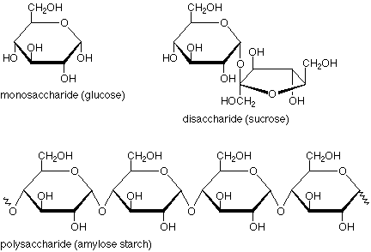

Slide 19
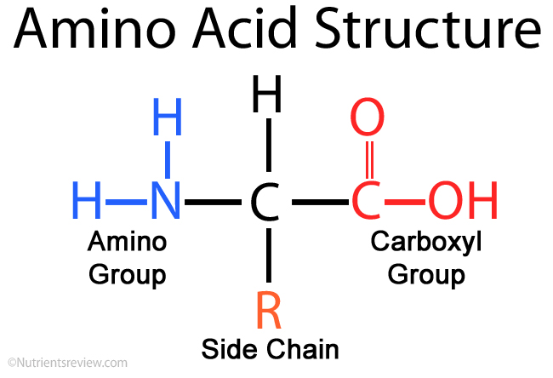
2-proteins
Proteins are made of smaller units called amino acids, which are attached to one another in long chains by peptide bonds . There are 20 different types of amino acids .all amino acids contain 2 important functional groups ; a carboxyl –COOH group and an amino- NH2 group . The sequence of amino acids determines each protein’s unique 3-dimensional structure and its specific function.

Slide 20
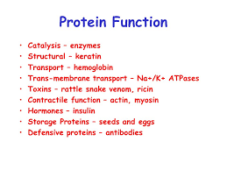

Slide 21
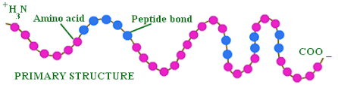
Levels of protein structure
The primary structure of a protein refers to the sequence of amino acids in the polypeptide chain. The primary structure is held together by peptide bonds.
The importance of sequence of amino acids in the protein of the organism as an example; The structural difference between a normal hemoglobin molecule and a sickle cell molecule.
Specifically, the amino acid glutamic acid is substituted by valine in the location 6 of the multi-chain peptide while Arrangement stays of the 145 amino acid component of hemoglobin unaffected.

Slide 22
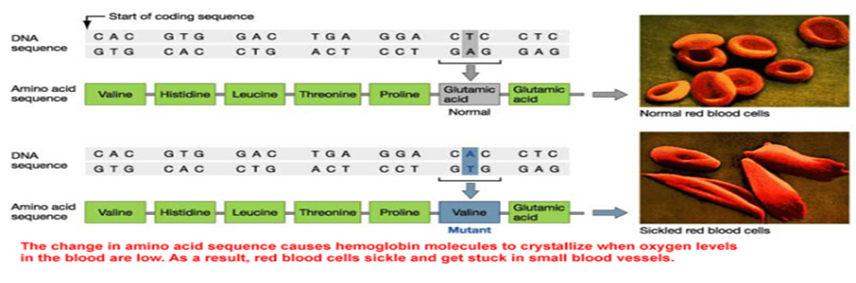

Slide 23
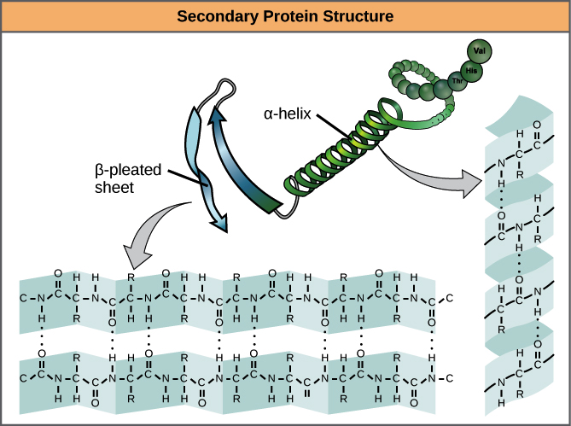
Secondary Structure - refers to the coiling or folding of a polypeptide chain that gives the protein its 3-D shape. There are two types of secondary structures observed in proteins.
1-the alpha (α) helix structure. This structure resembles a coiled spring and is secured by hydrogen bonding in the polypeptide chain.
2-the beta (β) pleated sheet. This structure appears to be folded or pleated and is held together by hydrogen bonding between polypeptide units.
Both structures are held in shape by hydrogen bonds, which form between the carbonyl O of one amino acid and the amino H of another.

Slide 24
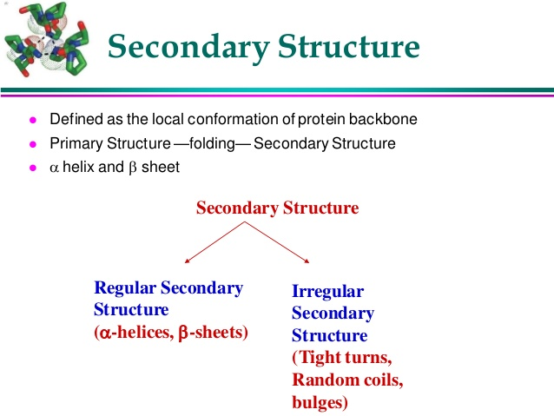

Slide 25
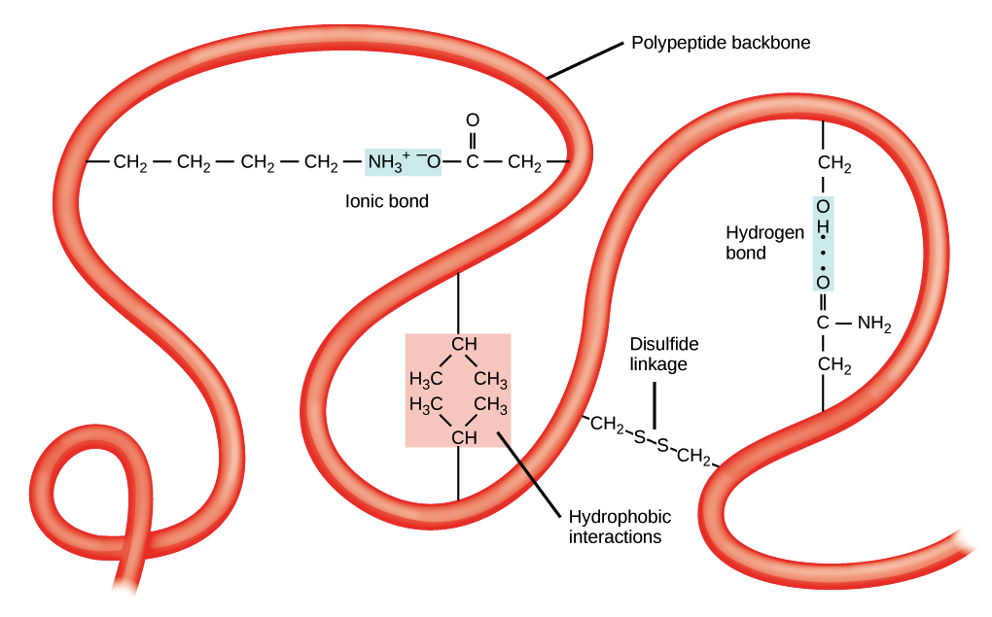
Tertiary Structure: Tertiary Structure refers to the comprehensive 3-D structure of the polypeptide chain of a protein. There are several types of bonds and forces that hold a protein in its tertiary structure.
R group interactions that contribute to tertiary structure include Hydrophobic interactions, hydrogen bonding, ionic bonding, disulfide bridge .

Slide 26

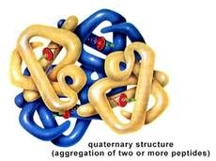
Quaternary Structure refers to the structure of a protein macromolecule formed by interactions between multiple polypeptide chains. Each polypeptide chain is referred to as a subunit. Proteins with quaternary structure may consist of more than one of the same type of protein subunit. They may also be composed of different subunits.
Hemoglobin is an example of a protein with quaternary structure. Hemoglobin, found in the blood, is an iron-containing protein that binds oxygen molecules. It contains four subunits: two alpha subunits and two beta subunits.

Slide 27
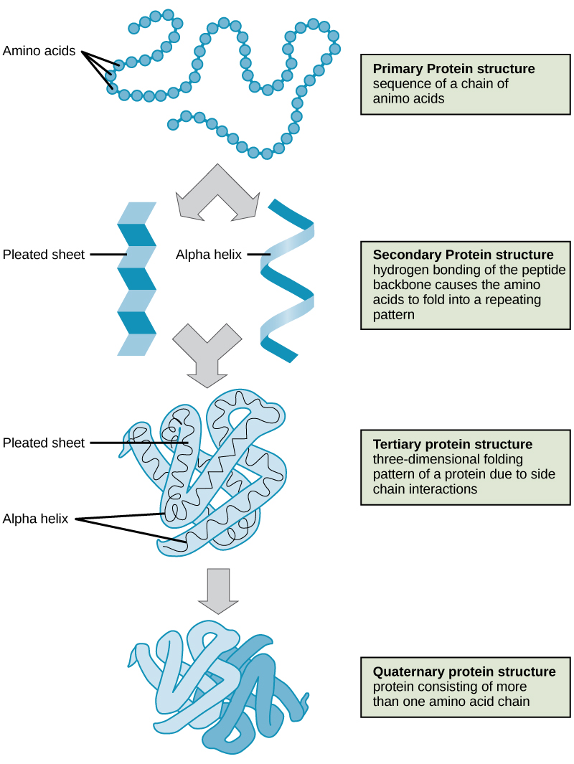

Slide 28
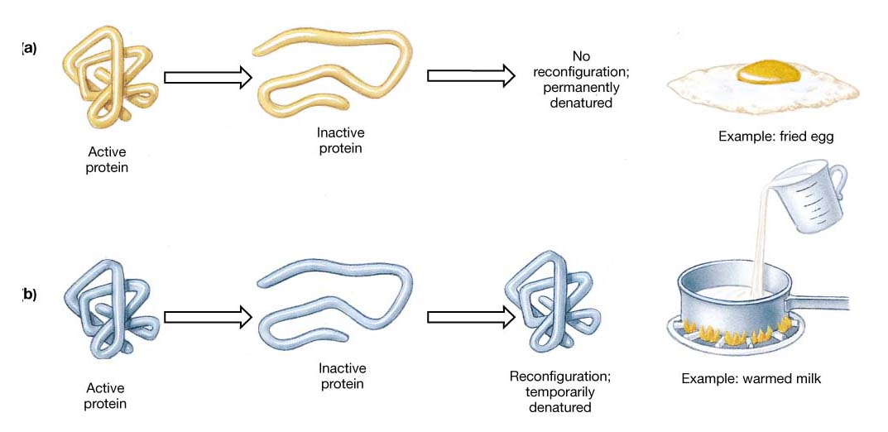
Denaturation of proteins
A process in which the folding structure of a protein is altered due to exposure to certain chemical or physical factors (e.g. heat, acid, solvents, etc.), causing the protein to become biologically inactive.
Both temperature and pH can bring about a change in protein shape.
For example ,
-the addition of acid to milk causes curdling ;
-heating causes egg white ,a protein called albumin to coagulate denaturation occurs because the normal bonding patterns between parts of a molecule have been disturbed .

Slide 29
Lipids
a lipid is a biomolecule that is soluble in nonpolar solvents. Non-polar solvents are typically hydrocarbons used to dissolve other naturally occurring hydrocarbon lipid molecules that do not dissolve in water, including fatty acids, waxes, sterols, fat-soluble vitamins (such as vitamins A, D, E, and K), monoglycerides, diglycerides, triglycerides, and phospholipids.
Function of Lipids
Storage of energy
Hormonal roles (e.g. steroids such as estrogen and testosterone)
Insulation
Protection of internal organs (e.g. triglycerides and waxes)
Structural components of cells (e.g. phospholipids and cholesterol)

Slide 30
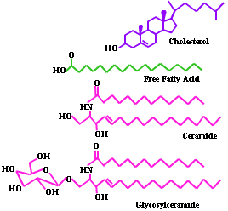

Slide 31
Types of Lipids
Triglycerides: energy source in animals (fats) and plants (oils)
Phospholipids: Structural component of cell membranes
Steroids: Act as hormones in plants and animals,
Waxes: Act as a protective layer against water loss in plant leaves and animal skin
Carotenoids: Light-absorbing accessory pigment in plants (involved in photosynthesis)
Glycolipids: Complexes of carbohydrate and lipid that function as cell receptor and cell recognition molecules

Slide 32
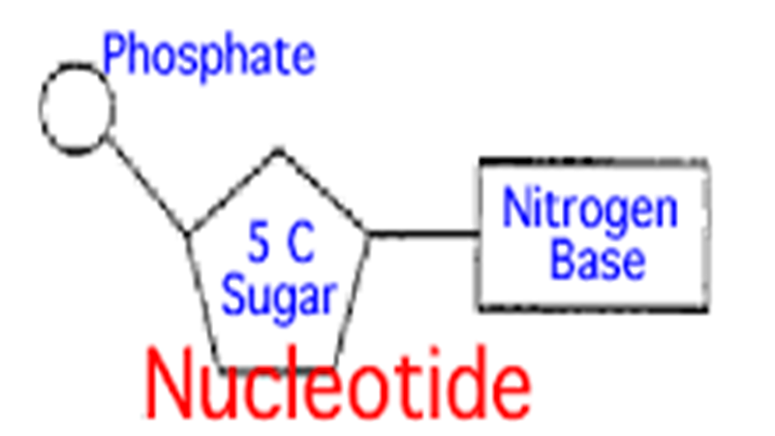
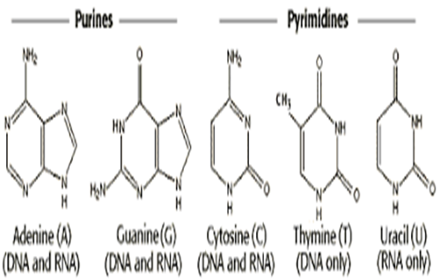
4-Nucleic acids
Nucleic acids are polymers of nucleotides ,These nucleotides are made of three parts:
1-Phosphate group
2-Pentose sugar
-in DNA the sugar is deoxyribose
-in RNA the sugar is ribose
3-Nitrogenous base , which consist of: purine and pyrimidine -Nitrogenous bases are Adenine, Thymine (Uracil in RNA) Guanine, and Cytosine in DNA.

Slide 33
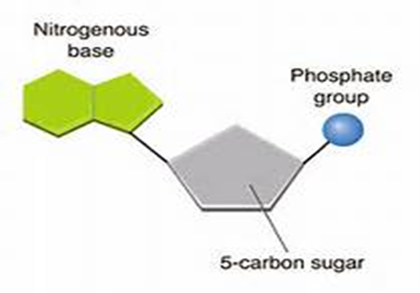
DNA and RNA are polymers of nucleotides,
which consist of: purine and pyrimidine bases linked to phosphorylated sugars,
-Adenine, guanine, and cytosine are also present in DNA, but RNA contains uracil in place of thymine.
---The bases are linked to sugars to form nucleosides. Nucleotides additionally contain one or more phosphate groups linked to the 5′ carbon of nucleoside sugars.
---The chemical linkage between nucleotide units in nucleic acids is a phosphodiester, which connects the 5’-hydroxyl group of one nucleotide to the 3’-hydroxyl group of the next nucleotide

Slide 34
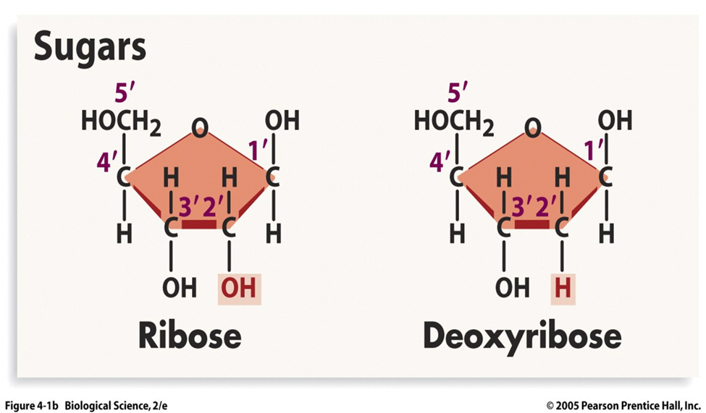
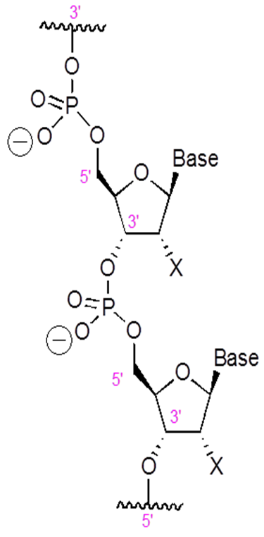
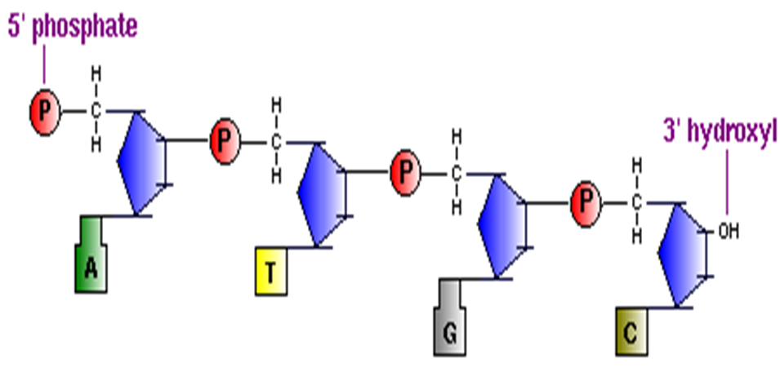

Slide 35
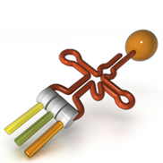
Different types of ribonucleic acid (RNA)
1- Messenger RNA(mRNA)
mRNA transcribes the genetic code from DNA into a form that can be read and used to make proteins. mRNA carries genetic information from the nucleus to the cytoplasm of a cell
2- Ribosomal RNA(rRNA)
rRNA is located in the cytoplasm of a cell, where ribosomes are found. rRNA directs the translation of mRNA into proteins.
3- Transfer RNA(tRNA)
acts as the middleman between mRNA and rRNA in the synthesis of protein. tRNA has two arms, with one of the arms attached to amino acids, while the other binds to the mRNA. Amino acids are carried by tRNA and connected by a peptide bond during the process of translation, to produce a protein.

Slide 36
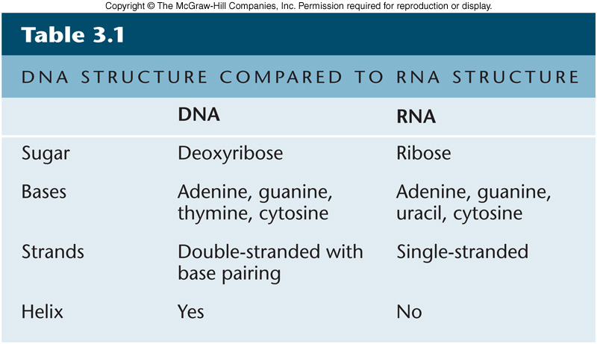

Slide 37
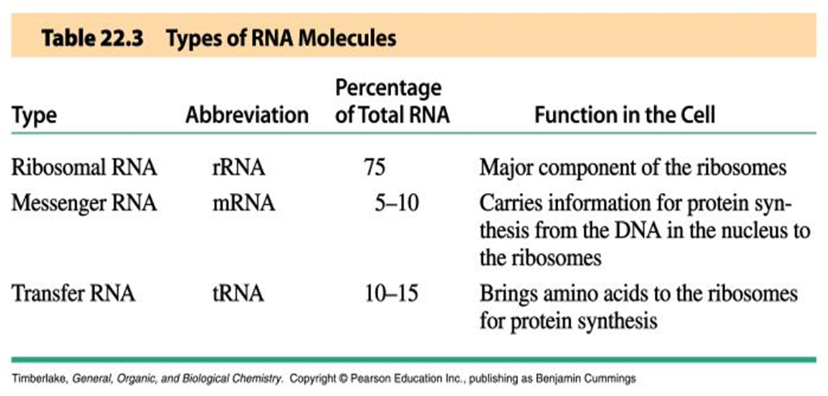

Slide 38


