Slide 1
Influence of Environmental Factors on Growth
Lec.4

Slide 2
Hydrogen ion (pH)
pH affects microbial growth , each M.O has a definite
pH growth range and optimum pH value. M.O has
been classified according to optimum pH values as
below:
.

Slide 3
Acidophiles: optimum pH range (0 - 5.5)
Neutrophiles: optimum pH range (5.5 - 8)
Alkalophiles: optimum pH range (8.5-11)
Extreme alkalophiles: have growth optima at pH 10 or higher.

Slide 4
Most bacteria are neutrophiles, with some exceptions. Changing in pH can harm M.O by disrupting the plasma membrane or inhibiting the activity of enzymes and membrane transport proteins.

Slide 5
Temperature
Temperature factor affect on the susceptibility of microorganisms because they are unicellular and their temperature varies with external environment conditions. Temperature affect on growth because it affect on enzyme-catalyzed reactions, temp. rise increases the growth rate because metabolism is more active at high temperatures, the velocity of an enzyme-catalyzed reaction is double for every 10° C rise in temp. High temp. damage M.O by denaturing enzymes, transport carriers and other proteins.

Slide 6
Microbial membranes are also disrupted by extreme temp. The lipid bilayer melts and disintegrates, the m.o may be damaged to such an extent that growth is inhibited and the damage cannot be repaired. At very low temp. Membranes solidify and enzymes don’t work rapidly, the cardinal temp. Depend on other environmental factors such as pH and the available nutrients. Microorganisms can be divided into 5 classes based on their temp. Ranges for growth:

Slide 7
Psychrophiles: grow well at 0°C and have an optimum temp. of 15°C or lower; the maximum around 20°C. They adapted to their environment in several ways; A. enzymes, transport systems and protein synthetic mechanisms function well at low temp. B. Cell membranes have high levels of unsaturated fatty acids and remain semi-fluid at the low temp.
Psychrotrophs: can grow at (0-7 °C) they are major factors in the spoilage of refrigerated foods.
Mesophiles: M.O growth optima around (20 -45°C). All human pathogens are mesophiles (37 °C).

Slide 8
Thermophiles: M.O that grow at temp. 55°C or higher, they have more heat-stable enzymes and protein synthetic systems, which can function properly at high temp. Thermophile DNA is stabilized by special histone like proteins. The membrane lipids of thermophiles are also quite temp. stable, they tend to be more saturated, more branched and higher molecular weight, which increasing the melting points of membrane lipids.
Hyperthermophiles: M.O that have growth optima between 80-113° C.

Slide 9
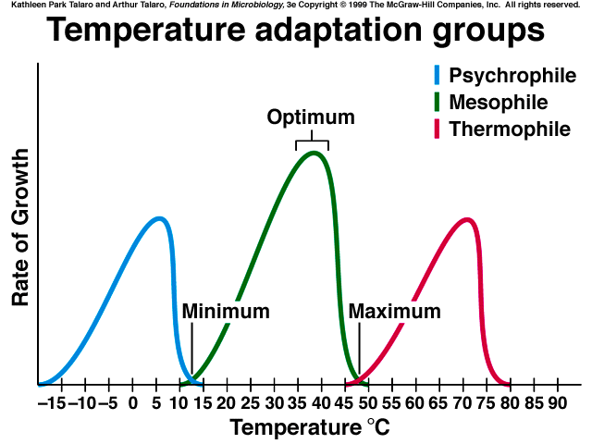
Figure-2: Temperature range of microbial growth
Text Fig. 7.16

Slide 10
Oxygen concentration
Oxygen serves as the terminal electron acceptor for the electron-transport chain in aerobic respiration. Microorganisms are divided into 4 types according to their need to oxygen:
Facultative anaerobes: does not require O2 for growth but grow better in it’s present.
Aerotolerant anaerobes: ignore O2 and grow equally well whether it is present or not.

Slide 11
Strict or obligate anaerobes: do not tolerant O2 at all and die in its presence. Aerotolerant and strict anaerobes cannot generate energy through respiration and must employ fermentation or anaerobic respiration pathways for this purpose.
Microaerophils: require only 2-10% of O2. It should be noted that the ability to grow in both aerobic and anaerobic environmental provides considerable flexibility and is an ecological advantage.

Slide 12
Many M.O. possess enzymes that afford protection against toxic O₂ products. Obligate aerobes and facultative anaerobes usually contain the enzymes superoxide dismutase (SOD) and catalase, which catalyze the destruction of superoxide radical and hydrogen peroxide, respectively. Peroxidase also can be used to destroy hydrogen peroxide:

Slide 13
Radiation
Sunlight is the major source of radiation, it is includes visible light, ultraviolet (UV) infrared ray and radio waves; these wave called electromagnetic radiation, as the wave length decrease, the energy of the radiation increase- gamma and X rays are much more energetic than visible light or infrared waves.

Slide 14
Visible light is a most important for life because of the ability of photosynthetic organisms to trap the light energy of the sun.
The ionizing radiation radiation (e.g., X-rays, gamma rays) are very harmful to microbial growth. Low levels of these radiations may cause mutations and may indirectly result in death whereas high levels may directly cause death of the microbes.

Slide 15
Ionizing radiation, however, destroys ring-structures, breaks hydrogen bonds, oxidizes double bonds and Sunlight is the major source of radiation, it is includes visible light, ultraviolet (UV) infrared ray and radio waves; these wave called electromagnetic radiation, as the wave length decrease, the energy of the radiation increase- gamma and X rays are much more energetic than visible light or infrared waves.

Slide 16
References
1. Microbial Physiology. Albert G Moat, John W Foster, Michael P. Spector. 2002. Fourth Edition. A John Wiley and sons, INC., publication.
2. Microbiology. Lansing M Prescott, John P. Harley, Donald A. Klein.2004. Sixth Edition. Higher Education.
3. Microbial an introduction. 2004. Gerard J Tortora, Berdell R Funke, Christine L Case. Eighth Edition.

Slide 17
Questions

Slide 18
Thank you

