Slide 1
Uptake of nutrients by the cell
Lec.2

Slide 2
The first step in nutrient use is uptake of the required nutrients by the microbial cell, uptake mechanism must be specific-that is the necessary substances, and not others, must be acquired. Nutrients must pass through a selectively permeable plasma membrane that will not permit the free passage of most substances.

Slide 3
The most important transport mechanisms are:
Passive diffusion: the process in which molecules move from a region of higher concentration to one of lower concentration because of random thermal tension. The rate of
passive diffusion is dependent on the size of the
concentration gradient between a cell’s exterior and it’s
interior, very small molecules (H2O,O2 & CO2) often
move across membranes by passive diffusion.

Slide 4
Facilitated diffusion: the rate of diffusion across selectively permeable membranes is greatly
increased by using carrier proteins, called
permeases, which are embedded in the plasma membrane. Because carrier helps the diffusion
process, it is called facilitated diffusion.

Slide 5
The rate of transport increases with the concentration
gradient much more rapidly and at lower concentrations
of the diffusing molecule than that of passive diffusion.
The curve below resembles an enzyme – substrate and
is different from the linear response seen with passive diffusion .Carrier proteins also resemble enzymes in
their specificity for the substance to be transported;
each carrier is selective and will transport only closely
related solutes.

Slide 6
M.O often live in habitats with very dilute nutrient sources, must be able to transport and concentrate these nutrients, thus facilitated diffusion mechanisms are not always adequate ,and other methods must be used ,the two most important transport mechanisms in such conditions are; active transport & group translocation , both energy-dependent processes.

Slide 7
Active transport; is the transport of solute molecules to higher concentrations, or against concentration gradient, with the use of metabolic energy. The carrier proteins or permeases bind particular solutes with great specificity, it is also characterized by the carrier saturation effect at high solute concentration.

Slide 8
Group translocation; many bacteria take up molecules by group translocation, a process in which a molecule is transported into the cell while being chemically altered. It is energy –dependent transport because metabolic energy is used. In the 1,2,3 types the solute molecules move across a membrane without modification.

Slide 9
The best-known group translocation system
is phosphoenolpyruvate;
Sugar phosphotransferase system (PTS).It is transports a variety of sugars into cells while phosphorylating
them using phosphoenolpyruvate (PEP) as the
phosphate donor.

Slide 10
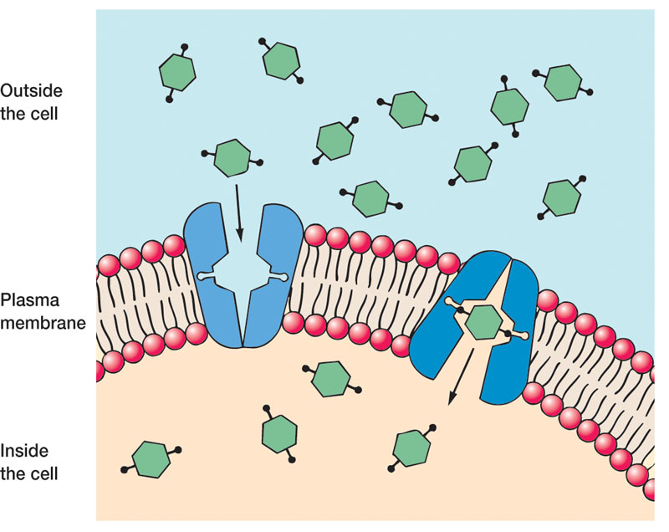
Figure -1 A model of facilitated diffusion the membrane can carrier change conformation after binding an external molecule and subsequently release

Slide 11
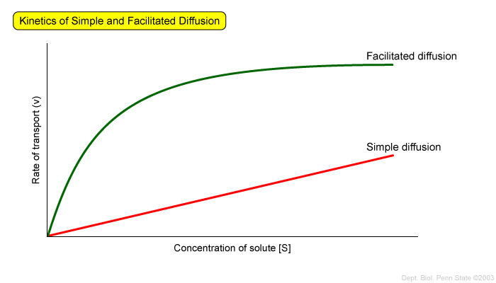
Figure -2 The kinetics of simple diffusion and facilitated diffusion

Slide 12
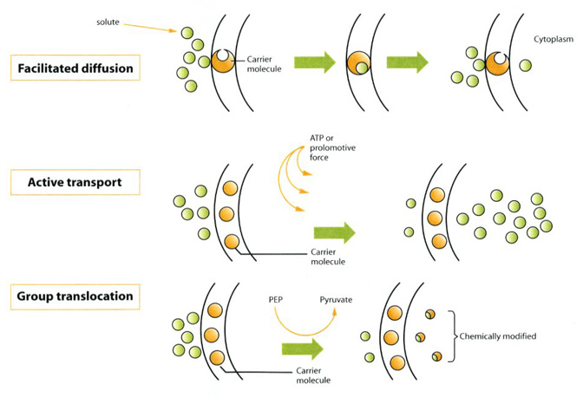
Figure-3 Operation of bacterial transport systems.

Slide 13
References
1. Microbial Physiology. Albert G Moat, John W Foster, Michael P. Spector. 2002. Fourth Edition. A John Wiley and sons, INC., publication.
2. Microbiology. Lansing M Prescott, John P. Harley, Donald A. Klein.2004. Sixth Edition. Higher Education.
3. Microbial an introduction. 2004. Gerard J Tortora, Berdell R Funke, Christine L Case. Eighth Edition.

Slide 14
Question

Slide 15
Thank you

