Slide 1
Chromosome banding
م.م رفل نعمان عباس

Slide 2
A band is defined as that part of a chromosome which is clearly distinguishable from its adjacent segments by appearing darker or brighter with one or more banding techniques. The chromosomes are visualized as consisting of a continuous series of bright and dark bands.
Chromosome banding is developed based on the presence of heterochromatin and euchromatin.
Heterochromatin is darkly staind whereas euchromatin is lightly staind during chromosome
There are a few types of Chromosomes banding : G bandig, C bandig, Q bandig, R bandig , T banding
Aunique banding pattern is used to identify each chromosome and to diagnosis
Chromosomal aberration
Chromosome breakage ,loss ,duplication or inverted segment
.

Slide 3
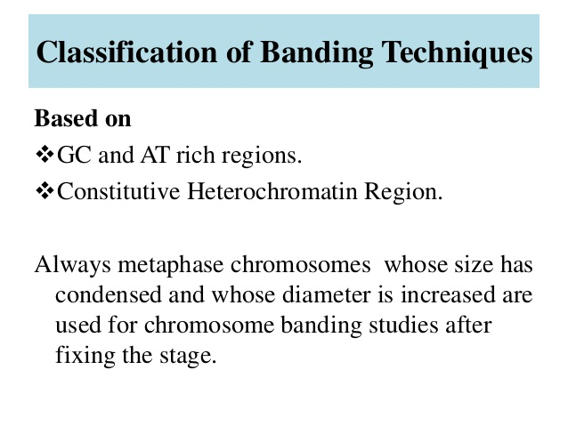

Slide 4
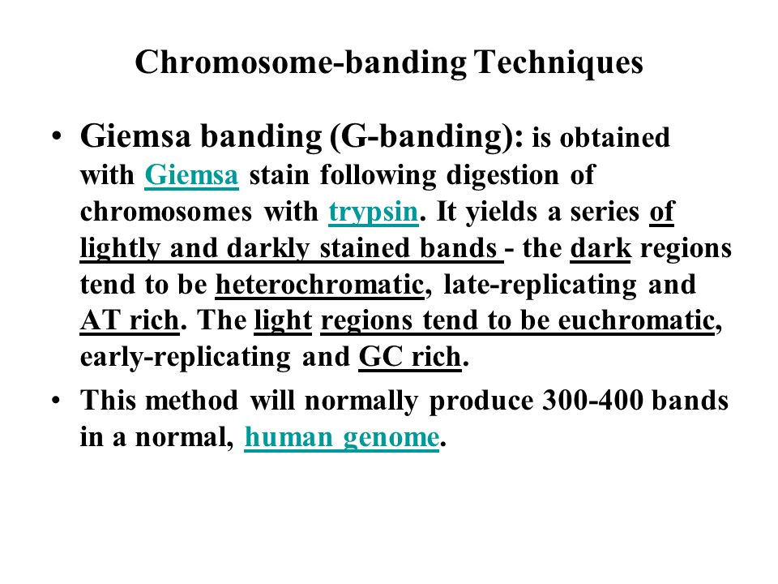

Slide 5
chromosome
Treat with Trypsin
Stain with Giemsa solution
Banding pattern
Region rich in AT bases
Region rich in GC bases
Dark staining
light staining
AT rich regions means less gene
CG rich regions means more gene

Slide 6
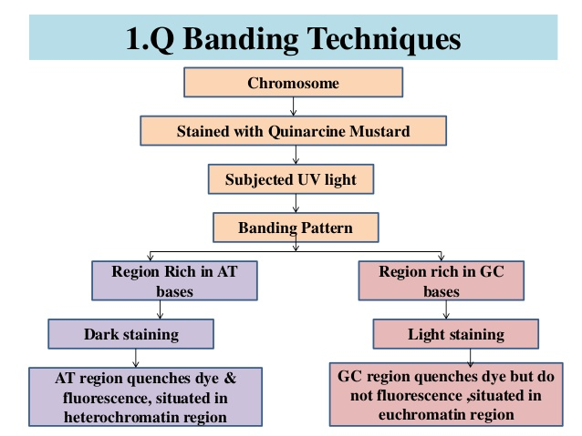
Q banding
Chromosome are with quinicrine musterd solution, a fluorescent stain , to identify specific chromosome and structural rearrangement

Slide 7
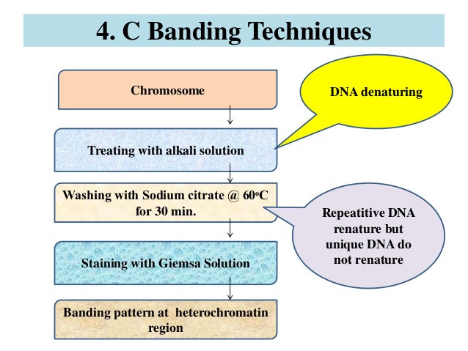
C- banding
To specifically stain the centromeric region and other region containing constitutive heterochromatin, the secondary contrictions of human chromosome 1,9,11, and the distal segment of the Y chromosome long arm.

Slide 8
R- banding
Is the reverse of G banding-
-Are useful analyzing deletion or translocations that involve the (telomeres) end of chromosome
chromosome
Denaturation of DNA
Treat with hot salt solution
Stain with Giemsa solution
AT rich regions

Slide 9
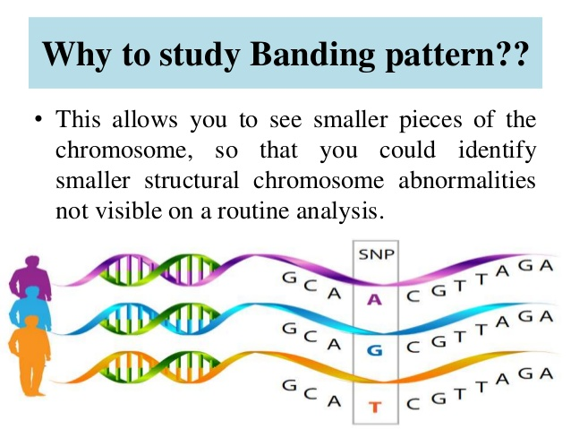
T- banding
Involves the staining of telomeric region of chromosome,using either Giemsa stain or
acridine orange after controlled thermal denaturation. T bands apparently representa sub set of the R bands because they are smaller that the corresponding R bands and are more strictly telomeric.

