Slide 1
The Course of Atmospheric Thermodynamics
MUSTANSIRIYAH UNIVERSITY
COLLEGE OF SCIENCES
ATMOSPHERIC SCIENCES DEPARTMENT
2019-2020
Dr. Sama Khalid Mohammed
SECOND STAGE
Lecture 8

Slide 2
Refresh Your Mind & Answer the Following?
What are the lines of the SKEW T-LOG P diagram? Outline them and define each one.

Slide 3
Question #1
A parcel of air has a temperature of -51 °C at the 250hPa level.
What is its potential temperature?
What temperature will the parcel have if it is compressed adiabatically to a pressure of 850 hPa?
* Hint: It can be solved using the skew T - ln p chart.

Slide 4
Solution #1
Locate the original state of the air parcel on the chart at pressure 250 hPa and temperature -51 °C. The label on the dry adiabat that passes through this point is 60 °C, which is therefore the potential temperature of the air.
The temperature acquired by the ambient air if it is compressed adiabatically to a pressure of 850 hPa can be found from the chart by following the dry adiabat that passes through the point located by 250 hPa and -51 °C down to a pressure of 850 hPa and reading off the temperature at that point. It is 34.0 °C.

Slide 5
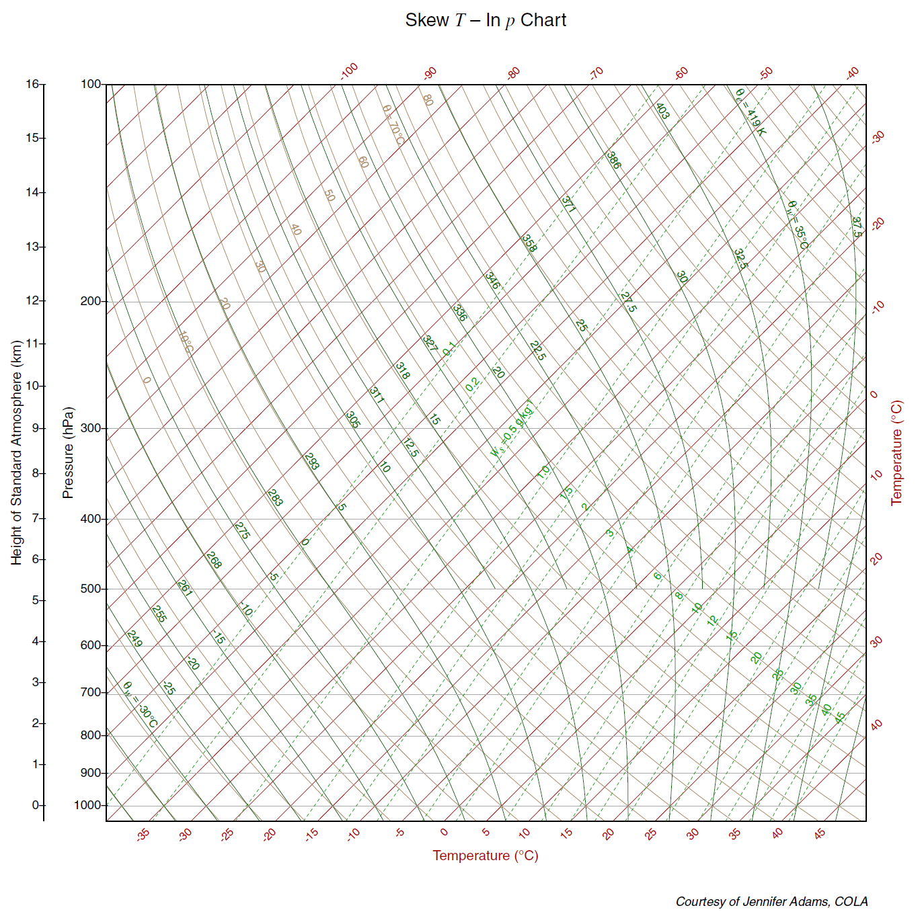
Follow the dry adiabat to 850 hPa
Cabin pressure 850 hPa
Temperature ~43°C

Slide 6
Question #2
An air parcel at 1000 hPa and 18°C has a mixing ratio of 6 g/kg.
What is its relative humidity and dew point temperture?
* Hint: It can be solved using the skew T - ln p chart.

Slide 7
Solution #2
First locate the point with pressure 1000 hPa and temperature18°C. We see from the chart that the saturation mixing ratio for this state is 13 g/ kg. Since the air specified in the problem has a mixing ratio of only 6 g/ kg, it is unsaturated and its relative humidity:
R.H. = w/w_{s} x100% = 6/13 * 100%=46%.
To find the dew point we move from right to left along the 1000 hPa until we intercept the saturation mixing ratio line of magnitude 6 g/kg; this occurs at a temperature of about 6.5 °C. Therefore, if the air is cooled at constant pressure, the water vapor it contains will just saturate the air with respect to water at a temperature of 6.5 °C which is the dew point of the air.

Slide 8
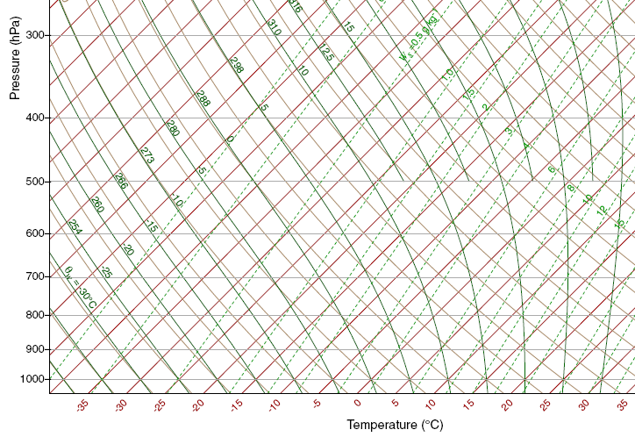
w = 6 g/kg
w_{s}
RH=6/13*100=46%
Dewpoint ~6.5ºC
Notes:
13g/kg saturation mixing ratio. => relative humidity 46%
Notice: if we know one moisture variable (mixing ratio) we know them all!

Slide 9
Refresh Your Mind & Answer the Following?
Define LCL(Lifting Condensation Level

Slide 10
Question #3
A parcel of air with an initial temperature of 15 °C and dew point 2 °C is lifted adiabatically from the 1000-hPa level.
Determine its LCL and temperature at that level.
If the air parcel is lifted a further 300 hPa above its LCL, What is its final temperature and how much liquid water is condensed during this rise?
* Hint: It can be solved using the skew T - ln p chart.

Slide 11
Solution #3
locate the initial state of the air on the chart at the intersection of the 15 °C isotherm with the 1000-hPa isobar.
The saturation mixing ratio line that passes through the 1000-hPa pressure level at 2 °C is found to be about 4.4 g kg.
Because the saturation mixing ratio at 1000 hPa and 15 °C is about 10.7 g/kg, the air is initially unsaturated.
Therefore, when it is lifted it will follow a dry adiabat (i.e., a line of constant potential temperature) until it intercepts the saturation mixing ratio line of magnitude 4.4 g/kg. Following upward along the dry adiabat that passes through 1000 hPa and 15 °C isotherm, the saturation mixing ratio line of 4.4 g/kg is intercepted at about the 820-hPa level. This is the LCL of the air parcel. The temperature of the air at this point is about -0.7 °C.

Slide 12
Solution #3
For lifting above this level the air parcel will follow a saturated adiabat. Following the saturated adiabat that passes through 820 hPa and 0.7 °C up to the 620-hPa level, the final temperature of the air is found to be about -15 °C. The saturation mixing ratio at 620 hPa and -15 °C is 1.9 g/kg. Therefore, about 4.4-1.9=2.5 g of water must have condensed out of each kilogram of air during the rise from 820 to 620 hPa.

Slide 13
LCL
B(1000,2,Ws(A))
A(1000,15,W)
Notes:
13g/kg saturation mixing ratio. => relative humidity 46%
Notice: if we know one moisture variable (mixing ratio) we know them all!

Slide 14
MCQ
1. A parcel of air rising when plotted on the Skew-T can only __________ as it rises.
a. Warm
b. Cool
c. Remain isothermal

Slide 15
MCQ
2. National Weather Service weather balloon launches are done _________ time(s) per day.
a. One
b. Two
c. Three
d. Four

Slide 16
MCQ
3. The environmental temperature is the:
a. Wet or dry adiabatic lapse rate
b. Parcel lapse rate
c. Dewpoint lapse rate
d. Actual temperature measured by the weather balloon

Slide 17
MCQ
4. Lifted unsaturated air will _____________ in relative humidity.
a. Increase
b. Decrease
c. Have a constant value

Slide 18
MCQ
5.At a particular pressure level, this is the temperature that results after complete evaporation occurs into initially unsaturated air:
a. Dewpoint
b. Mixing ratio
c. Wet Bulb
d. Potential

Slide 19
MCQ
6. This is the distance between two pressure levels and is a function of the temperature and moisture characteristics of that column of air between two pressure levels:
a. Thickness
b. Helicity
c. SWEAT
d. Temperature gradient

Slide 20
MCQ
7. An inversion is ______________.
a. A wind shift with height
b. A temperature increase with height
c. A dewpoint increase with height
d. A temperature decrease with height

Slide 21
MCQ
8. If the temperature is -5 C and the dewpoint is -10 C then the dewpoint depression in Celsius difference is:
a. 15
b. -5
c. 5
d. 15

Slide 22
MCQ
9. A line of equal temperature is called a(n) __________________.
a. Isodrosotherm
b. Height contour
c. Thickness line
d. Isotherm

Slide 23
MCQ
10. The wet adiabates will be nearly parallel to the dry adiabates when rising saturated air is:
a. Very warm
b. Accelerating
c. Very cold
d. Deceleration

Slide 24
MCQ
11. The dry adiabatic lapse rate is equal to:
a. 9.8 C/km
b. 6.5 C/km
c. 5.5 C/km
d. 1.0 C/km

