Slide 1

The Course of Atmospheric Thermodynamics
MUSTANSIRIYAH UNIVERSITY
COLLEGE OF SCIENCES
ATMOSPHERIC SCIENCES DEPARTMENT
2019-2020
Dr. Sama Khalid Mohammed
SECOND STAGE
Lecture 4

Slide 2

THIS LECTURE INCLUDING THE FOLLOWING ITEMS
MOIST AIR – Continue
Wet Bulb Temperature
Wet Bulb Depression
DEW-POINT TEMPERATURE &
RELATIVE HUMIDITY
Thermodynamic Diagrams

Slide 3
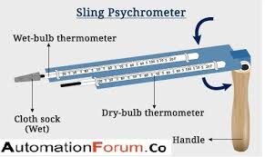
Wet Bulb Temperature T_{w}
Meteorologists commonly measure humidity by measuring the wet-bulb temperature.
The wet-bulb temperature is the lowest temperature that can be achieved by evaporating water into the air parcel at constant pressure (the evaporation requires heat, which is supplied by the air parcel).
It is measured using
A PSYCHROMETER.

Slide 4
Wet Bulb Depression
The difference between the air temperature (dry-bulb temperature) and the wet-bulb temperature is called WET-BULB DEPRESSION
The wet-bulb depression is a relative measure of the moisture content of the air.
Dry air can be cooled much further by evaporation than moist air, so a larger wet-bulb depression means less humidity (for the same dry-bulb temperature).
The dew-point temperature and relative humidity are found by using psychrometric tables, with dry-bulb temperature and wet-bulb depression as the independent variables ( watch this video and do the exercise using the charts in the following slides
https://www.youtube.com/watch?v=yC7EMtRCqBM

Slide 5
FYI: THE DEW-POINT TEMPERATURE AND RELATIVE HUMIDITY
The dew-point temperature and relative humidity are found by using
psychrometric tables, with dry-bulb temperature and wet-bulb depression as the independent variables ( watch this video and do the exercise using the charts in the following slides, assuming T=12°C and T_{w}=14°C and find the relative humidity and dew point temperture.
https://www.youtube.com/watch?v=yC7EMtRCqBM

Slide 6
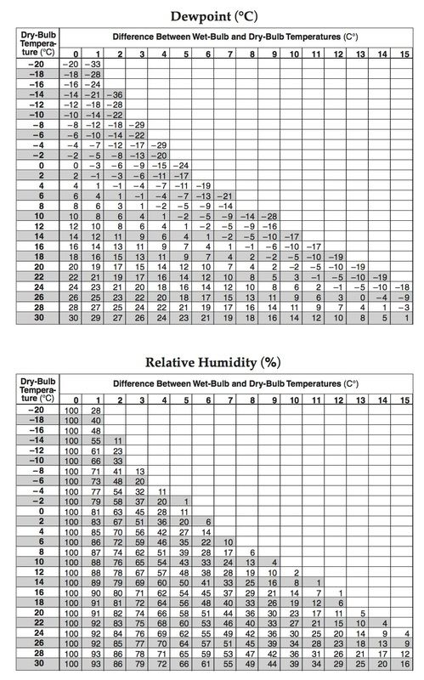
FYI: The relative humidity can be found using the dry bulb temperature and wet bulb depression

Slide 7
FYI: The dew point can be found using the dry bulb temperature and wet bulb depression

Slide 8


The relative humidity can be converted to dew point depression as follows:
Recall from the previous lecture,
So, A simple rule of thumb for converting RH to a dew point depression (T - Td) for moist air (RH >50%) is that Td decreases by 1 °C for every 5% decrease in RH (starting at Td = dry bulb temperature (T), where RH = 100%).
For example, if the RH is 85%,
and the dew point depression is T - Td = 3 °C.

Slide 9

THE DEW-POINT TEMPERATURE AND RELATIVE HUMIDITY
At the Earth’s surface, the pressure typically varies by only a few percent from place to place and from time to time. Therefore, the dew point is a good indicator of the moisture content of the air.
In warm, humid weather the dew point is also a convenient indicator of the level of human discomfort.
For example, most people begin to feel uncomfortable when the dew point rises above 20 °C, and air with a dew point above about 22 °C is generally regarded as extremely humid or “sticky.” Fortunately, dew points much above this temperature are rarely observed even in the tropics.

Slide 10

THE DEW-POINT TEMPERATURE AND RELATIVE HUMIDITY
In contrast to the dew point, relative humidity depends as much upon the temperature of the air as upon its moisture content.
On a sunny day the relative humidity may drop by as much as 50% from morning to afternoon, just because of a rise in air temperature.
Neither is relative humidity a good indicator of the level of human discomfort.
For example, a relative humidity of 70% may feel quite comfortable at a temperature of 20 °C, but it would cause considerable discomfort to most people at a temperature of 30 °C.

Slide 11
THE DEW-POINT TEMPERATURE AND RELATIVE HUMIDITY
The highest dew points occur over warm bodies of water or vegetated surfaces from which water is evaporating.
In the absence of vertical mixing, the air just above these surfaces would become saturated with water vapor, at which point the dew point would be the same as the temperature of the underlying surface.
Complete saturation is rarely achieved over hot surfaces, but dew points in excess of 25 °C are sometimes observed over the warmest regions of the oceans.

Slide 12
The Saturated Adiabatic Lapse Rate
In contrast to the dry adiabatic lapse rate Γd, which is constant, the numerical value of the saturated adiabatic lapse rate Γs varies with pressure and temperature.
Because water vapor condenses when a saturated air parcel rises, it follows that Γs < Γd.
Actual values of Γs range from about 4 K/km near the ground in warm, humid air masses to typical values of 6-7 K/km in the middle troposphere.

Slide 13
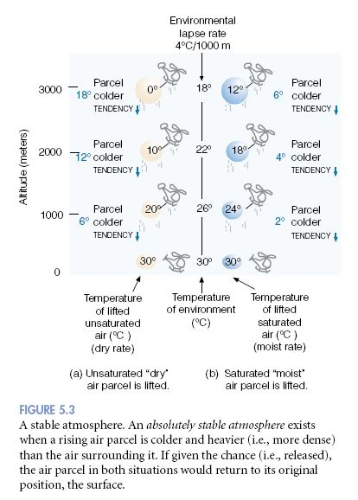
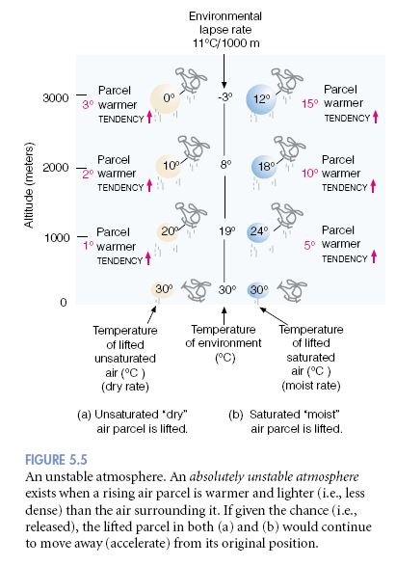
Stability of Saturated Air
The parcels will be stable when γ < Γs, Neutral γ =Γs ,Unstable γ > Γs

Slide 14
Thermodynamic Diagrams
we can look at the following equation of potential temperature graphically, then we will get e.g., the ‘Pseudo-adiabatic’ chart
Re-arrange:
So if you plot: p^{0.286} on y-axis, T on x-axis
For a constant θ, (p₀^{0.286}/θ) is also a constant, so the graph yields a straight line with gradient given by (p₀^{0.286}/θ), and passing through T=0 and p=0

Slide 15
‘Pseudo-adiabatic’ chart
Earth’s
atmosphere
y-axis is linear for p^{0.286}
also linear for ln(p)

Slide 16
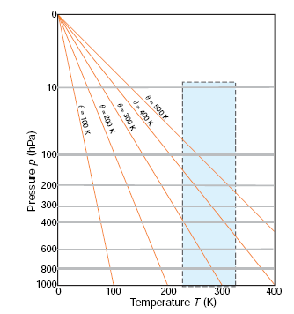
‘Pseudo-adiabatic’ chart
isotherms are vertical and dry adiabats (constant θ) are oriented at an acute angle relative to isotherms.
Because changes in temperature with height in the atmosphere generally lie between isothermal and dry adiabatic, most temperature soundings lie within a narrow range of angles when plotted on a pseudo-adiabatic chart.
Advantage:
we can follow each line and determine graphically temperature at any pressure, assuming adiabatic expansion / compression.
Disadvantage:
Everything happens in small region of the chart.

Slide 17
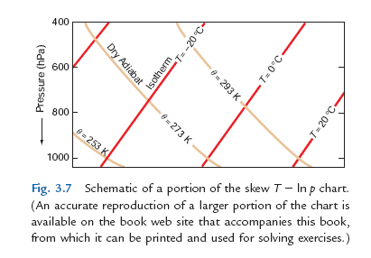
‘Skew T – ln P ’ chart
This restriction is overcome in the so-called skew T -ln p chart, in which the ordinate (y) is ln p and the abscissa (x) is x=T+(constant)y = T-(constant)ln p
So y=(x−T)/(constant)
and for an isotherm T is constant, the relationship between y and x for an isotherm is of the form y = mx + c, where m is the same for all isotherms
and c is a different constant for each isotherm. Therefore, on the skew T - ln p chart, isotherms are straight parallel lines that slope upward from left to right.

Slide 18
‘Skew T – ln P ’ chart
The scale for the x axis is generally chosen to make the angle between the isotherms and the isobars about 45°, as depicted schematically in Fig. Note that the isotherms on a skew T - ln p chart are intentionally “skewed” by about 45° from their vertical orientation in the pseudoadiabatic chart (hence the name skew T ln p chart).

Slide 19
‘Skew T – ln P ’ chart
From (eq 1), the equation for a dry adiabat (θ constant) is –ln P = (constant) ln T + constant
Hence, on a ln p versus ln T chart, dry adiabats would be straight lines. Since ln p is the ordinate on the skew T – ln p chart, but the abscissa is not ln T, dry adiabats on this chart are slightly curved lines that run from the lower right to the upper left. The angle between the isotherms and the dry adiabats on a skew T ln p chart is approximately 90° .
Therefore, when atmospheric temperature soundings are plotted on this chart, small differences in slope are more apparent than they are on the pseudoadiabatic chart.

Slide 20
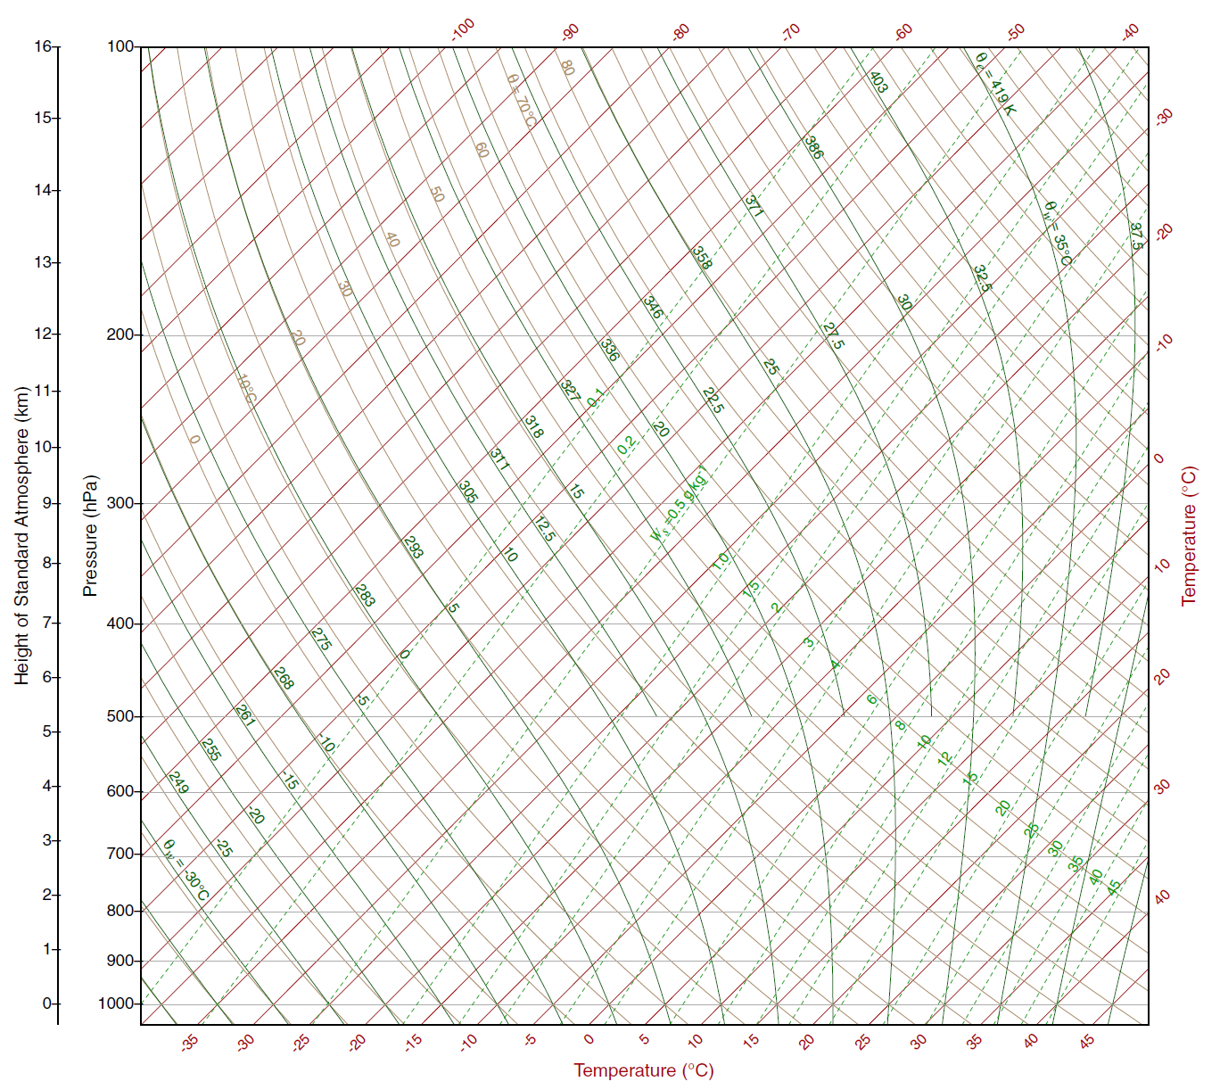
What are all the
lines on the skew T-ln p chart?
isobar
isotherm
dry
adiabat
saturated
adiabat
saturation
mixing
ratio

