Slide 1
Computer Networks
Dr. Abbas abdulazeez

Slide 2
Computer network
It is possible to connect a number of computers and other electronic devices to form what is called a computer network.
The computers and devices which are part of the network can "talk" to each other and exchange information. In addition to the computers and devices which are connected, other devices are often needed for the network to operate properly.
Examples for such devices include hubs and switches. A network using one technology can be connected to another one using a different technology with a component which is known as router.
A network is a group of two or more computer systems linked together through communication channels .

Slide 3
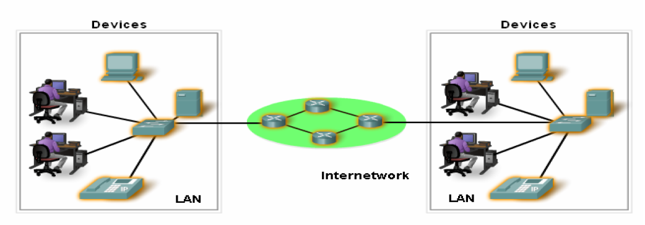
Computer network

Slide 4
Uses of Computer Networks
Communication is almost as important to us as our reliance on air, water, food, and shelter.
Applications help us to
  Chatting
  Download Files
  Purchasing
  Read News
  See & speak to others
  Education
  Sharing
  Many other things

Slide 5
Uses of Computer Networks
1- Business Applications
Most companies have a substantial number of computers. For example, a company may have a computer for each worker and use them to design products, write brochures, and do the payroll.
The goal is to make all programs, equipment, and especially data available to anyone on the network without regard to the physical location of the resource or the user as shown in Figure 1.1.

Slide 6
Uses of Computer Networks
In the simplest of terms, one can imagine a company’s information system as consisting of one or more databases with company information and some number of employees who need to access them remotely., This called client/server model.
In this model, the data are stored on powerful computers called servers. Often these are centrally housed and maintained by a system administrator. In contrast, the employees have simpler machines, called clients, on their desks, with which they access remote data.

Slide 7
Client/server model
In the client/server model, the device requesting the information is called a client and the device responding to the request is called a server. The client and server machines are connected by a network, as illustrated in Figure 1.2.

Slide 8
Client/server model
The most popular realization is that of a Web application, in which the server generates Web pages based on its database in response to client requests that may update the database.
The client-server model is applicable when the client and server are both in the same building (and belong to the same company), but also when they are far apart.

Slide 9
Client/server model
If we look at the client-server model in detail, we see that two processes (i.e., running programs) are involved, one on the client machine and one on the server machine. Communication takes the form of the client process sending a message over the network to the server process. The client process then waits for a reply message. When the server process gets the request, it performs the requested work or looks up the requested data and sends back a reply. These messages are shown in Figure 1.3.

Slide 10
Uses of Computer Networks
2- Home Applications
Home users can access information, communicate with other people, and buy products and services with e-commerce.
Information available includes the arts, business, cooking, government, health, history, hobbies, recreation, science, sports, travel, and many others.
Popular model for accessing information that goes by the name of Peer-to-Peer communication.

Slide 11
Peer-to-Peer network
In a peer-to-peer network, two or more computers are connected via a network and can share resources (such as printers and files) without having a dedicated server.
Every connected end device (known as a peer) can function as either a server or a client. One computer might assume the role of server for one transaction while simultaneously serving as a client for another.

Slide 12
Peer-to-Peer network
Unlike the client/server model, which uses dedicated servers, peer-to-peer networks decentralize the resources on a network. Instead of locating information to be shared on dedicated servers, information can be located anywhere on any connected device.
It is difficult to enforce security and access policies in networks containing more than just a few computers.

Slide 13
Uses of Computer Networks
3- Mobile Users
People on the go often want to use their mobile devices to read and send email, tweet, watch movies, download music, play games, or simply to surf the Web for information. They want to do all of the things they do at home and in the office. Naturally, they want to do them from anywhere on land, sea or in the air.
Connectivity to the Internet enables many of these mobile uses. Since having a wired connection is impossible in cars, boats, and airplanes, there is a lot of interest in wireless networks.
Example: Smart phones, GPS, mobile-commerce, Sensor networks .

Slide 14
Uses of Computer Networks
4- Social Issues
Social networks, message boards, content sharing sites, and a host of other applications allow people to share their views with like-minded individuals. As long as the subjects are restricted to technical topics or hobbies like gardening, not too many problems will arise. These problems such as Copyright, versus, cookies, spam, …etc.

Slide 15
Networks
A network is a set of devices (often referred to as nodes) connected by communication links.
A node can be a computer, printer, or any other device capable of sending and/or receiving data generated by other nodes on the network.
Most networks use distributed processing, in which a task is divided among multiple computers. Instead of one single large machine being responsible for all aspects of a process, separate computers (usually a personal computer or workstation) handle a subset.

Slide 16
The Elements of Computer Network
The devices must be interconnected. Network connections can be wired or wireless. In wired connections, the medium is either copper, which carries electrical signals, or optical fiber, which carries light signals. In wireless connections, the medium is the Earth's atmosphere, or space, and the signals are microwaves.

Slide 17
The Elements of Computer Network

Slide 18
The Elements of Computer Network
Devices interconnected by medium to provide services must be governed by rules, or protocols.
The Protocols are the rules that the networked devices use to communicate with each other. The industry standard in networking today is a set of protocols called TCP/IP (Transmission Control Protocol/Internet Protocol).

Slide 19
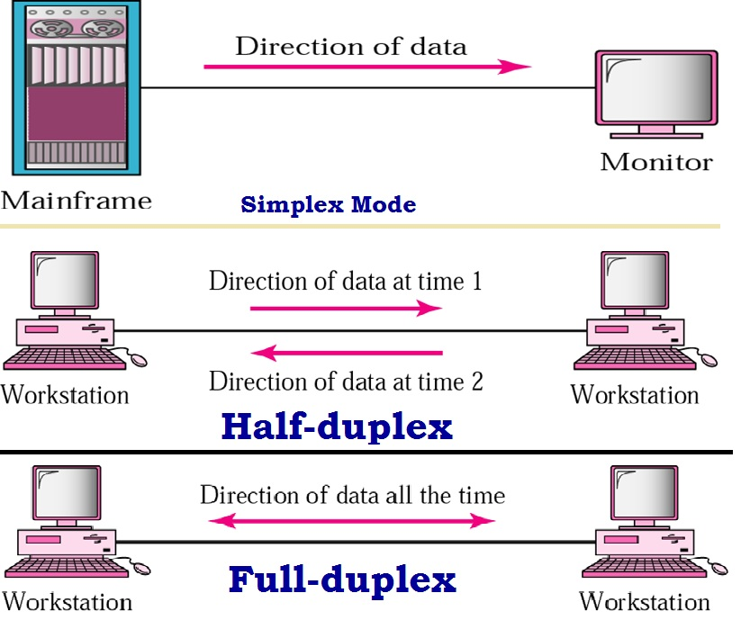
Data Flow

Slide 20
Network Criteria
a) Performance
Performance can be measured in many ways, including transit time and response time.
Transit time is the amount of time required for a message to travel from one device to another.
Response time is the elapsed time between an inquiry and a response.
The performance of a network depends on a number of factors, including the number of users, the type of transmission medium, the capabilities of the connected hardware, and the efficiency of the software.

Slide 21
Network Criteria
Performance is often evaluated by two networking metrics: throughput and delay.
We often need more throughput and less delay. However, these two criteria are often contradictory. If we try to send more data to the network, we may increase throughput but we increase the delay because of traffic congestion in the network.

Slide 22
Network Criteria
b) Reliability
In addition to accuracy of delivery, network reliability is measured by the frequency of failure, the time it takes a link to recover from a failure, and the network's robustness in a catastrophe.
c) Security
Network security issues include protecting data from unauthorized access, protecting data from damage and development, and implementing policies and procedures for recovery from breaches and data losses.

