Slide 1
The Course of Atmospheric Thermodynamics
MUSTANSIRIYAH UNIVERSITY
COLLEGE OF SCIENCES
ATMOSPHERIC SCIENCES DEPARTMENT
2019-2020
Dr. Sama Khalid Mohammed
SECOND STAGE
Lecture 2

Slide 2
This lecture including the following items
DRY AIR DEFINITION
STABILITY OF DRY AIR / DRY ADIABATIC LAPSE RATE
BUOYANCY
STABILITY IN A DRY ATMOSPHERE
POTENTIAL TEMPERATURE

Slide 3
Dry Air Definition
In meteorology, there are two ways in which dry air is referenced:
A sample of air that has no water vapor (The amount of water vapor in the air depends on the dewpoint of the air).
A sample of air that has a low relative humidity
At a temperature of 30° C with a relative humidity (RH) of 50% the dew point is 18.45 ° C.
For drier air with temperature of 30 ° C and RH of 20 the dew point is 4.61 ° C.
Notes:
The dewpoint may alternatively be defined as the temperature at which the saturation vapor pressure of the parcel is equal to the actual vapor pressure of the contained water vapor.
relative humidity: The ratio of the vapor pressure to the saturation vapor pressure with respect to water.
The dew point is a temperature. If the air has no moisture in then no matter how much you cool it there will not be any condensation.

Slide 4
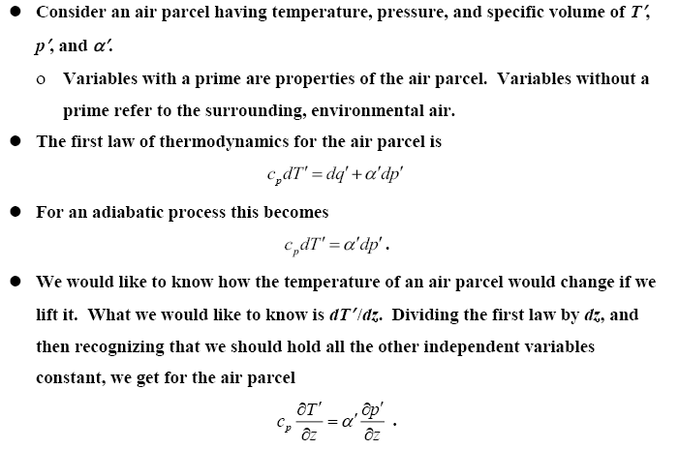
Stability of Dry Air
DRY ADIABATIC LAPSE RATE

Slide 5
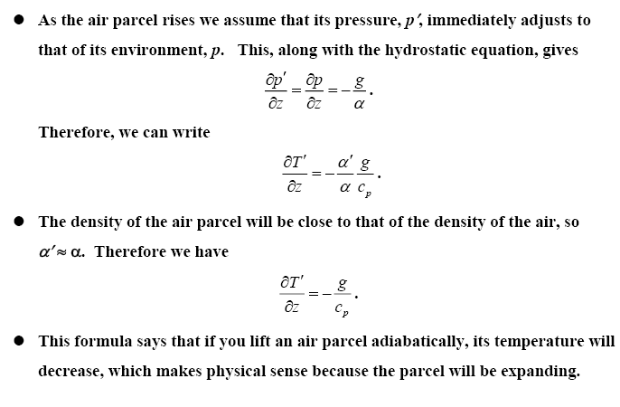
Stability of Dry Air
DRY ADIABATIC LAPSE RATE
This formula says that if you lift an air parcel adiabatically, its temperature will decrease, which makes physical sense because the parcel will be expanding.

Slide 6
Stability of Dry Air
DRY ADIABATIC LAPSE RATE

Slide 7
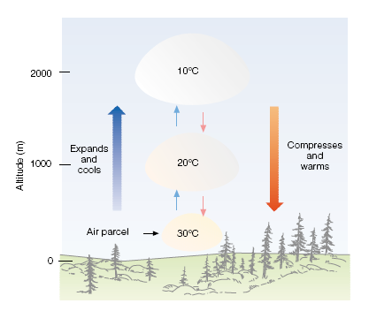
BUOYANCY

Slide 8
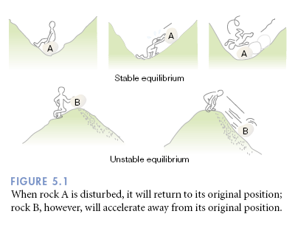
STABILITY IN A DRY ATMOSPHERE
Stability refers to whether an air parcel, one moved vertically, will continue to accelerate in the direction that it was pushed (unstable), or return in the direction from which it came (stable).

Slide 9
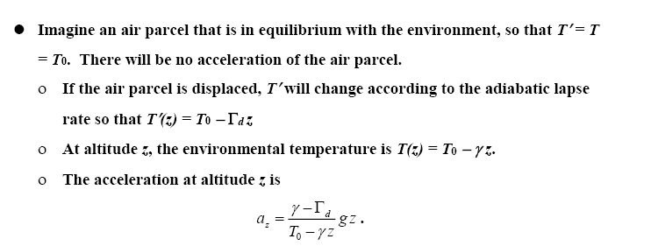
STABILITY IN A DRY ATMOSPHERE

Slide 10
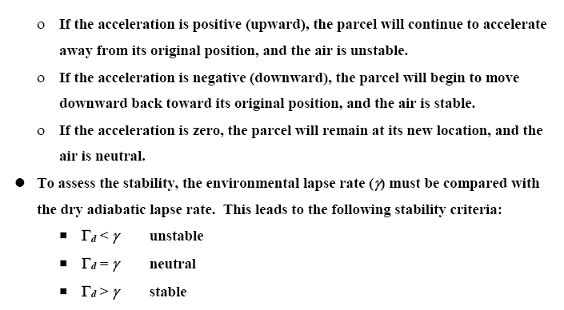
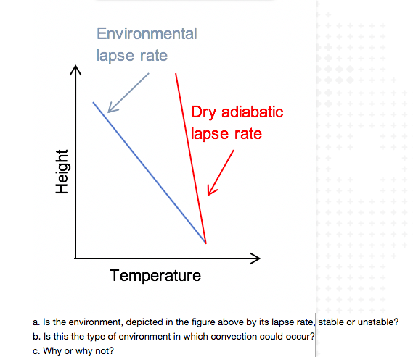
STABILITY IN A DRY ATMOSPHERE

Slide 11
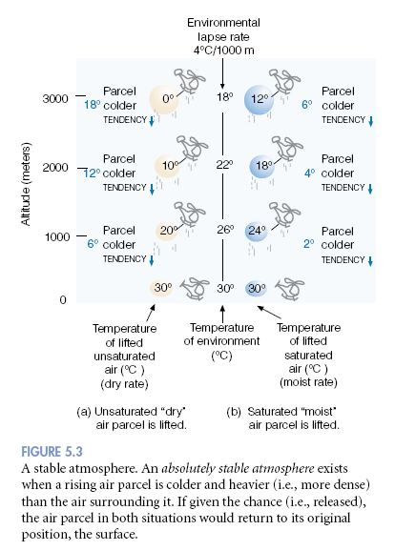
A stable atmosphere.
An absolutely stable atmosphere exists when a rising air parcel is colder and heavier (i.e., more dense) than the air surrounding it. If given the chance (i.e., released), the air parcel in both situations would return to its original position, the surface.

Slide 12
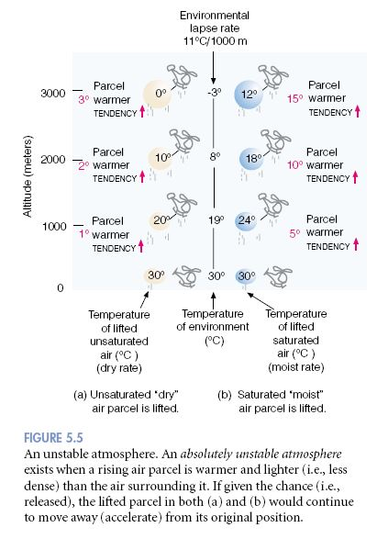
An ustable atmosphere.
An absolutely unstable atmosphere exists when a rising air parcel is warmer and lighter (i.e., less dense) than the air surrounding it. If given the chance (i.e., released), the lifted parcel in both (a) and (b) would continue to move away (accelerate) from its original position

Slide 13
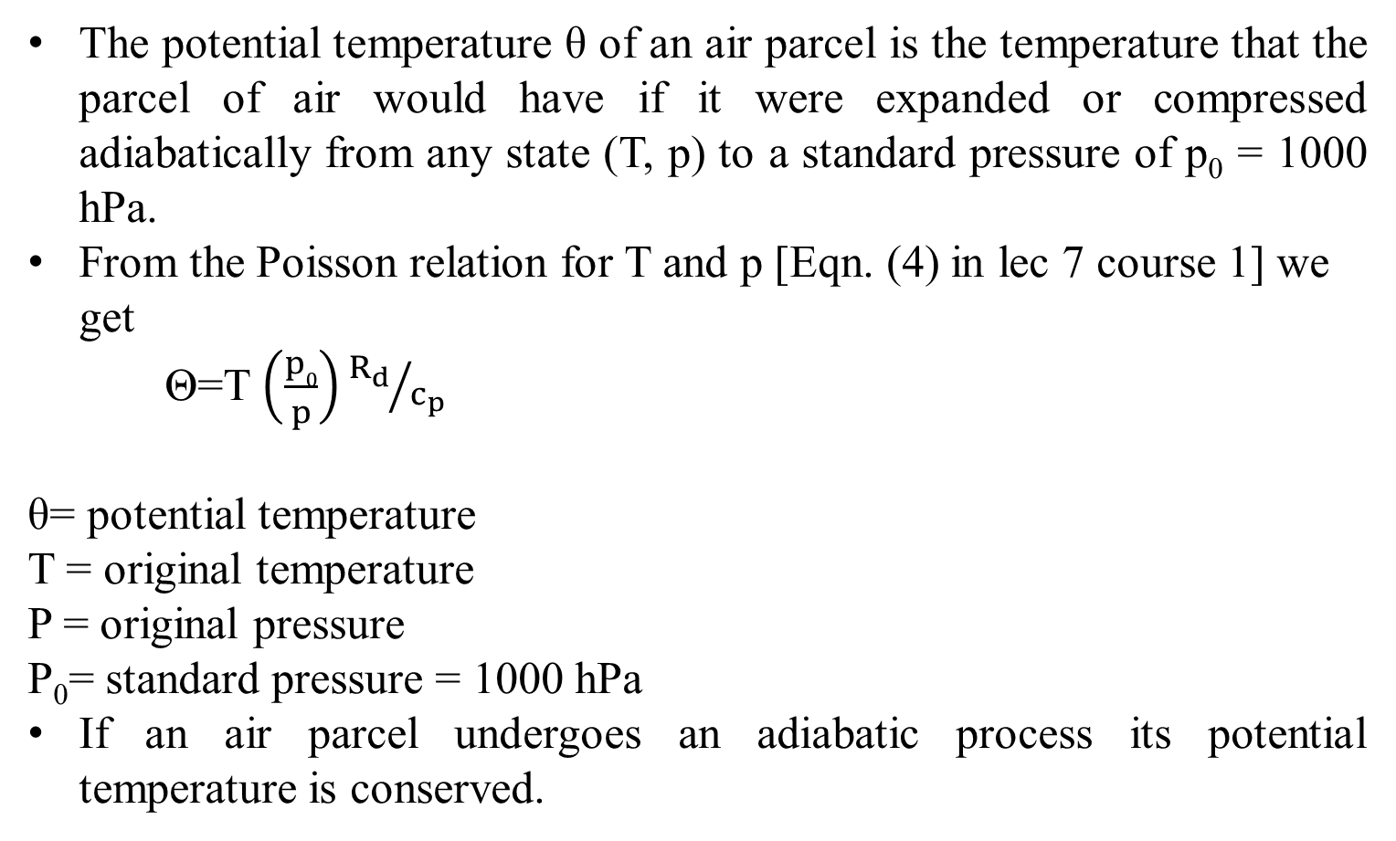
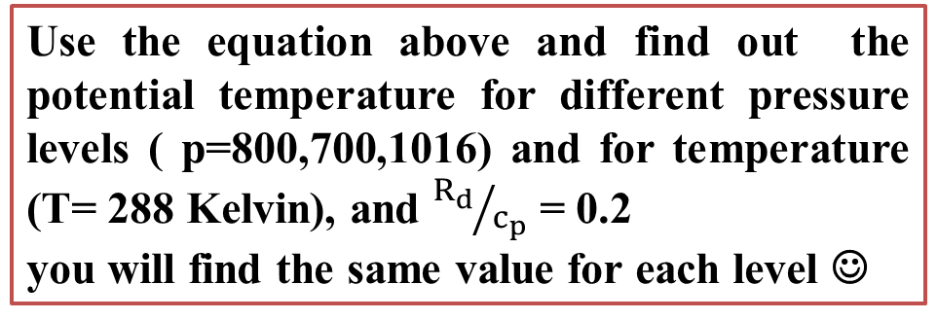
POTENTIAL TEMPERATURE
The potential temperature θ of an air parcel is the temperature that the parcel of air would have if it were expanded or compressed adiabatically from any state (T, p) to a standard pressure of p₀ = 1000 hPa.
From the Poisson relation for T and p [Eqn. (4) in lec 7 course 1] we get
Θ=T $\left(\frac{p0}{p}\right){R_{d}}/{c_{p}}$
θ= potential temperature
T = original temperature
P = original pressure
P₀= standard pressure = 1000 hPa
If an air parcel undergoes an adiabatic process its potential temperature is conserved.
Use the equation above and find out the potential temperature for different pressure levels ( p=800,700,1016) and for temperature (T= 288 Kelvin), and ${R_{d}}/{c_{p}}$ = 0.2
you will find the same value for each level ☺
Notes:
The dry adiabatic lapse rate Γ=-dT/dz = g/cp = 9.8 c/km

Slide 14
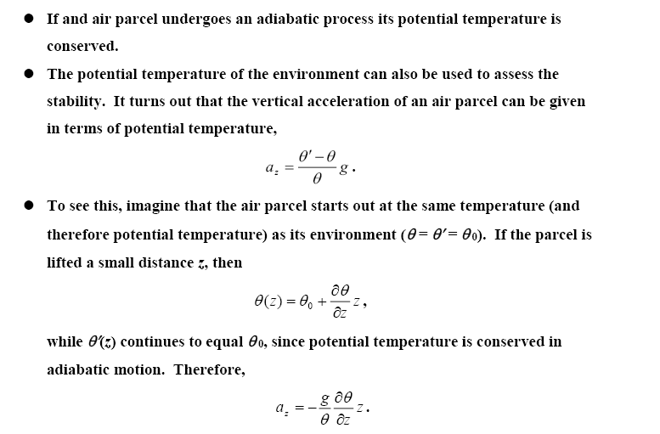
POTENTIAL TEMPERATURE

Slide 15
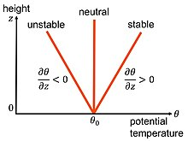
POTENTIAL TEMPERATURE

