Slide 1
Inorganic Spectra
Dr. Ahmed Hussein
Lecture: 1
Infra – red spectra of
coordination compounds

Slide 2
THE ORIGINS OF THE INFRARED SPECTRUM
In the most basic terms, the infrared spectrum is formed as a consequence of the absorption of electromagnetic radiation at frequencies that correlate to the vibration of specific sets of chemical bonds from within a molecule. First, it is important to reflect on the distribution of energy possessed by a molecule at any given moment, defined as the sum of the contributing energy terms:
E total= E electronic + E vibrational + E rotational + E translational
The translational energy relates to the displacement of molecules in space as a function of the normal thermal motions of matter. Rotational energy, which gives rise to its own form of spectroscopy, is observed as the tumbling motion of a molecule, which is the result of the absorption of energy within the microwave region. The vibrational energy component is a higher energy term and corresponds to the absorption of energy by a molecule as the component atoms vibrate about the mean center of their chemical bonds. The electronic component is linked to the energy transitions of electrons as they are distributed throughout the molecule, either localized within specific bonds, or delocalized over structures, such as an aromatic ring. In order to observe such electronic transitions, it is necessary to apply energy in the form of visible and ultraviolet radiation :
E = h ν
The fundamental requirement for infrared activity, leading to absorption of infrared radiation, is that there must be a net change in dipole moment during the vibration for the molecule or the functional group under study.

Slide 3
While it was stated that the fundamental infrared absorption frequencies are not the only component to be evaluated in a spectral interpretation, they are the essence and foundation of the art. For the most part, the basic model of the simple harmonic oscillator and its modification to account for anharmonicity suffice to explain the origin of many of the characteristic frequencies that can be assigned to particular combinations of atoms within a molecule. From a simple statement of Hooke’s law we can express the fundamental vibrational frequency of a molecular ensemble according to Equation :
ν = 1/ 2πc ĸ/µ
Where ν = fundamental vibration frequency, k = force constant, and µ = reduced mass. The reduced mass, µ = m1m2/(m1 + m2), where m1 and m2 are the component masses for the chemical bond under consideration. This simple equation provides a link between the strength (or springiness) of the covalent bond between two atoms (or molecular fragments), the mass of the interacting atoms (molecular fragments) and the frequency of vibration. Although simple in concept, there is a reasonably good fit between the bond stretching vibrations predicted and the values observed for the fundamentals. It can be shown that the number of normal modes of vibration for a given molecule can be determined as:
number of normal modes = 3N - 6 (nonlinear)
= 3N - 5 (linear)
where N is the number of component atoms in the molecule. In practice, apart from the simplest of compounds, most molecules have nonlinear structures, except where a specific functional group or groups generate a predominant linear arrangement to the component atoms. If we calculate the number of modes for a simple hydrocarbon, such as methane (nonlinear, tetrahedral structure), a value of nine are obtained. This would imply that nine sets of absorption frequencies would be observed in the spectrum of methane gas. In reality, the number observed is far less, corresponding to the asymmetric and symmetric stretching and bending of the C – H bonds about the central carbon atom. The reason for the smaller than expected number is that several of the vibrations are redundant or degenerate, that is, the same amount of energy is required for these vibrations.

Slide 4
Simple Inorganics: Characterization of compounds via infrared spectroscopy is not limited to organic compounds. Any inorganic compound that forms bonds of a covalent nature within a molecular ion fragment, cation or anion, will produce a characteristic absorption spectrum, with associated group frequencies. In a manner, certain aspects have already been covered for inorganic compounds in the form of salts of carboxylic acids and amino and ammonium compounds, which can be extended to metal complexes, chemical fragments associated with heterooxy groups (nitrates, sulfates, phosphates, silicates, etc.), and transition metal carbonyl compounds.
All complex ionic compounds (containing more than one atom) and coordination compounds produce characteristic spectra. Many of the associated group frequencies can be used diagnostically for characterization. The structure and orientation of the ion or complex, both as an isolated entity or within a crystal lattice, are important factors that affect the appearance and nature of the infrared spectrum. Hydration of compounds (water of crystallization) also has a large effect on the spectrum, and often adds a lot of complexity, in the form of additional absorption bands and structure to existing bands. The subject is far too broad to be covered in this article, and only a few example group frequencies are included here.
Example group frequencies for common inorganic ions
Group frequency (cm⁻¹) Functional group/assignment
1490–1410/880–860 Carbonate ion
1130–1080/680–610 Sulfate ion
1380–1350/840–815 Nitrate ion
1100–1000 Phosphate ion
1100–900 Silicate ion
3300–3030/1430–1390 Ammonium ion
2200–2000 Cyanide ion, thiocyanate ion, and related ions

Slide 5
THE PRACTICAL SITUATION – OBTAINING THE SPECTRUM AND INTERPRETING THE RESULTS
1. The sample (or spectrum) is a ‘‘total unknown’’ and an identification is required – examples include forensic samples, environmental waste samples, or new discovery samples, where a new material has been synthesized or discovered.
2. The sample (or spectrum) is an unknown and it needs to be characterized or classified – examples include commercial applications where new additives or components are included in a material to provide a specific property; in such cases this could be considered the basis of competitive product analysis.
3. The sample generally is known but the existence of a specific chemical class needs to be determined – examples include contaminant analysis, analysis for toxicology or environmental reasons, material additives, etc.
4. The sample is a complete known and the interpretation is required to confirm the material composition and/or quality – examples include product quality control and the confirmation of a structure or functionality of a newly synthesized material.
A Quick Diagnostic Assessment of an Infrared Spectrum
Step 1: Overall Spectrum Appearance
Step 2: Testing for Organics and Hydrocarbons – Absorptions in the Region 3200–2700 cm⁻¹
Step 3: Testing for Hydroxy or Amino Groups – Absorptions in the Region 3650–3250 cm⁻¹
Step 4: Testing for Carbonyl Compounds – Absorptions in the Region 1850–1650 cm⁻¹
Step 5: Testing for Unsaturation – Weak to Moderate Absorption in the Region 1670–1620 cm⁻¹
Step 6: Testing for Aromatics – Well-defined Absorptions in the Region 1615–1495 cm⁻¹
Step 7: Testing for Multiple Bonding (Often with a Bond Order of 2 or Higher) – Absorption in
the Region 2300–1990 cm⁻¹

Slide 6
In general some changes noticed in the infra – red spectra of any ligand in the coordinated compounds when compared with the spectra of the free ligand, which could be summarized in the following :
– Some bands shifted to lower or upper region( 5 – 40 cm⁻¹). Why?
– Some sharp bands could be changed to a broad ones. Why ?
– Some bands could be split to many bands. Why ?
– A new bands will be recorded in the region( 600 – 200 cm ⁻¹) not founds in the original spectra. Why ?
1) Ammine & it`s derivatives: The simplest complexes , hexaammine geometry such as [Co(NH₃) ₆]Cl₂ showed an infra – red spectra ( Fig. 1) quite close as 1:1 (metal:ligand) and that spectra attributed to ; antisymmetric and symmetric NH₃ , stretching, degenerate deformation, symmetric deformation and rocking vibration appears in the regions of ; 3400 – 3000, 1650 – 1550, 1370 – 1000, 950 – 600 cm⁻¹ respectively. These bands could be assigned to the model showed in Fig. 2.
The NH₃ stretching frequencies of the complexes are lower than those of the free NH₃ molecule for two reasons; One is the effect of coordination , upon coordination the N – H bond is weakened and the NH₃ frequencies are lowered , the stronger the M – N bond the weaker the N – H bond . Thus the NH₃ stretching frequencies may be used as a rough measure of M – N bond strength. The other reason is the effect of the counter ion ( Cl), due to the formation of hydrogen bonding N – H ….. Cl. The intensity of the M – N stretching mode increase as the M – N bond becomes more ionic and as the M – N stretching frequency become more lower. So the vibrations changes as follow:
ν( M⁺⁴ – N ) > ν( M⁺³ – N ) > ν( M⁺²– N ) > ν( M⁺¹ – N )

Slide 7
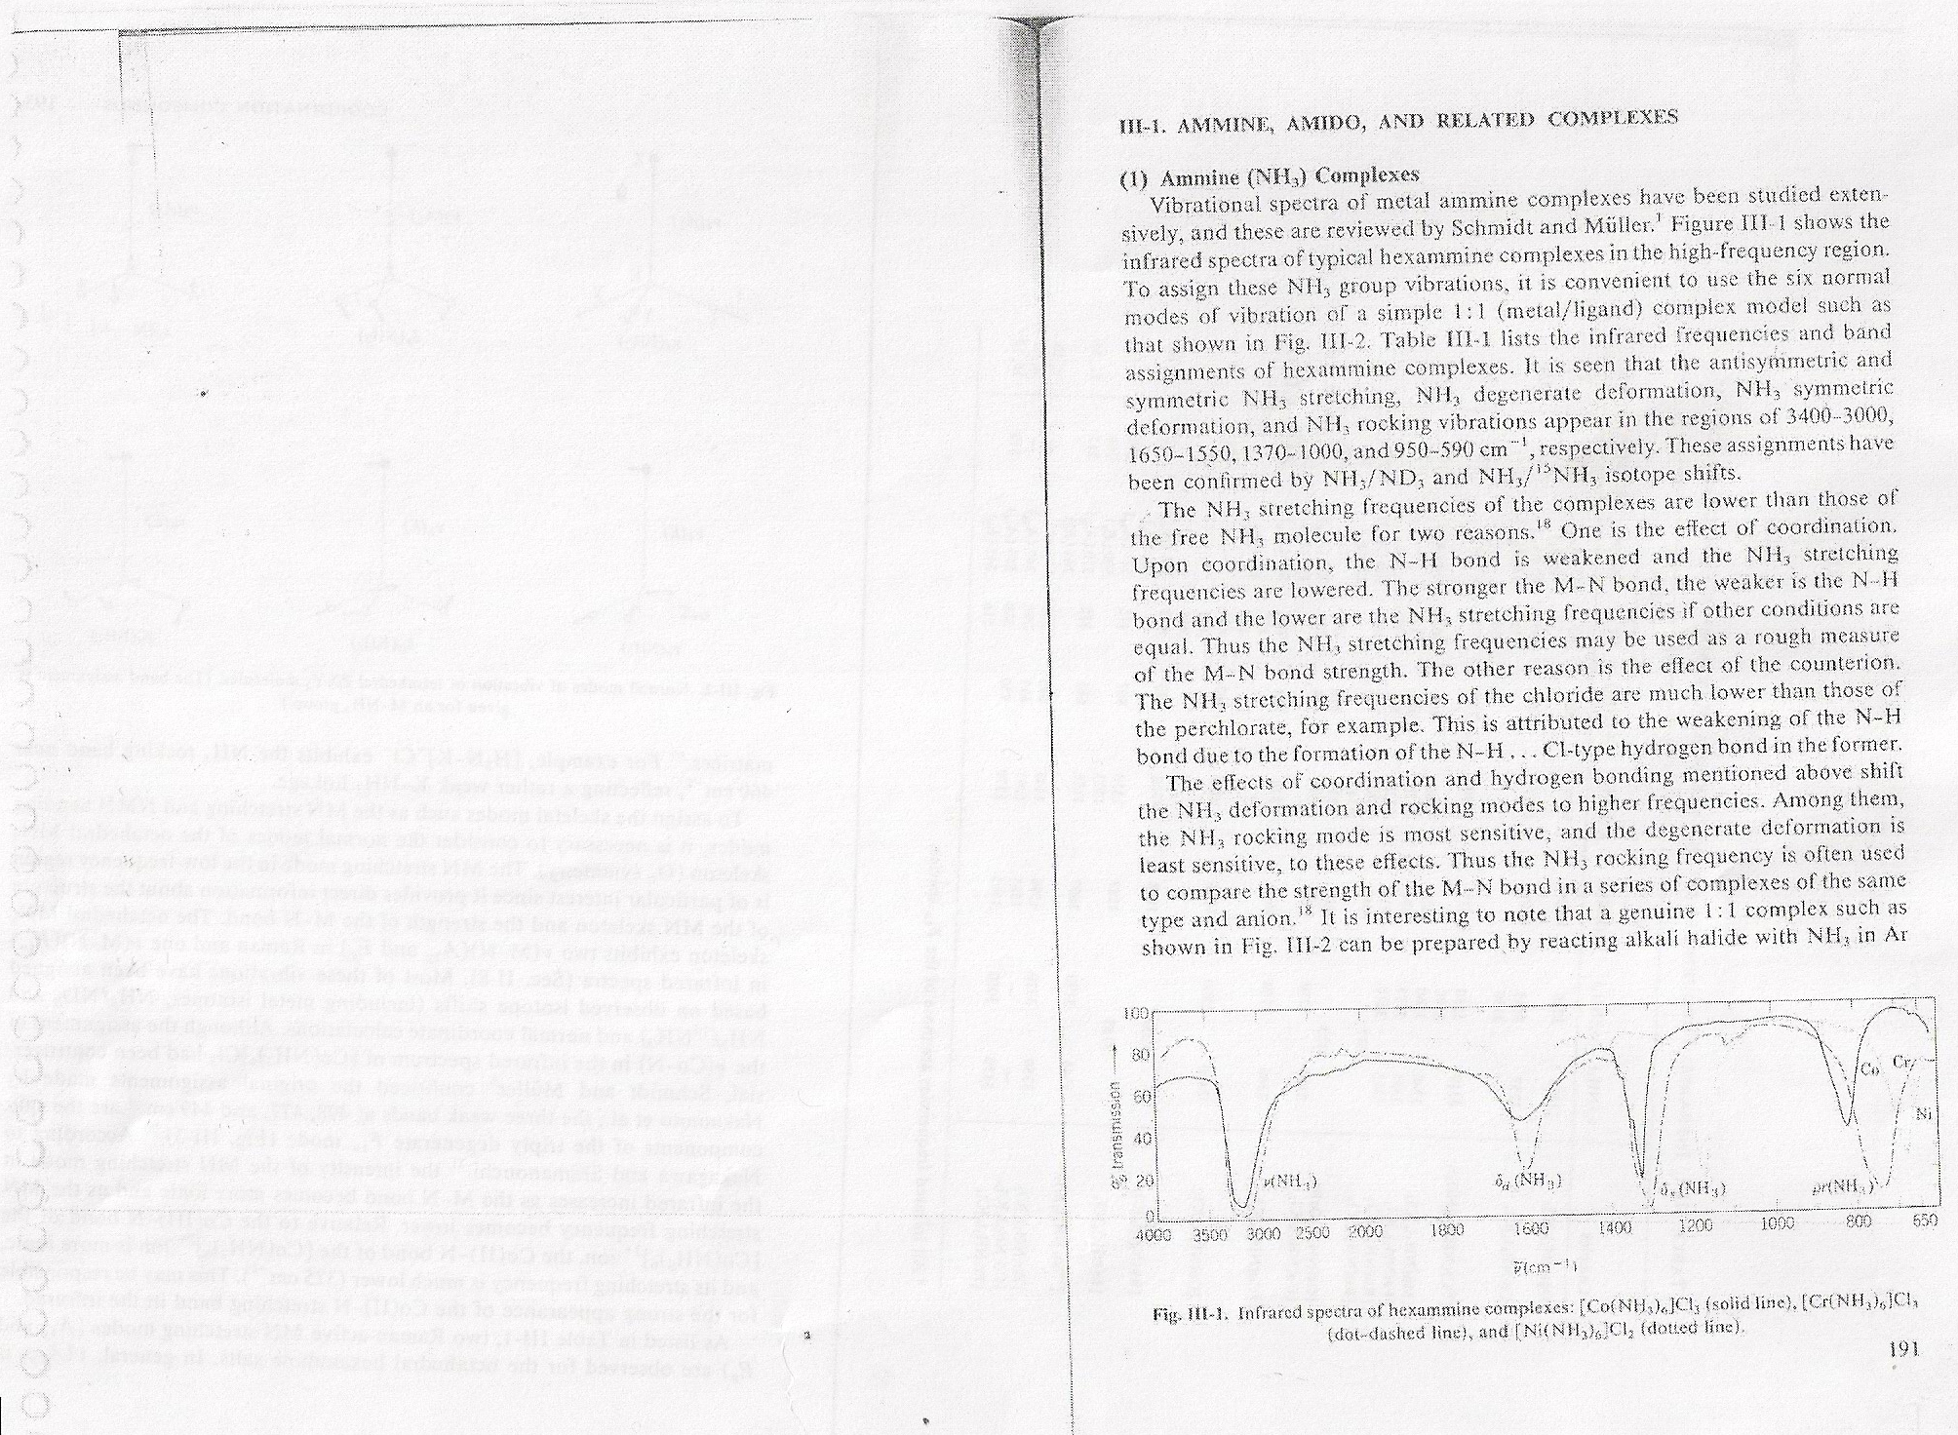
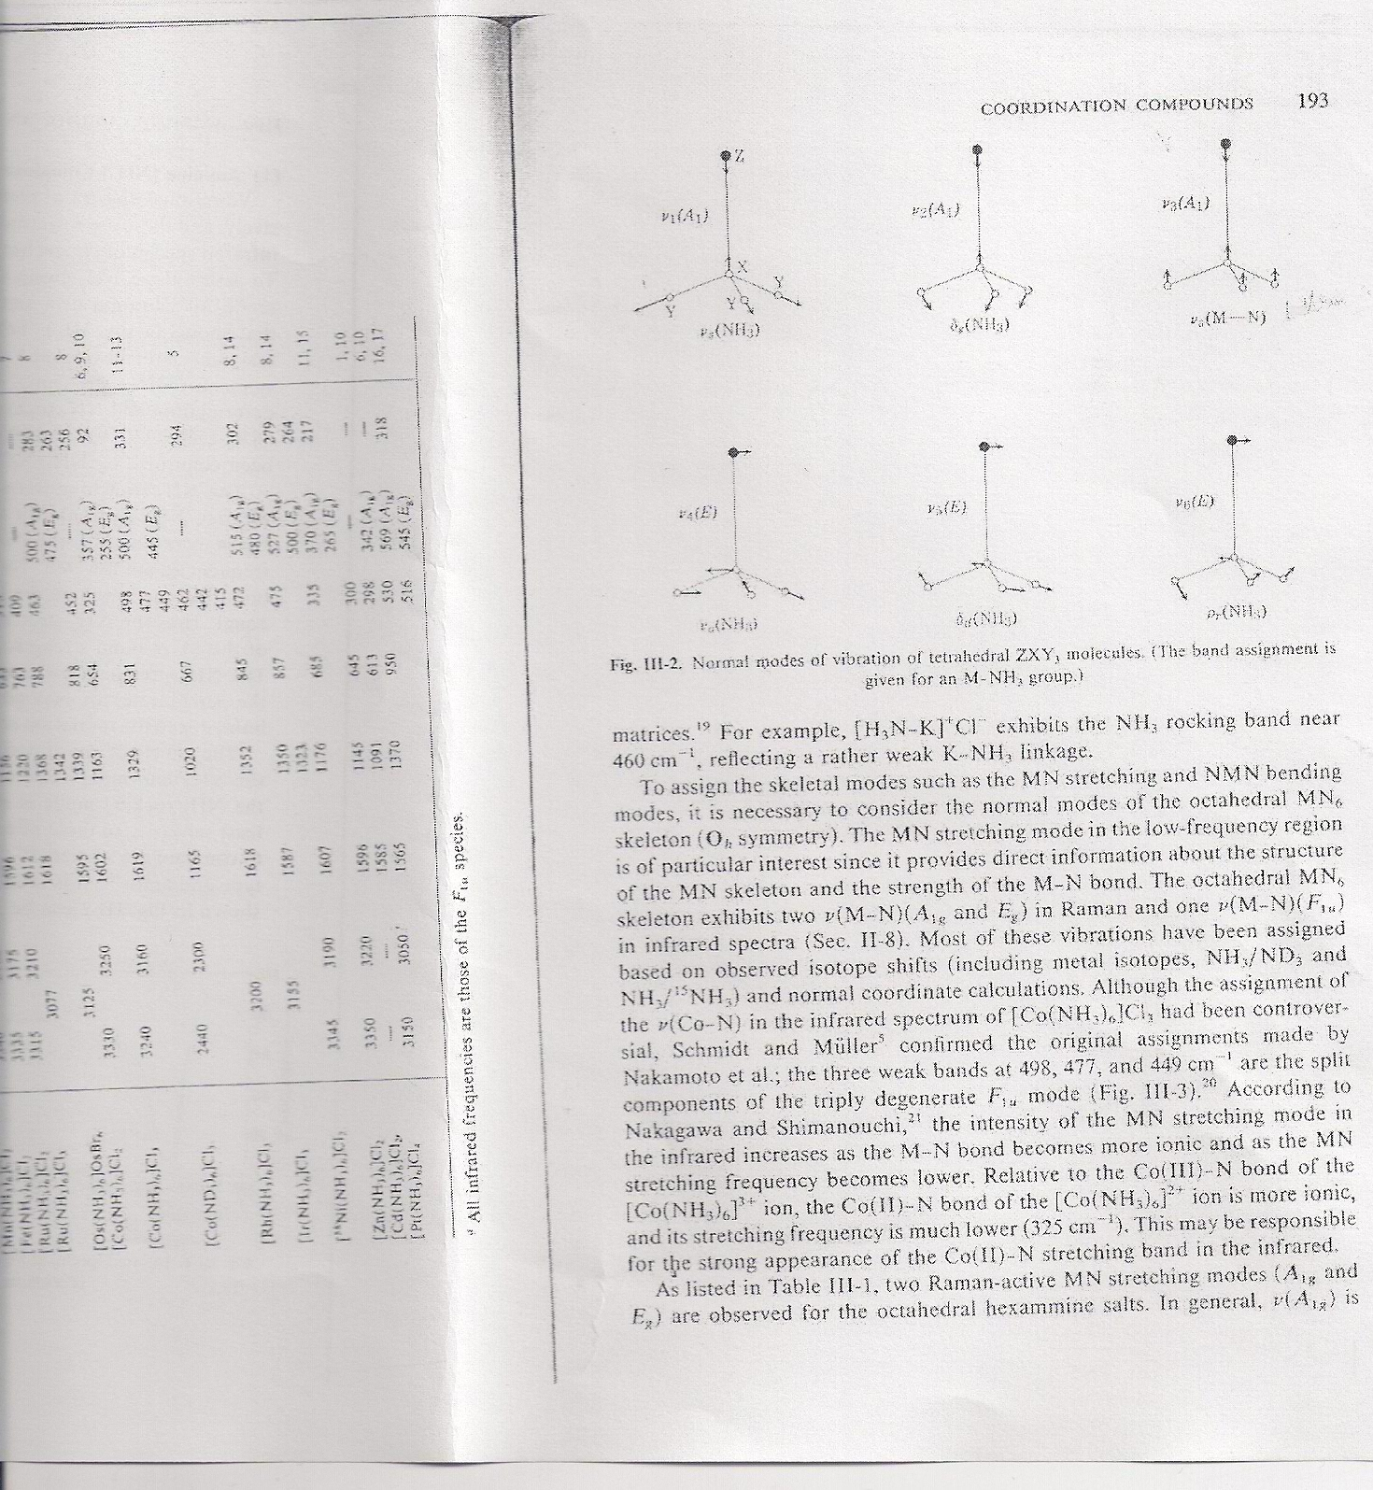
Fig. 1 infra – red spectra of [Co(NH₃) ₆]Cl₂
Fig. 2 Vibration modes of the model MNH₃

Slide 8
For a series of divalent metals, the order is found to be parallel to Irving – Williams series :
Zn⁺² < Cu⁺² > Ni⁺² > Co⁺² > Fe⁺² > Mn⁺²
When NH₃ groups of hexammine complexes are partly replaced with other groups, the degenerate are split because of lowering of symmetry and new bands belonging to other groups are appears as the complex [Co(NH₃) ₄X₂]. The stretching force constant for Co – N bond found to be 1.05 UBF, while it is 0.99 , 0.91 and 0.62 for X= F, Cl and I respectively. Fig. 3 showed the position for Co – N in octahedral complexes [Co(NH₃) ₄X₂], with different halogen. In addition to that, it was found that trans – [Co(NH₃) ₄X₂], exhibit one M – N and one M – X stretching frequencies , while it is four M – N and two M – X for cis isomer.

Slide 9
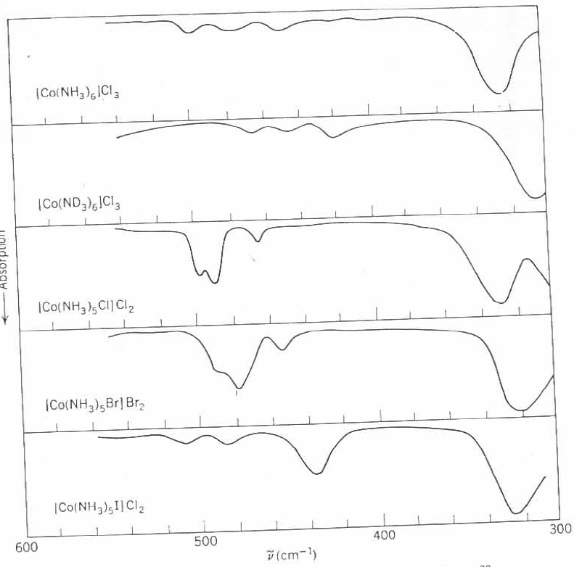
Fig. 3 M – N stretrching frequencies ( 600 - 300 cm⁻¹)in octahedral complexes with different halogen

