Slide 1
References : 1-Security in Computing By Charless 2-Cryptography and Networks Security by W. STALLIN
Computer and Information Security
By
DR Bashar M. Nema

Slide 2
Chapter 1

Slide 3
In This Chapter
The risks involved in computing
The goal of secure computing: confidentiality, integrity, availability
The threats to security in computing: interception, interruption, modifications, fabrication
Controls available to address these threats: encryption, programming controls, operating systems, network controls, administrative controls, laws and ethics

Slide 4
Definitions
Computing system is a collection of five things :
Hardware, Software, Storage media, Data, People/User
The major Assets of computing system are Hardware ,Software, and Data.
Principle of Easiest Penetration - An intruder must be expected to use any available means of penetration. Penetration may not necessarily be by the most obvious means, nor via the one we have the most defense against.
Consider all the means of penetration
Checked repeated times
Don’t underestimate the attacker/think like an attacker
Strengthening one thin might weaken another

Slide 5
Type of System Security Threats in computing
Interruption:-An asset of the system becomes lost or unavailable or unusable.
Interception:- Unauthorized party has gained access to an asset .
Modification:-An unauthorized party has not only accesses but tampers with an asset
Fabrication:-An unauthorized party might fabricate counterfeit objects for a computing system.

Slide 7
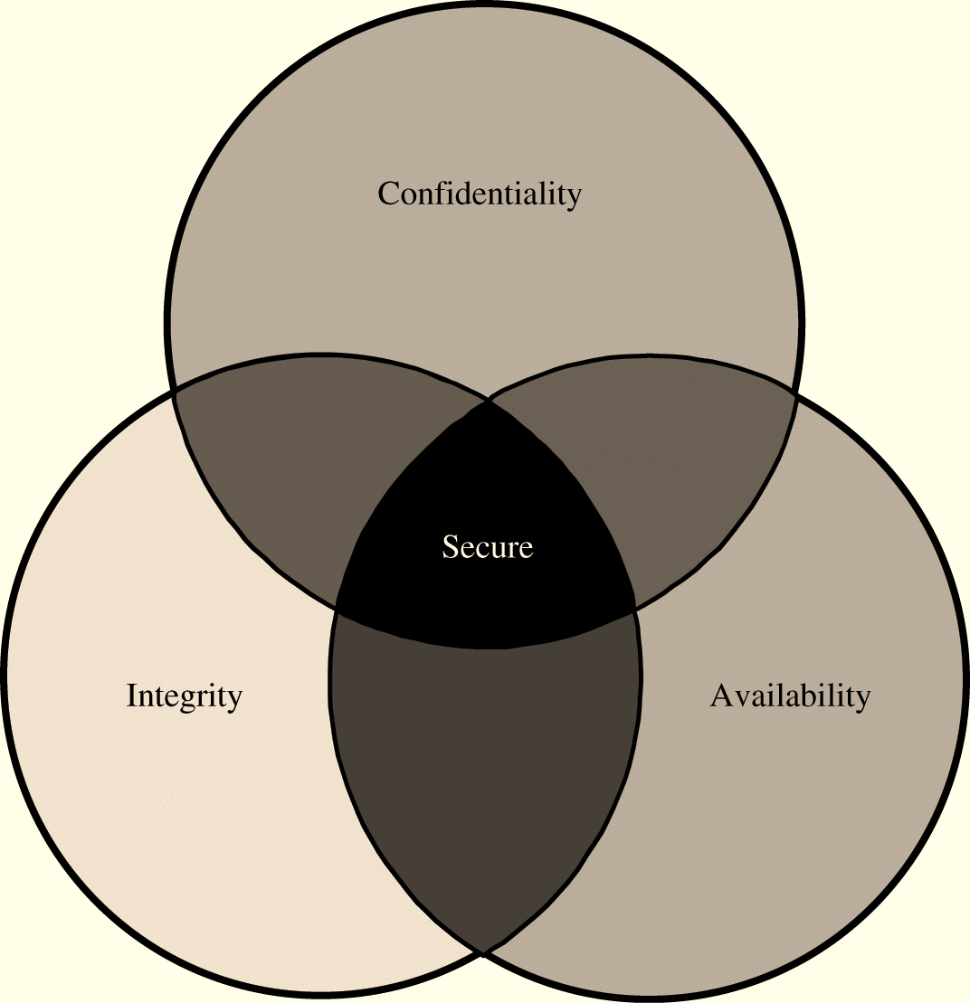
Security Goals
Secrecy (Confidentiality or Privacy)- assets accessed only by authorized parties
Not only reading but viewing, printing or knowing about the asset
Integrity – assets modified only by authorized parties
Includes writing, changing, changing the status, deleting or creating
Availability – assets are accessible to authorized parties at appropriate times.
Denial of Service
In terms called CIA

Slide 8
Types of Attacks(Vulnerabilities)
Attacks on Hardware
It is very visible
Easy to attack
Water, burned, frozen, gassed and electrocuted, dust, time, rodents, environment الماء ، الحروق ، التجمد ، بالغاز والكهرباء ، الغبار ، الوقت ، القوارض ، البيئة
Attacks on Software
Software Deletion
Software Modification
Software Theft
Malicious Modification of Software
Trojan Horse
Virus
Trapdoor
Information leaks

Slide 9
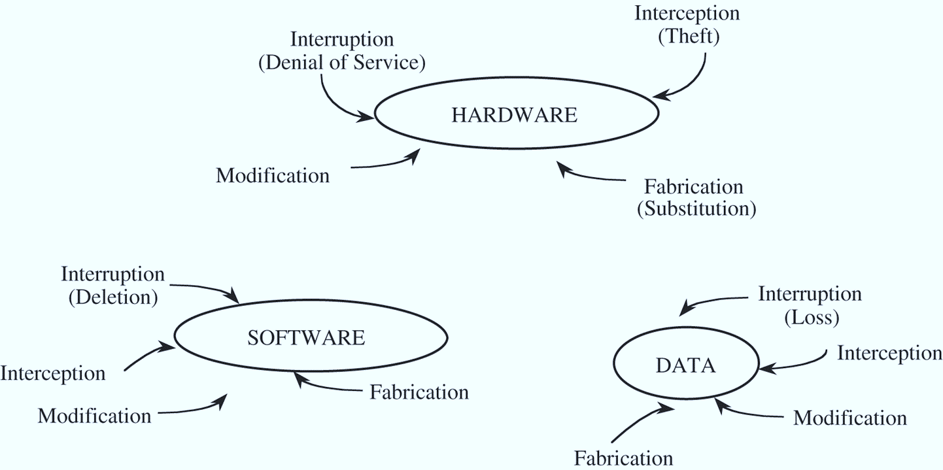
Attacks on Data:
Effects everyone
Data is more than just an electronic file
Principle of Adequate Protection –
Data Confidentiality
Data Integrity
Other Exposed Assets
Networks
Access
Key People

Slide 11
Methods of Defense(Controls)
Controls– attempt to prevent the exploitation of a vulnerability
Computer Security has lots of controls
Simple or Difficulty
Inexpensive or Expensive
Types of Control
Encryption – formal name for the scrambling process
deals with confidentially and integrity
Does not solve computer security problems.
Plaintext (Cleartext)
Ciphertext

Slide 12
Physical Controls – locks/security officer/backups
Software Controls
Programs must be secure to prevent attacks
Program Controls:
Internal Program Controls
Operating System and Network System Controls
Independent Control Programs (virus checker)
Development Controls (quality standards in construction)
Software controls effect the user
Hardware Controls
Smart cards, locks, devices to ID users, firewalls, intrusion detection systems, circuitry control
Policies and Procedures
Policies – an agreement of way things are done
Must be written and training provided

Slide 13
Effectiveness of Controls
Controls must be properly used!
Awareness of Problem
Likelihood of Use
Principles of Effectiveness - Control must be used-and used properly- to be effective. They must be efficient, easy to use, and appropriate.
Overlapping Controls
Periodic Review – controls are not permanent

Slide 14
Chapter 2
Basic Encryption and Decryption

Slide 15
Terminology and Background
Notations and Symbols:
P: Plaintext, C: Ciphertext
S: Sender
R: Receiver
T: Transmission medium
O: outsider, interceptor, intruder, attacker, or, adversary
S wants to send a message to R
S entrusts the message to T who will deliver it to R
Possible actions of O
interrupt, intercept, modify, fabricate

Slide 16
Encryption and Decryption
Encryption: a process of encoding a message so that its meaning is not obvious
Decryption: the reverse process
Encode(encipher) vs. decode(decipher)
Encoding: the process of translating entire words or phrases to other words or phrases
Enciphering: translating letters or symbols individually
Encryption: the group term that covers both encoding and enciphering

Slide 17
Terminology
Plaintext vs. Ciphertext
P: Plaintext (P): the original form of a message ex. Computer , University, Home, Paper,……
C: Ciphertext(C) :the encrypted form ex. xuldf zjhgf ….
Basic operations
plaintext to ciphertext: Encryption:
C = E(P)
ciphertext to plaintext: Decryption:
P = D(C)

Slide 18
Encryption with key
Encryption key: Ke
Decryption key: Kd
C = E(Ke, P)
P = D(Kd, E(Ke, P)) ….. P = D(Kd,C)
Keyless Cipher is a cipher that does not require the use of a key.
If the encryption algorithm fall into the interceptor’s hands, future messages can still be kept secret because the interceptor will not know the key value

Slide 19
Symmetric Cryptosystem: KE=KD
Asymmetric Cryptosystem: KE≠KD
Cryptography
cryptography means hidden writing, the practice of using encryption to conceal text
Cryptanalysis
cryptanalyst studies encryption and encrypted message, with the goal of finding the hidden meaning of the messages
Cryptology
includes both cryptography and cryptanalysis
Cryptanalyst.

Slide 20
Cryptanalyst can do any or all of
three different things:
1-attempt to break a single message
2-attempt to recognize patterns in encrypted messages, in order to be able to break subsequent ones by applying straightforward decryption algorithm
3-attempt to find general weakness in an encryption algorithm, without necessarily having intercepted any messages
Breakable encryption
An encryption algorithm may be breakable, meaning that given enough time and data, cryptanalyst could determine the algorithm (or the key) practicality.

Slide 21
Two forms of Encryption
Substitution:
“One letter is exchanged for another.”
1-Monoalphabetic Substitution Cipher
2-Polyalphabetic Substitution Cipher
Transposition:
“The order of the letters is rearranged.”
1-Columnar Transposition Cipher
2-Double Transposition Cipher

Slide 22
Monoalphabetic Ciphers(Substitution):
Simple substitution–use a correspondence table substitute each character by another character or symbol.
The Caesar Cipher Named for Julious Caesar. Caesar used a shift of 3–translation chart.
Plaintext A B C D E F G H I J K L M N O P Q R S T U V W X Y Z
Ciphertext de f g h i j klmnop q r s t uvw x y z a bc
TREATY IMPOSSIBLE
wuhdwb lp s rvv leo h
0 1 2 3 4 5 6 7 8 9 10 11 12 13 14 15 16 17 18 19 20 21 22 23 24 25
ABCD EFGH I J K L M N O P Q R S T U V W X Y Z
C= (P+3) Mod 26 “ Encryption “
P= (C-3) Mod 26 “ Decryption “

Slide 23
Cryptanalysis of the Caesar cipher
Ex. Decrypt the following ciphertext:-
wklv phvvdjh lv qrw wrr kdug wr euhdn
wrr = “odd” or “see” or “too”

Slide 24
Advantages and Disadvantages of the Caesar Cipher
Advantage :-Easy to use
Disadvantage:- Simple structure and easy to break
Other Monoalphabetic Substitutions
Plaintext
A B C D E F G H I J K L M N O P Q R S T U V W X Y Z
Ciphertext
k e y a b c d f g h i j l m n o p q r s t u v w x z
Other Monoalphabetic Substitutions
Plaintext
A B C D E F G H I J K L M N O P Q R S T U V W X Y Z
Ciphertext
s d g j m p a v y b e h k n q t w z c f i l o r u x

Slide 25
Cryptanalysis of Monoalphabetic ciphers
Frequency distributions
Plaintext Frequency :-
E
T
A, O, R, N , I
.H , C , D , L, M
.
.
X , J ,Z , Q

Slide 26
English Letters Frequencies
Notes:
Note that all human languages have varying letter frequencies, though the number of letters and their frequencies varies. Stallings Figure 2.5 shows English letter frequencies. Seberry & Pieprzyk, "Cryptography - An Introduction to Computer Security", Prentice-Hall 1989, Appendix A has letter frequency graphs for 20 languages (most European & Japanese & Malay).

Slide 27
Sample Ciphertext
hqfubswlrq lv d phdqv ri dwwdlqlqj vhfxuh frppxulfdwlrq ryhu lqvhfxuh fkdqqhov eb xvlqj hqfubswlrq zh glvjxlvh wkh phvvdjh vr wkdw hyhq li wkh wudqvplvvlrq lv glyhuwhg wkh phvvdjh zloo qrw eh uhyhdohg
https://charactercounttool.com/
https://www.mtholyoke.edu/courses/quenell/s2003/ma139/js/count.html
Notes:
From Page 30 of Pfleeger

Slide 28
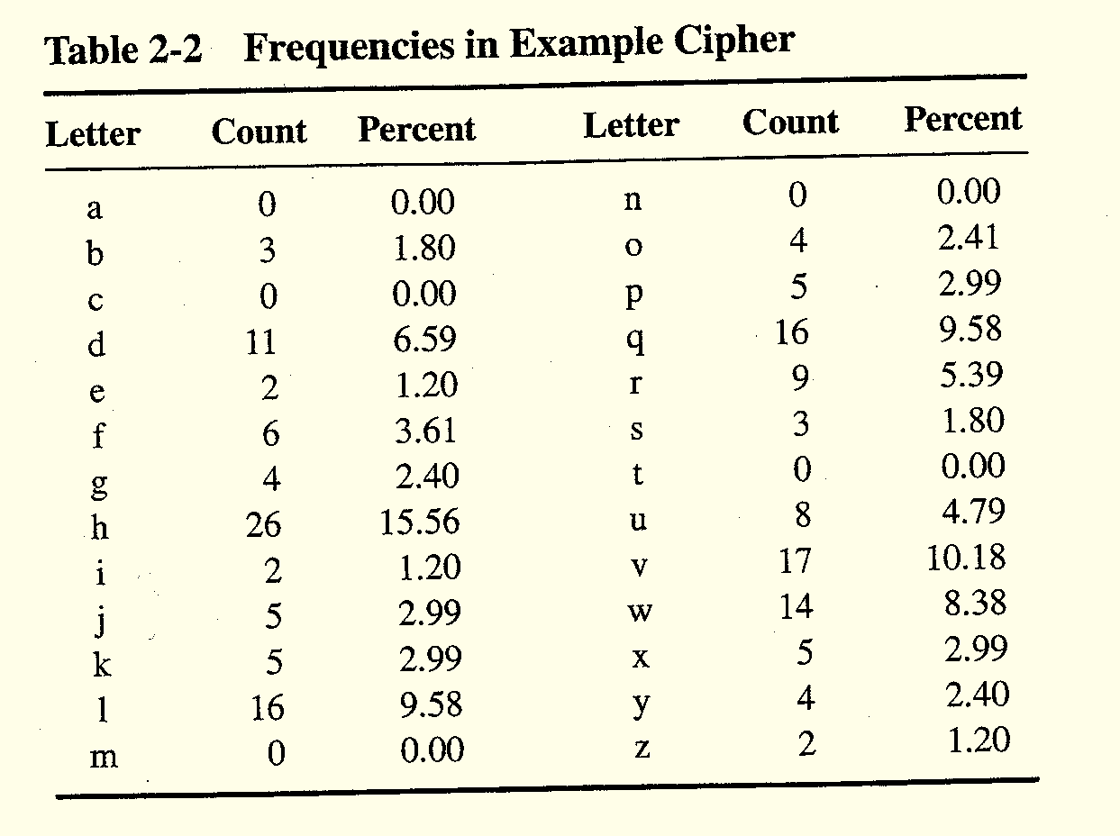
Note similarity of e and h.

Slide 29
Cryptanalysis of the message
hqfubswlrq lv d phdqv ri dwwdlqlqj
ENCRYPTION IS A MEANS OF ATTAINING
vhfxuh frppxqlfdwlrq ryhu lqvhfxuh
SECURE COMMUNICATION OVER INSECURE
fkdqqhov eb xvlqj hqfubswlrq zh glvjxlvh
CHANNELS BY USING ENCRYPTION WE DISGUISE
wkh phvvdjh vr wkdw hyhq li wkh
THE MESSAGE SO THAT EVEN IF THE
wudqvplvvlrq lv glyhuwhg wkh phvvdjh
TRANSMISSION IS DIVERTED THE MESSAGE
zloo qrw eh uhyhdohg
WILL NOT BE REVEALED

Slide 30
Playfair Cipher
The Playfair cipher was invented in 1854 by Charles Wheatstone, but named after lord Playfair who heavily promoted the use of the cipher.
It is a polygraphic substitution cipher,
which encrypts pair of letters instead of single letters.
This makes frequency analysis much more difficult, since there are around 600 combinations instead of 26.
A grid of 5x5 letters is used for encryption. Since there are only 25 spots, one character has to be omitted (for instance J, which is replaced by I).
The grid is formed by first taking a code word (with duplicate letters removed) and then adding any alphabet characters missing.
Notes:
Consider ways to reduce the "spikyness" of natural language text, since if just map one letter always to another, the frequency distribution is just shuffled. One approach is to encrypt more than one letter at once. The Playfair cipher is an example of doing this.

Slide 31
Playfair Key Matrix
A 5X5 matrix of letters based on a keyword
Fill in letters of keyword (sans duplicates)
Fill rest of matrix with other letters
eg. using the keyword MONARCHY
M | O | N | A | R
C | H | Y | B | D
E | F | G | I/J | K
L | P | Q | S | T
U | V | W | X | Z
http://www.online.crypto-it.net/eng/playfair.html
Notes:
The best-known multiple-letter encryption cipher is the Playfair, which treats digrams in the plaintext as single units and translates these units into ciphertext digrams. The Playfair algorithm is based on the use of a 5x5 matrix of letters constructed using a keyword. The rules for filling in this 5x5 matrix are: L to R, top to bottom, first with keyword after duplicate letters have been removed, and then with the remain letters, with I/J used as a single letter. This example comes from Dorothy Sayer's book "Have His Carcase", in which Lord Peter Wimsey solves it, and describes the use of a probably word attack.

Slide 32
Encrypting and Decrypting
plaintext is encrypted two letters at a time
If a pair is a repeated letter, insert filler like 'X’
If both letters fall in the same row, replace each with letter to right (wrapping back to start from end)
If both letters fall in the same column, replace each with the letter below it (again wrapping to top from bottom)
Otherwise each letter is replaced by the letter in the same row and in the column of the other letter of the pair.
The table used for encryption and decryption, created based on the provided password.
The following assumptions were made:
if two letters are in the same row, the letters to the right (during encryption) or to the left (during decryption) would be taken to replace them.
if two letters are in the same column, the letters below them (during encryption) or above them (during decryption) would be taken to replace them.
Notes:
Plaintext is encrypted two letters at a time,according to the rules as shown. Note how you wrap from right side back to left, or from bottom back to top.
if a pair is a repeated letter, insert a filler like 'X', eg. "balloon" encrypts as "ba lx lo on"
if both letters fall in the same row, replace each with letter to right (wrapping back to start from end), eg. “ar" encrypts as "RM"
if both letters fall in the same column, replace each with the letter below it (again wrapping to top from bottom), eg. “mu" encrypts to "CM"
otherwise each letter is replaced by the one in its row in the column of the other letter of the pair, eg. “hs" encrypts to "BP", and “ea" to "IM" or "JM" (as desired)
Decrypting of course works exactly in reverse. Can see this by working the example pairs shown, backwards.

Slide 33
Playfair Example
Use the following table:
Playfair Example
Break the plaintext in a two character diagram:
Plaintext is divided into 2-letter diagram
Use X to separate double letter
Use X to pad the last single letter
TH ES CH EM ER EA LL YW OR KS
TH ES CH EM ER EA LX LY WO RK SX
Encrypting the message :-
:
THE SCHEME REALLY WORKS

Slide 34
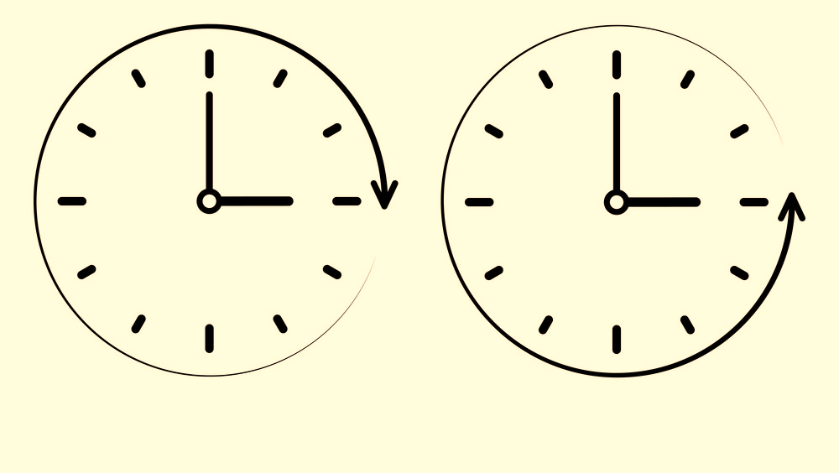
Cont. Playfair Example
TH -> RP
ES -> SB
CH -> HA
EM -> GD
ER -> DC
EA -> BC
LX -> AZ
LY -> RZ
WO -> PV
RK -> AM
SX -> WB
Enc
Dec

Slide 35
Cont. Playfair Example
Thus the message:
" THE SCHEME REALLY WORKS“
Becomes
“RP SB HA GD DC BC AZ RZ PV AM WB “
rpsbh agddc bcazr zpvam wb
H/W:: Write C# program to encrypt “ZOOM TEST” using Playfair. You can use the following Link to programming (Online).
https://rextester.com/

Slide 36
Security of Playfair Cipher
security much improved over monoalphabetic
since have 26 x 26 = 676 digrams
would need a 676 entry frequency table to analyse (verses 26 for a monoalphabetic)
and correspondingly more ciphertext
was widely used for many years
eg. by US & British military in WW1
it can be broken, given a few hundred letters
since still has much of plaintext structure
Notes:
The Playfair cipher is a great advance over simple monoalphabetic ciphers, since there are 26*26=676 digrams (vs 26 letters), so that identification of individual digrams is more difficult. Also,the relative frequencies of individual letters exhibit a much greater range than that of digrams, making frequency analysis much more difficult. The Playfair cipher was for a long time considered unbreakable. It was used as the standard field system by the British Army in World War I and still enjoyed considerable use by the U.S.Army and other Allied forces during World War II. Despite this level of confidence in its security,the Playfair cipher is relatively easy to break because it still leaves much of the structure of the plaintext language intact

Slide 37
Hill Cipher
The Hill Cipher uses matrix multiplication to encrypt a message. First, you need to assign two numbers to each letter in the alphabet and also assign numbers to space, . , and ? or !. The key space is the set of all invertible matrices over Z₂₆. 26 was chosen because there are 26 characters, which solves some problems later on.

Slide 38
Hill Cipher example
Encryption:- C= K*P Mod 26
-1
Decryption:- P= K *C
A B C D E F G H I J K L M N O P Q R S
1 2 3 4 5 6 7 8 9 10 11 12 13 14 15 16 17 18 19
T U V W X Y Z
20 21 22 23 24 25 26
Consider the following message:
Herbert Yardley wrote The American Black Chamber

Slide 39
Hill Cipher example
Break the message into:
he rb er ty ar dl ey wr ot et he am er ic an bl ac kc ha mb er
Now convert letters into number-pair:
8 5 18 2 5 18 20 25 1 18 4 12 5 25 23 18 15 20
5 20 8 5 1 13 5 18 9 3 1 14 2 12 1 3
11 3 8 1 13 2 5 18
Now using the matrix (key)

Slide 40
Hill Cipher example
Make the first pair a column vector (h (8) e (5)),
and multiply that matrix by the key.
Of course, we need our result to be mod 26
The ciphertext is G (7) V (22).

Slide 41
Hill Cipher example
For the next pair r (18) b (2),
and 16 corresponds to P and 10 corresponds to J.
Do this for every pair and obtain
GVPJKGAJYMRHHMMSCCYEGVPEKGVCWQLXXOBMEZAKKG
https://www.dcode.fr/hill-cipher

Slide 42
Polyalphabetic Substitution Cipher
Vignere Cipher is a collection of 26 permutations. Usually these permutations are written as 26*26 matrix with all 26 letters in each row and each column .
PLAINTEXT
A B C D E F G H I J K L M N O P Q R S T U V W X Y Z
K A a b c d e f g h i j k l m n o p q r s t u v w x y z
E B b c d e f g h i j k l m n o p q r s t u v w x y z a
Y C c d e f g h i j k l m n o p q r s t u v w x y z a b
. D d e f g h i j k lm n o p q r s t u v w x y z a b c
. …………………………….…………………………………………………………..
. ……………………CIPHERTEXT…………………………………………......
Z z a b c d e f g h i j k l m n o p q r s t u v w x y z
If Pt= BAD & Key =ABD Then Ct = bbg
https://www.dcode.fr/vigenere-cipher

Slide 44
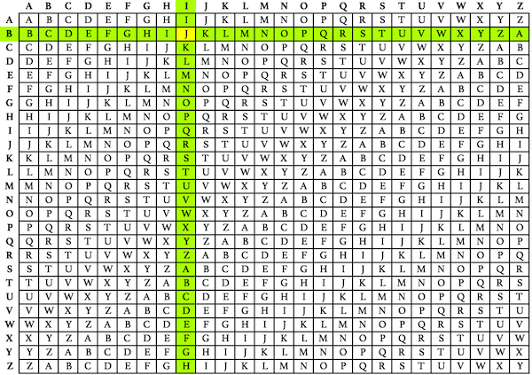
Example: To Encrypt DCODE, the key is KEY.
Locate the first letter of the plaintext message in the first line of the table and the first letter of the key on the left column. The cipher letter is at the intersection.
Example: Locate the letter D on the first row, and the letter K on the first column, the ciphered letter is the intersection cell N.
Continue with the next letter of the plaintext, and the next letter of the key. When arrived at the end of the key, go back to the first letter of the key.
Result: NGMNI is the ciphertext of Plain=DCODE.
https://dotnetfiddle.net/uPHxwr
Example: To decrypt NGMNI, the key is KEY.
Locates the first letter of the key in the left column, and locates on the row the first letter of the ciphered message. Then go up in the column to read the first letter, it is the corresponding plain letter.
Example: Locate the letter K on the first column, and on the row of it, find the cell of the letter N, the name of its column is D, it is the first letter of the plain message.
Continue with the next letters of the message and the next letters of the key, when arrived at the end of the key, go back the first key of the key.
Result: The original plain text is DCODE.

Slide 45
Cryptanalysis of polyalphabetic Substitutions
Kasiski method for repeated patterns.
1- identify repeated pattern of three or more characters
2- for each pattern write down the position at which each instance of the pattern begin
3-compute the difference between the starting points of successive instances
4- determine all factors of each difference
5- if a polyalphabetic cipher was used, the key length will be one of the factors that appears often in step 4

Slide 46
Example
xughr trtei mngfh ggfkl rtrah ggfui fbdnc kmlph ggfty nbvcf
15 25-15=10 1,2,5,10
25 40-25=15 1,3,5,15
40 40-15=25 1,5,25
Key length= 5

Slide 47
example
xulgh xcopr zsesd wwert fghty ttyui rtrty
Jbfgh xdcfv ltfgy sdfew hygth oilji cvbnl
tyree bcgfv hgtfg htdju fhrye jghhk ydftf
ghtgt
20 (83-20)=63 1,3 ,7,9,21,63
83 (104-20)=84 1,2,3,4,6,7,12,14,21,42,84
104 (104-83)=21 1, 3,7,21
Is Key length 3 or 7 or 21 ?

Slide 48
Calculating the IC
The formula used to calculate IC (Index of Coincidence):
Σ(fi * (fi-1))
N(N-1)
where 0 > i > 25,
fi is the frequency of the i^{th} letter of the alphabet in the sample,
and N is the number of letters in the sample

Slide 49
Example
The IC of the text THE INDEX OF COINCIDENCE would be given by:
c(3*2)+ d(2*1)+ e(4*3)+ f(1*0)+ h(1*0)+ i(3*2)+ n(3*2)+ o(2*1)+ t(1*0)+ x(1*0) = 34
divided by N*(N-1) = 21*20 = 420
which gives us an IC of 34/420 = 0.0809
The IC of the text BMQVSZFPJTCSSWGWVJLIO would be given by:
b(1*0)+ c(1*0)+ f(1*0)+ g(1*0)+ i(1*0)+ j(2*1)+ l(1*0)+ m(1*0)+ o(1*0) + p(1*0)+ q(1*0)+ s(3*2)+ t(1*0)+ v(2*1)+ w(2*1)+ z(1*0) = 12
divided by N*(N-1) = 21*20 = 420
which gives us an IC of 12/420 = 0.0286

Slide 50
How is this helpful?
IC can be used to test if text is plain text or cipher text.
Text encrypted with a substitution cipher would have an IC closer to 0.0385, since the frequencies would be closer to random.
English plaintext would have an IC closer to 0.0667.
This measure allows computers to score possible decryptions effectively.

Slide 51
Any Question ?

