Slide 1
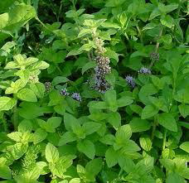
Biological Synthesis of Nanoparticles from Plants

Slide 2
PHYSICAL AND CHEMICAL METHODS
Various physical and chemical processes have been exploited in the synthesis of several organic metal nanoparticles.
-The high energy requirement in physical methods of nanoparticle synthesis.
-and the waste disposal problems in chemical synthesis,
-so both methods are costly.
-and generate toxic by product are major demerits of the conventional nanoparticle synthesis.

Slide 3
Biosynthesis of nanoparticles
Accordingly, there is a necessary need to extend for environmentally benign procedures for synthesis of nanoparticles.
A promising move towards to reach this objective is to develop the array of biological resources in nature.

Slide 4
Such drawbacks demand the development of clean,
biocompatible,
nonhazardous,
inexpensive,
energy-efficient,
and eco-friendly methods for nanoparticles synthesis.

Slide 5
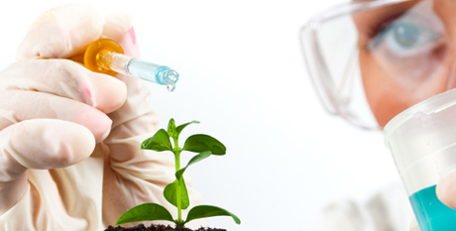
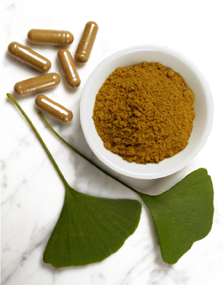
Biological (Green) synthesis:
Microscopic agent: Bacteria, Fungi Actinomycetes.
Macroscopic: Algae, Sea weeds, Plant Extracts (Leaves, Bark, Stem, Shoots, Seeds, Latex, Secondary metabolites, Roots, Twigs, peel, fruit, seedlings, essential oils, Tissue cultures, Gum).

Slide 6
Nanomaterials fabrication
methods can be classified according to whether their assembly followed either:
i) Bottom-up approach, where smaller components of atomic or molecular dimensions self-assemble together, according to a natural physical principle or an externally applied driving force, to give rise to larger and more organized systems;

Slide 7
Self-assembly
Self-assembly is the ‘fabrication tool’ of nature: all natural materials, organic and inorganic, are produced through a self-assembly route to create complex structures with nanoscale precision.
Examples are the formation of the DNA double helix or the formation of the membrane cell from phospholipids.

Slide 8
In self-assembly, sub-units spontaneously organize and aggregate into stable, well-defined structures through non-covalent interaction.

Slide 9
ii) the top-down approach, a process that starts from a large piece and subsequently uses finer and finer tools for creating correspondingly smaller structures.

Slide 10
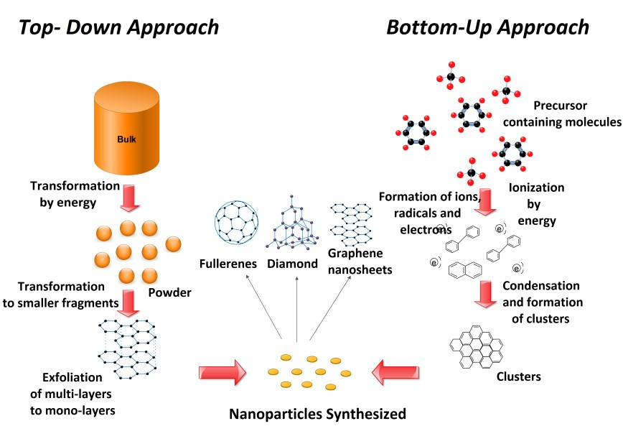

Slide 11
phytonanotechnology
phytonanotechnology has provided new avenues for the synthesis of nanoparticles and is an:
ecofriendly,
simple,
rapid,
stable,
and cost-effective method.

Slide 12
Phytonanotechnology has advantages, including:
biocompatibility,
Scalability, and
the medical applicability of synthesizing nanoparticles using the universal solvent, water, as a reducing medium.

Slide 13
Mechanism of Biosynthesis
The exact mechanism and the components responsible for plant-mediated synthetic nanoparticles remain to be elucidated.
It has been proposed that proteins, amino acids, organic acid, vitamins, as well as secondary metabolites, such as:

Slide 14
flavonoids, alkaloids, polyphenols, terpenoids, heterocyclic compounds, and polysaccharides,
have significant roles in metal salt reduction and, furthermore,
act as capping and stabilizing agents
for synthesized nanoparticles.

Slide 15
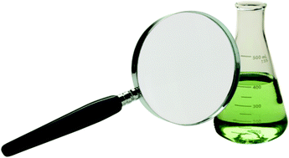
Reports also suggest that different mechanisms for synthesizing nanoparticles exist in different plant species.

Slide 16
Plant extracts
The reduction method using plant extracts is
one step, low cost and eco-friendly, hence considered as the most preferred way for the synthesis of metal nanoparticles.
Thus, this method may be included in the class of green technology.

Slide 17
various plant parts, including leaves, fruits, stems, roots, and their extracts, have been used for the synthesis of metal nanoparticles.

Slide 18
Among various nanometals explored so far, nanoparticles of silver, gold, copper, zinc, palladium, titanium, nickel, indium etc. have been prepared by using a wide variety of plant extracts.

Slide 19
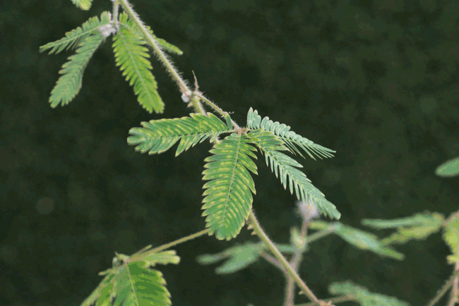
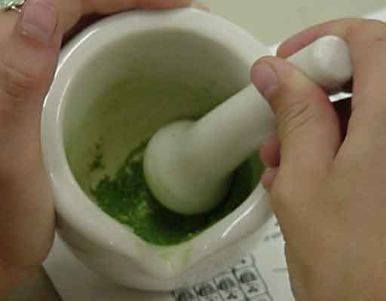
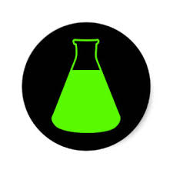
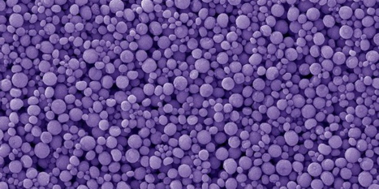
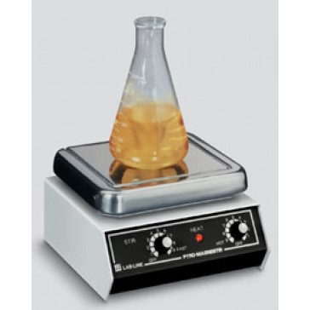
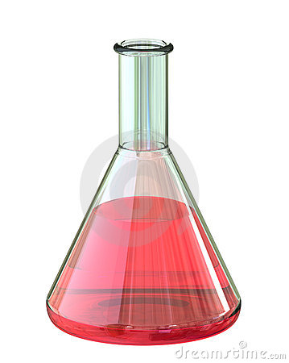
PLANT
EXTRACTION FROM PLANT
PLANT EXTRACT
NANOPARTICLE RECOVERY
STIRRING
EXTRACT AND METAL SOLUTION

Slide 20
Leaf extracts
The leaves of plants like Mentha, Ocimum, and Eucalyptus were reported for the synthesis of gold nanoparticles.
Ocimum leaf provided finer particles compared with other plant leaves used.
The polymorphic gold nanoparticles synthesis was reported from Citrus limon
The gold nanoparticles were polymorphic, stable, size 30–130 nm in non agglomerated form.

Slide 21
Seed extracts
The synthesis of silver nanoparticles through seeds of the plant Elaeocarpus granitrus was reported.
The nanoparticles were involved for development of bionanocomposite with chitosan matrix and antimicrobial assay was done.

Slide 22
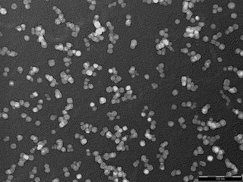
The synthesis of silver nanoparticles was reported using aqueous seed extract of Jatropha curcas.
The stable silver nanoparticles at different concentration of AgNO3 were spherical in shape with diameter ranging from 15 to 50 nm.

Slide 23
Essential oils
The synthesis of gold nanoparticles with essential oils extracted from the fresh leaves of Anacardium occidentale was reported.
The NPs synthesized at room temperature were hexagonal in shape while at higher temperature were mixture of an isotropic particles.

Slide 24
peel extract
The biosynthesis of silver nanoparticles (AgNPs) from Citrus sinensis peel extract was reported.
The synthesized AgNPs were effective antibacterial agent.
The aqueous extracts from the peels of Citrus fruits (orange, grapefruit, tangelo, lemon and lime) were used for the synthesis of AgNPs using microwave technology; the synthesis was successful for the orange peel extract.

Slide 25
Secondary metabolites
The plant broth of Phyllanthus amarus containing secondary metabolites was used for the formation of silver nanoparticles (AgNPs).
The coconut water was used for synthesis of gold nanoparticles through microwave irradiation.
The nanoparticles were tested for cytotoxicity on two human cancer cell lines, and found to be nontoxic.

Slide 26
Stem extracts
The stem extract of Breynia rhamnoides was used for synthesis of gold and silver nanoparticles was reported.
The nanoparticles showed antibacterial property against multi-drug resistant bacteria such as Pseudomonas aeruginosa, Escherichia coli, and Staphylococcus aureus.

Slide 27
Fruit extracts
Tribulus terrestris fruit bodies were used for synthesis of silver nanoparticles.
The nanoparticles were spherical shaped with 16-28 nm of size.

Slide 28
Latex extracts
The latex of Jatropha curcas was used in silver nanoparticles synthesis.
The particles radius was 10–20 nm and stabilized by the cyclic peptides.
The latex of Euphorbia milii was used in silver nanoparticles synthesis, and sizes were of 10–50 nm .

Slide 29
Tissue culture extracts
The extracts from tissue culture-derived callus and leaf of the salt marsh plant (Sesuvium portulacastrum L.) used in the synthesis of silver nanoparticles.
The callus extract was able to produce antimicrobial silver nanoparticles than leaf extract.
The silver nanoparticles synthesized were spherical in shape with size 5 to 20 nm.

