Slide 1
Survival of Infectivity
PRESERVATION OF VIRUS INFECTIVITY
There are several practical situations in which there is a need to preserve virus
infectivity. A prime example is during the storage and distribution of live virus
vaccines , when there is a need to retain the potency of
the vaccine. A second example is during the transport and storage of blood, feces,
saliva, and other specimens from human and animal patients prior to testing in a
diagnostic virology laboratory. Last, but by no means least, virologists need to
preserve the infectivity of the viruses that they work with.
DESTRUCTION OF VIRUS INFECTIVITY
There are many situations in which there is a requirement to destroy virus
infectivity. Procedures to minimize the transmission of pathogenic viruses (and
other micro-organisms) in hospitals and other health care facilities include the
disinfection of surfaces and the sterilization of equipment and materials. A good
example of a situation requiring rigorous action is an outbreak of winter vomiting
disease caused by a norovirus; patients' vomit contains significant quantities of
virus, which must be inactivated if the outbreak is to be brought under control.
Inactivated (killed) virus vaccines are made from preparations of
virulent viruses, so it is essential that all infectivity is destroyed. Blood products,
such as clotting factors for hemophiliacs and immunoglobulins, are treated to
destroy any viruses (e.g. . HIV, hepatitis viruses) that might be present in the
donated blood. Continuing the theme of human and animal health, water supplies
that are free from pathogenic viruses (and other micro-organisms) are of
fundamental importance, so water treatment procedures must include processes
that destroy these agents. The same applies to the treatment of swimming pool
water.
•
•
•
•
•

Slide 2
The processes for production of cheese, yogurt, and other dairy products utilize
lactic acid bacteria to ferment the milk. There are many phages that infect these
bacteria, and a phage infection during a production process can result in delay or
failure of the fermentation, or in a poor quality product. To minimize the risk,
procedures are required for treatment of the milk or whey to inactivate any phages
present, and for the disinfection of the factory environment.
Finally, virologists need supplies of pipettes, cell culture vessels, and other
laboratory m ateria ls that a re gua ra nteed free from viruses (and other
micro-organisms), then after these materials have been used any viruses present
must be inactivated before disposal.
INACTIVATI01N TARGETS IN VIRIONS
The infectivity of a virion can be destroyed by the alteration or removal of its
nucleic acid and/or one or more of its proteins (Figure 24.1). A protein molecule
may be altered by the induction of a conformational change or, more drastically, by
the breaking of covalent bonds, such as peptide bonds and disulfide bonds.
Figure 24. 1 Inactivation targets in virions. Infectivity of a virion may be destroyed
by damage to a nucleic acid, a protein, and/or a lipid membrane. Alteration of a
surface protein might prevent a virion from attaching to its host cell and/or from
entering the cell. Stripping the envelope from an enveloped virion removes the
surface proteins and achieves the same outcome. Alteration of internal proteins can
destroy properties, such as enzyme activities, essential for the replication of the
virus.

Slide 3
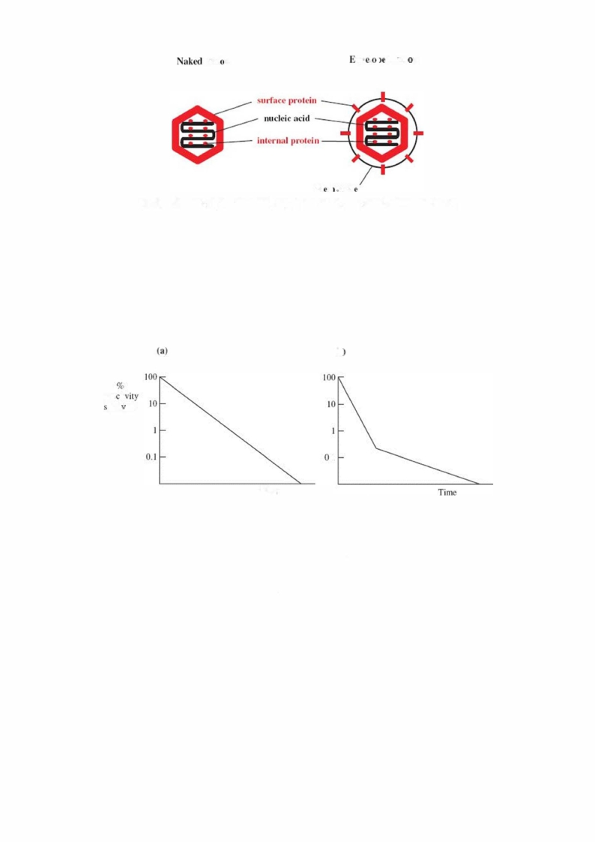
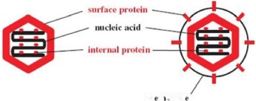
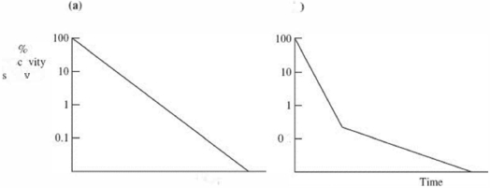
Viri n
nv J l
d Viri n
m
n bran
INACTIVATION KINETICS
The rate at which a virus loses infectivity under defined conditions (for exaMple, at
a particular temperature and pH value) can be deterMined by incubating aliquots of
the virus preparation under those conditions. At various tiMe intervals the surviving
infectivity in an aliquot is deterMined in an infectivity assay appropriate for the virus
. The logarithM of the percentage infectivity surviving is plotted
against time (Figure ).
Figure Loss of virus infectivity (a) at one rate and (b) at two rates.
(b
infe ti
urvi ins
. I
Time
In soMe circuMstances infectivity is lost at a constant rate until no further infectivity
can be detected (Figure (a)). The slope of the line is a Measure of the rate of
infectivity loss. SoMetiMes there is a change in the rate of infectivity loss after Most
(usually more than 99°/o) of the infectivity has been destroyed (Figure (b)). It
is not entirely clear why a sMall fraction of soMe virus preparations loses infectivity
at a slower rate. It has been suggested that this fraction Might contain virions that
have a higher degree of resistance to the inactivating factor and/or that the
preparation might contain virion clumps, with virions at the centers of the cluMps
having some protection.

Slide 4
AGENTS THAT INACTIVATE VIRUS INFECTIVITY
1 Physical agents
1.a Temperature
All infective viruses lose infectivity over time, the rate of infectivity loss being highly
dependent on temperature. There is a lot of variability between viruses in the rates
at which they are inactivated. In general, naked viruses are more stable than
enveloped viruses; most naked viruses lose little infectivity after several hours at 37
°C, whereas most enveloped viruses lose significant infectivity under the same
conditions. This generalization is broad, as there may be significant differences in
stability between closely related viruses. Under dry conditions varicella-zoster virus
survives well, while the related herpes simplex viruses survive poorly.
At temperatures below -35 °C most viruses lose infectivity very slowly, so for
long-term storage of viruses they are placed in freezers or in liquid nitrogen.
Preservation of infectivity may be enlhanced by storing virus preparations in a
freeze-dried form, rather than as aqueous suspensions. Moving to higher
temperatures, most viruses are completely inactivated within 30 minutes at 60 °C
or within a few seconds at 100 °C.
Some of the bacteriophages of lactic acid bacteria that cause problems in the dairy
industry are quite heat resistant, and some infectivity may survive the heat
treatments used in the decontamination procedures .

Slide 5
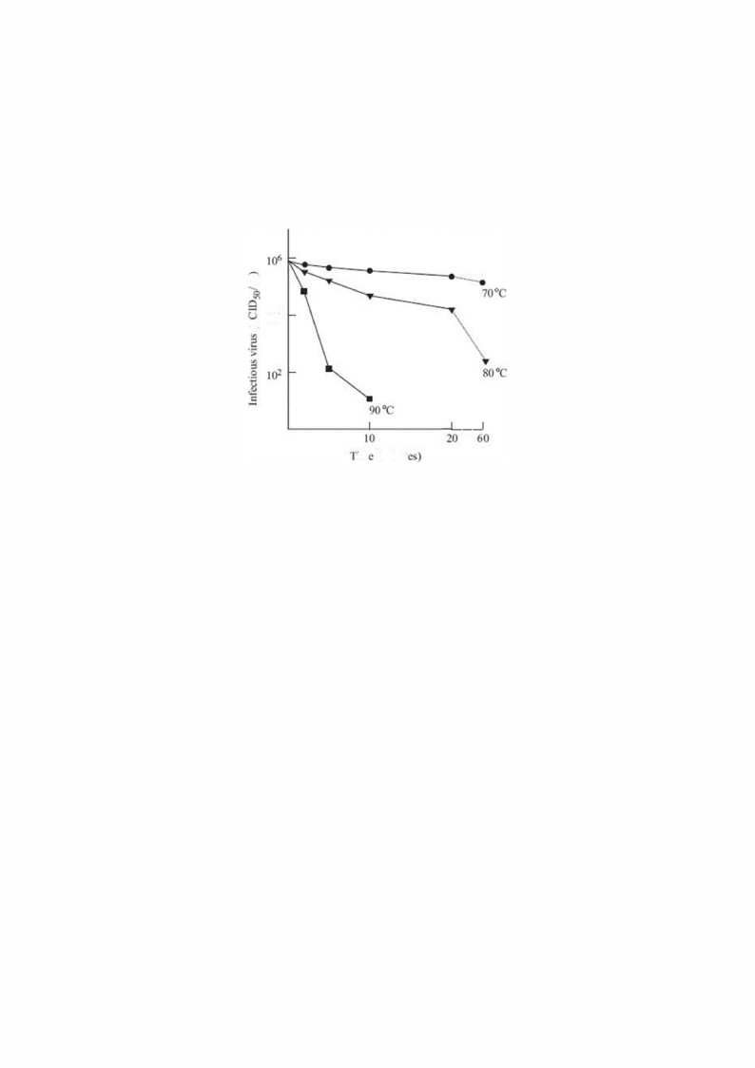
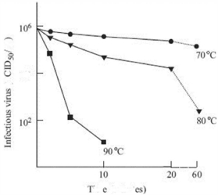
The virions of some viruses, such as hepatitis A virus (HAV) and parvoviruses, are
exceptionally heat stable. Data for the minute virus of mice (a parvovirus) indicate
some infectivity surviving after 60 minutes at 80 °C (Figure ).
Figure Inactivation of minute virus of mice infectivity in water at 70, 80, and
90 °C.
e
t:
10"*
nn
(mimu
Exceptions to the generalization concerning the stability of naked and enveloped
virions include those of hepatitis B virus (HBV), which are enveloped but have high
stability, and those of poliovirus, which are naked but have low stability.
Interestingly, HAV (heat-stable virions) and poliovirus (heat-labile virions) are both
members of the family Picornaviridae, so, as with the herpesviruses, there is not
always consistency in the degree of stability between viruses with similar
structures.
The fact that virus preparations lose infectivity means that special precautions have
to be taken to minimize infectivity loss during transport and storage of live
vaccines, such as polio, mumps, measles, and rubella. These precautions include a
"cold chain" of containers and vehicles that are refrigerated and/or insulated. This
adds considerably to the expense of vaccination programs.
The rate of infectivity loss depends on the nature of the medium containing the
virus. The presence of proteins, fats, glycerol, or certain salts may protect
infectivity. Magnesium ions reduce the rate of inactivation of many RNA viruses,
including poliovirus, so magnesium chloride is added to live polio vaccines to extend
their shelf life.
The most heat-resistant viruses known are those that infect the thermophilic
prokaryotes that inhabit hot springs. The optimum temperature for the growth of
many of the hosts of these viruses is around 85 °C. Prions are also remarkably heat
resistant.

Slide 6
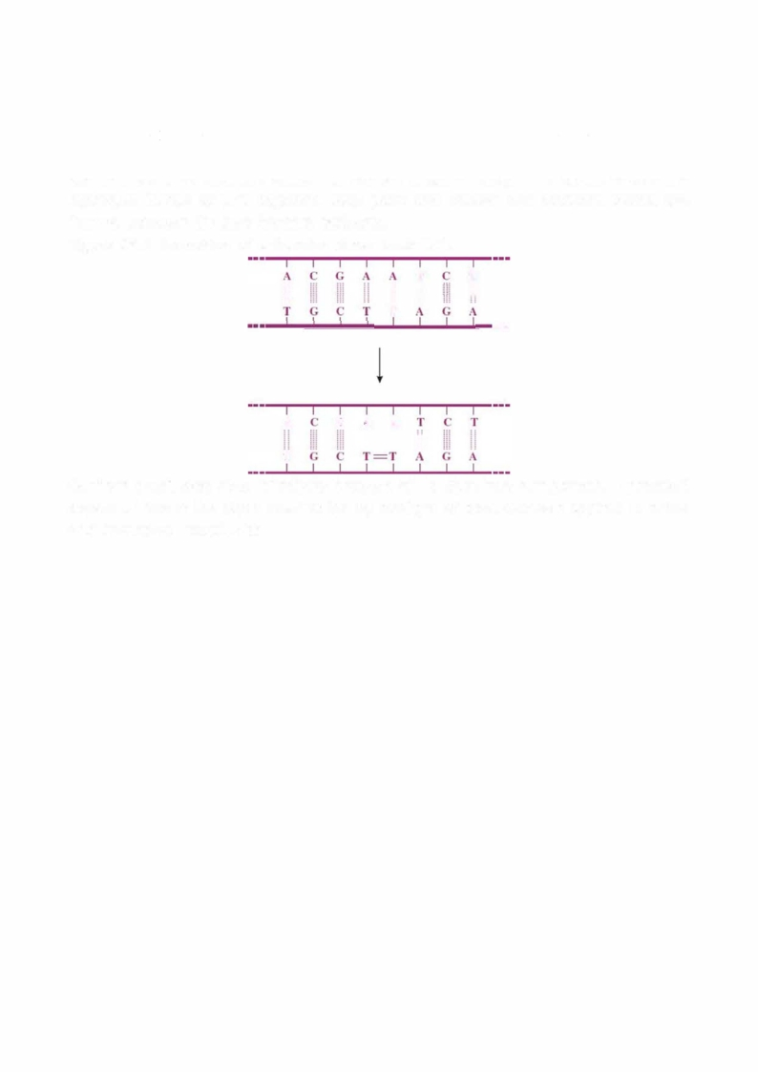
1.b Radiation
Some forms of radiation inactivate virus infectivity because they damage nucleic
acids; for exaMple, X-rays, gamma rays, and ultraviolet rays cause breaks in nucleic
acids. Ultraviolet rays also cause other types of damage to nucleic acids, including
the formation of thymine dimers in dsDNA (Figure ). The thymine-adenine
hydrogen bonds at two adjacent base pairs are broken and covalent bonds are
formed between the two thymine residues.
Figure Formation of a thymine dimer in dsDNA.
ii
T
·r II
T
II
II
•••
A
G
.\
A
II
l'
Sunlight inactivates virus infectivity because of its ultraviolet component. A practical
aspect of this is the rapid inactivation by sunlight of baculoviruses applied to crops
and forests as insecticides.
Chemical agents
Chemicals that inactivate virus infectivity do so with similar kinetics to physical
agents, with either one or two inactivation rates (Figure ). When soMe
inactivation data are plotted the initial part of the graph has a small shoulder before
the straight line. This could be due to a delay while the chemical reaches its target
in the virion. Many chemicals can inactivate virus infectivity, but for many of them
the inactivation target(s) are uncertain. We now consider the effects of hydrogen
ion concentration (pH) and of a variety of other chemical agents on virus infectivity.
2.a Acids and alkalis
Most viruses are fairly stable at pH values between 5 and 9, but at more extreme
pH values virions may undergo conformational changes and rates of infectivity loss
usually increase. At high pH values both nucleic acids and proteins can be
daMaged. Alkali, in the form of dilute sodiuM hydroxide (soMetimes in combination
with steaM ), is used to disinfect Manufacturing vessels and tools in the
pharmaceutical industry.
The infectivity of some viruses is inactivated at low pH values as a result of
alterations to surface proteins. Viruses that infect humans and other mammals via
the gastrointestinal route, however, are relatively stable at low pH values. These
viruses, which include rotaviruses , have to survive in the stomach

Slide 7
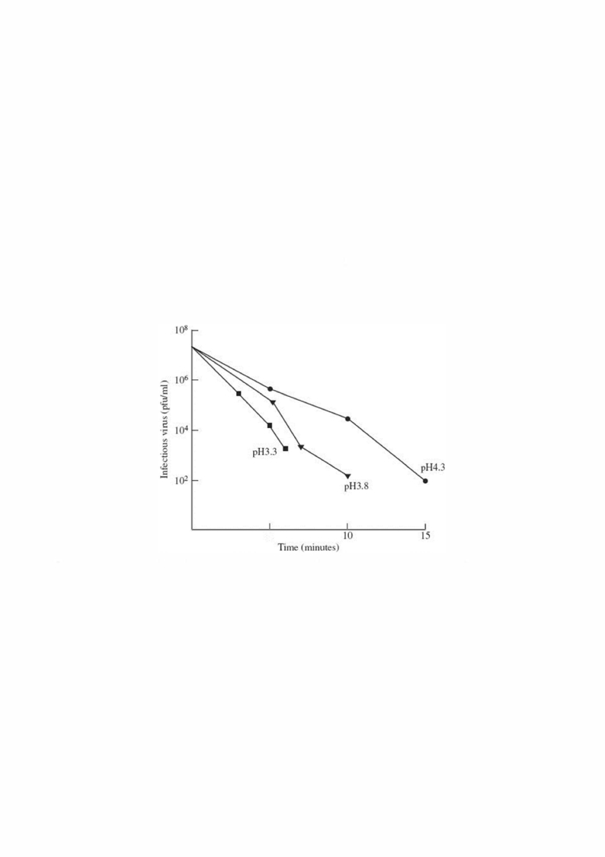
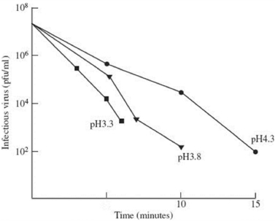
contents, which are commonly at a pH value between 1 and 2. Furthermore, their
virions must be able to withstand the sudden increase in pH when they are moved
from the stomach to the intestine (pH about 7.5), and they must be resistant to
inactivation by bile salts and proteolytic enzymes.
HAV and many enteroviruses infect their hosts via the gastrointestinal tract. These
viruses a re picornaviruses , but, when com pared to those
picornaviruses (such as rhinoviruses and aphthoviruses) that infect their hosts via
other routes, their virions are much more acid-resistant. It can be seen in Figure
that HAV infectivity can still be detected after 6 minutes at pH 3.3 at a
temperature of 85 °C; thus, HAV is an example of a virus with high resistance to
inactivation by both heat and acid..
Figure . Inactivation of hepatitis A virus infectivity at three pH values at 85 °C.
5
Phenol, which is a weak acid, destroys the capsids of virions without altering nucleic
acids. It is commonly used in the laboratory to extract nucleic acids from virions.
b. Hypochlorite
One of the most widely used disinfectants is hypochlorite. Both the hypochlorite ion
(OCI-) and the undissociated hypochlorous acid (HOCI) are excellent disinfectants;
they act by oxidizing organic molecules, such as proteins. Hypochlorite ions are
either supplied as sodium hypochlorite or they are generated by dissolving chlorine
gas in water. The latter process is used to treat drinking water supplies and
swimming pool water.
Sodium hypochlorite is one of the disinfectants used in the dairy industry to control
phages of lactic acid bacteria such as Lactobacillus spp. The inactivation of a
Lactobacillus phage at four concentrations of hypochlorite is shown in Figure .

Slide 8
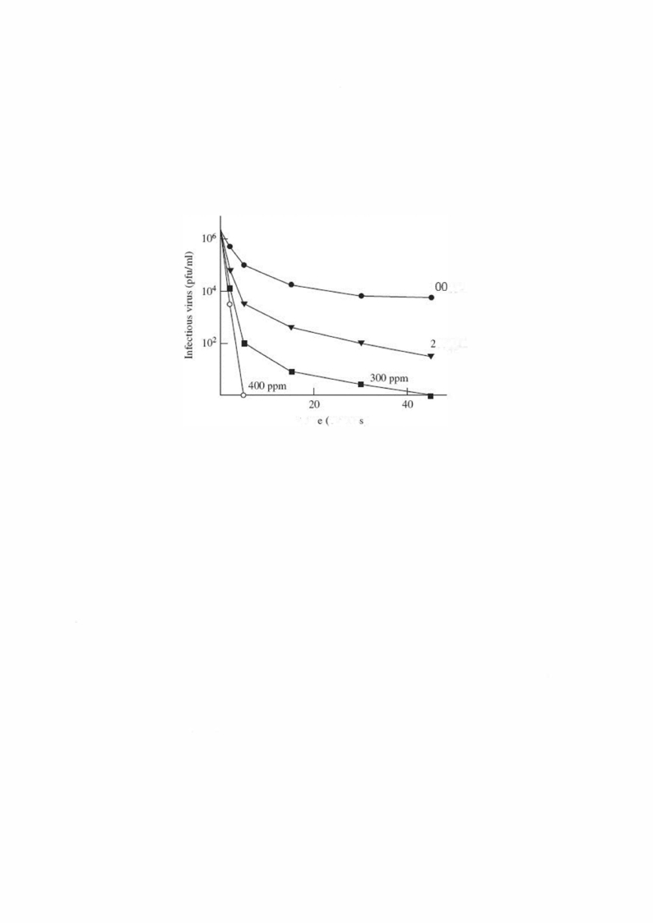
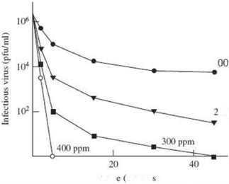
At free chlorine concentrations 100-3 00 ppm there were slower rates of
inactivation for a small percentage of the virions.
Figure. Inactivation of Lactobacillus phage BYM by hypochlorite. The
concentrations are shown as parts per million (ppm) of free chlorine. The phage
suspensions were at 25 °C and pH 7.
1
ppm
OO ppm
Tim
minute )
c. Aldehydes and alcohols
Formaldehyde and glutaraldehyde damage both enveloped and non-enveloped
virions. Formaldehyde cross-links proteins and reacts with amino groups in nucleic
acids; it is used to destroy the infectivity of poliovirus and other viruses for use in
inactivated vaccines. Glutaraldehyde is useful for disinfecting metal
surfaces because it is non-corrosive.
Ethanol and isopropyl alcohol are used as general purpose disinfectants and in
waterless hand washes.
d. Lipid solvents
Detergents and many organic solvents, such as chloroform, destroy the infectivity
of enveloped viruses by removing their lipid mem branes and associated
glycoproteins. Detergents and solvents are used in the preparation of clotting
factors and other blood products to destroy enveloped viruses (particularly HIV,
HBV, and HCV) that may be present in pooled blood donations. Lipid solvents may
also damage virions with internal lipid, such as the corticoviruses and the
tectiviruses .
Quaternary ammonium compounds are cationic and disrupt virion envelopes.
Several of them are used as disinfectants, especially chlorhexidine gluconate, which
is widely used in health care institutions. Anionic detergents, such as sodium
dodecyl sulfate, disrupt virion envelopes and capsids.

