Slide 1
Types of Nanostructures
Lec.3

Slide 2
Nanostructures
Nanostructures- objects with nanometer scale Made by human.
Individual nanostructures come in a range of different forms including:
clusters, nanoparticles, nanocrystals, quantum dots, nanowires, nanotubes, nanofibres, nanodots, and aggregated dendritic forms which are often three dimensional spherical in shape.

Slide 3
In general most agree that three things are important in nanostructures:
1. Small size, measured in 100 of nanometers or less.
2. Unique properties because of the small size.
3. Control the structure and composition on the nm scale in order to control the properties.

Slide 4
Metallic Nanoparticles
Compared with other nanostructures, metallic NPs have been proven to be the most flexible nanostructures owing to the synthetic control of their size, shape, composition, structure, assembly, and encapsulation, as well as the resulting turnability of their optical properties.

Slide 5
Compared with other metallic nanostructures, colloidal gold and silver NPs are especially promising in nanobiotechnology because of their simple and fast preparation and able to bioconjugation.

Slide 6
Metal Oxide Nanoparticles
Metal oxide NPs can exhibit unique chemical properties due to their limited size and a high density of corner or edge surface sites.
Metal oxide particles serve many functions in the various field of plant technology and others.

Slide 7
Polymeric Nanoparticles
The term polymer nanoparticle is given for any type of polymer NPs but specifically for nanospheres and nanocapsules.
These are obtained from synthetic polymers, such as polyacrylate.
or natural polymers, albumin, DNA, chitosan, and gelatin.

Slide 8
Carbon nanotube (CNTs)
*CNTs, most simply, are molecules of carbon.
CNTs display extraordinary mechanical, electronic, and optical properties.
*One of the key advantages of CNTs is their strength. *CNTs are expected to have huge applications in nanometer-sized electronics and other biological and biomedical application.

Slide 9
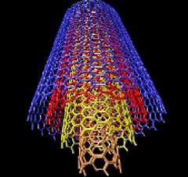
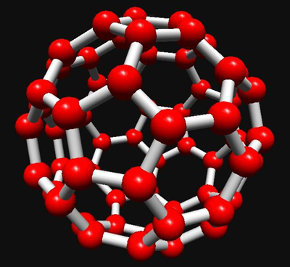
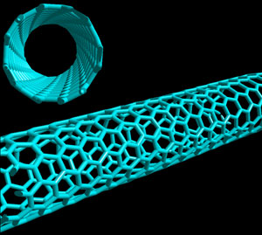
Multi and single-walled carbon nanotubes

Slide 10
Nanoclay
Nanoclay: a clay consisting of nano-sized particles.
There are two origins of nanoclay, firstly, the in situ alteration of volcanic ash, and secondly the hydrothermal alteration of volcanic rocks.
there is interest to use it in food packaging applications such as to make transparent containers and covering films.

Slide 11
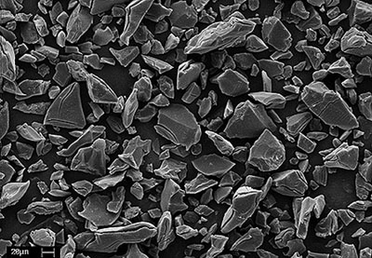
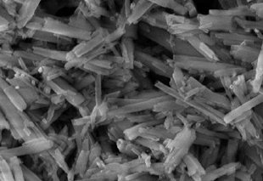
Types of nanoclay
The structure of the nanoclay particles can be divided into two main groups, platelets and nanotubes.

Slide 12
Quantum Dots
Quantum dots are one of the most interesting nanotechnology developments.
About 1 to 6 nanometers in diameter, a quantum dot is a nano-sized semiconductor crystal, and are so small that they are also known as artificial atoms.
Quantum dots have a range of remarkable electrical, magnetic, optical, and catalytic properties.

Slide 14
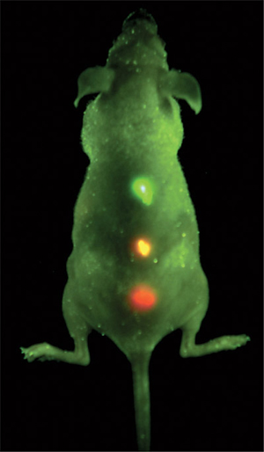
Quantum dots are spherical or cubic-like in shape and are made up of thousands of atoms.
With highly luminous quantum dots, doctors are able to identify cancerous tissue in vivo by using a Mercury lamp.
The quantum dots are
attracted to cancerous tissue.

Slide 15
Nanocrystals
Nanocrystals are grown from inorganic materials.
Atoms aggregate into a crystalline form which is known as a cluster.
Usually, nanocrystals are grown from metals and semiconductors, however, they have been made from, gold, rhodium, platinum, palladium, and silver.

Slide 16
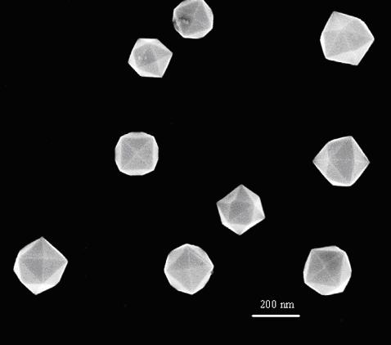
Nanocrystals in diameter are roughly 10 nanometers.
The most interesting application of nanocrystals may be in the development of solar cells.

Slide 17
Nanoshells
Nanoshells consist of a silica core, with an ultrathin metallic coating.
Nanoshells are ball shaped and about 5% the size of a red blood cell.
The core of the nanoshell, which has a diameter of about 100 nm, is non-conducting , while the outer laying, usually gold or silver, approximately 8 to 10 nm is conducting.

Slide 18
Growth steps of nano-gold coating “shells” around
nanoparticles of silica .

Slide 19
Nanoshells can be created with all shapes, and sizes. It can look like rods, balls, or eggs.
Non-toxic cancer treatment is the most exciting applications of nanoshells.
nanoshells have been injected into the bodies of animals and then illuminated giving off intense heat destroying tumor cells.

Slide 20
Nanowires
A nanowire is simply a wire made of metal, silicon, or another conductor which is nano-sized.
Nanowires are also known as quantum wires.
Nanowires allow the creation of other nano-sized technologies such as nano-robots.
Such nano-sized robots could be used in the medical diagnoses.

Slide 21
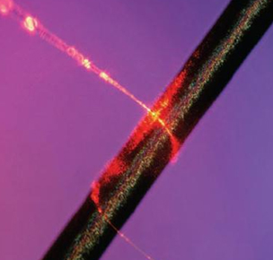

Slide 22
Self assembly lipid microtube
Glycero-phosphatidylcholine it can self-assembly into a lipid microtubule structure.
The lipid microtubule is a stable structure.
Both lipid microtubules and metalized microtubules can be used as vehicles for encapsulating biological active molecules to control their release and to develop micro-components in biological and mechanical systems.

Slide 24
Peptide nanotubes
Peptide nanotubes consist of cyclic peptide from an equal number of D-amino acid and L-amino acid. the inner diameter of the tube is determines by the number of amino acids.
Peptide nanotubes is used as a new type of antibiotics used to treat bacterial infections that resistant to conventional antibiotics.
It is Called smart drugs. These cyclic peptides is called nanobiotics .

Slide 25
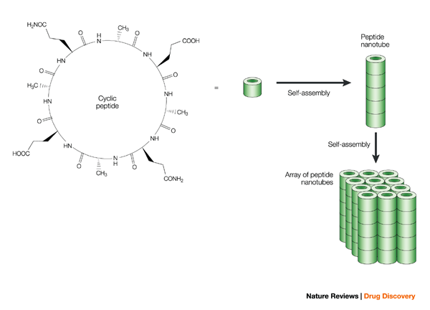

Slide 26
Magnetic nanoparticles
Magnetic nanoparticles are a class of nanoparticle which can be manipulated using magnetic field.
Such particles commonly consist of magnetic elements such as iron, nickel and cobalt and their chemical compounds.
In most cases, the particles range from 1 to 100 nm in size.

Slide 27
Application of magnatic nanoparticles
Magnetic immunoassay
drug targeting
biomedicine & Biomedical imaging
environmental remediation
Waste water treatment
Genetic engineering

Slide 28
Inorganic Nanocages
Inorganic Nanocages are hollow porous gold nanoparticles ranging in size from 10 to over 150 nm.
Gold nanocages also absorb light and heat up, killing surrounding cancer cells.
functionalized nanocages with cancer-specific antibodies so they specifically attach to cancer cells.

Slide 29
Metal Nanofoams
Nanofoams of iron, cobalt, nickel, copper, silver, and palladium have been prepared.
These foams are effective catalysts and are being investigated for other applications.

Slide 30
Nanofibers
Nanofibers are defined as fibers with diameters less than 100 nm.
The most frequently mentioned materials with nanofiber morphology are:
titanium dioxide (TiO₂), silicon dioxide (SiO₂), aluminum oxide (Al₂O₃), or platinum (Pt).
In Medical uses:
artificial organ components, tissue engineering, drug delivery, wound dressing, medical textile materials.

Slide 32
Nanomesh
The nanomesh is an inorganic nanostructured two-dimensional material.
The nanomesh looks like an assembly of hexagonal pores at the nanometer scale.
The distance between 2 pore centers is only of 3.2 nm, whereas each pore has a diameter of about 2 nm and is 0.05 nm deep.
interesting applications of the nanomesh in areas like nanocatalysis, surface functionalisation, etc.

Slide 33
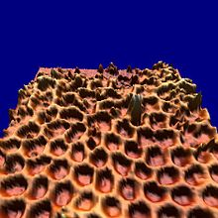

Slide 34
Nanoflowers
These crystalline are nanostructures of silicon carbide are grown from droplets of gallium on a silicon surface.
These nanoflowers will be used in new applications, such as water repellant coatings or new types of solar cells.

Slide 35
