Slide 1
Physical and Chemical Nature of Nanoparticles
Lec.2

Slide 2
Non-engineered and engineered NPs.
Nanoparticles are of two types:
Non-engineered NPs present in the environment are derived from natural events such as terrestrial dust storms, erosion, volcanic eruption, and forest fires.

Slide 3
Terrestrial dust storms
Dust storms appear to be the largest single source of environmental nanoparticles.
Approximately 50% of troposphere atmospheric aerosol particles are minerals originating from the deserts.
The size of particles produced during a dust storm varies from 100 nm to several microns.

Slide 4
Extraterrestrial dust
Nanoparticles exist widely in extra-terrestrial space.
Examples of dust collected from space, from the moon, and on Mars.
The extraterrestrial dust poses major environmental problems for astronauts as well as for equipment.

Slide 6
Forest fires
Forest fires and grass fires are primarily caused by lightning strikes or by human activity.
Major fires can spread ash and smoke over thousands of square miles and lead to an increase of particulate matter (including nanoparticles) exceeding ambient air quality standards.

Slide 7
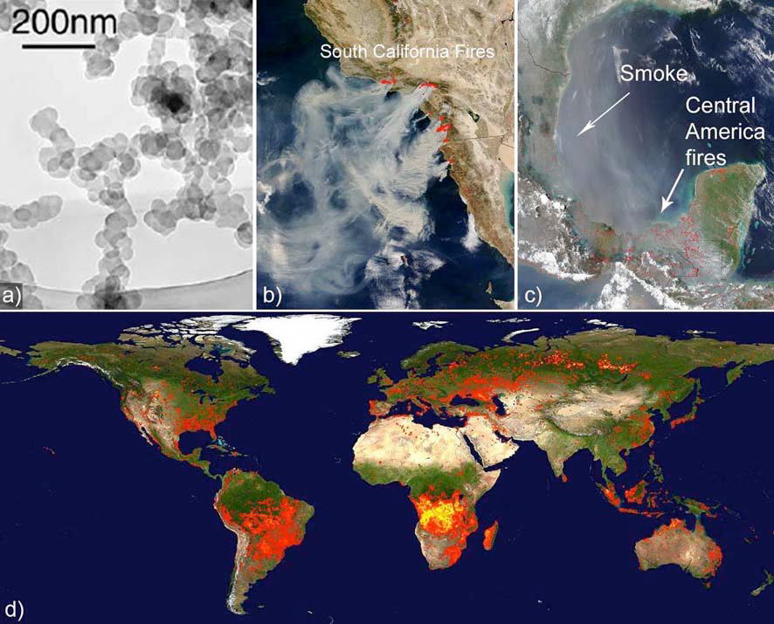

Slide 8
Volcanoes
When a volcano erupts, ash and gases containing particulate matter ranging from the nanoscale to microns, are propelled high into the atmosphere, sometimes reaching heights over 18000 meters.
a single volcanic eruption can eject up to 30 million tons of ash.

Slide 10
Engineered NPs (ENPs)
are intentionally produced by man using many different materials, such as
metals (including Au, Ag, Zn, Ni, Fe, and Cu)
metal oxides (TiO2, Fe2O4, SiO2, CeO2, and Al2O3)
nonmetals (silica and quantum dots)
carbon (graphene and fullerene)
Polymers (alginate, chitosan, hydroxyethyl cellulose, polyhydroxyal kanoates).
and lipids (soybean lecithin and stearic acid)

Slide 11
Physical and chemical properties

Slide 12
When the size of the nanomaterial is reduced, and the nanoscale level is reached, it is possible that the same material will display totally different properties (different melting point, conductivity, etc.).
This is because matter at the nanoscale no longer follows Newtonian physics but rather quantum mechanics.

Slide 13
In other words, the properties of materials can be size-dependent.
This might be a rather new concept, conventionally, the properties of a substance (solid, liquid or gas) are related to the atoms and molecules that make up the substance, and the way they are connected to one another (chemical bonds).

Slide 14
Physical Properties of Nanoparticles
Physical properties of NPs include shape, size, specific surface area, agglomeration/ aggregation, state of size distribution, surface morphology/topography, and structure including crystallinity, defect structure, and solubility.
The size, shape, surface area, and size distribution of NPs are important deciding factors controlling their uptake by organisms.

Slide 15
NPs of the different parameters such as dispersion, surface properties, agglomeration and de-agglomeration can be controlled using :
ultrasonication, ionic strength and pH of aqueous solutions, physiological buffers, and cell culture media.

Slide 16
Size and Shape
The size and shape can be identified as the most important parameter to define the nanomaterial in general.
NPs below 20–30 nm in size are characterized by an excess of energy at the surface and are thermodynamically unstable because of the interfacial tension, acting as a driving force, which leads to a spontaneous reduction of the surface area.

Slide 17
The design of NPs has gained a lot of attention, resulting in particles with various shapes such as spheres, rods, tubes, fibers, and disks, etc.
and more extraordinary geometries such as worms, squares, urchins, and ellipsoids.
The optical properties of NPs also depend on its size and shape.

Slide 18
Difference in the optical properties of gold NPs for different shapes

Slide 19
Surface and Size Distribution of Nanoparticles
The surface morphology and surface area of NPs can be analyzed using scanning electron microscope (SEM).
To get a higher resolution of approximately 0.2 nm, atomic force microscopy (AFM) can be used. It provides real topographical images of sample surfaces.
X-ray diffraction (XRD) is the most essential tool used to characterize crystal structures.

Slide 20
Increased surface-to-volume ratio:
one of the distinguishing properties of nanomaterials is that they have an increased surface area.
It has already been stated that a nanomaterial is formed of at least a cluster of atoms, often a cluster of molecules.
It follows that all types of bonding that are important in chemistry are also important in nanoscience.

Slide 21
They are generally classified as:
Intramolecular bonding (chemical interactions):
these are bonding that involve changes in the chemical structure of the molecules and include ionic, covalent and metallic bonds;

Slide 22
Intermolecular bonding (physical interaction):
these are bonding that do not involve changes in the chemical structure of the molecules and include :
ion-ion and ion-dipole interactions; van der Waals interactions; hydrogen bonds; hydrophobic interactions.

Slide 23
Shape also matters
Given the same volume, the extent of the surface area depends on the shape of the material.
A simple example is a sphere and a cube having the same volume.
The cube has a larger surface area than the sphere.
For this reason, in nanoscience, not only the size of a nanomaterial is important, but also its shape.

Slide 25
The fact that in a nanomaterial a larger fraction of the atoms is at the surface influences some physical properties such as the melting point.
Given the same material, its melting point will be lower if it is nano-sized.
Surface atoms are more easily removed than bulk atoms, so the total energy needed to overcome the intermolecular forces that hold the atom ‘fixed’ is less, thus the melting point is lower.

Slide 26
Surface energy
Atoms and molecules that exist at the surface or at an interface are different from the same atoms or molecules that exist in the interior of a material.
This is true for any material.
Atoms and molecules at the interface have enhanced reactivity and a greater tendency to agglomerate: surface atoms and molecules are unstable, they have high surface energy.

Slide 27
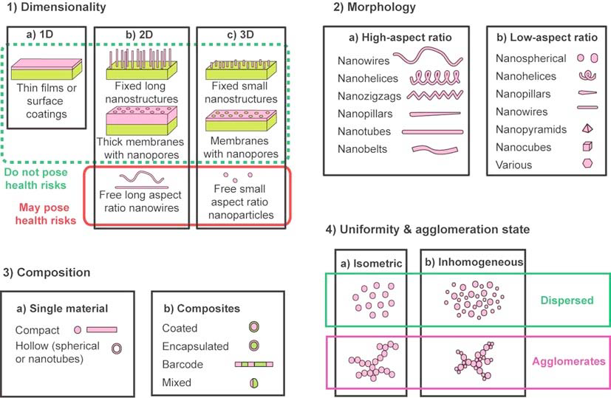

Slide 28
Chemical Properties of Nanoparticles
Chemical properties include the elemental composition of nanomaterials and its surface chemistry such as zeta potential and photocatalytic properties.
The chemical properties of a material are determined by the type of motion of its electrons.

Slide 29
Electrical properties
Some nanomaterials exhibit electrical properties that are absolutely exceptional.
Their electrical properties are related to their unique structure.
Two of these are fullerenes and carbon nanotubes.
For instance, carbon nanotubes can be conductors or semiconductors depending on their nanostructure.

Slide 30
Optical properties
Some nanomaterials display very different optical properties, such as color and transparency, compared to bulk materials.
Nanomaterials in general can have peculiar optical properties as a result of the way light interacts with their fine nanostructure.

Slide 31
Magnetic properties
In general, the magnetic behavior of a material depends on the structure of the material and on its temperature.
The typical size of expected magnetic domains is around 1 μm.
When the size of a magnet is reduced, the number of surface atoms becomes an important fraction of the total number of atoms, surface effects become important, and quantum effects start to prevail.

Slide 32
Mechanical properties
Some nanomaterials have inherent exceptional mechanical properties which are connected to their structure.
One such material is carbon nanotubes: these are extremely small tubes having the same honeycomb structure of graphite, but with different properties compared to graphite. They can be single-walled or multi-walled.
Carbon nanotubes are 100 times stronger than steel but six times lighter!!

Slide 33
Merits and Demerits of Nanoparticles
Due to instability of the NPs, retaining the size and shape of NPs is highly challenging.
As the kinetics associated with NPs is rapid and is highly reactive, they inherently interact with impurities.
In addition, encapsulation of NPs becomes necessary when they are synthesized in a solution.

Slide 34
Synthesis of pure NPs becomes highly difficult. Hence, retaining high purity in NPs can become a challenge hard to overcome.
It is noticeable that most experimental studies with NPs have been carried out with aggregates/agglomerates of NPs.

