Slide 1
Page | 1
VIRUS-CELL INTERACTION
cellular tropism of viruses is determined by the presence of appropriate cellular receptors and frequently, cell-type specific transmission factor. Viruses typically encode genes that modulate host-cell function for their own benefit and of course the host has elaborate innate defense to restrict viral functions. Thus the viral and cellular factor that influence the outcome of infection are often in delicate balance and easily shifted one way or the other.
Virus infection causes a wide variety of potentiality victorious changes in the many different kinds of cells that occur in the animal host. The disruption of cellular function, the induction of cell death or transformation or the activation of an inappropriate immune response are all potentiality manifested as disease by the infected host.
Many virus-cell interactions are transient and asynchronous, involving intermediate steps on the pathway, each featuring dynamic interactions between different viral and cellular components.

Slide 2
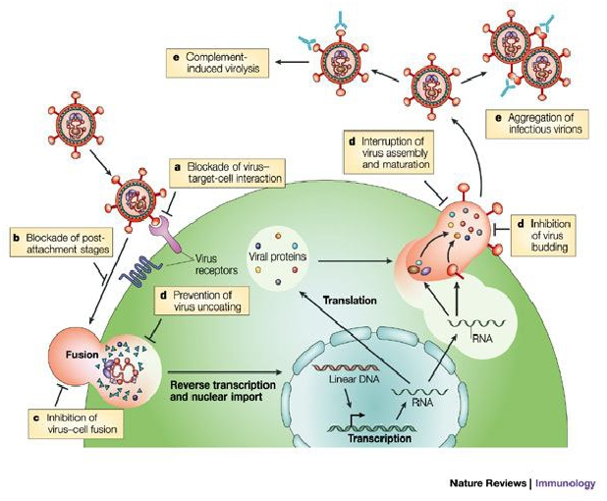
Page | 2
TYPES OF VIRUS-CELL INTERACTION
Viral infection may be Cytocidal or non cytocydal and productive or non-productive that is, not all infection leads to cell death or the production and release of new versions. However criticalchanges can occur in virus infected cells regardless of whether the infection is productive or not.
Some of the most important of all nonproductive virus cell interactions are those associated with persistent infections or latent infections. The term persistent infection simply describes an infection that lasts a long time. The term latent infection describes an infection that "exists but is not exhibited," i.e., an infection in which infectious virions is not formed. In either case, the virus or its genome is maintained indefinitely in the cell, either by the integration of the viral nucleic acid into the host cell DNA or by carriage of the viral nucleic acid in the form of an episome. In these instances, the cell survives, indeed may divide repeatedly. In some instances such cells
never release virions, in others the infection may become productive when induced by an appropriate stimulus. Persistent or latent infections may also be associated with cell transformation. The various types of interaction that can occur between virus and cell are summarized.
FIGURE: VIRUS-CELLINTERACTION

Slide 3
Page | 3
Types of Virus-Cell Interaction
TYPE OF INFECTION | EFFECTS ON CELL | PRODUCTION OF INFECTIOUS VIRIONS | EXAMPLES
Cytocidal | Morphologic changes in Cells (cytopathic effects); Inhibition of protein, RNA and DNAsynthesis; Cell death | Yes | Alphaherpesviruses, enteroviruses, Reoviruses
Persistent, productive | No cytopathic effect; Little metabolic disturbance; cells Continue to divide; may Be loss of the special Functions of some Differentiated cells | Yes | Pestiviruses, Arenaviruses, rabies virus, most Retroviruses
Persistent, nonproductive | Usually nil | No,but virus may Be Induced | Canine distemper Virus in brain Polyomavirus, Adenoviruses
Transformation | Alteration in cell morphology; cells can be Passaged indefinitely; May produce tumors When transplanted to Experimental animals | No, oncogenic DNA viruses Yes, oncogenic retroviruses | Murine, avian leukosis, and sarcoma Viruses

Slide 4
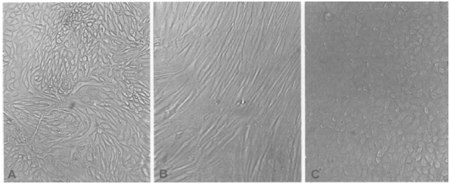
Page | 4
Figure: Unstained confluent monolayers of the three main types of cultured cells as
they appear by low power light microscopy through the wall of the glass or plastic
flask in which they form a monolayer. (A) Primary monkey kidney epithelial cells
obtained directly by the dissociation of cells from a kidney; this produces a mixed
population of mainly epithelial cells. (B) Diploid cell line of fetal fibroblasts. (C)
Continuous line of malignant epithelial cells.
CYTOCIDAL CHANGES IN VIRUS-INFECTED CELLS
Cytopathic viruses kill the cells in which they replicate. When a monolayer of cultured cells is inoculated with a cytopathic virus, the first round of infection yields progeny virus that spreads through the medium to infect adjacent as well as distant cells eventually all cells in the culture may become infected. The resulting cell damage is known as a cytopathic effect (CPE).
Cytopathic effect can usually be observed by low-power light microscopy of unstained cell cultures.
Mechanisms of Cell Damage
So many pathophysiologic changes occur in cells infected with cytopathic viruses that the death of the cell usually cannot be attributed to any particular event; rather, cell death may be the final result of the cumulative action of many insults.

Slide 5
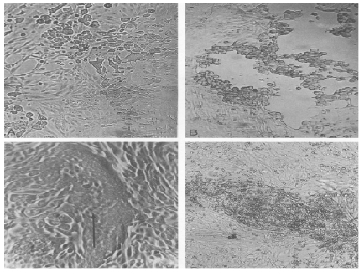
Inhibition of Host Cell Nucleic Acid Synthesis
Inhibition of host cell DNA synthesis is common in viral infections. It is an inevitable consequence of viral inhibition of host cell protein synthesis and its effect on the machinery of DNA replication, but some viruses employ more specific mechanisms. For example, poxviruses produce a DNAse that degrades cellular DNA, and herpes viruses specifically displace the synthesis of host cell DNA with their own synthetic processes.
Inhibition of Host Cell RNA Transcription
Many different classes of viruses including poxviruses, rhabdoviruses, reoviruses, paramyxoviruses, and picornaviruses, inhibit host cell RNA transcription. In some instances, this inhibition may be the indirect consequence of viral effects on host cell protein synthesis, which decreases the availability of transcription factors required for RNA polymerase activity. In other instances, viruses encode specific transcription factors for the purpose of regulating the expression
of their own genes and, in some instances; these factors modulate the expression of cellular genes as well. For example, herpesviruses encode proteins that bind directly to specific viral DNA sequences, thereby regulating the transcription of viral genes.
Figure: Cytopathic effects produced by different viruses. The cell monolayers are shown as they would
normally be viewed in the laboratory, unfixed and unstained. (A) Typical cytopathology of an
enterovirus: rapid rounding of cells, progressing to complete cell lysis. (B) Typical cytopathology of a
herpesvirus: focal areas of swollen rounded cells. (C) Typical cytopathology of a paramyxovirus: focal
clusters of cells are fused to form syncytia. (D) Hemadsorption: erythrocytes adsorb to infected cells
that have incorporated hemagglutinin into the plasma membrane.

Slide 6
Inhibition of Processing of Host Cell mRNAs
Many viruses, including vesicular stomatitis viruses, influenza viruses, and herpesviruses, interfere with the splicing of cellular primary mRNA transcripts that are needed to form mature mRNAs. In some instances, spliceosomes are formed, but subsequent catalytic steps are inhibited.
For example, a protein synthesized in herpesvirus- infected cells suppresses RNA splicing and leads to reduced amounts of cellular mRNAs and the accumulation of primarymRNA transcripts.
Inhibition of Host Cell Protein Synthesis
The shutdown of host cell protein synthesis, while viral protein synthesis continues, is a characteristic of many virus infections. This shutdown is particularly rapid and profound in picornavirus infections, but it is also pronounced in togavirus, influenzavirus, rhabdovirus, poxvirus, and herpesvirus infections. With some other viruses, the shutdown occurs late in the course of infection and is more gradual, whereas with noncytocidal viruses, such as pestiviruses, arenaviruses, and retroviruses, there is no shutdown and no cell death. The mechanisms underlying the shutdown of host cell protein synthesis are varied: some are as mentioned earlier, whereas others include (1) the production of viral enzymes that degrade cellular mRNAs, (2) the
production of factors that bind to ribosomes and inhibit cellular mRNA translation, and (3) the alteration of the intracellular ionic environment favoring the translation of viral mRNAs over cellular mRNAs. Most importantly, some viral mRNAs simply out compete cellular mRNAs for cellular translation machinery by mass action; i.e., the large excess of viral mRNA outcompetes cellular mRNA for host ribosomes. Viral proteins may also inhibit the processing and transport of cellular proteins from the endoplasmic reticulum, and this inhibition may lead to their degradation. This effect is seen in lentivirus and adenovirus infections.
Cytopathic Effects of Toxic Viral Proteins
Large amounts of various viral components may accumulate in the cell late in infection. Most cell damage has been recognized as the supervening of viral replication events on cellular events. Some exceptions for example, the toxicity of adenovirus penton and fiber proteins seems direct and independent of adenovirus replication.
Cytopathic Changes Involving Cell Membranes
Cellular membranes participate in many phases of viral replication, from viral attachment and entry, to the formation of replication complexes, to virion assembly. Viruses may alter plasma

Slide 7
membrane permeability, affect ion exchange and membrane potential, induce the synthesis of new intracellular membranes, and induce the rearrangement of previously existing membranes. A generalized increase in membrane permeability, detected by entry into cells of normally excluded macromolecules or escapes of intracellular molecules, occurs early during picornavirus, alphavirus, reovirus, rhabdovirus, and adenovirus infections. Most importantly, enveloped viruses also direct the insertion of their surface glycoproteins, including fusion proteins, into host cell membranes as part of their budding process, often leading to membrane fusion and syncytium formation.
Cell Membrane Fusion and Syncytium Formation
A conspicuous feature of infection of cell monolayers by lentiviruses, paramyxoviruses, morbilliviruses, pneumoviruses, some herpesviruses, and some other viruses is the production of syncytia which result from the fusion of an infected cell with neighboring infected or uninfected cells. Such syncytia may represent an
important mechanism of viral spread in tissues. Cell membrane fusion is mediated by viral fusion proteins or fusion domains.
NON-CYTOCIDAL CHANGES IN VIRUS-INFECTED CELLS
Non-Cytocidal viruses usually don’t kill cell in which they will replicate. On the contrary, they often cause persistent infection, in which infected cell produce and release virions but overall cellular metabolism is little affected. In many instances the infected cells even continue grow and divided.
Effect of Non-Cytocidal Viral Infection on Function of Specialized Cell
Some viruses such as pestiviruss, arenaviruses and retroviruses that do not shut down host cell DNA, RNA or protein synthesis or do not killed their host cell produce important pathophysiologic changes in their host by affecting crucial functions that are neither associated with the integrity of the cells or their basic housekeeping functions.

Slide 8
Inclusion Bodies
A characteristic morphological change in cells infected by certain virus is the formation of Inclusion Bodies, which may be recognized by light microscopy following fixation and staining.
Depending on the virus Inclusion Bodies may be intranuclear or intracytoplasmic, single or multiple, large or small, round or irregular shape and acidophilic or basophilic.
Polarity of Viral Infection
In the course of their replication viruses belonging to several families of enveloped virus insert their glycoprotein into plasma membrane of their host cell,this insertion is not a random matter.
For example in reservoir host species rabies virus is shed from the apical surface of salivary gland epithelial cells where it enters the saliva and is transmitted by bite. However, lentiviruses bud from basolateral plasma membranes and pass directly from cell to cell or become disseminated through tissue spaces and the bloodstream.
Ultrastructural Changes in Virus-Infected Cells
Early changes in cell structure often are dominated by proliferation of various cell membranes: for example, herpesviruses cause increased synthesis, even reduplication, of nuclear membranes; flaviviruses cause proliferation of the endoplasmic reticulum; picornaviruses and caliciviruses cause a distinctive proliferation of vesicles in the cytoplasm; and many retroviruses cause peculiar fusions of cytoplasmic
membranes. Other ultrastructural changes that are prominent in many viral infections include disruption of cytoskeletal elements, mitochondrial damage, and changes in the density of the cytosol. Late in the course of infection, many cytolytic viruses cause nuclear, organelle, and cytoplasmic rarefaction and/or condensation, with terminal loss of host cell membrane integrity.

