Slide 1
Kingdom: Monera
1- They do not have true nucleus & the nuclear material in the cells is not surrounded by a nuclear membrane.
2- Chlorophyll may be present in the cells but there are no chloroplasts.

Slide 2
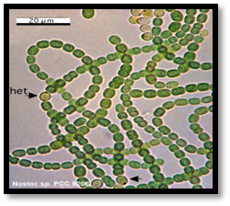
The Monera kingdom is divided into two phylum
A- Blue- Green Algae.(e.x: Nostoc , Oscillatoria )

Slide 3
B- Bacteria.( Bacteria )
One- celled, most of them have no chlorophyll, it has three basic shapes (Coccus, Spherical and Bacillus)
Bacteria that have chlorophyll can make their food by (photosynthesis) but other bacteria did not have chlorophyll so they obtain food by growth on living thing & called Parasites or by dead organic and called Saprophytes.

Slide 4
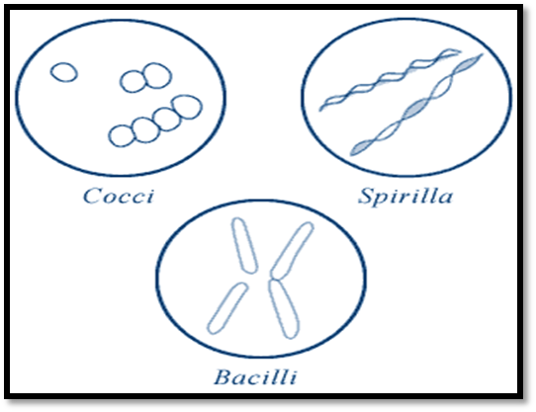

Slide 5
2- Kingdom: Protista
1- Most of the protista are unicellular .
2- They have a true nucleus. (Eukaryotic) .
صفات كثيرة لهذه العائلة المطلوب صفتين فقط

Slide 6
The phylum of Protista Kingdom:
1- Euglenophyta → Euglena
2- Chrysophyta (golden algae) → Diatoms
3- Pyrophyta →Ceratium
4- Sarcodina → Amoeba
5- Ciliophora (Ciliates) → Paramecium
6- Mastoigophora → Trichomonas , Trypansoma
7- Sporozoa → Plasmodium
8- Myxomycota (Slime Molds) → Physarum
الاطلاع على الجميع وحفظ الملون فقط

Slide 7
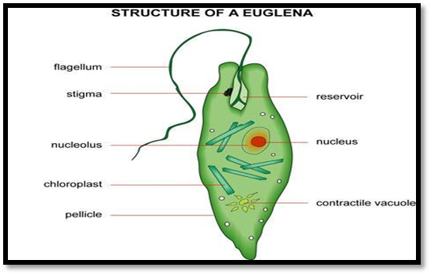
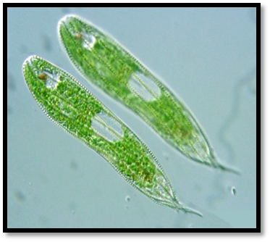
Some examples about Protista:
Euglena:
1- Are unicellular, live in water
2- Euglena have tail called a flagellum
3 Euglena has chloroplast and can make its own food.

Slide 8
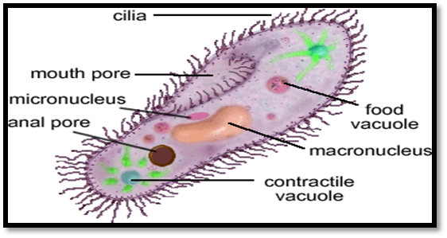
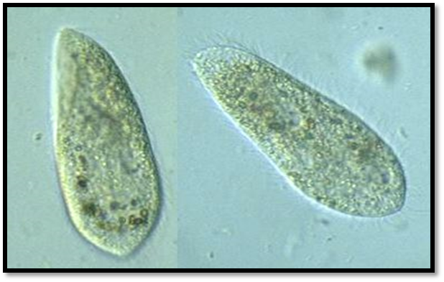
Paramecium:
1- Paramecium is a Sporozoa with two nucleuses, large nucleus controls cell activities and small nucleus is involved in reproduction. 2- Ciliated do not have cell wall, but they have cell membrane.

