Slide 1
Lab 5
Muscle tissue

Slide 2
Classification of Muscle tissues
a. Skeletal muscle
1) Striated and voluntary
2) Found mostly attached to the skeleton
3) Nuclei are peripherally located

Slide 3
b. Cardiac muscle
1) Striated and involuntary
2) Composes the majority of the heart wall (myocardium)
3) One central nucleus

Slide 4
c. Smooth muscle
1) Non striated and involuntary
2) Found mostly in the walls of hollow organs and vessels
3) One central nucleus

Slide 5
Nervous tissue
Is a tissue that are specialized for receiving different types of stimuli.
Neuron Consists of:
Cell Body : contains Nucleus, Mitochondria, Nissl bodies
Dendrites: highly branched extensions of the cell body. Conduct impulses towards the cell body
Axon: a single long process. Conducts impulses away from the cell body.
Is a tissue that are specialized for receiving different types of stimuli.
Neuron Consists of:
• Cell Body : contains Nucleus, Mitochondria, Nissl bodies
• Dendrites: highly branched extensions of the cell body. Conduct impulses towards the cell body
• Axon: a single long process. Conducts impulses away from the cell body.

Slide 6
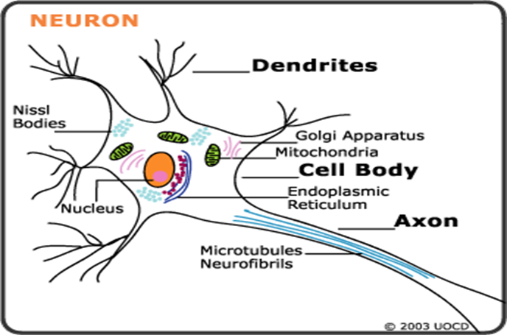

Slide 7
Structural of Neurons:
1. Multipolar neurons: more than two processes one is the axon and the rest are dendrites
2. Bipolar neurons: have two processes one is axon and other one is dendrites
3. Pseudo unipolar neurons: have a single process close to the perikaryon.

Slide 8
