Slide 1

The Course of Fundamentals of Thermodynamics
MUSTANSIRIYAH UNIVERSITY
COLLEGE OF SCIENCES
ATMOSPHERIC SCIENCES DEPARTMENT
2019-2020
Dr. Sama Khalid Mohammed
SECOND STAGE
LECTURE SEVEN

Slide 2
This lecture including the following items
Processes
  Isolated Processes
  Cyclic Processes
  Isothermal Processes
  Isochoric Processes
  Isobaric Processes
  Adiabatic Processes
Adiabatic Free Expansion
Potential Temperature
Exercises

Slide 3
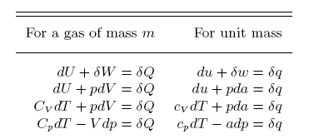
Just to remind you
The equation of the first law of Thermodynamics
du = dq + dw
And then we derived some other expressions of the first law of Thermodynamics as shown in the table below

Slide 4
Processes
Often systems undergo a Change of State (transformation), which means one or more properties of the system has changed.
Process: is a succession of changes of state.
We assume our processes are all sufficiently slow such that each stage of the process is near equilibrium.
Certain common processes are given special names, based on the Greek “isos” , meaning “equal”

Slide 5


Isolated Process
An isolated process is one where the system does no work, and there is no heat flow: W = Q = 0
and hence U2 = U1 = ΔU = 0
so the internal energy of an isolated system is constant.
A cyclic process is one where the system returns to its original state.
Since the final state is the same as the initial state, the total energy change must be zero; so U2 = U1 and Q = W
Cyclic processes

Slide 6
Thermodynamic processes
We can identify four specific kinds of thermodynamic processes that often occur:
    Isothermal – occurs at constant temperature
    Isochoric – occurs at constant volume
    Isobaric – occurs at constant pressure
    Adiabatic – no heat transfer into or out of the system

Slide 7

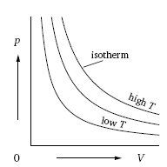
Isothermal process: is the process takes place at constant temperature
the initial and final temperatures are the same, (e.g. freezing of water to ice at –10°C).
Thus (dT = 0) and for an ideal gas the first law becomes: dq=pdα
For this process, any heat flow must occur slowly enough that thermal equilibrium is maintained.
du
C_{v} dT=dq-pdα
Boyle's Law: PV = C علاقة عكسية
Isothermal Process
ΔU= 0
Q=W
W
P₁,V₁,T₁ P₂,V₂,T₁
U₁ U₁

Slide 8
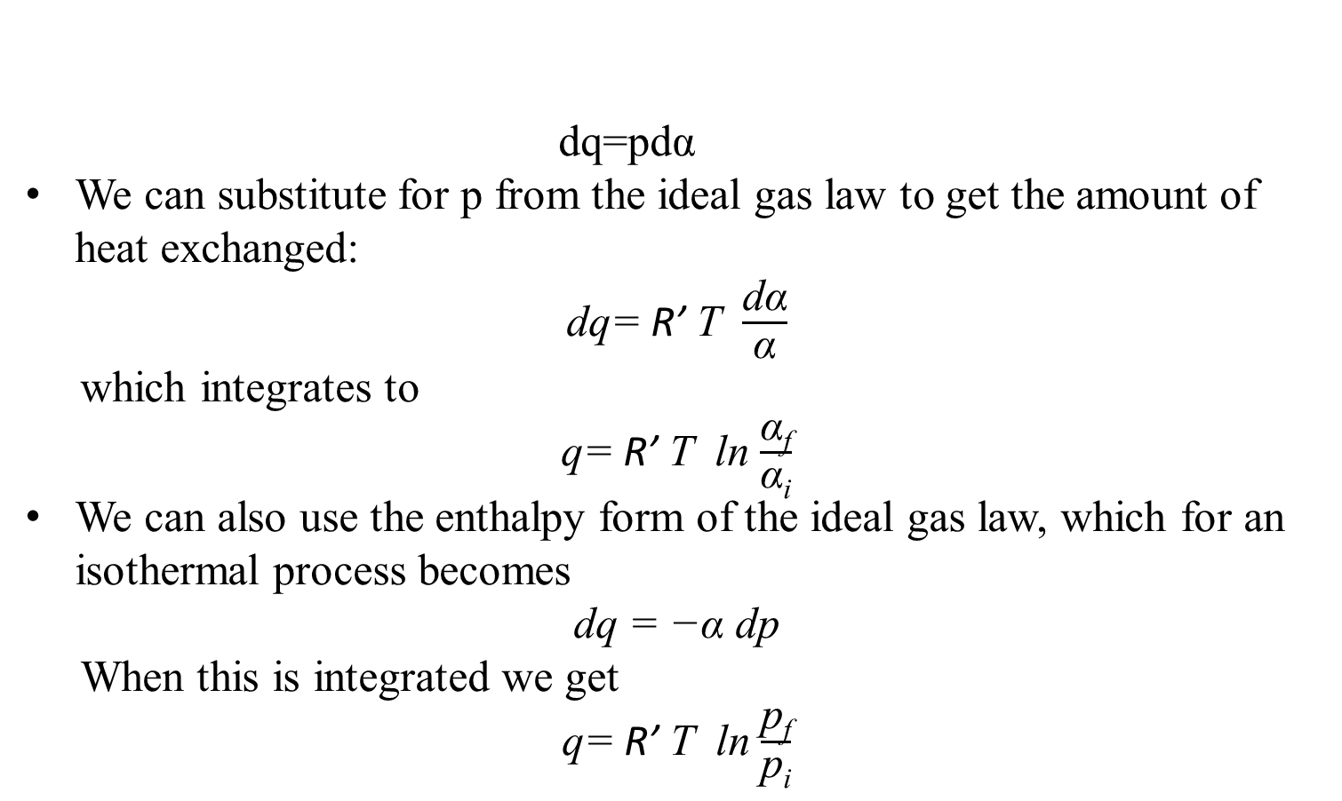
dq=pdα
We can substitute for p from the ideal gas law to get the amount of heat exchanged:
dq= R’ T $\frac{\text{d}\text{α}}{\text{α}}$
which integrates to
q= R’ T ln $\frac{\text{α}\text{f}}{\text{α}\text{i}}$
We can also use the enthalpy form of the ideal gas law, which for an isothermal process becomes
dq = −α dp
When this is integrated we get
q= R’ T ln $\frac{\text{p}\text{f}}{\text{p}\text{i}}$
pα=Rʹ T
dh
C_{p} dT=dq+ αdp

Slide 9
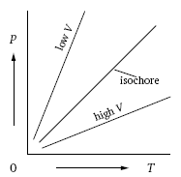
Isochoric is the process takes place at constant volume (e.g. heating of gas in a sealed metal container)
All the energy added as heat remains in the system as an increase in internal energy (Q=ΔU)
If a process is isochoric (dv=0 or dα=0), then the first law for an ideal gas becomes dq=c_{v} dT
du
C_{v} dT=dq-pdα
Isochoric Process
Gay-Lussac's Law: P / T = C علاقة طردية
ΔU= U₂ ₋₋ U₁
Q= ΔU
W=0
P₁,V₁,T₁ P₂,V₁,T₂
U₁ U₂

Slide 10
dq=c_{v} dT
This can be integrated to get (assuming c_{v} is constant)
q=c_{v} (T_{f} -T_{i} )
The amount of heat required to raise the temperature of the gas from T_{i} to T_{f} at constant volume.

Slide 11

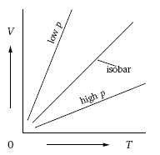
Isobaric is the process takes place at constant pressure (e.g. heating of water in open air under atmospheric pressure)
For an isobaric process, dp = 0. Therefore the first law for an ideal gas becomes dq=c_{p} dT
dh
C_{p} dT=dq+ αdp
Charles' Law: V / T = C علاقة طردية
Isobaric Process
ΔU= U₂ ₋₋ U₁
Q= ΔU+W
W
P₁,V₁,T₁ P₁,V₂,T₂
U₁ U₂

Slide 12
dq=c_{p} dT
which integrates to
q=c_{p} (T_{f} -T_{i} )
The amount of heat required to raise the temperature of the gas from T_{i} to T_{f} at constant pressure.

Slide 13
Adiabatic process is the process takes place when a system changes its state (pressure, volume, or temperature) without heat transfer (dq = 0) during the process (no heat is added/removed to/from the system).
A process can be adiabatic if the system is thermally insulated, or if it is so rapid that there is not enough time for heat to flow.
The two forms of the first law of thermodynamics for an adiabatic process in an ideal gas are
c_{v} dT= - pdα c_{p} dT= αdp
C_{v} dT=dq-pdα ; C_{p} dT=dq+ αdp
Adiabatic Process
For an adiabatic process the change in internal energy is solely due to work done on or by the system,
du = -c_{v}dT = - dw.
ΔU= U₂ ₋₋ U₁
W = U₁ ₋₋ U₂
= - ΔU
Q = 0
W
P₁,V₁,T₁ P₂,V₂,T₂
U₁ U₂

Slide 14
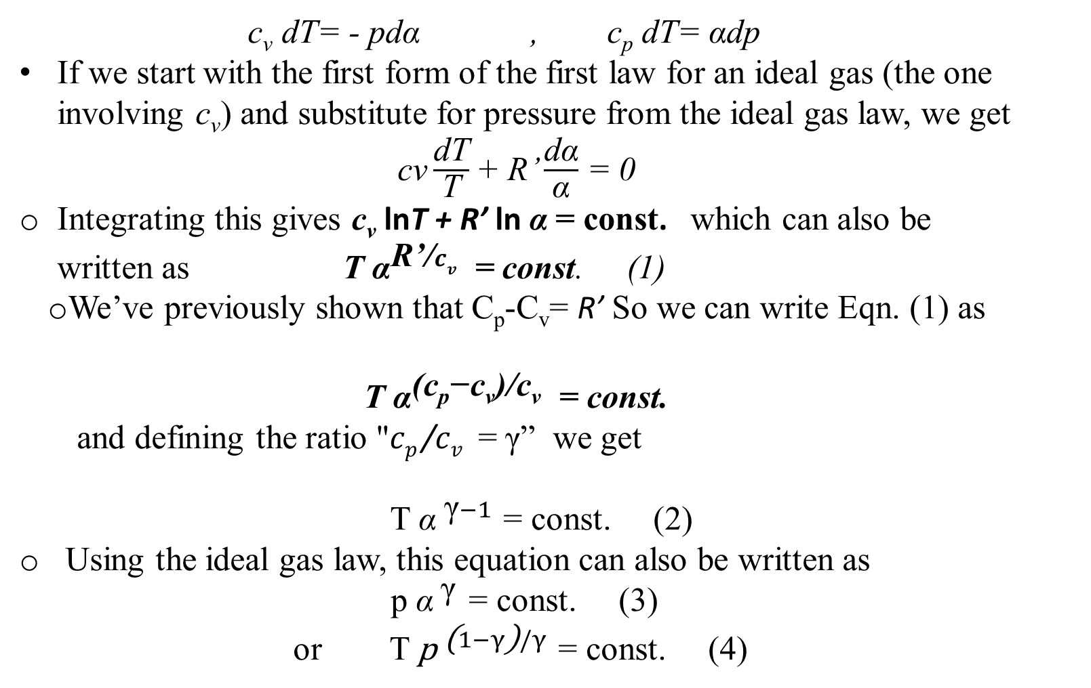
c_{v} dT= - pdα , c_{p} dT= αdp
If we start with the first form of the first law for an ideal gas (the one involving c_{v}) and substitute for pressure from the ideal gas law, we get
$\text{cv}\frac{\text{dT}}{\text{T}}$+ R’ $\frac{\text{d}\text{α}}{\text{α}}$ = 0
Integrating this gives $\text{c}\text{v}$ lnT + R’ ln $\text{α}$= const. which can also be written as T ${\text{α}}^{\text{R}\text{’/}cv}$ = const. (1)
  We’ve previously shown that C_{p}-C_{v}= R’ So we can write Eqn. (1) as
  T ${\text{α}}^{\text{(}\text{c}\text{p}\text{−}\text{cv}\text{)}\text{/}\text{cv}}$ = const.
and defining the ratio "$cp \text{/}cv$ = γ” we get
T ${\text{α} }^{\text{γ}−1}$ = const. (2)
Using the ideal gas law, this equation can also be written as
p ${\text{α} }^{\text{γ}}$ = const. (3)
or T ${\text{p} }^{\text{(}1−γ\text{)}/γ}$ = const. (4)
pα=Rʹ T

Slide 15
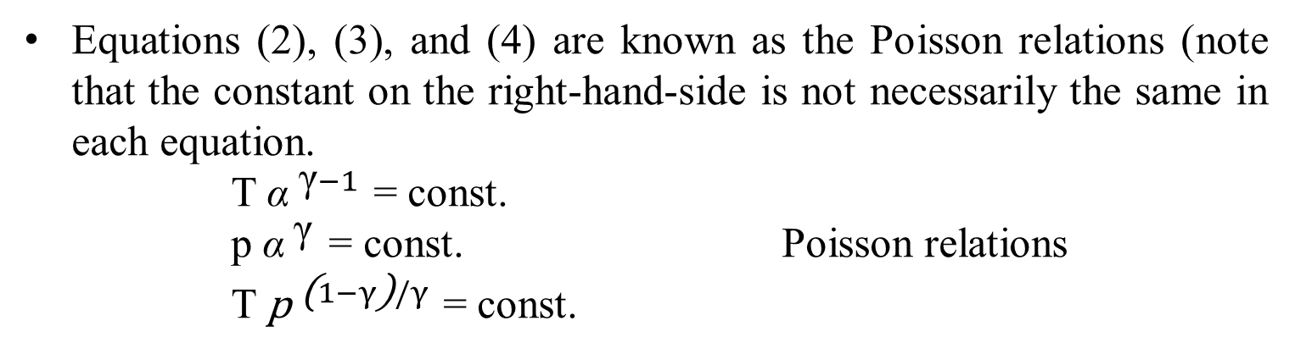
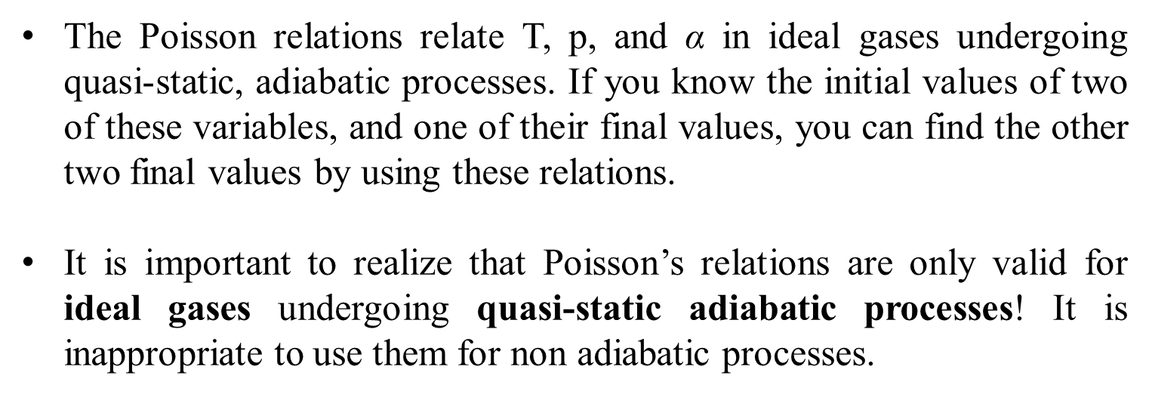
Equations (2), (3), and (4) are known as the Poisson relations (note that the constant on the right-hand-side is not necessarily the same in each equation.
T ${\text{α} }^{\text{γ}−1}$ = const.
p ${\text{α} }^{\text{γ}}$ = const. Poisson relations
T ${\text{p} }^{\text{(}1−γ\text{)}/γ}$ = const.
The Poisson relations relate T, p, and $\text{α}$ in ideal gases undergoing quasi-static, adiabatic processes. If you know the initial values of two of these variables, and one of their final values, you can find the other two final values by using these relations.
It is important to realize that Poisson’s relations are only valid for ideal gases undergoing quasi-static adiabatic processes! It is inappropriate to use them for non adiabatic processes.

Slide 16
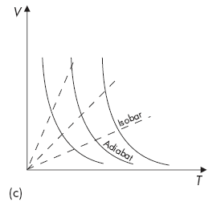

T ${\text{α} }^{\text{γ}−1}$ = const. (2)
Since for dry air γ = 1.4 > 0 equation (2) proves something that as an air parcel rises and expands (i.e. V increases), it does work, so U drops and T drops, and thus its temperature must decrease.

Slide 17
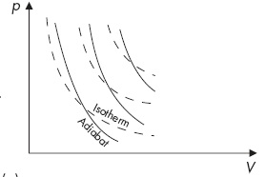
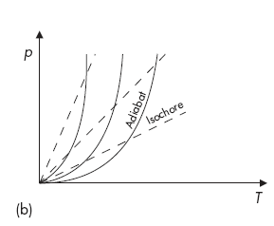
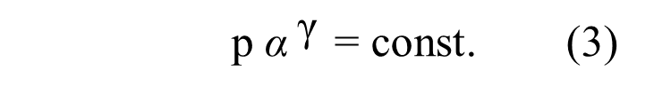
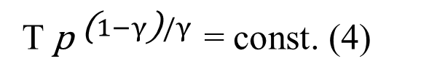
p ${\text{α} }^{\text{γ}}$ = const. (3)
From equation (3) , since γ > 1 the adiabats will be steeper than the isotherms.
T ${\text{p} }^{\text{(}1−γ\text{)}/γ}$ = const. (4)

Slide 18
ADIABATIC FREE EXPANSION
If an ideal gas is allowed to adiabatically freely expand, unopposed, its temperature will not change.
To see why, recall that for an ideal gas undergoing adiabatic expansion dw = c_{v}dT
  In a free expansion there is no work done, so there is no change in temperature.
But what about the expression dw = − pdα ?
The gas expanded, so specific volume changed, so shouldn’t there be work accomplished?
KEY POINT: Remember that the expression dw = − pdα only applies to quasi static processes. A free expansion is not quasi-static, so we can’t calculate work using this expression.

Slide 19
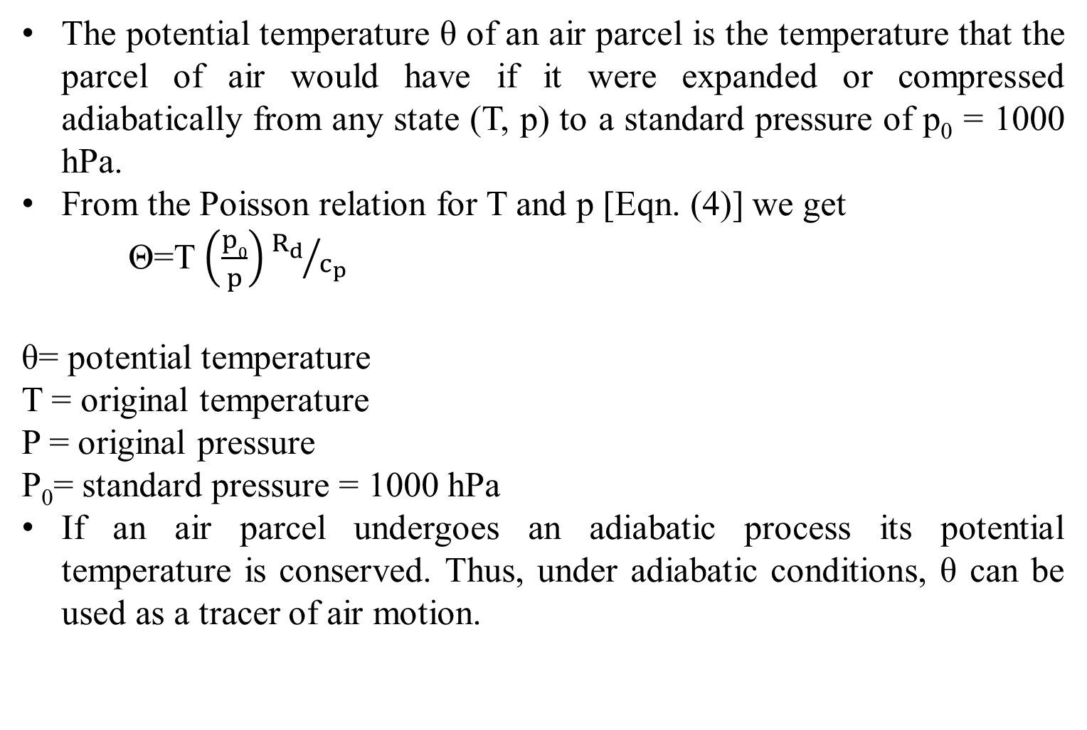
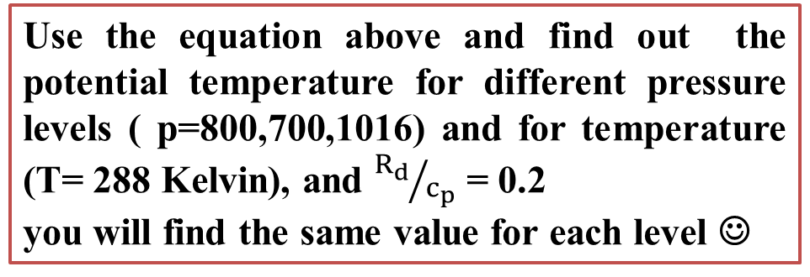
POTENTIAL TEMPERATURE
The potential temperature θ of an air parcel is the temperature that the parcel of air would have if it were expanded or compressed adiabatically from any state (T, p) to a standard pressure of p₀ = 1000 hPa.
From the Poisson relation for T and p [Eqn. (4)] we get
Θ=T $\left(\frac{p0}{p}\right){R_{d}}/{c_{p}}$
θ= potential temperature
T = original temperature
P = original pressure
P₀= standard pressure = 1000 hPa
If an air parcel undergoes an adiabatic process its potential temperature is conserved. Thus, under adiabatic conditions, θ can be used as a tracer of air motion.
Use the equation above and find out the potential temperature for different pressure levels ( p=800,700,1016) and for temperature (T= 288 Kelvin), and ${R_{d}}/{c_{p}}$ = 0.2
you will find the same value for each level ☺
Notes:
The dry adiabatic lapse rate Γ=-dT/dz = g/cp = 9.8 c/km

