Slide 1
Practical Mobile computing
Custom checkbox
Fourth class IT&CS
Mhanad ali

Slide 2
Custom check box
الهدف من البرنامج هو لتاشير حقل الصندوق ليتحول من حالة عدم تاشير حالة تاشير المربع

Slide 3
Design the layout
Drag and drop two object from widget
1- two text view
A- for click on checkbox
B- for unchecked
2- Check box

Slide 4
The layout of design

Slide 5
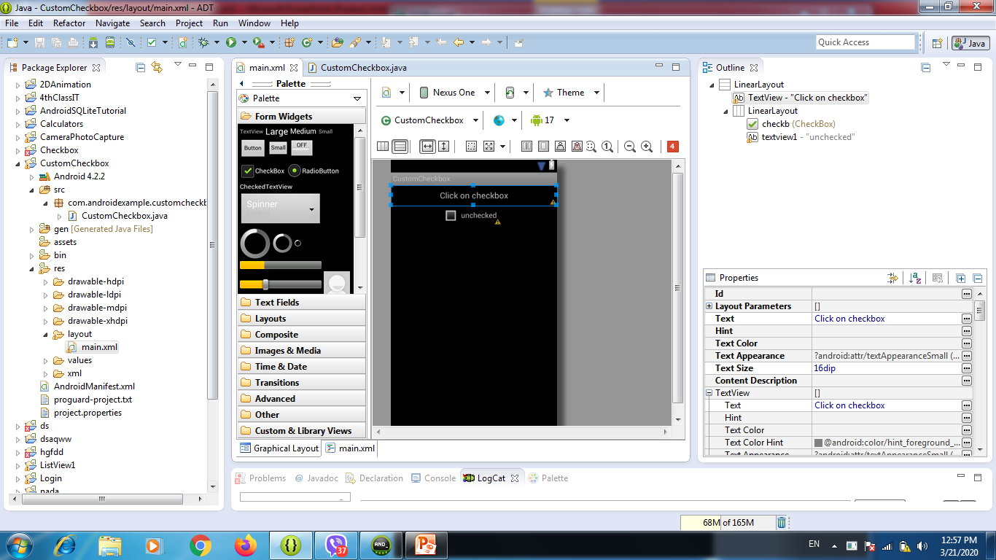

Slide 6
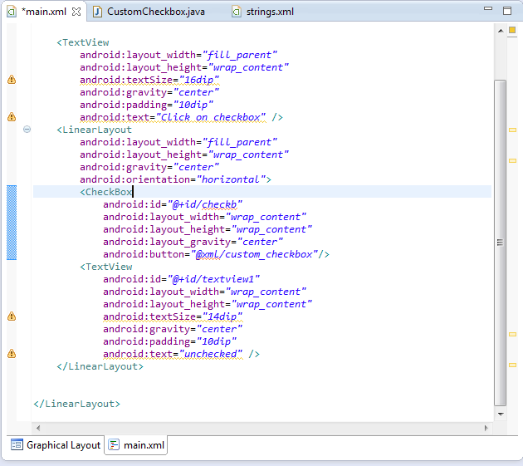
Code of XML

Slide 7
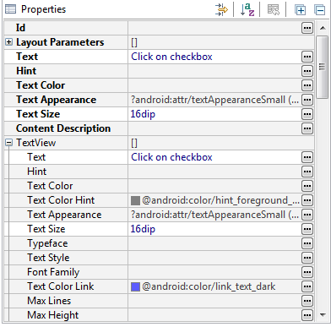
Properties of click on checkbox(textview)

Slide 8
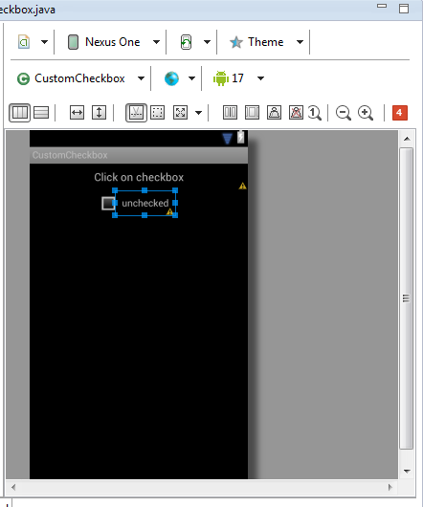
Uncheckedbox

Slide 9
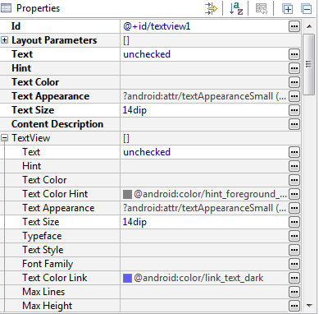
Properties for textview1(unchecked)

Slide 10
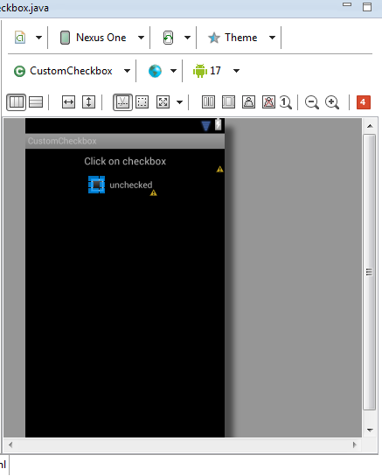
Checkbox button

Slide 11
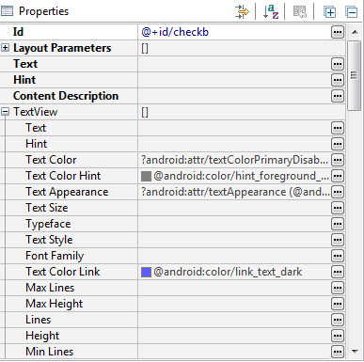
Properties of checkbox button

Slide 12
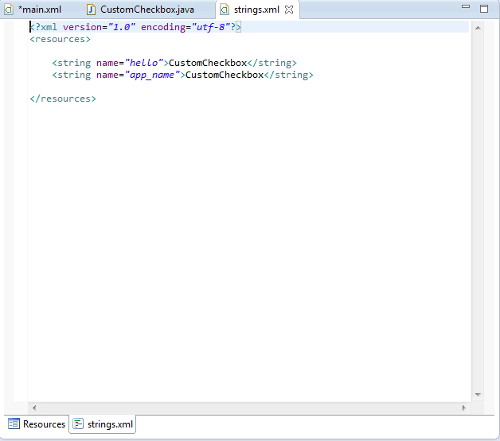
The value of string

Slide 13
Code of java1
package com.androidexample.customcheckbox;
import android.app.Activity;
import android.os.Bundle;
import android.view.View;
import android.view.View.OnClickListener;
import android.widget.CheckBox;
import android.widget.TextView;
public class CustomCheckbox extends Activity implements OnClickListener {
/** Called when the activity is first created. */
@Override
public void onCreate(Bundle savedInstanceState) {
super.onCreate(savedInstanceState);
setContentView(R.layout.main);
CheckBox checkb = ( CheckBox ) findViewById( R.id.checkb );
checkb.setOnClickListener(this);
}

Slide 14
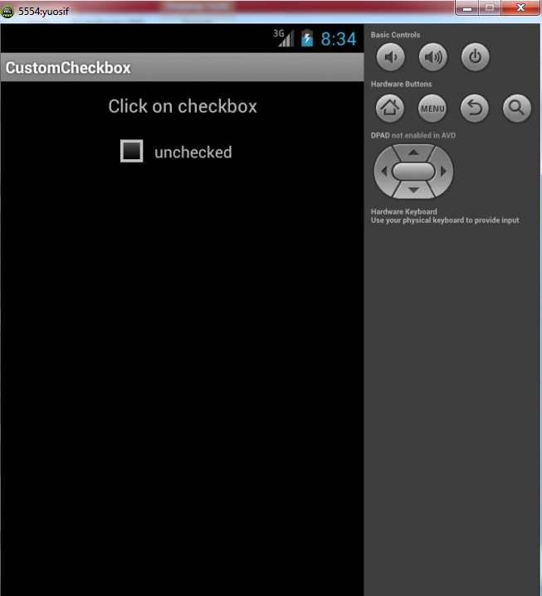
AVD when unchecked

Slide 15
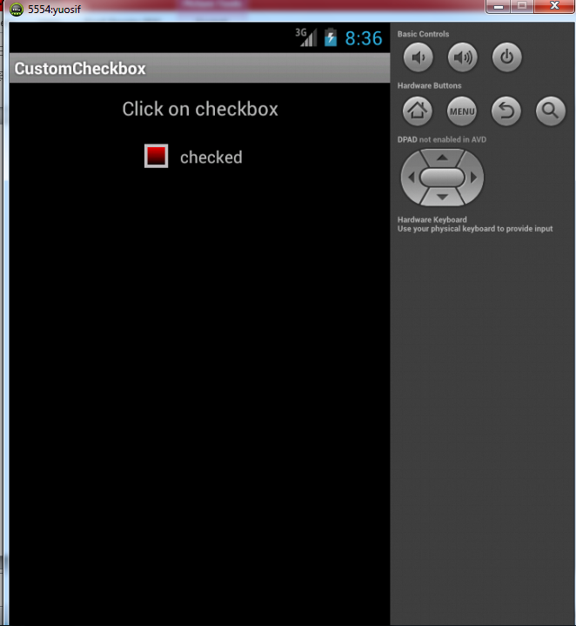
AVD when checked

Slide 16
Code of java2
@Override
public void onClick(View v) {
TextView output = (TextView)findViewById(R.id.textview1);
if (((CheckBox)v).isChecked()) {
output.setText("checked");
} else {
output.setText("unchecked");
}
}
}

