Slide 1
The Course of Fundamentals of Thermodynamics
MUSTANSIRIYAH UNIVERSITY
COLLEGE OF SCIENCES
ATMOSPHERIC SCIENCES DEPARTMENT
2019-2020
Dr. Sama Khalid Mohammed
SECOND STAGE

Slide 2
Welcome Students In The Sixth Lecture ☺

Slide 3
This lecture including the following items
Enthalpy and why it is used.
Heat capacities and specific heats
Relation between c_{v} and c_{p}
Specific heats for ideal gases
The first law of thermodynamics for ideal gases
Exercises

Slide 5
For Your Information
If heat is added to a material at constant pressure so that the specific volume of the material increases from α₁ to α₂, the work done by a unit mass of the material is p(α₂ - α₁).
as we know that:
Then the finite quantity of heat Δq added to a unit mass of the material at constant pressure is given by :
where u1 and u2 are, respectively, the initial and final internal energies for a unit mass of the material.
Therefore, at constant pressure,
where h is the enthalpy of a unit mass of the material,which is defined by
Because u, p, and α are functions of state, h is a function of state. Differentiating the last equation, we obtain

Slide 6
ENTHALPY
It is one of the state variables, and is defined as
H ≡ U + pV
The differential of H is given as
dH = dU + pdV + Vdp
This makes it possible to write the first law of thermodynamics as:
dH = dQ +Vdp (1)

Slide 7
WHY USING ENTHALPY?
The reason enthalpy is convenient to use is that for constant pressure processes, dp = 0 and so dH = dQ.
Since many thermodynamic processes in the atmosphere occur at constant pressure, change in enthalpy and heat are equivalent and are used interchangeably in such processes.
In an isobaric (constant pressure) process, dW = dU − dH , which states that the work is the difference in the changes of internal energy and enthalpy.
From the first form of the first law, dU = dQ – pdV, we see that at constant volume, dU = dQ.
For constant volume processes, heat and change in internal energy are interchangeable.
For constant pressure processes, heat and enthalpy change are equivalent.
For constant volume processes, heat and internal energy change are equivalent.

Slide 8


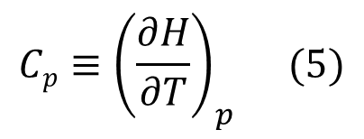
HEAT CAPACITIES AND SPECIFIC HEATS
Heat capacity is the amount of heat Q needed to raise the temperature of a substance T by one degree.
Heat capacity is defined in terms of either a constant volume process or a constant pressure process (At constant pressure, some of the heat supplied goes into doing work of expansion and less is available with the system )
${Cv=\left(\frac{∂Q}{∂T}\right)}_{v}$ (2)
${Cp=\left(\frac{∂Q}{∂T}\right)}_{p}$ (3)
From the two forms of the first law (dH = dQ), and (dU = dQ), we can show that:
so that the definitions for heat capacity can also be written as
$${{\left(\frac{∂Q}{∂T}\right)}_{v}=\left(\frac{∂U}{∂T}\right)}_{v}$$
$${{\left(\frac{∂Q}{∂T}\right)}_{p} =\left(\frac{∂H}{∂T}\right)}_{p}$$
${Cv≡\left(\frac{∂U}{∂T}\right)}_{v}$ (4)
$${Cp≡\left(\frac{∂H}{∂T}\right)}_{p} (5)$$
Notes:
Note that bodies (systems) contain internal energy and not heat.
pressure. At constant pressure, some of the heat supplied goes into doing work of expansion and less is available with the system (to raise it temperature).

Slide 9
HEAT CAPACITIES AND SPECIFIC HEATS
The units of heat capacity are J K⁻¹.
Heat capacity is an extensive property (depends on ‘amount of matter’), tts intensive counterpart is called specific heat, and is defined as
The units of specific heat are J K⁻¹ kg⁻¹.
Heat capacities and specific heats are not constant, but are functions of T and p.
If a substance has higher heat capacity, then more heat has to be added to raise its temperature.
${Cv≡\frac{Cv}{m}=\left(\frac{∂u}{∂T}\right)}_{v}$ (6)
${Cp≡\frac{Cp}{m}=\left(\frac{∂h}{∂T}\right)}_{p}$ (7)

Slide 10
RELATION BETWEEN Cv and Cp
To see the relation between C_{v} and C_{p} we start with the:
From the definition of enthalpy,
H =U + pV ,
we take the partial derivative with respect to T at constant pressure to get:
Substituting (9) into (8) we get
The differential of U is:
${Cp−Cv=\left(\frac{∂H}{∂T}\right)}_{p}$ ${−\left(\frac{∂U}{∂T}\right)}_{v} (8)$
${{\left(\frac{∂H}{∂T}\right)}_{p}=\left(\frac{∂U}{∂T}\right)}_{p}$ ${+p\left(\frac{∂V}{∂T}\right)}_{p}$ (9)
${{Cp−Cv=\left(\frac{∂U}{∂T}\right)}_{p}+p\left(\frac{∂V}{∂T}\right)}_{p}$ ${−\left(\frac{∂U}{∂T}\right)}_{v}$ (10)
${dU=\left(\frac{∂U}{∂T}\right)}_{v}$dT ${+\left(\frac{∂U}{∂V}\right)}_{T} dV$

Slide 11

RELATION BETWEEN Cv and Cp
Dividing by dT gives:
and assuming constant pressure we get:
Or
Substituting this into (10)
$\text{gives} Cp−Cv=\left[{\left(\frac{∂U}{∂V}\right)}_{T}+p\right]$ ${\left(\frac{∂V}{∂T}\right)}_{P} (12)$
${\frac{∂U}{dT}=\left(\frac{∂U}{∂T}\right)}_{v}$ ${+\left(\frac{∂U}{∂V}\right)}_{T} \frac{dV}{dT}$
${{\left(\frac{dU}{dT}\right)}_{p}=\left(\frac{∂U}{∂T}\right)}_{v}$ ${+\left(\frac{∂U}{∂V}\right)}_{T}{\left(\frac{dV}{dT}\right)}_{p}$
${{\left(\frac{∂U}{∂T}\right)}_{p}=\left(\frac{∂U}{∂T}\right)}_{v}$ ${+\left(\frac{∂U}{∂V}\right)}_{T}{\left(\frac{∂V}{∂T}\right)}_{p}$ (11)
${{Cp−Cv=\left(\frac{∂U}{∂T}\right)}_{p}+p\left(\frac{∂V}{∂T}\right)}_{p}$ ${−\left(\frac{∂U}{∂T}\right)}_{v}$ (10)

Slide 12
RELATION BETWEEN Cv AND Cp
In terms of specific heats this is:
$Cp−Cv=\left[{\left(\frac{∂u}{∂α}\right)}_{T}+p\right]$ ${\left(\frac{∂α}{∂T}\right)}_{P} (13)$
(𝜕𝑈/𝜕𝑉)_{𝑇} or (𝜕𝑢/𝜕α)_{T} is called the internal pressure, and is due to forces between the molecules of the substance.
Riddles
For gases, C_{p} > C_{v}, why?
Notes:
For gases, C_{p} is greater than C_{v}. This is because in a constant pressure process some of the heat added will be used to do work as the system expands, so the internal energy cannot increase as much as in a constant volume process.

Slide 13




SPECIFIC HEATS FOR IDEAL GASES
Recall that the specific heat at constant volume and the specific heat at constant pressure was defined as:
Since the internal energy and enthalpy of an ideal gas depend only on
temperature, then for an ideal gas we don’t have to write the specific heats as partial derivatives, but can instead use full derivatives
From the expressions for the internal energy of ideal gases,
we get that
$${Cv≡\left(\frac{∂u}{∂T}\right)}_{v}$$
$${Cp≡\left(\frac{∂h}{∂T}\right)}_{p}$$
$$Cv≡\frac{du}{dT}$$
$$Cp≡\frac{dh}{dT}$$
$$Cv≡\frac{5}{2}\text{R}\text{’ }\text{for} \text{di}\text{atomic} \text{gas}$$
$Cv≡\frac{3}{2}$ R’ for monatomic gas ;

Slide 14
SPECIFIC HEATS FOR IDEAL GASES
The expression relating the specific heats at constant pressure and at constant volume is also greatly simplified for an ideal gas. The general expression [Eqn. (13)] becomes, for an ideal gas,
C_{p}-C_{v}=R’ (14)
which tells us that:
99% of the atmosphere is composed of diatomic molecules (N₂ and O₂), and has a specific gas constant of 287.1 J-kg⁻¹-K⁻¹. This leads to values of C_{v} and C_{p} of 718 J-kg⁻¹-K⁻¹ and 1005 J-kg⁻¹-K⁻¹. These values are extremely close to the measured values for the atmosphere.
$$Cp≡\frac{7}{2}\text{R}\text{’ }\text{for} \text{di}\text{atomic} \text{gas}$$
$Cp≡\frac{5}{2}$ R’ for monatomic gas ;

Slide 15


THE FIRST LAW OF THERMODYNAMICS FOR IDEAL GASES
The specific heats for ideal gasses are
$From these we can write du$=C_{v} dT dh=C_{p} dT
Using these expressions in the first law of thermodynamics results in the following two forms for the first law:
C_{v} dT=dq-pdα ; C_{p} dT=dq+ αdp
(First Law of Thermodynamics for Ideal Gas)
We are often most interested in how the thermodynamic variables change with time. By dividing the first law by dt we get:
C_{v} $\frac{dT}{dt}$=$\frac{dq}{dt}$-p $\frac{dα}{dt}$ ; C_{p}$\frac{dT}{dt}$=$\frac{dq}{dt}$+α$\frac{dp}{dt}$
(First Law of Thermodynamics for Ideal Gas)
$$Cv=\frac{du}{dT}$$
$$Cp=\frac{dh}{dT}$$

Slide 16
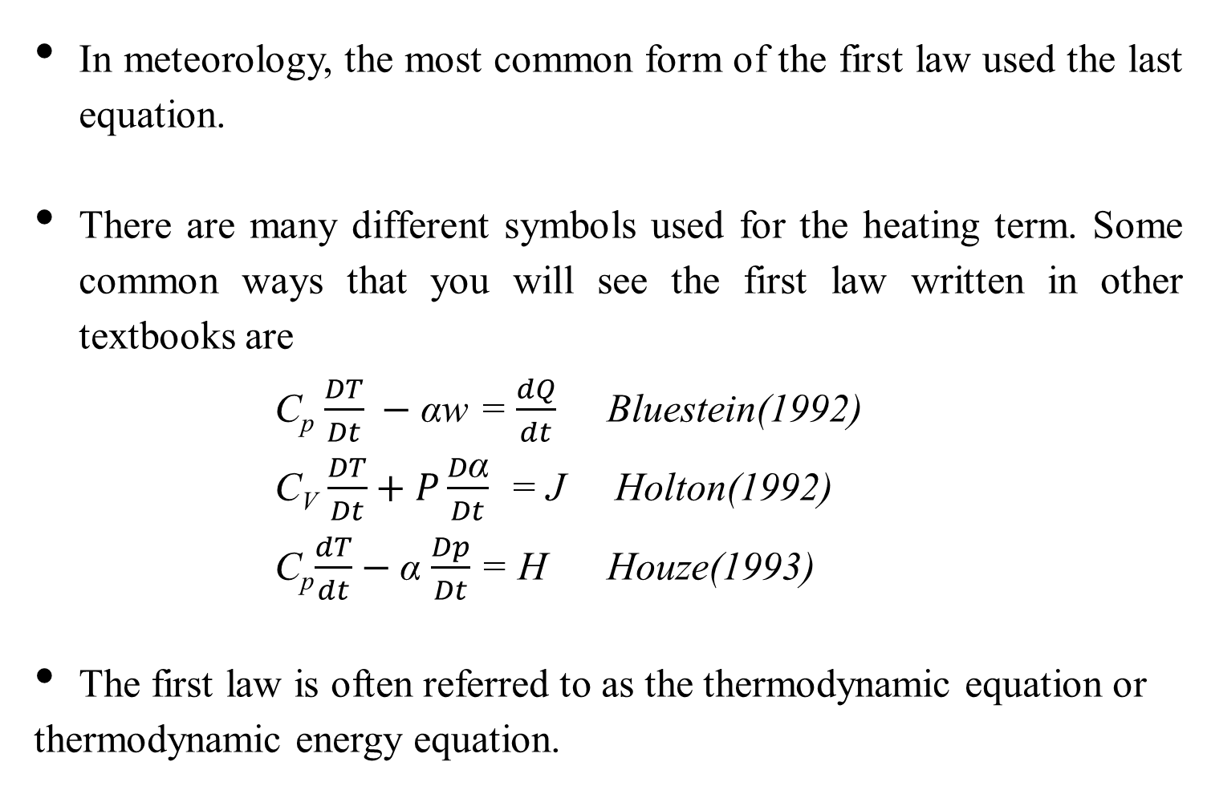
THE FIRST LAW OF THERMODYNAMICS FOR IDEAL GASES
In meteorology, the most common form of the first law used the last equation.
There are many different symbols used for the heating term. Some common ways that you will see the first law written in other textbooks are
C_{p} $\frac{DT}{Dt} −$αw = $\frac{dQ}{dt}$ Bluestein(1992)
C_{V} $\frac{DT}{Dt}+P\frac{D\text{α}}{Dt}$ = J Holton(1992)
C_{p}$\frac{dT}{dt}$ $−$α $\frac{Dp}{Dt}$ = H Houze(1993)
The first law is often referred to as the thermodynamic equation or
thermodynamic energy equation.
C_{v} $\frac{dT}{dt}$=$\frac{dq}{dt}$-p $\frac{dα}{dt}$ ; C_{p}$\frac{dT}{dt}$=$\frac{dq}{dt}$+α$\frac{dp}{dt}$

