Slide 1
Lipids are hydrophobic, nonpolar organic molecules.
They are insoluble in water and highly soluble in one or more of the following solvents: ether, chloroform, benzene and acetone.
Make up about 5% from organic substances which enter in the structure of living cell .
Lipids

Slide 2
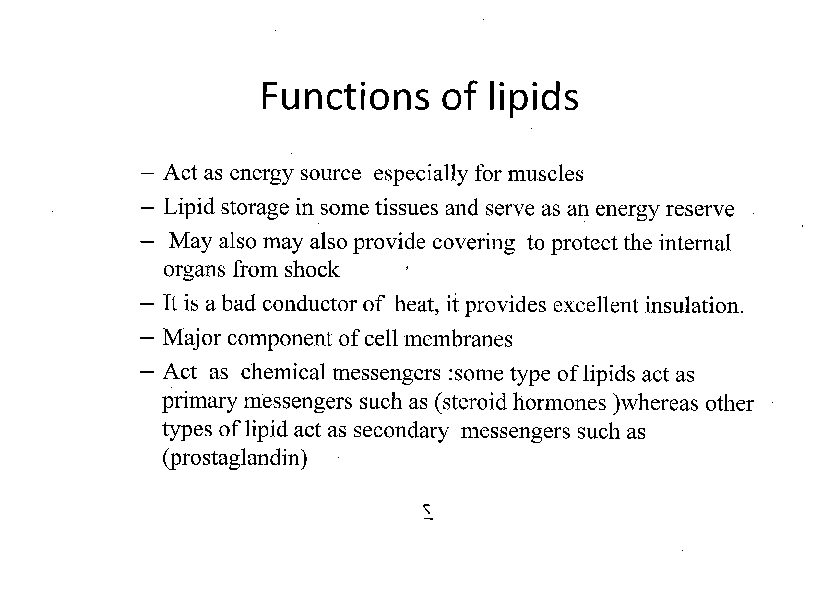

Slide 3
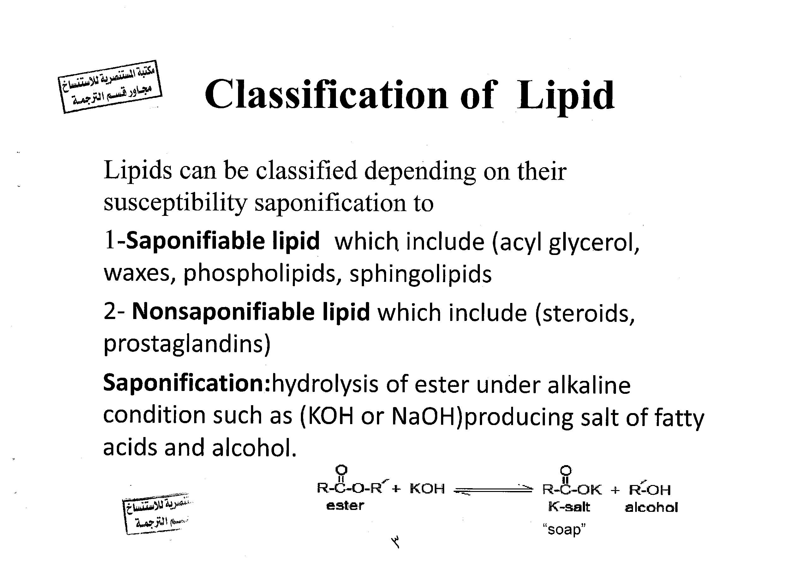

Slide 4
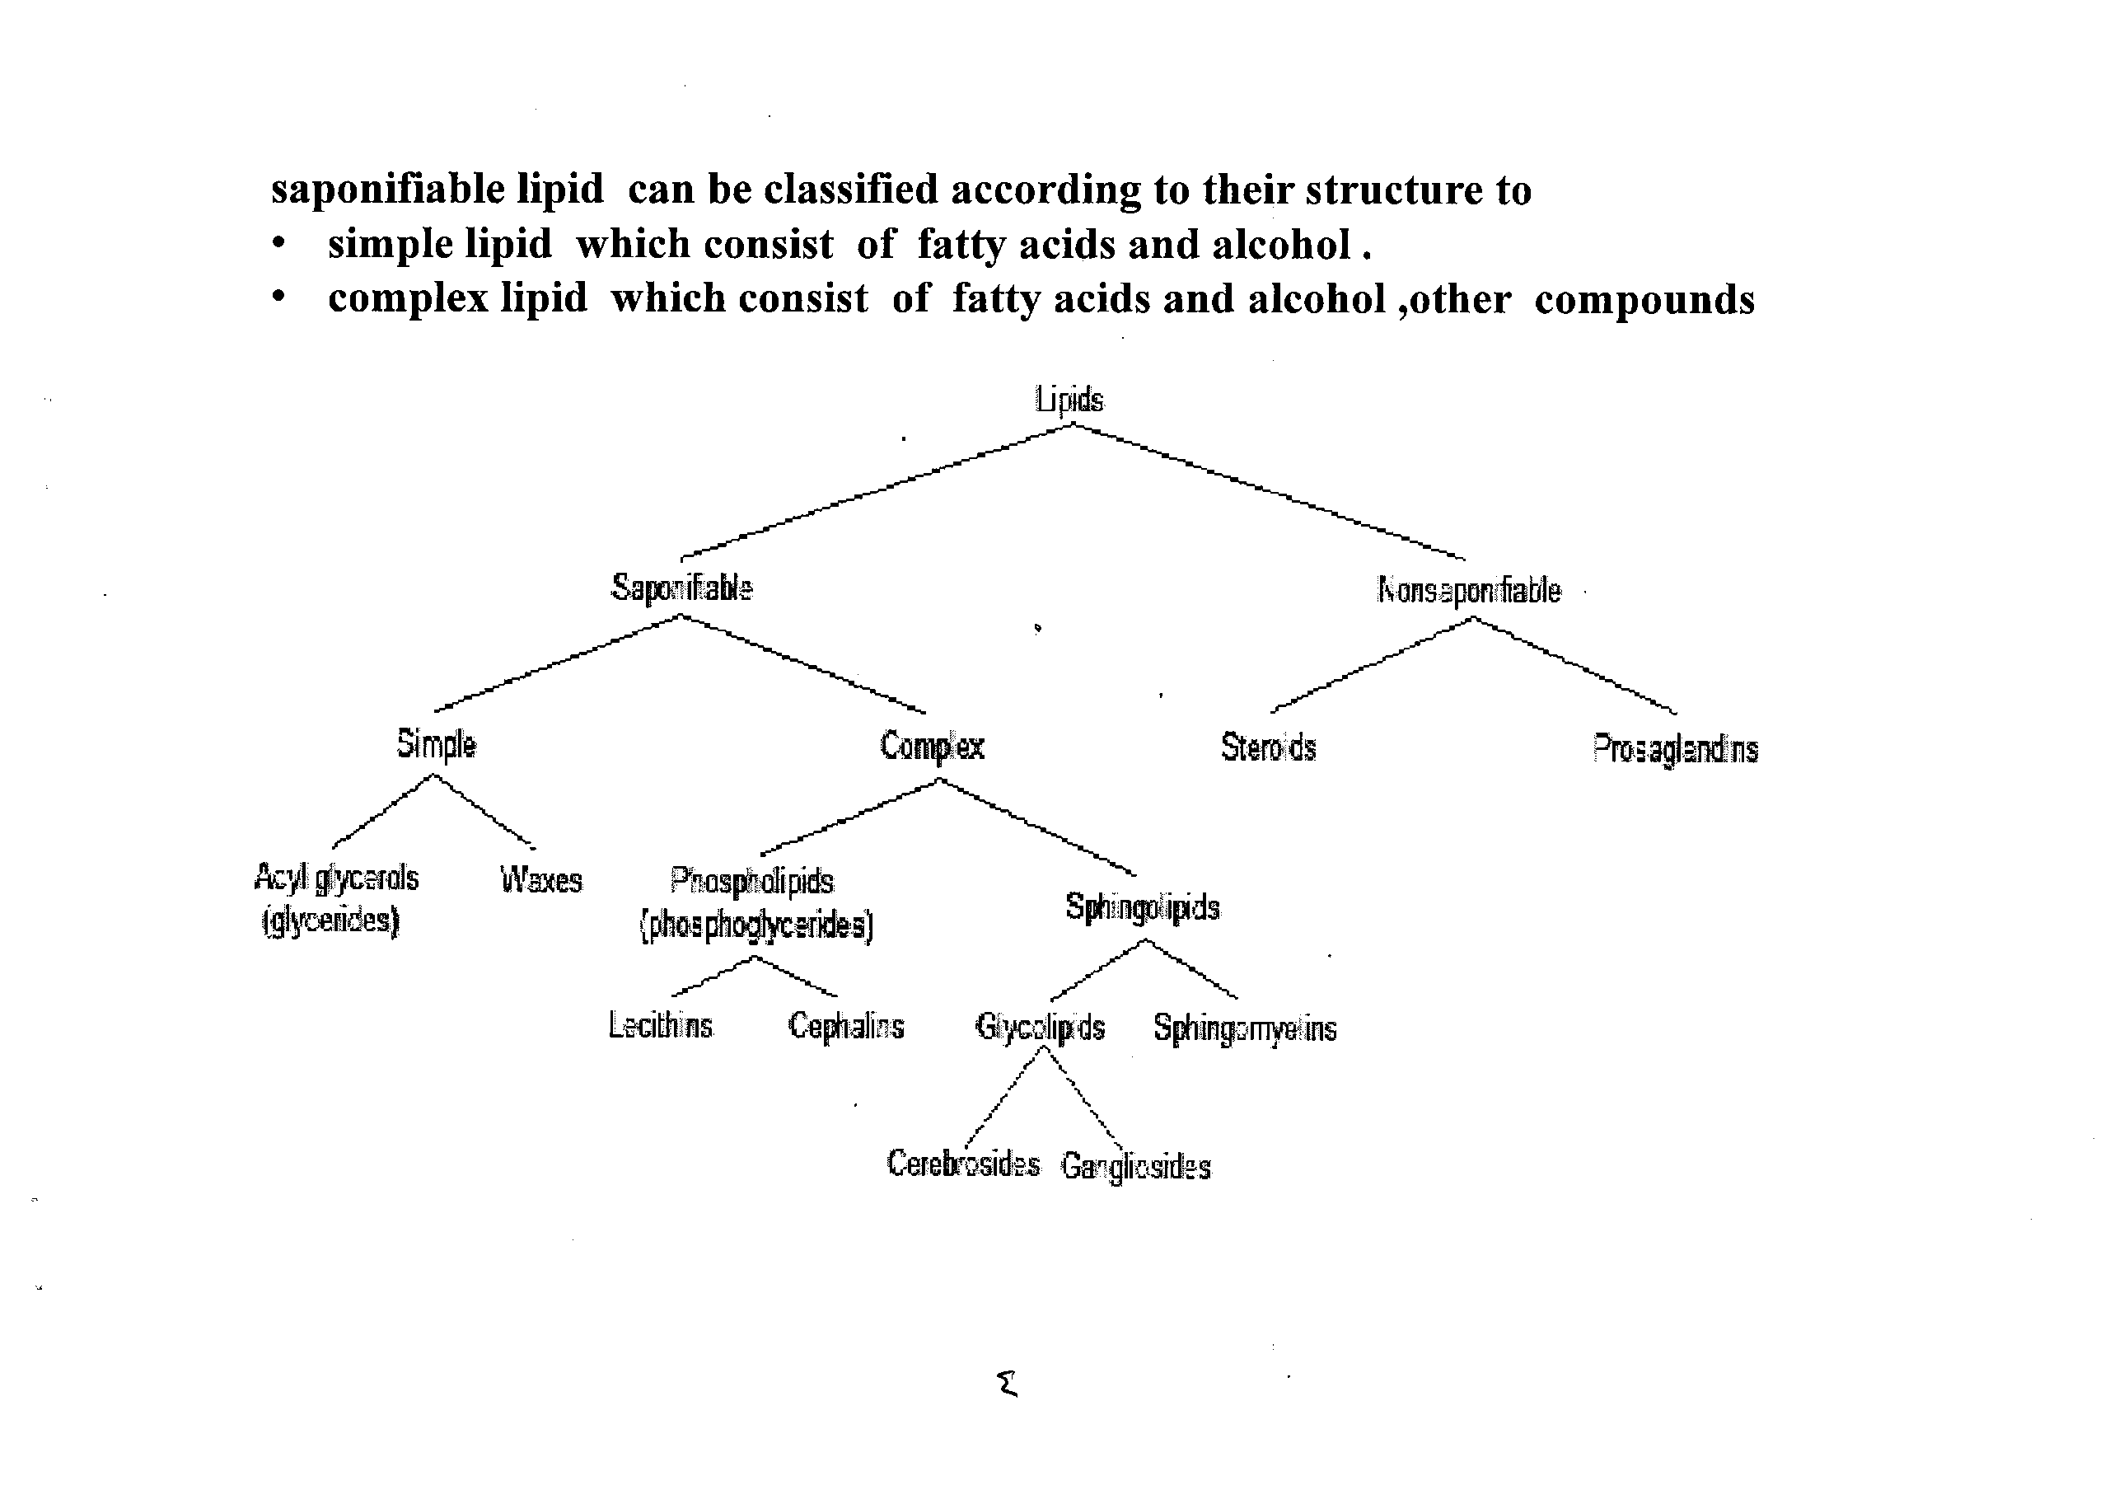

Slide 5
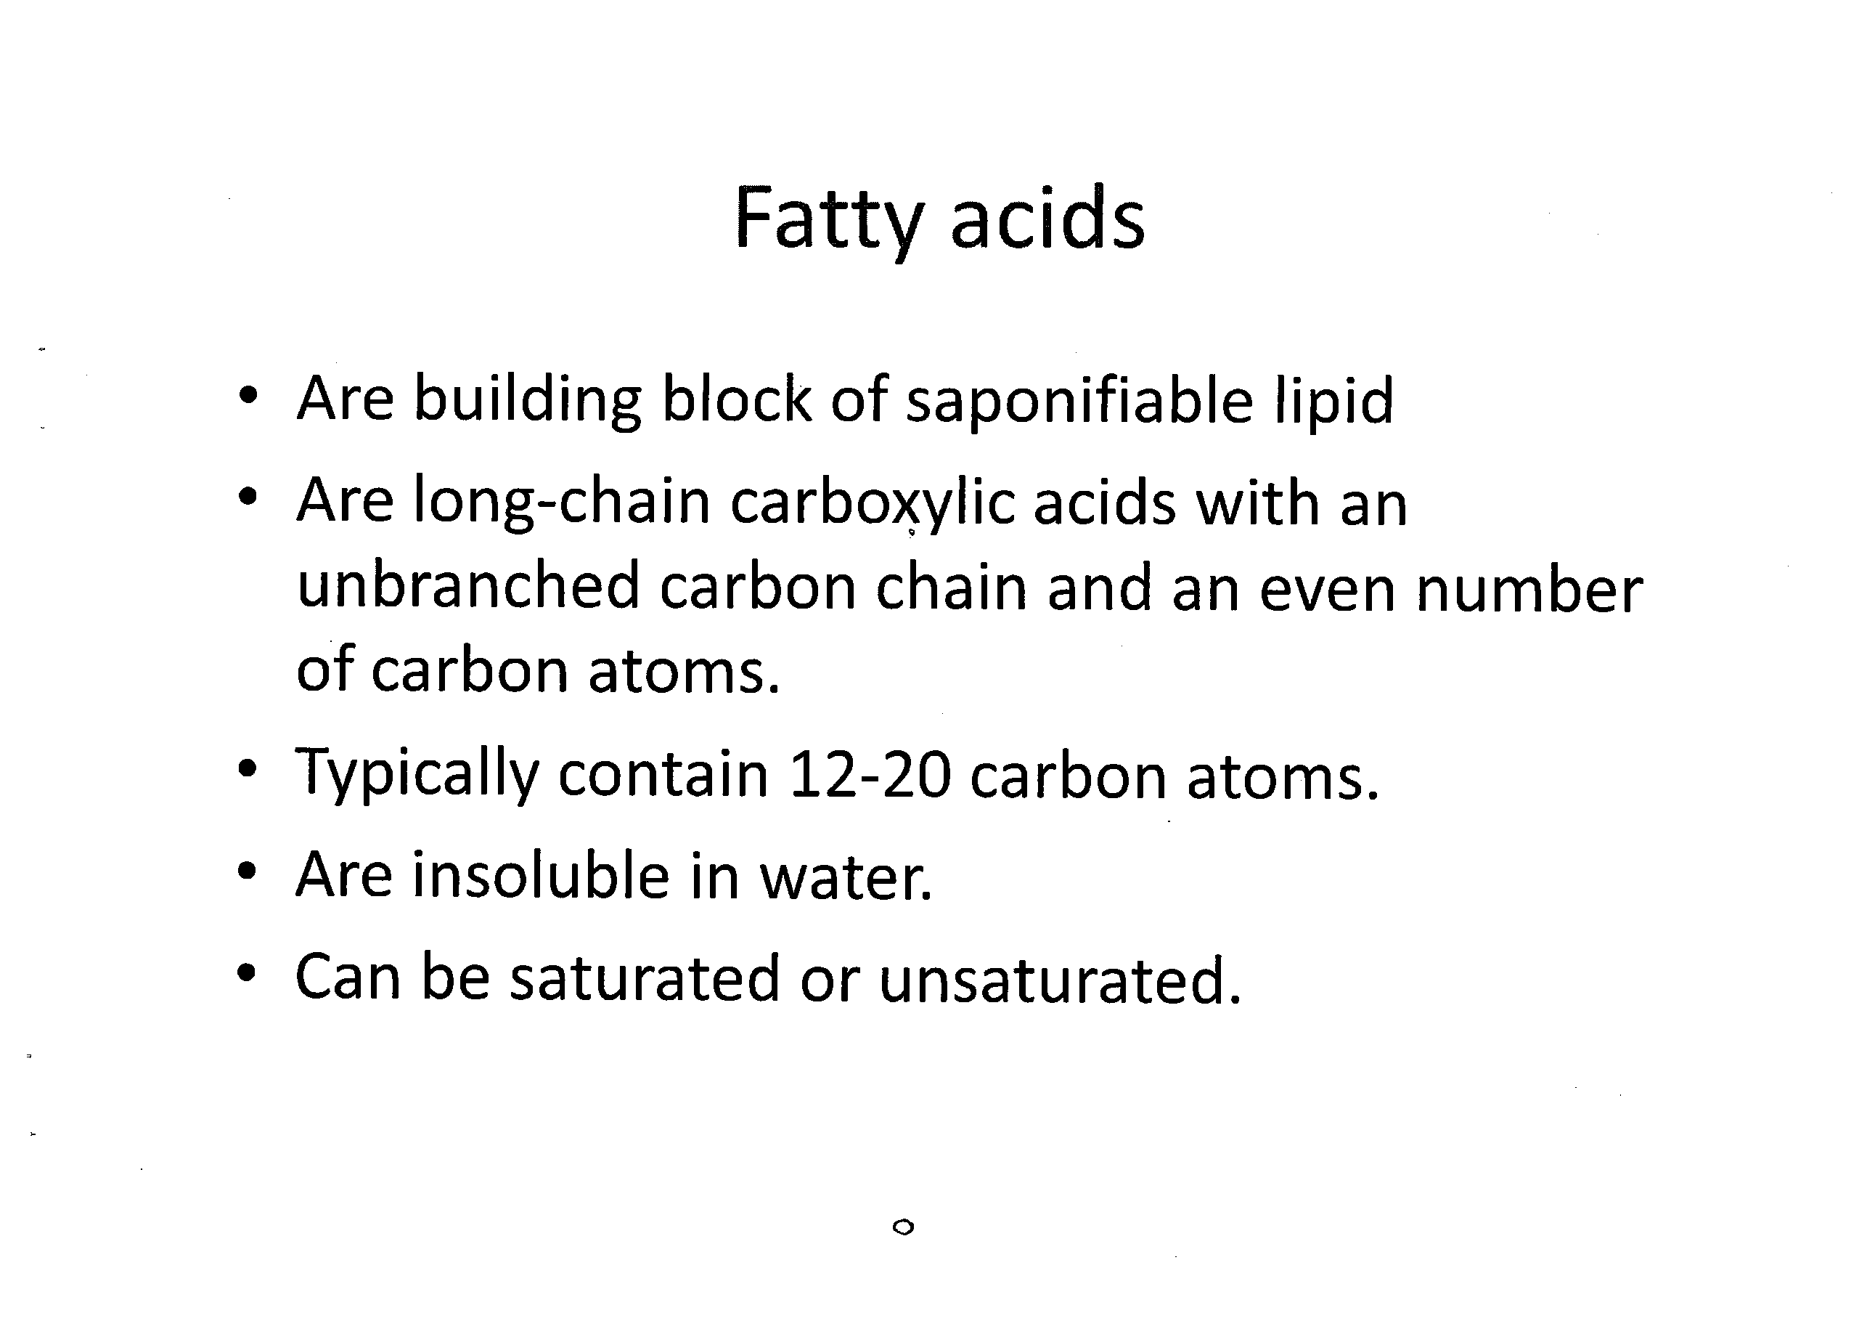

Slide 6
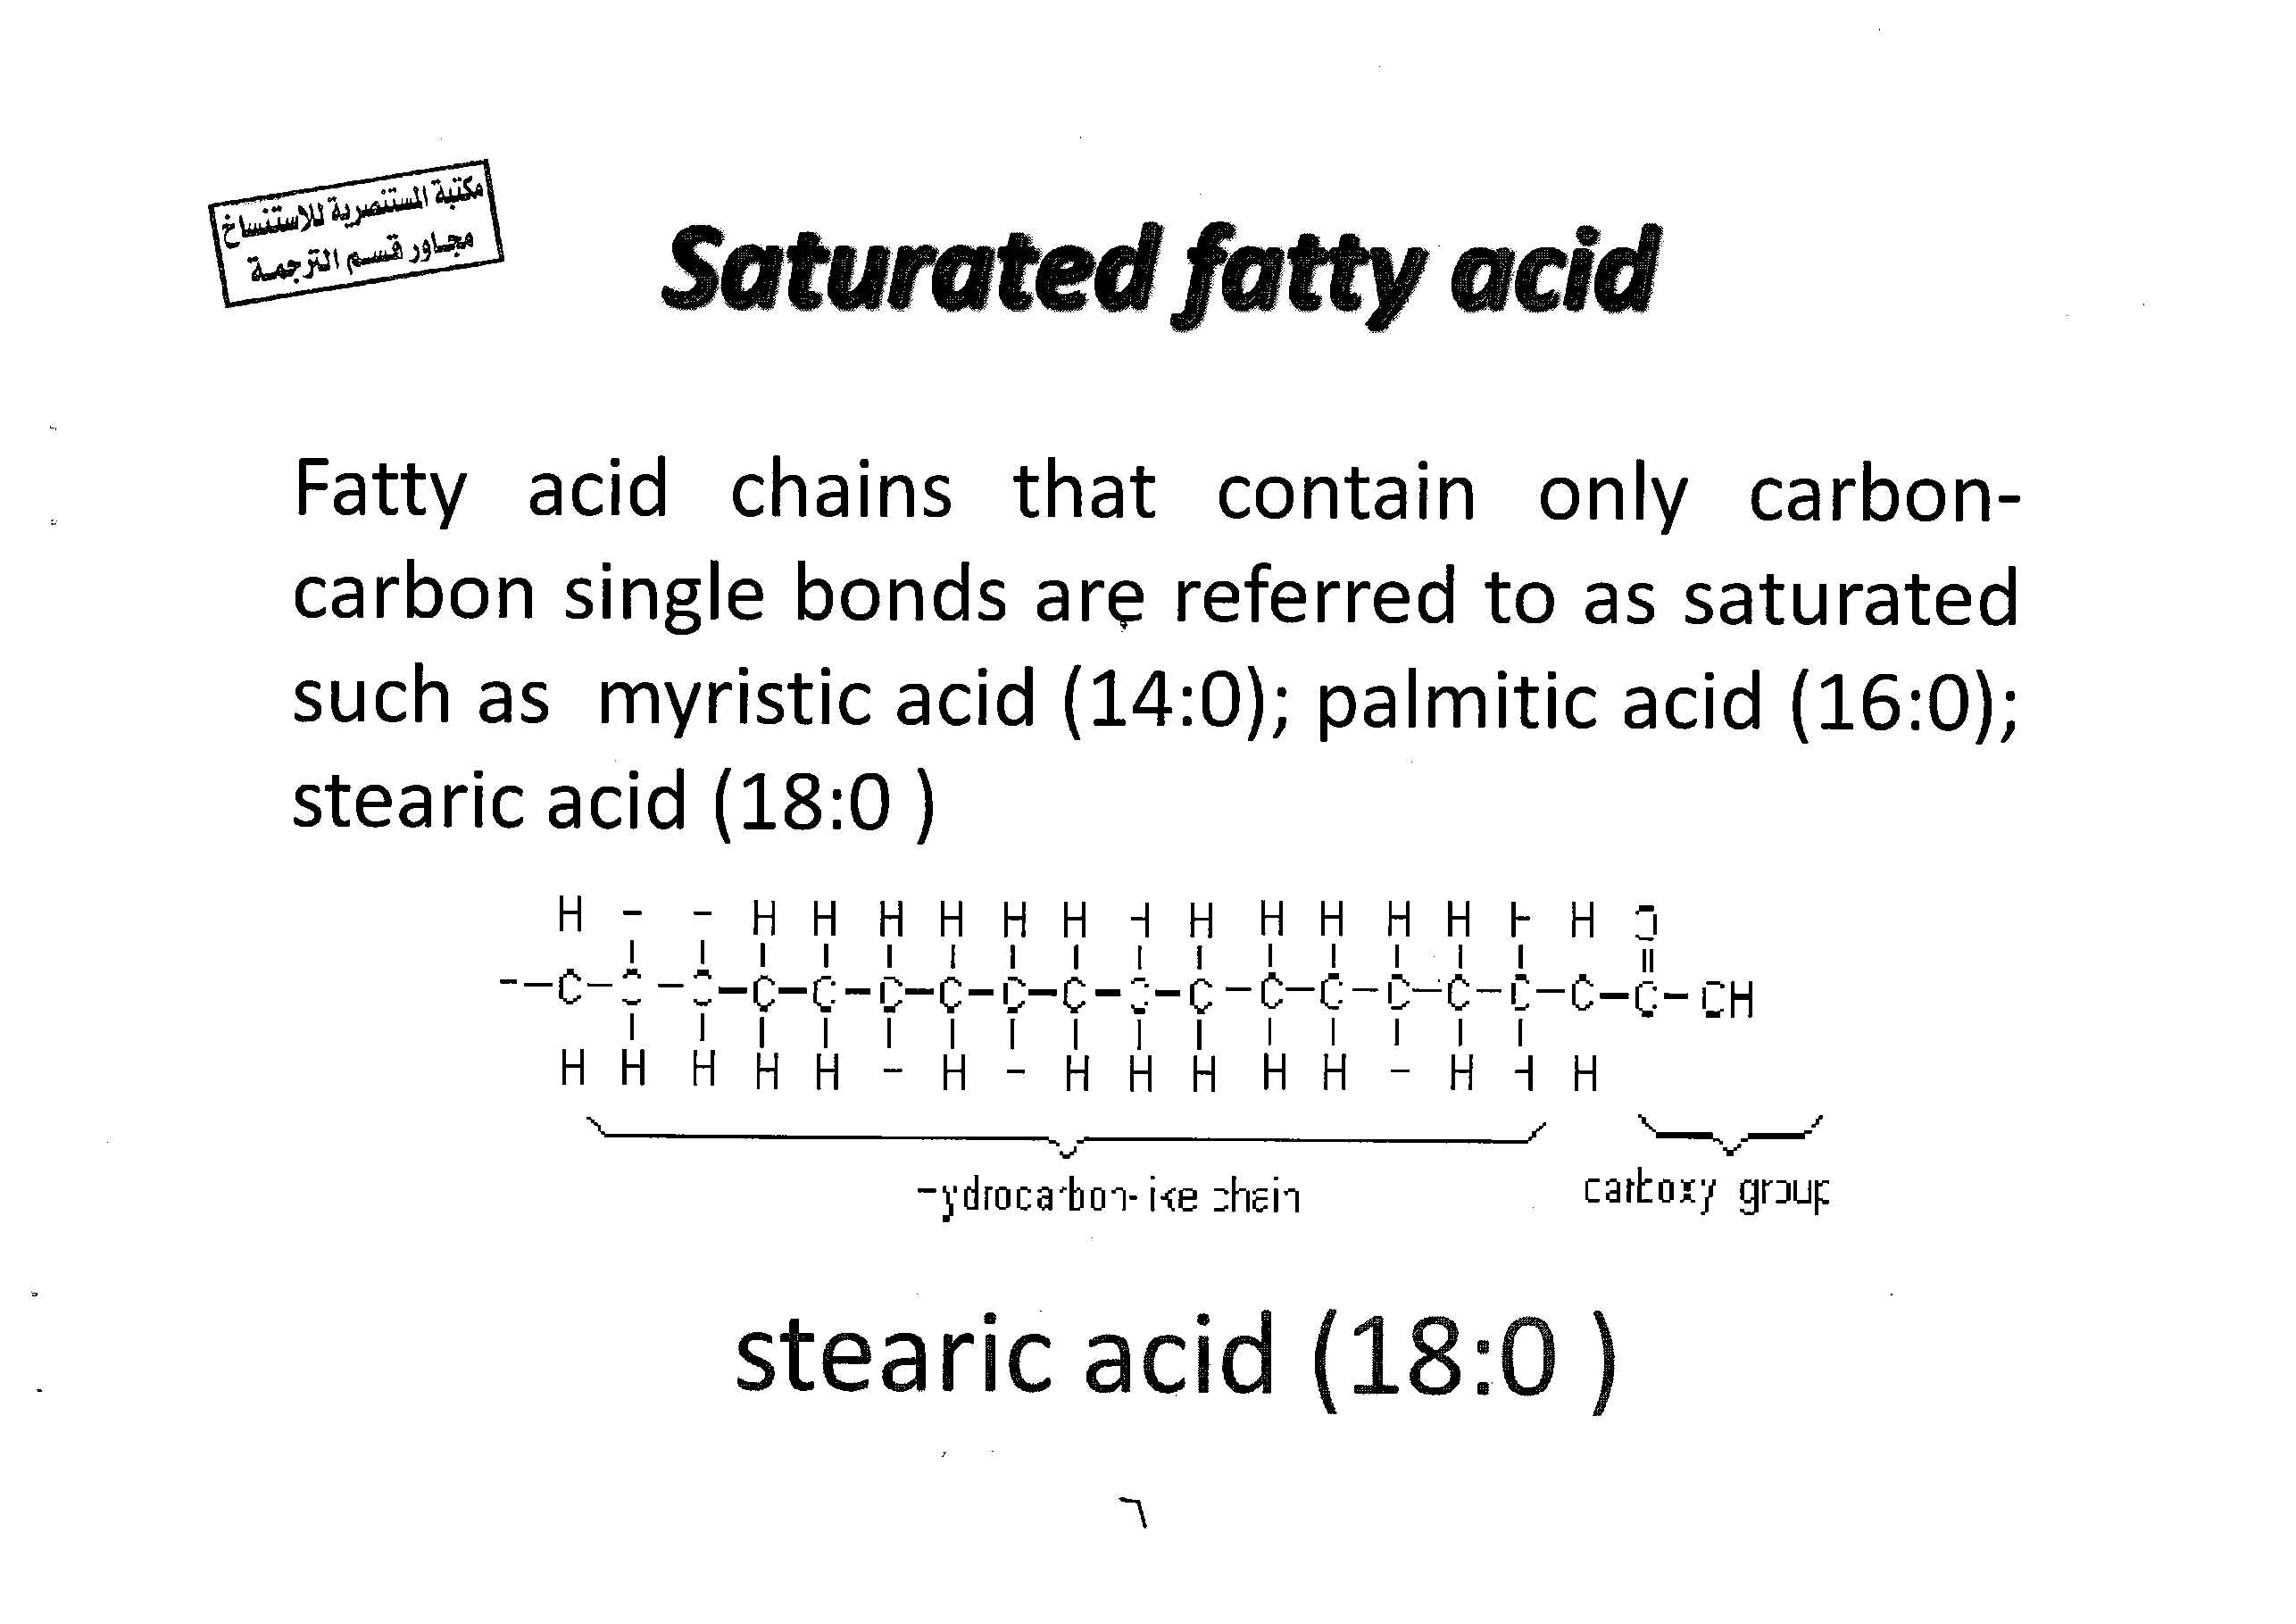
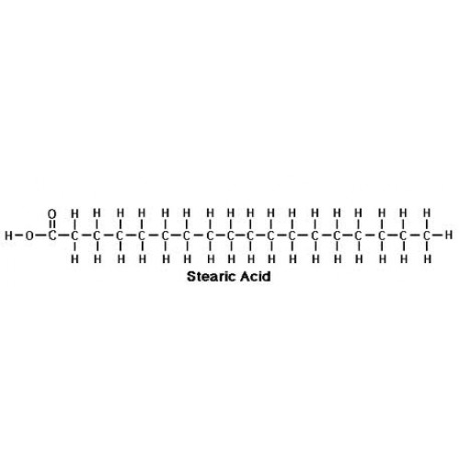

Slide 7
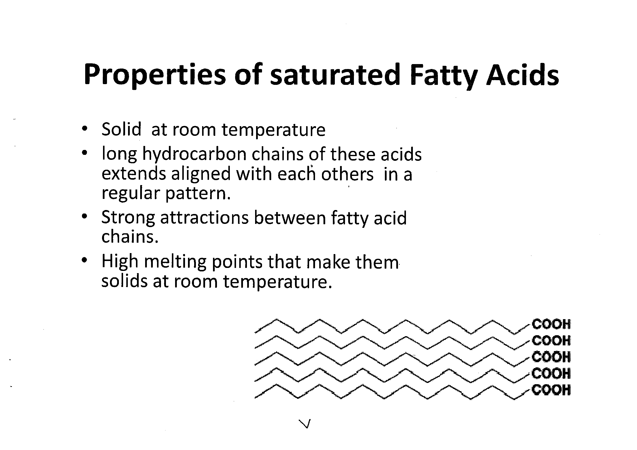

Slide 8
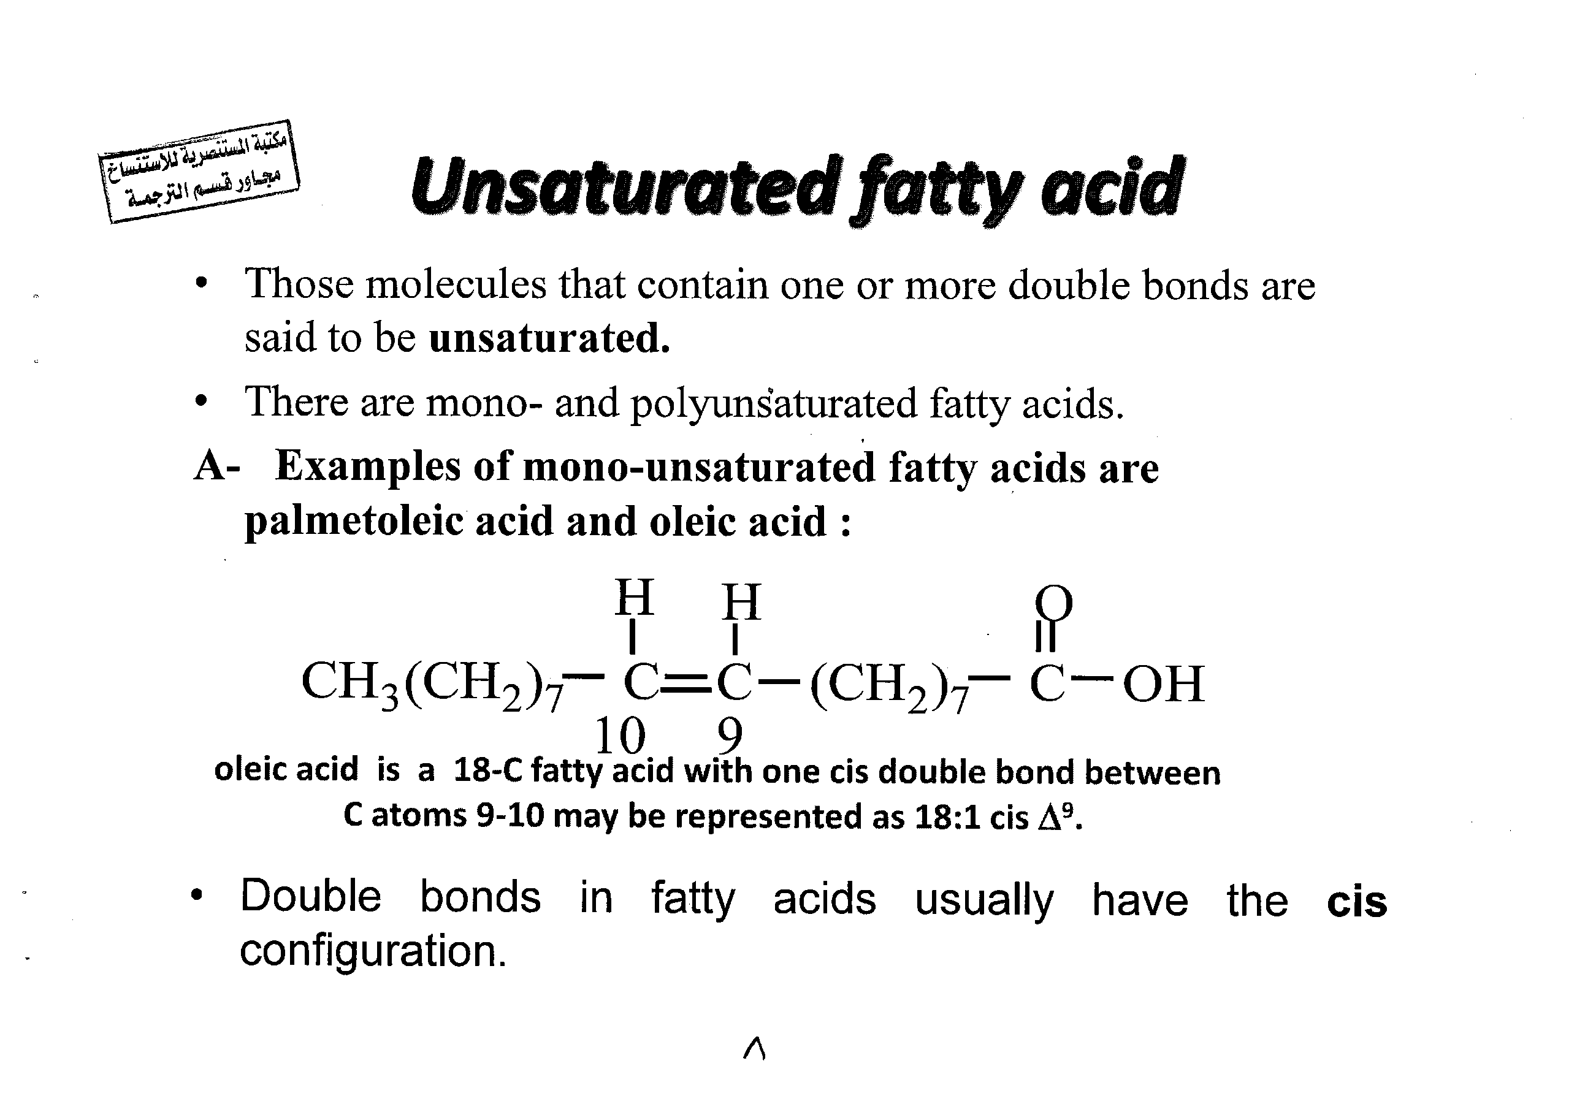

Slide 9
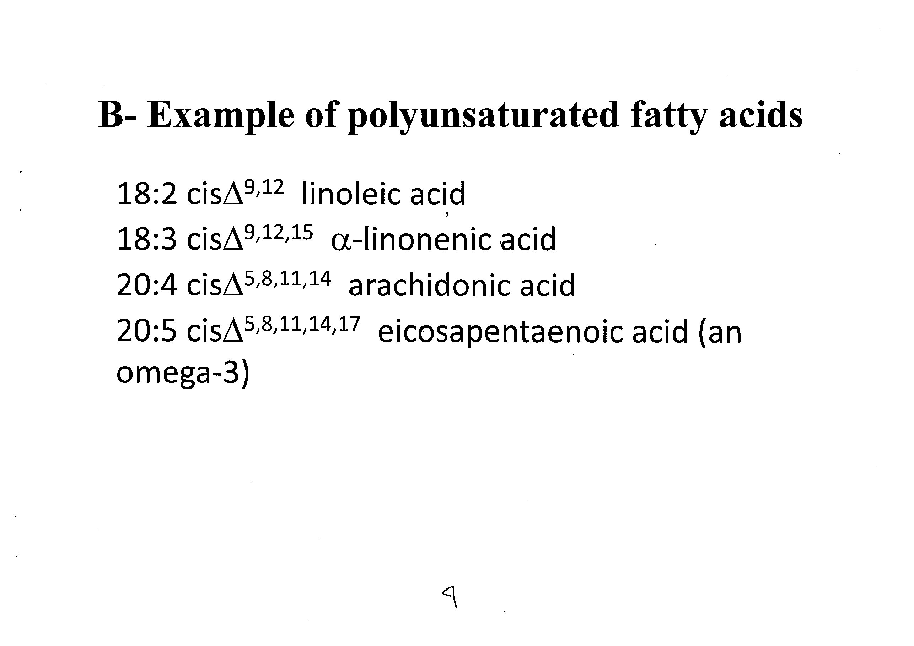

Slide 10
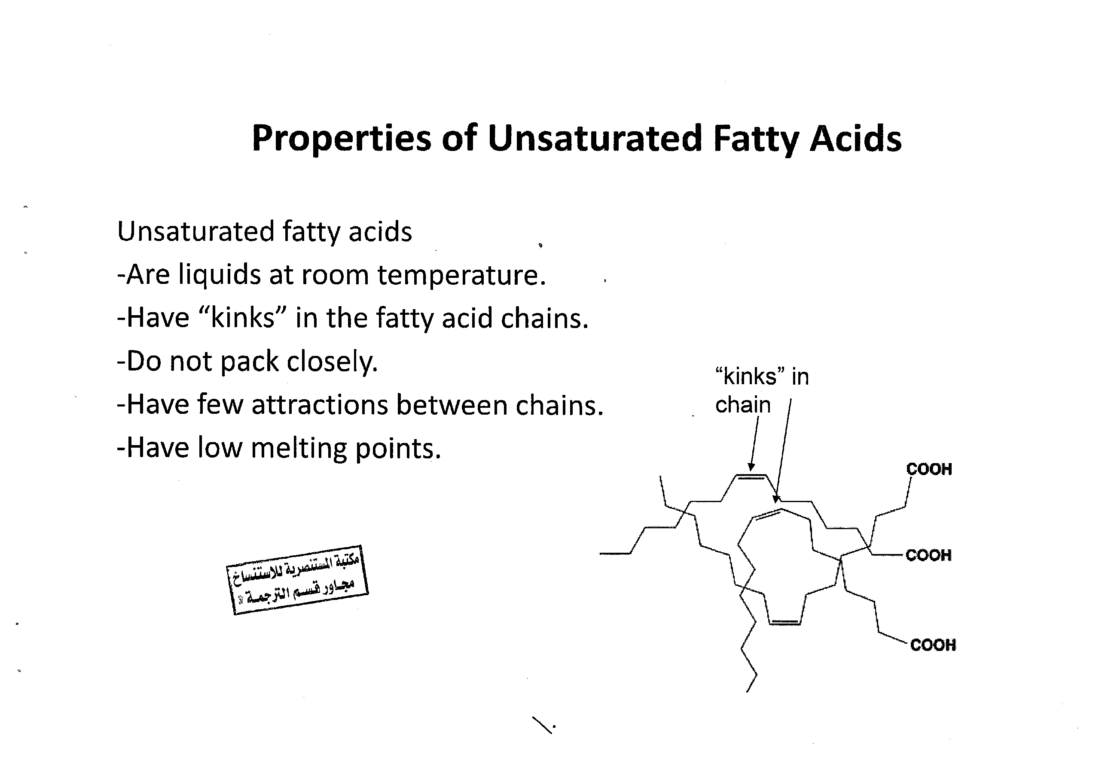

Slide 11
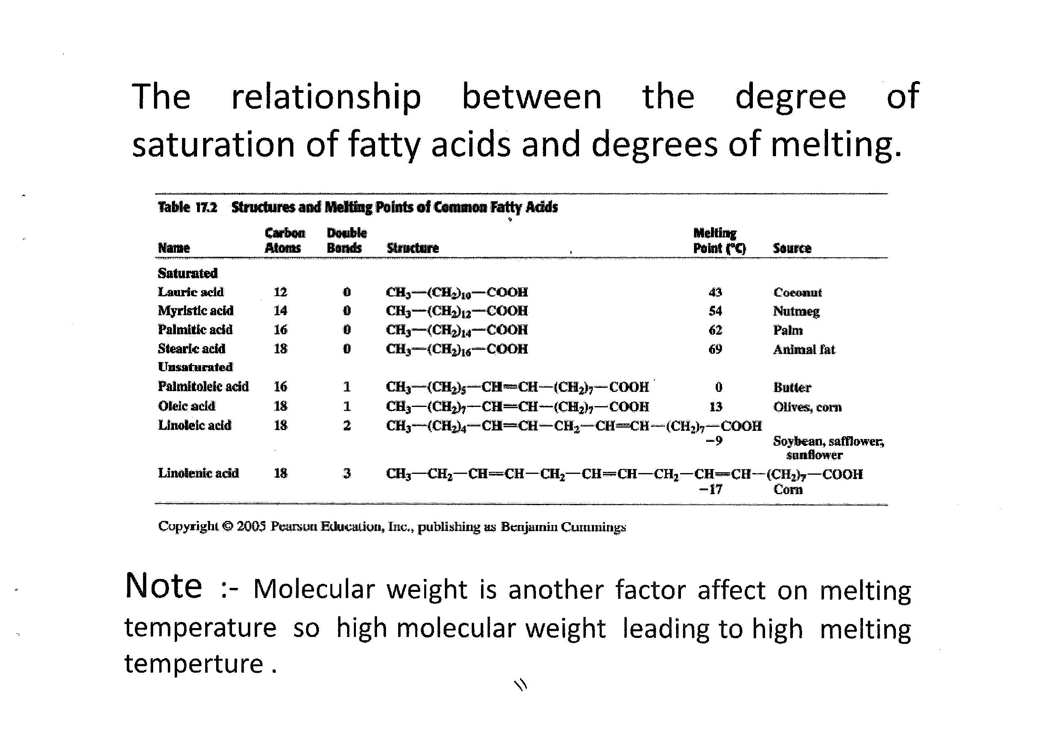

Slide 12
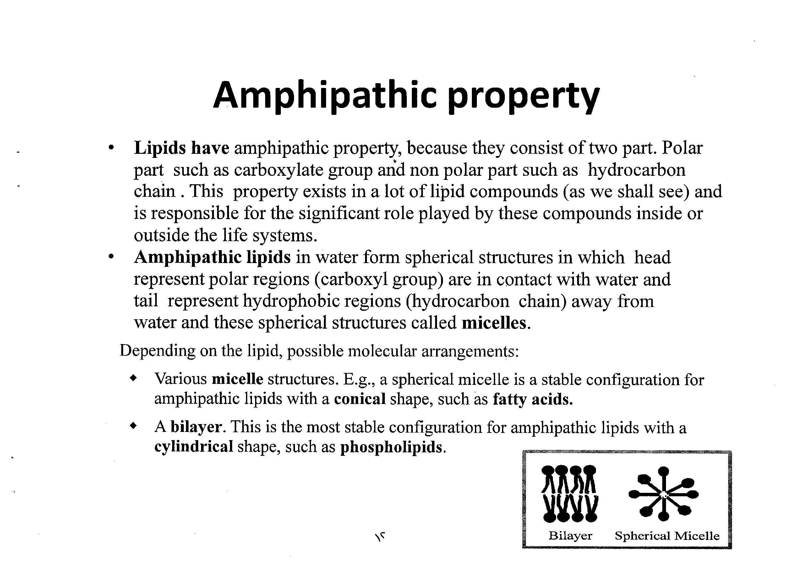

Slide 13
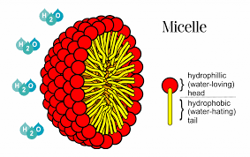

Slide 14
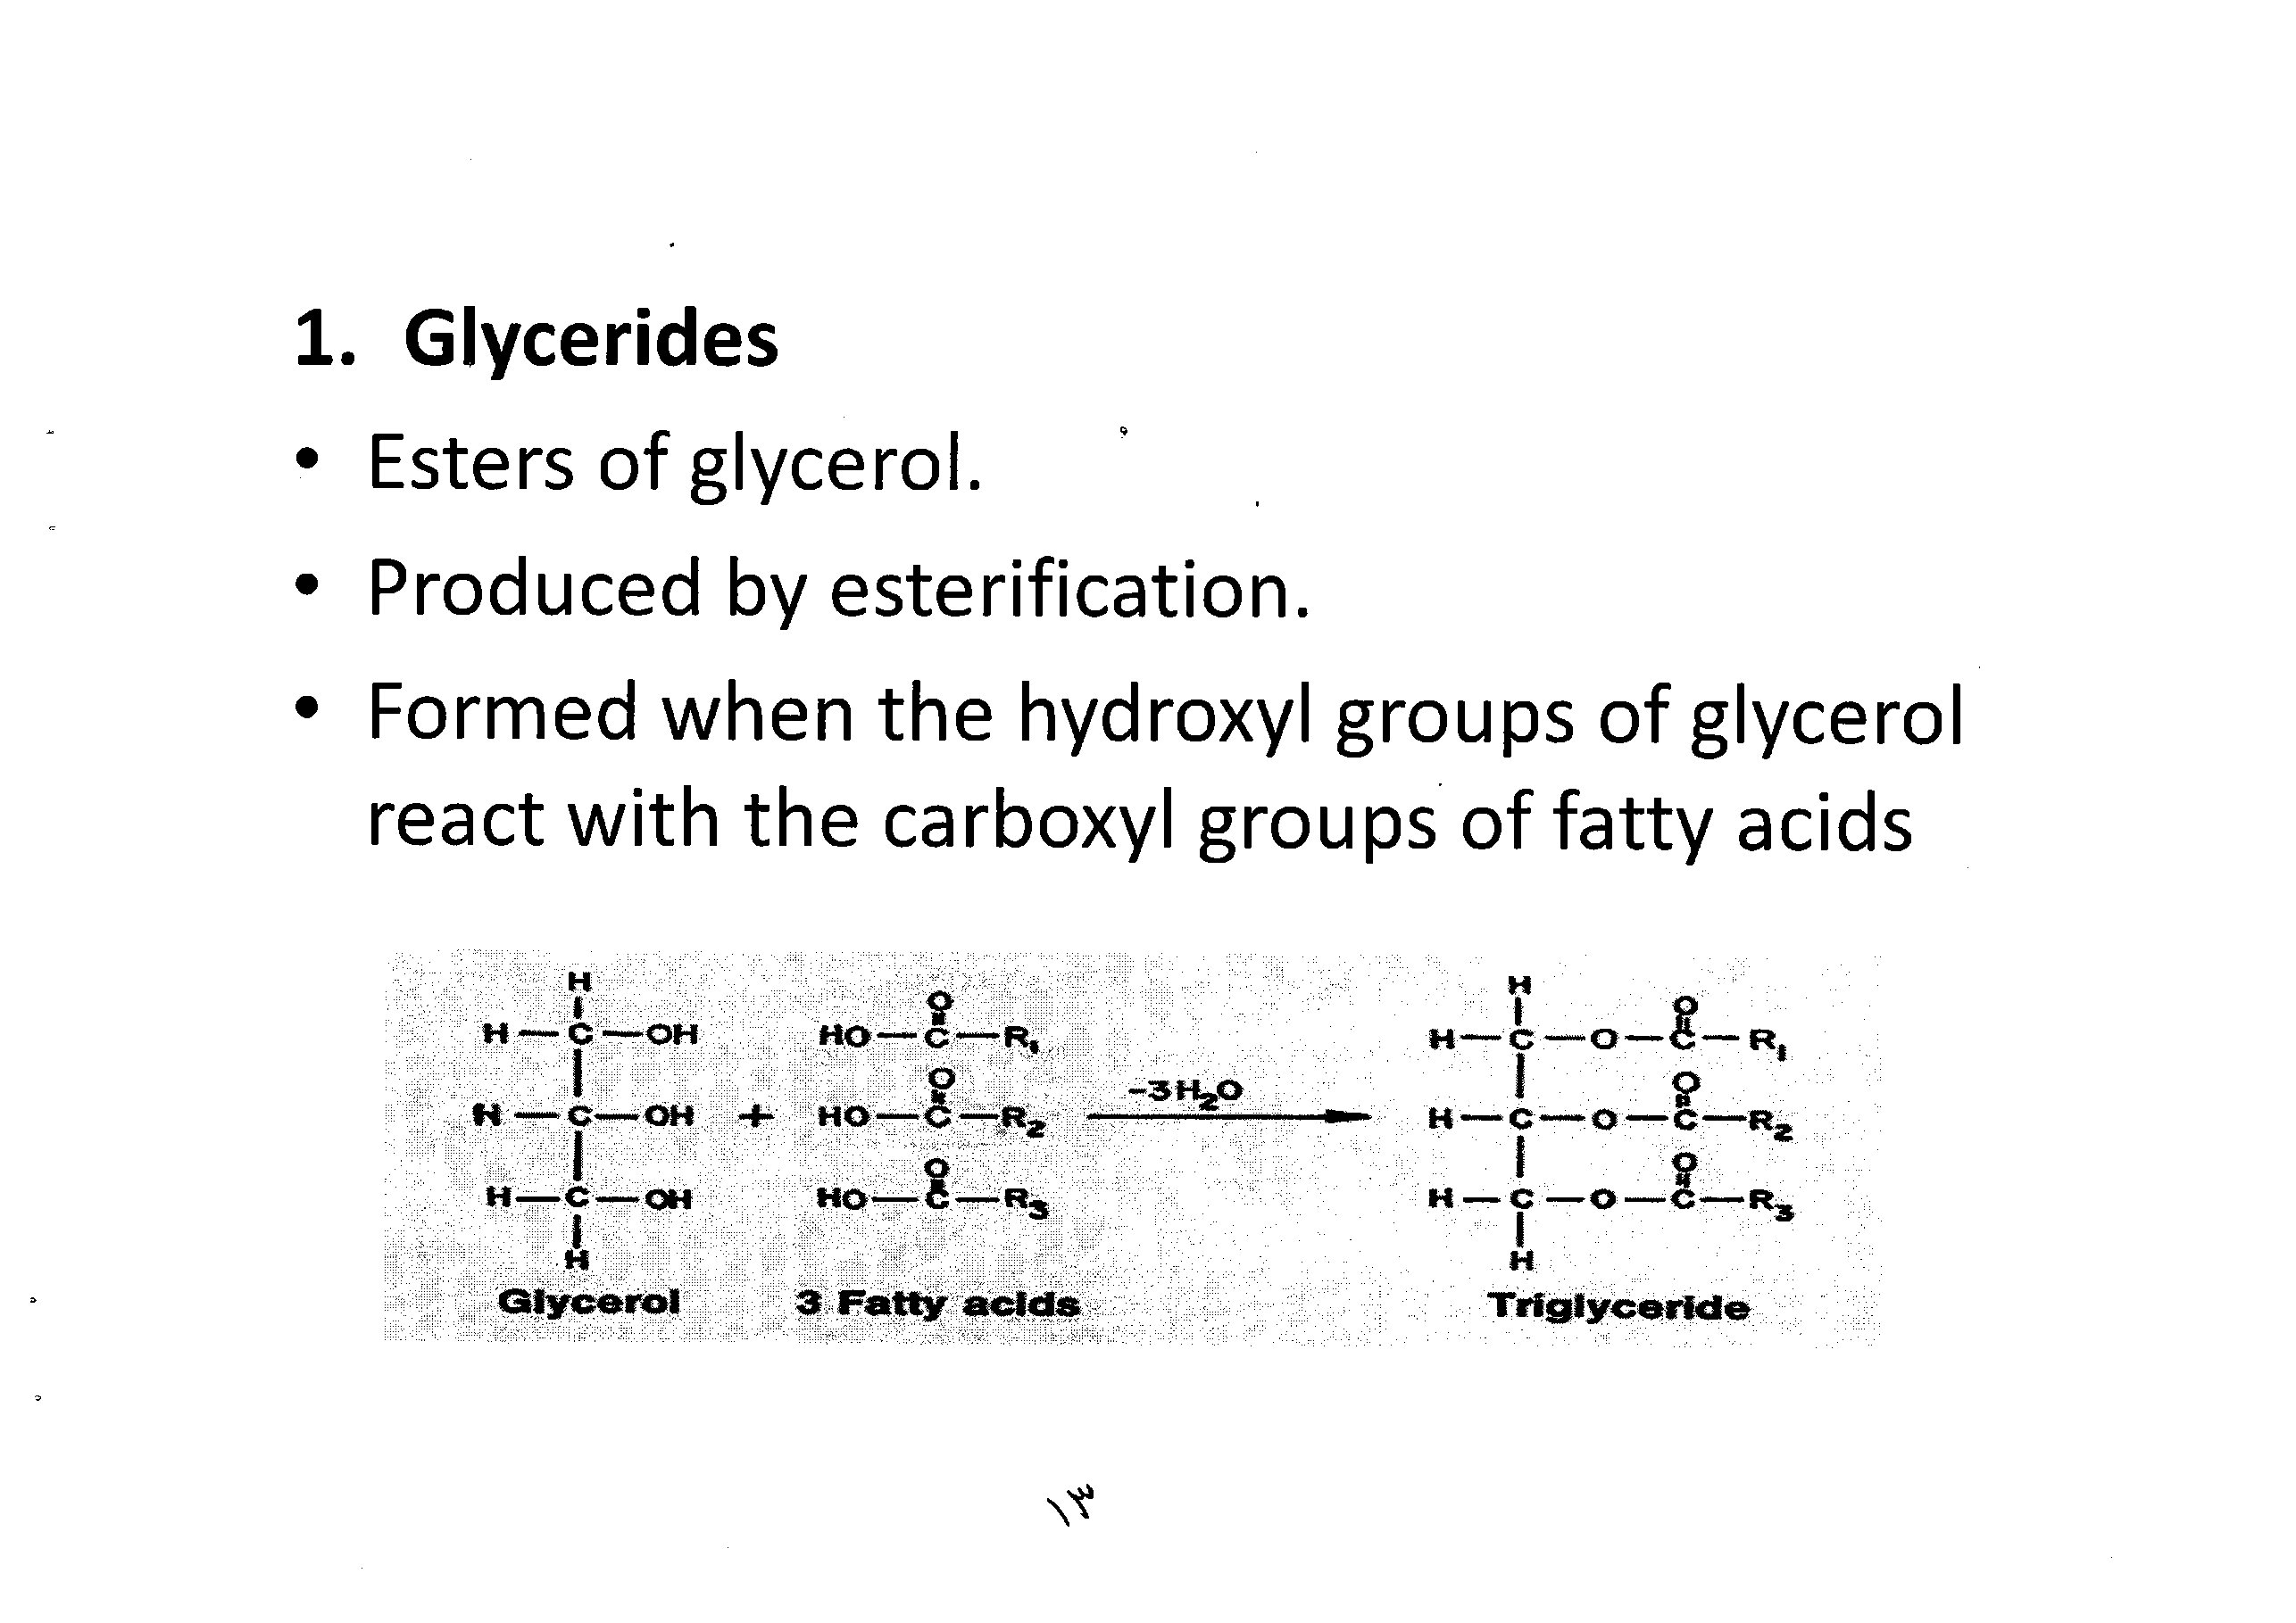

Slide 15
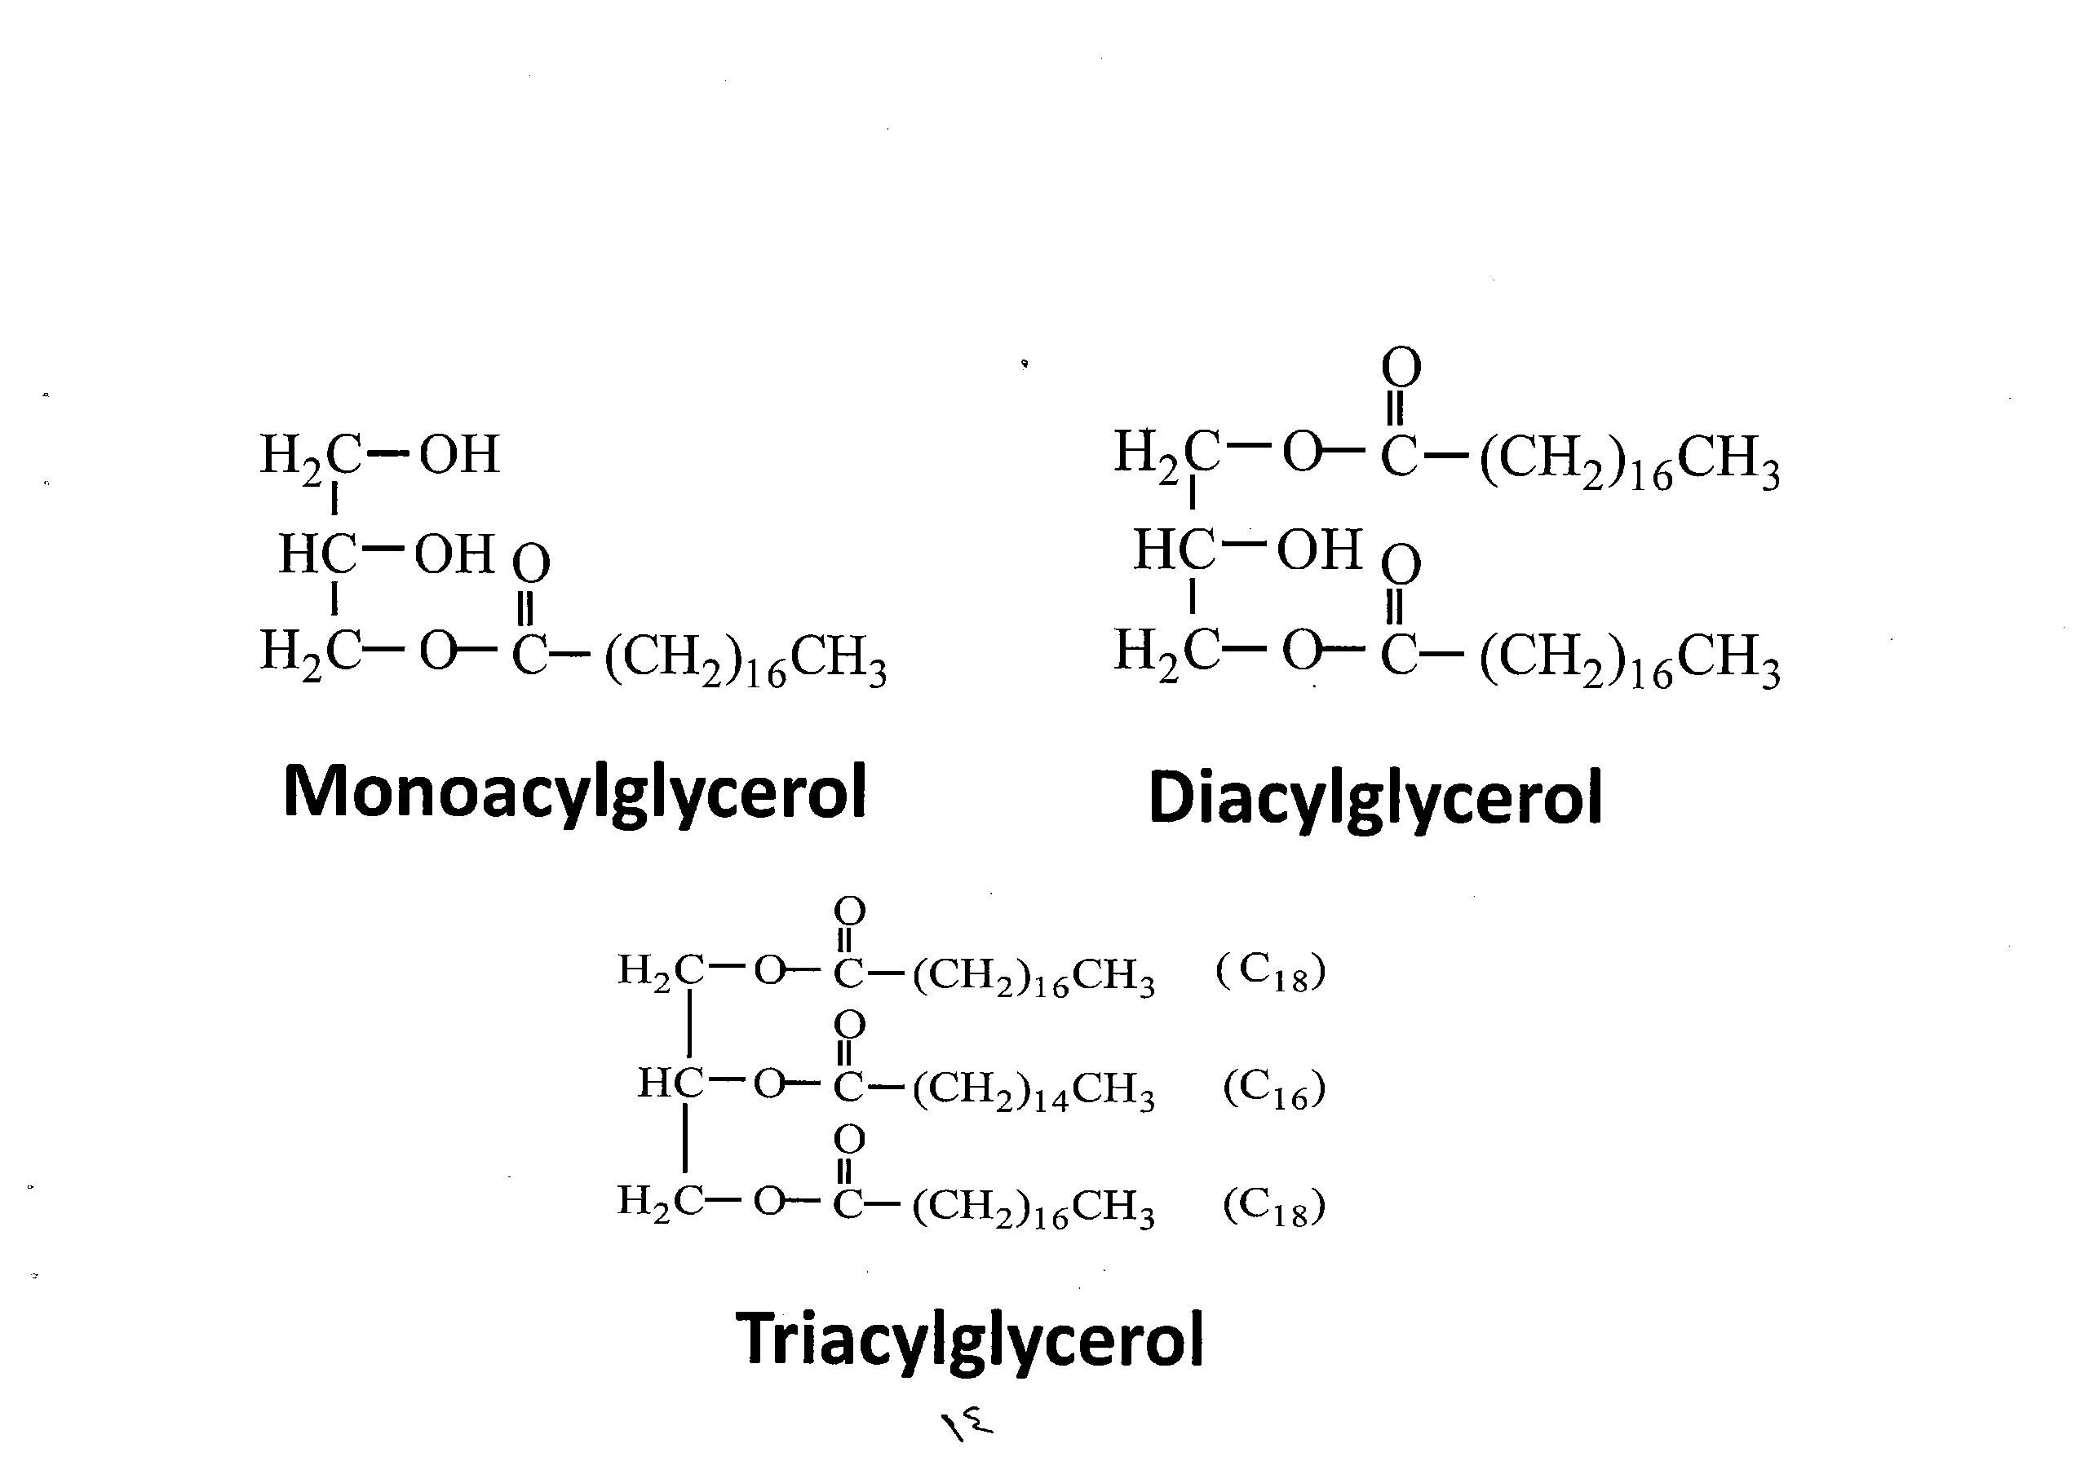

Slide 16
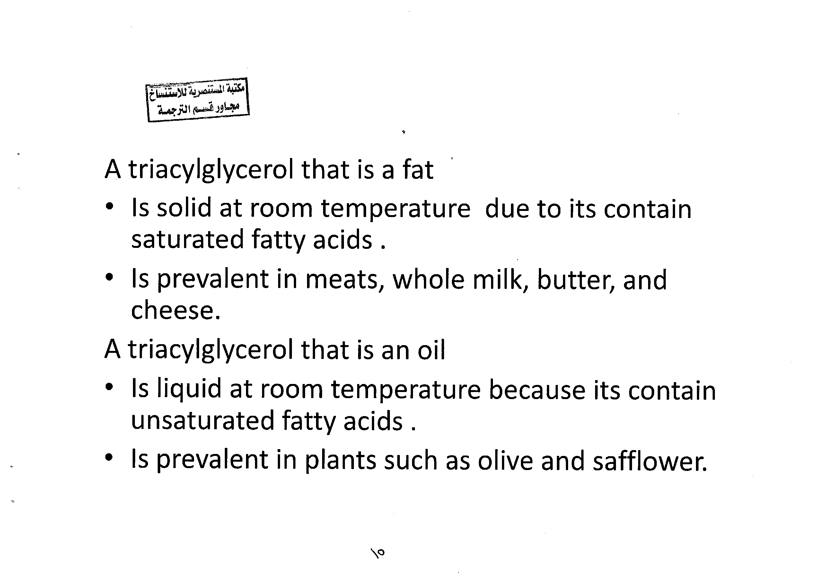

Slide 17
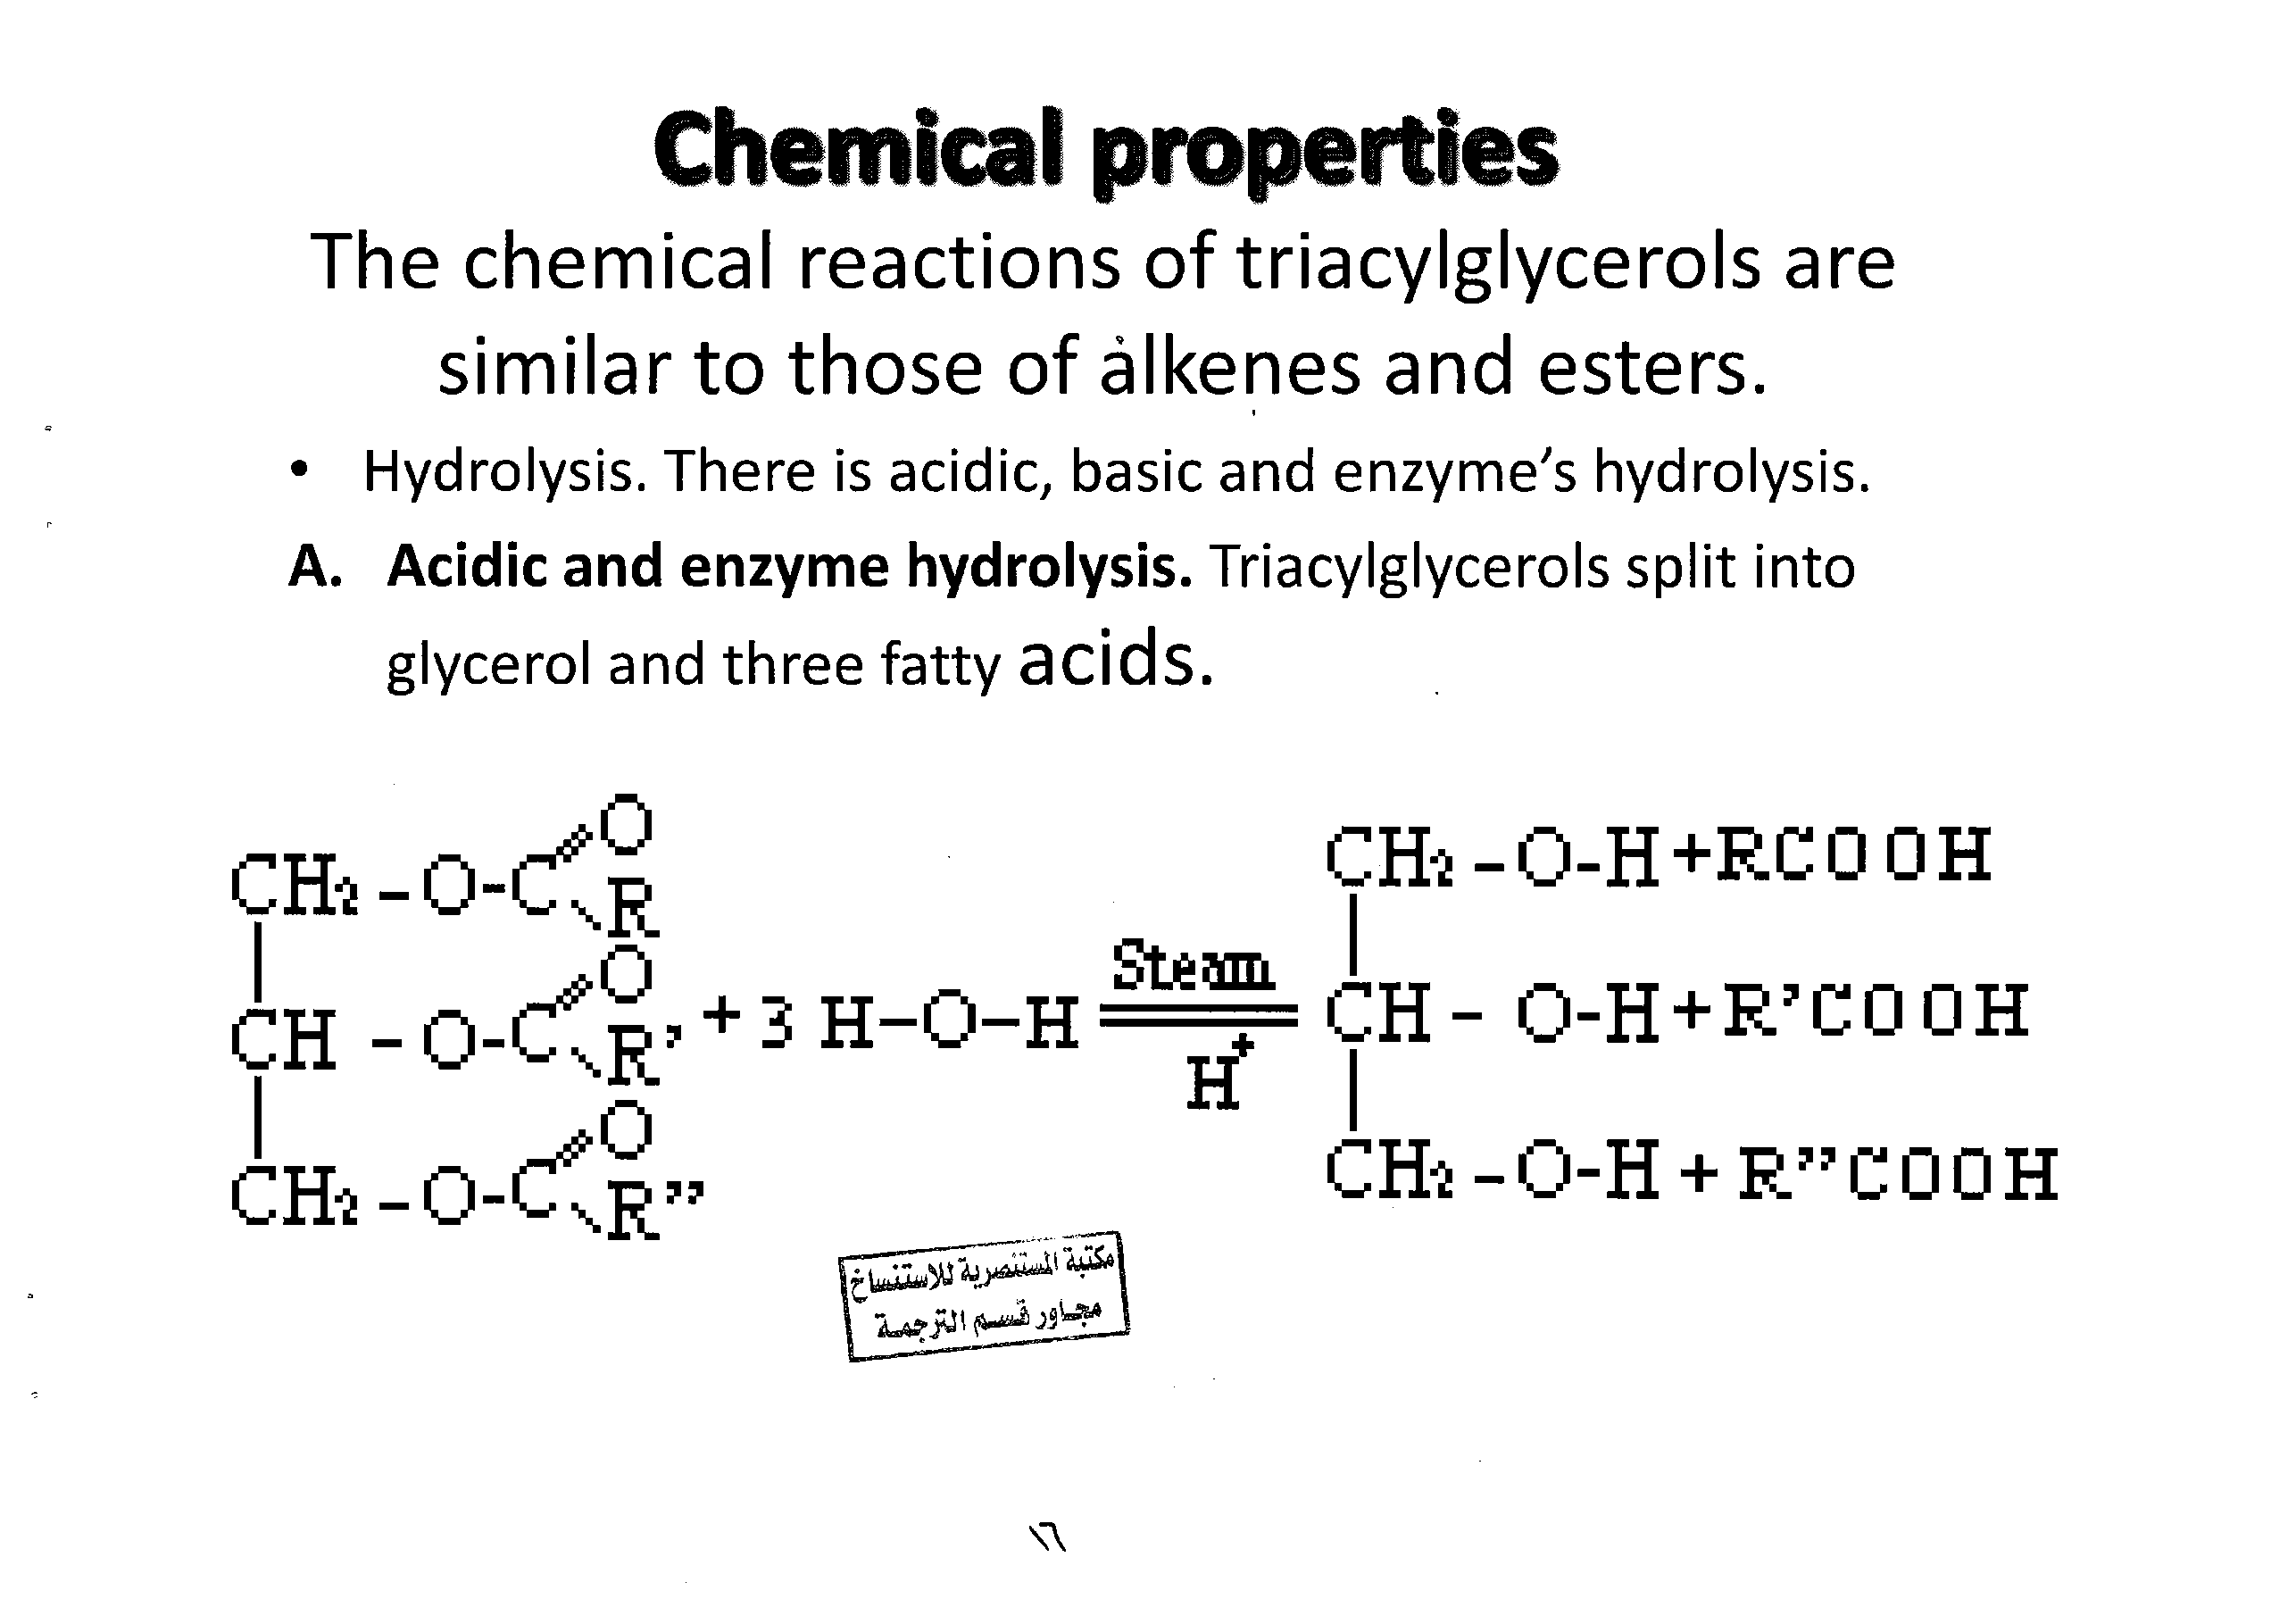

Slide 18
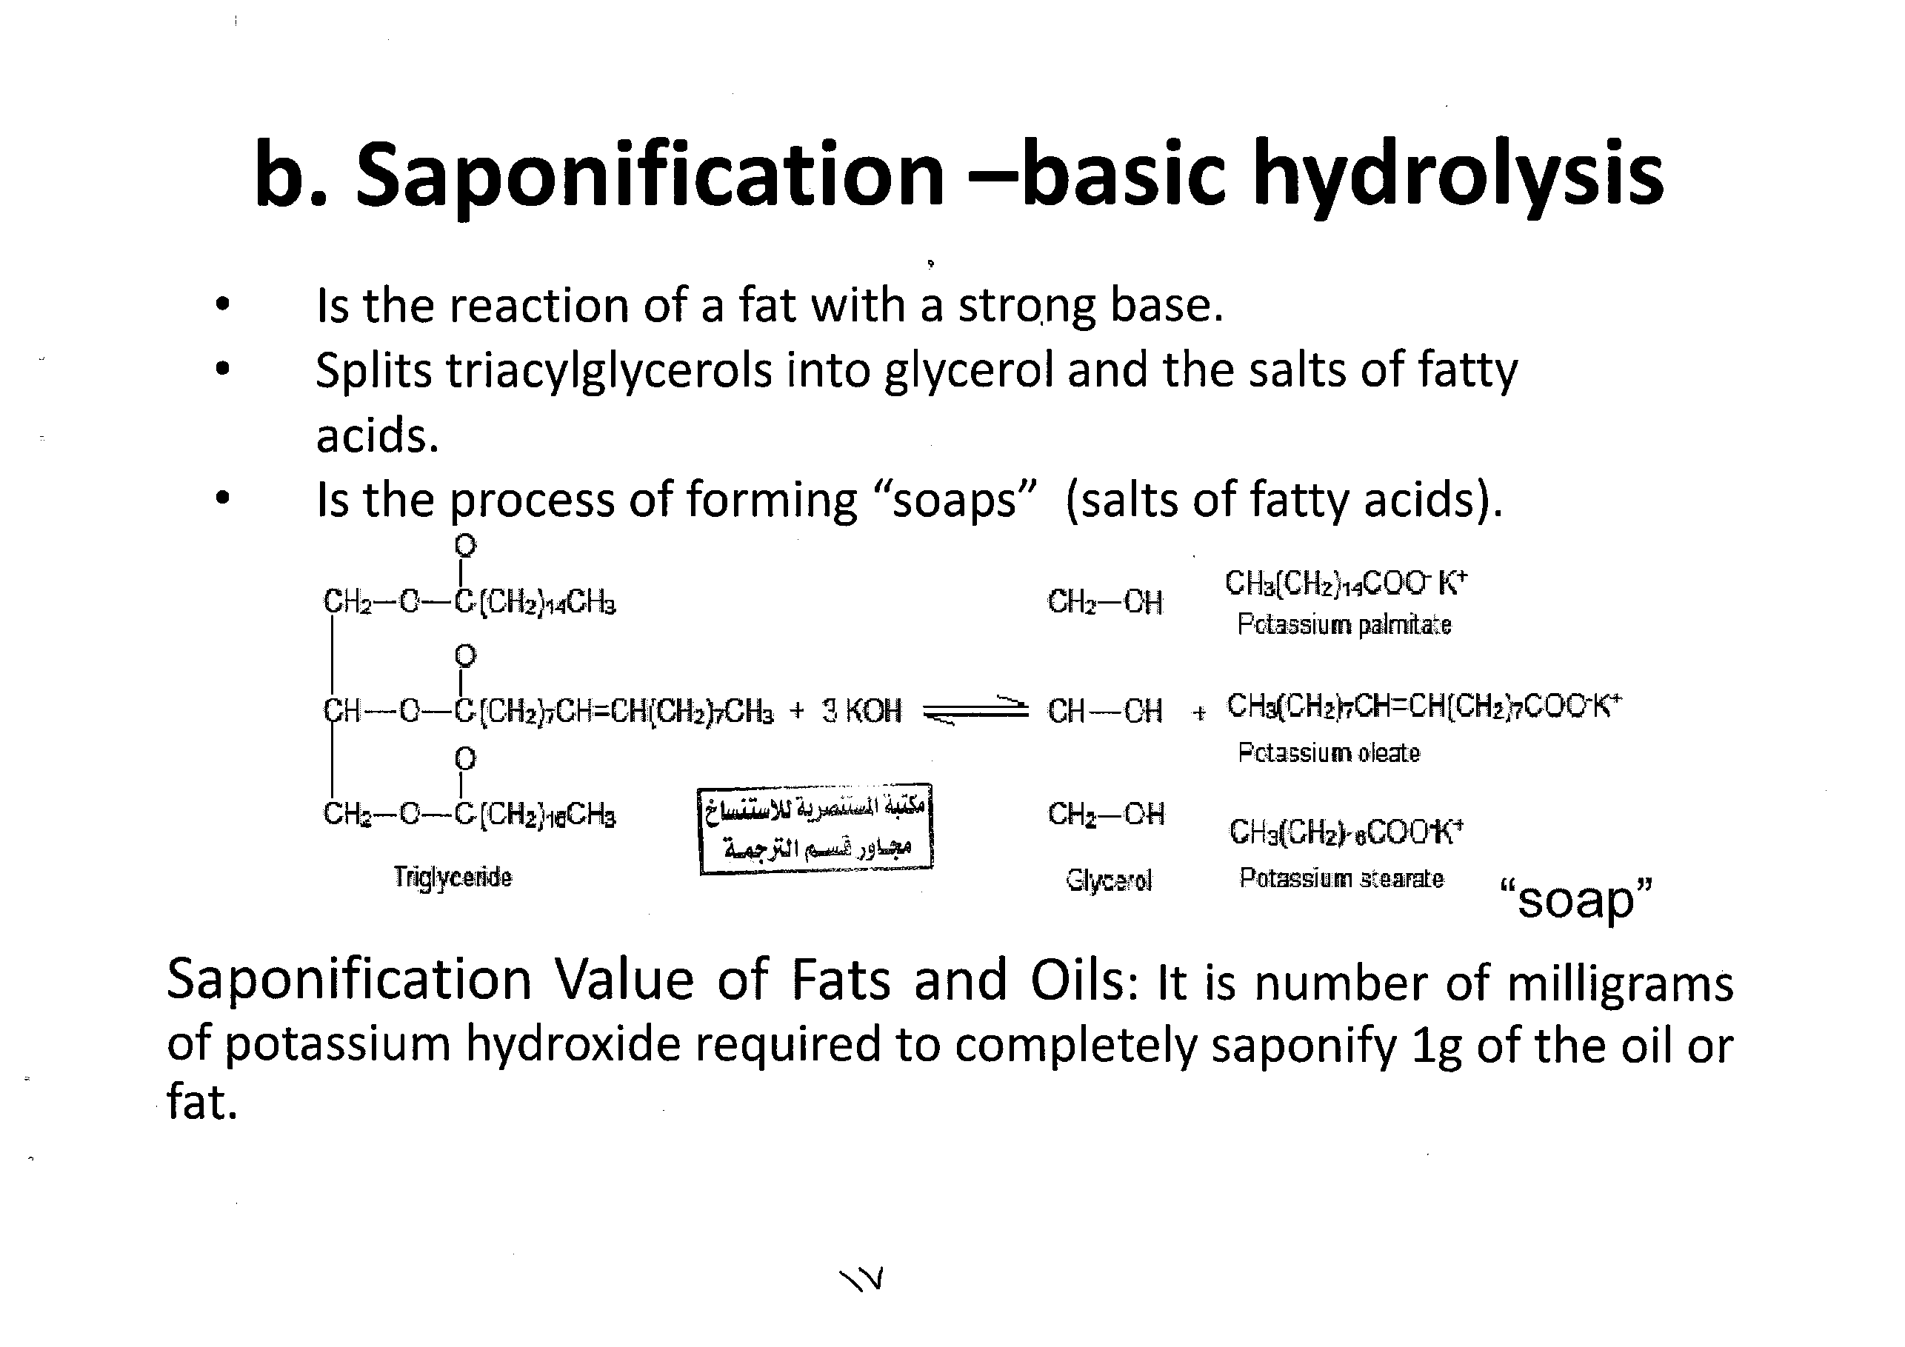
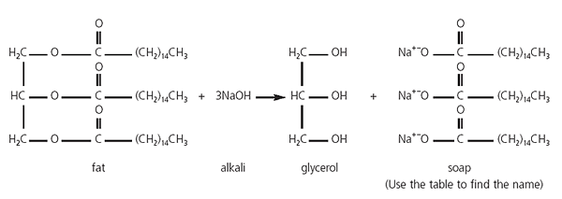

Slide 19
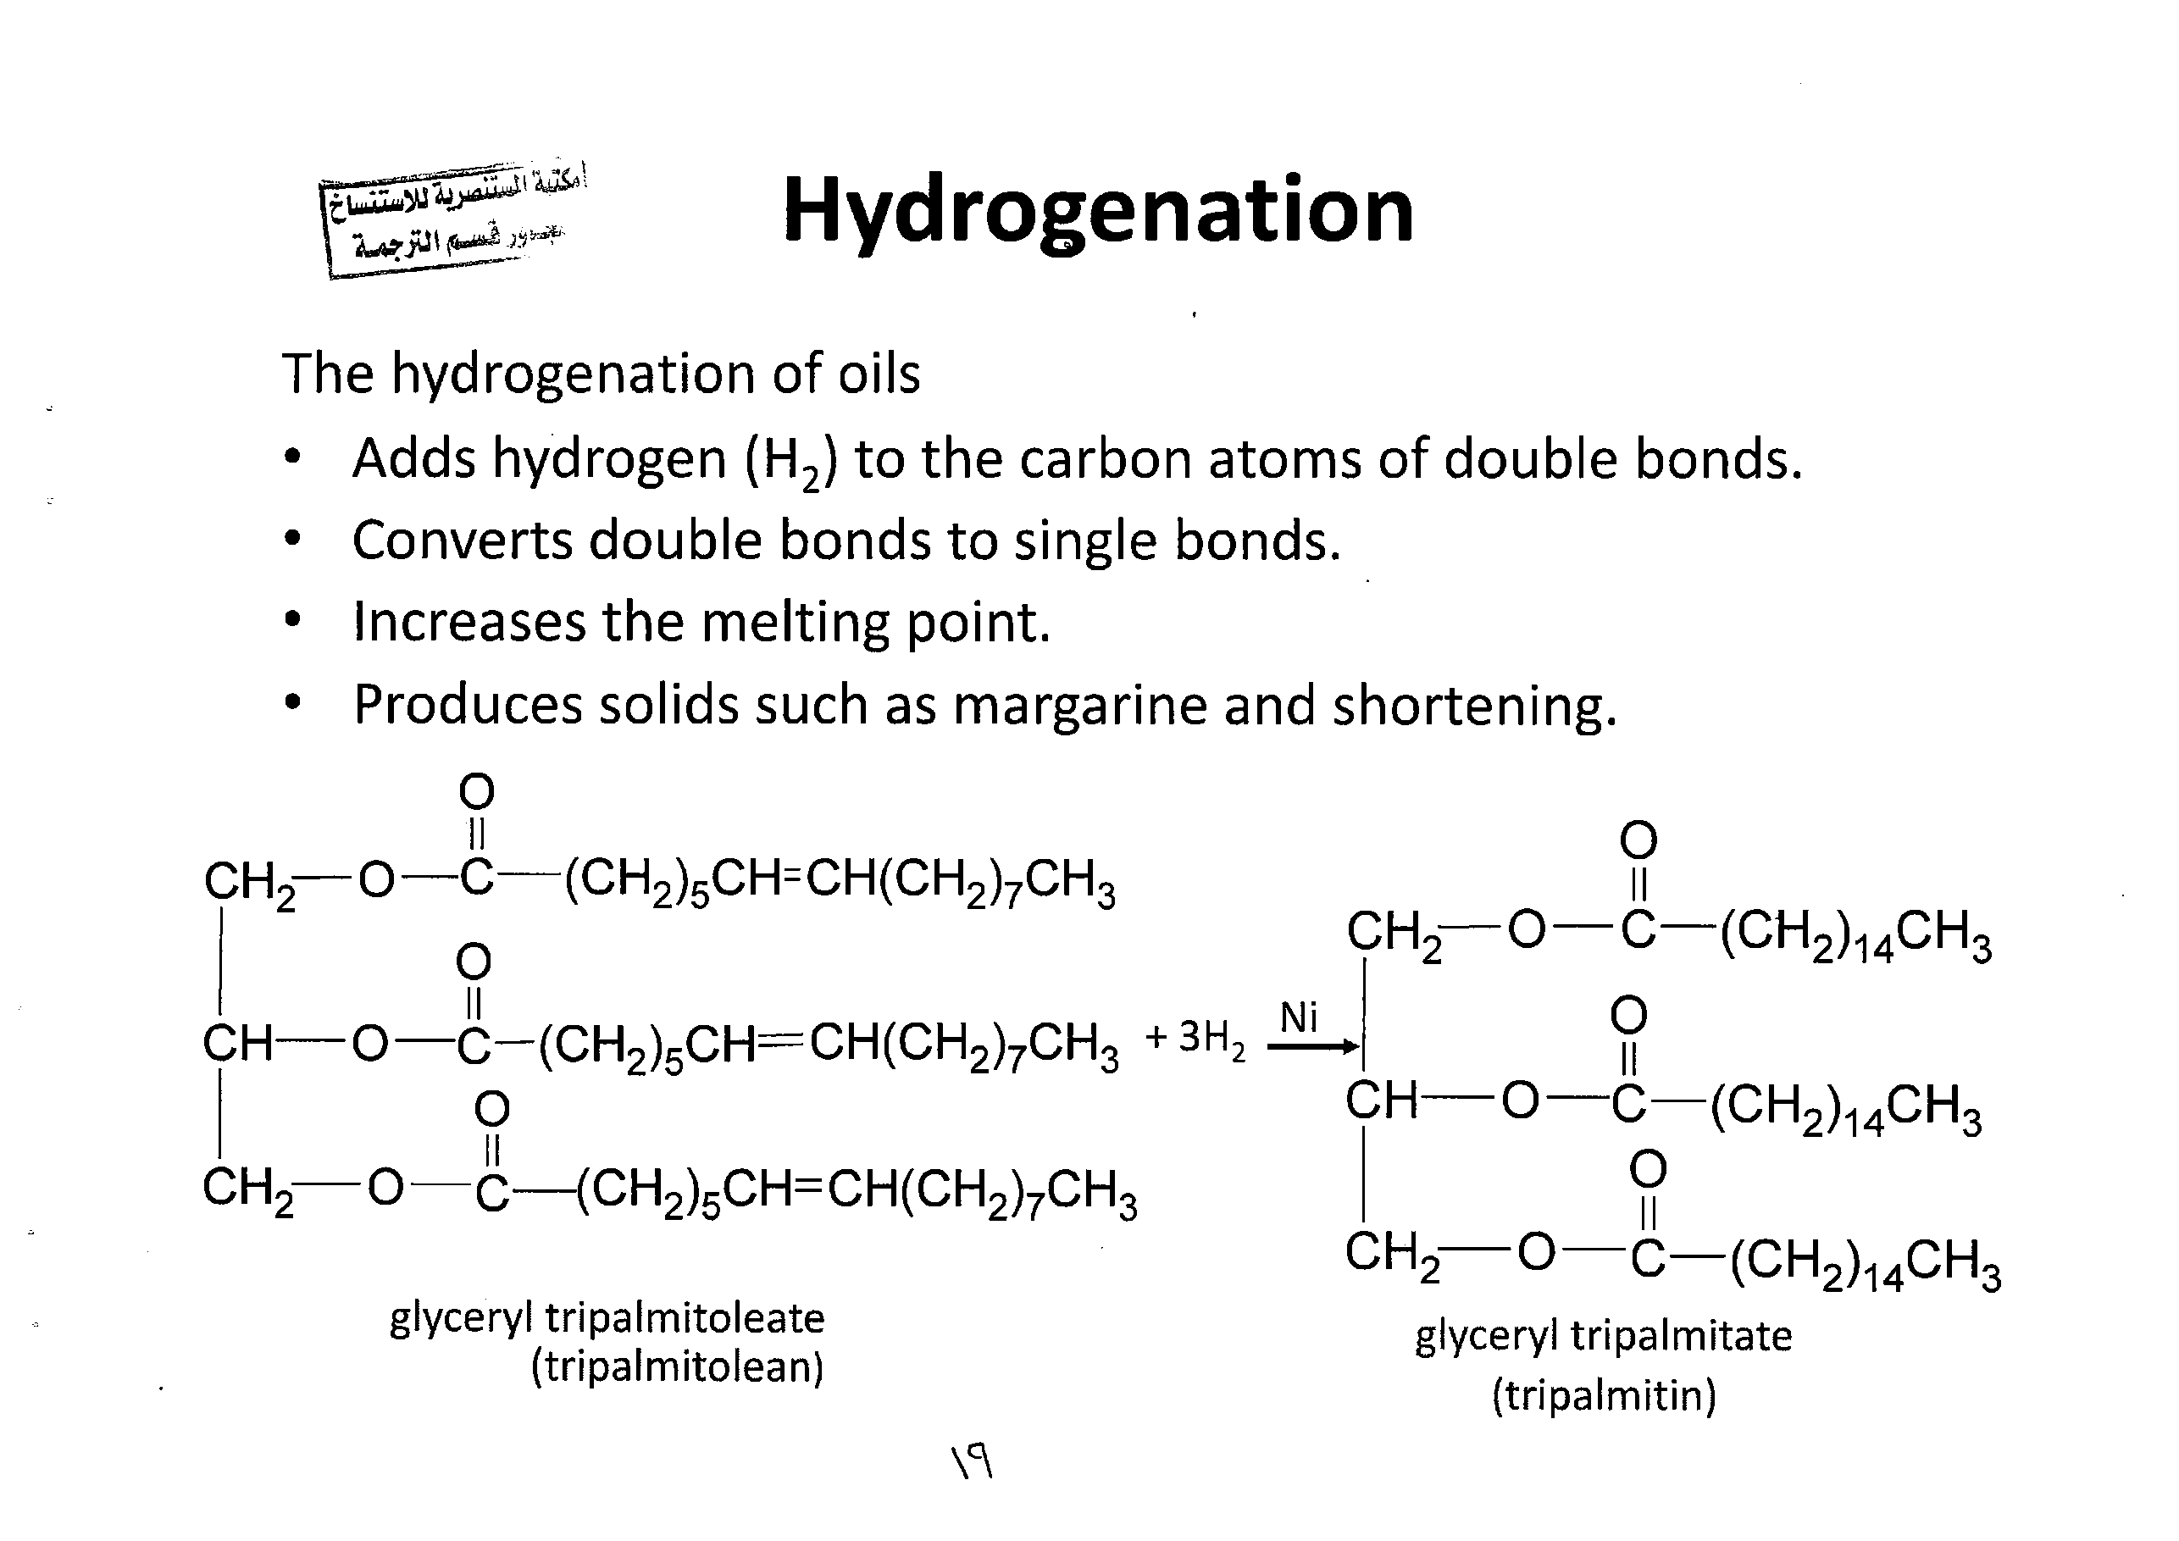

Slide 20
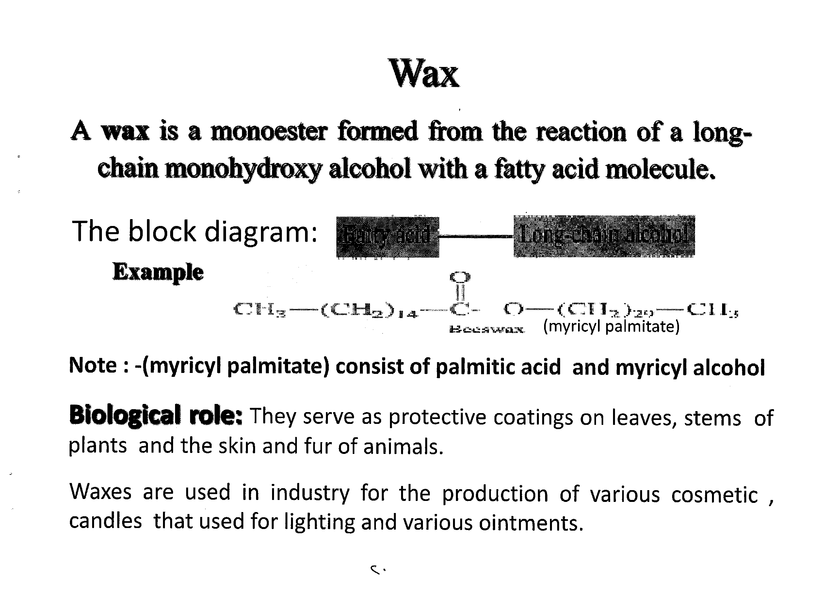
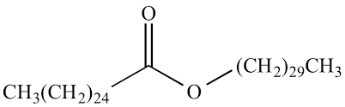
Fatty acid
Long chain alcohol

Slide 21
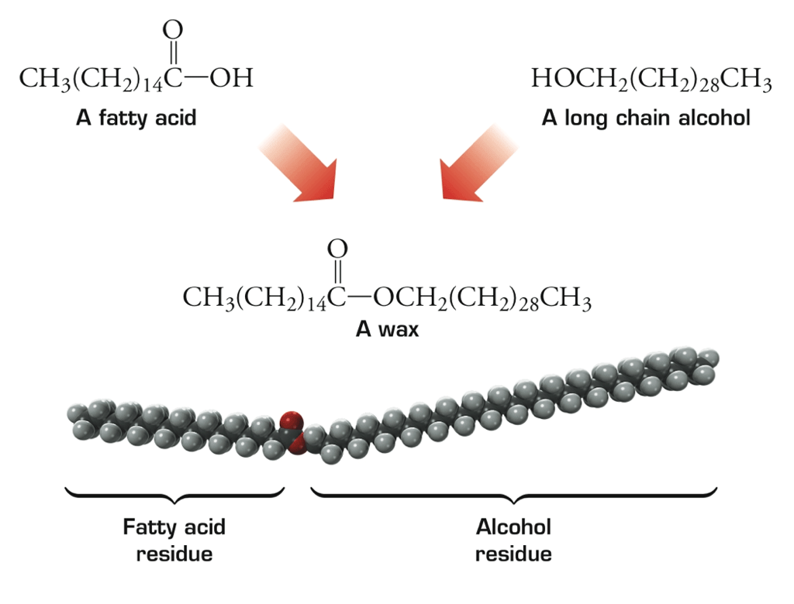

Slide 22
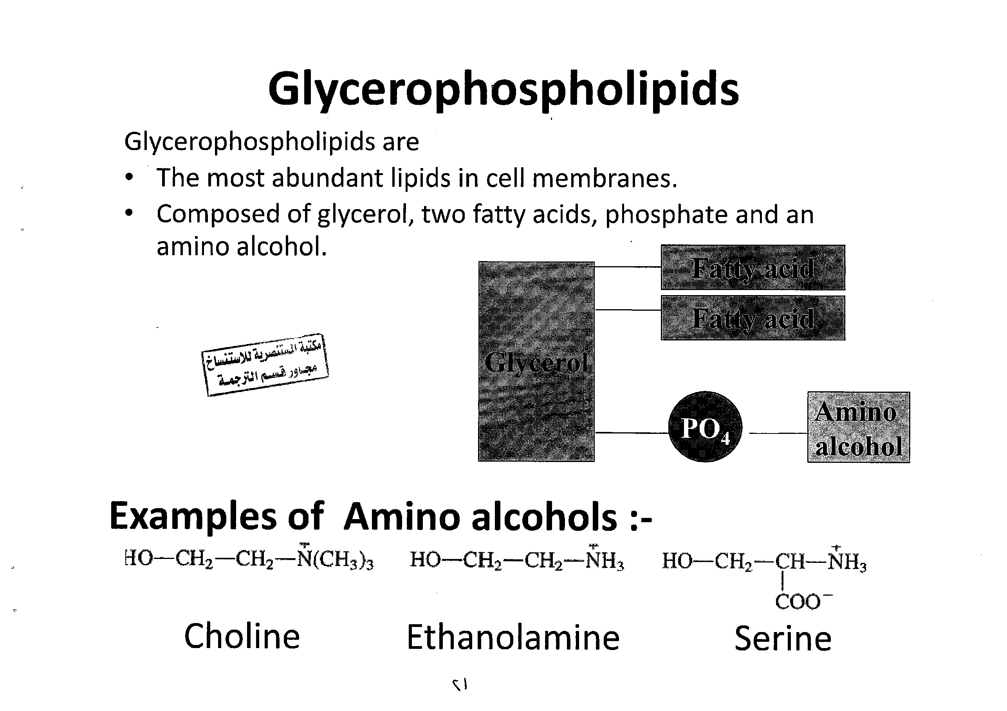
Fatty acid
Glycerol
Fatty acid
PO4

Slide 23
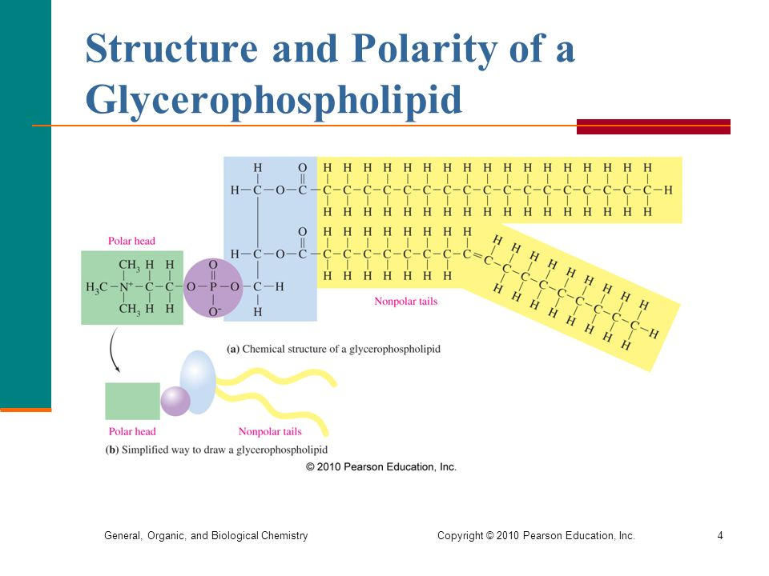

Slide 24
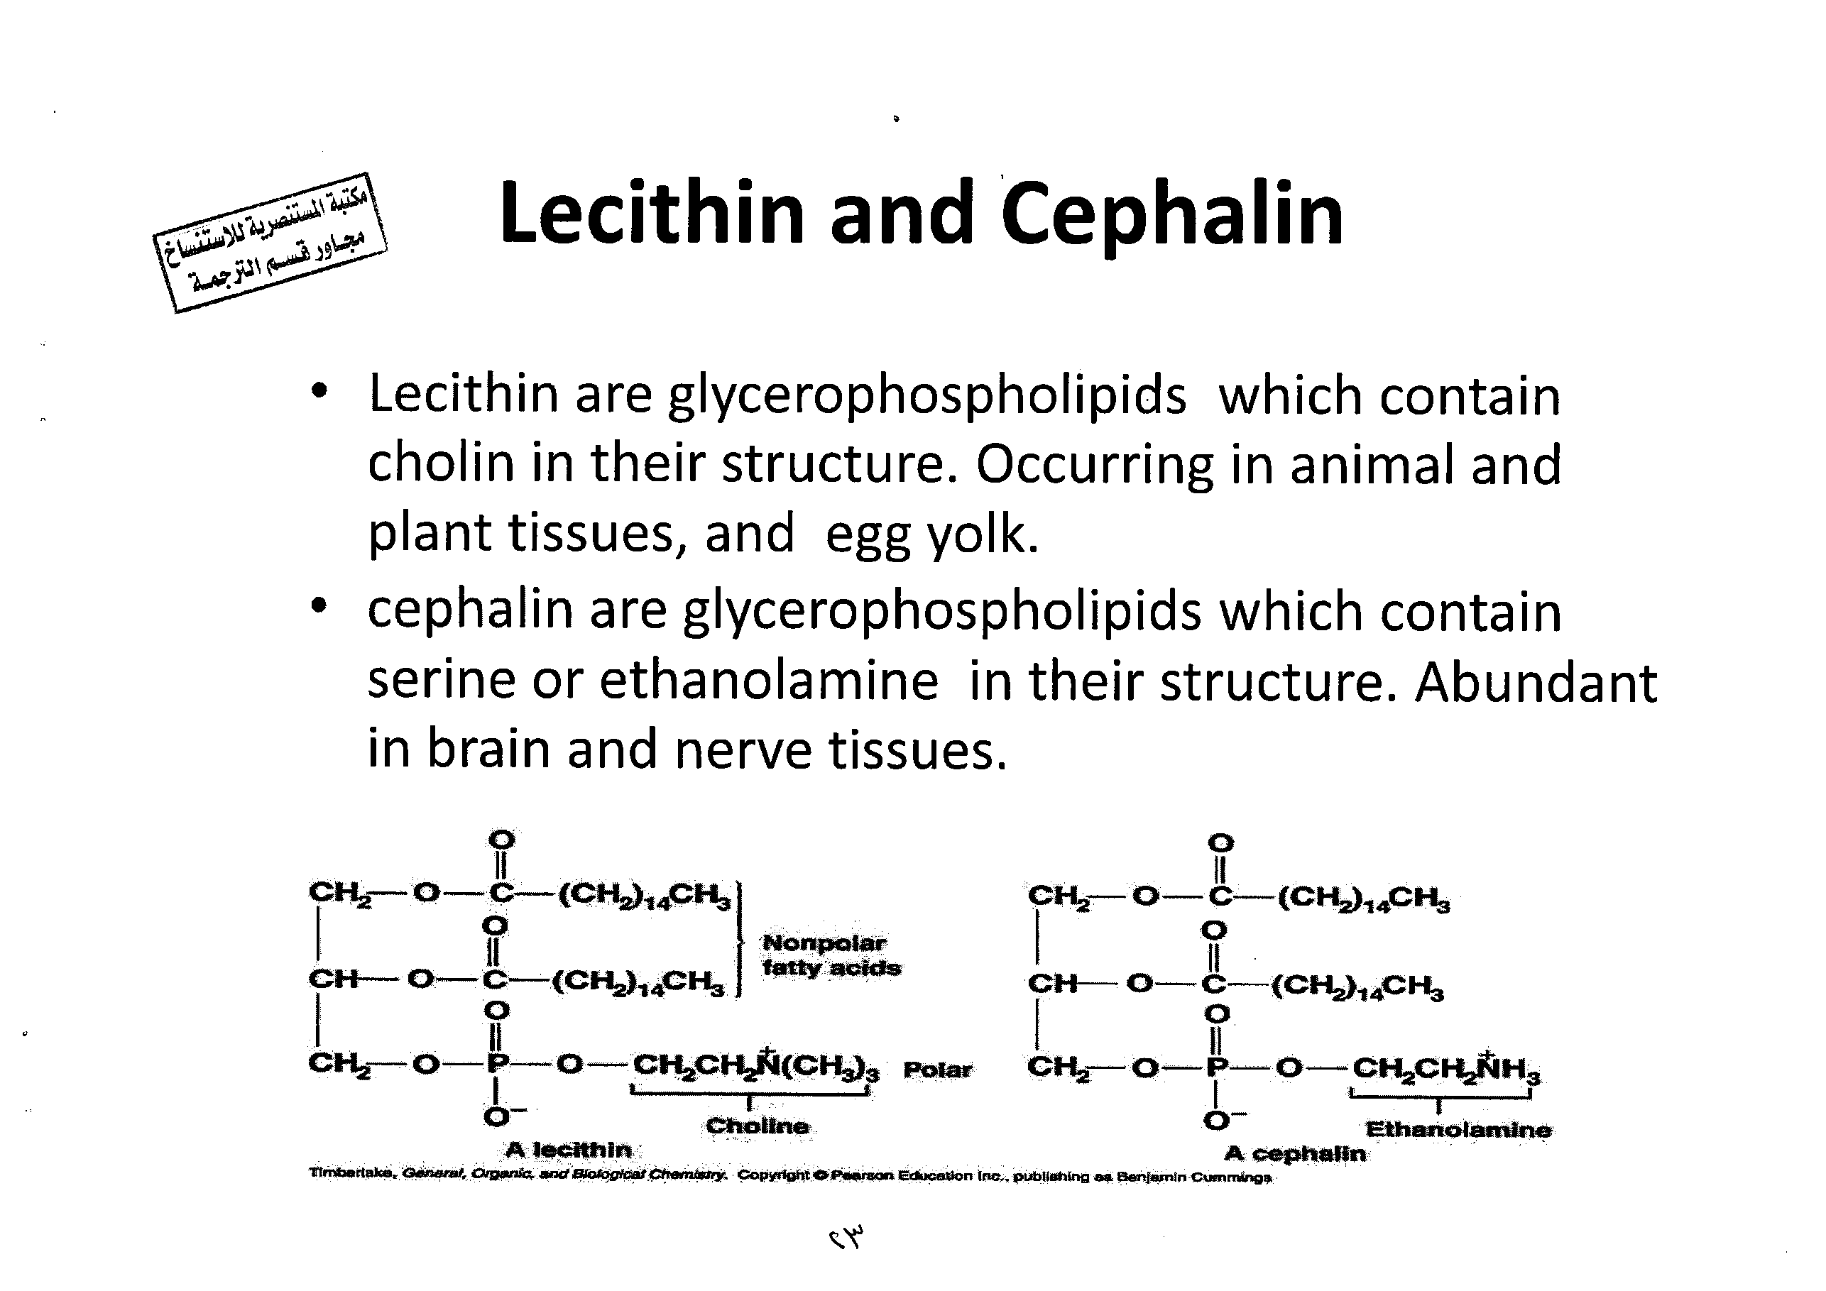

Slide 25
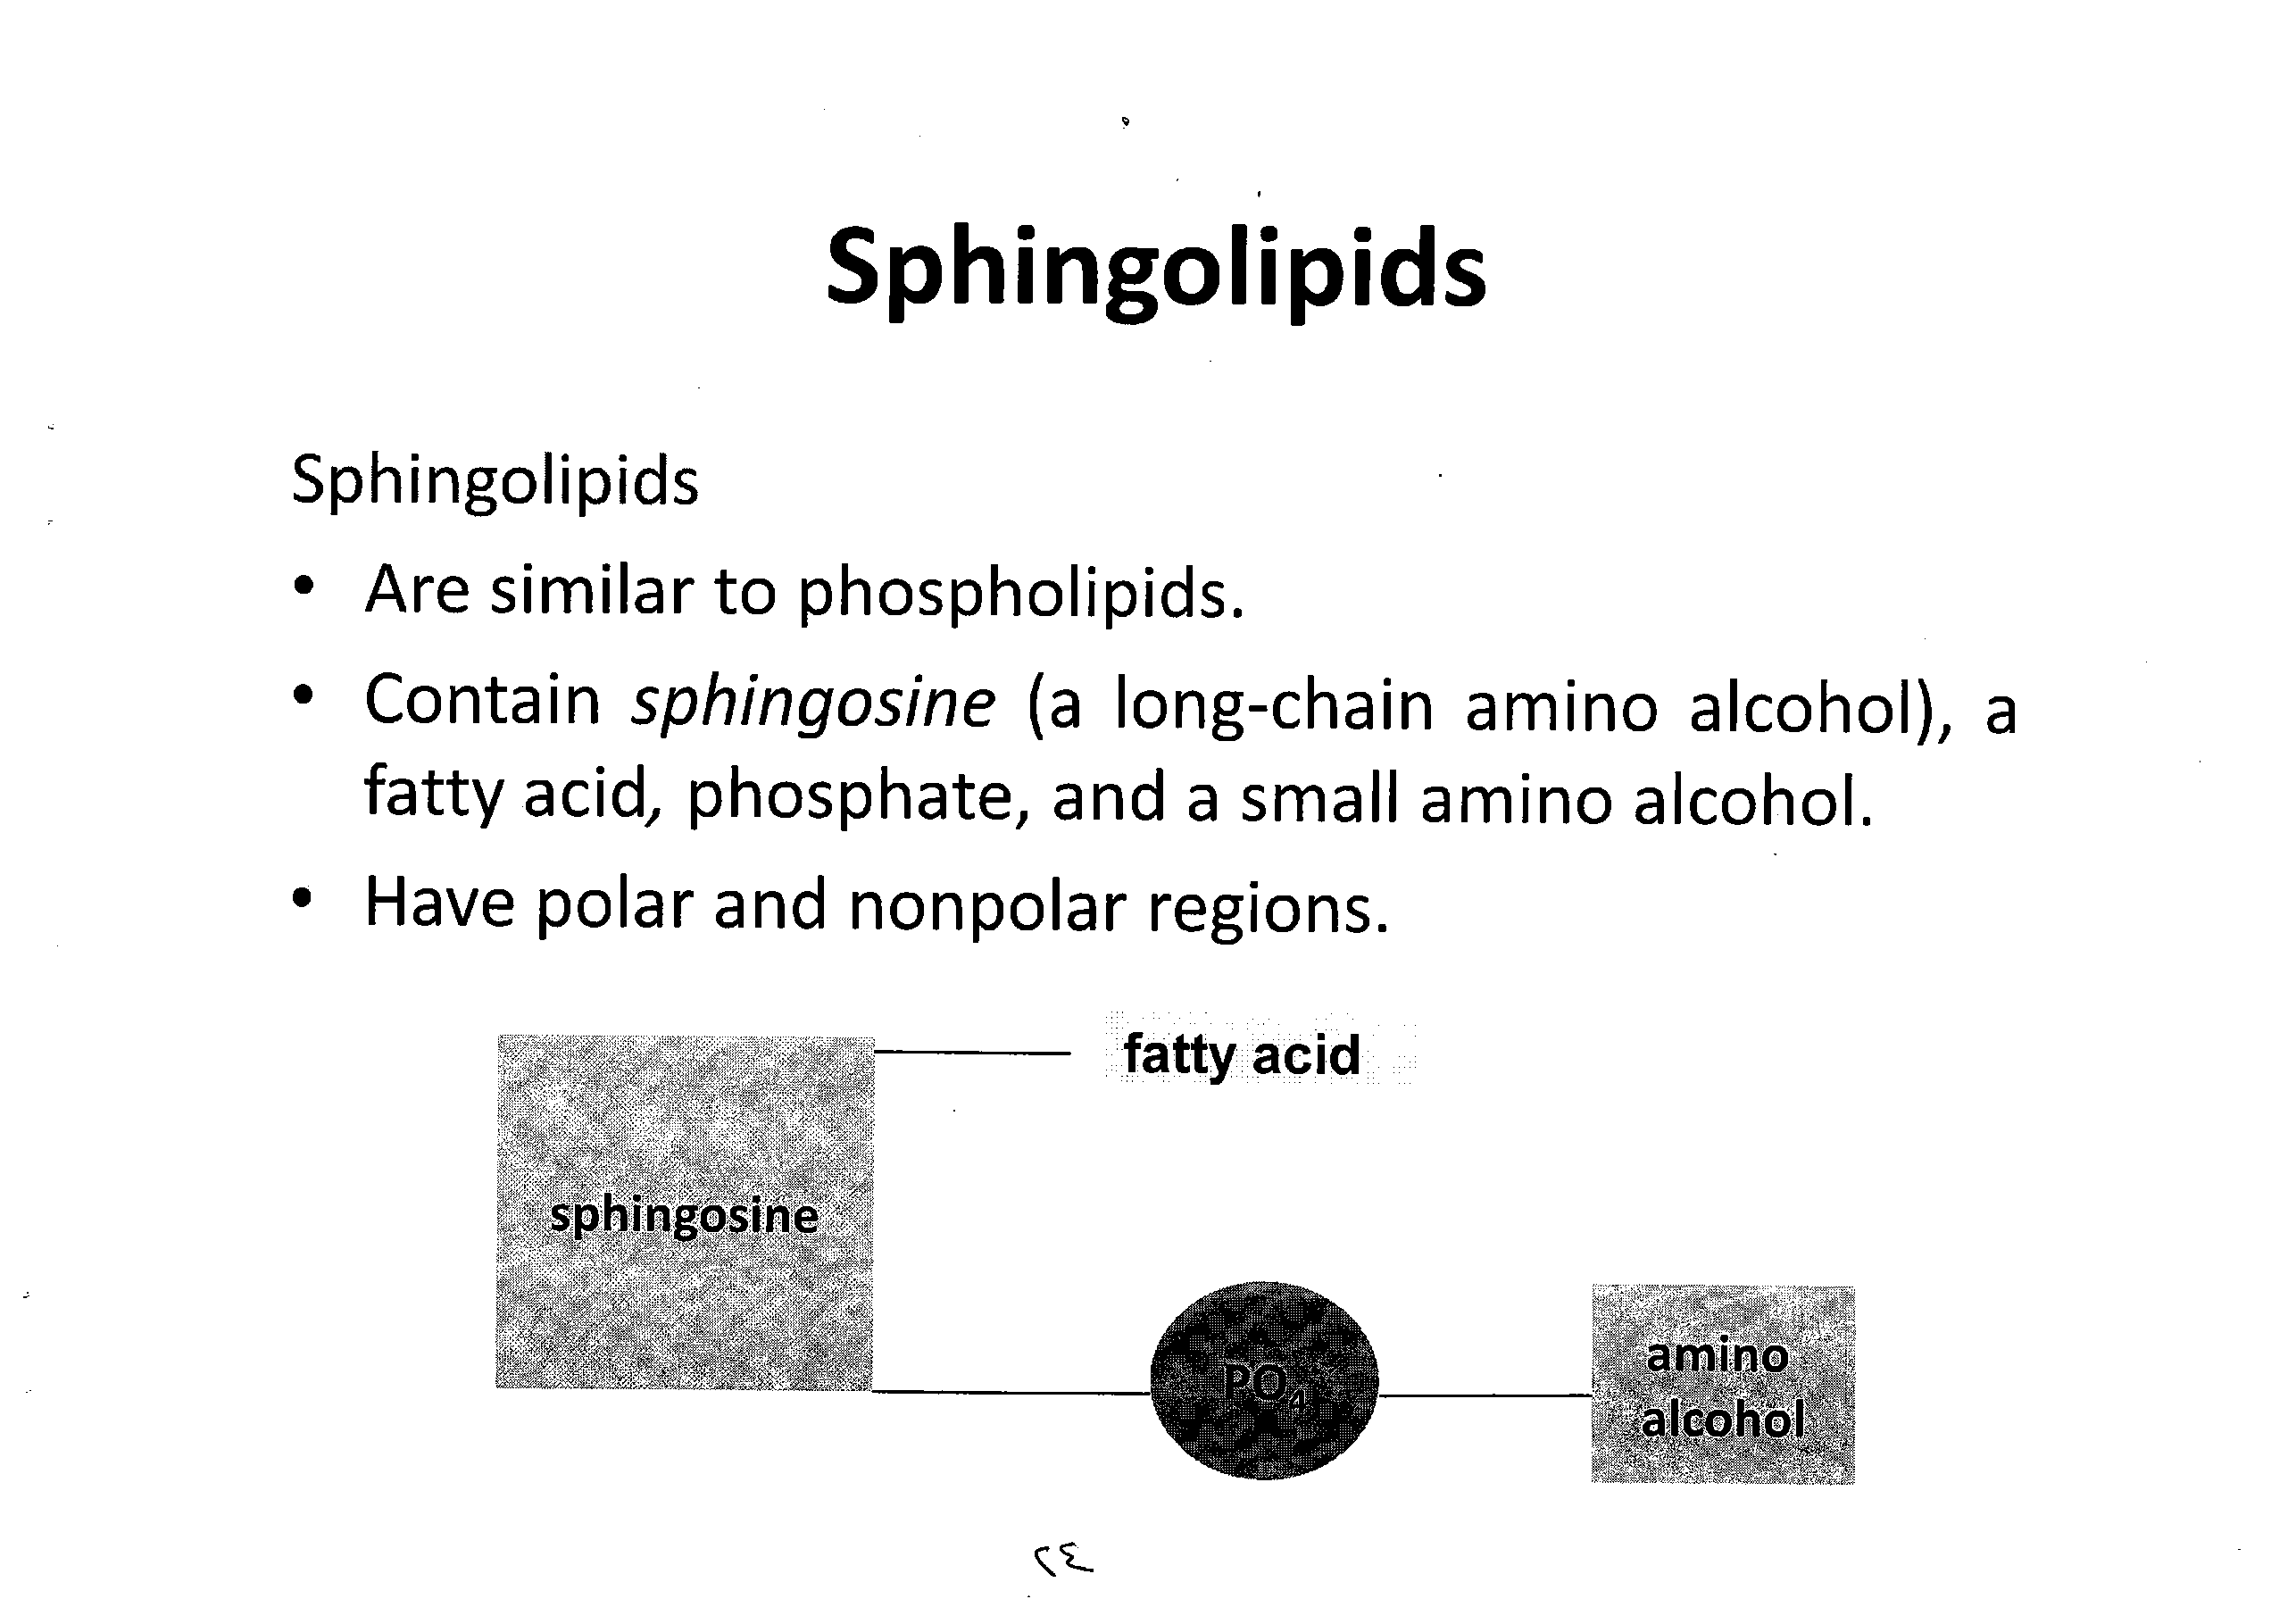
Sphingosine
PO4

Slide 26
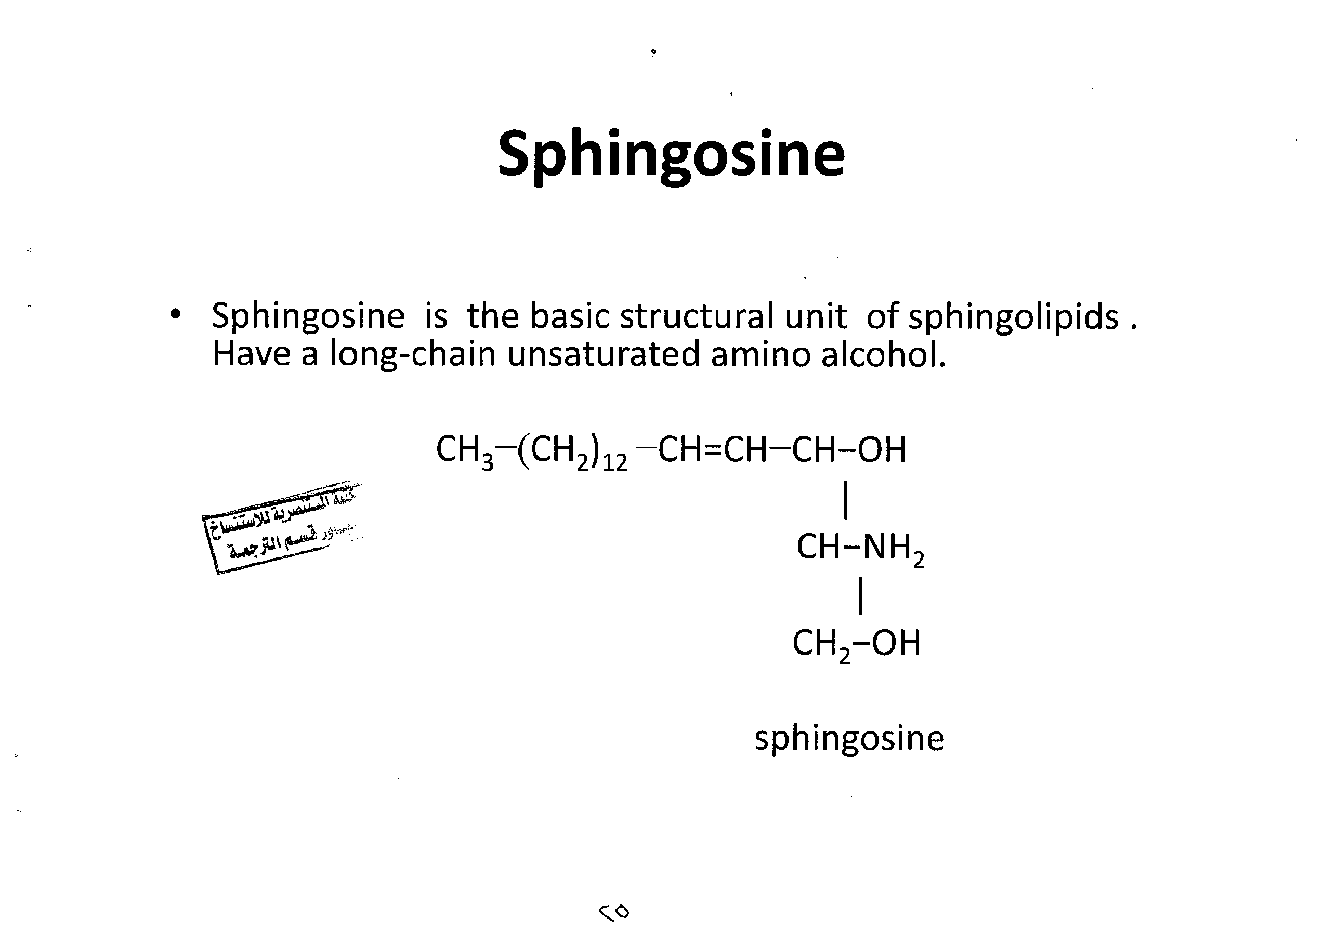

Slide 27
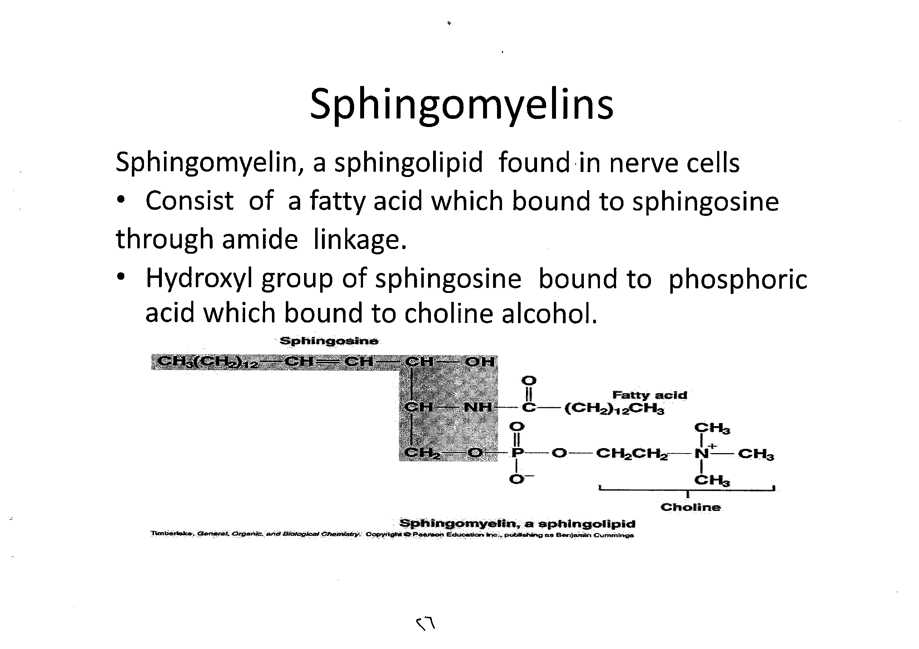

Slide 28
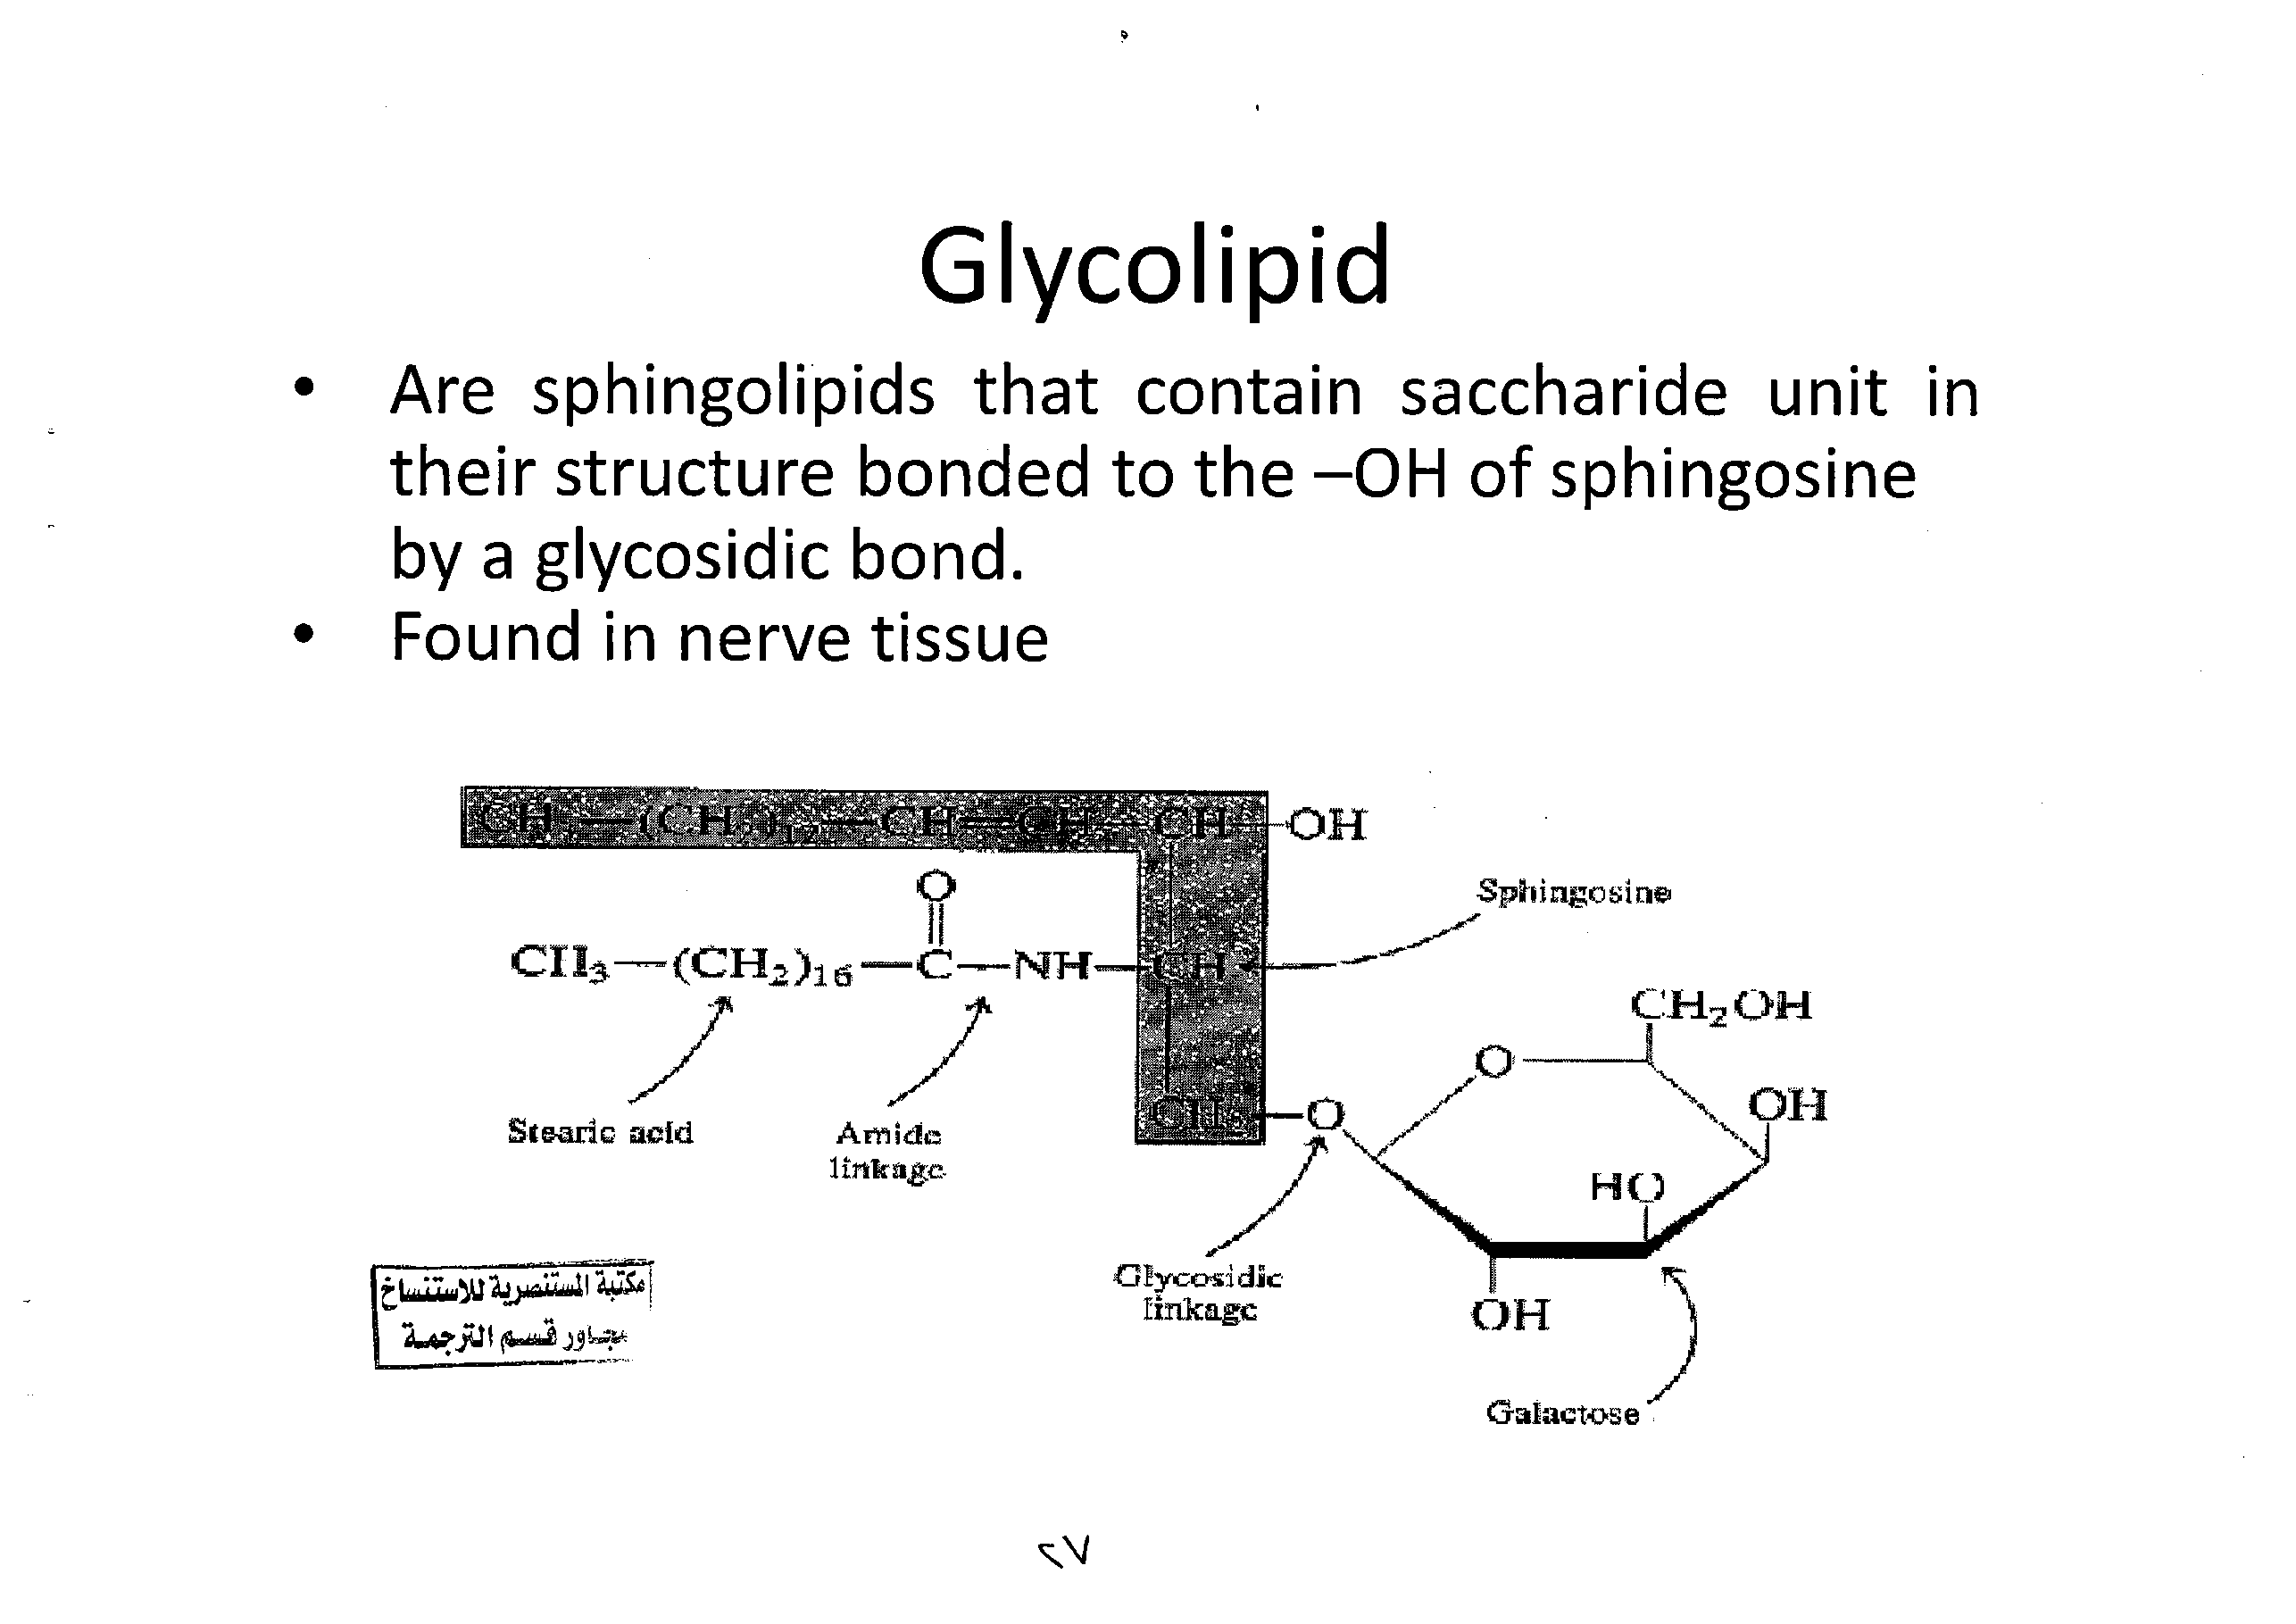
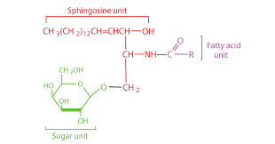

Slide 29
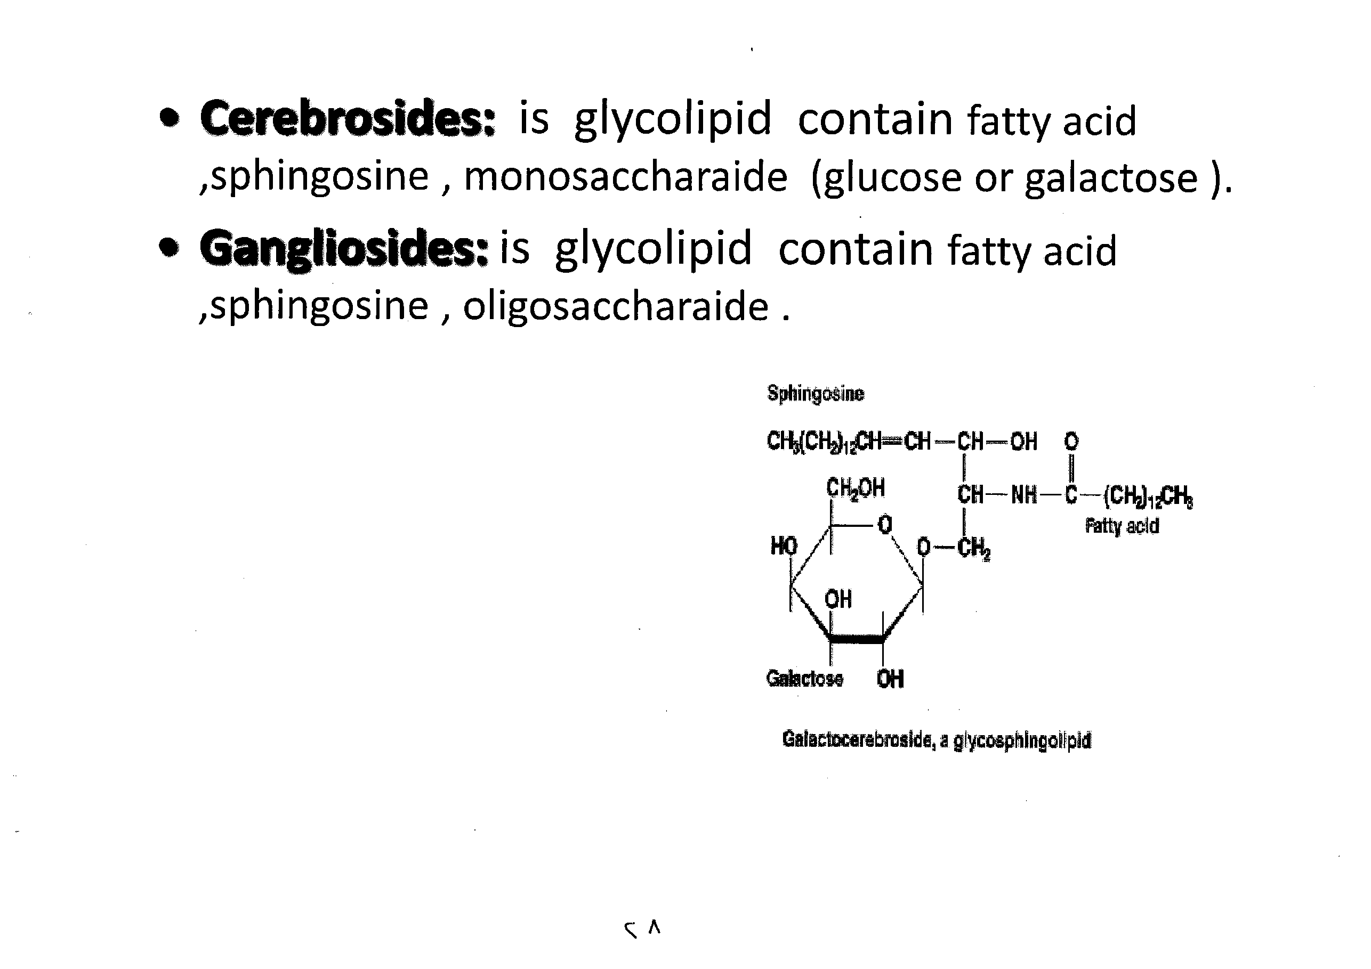

Slide 30
Biological Membrane
Membranes are lipid bilayers that act as a boundary to various cellular structures; however they also allow for careful transfer of ions and organic molecules into and out of the cell.
The stuff that biological membranes are made of Phospholipids and Glycolipids.
  Like the soaps, these molecules are highly amphipathic, and when mixed with water spontaneously form membranes that are described as lipid bilayers.

Slide 31
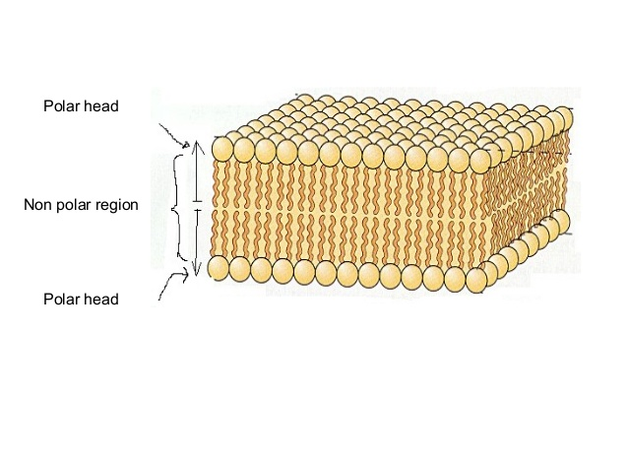
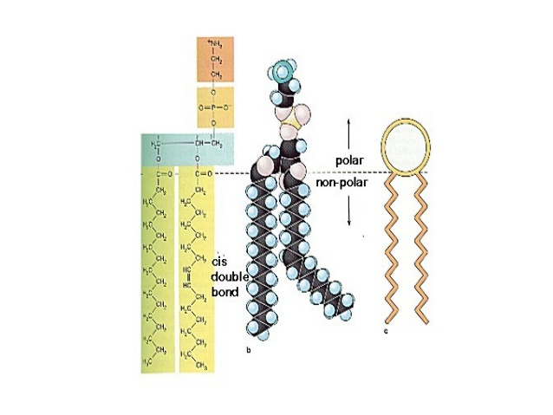

Slide 32
Terpenes and terpenoids are the most important constituents in essential oils Terpenes are built from C5 isoprene units
Terpenes are repeating isoprene units.
Terpenes may be substituted, cyclic
Examples of Terpenes include carotene, retinol (vitamin A), tocopherol (vitamin E), and squalene

Slide 33
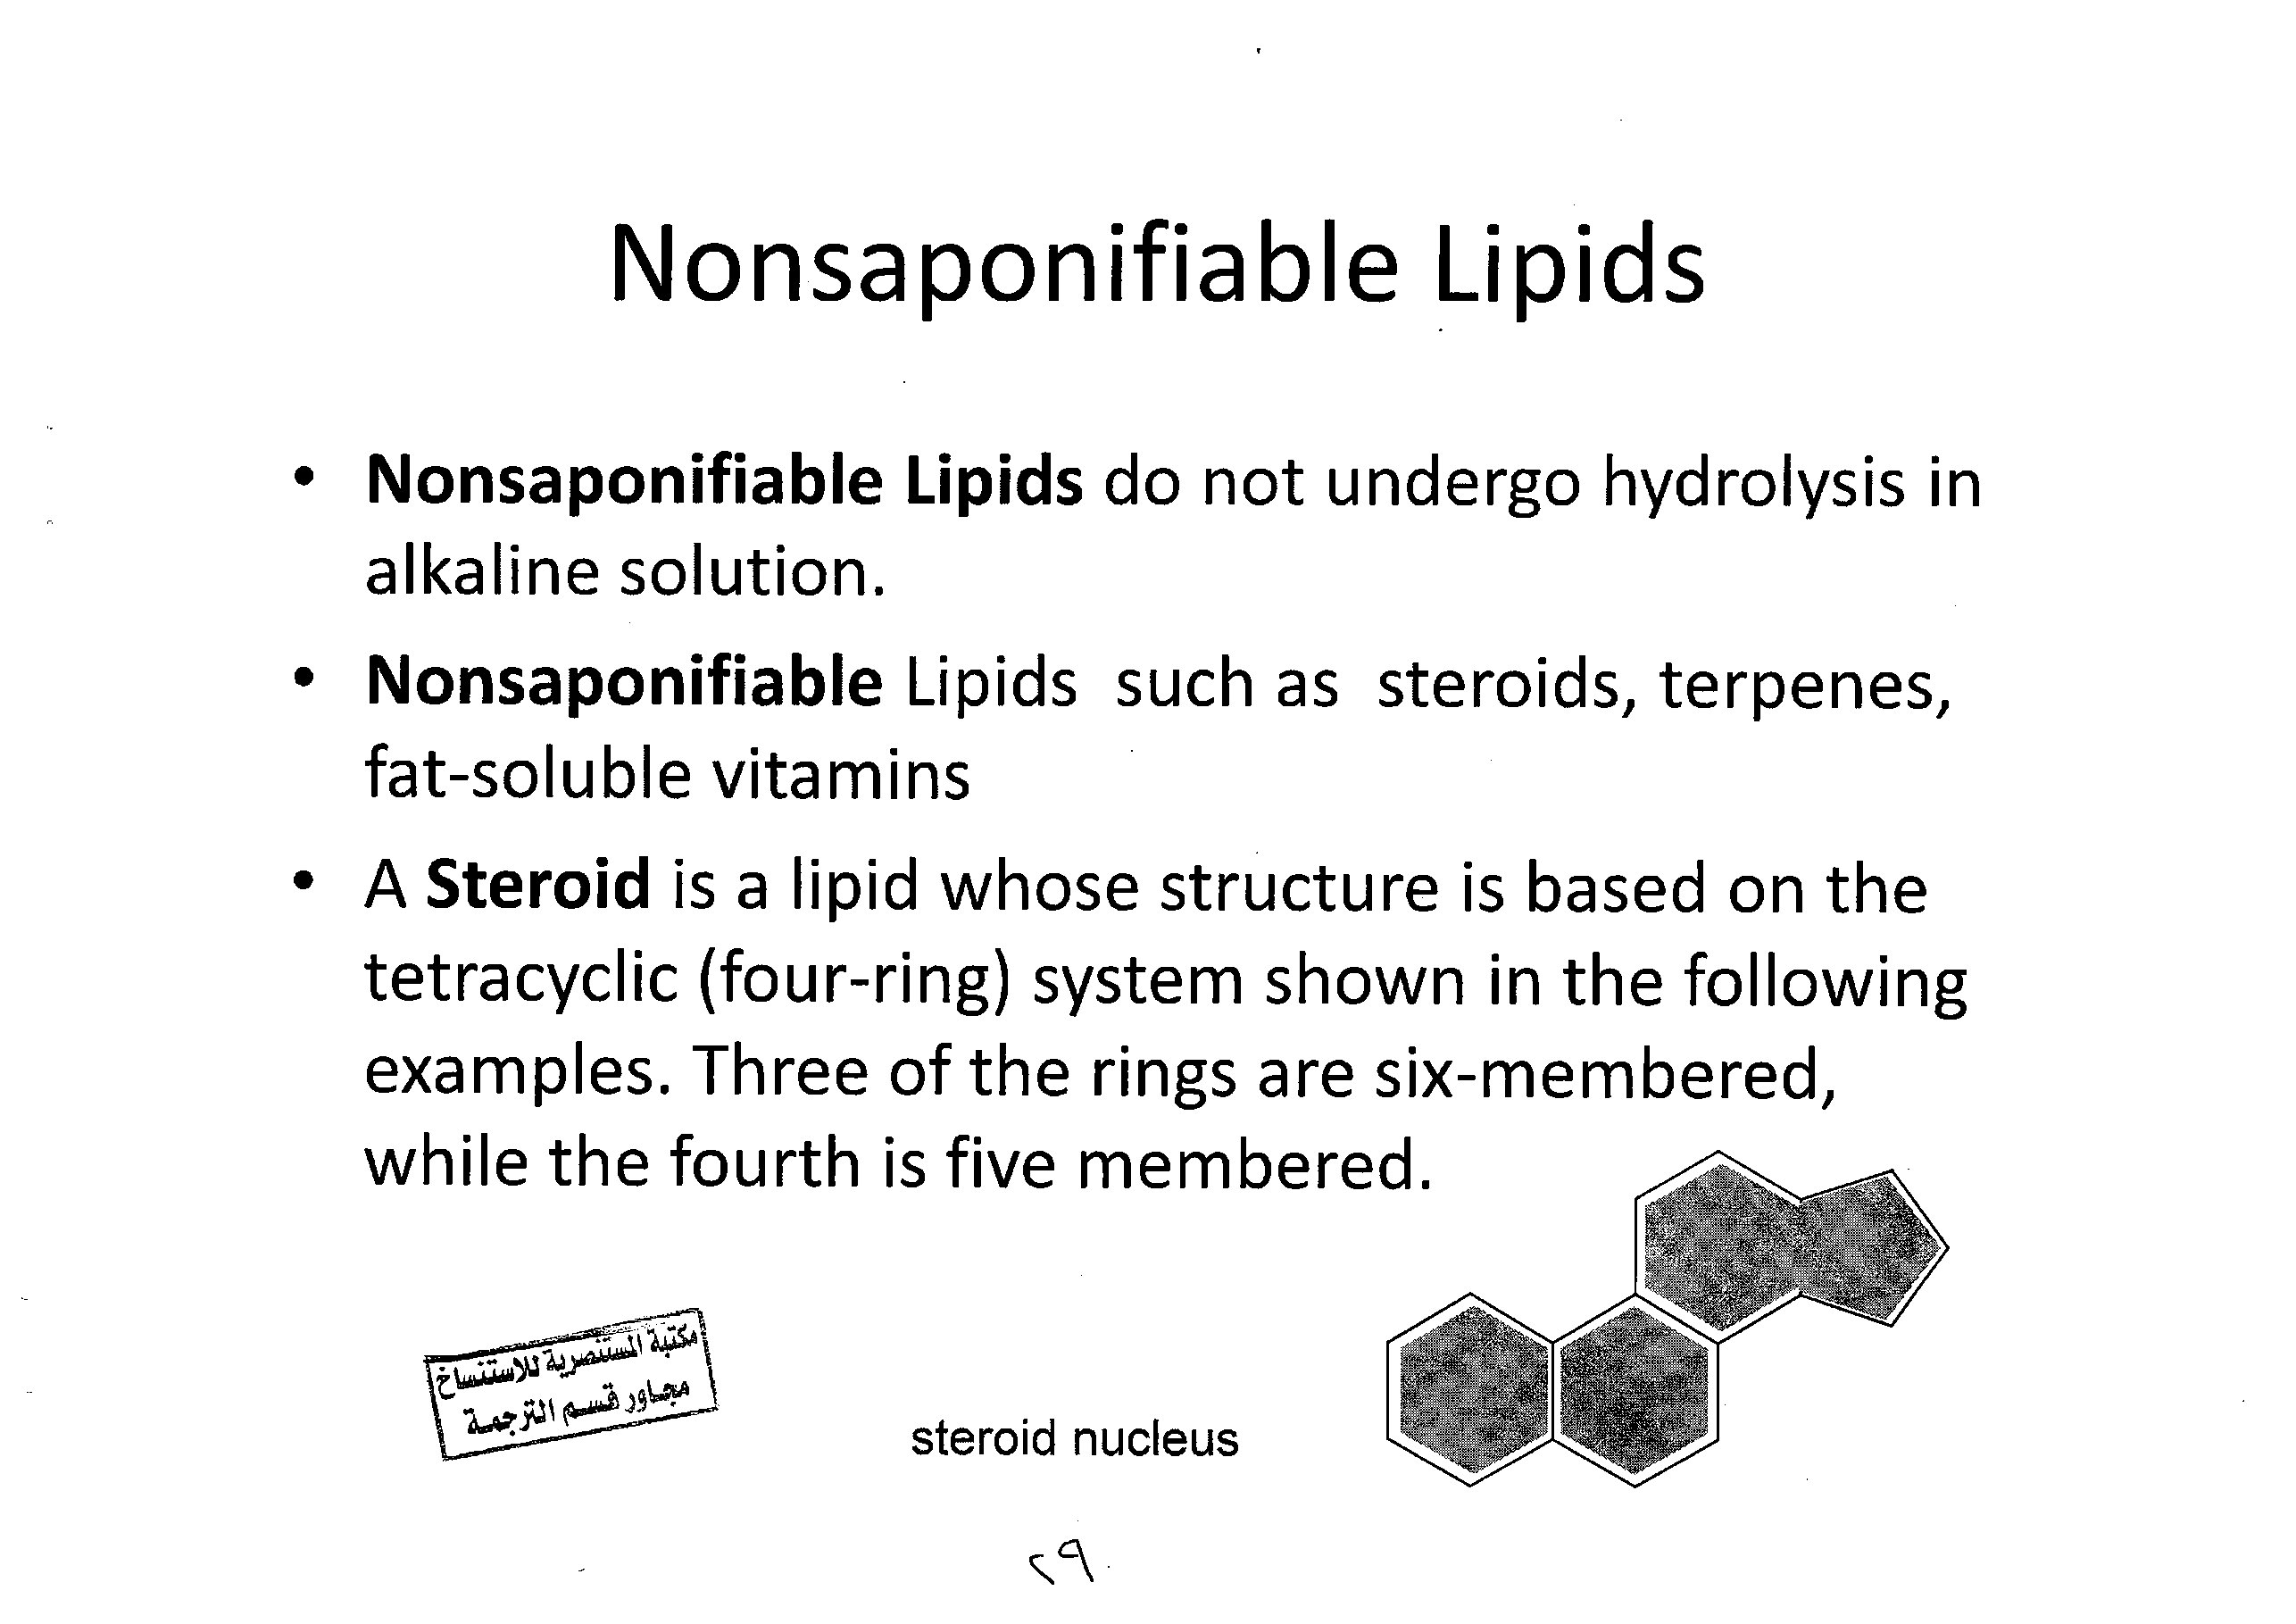

Slide 34

Isoprenoids
Isoprenoids are molecules contained Isoprene unit or, or (2-methyl-1,3-butadiene) with five carbon atom .
The isoprene skeleton can be found in naturally occurring compounds called
Terpenes

Slide 35
Terpenes and terpenoids are the most important constituents in essential oils Terpenes are built from C5 isoprene units
Terpenes are repeating isoprene units.
Terpenes may be substituted, cyclic
Examples of Terpenes include carotene, retinol (vitamin A), tocopherol (vitamin E), and squalene

Slide 36
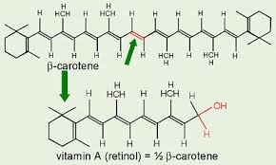
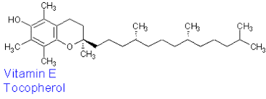
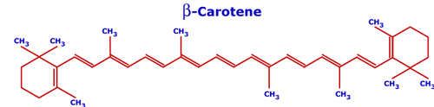


Slide 37
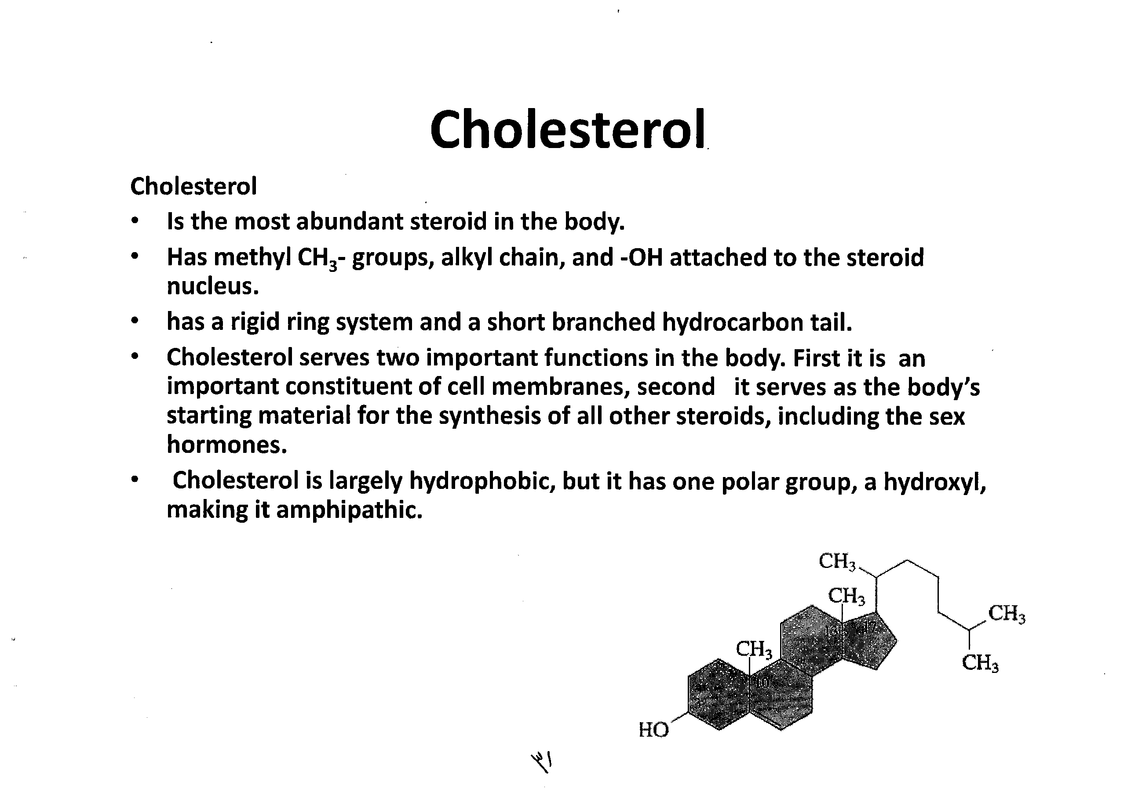

Slide 38
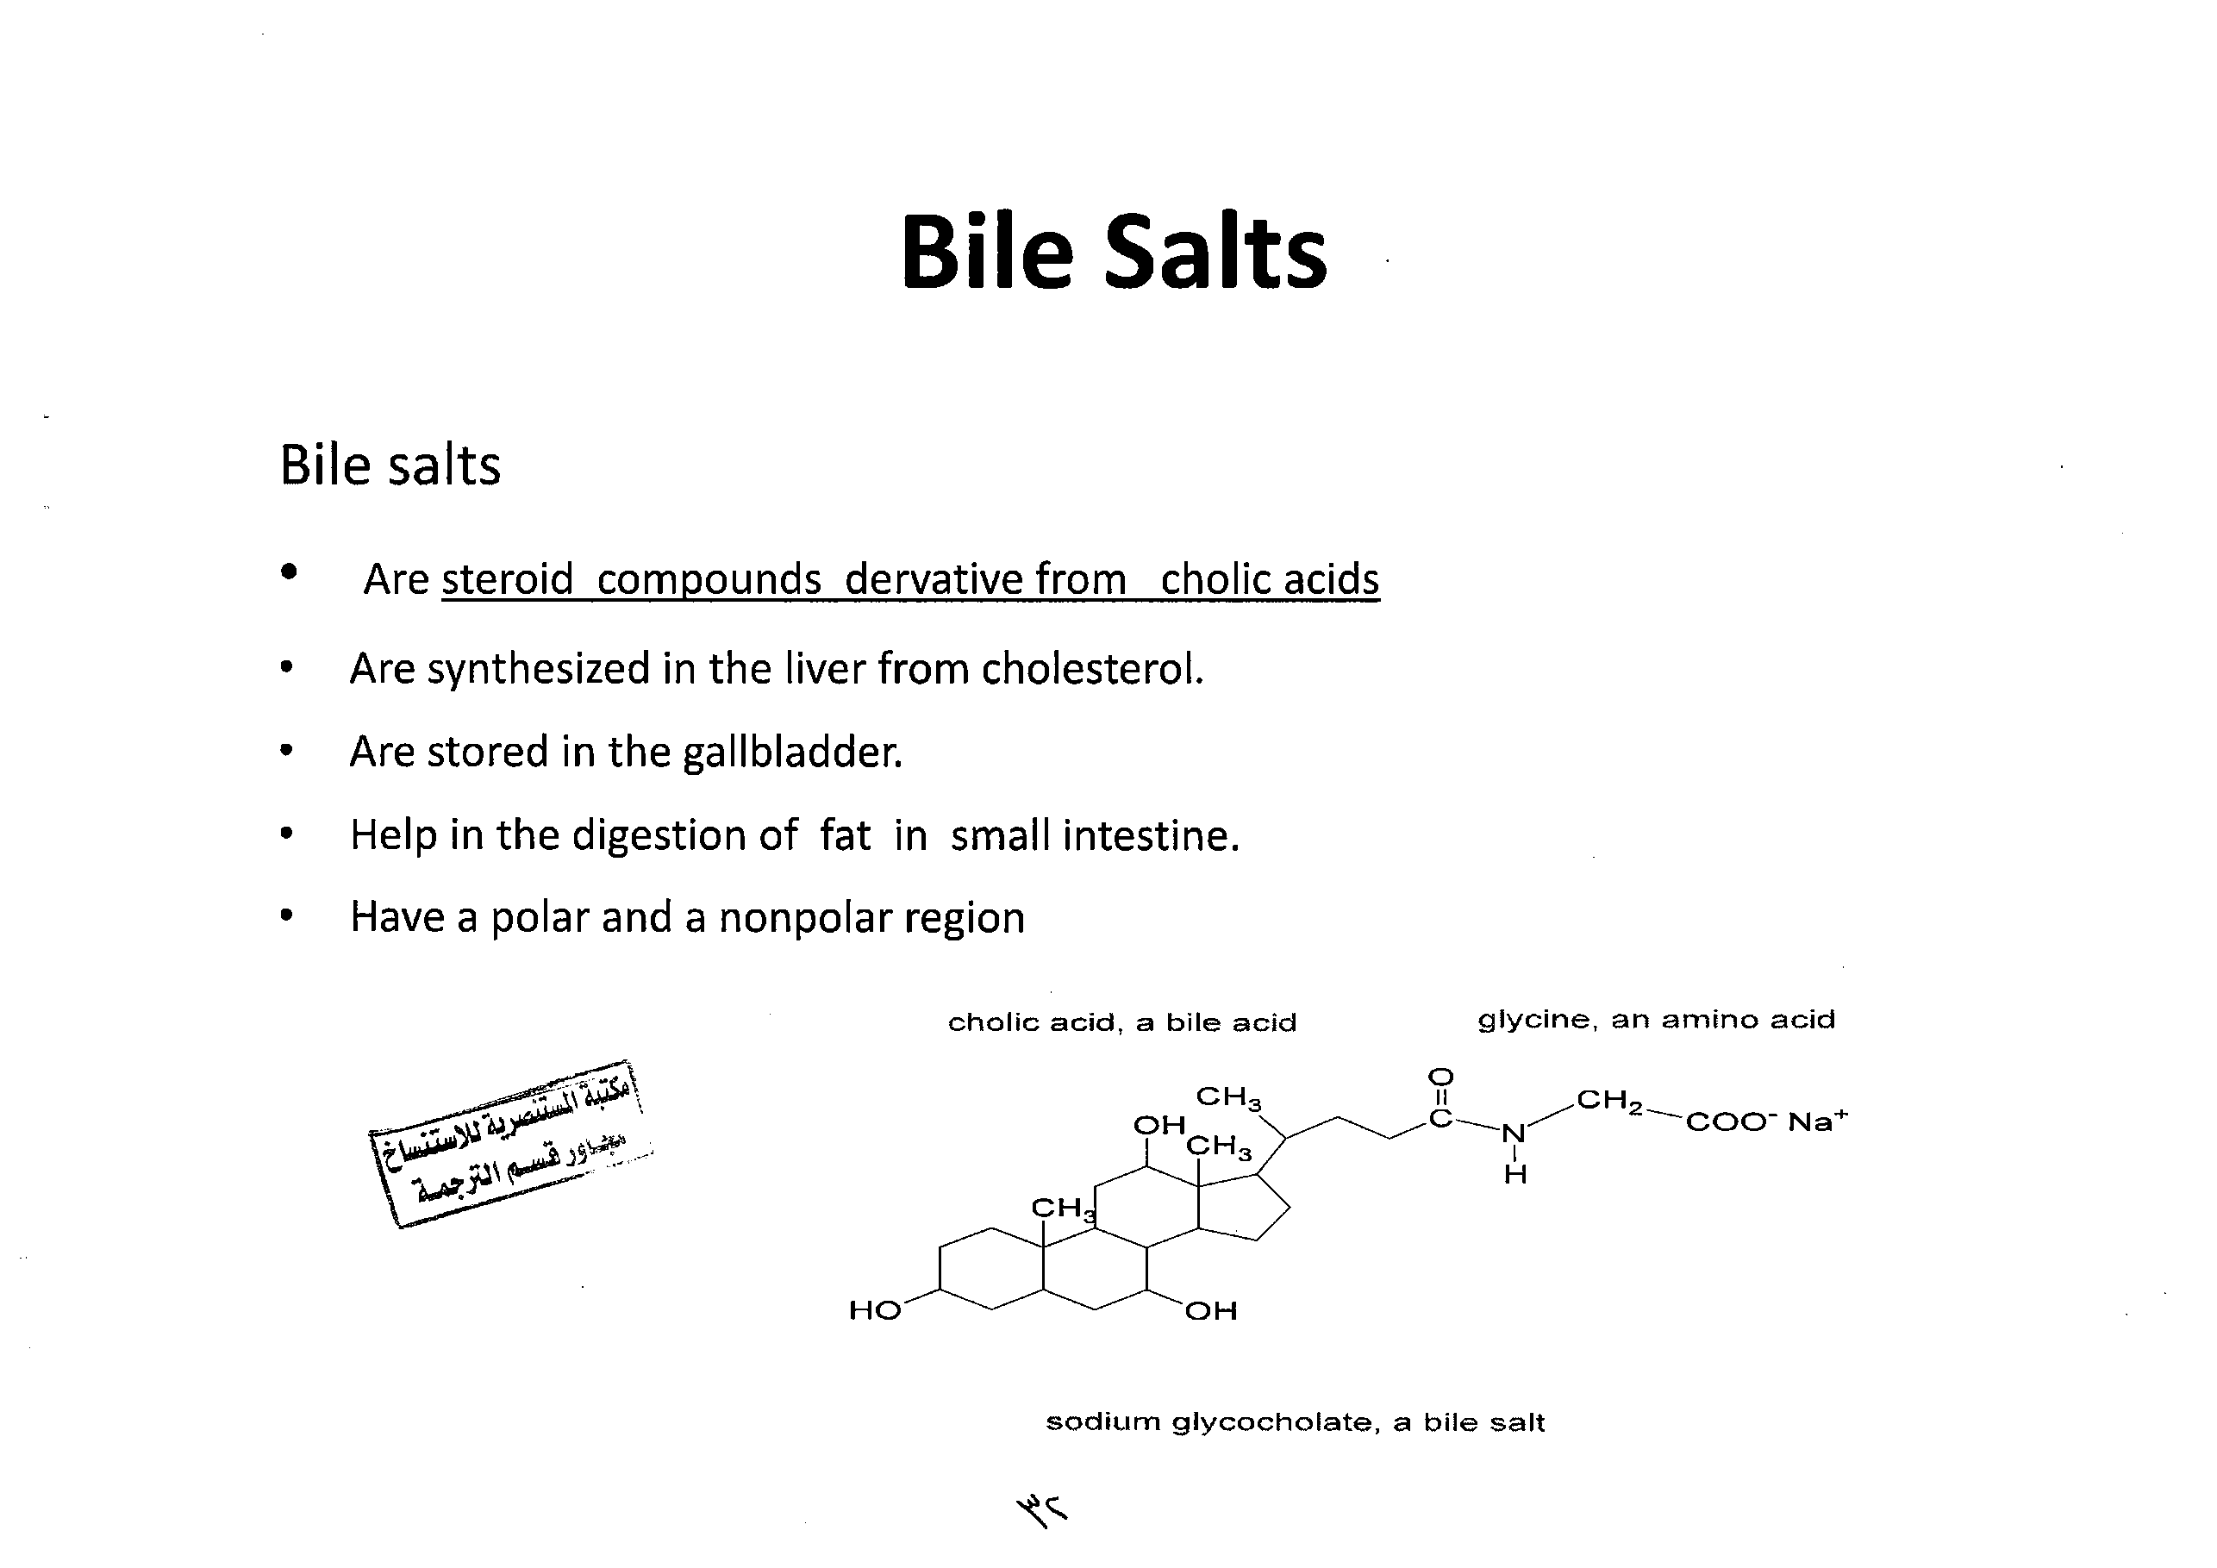

Slide 39
Steroids Hormones
The chemical messengers in our bodies are known as Hormones which are organic compounds synthesized in glands and delivered by the bloodstream to certain tissues in order to stimulate or inhibit a desired process.
Steroids Hormones are a type of hormone which are usually recognized by their tetracyclic skeleton

Slide 40
These are derived from cholesterol from the diet and exert their effects in two ways:
i) They bind directly to membrane receptors.
ii) As they are fat soluble they pass through cell membranes where they attach to receptors in the cytoplasm. There are several types of steroid hormones:
A) Corticoids.
Glucocorticoids (principally cortisol) are released by the adrenal glands in response to stress.
They increase the breakdown of fats and proteins into glucose to trigger escape or defense ("fight or flight").
Mineralocorticoids (e.g. aldosterone) are also produced by the adrenal glands and reduce salt secretion in the kidneys.

Slide 41
b) Sex Steroids.
These are released mainly by the ovaries and testes but also by the adrenal glands. They comprise:
Androgens: Testosterone is produced in large amounts in males and has masculinising and defeminising effects; maintaining male secondary sexual characteristics and promoting courtship, aggressive and sexual behaviours.
Estrogens: Estradiol is produced in large amounts in females and has feminising effects, promoting female secondary sexual characteristics, water retention, calcium metabolism, sexual behaviour and maternal behaviours.
Progesterone prepares the uterus for the implantation of a fertilised ovum and regulates the stages of pregnancy.

Slide 42
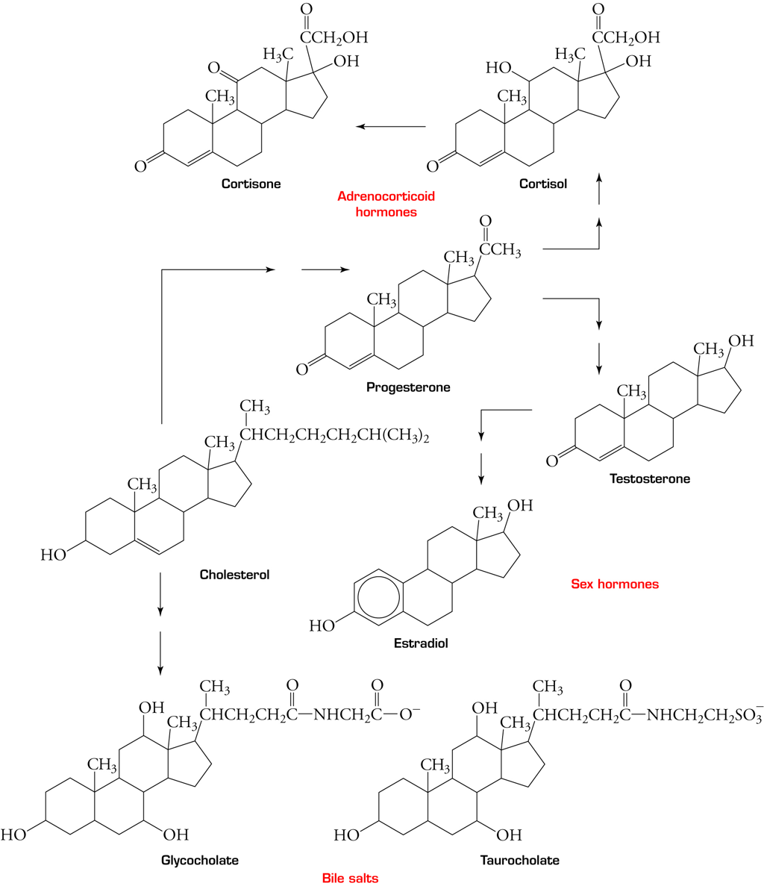

Slide 43
Prostaglandins
Prostaglandin is “any member of a group of lipid compounds that are derived enzymatically from unsaturated fatty acids having diverse hormone-like effects in animals. Prostaglandins have been found in almost every tissue in humans and other animals.
Every prostaglandin contains 20 carbon atoms, including a 5-carbon ring .” Prostaglandins are responsible for an array of physiological effects, such as inflammation, blood pressure ,blood clotting, fever, pain, the induction of labor ,and sleep-wake cycle

Slide 44
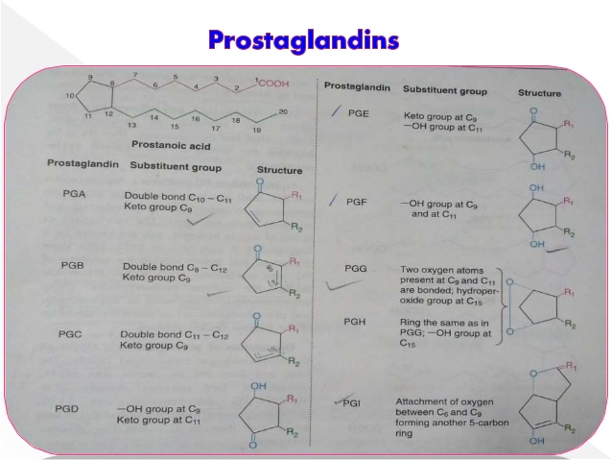

Slide 45
Lipoproteins
Lipoproteins are used to transport the water insoluble lipids such as triglycerides, phospholipids and cholesterol, in the blood.

Slide 46
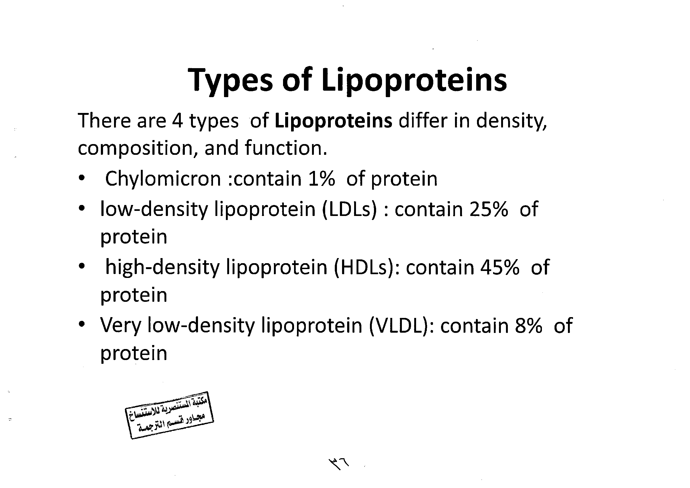

Slide 47
The HDL and LDL levels in the blood can be used to assess ones risk for atherosclerosis.
  High levels of HDL is considered good
    This is why HDL is sometimes referred to as “good cholesterol”
    > 40 mg/dL is good.
  High levels of LDL is considered bad
    This is why LDL is sometimes referred to as “bad cholesterol”
    > 100 mg/dL is bad.

