Slide 1
Mobile Computing

Slide 2
Presentation Outline
What is mobile computing?
Comparison to wired networks
Why go mobile?
Types of wireless devices
Mobile objects
Applications of mobile computing
Challenges
Future of mobile computing
Conclusion

Slide 3
What Is Mobile Computing? (Cont.)
Mobile Computing:
Is an umbrella term used to describe technologies that enable people to access network services anyplace, anytime, and anywhere.

Slide 4
Comparison to Wired Net.
Wired Networks
high bandwidth
low bandwidth variability
can listen on wire
high power machines
high resource machines
need physical access(sec.
low delay
connected operation
Mobile Networks
low bandwidth
high bandwidth variability
hidden terminal problem
low power machines
low resource machines
need proximity
higher delay
disconnected operation

Slide 5
Why Go Mobile?
Enable anywhere/anytime connectivity
Bring computer communications to areas without pre-existing infrastructure
Enable mobility
Enable new applications
An exciting new research area

Slide 6
Applications of Mobile Computing (Cont.)
For Estate Agents
In courts
In companies
Stock Information Collection/Control
Credit Card Verification
Taxi/Truck Dispatch
Electronic Mail/Paging

Slide 7
Challenges
Disconnection
Low bandwidth
High bandwidth variability
Low power and resources
Security risks
Wide variety terminals and devices with different capabilities
Device attributes
Fit more functionality into single, smaller device

Slide 8
Future of Mobile Computing
Use of Artificial Intelligence
Integrated Circuitry -> Compact Size
Increases in Computer Processor speeds

Slide 9
Features of Android
Android can run multiple apps at the Same Time
Also support optimized graphics VGA, 2D graphics and 3D graphics
Android has a better app market
Android lets you change your settings faster
It gives you more options to fit your budget
Android keeps information visible on your home screen.
Android also support Java applications.

Slide 10
Conclusion
Mobile computing has severe limitations
- however, it is far from impossible, and technology improves all the time
Lots of challenges
- some have (good) solutions, many others are still waiting to be solved

Slide 11
Thank You
Questions and Comments?

Slide 12
Android Development
Training for Beginners
FIRST DAY MODULE
By: Joemarie Comeros Amparo

Slide 13
Outline:
Overview on Android
Installing ADT on Eclipse
Explore Project Components
Sample Android Project
Running Android Project

Slide 14
What is Android?
Android is an open mobile phone platform that was developed by Google and later by Open Handset Alliance. Google defines Android as a "software stack" for mobile phones.
Software stack is made up of operating system(the platform on which everything runs), the middleware (the programming that allows applications to talk to a network and to one another) and the applications (the actual programs that phone will run)

Slide 15
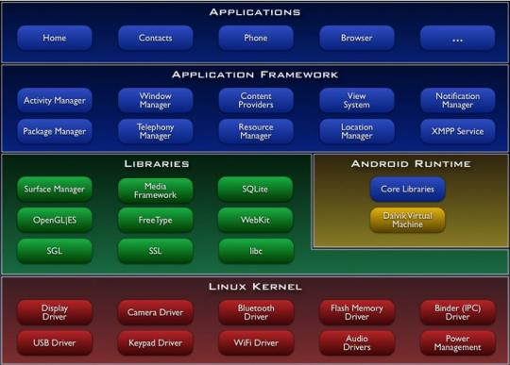
Android Software Stack Architecture

Slide 16
Brief History
July 2005 - Google Inc. bought from Danger Inc.
Open Handset Alliance was formed headed by Google which is composed of companies like Intel, T-Mobile, Spring Nextel and more.
In 2008, Android became available as an open source and ASOP(Android Open Source Project) is responsible for maintaining and development of android.
February 2009, the first android version was released, Android 1.1. for Mobile G1.

Slide 17
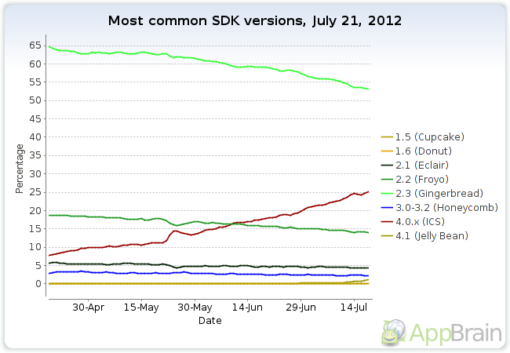
Android Version Market Share
Note: When developing an application, consider the market share of the android version. The higher the market share, the higher number your target market is.

Slide 18
Installation on Eclipse
Please refer to:
www.developershaven.net

Slide 19
Application Components
Activity
Example: a list of menu items users can choose from
Services
Example: calculate and provide the result to activities that need it
Broadcast Receivers
Example: announcements that the time zone has changed
Content Providers
Example: Android ships with a number of content providers for common
Intents
Example: convey a request for an activity to present an image to the user or let the user edit some text
Present a visual user interface for one focused endeavor the user can undertake
Run in the background for an indefinite period of time
Receive and react to broadcast announcements
Store and retrieve data and make it accessible to all applications
Hold the content of a message

Slide 20
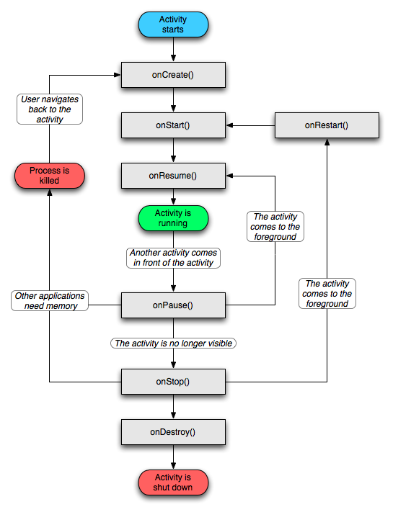
ActivitY CYCLE

Slide 21
Inside an Activity
public class CCSActivity extends Activity
{
@Override
public void onCreate(Bundle
savedInstanceState)
{
super.onCreate(savedInstanceState);
setContentView(R.layout.main);
}
}

Slide 22
Services
Run in the background
Can continue even if Activity that started it dies
Should be used if something needs to be done while the user is not interacting with application
Otherwise, a thread is probably more applicable
Should create a new thread in the service to do work in, since the service runs in the main thread
Can be bound to an application
In which case will terminate when all applications bound to it unbind
Allows multiple applications to communicate with it via a common interface
Needs to be declared in manifest file
Like Activities, has a structured life cycle

Slide 23
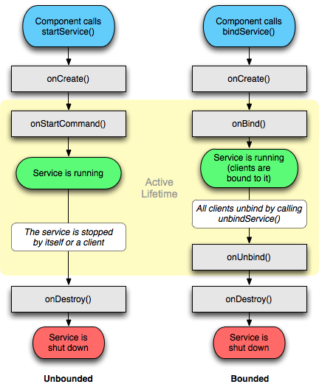
Services CYCLE

Slide 24
Project Components
SRC
The project source code
GEN
Auto generated code
Example: R.java
Included libraries
Resources
Drawables
Layout
Values like strings
Manifest File
A must have xml file. Contains essential information about the system to the android system

Slide 25
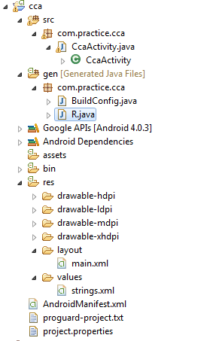
Project Component on Eclipse

Slide 26
R Class
Auto-generated: YOUR SHOULD’NT EDIT IT!
Contains IDs of the project resources
Enforces good software engineering
Use findViewById and Resources object to get access to the resources
Ex. Button b = (Button)findViewById(R.id.button1)
Ex. getResources().getString(R.string.hello));

Slide 27
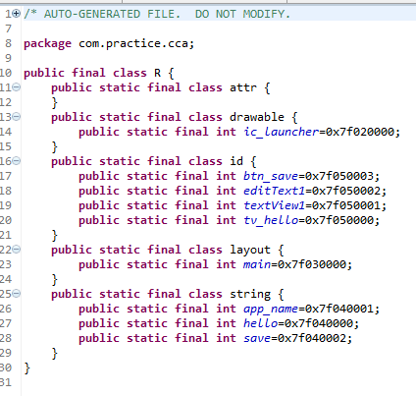
R.Java Class

Slide 28
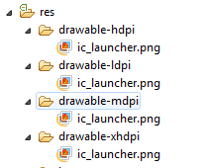
Drawables

Slide 29
Layouts
Eclipse has a great UI creator
Generates the XML for you
Composed of View objects
Can be specified for portrait and landscape mode
Use same file name, so can make completely different UIs for the orientations without modifying any code

Slide 30
Resources & Acknowledgements
Installation: http://developershaven.net
Google API: http://mfarhan133.wordpress.com/2010/10/01/generate-google-maps-api-key-for-android/
Android Developer’s Website : http://developer.android.com/index.html
Numerous Forums & other developer sites, including:
http://www.javacodegeeks.com/2011/02/android-google-maps-tutorial.html
http://efreedom.com/Question/1-6070968/Google-Maps-Api-Directions
http://stackoverflow.com
http://www.anddev.org/google_driving_directions_-_mapview_overlayed-t826.html

Slide 31
THANK YOU VERY MUCH!
Joemarie Comeros Amparo
about.me/joemarieamparo
Skype/Ymail/Gmail : joemarieamparo
Facebook: joemarieamparo@yahoo.com

Slide 34
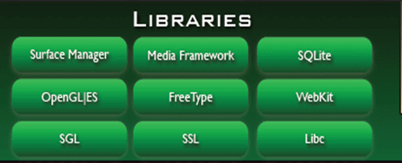

Slide 41
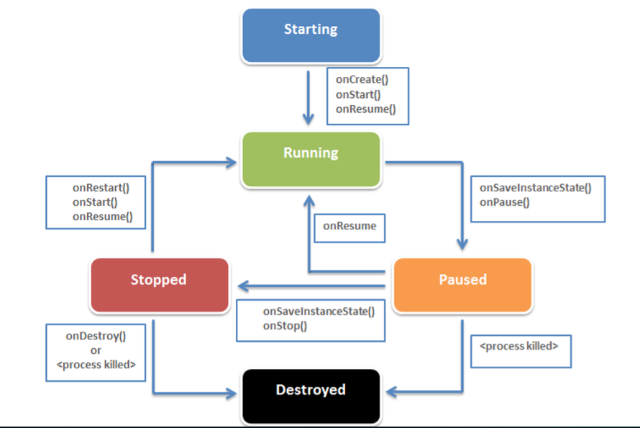

Slide 52
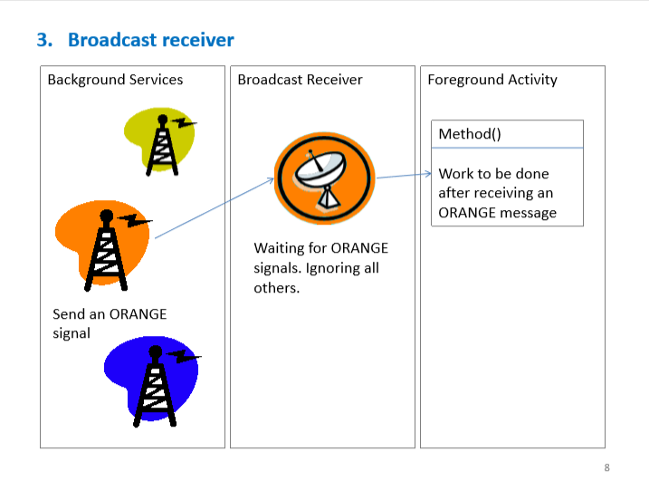

Slide 54
