Slide 1

The Course of Fundamentals of Thermodynamics
MUSTANSIRIYAH UNIVERSITY
COLLEGE OF SCIENCES
ATMOSPHERIC SCIENCES DEPARTMENT
2019-2020
Dr. Sama Khalid Mohammed
SECOND STAGE

Slide 2
Welcome Students In The New Course
and In The Fourth Lecture ☺

Slide 3
This lecture including the following items
Some notes about Work
Equation of State

Slide 4
Some Notes About Work
If a system (parcel of air, for example) is at equilibrium with its environment no changes take place in either of them.
If the pressure of the surroundings changes, then the force associated with the pressure change will disturb the parcel thereby forcing it away from equilibrium.
In order for the parcel to adjust to the pressure changes of the surroundings, the parcel will either contract or expand.
If the parcel expands we say that the parcel performs work on the environment and if the parcel contracts we say that the environment performs work on the parcel.
By definition, if the volume change is dV then the incremental work done, dW, is dW = pdV.

Slide 5

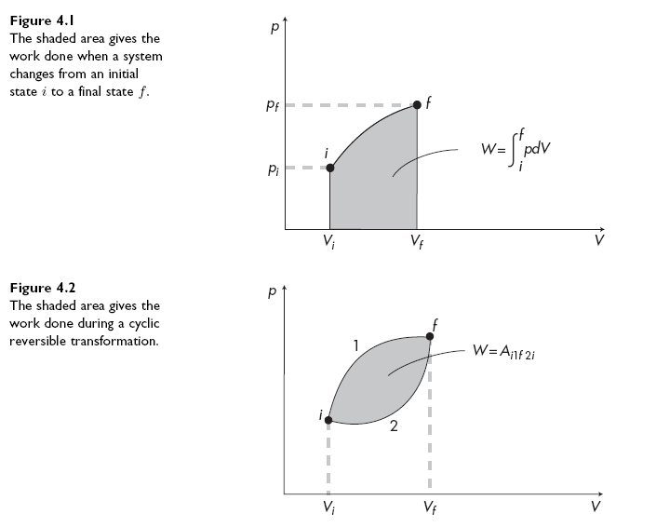
Accordingly, when the system changes from an initial state i to a final state f the total work done, either by the system or on the system, is:
The above equation indicates that the work done is given by an area in a (p, V ) diagram
Is the work represent an exact or inexact differentials ?

Slide 6

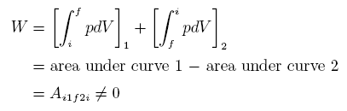
Now let us consider a situation where the system expands through a reversible transformation from i to f and then contracts from f to i along exactly the same path in the (p, V ) diagram. Then, the total work done will be
If the system expands from i to f and then contracts from f to i but along a different reversible transformation (different path), then the total work done would be:
where Ai1f2i is the area enclosed by the two paths. It follows that
and thus dW is not an exact differential, which means that work is not a state function. As such it depends on the particular way the system goes from i to f. Because of this from now on we will denote the incremental change in work as δW not as dW.
Notes:
يوصف الشغل الصافي في عملية دورية رياضيا بالتكامل الكنتوري لكل المسار
تتلاشى قيمة التكامل الكنتوري للمقادير التفاضلية المضبوطة لانها تبدا وتنتهي بنفس القيمة ولكن الامر يختلف في حالة المقادير التفاضلية غير المضبوطة مثل الشغل

Slide 7
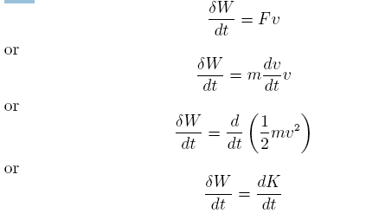
If we write dV = dAds (where dA is an area element and ds a distance element) we have that δW = pdAds = Fds = Fvdt or that
where v denotes the velocity of the parcel and K is the kinetic energy of the parcel. It follows that the work done and the kinetic energy are related.
The last equation indicates that one way by which a thermodynamic system can exchange energy with its environment is by performing work. The other is through transfer of heat.

Slide 8
According to the last equation, the units for work are those of energy. Thus, the unit for work in the MKS system is the joule which is defined as J = Nm where the newton N = kgms−2. In the cgs system, the unit is the erg which is defined as erg = dyn cm where dyn = g cm s−2. It follows that 1 joule = 107 erg.

Slide 9
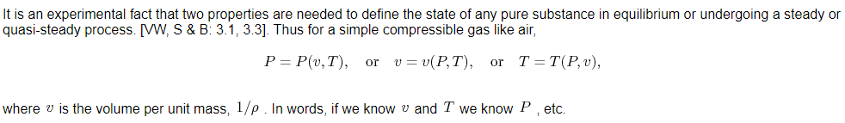
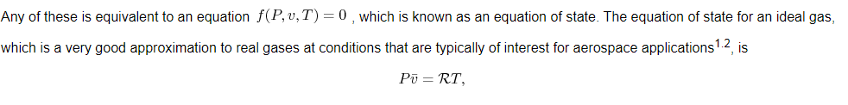
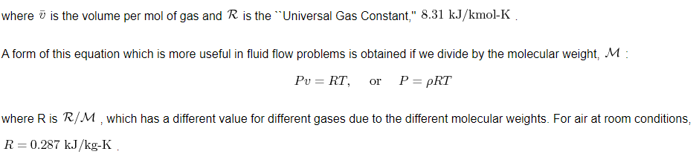
Equations of state
It is an experimental fact that two properties are needed to define the state of any pure substance in equilibrium or undergoing a steady or quasi-steady process. Thus for a simple compressible gas like air,

