Slide 1

Management Information System

Slide 2
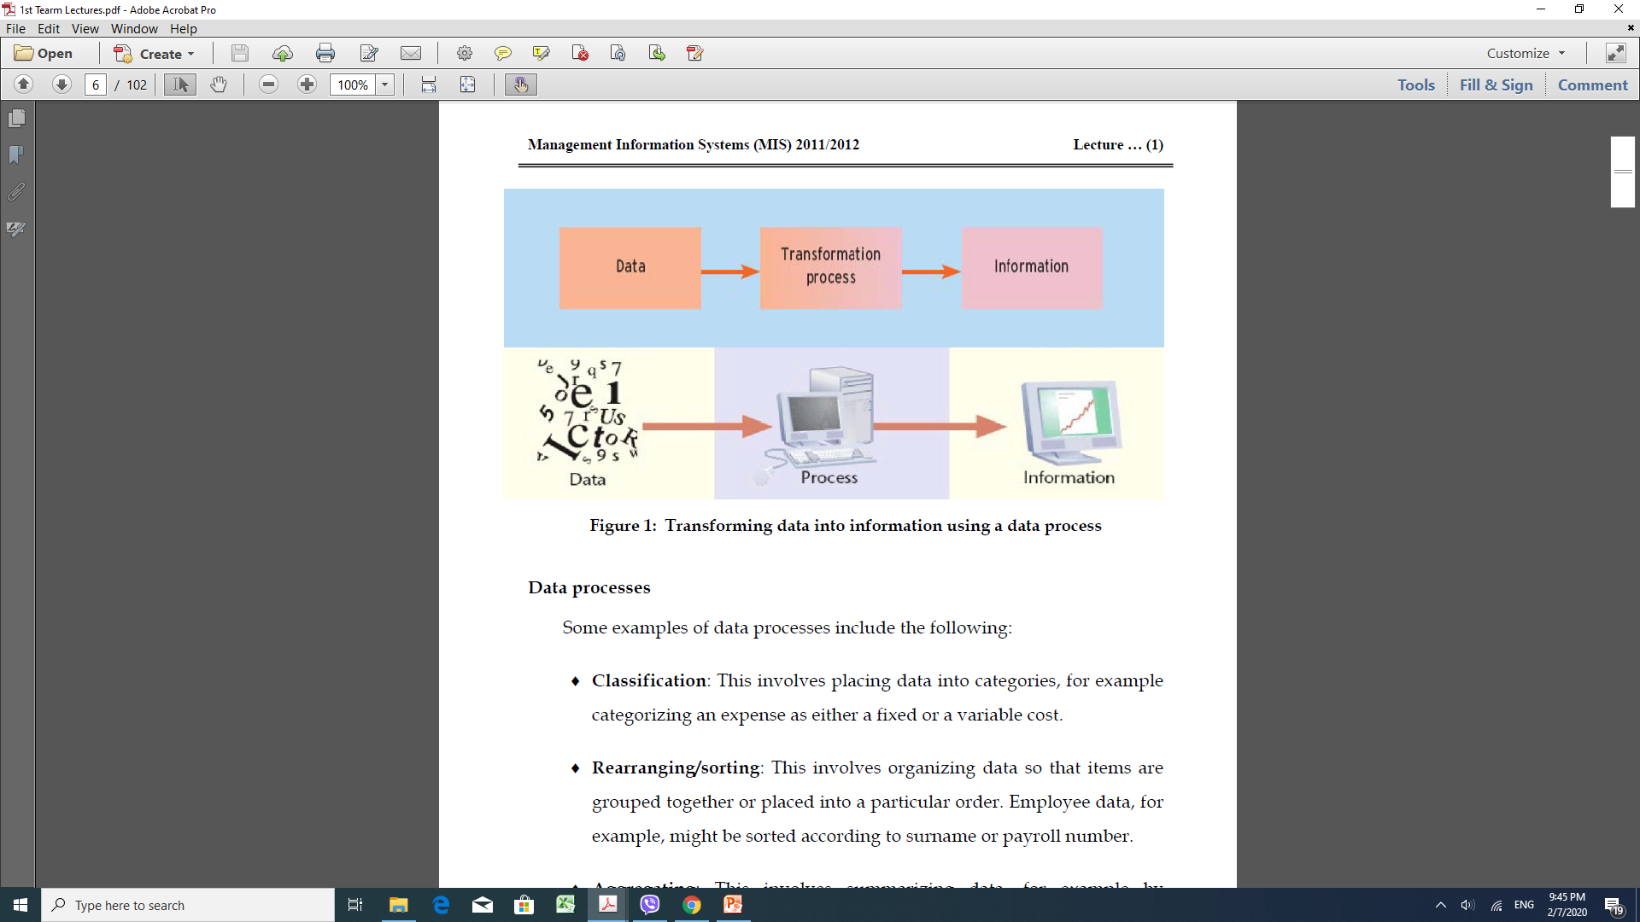
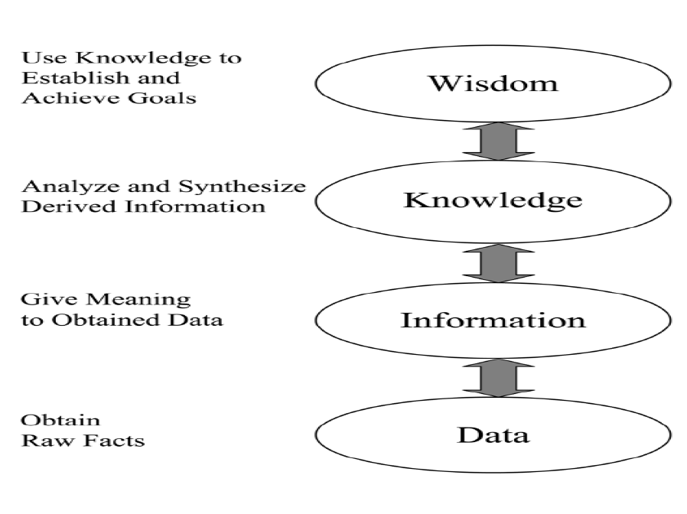
♦ Classification:
♦ Rearranging/sorting:
♦ Aggregating:
♦ Performing calculations
♦Selection:

Slide 3
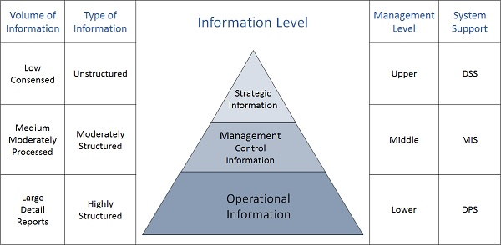
Categories of Information

Slide 4
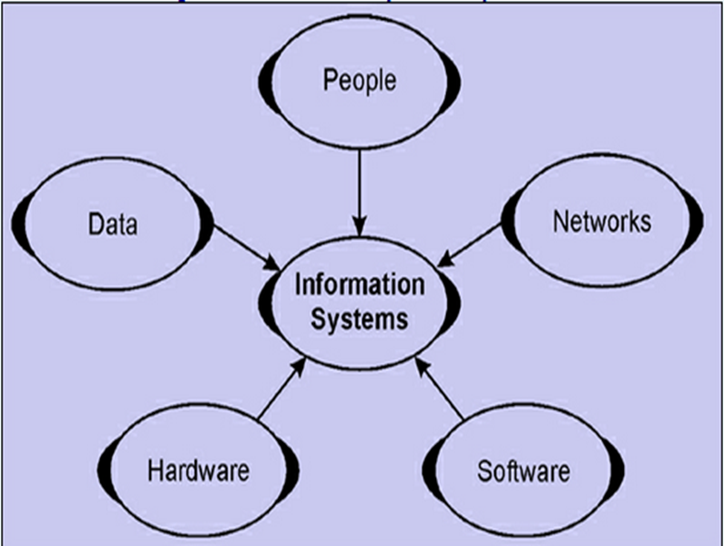
A system is a group of interrelated components working together toward a common goal by accepting inputs and producing outputs in an organized transformation process.
Information system is an organized combination of People, Hardware, Software, Communication networks and data Resource that collects,
Transforms and distributes
information in an organization.

Slide 5
Management
is the process of allocating an organization's inputs, including human and resources, by planning, organizing, directing, and controlling for the purpose of producing goods or services desired by customers so that organizational objectives are accomplished.
If management has knowledge of the planning, organizing, directing, and controlling of the business, its decisions can be made on the basis of facts, and decisions are more accurate and timely as a result.

Slide 6
Management Information System
A management information system (MIS) is a system or process that provides the information necessary to manage an organization effectively.
Used by managers throughout the organization to help them in directing, planning, coordinating, communicating, and decision-making.
Management Information System is defined as an integrated user-machine system for providing information to support operations, management and decision-making functions in an organization.

Slide 7
the MIS is a system that supports the decision making function of the organization.
An organization with a well-defined information system will generally have a competitive advantage over organization with poor MIS and no MIS.

Slide 8
IT and MIS
Information Technology (IT) is sometimes referred to as a technological side of an information system, which includes hardware, software, networks and other devices. In other words, IT is a sub-system of an information system or management information system.

Slide 9
Functions of MIS
MIS performs following functions to achieve organizational goal:
Data Capturing ( collect data)
: MIS captures data from various internal and external sources of an organization. Data capturing may be manual or through computer terminals..
Processing of Data:
The captured data is processed to convert it into the required management information. Processing of data is done by such activities as calculating, comparing, sorting, classifying and summarizing.
                Organize data
                Analysis on data
                Apply statistical, mathematical, operations
                To create predictive modeling
                Research and forecasting
Information storage
Information retrieval
MIS stores data as an organizational record and processed for future use. The data organizes as a fields, records, files and databases for future use. Information retrieval comprises to access the stored data as per the requirements of the management users.
Distributing management information (Dissemination of Information)
information of finished product is categorizes and distributed to the users in an organization as per the needs. This information could be periodic, through reports or online through computer terminals.

Slide 10



Value of Information
Information value is closely tied to the decisions that result from its use.
Information does not have an absolute universal value(can not be true or false)
Information Value =who use it+ when it is used+ in what situation it is used.
Value of water

Slide 11
Comprehension

Slide 12
Characteristics of information
Completeness
Source Trustworthiness
Communication with the right person
Detail
Comprehension
Punctuality
Information is considered to be completed if it informs us on the key points of the problem we are analyzing
Information should contain the minimum number of details for effective decision making
Vital information for the company may become worthless if it takes too long to obtain, or delays occur in processing and communicating the information
If the information is not understood it cannot be used and therefore it cannot add value. Many factors intervene in understanding information

Slide 13

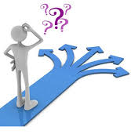
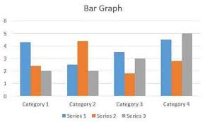

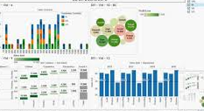
Information as an Aid to Decision
Making
The process of decision making can be described as comprising four
Intelligent
Decision
Choice
Review

Slide 14
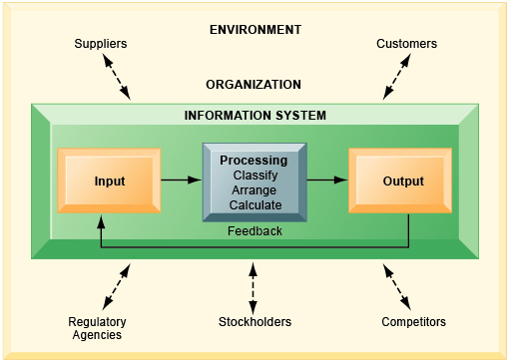
An information system contains information about an organization and its surrounding environment.
Three basic activities—input, processing, and output—produce the information organizations need.
Feedback is output returned to appropriate people in the organization to evaluate and refine the input.
Environmental actors, such as customers, suppliers, competitors, stockholders, and regulatory agencies, interact with the organization and its information systems.
It is important to distinguish information systems, which are designed to produce information and solve organizational problems, from the computer technology and software that is typically used to create and manage information systems.

Slide 15
What parameter measures the relevance of information?
Information is relevant if it helps the manager make decision regards to the case in hands.
The components of a system must be interrelated, true or false
the system may have several single units, the units must interrelate in common goal. Hence, the statement is true

Slide 16
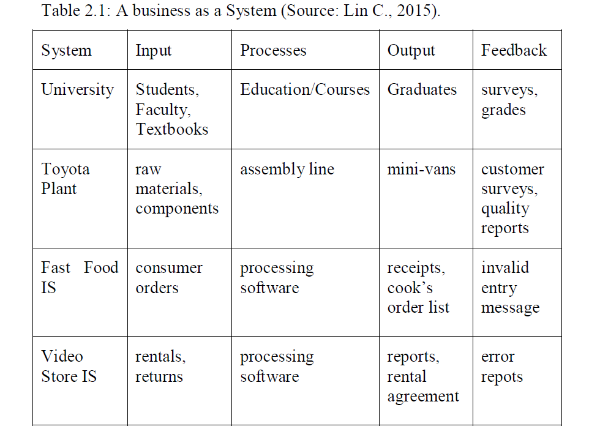
For the following Business specify its system ( from the view point of (IPOF)
(University, Toyota , Fast Food IS, Video store IS)

Slide 17
types of MIS
Transaction Processing System
that deals with the data related to different financial related activities in an organization. Different processed occur in an organization that is related to different inflows and outflows of cash and the data of each transaction is kept in the system to promote accuracy and authenticity in the organization.
Management Information System
system is managing and accessing data and to present it in the simple form. The data MIS provided is the number of products sold. The data reported is in the simple form.
Decision Support System
is the use of data to make intelligent decisions. Information system software gives us the simple, more easily manageable and data in a more informative way to make intelligent decisions.
Expert Systems and Artificial Intelligence
Example: Management Reporting Systems, Sales management System, Inventory control System
Example: Logistics Systems, Financial Planning Systems
Office automation system

