Slide 2
Gates and Logic: Logic Gates and Logic Circuits

Slide 3
Goals for Today
From Switches to Logic Gates to Logic Circuits
Logic Gates
From switches
Truth Tables
Logic Circuits
Identity Laws
From Truth Tables to Circuits (Sum of Products)
Logic Circuit Minimization
Algebraic Manipulations
Truth Tables (Karnaugh Maps)
Transistors (electronic switch)

Slide 4
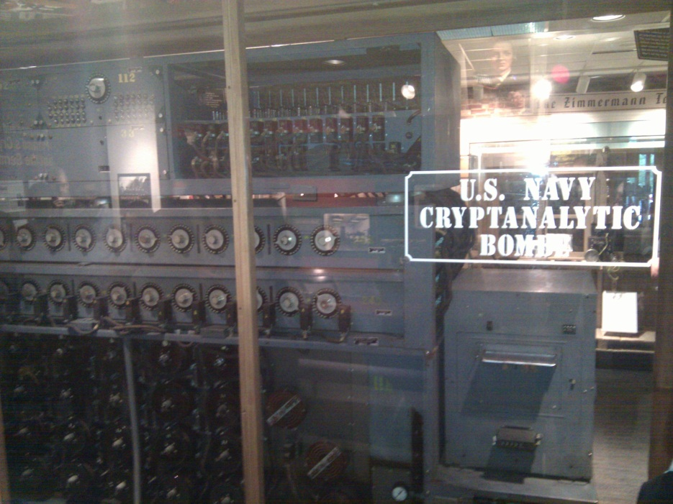
A switch
Acts as a conductor or insulator
Can be used to build amazing things…
The Bombe used to break the German
Enigma machine during World War II
Notes:
Pictures show the Bombe built by Alan Turing to break the enigma machine ciphers.
They were Fixed-Program Computers came before stored-program computers (general purpose)
The former required re-wiring (e.g. ENIAC took 3 weeks to “re-wire”).

Slide 5
Basic Building Blocks: Switches to Logic Gates
Either (OR)
Both (AND)
+
A
Truth Table
-
A | B | Light
OFF | OFF
OFF | ON
ON | OFF
ON | ON
B
+
A
-
A | B | Light
OFF | OFF
OFF | ON
ON | OFF
ON | ON
B
Notes:
Speed and size of a mechanical switch

Slide 6
Basic Building Blocks: Switches to Logic Gates
Either (OR)
Both (AND)
A
Truth Table
-
A | B | Light
OFF | OFF
OFF | ON
ON | OFF
ON | ON
OR
B
A
-
A | B | Light
OFF | OFF
OFF | ON
ON | OFF
ON | ON
AND
B
Notes:
Speed and size of a mechanical switch

Slide 7
Basic Building Blocks: Switches to Logic Gates
Either (OR)
Both (AND)
A
Truth Table
-
A | B | Light
0 | 0
0 | 1
1 | 0
1 | 1
OR
0 = OFF
1 = ON
B
A
-
A | B | Light
0 | 0
0 | 1
1 | 0
1 | 1
AND
B
Notes:
Speed and size of a mechanical switch

Slide 8
Basic Building Blocks: Switches to Logic Gates
A
OR
B
A
Did you know?
George Boole Inventor of the idea of logic gates. He was born in Lincoln, England and he was the son of a shoemaker in a low class family.
AND
B
Notes:
E.g. logic statements:
“Jane will only go to the cinema tonight if a good film is on AND she has enough money.”
“Stuart will only go to the birthday party on Sunday if Katie OR Sujit is going too.”

Slide 9
Takeaway
Binary (two symbols: true and false) is the basis of Logic Design
Notes:
Add takeways at end of a block. Possibly build on takeaways throughout lecture

Slide 10
Building Functions: Logic Gates
A | Out
NOT:
AND:
OR:
Logic Gates
digital circuit that either allows a signal to pass through it or not.
Used to build logic functions
There are seven basic logic gates:
AND, OR, NOT,
NAND (not AND), NOR (not OR), XOR, and XNOR (not XOR) [later]
In
A | B | Out
0 | 0 | 0
0 | 1 | 0
1 | 0 | 0
1 | 1 | 1
A
B
A | B | Out
0 | 0 | 0
0 | 1 | 1
1 | 0 | 1
1 | 1 | 1
A
B
Notes:
Flash Drives
Create truth table of AND or OR: state what they do

Slide 11
Building Functions: Logic Gates
A | Out
0 | 1
1 | 0
NOT:
AND:
OR:
Logic Gates
digital circuit that either allows a signal to pass through it or not.
Used to build logic functions
There are seven basic logic gates:
AND, OR, NOT,
NAND (not AND), NOR (not OR), XOR, and XNOR (not XOR) [later]
In
A | B | Out
0 | 0 | 0
0 | 1 | 0
1 | 0 | 0
1 | 1 | 1
A
B
A | B | Out
0 | 0 | 0
0 | 1 | 1
1 | 0 | 1
1 | 1 | 1
A
B
Notes:
Flash Drives
Create truth table of AND or OR: state what they do
Did you know? Logic gates allow the computer to do things such as add, divide, multiply, do simple yes and no reasoning in certain situations along with other things.

Slide 12
Building Functions: Logic Gates
A | Out
0 | 1
1 | 0
NOT:
AND:
OR:
Logic Gates
digital circuit that either allows a signal to pass through it or not.
Used to build logic functions
There are seven basic logic gates:
AND, OR, NOT,
NAND (not AND), NOR (not OR), XOR, and XNOR (not XOR) [later]
In
A | B | Out
0 | 0 | 0
0 | 1 | 0
1 | 0 | 0
1 | 1 | 1
A | B | Out
0 | 0 | 1
0 | 1 | 1
1 | 0 | 1
1 | 1 | 0
NAND:
A
A
B
B
NOR:
A | B | Out
0 | 0 | 0
0 | 1 | 1
1 | 0 | 1
1 | 1 | 1
A | B | Out
0 | 0 | 1
0 | 1 | 0
1 | 0 | 0
1 | 1 | 0
A
A
B
B
Notes:
Flash Drives
Create truth table of AND or OR: state what they do
Did you know? Logic gates allow the computer to do things such as add, divide, multiply, do simple yes and no reasoning in certain situations along with other things.

Slide 13
Activity#1.A: Logic Gates
Fill in the truth table, given the following Logic Circuit made from Logic AND, OR, and NOT gates.
What does the logic circuit do?
a | b | Out
a
b
Out
Notes:
Fill out table
Put, NOT, AND, OR labels in box

Slide 14
Activity#1: Logic Gates
Fill in the truth table, given the following Logic Circuit made from Logic AND, OR, and NOT gates.
What does the logic circuit do?
a | b | d | Out
0 | 0 | 0
0 | 0 | 1
0 | 1 | 0
0 | 1 | 1
1 | 0 | 0
1 | 0 | 1
1 | 1 | 0
1 | 1 | 1
a
d
Out
b
Notes:
Fill out table

Slide 15
Goals for Today
From Switches to Logic Gates to Logic Circuits
Logic Gates
From switches
Truth Tables
Logic Circuits
Identity Laws
From Truth Tables to Circuits (Sum of Products)
Logic Circuit Minimization
Algebraic Manipulations
Truth Tables (Karnaugh Maps)
Transistors (electronic switch)

Slide 16
Logic Gates
A | Out
0 | 1
1 | 0
NOT:
AND:
OR:
XOR:
L
ogic Equations
Constants: true = 1, false = 0
Variables: a, b, out, …
Operators (above): AND, OR, NOT, etc.
In
A | B | Out
0 | 0 | 0
0 | 1 | 0
1 | 0 | 0
1 | 1 | 1
A
B
A | B | Out
0 | 0 | 0
0 | 1 | 1
1 | 0 | 1
1 | 1 | 1
A
B
A | B | Out
0 | 0 | 0
0 | 1 | 1
1 | 0 | 1
1 | 1 | 0
A
B
Notes:
XOR is not a basic Logic Gate since it can be created from AND and OR gates, but it is often used as a basic Logic Operator

Slide 17
Logic Gates
A | Out
0 | 1
1 | 0
NOT:
AND:
OR:
XOR:
L
ogic Equations
Constants: true = 1, false = 0
Variables: a, b, out, …
Operators (above): AND, OR, NOT, etc.
In
A | B | Out
0 | 0 | 0
0 | 1 | 0
1 | 0 | 0
1 | 1 | 1
A | B | Out
0 | 0 | 1
0 | 1 | 1
1 | 0 | 1
1 | 1 | 0
NAND:
A
A
B
B
NOR:
A | B | Out
0 | 0 | 0
0 | 1 | 1
1 | 0 | 1
1 | 1 | 1
A | B | Out
0 | 0 | 1
0 | 1 | 0
1 | 0 | 0
1 | 1 | 0
A
A
B
B
XNOR:
A | B | Out
0 | 0 | 0
0 | 1 | 1
1 | 0 | 1
1 | 1 | 0
A | B | Out
0 | 0 | 1
0 | 1 | 0
1 | 0 | 0
1 | 1 | 1
A
A
B
B
Notes:
XOR is not a basic Logic Gate since it can be created from AND and OR gates, but it is often used as a basic Logic Operator

Slide 18
Logic Equations
NOT:
out = ā = !a = ¬a
AND:
out = a ∙ b = a & b = a ∧ b
OR:
out = a + b = a | b = a ∨ b
XOR:
out = a ⊕ b = a$\overline{b}$ + āb
Logic Equations
Constants: true = 1, false = 0
Variables: a, b, out, …
Operators (above): AND, OR, NOT, etc.
Notes:
Apologize that there are three ways to represent the same logic equation
XOR is not a basic Logic Gate since it can be created from AND and OR gates, but it is often used as a basic Logic Operator
AND is “product”
OR is “sum”
Read outloud

Slide 19
Logic Equations
NOT:
out = ā = !a = ¬a
AND:
out = a ∙ b = a & b = a ∧ b
OR:
out = a + b = a | b = a ∨ b
XOR:
out = a ⊕ b = a$\overline{b}$ + āb
Logic Equations
Constants: true = 1, false = 0
Variables: a, b, out, …
Operators (above): AND, OR, NOT, etc.
NAND:
out = $\overline{a \text{∙} b}$ = !(a & b) = ¬ (a ∧ b)
NOR:
out = $\overline{a+b}$ = !(a | b) = ¬ (a ∨ b)
XNOR:
out = $\overline{a \text{⊕} b}$ = ab + $\overline{ab}$
.
Notes:
Apologize that there are three ways to represent the same logic equation
XOR is not a basic Logic Gate since it can be created from AND and OR gates, but it is often used as a basic Logic Operator
AND is “product”
OR is “sum”
Read outloud

Slide 20
Logic Manipulation
functions: gates ↔ truth tables ↔ equations
Example: (a+b)(a+c) = a + bc
a | b | c
0 | 0 | 0
0 | 0 | 1
0 | 1 | 0
0 | 1 | 1
1 | 0 | 0
1 | 0 | 1
1 | 1 | 0
1 | 1 | 1
Notes:
(a+b)(a+c)
= aa + ab + ac + bc
= a + a(b+c) + bc
= a(1 + (b+c)) + bc
= a + bc

