Slide 1
Web Design and Programming
2019-2020
First Semester

Slide 2
Introduction
The Internet is a collection of computers around the world connected to each other via a high speed series of networks. The Internet becomes the main method in exchanging cultures and transferring knowledge between people.
The Web was originally designed to deliver static Web pages from a Web server connected somewhere on the Internet to a Web browser sitting on a user‟s desktop computer. Basically, all a user could do by click on a hot spot or hypertext link to retrieve a new page, read it, and then go on to the next page. Also, the Web was designed to deliver and promotional data with transactional systems for processing orders and with payment systems for handling credit card purchases and settlements.

Slide 3
So, Web design is a multi-faceted term for a variety of skills used to produce anything from an accessible document to a multimedia experience. From the earliest beginnings the Web has grown from an estimated 50 websites worldwide in 1994 to where information has become in any place.
Just as there is a diversity of programming languages available and suitable for conventional programming tasks, there is a diversity of languages available and suitable for Web programming. The World Wide Web – or Web – consists of a vast assortment of files and documents that are stored on these computers and written in some form of HyperText Markup Language ( HTML ) that tells browsers how to display the information. The computers that store the files are called servers because they can serve requests from many users at the same time. Users access these HTML files and documents via applications called browsers.

Slide 4
The Internet is the global system of interconnected computer networks. The computers on the Internet communicate with one another using the Transmission Control Protocol/Internet Protocol suite, abbreviated to (TCP/IP) to link devices worldwide.
So, It is a network of networks that consists of private, public, academic, business, and government networks of local to global scope, linked by a broad array of electronic, wireless, and optical networking technologies. The Internet carries an unlimited range of information resources and services, such as the inter-linked hypertext documents and applications of the World Wide Web (WWW), electronic mail, telephony, and file sharing.
Computers on the Internet use a client/server architecture. This means that the remote server machine provides files and services to the user‟s local client machine.

Slide 5
Software can be installed on a client computer to take advantage of the latest access technology. An Internet user has access to a wide variety of services: electronic mail, file transfer, vast information resources, interest group membership, interactive collaboration, multimedia displays, real-time broadcasting.

Slide 6
Web Server
A Web Server is a computer purposed to runs special serving software.That software "serves" HTML pages and the files associated with those pages when requested by a client, usually a Web browser. The computer is secured so that only authorized people can access it to make changes to the data, so, If a person is on the same network as the Web Server, he or she may be able to save the data directly onto the Web Server computer (if authorized).
Client
The Client (front end) or user, side of the Web. It typically refers to the Web browser in the user's machine. It may also refer to plug-ins and helper applications that enhance the browser to support special services from the site. The term may imply the entire user machine or refer to a handheld device that provides Web access.

Slide 7
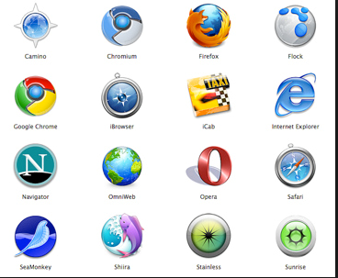
Web Browsers
Generally, a web browser is a software application or program for retrieving, displaying , and traversing information resources on the World Wide Web. An information resource is identified by a Uniform Resource Identifier (URI) and may be a web page, image, video, or other piece.

Slide 8
Uniform Resource Locator
It is the complete address of World Wide Web page and consists of a three components that identifies where the web page is stored on the Internet. These parts are: the protocol, the site name, and the absolute path to the document or resource as shown in the following example
http:// The first thing the URL does is define the protocol that will be used for that particular transaction. The letters HTTP let the server know to use Hypertext Transfer Protocol, or get into “web mode.”

Slide 9
www.example.com The next portion of the URL identifies the website by its domain name. In this example, the domain name is example.com. The “www.” part at the beginning is the particular host name at that domain. The host name “www” has become a convention, but is not a rule. In fact, sometimes the host name may be omitted. There can be more than one website at a domain (sometimes called subdomains). For example, there might also be development.example.com, clients.example.com, and so on.
/2012/samples/first.html This is the absolute path through directories on the server to the requested HTML document, first.html. The words separated by slashes are the directory names, starting with the root directory of the host.

Slide 10
Example http://www.icci.org/studies/ips.html .
1. Protocol: http.
2. Host computer name: www.
3. Second-level domain name: icci.
4. Top-level domain name: org.
5. Directory name: studies.
6. File name: ips.html.  http://www.icci.org/studies/ips.html .

Slide 11
Several Top-level domain are common:
com: commercial enterprise. شركات
edu: educational institution. للمؤسسات التعليمية
gov: government entity. للمؤسسات الحكومية
mil: military entity. للمواقع العسكرية
net: network access provider. للمواقع ذات النشاط الخاص
org: usually nonprofit organizations منظمة رسمية غير حكومية
biz: Businesses مواقع الاعمال التجارية
pro: Professionals, such as doctors and attorneys

Slide 12
Internet Service Provider (ISP):
Is an organization that provides individuals and other companies’ access to the Internet and other related services such as e-mail.
Hyper Text Transfer Protocol (HTTP)
The Hypertext Transfer Protocol (HTTP) is an application-level protocol for distributed, collaborative, hypermedia information systems
Client-side:
HTML / XHTML (Extensible HyperText Markup Language)
JavaScript / VBScript (client-side scripting).
Applets / ActiveX controls
Server-side:
JSP (Java Server Pages)
ASP (Active Server Pages)
ASP.NET (next generation of ASP)
PHP
Phython

Slide 13
Web Operation
The Web works on client- server approach. Following steps explains how the web works:
User enters the URL (say, http://www.tutorialspoint.com) of the web page in the address bar of web browser.
Then browser requests the Domain Name Server for the IP address corresponding to www.tutorialspoint.com.
After receiving IP address, browser sends the request for web page to the web server using HTTP protocol which specifies the way the browser and web server communicates.
Then web server receives request using HTTP protocol and checks its search for the requested web page. If found it returns it back to the web browser and close the HTTP connection.
Now the web browser receives the web page, It interprets it and display the contents of web page in web browser’s window.

Slide 14
The Web Concepts
The World-Wide Web (W3) was developed to be a pool of human knowledge, and human culture, which would allow collaborators in remote sites to share their ideas and all aspects of a common project. The main Web concepts are:
Web Page
The Web page is a space of information on the Internet that presents information about a particular person, business, or organization or cause.
The Web consists of files, called Web pages (documents).
It is containing links to resources (text, images, audios, videos, and other data), throughout the Internet

Slide 15
Web Site
Web site can be defined as a collection of web pages which are grouped together and usually connected together in various ways. Often called a "web site" or simply a "site." The web site usually presents information about a particular person, business, organization or cause.
Generally there are two type of website styles, Static and Dynamic website:
A static Website is one that has web pages stored on the server in the same form as the user will view them. It is primarily coded in HTML.
A dynamic Website is one that does not have web pages stored on the server in the same form as the user will view them. Instead, the web page content changes automatically and/or frequently based on certain criteria. There are two meaning for dynamic website. The first is that the web page code is constructed dynamically, piece by piece. The second one is that the web page content displayed varies based on certain criteria. The criteria may be pre-defined rules or may be based on variable user input.

Slide 16
Site Structure
Every Web site was built in inherit structure and should have a consistent and simple organization – called a site structure. A site is a collection of HTML files, documents and images contained in a single master folder (the root folder). Within this root folder you can save your documents and subfolders organized in a manner that makes sense to you, as well as to others in your department that may need to edit the information.
Therefore it is recommend that the structure of Web site include:
1. A root folder that contains the Web site.
2. A Web page entitled index.htm (or index.html) that resides within the root folder to represent the default homepage for the Web site.
3. May be images folder that contains the graphics, illustrations, images and photographs used in
the Web pages.
4. Additional folders for organizing the content.

Slide 17
Example
Hyperlinks
Hyperlinks are the primary method used to navigate between pages and Web sites. Links can point to other web pages, web sites, graphics, files, sounds, e-mail addresses, and other locations on the same web page. When text is used as a hyperlink, it is usually underlined and appears as a different color. There are four types of hyperlinks.
• Text hyperlink – Uses a word or phrase to take visitors to another page, file or document.
• Image hyperlink – Uses an image to take visitors to another page, file or document.
• Bookmark hyperlink – Uses text or an image to take visitors to another part of a web page.
• E-mail hyperlink – Allows visitors to send an e-mail message to the displayed e-mail address.

Slide 18
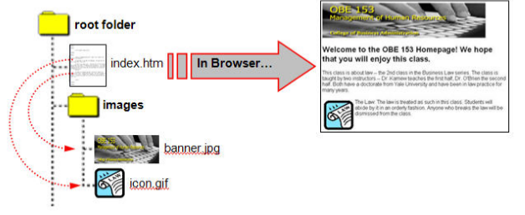
How Browsers Display Web pages
When a Web page is opened in a browser, the browser reads and interprets the HTML file and formats the Web page for display. If there are references to external files, such as images or multimedia, these files are downloaded from the server and displayed in the browser window. It is important to note that HTML files are text files that only contain references to the external files – you do not “embed” these files into the Web page.

Slide 19
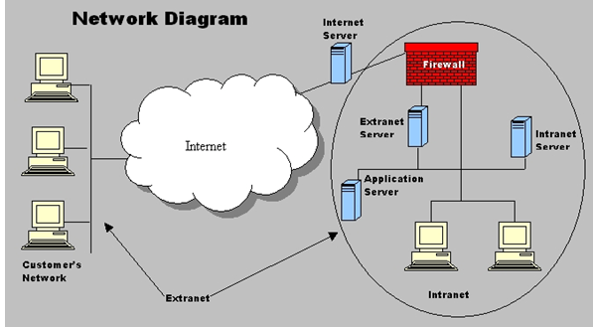
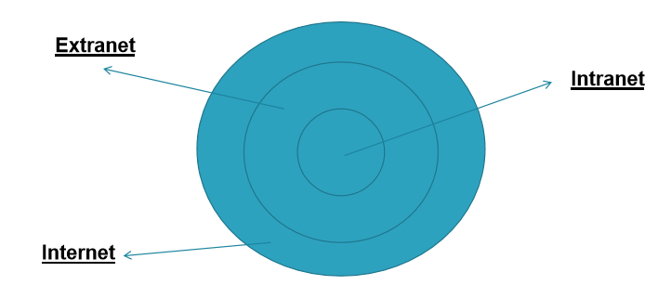
The Web Environment
There are three main type of Web sites according to environment or level of access. The Internet, extranets, and intranets all rely on the same TCP/IP technologies. However, they are different in terms of the levels of access they allow to various users inside and outside the organization and the size of the network.
An intranet allows for restricted access to only members of an organization;
An extranet expands that access by allowing non-members such as suppliers and customers to use company resources.
The difference between the Internet and extranets is that while the extranet allows limited access to non-members of an organization, the Internet generally allows everyone to access all network resources.

Slide 20
HTML
HTML is the standard markup language for creating Web pages.
HTML stands for Hyper Text Markup Language
HTML describes the structure of Web pages using markup
HTML elements are the building blocks of HTML pages
HTML elements are represented by tags.
HTML element starts and ends with tags—the opening tag and the closing tag. Each tag consists of an opening angled bracket (<), some text, and a closing bracket (>).
HTML tags label pieces of content such as "heading", "paragraph", "table", and so on
Browsers do not display the HTML tags, but use them to render the content of the page.

Slide 21
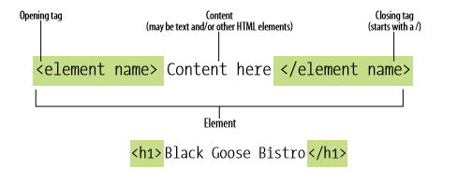
HTML Tags
Every HTML tag is made up of a tag name, and sometimes followed by optional attributes and all appears between angle brackets < >.
The tags normally come in pairs like <head> and </head>
The first tag in a pair is the start tag, the second tag is the end tag
The end tag is written like the start tag, but with a forward slash inserted before the tag name
Nothing within the brackets will be displayed in the browser.
The tag name is generally abbreviation to the tag function.
Attributes are the properties that extend or refine to the tag function.
The name and attributes of the tag are not case sensitive.

Slide 22
HTML Editors
Web pages can be created and modified by using professional HTML editors.
A simple text editor like Notepad (PC) or TextEdit (Macintosh) is recommended for learning HTML.
HTML Editors enable users to create documents quickly and easily by pushing a few buttons. Instead of entering all of the HTML codes by hand and these programs will generate the HTML Source Code.
After creating the HTML source code, this code will be saved in html extension.
HTML document structure
HTML document contains the text (the content of the page) with embedded tags, which provide instruction, appearance and function of the content. The HTML document is divided into two major portions: the head and the body.
The head contains information about the document such as the title and "meta" information describing the content.
The body contains the actual contents of the document (the parts that is displayed in the browser window).

Slide 23
< ! DOCTYPE html>
<html>
<head>
<meta charset=”utf-8”>
<title>title here </title>
</head>
<body>
Page content here
<body>
</html>
1
4
3 3
5
2
6
It is a document type declaration (also called DOCTYPE declaration) that identifies this document as an HTML document.
The <html> element is called the root element of an HTML page because it contains all the elements in the document. Within the html element, the document is divided into a head and a body.
The <head > element: The head element contains descriptive information about the document itself, such as its title, the style sheet(s) it uses, scripts, and other types of “meta” information

Slide 24
4- The meta elements within the head element provide information about the document itself but no information that will be displayed on the page itself. A meta element can be used to provide all sorts of information, but in this case, it specifies the character encoding (the standardized collection of letters, numbers, and symbols) used in the document
5- The <title> element also in the head element, which tells the browser what to display in its
title bar (the title bar is the very top part of the browser window—the part with the
minimize, maximize, and close buttons)
6- The <body> element contains the visible page content also body element contains almost
everything that you see on the screen: headings, paragraphs, images, any navigation that’s
required, and footers that sit at the bottom of the web page

Slide 25
Example1
< ! DOCTYPE html>
<Html>
<Head>
<Title>The first example </Title>
</Head>
<Body>
Welcome to HTML
</Body>
</Html>
The purpose of a web browser is to read HTML documents and display them. The browser does not display the HTML tags, but uses them to determine how to display the document:

Slide 26
Example2: if we write the same program as below
<Html>
<Head>
<Title>The second example</Title>
</Head>
<Body>
<h1>Welcome to HTML</h1>
</Body>
</Html>
Then the output will be
In this example the <h1> tag representing heading element within the body element. The opening <h1> and closing </h1> tags are wrapped around the words “Welcome to HTML” making that the main heading for the page.

Slide 27
Example3: if we add another element <p> such as
<Html>
<Head>
<Title>The third example</Title>
</Head>
<Body>
<h1>Welcome to HTML</h1>
<p>Welcome to HTML<p>
</Body>
</Html>
The output will be
So, the <p> element defines a paragraph. This element is use to deal with blocks of text is the p element. It’s easy to remember as p is for paragraph

Slide 28
Q1 What the output of the following HTML code? How many element in this example, specify them.
<html>
<head>
<title>The Most Basic Web Page </title>
</head>
<body>
<h1>The Most Basic Web Page </h1>
<p>This is a very simple web page to get you started. Hopefully you will get to see how the markup that drives the page relates to the end result that you can see on screen.
</p>
<p>This is another paragraph, by the way. Just to show how it works .</p>
</body>
</html>

Slide 29
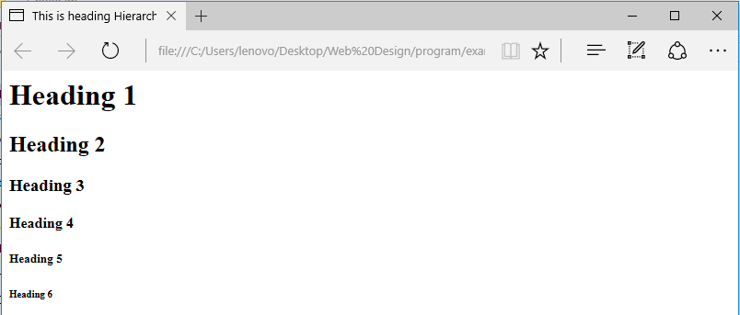
Headings and Document Hierarchy
In the example3 above, we use an h1 element to show a major heading. If we wanted to include a subheading beneath this heading, we’d use the h2 element. A subheading under an h2 would use an h3 element, and so on, until we hit h6. The lower the heading level, the lesser its importance and the smaller the font size: h1 h2 h3 h4 h5 h6
Example 4
<html>
<title> This is heading Hierarchal example </title>
<body>
<h1>Heading 1</h1>
<h2>Heading 2</h2>
<h3>Heading 3</h3>
<h4>Heading 4</h4>
<h5>Heading 5</h5>
<h6>Heading 6</h6>
</body> </html>
In example 4 each HTML heading has a default size. However, you can specify the size for any heading with the following style attribute
style="font-size:60px;”
This attribute is writing within h tag.

Slide 30
Taking a Break
To signify the start of a new line, rather than anew paragraph, the element you need is br, Note that br is an empty element, so in HTML it’s written as <br/>.
Example 5: Rewrite Q1using Break?
<html>
<head>
<title>The Most Basic Web Page
</title>
</head>
<body>
<h1>The Most Basic Web Page </h1>
<p>This is a very simple web page to get you started. Hopefully you will get to see how the markup that drives the page relates to the end result that you can see on screen.
</p>
<br>This is another paragraph, by the way. Just to show how it works .</br>
</body>
</html>

Slide 31
HTML Horizontal Rules
The <hr> tag defines a thematic break in an HTML page, and is most often displayed as a horizontal rule. The <hr> element is used to separate content (or define a change) in an HTML page. The <hr> tag is an empty tag, which means that it has no end tag.
Example 6: Write HTML code to display a web page with three paragraphs separated by horizontal breaks and with title “Try the horizontal break”?
HTML Comment Tags
You can add comments to your HTML source by using the following syntax:
<!-- Write your comments here -->
Anything you put between comment tags (<!-- -->) will not display in the browser and will not have any effect on the rest of the source. Comments are perfect for making notes on the written work and are useful for labeling and organizing long documents, particularly when they are shared by a team of developers. An example of a comment:
<!-- This is a comment --> <p>This is a paragraph.</p> <!-- Remember to add more information here -->
What is the output of this segment HTML code????

Slide 32
Q3 What are the output of the following HTML code? Specify the elements and the comments?
<html>
<head>
<title> This is HTML page </title>
</head>
<body>
<!—there are two heading separated by horizontal lines -->
<h1> Software Competition
<hr/>
</h1>
<h2> Announcement
<hr/>
</h2>
<!-- This is an announcement required -->
<p>This is an announcement about a competition to design a site that includes simple elementary education classes
<br>The site includes the following lessons:</br>
<br>1- Arabic characters</br>
<br>2- English characters</br>
<br>3- Numbers in Arabic </br>
<br>4- Numbers in English</br>
</p>
<!—The end of required -->
<!-- the date of competition -->
<p>The last date to submit the design is the end of the this month</P>
</body>
</html>

Slide 33
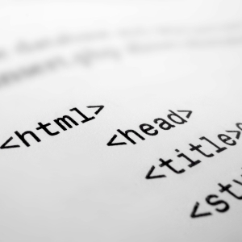
Languages in WEB

Slide 34
Agenda
Web design
HTML
JavaScript
PHP
XML
AJAX

Slide 35
What is Web design?
Web design is the skill of designing presentations of content that is delivered to an end-user through the World Wide Web, by the way of a browser
Languages that are used for the purpose of web designing are called Web Languages

Slide 36
Web designing languages
Markup languages- HTML and XML
Style sheet languages- CSS and XSL
Client-side scripting- JavaScript and VBScript
Server-side scripting- PHP and ASP
Multimedia technologies- Flash and Silverlight

Slide 37
HTML
HyperText Markup Language
Used to design Web Pages
Is a text and image formatting language used by internet browsers
Is written in the form of "tags" that are surrounded by angle brackets
Plain text editor like NOTEPAD can be used to edit HTML
Professional developers prefer HTML editors like FrontPage or Dreamweaver
Don’t need any Web server or Website to view HTML file
To publish your work, you must save your pages on a web server.
IIS or PWS turns your computer into a web server.
IIS comes with Windows 2000, XP, Vista and NT
PWS is outdated now for professional use

Slide 38
HTML Elements
<HTML>
<HEAD> </HEAD>
<BODY> …</BODY>
</HTML>
<P>This is a paragraph</P>
<A href="http://www.google.com">This is a link</A>
<img src=“nisha.jpg" width="104" height="142" />
<TABLE>
<TR>
<TD> Cell 1 </TD>
</TR>
</TABLE>

Slide 39
JavaScript
Official name is ECMAScript
Scripting language
Designed to add interactivity to HTML pages
Case sensitive
Embedded directly into HTML pages
Interpreted language
Everyone can use JavaScript without purchasing a license
Can react to events
Can be used to validate data before submitted to the Server
Can be used to detect Visitor’s browser
Can be used to create Cookies
JavaScript in the body section will be executed WHILE the page loads
JavaScript in the head section will be executed when CALLED

Slide 40
JavaScript Statements
<script type="text/javascript">
document.write("<h1>This is a heading</h1>");
</script>
if (condition)
{
document.write("<b>Good morning</b>");
}
switch (n) { case1: …….. }
for (var=startvalue;var<=endvalue;var=var+increment) { code to be executed }
Many other statements like while loop, exception catching, boolean expression and validations are possible

Slide 41
PHP
PHP: Hypertext Preprocessor
Server-side scripting language, like ASP
Scripts are executed on the server
Supports many databases like (MySQL, Informix, Oracle, Sybase, Solid, PostgreSQL, Generic ODBC, etc.)
Open Source software
File extensions are ‘.php’, ‘.php3’ or ‘.phtml’
PHP runs on different platforms (Windows, Linux, Unix, etc.)
PHP is compatible with almost all servers used today (Apache, IIS, etc.)
PHP is FREE to download from the official PHP resource: www.php.net
PHP is easy to learn and runs efficiently on the server side

Slide 42
PHP statements
A PHP scripting block always starts with <?php and ends with ?>.
A PHP scripting block can be placed anywhere in the document.
PHP automatically converts the variable to the correct data type, depending on its value
Just like ASP it uses Variables, Strings, Operators, IF.. Else, Switch, For Loops, Functions, Forms, Arrays

Slide 43
XML
EXtensible Markup Language
Designed to transport data and not display data
Tags are not predefined. User can define Tags.
Self descriptive
Used to create new languages like XHTML, WSDL, WAP
Simplifies data sharing and data transport
XML documents form a Tree structure
XML parser can be used to convert XML to JavaScript

Slide 44
AJAX
Asynchronous JavaScript and XML
a new technique for creating better, faster, and more interactive web applications.
a JavaScript can trade data with a web server, without reloading the page.
Based on HTML, JavaScript, XML & CSS
It is browser and platform independent
Google suggests to use AJAX

Slide 45
Web Design -- Continuing Studies CS 21
Fundamentals of Web Design - slide 2
The Making of a Good Design - slides 3-4
Typical Web Site Evolution - slide 5
The Process of Web Design - slides 6-9
Pre-design Work - slides 10-11
Influences on Design - slides 12-24
Technology, Content, Economy, Visuals, Usability, Conventions
Accessibility Issues - slides 25-26
Maintenance/Improvement - slides 27-28
Resources - slides 29-30
Notes:
After discussing what we’ll be talking about today, on 2 screens, show examples of both good design and bad design.
Bad design=show webpagesthatsuck.com, http://www.webpagesthatsuck.com/wpts1/, http://www.ty.com, http://www.cuttingedgebankcard.com/, http://www.daltonmailingservice.com/
Good design = show coolhomepages.com, kinkos, gap, disney, https://itss.stanford.edu/organization/clientsupport/dtl/training/who.html
http://coursework.stanford.edu

Slide 46
12 Principles of good web design
Visitor-centric, clear purpose
Progressive disclosure
Displays quickly
Browser compatible
Intuitive navigation
Spelling, grammar, writing
Secure (eCommerce)
Attractive design, easy to read
Cultural bias? (Regional? Domestic? International?)
No technical problems (broken links, buggy scripts)
Maintainable (separate content from style)
Search Engine Accessible

Slide 47
Fundamentals of Web Design
Purpose of Web Design
Inform/Educate
Persuade
Influences on Web Design
Technology Used by Both Target Audience and Designer
Nature of the Content
Economy (Budget, Time, and Scale of the Project)
Amount and Type of Visuals Included
Meeting Usability Objectives

Slide 48
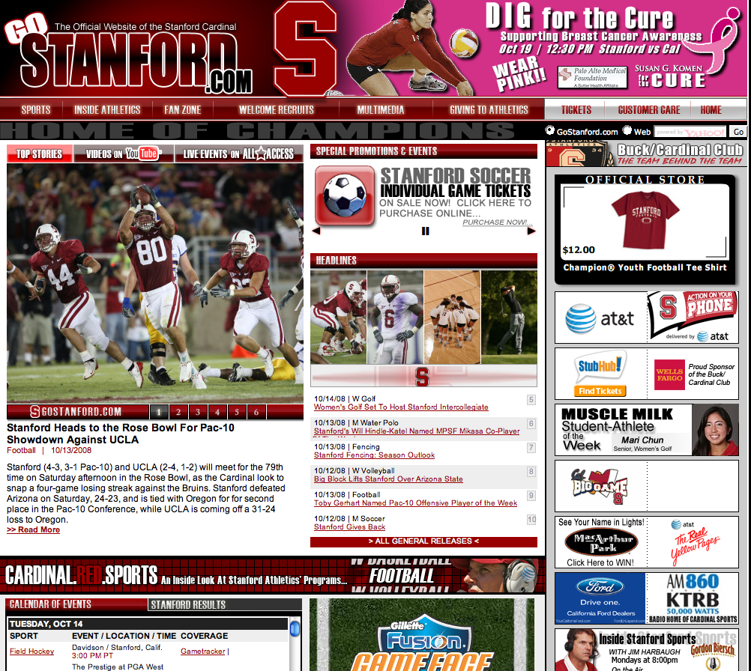
The Making of a Good Design
Content is important, but content alone will not make your site work.
Notes:
Biggest mistake in web design is to build a site for the designer, not the user.
Users expect sites to be flawless.
Looks matter. Site should be pleasing to the eye. Site should evoke trust and value.

Slide 49
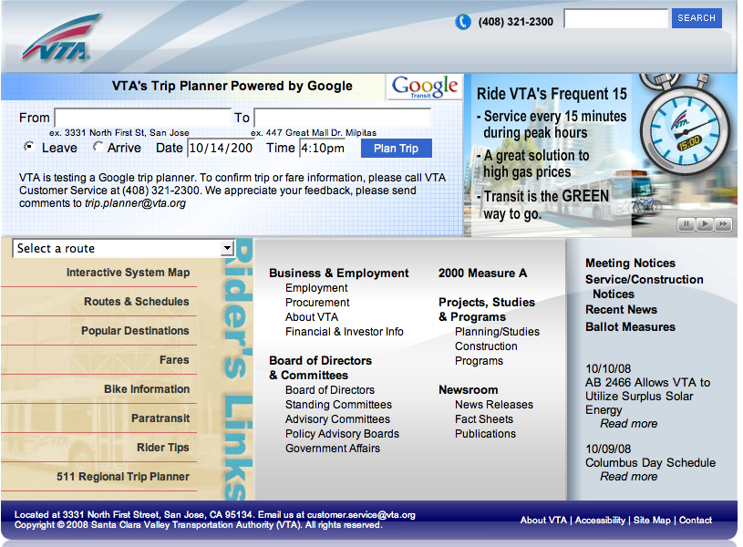
The Making of a Good Design
Content is important, but content alone will not make your site work.
Good Design is:
Understandable
Interesting
Easy to use
Uniform in look and feel
Done from a visitor’s point of view:
WYSIWYW (What You See Is What You WANT)
Notes:
Biggest mistake in web design is to build a site for the designer, not the user.
Users expect sites to be flawless.
Looks matter. Site should be pleasing to the eye. Site should evoke trust and value.

Slide 50
Good Design Maxims
“Rules” are only guidelines -- no single model fits every situation, and there is no such thing as the “right” way to create a web site.
Remember WYSIWYW
Web users want control over the online material -- they want to seamlessly obtain the information they need.
Don’t force visitors down a specific path -- give them control.

Slide 51
Typical Website Evolution
Generation 1 -- replaces paper information
Generation 2 -- has flashy elements
Generation 3 -- is bleeding edge, causing content to suffer
Generation 4 -- content and technology are integrated
Ideally, try to skip the problems of Generations 1-3 by planning your web site carefully.

