Slide 1
The 4th lecture in molecular biology
by Dr. Sawsan Sajid
Dr. Nadal Abdulameer Ali Dr. Susan A. Ibrahim
RNA structure and functions

Slide 2
Gene structure
promoter
Coding region
Gene
terminator
5 AATATTGATAATATAAAG ATGTCTGCTGCTGCTGATAGATTAAACTT...TAA AACTTCCGGCCACTT 3
3 TTATAACTATTATAT T TC TACAGACGACGACGACTATCTAATTTGAA….ATTTTGAAGGCCGGTGAA5
Operon

Slide 3
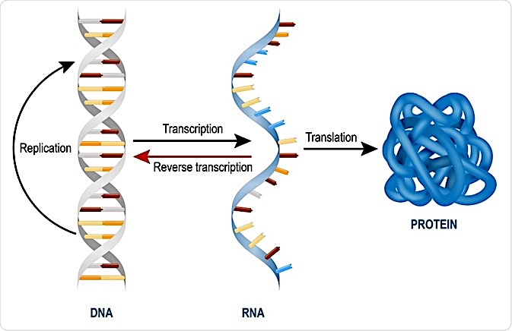
RNA molecules represent the second macromolecules in the cell. They are produced as the second step in gene expression process via transcription process. usually these molecules present in cytoplasm and in some cases they represent the genetic material for some viruses like HIV (فايروس الايدز) polioviruses (فايروس شلل الاطفال) and influenza virus.

Slide 4
Types of RNA There are 3 types of RNA which are synthesized via Transcription process. They are classified to two types stable and unstable (degradable ) 1-tRNA : stable RNA, It represent 10% from the total RNA 2-rRNA: also stable, It is the main component of ribosome beside some poly peptide protein. It represent 80-85% from total RNA 3- mRNA: not stable type because it will degraded once it translated thus it represent 5% of total RNA. non-coding RNAs are transfer RNA (tRNA ) and ribosomal RNA (rRNA), both of which are involved in the process of translation.

Slide 5
Structure of mRNA:
Messenger RNA carries information from DNA to the ribosome, the sites of protein synthesis (translation) in the cell. The coding sequence of the mRNA determines the amino acid sequence in the protein .
The basic differences in mRNA structure in prokaryotic and eukaryotic
1) The mRNAs of many bacteria and bacteriophage are polycistronic . A polycistronic mRNA sharing several structural genes of an operon with one operator and one terminator. It contains several sites for initiating and terminating for more than a polypeptide product . On the other hand, all known eukaryotes have only one site for initiation one protein synthesis. Thus eukaryote mRNAs are monocistronic.

Slide 6
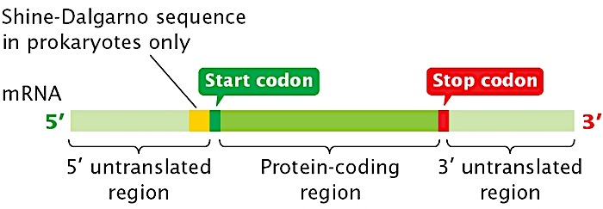
2- mRNA in prokaryotic cell start(5́ end ) with Leader sequence (upstream regionمنطقة اعلى التيار ) contain the ribosomal binding proteins (Shine –Dalgarno sequence ), which has a complementary sequence in 16s rRNA (anti shine –Dalgarno sequence) followed by start codon AUG (in the down stream region منطقة اسفل التيار ( then the coding region then stop codon and the terminate region at 3́ end. In Eukaryotic cell there will be CAP structure at 5́ end and poly A tail at 3́ end

Slide 7
(3) In most bacterial mRNAs translation begins while the mRNA is still being transcribed on DNA. In eukaryotes the mRNA transcribed on the chromosomes passes through the nuclear pores into the cytoplasm. Here it forms complexes with ribosomes, which synthesize proteins. Thus translation usually begins only after transcription is completed.
(4) Prokaryote mRNA is very short lived in the cell. It is constantly under going breakdown to its constituent ribonucleotides by ribonucleases. In E. coli the average half life of some mRNAs is about two minutes. In bacteria mRNA may be so short lived that while one end is translating proteins the other end may be undergoing breakdown.

Slide 8
The short life of bacterial mRNAs has been explained on the grounds that it provides greater flexibility to the bacteria by adjusting to changing environmental conditions. The short life of its mRNAs enables a bacterium to synthesize different enzymes in response to environmental changes. In general, eukaryote mRNAs have longer half lives than bacterial mRNAs . Eukaryote mRNAs are metabolically stable.
(5) In prokaryotes the mRNAs undergo very little processing after being transcribed. There is a very short time interval between transcription and translation. In fact considerable translation may already take place before completion of transcription, and degradation of mRNA may begin. In eukaryotes the transcribed mRNA undergoes considerable processing before mature mRNA is formed.

Slide 9
In molecular genetics, an untranslated region (or UTR) refers to either of two sections, one on each side of a coding sequence on a strand of mRNA. If it is found on the 5' side, it is called the 5' UTR (or leader sequence), or if it is found on the 3' side, it is called the 3' UTR (or tailer sequence). There is a cap structure in 5 end (Eukaryotic )and poly A at 3 end this will protect m RNA from degradation at lest few days

Slide 10
ملاحظات عامة عن منطقة shine – Dalgarno
The Shine-Dalgarno (SD) sequence, proposed by Australian scientists John Shine (b.1946) and Lynn Dalgarno (b.1935), is a ribosomal binding site in prokaryotic mRNA, generally located around 8 bases upstream of the start codon AUG. The Shine-Dalgarno sequence exists both in bacteria and archaea, being also present in some chloroplast and mitochondrial transcripts. The six-base consensus sequence is AGGAGG; in Escherichia coli, for example, the sequence is AGGAGGU. Shine-Dalgarno sequence helps recruit the ribosome to the mRNA to initiate protein synthesis by aligning it with the start codon.
For the m RNA in Eukaryotic cell it start with cap structure at 5 end then the leader sequence (untranslated region ) followed by start codon then the coding region , at the 3 end there is the poly A tail (250-300 Adenine residue )

Slide 11
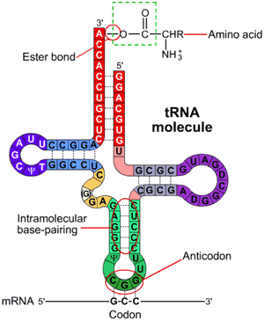
Transfer RNA (tRNA) is a small RNA chain of about 80 nucleotides that transfers a specific amino acid to a growing polypeptide chain at the ribosomal site of protein synthesis during translation. It has sites for amino acid attachment at acceptor arm at the CCA 3́́ OH end and an anticodon region for codon recognition that binds to a specific sequence on the messenger RNA chain through hydrogen bonding

Slide 12
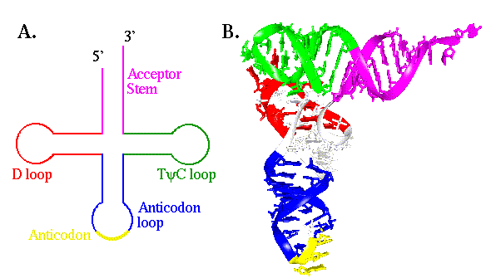
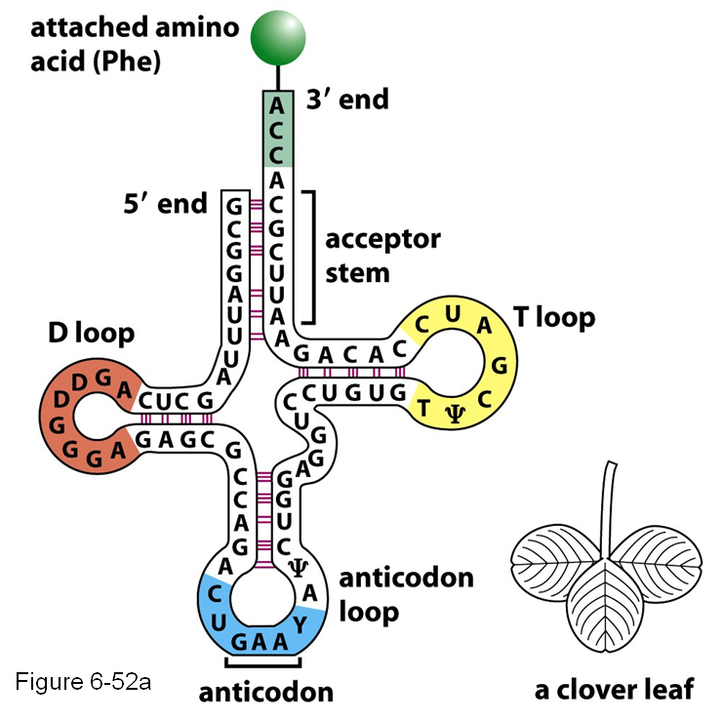
Also It contain unusual nitrogen base like Pseudouridine(Ψ), and ribo thymidine (T), which are found in various places specially TΨC loop of tRNA. Another notable modified base is Dihydroxy uracil in DUH2 loop, the third loop is the anti-codon loop that contain the complementary sequences to m RNA triplet codon.

Slide 13
general the function of t RNA (uncharged) is to attached to A.A via Aminoacyl tRNA transferase enzyme and the reaction require ATP. once the attachment complete the tRNA become charged . tRNA(uncharged)+ A.A→AA-tRNA complex (charged or acylated t RNA)

Slide 14
Ribosomal RNA (rRNA) is the catalytic component of the ribosome's. Eukaryotic ribosomes contain four different rRNA molecules: 18S, 5.8S, 28S and 5S rRNA. Three of the rRNA molecules are synthesized in the nucleolus, and one is synthesized elsewhere. In the cytoplasm, ribosomal RNA and protein combine to form a nucleoprotein called a ribosome. The ribosome binds mRNA and carries out protein synthesis. Several ribosome's may be attached to a single mRNA at any time. Nearly all the RNA found in a typical eukaryotic cell is rRNA

Slide 16
