Slide 1
Virtual Potential Temperature

Slide 2
Potential temperature :
The potential temperature is the temperature that the parcel would attain if adiabatically brought to a standard reference pressure P0 usually (1,000 mb) or (100 kPa).
.
The concept of potential temperature applies to any stratified fluid. It is most frequently used in the atmospheric sciences and oceanography.
Potential temperature is a more dynamically important quantity than the actual temperature. This is because it is not affected by the physical lifting or sinking associated with the flow over obstacles.
A parcel of air moving over a small mountain will expand and cool as it ascends the slope, then compress and warm as it descends on the other side- but the potential temperature will not change in the absence of heating, cooling, evaporation, or condensation (these effects are referred to as dry adiabatic).
Potential temperature is a useful measure of the static stability of the unsaturated atmosphere. When θv is constant, the atmosphere is statically neutral. When it decreases with elevation, the atmosphere is statically unstable. When it increases with elevation, the atmosphere is statically stable.
Potential temperature perturbations
potential temperature perturbation is defined as the difference between the potential temperature of the ABL and the potential temperature of the free atmosphere above the ABL.

Slide 3
Virtual temperature (Tv) :
Virtual potential is the temperature at which dry air would have the same density as the moist air, at a given pressure. The virtual temperature of unsaturated moist air is always greater than the absolute air temperature.
The suspension of cloud droplets in an air parcel is called liquid water loading, and it always reduces the virtual temperature.
Virtual potential temperature :
Virtual potential temperature is similar to potential temperature in that it removes the temperature variation caused by changes in pressure. Virtual potential temperature is useful as a surrogate for density in buoyancy calculations and in turbulence transport which includes vertical air movement.
Buoyancy is one of the driving forces for turbulence in the BL. Thermals of warm air rise because they are less dense than the surrounding air, and hence positively buoyant

Slide 4
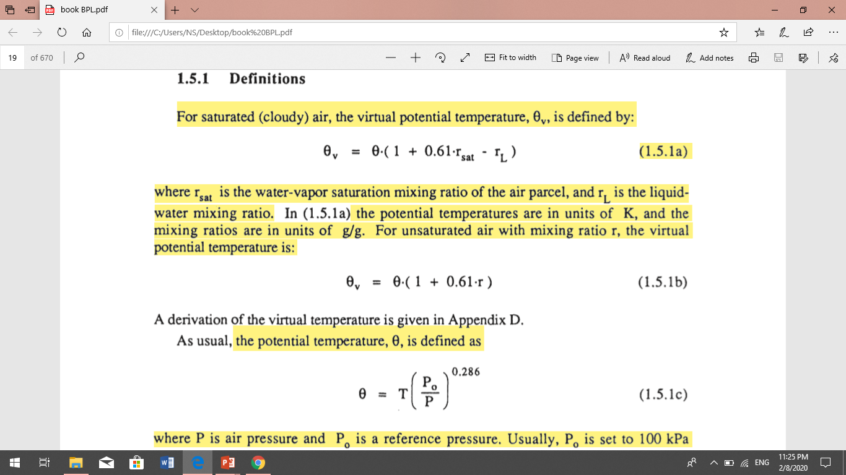

Slide 6
Even though the virtual potential temperature is only about 4 K warmer than the potential temperature, this difference is on the same order as the difference between the warm air rising in thermals and the surrounding environment. Thus, neglect of the humidity in buoyancy calculations could lead to erroneous conclusions regarding convection and turbulence.

Slide 7
Boundary Layer Depth and Structure :-
Over oceans, the boundary layer depth varies relatively slowly in space and time. The sea surface temperature changes little over a diurnal cycle because of the tremendous mixing within the top of the ocean. Also, water has a large heat capacity, meaning that it can absorb large amounts of heat from the sun with relatively little temperature change. Thus, a slowly varying sea surface temperature means a slowly varying forcing into the bottom of the boundary layer. Most changes in boundary layer depth over oceans are caused by synoptic and mesoscale processes of vertical motion and advection of different air masses over the sea surface.
Over both land and oceans, the general nature of the boundary layer is to be thinner in high-pressure regions than in low-pressure regions (Fig 1.6). The subsidence and low-level horizontal divergence associated with synoptic high-pressure move boundary layer air out of the high towards lower pressure regions. The shallower depths are often associated with cloud-free regions. If clouds are present, they are often fair-weather cumulus or stratocumulus clouds.
In low-pressure regions the upward motions carry boundary-layer air away from the ground to large altitudes throughout the troposphere. It is difficult to define a boundary layer top for these situations.
boundary layer meteorologists may actually be thinner in low-pressure regions than in high-pressure ones (see Fig 1.6).

Slide 8
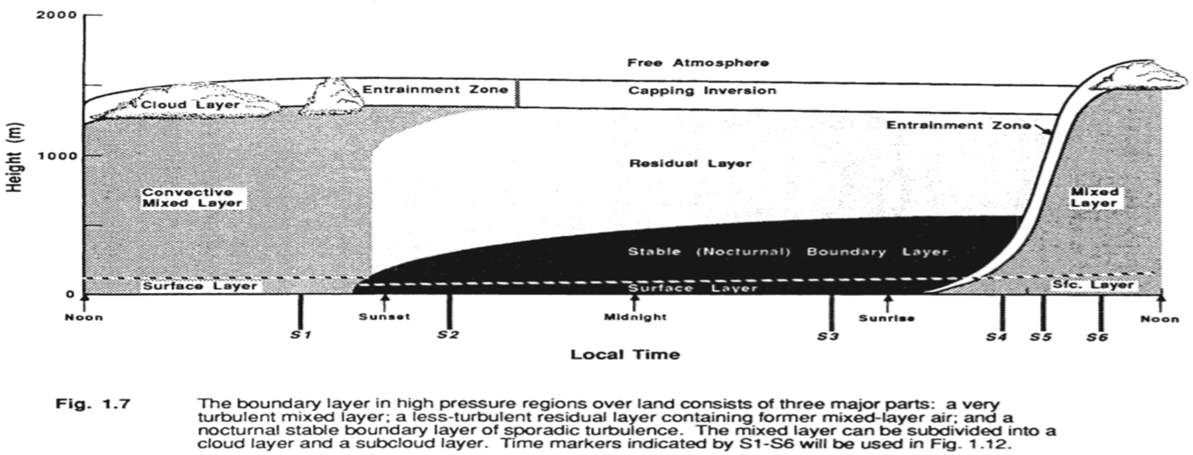
Over land surfaces in high pressure regions the boundary layer has a well defined structure that evolves with the diurnal cycle (Fig 1.7). The three major components of this structure are the mixed layer, the residual layer, and the stable boundary layer. When clouds are present in the mixed layer, it is further subdivided into a cloud layer ' and a sub cloud layer. The surface layer is the region at the bottom of the boundary layer where turbulent fluxes and stress vary by less than 10% of their magnitude. Thus, the bottom 10% of the boundary layer is called the surface layer, regardless of whether it is part of a mixed layer or stable boundary layer. Finally, a thin layer called a microlayer or interfacial layer has been identified in the lowest few centimeters of air, where molecular transport dominates over turbulent transport.

