Slide 1

The Course of Fundamentals of Thermodynamics
MUSTANSIRIYAH UNIVERSITY
COLLEGE OF SCIENCES
ATMOSPHERIC SCIENCES DEPARTMENT
2019-2020
Dr. Sama Khalid Mohammed
SECOND STAGE

Slide 2
Welcome Students In The New Course
and In The Second Lecture ☺

Slide 3
This lecture including the following items
Definitions
Systems, equilibrium
types of energy
state variables
extensive versus intensive variables
Transformations
reversible and irreversible processes.

Slide 4
Atmospheric
Thermodynamics
The theory of thermodynamics is one of the cornerstones of classical physics.
It has applications in physics, chemistry, Earth sciences, biology and economics.
Thermodynamics plays an important role in our quantitative understanding of atmospheric phenomena ranging from the smallest cloud microphysical processes to the general circulation of the atmosphere.

Slide 5
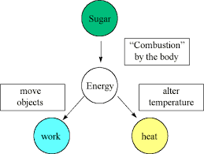
Thermodynamics
Thermodynamics, science of the relationship between heat, work, temperature, and energy.
thermodynamics deals with the transfer of energy from one place to another and from one form to another.
The key concept is that heat is a form of energy corresponding to a definite amount of mechanical work.
Riddles
What is the difference between heat and temperature?
What is the difference between heat and work?
What is the energy?
What are the types of Energy?
Notes:
Energy The property of a system that generally enables it to do work. Some forms of energy are kinetic, radiant, potential, chemical, electric, and magnetic.
Heat and work are two different ways of transferring energy from one system to another. The distinction between Heat and Work is important in the field of thermodynamics.
Heat is the transfer of thermal energy between systems, while work is the transfer of mechanical energy between two systems
https://keydifferences.com/difference-between-heat-and-temperature.html
Heat is the amount of energy in a body.
Temperature is the measure of the intensity of heat.

Slide 6
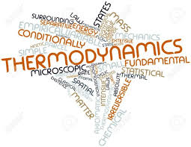
Thermodynamics
Thermodynamics is defined as the study of equilibrium states of a system which has been subjected to some energy transformation.
More specifically, thermodynamics is concerned with transformations of heat into mechanical work and of mechanical work into heat.

Slide 7
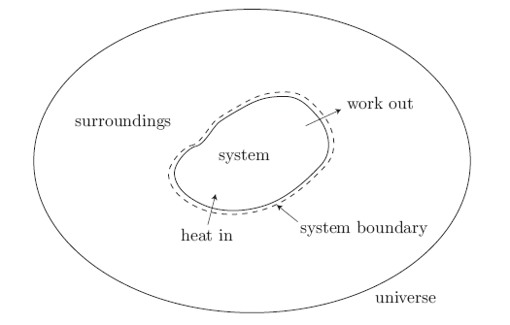
Some Definitions
Thermodynamic system: a quantity of fixed mass under investigation (matter and or energy). Examples of systems are (A parcel of air , A glass of water , An ice cube, The entire atmosphere , The entire Earth and atmosphere , The Universe )
Surroundings: everything external to the system,
System boundary: interface separating system and surroundings, and
Universe: combination of system and surroundings.
We allow two important interactions between the system and its surroundings:
• heat can cross into the system (our potato can get hot), and
• work can cross out of the system (our potato can expand).

Slide 8
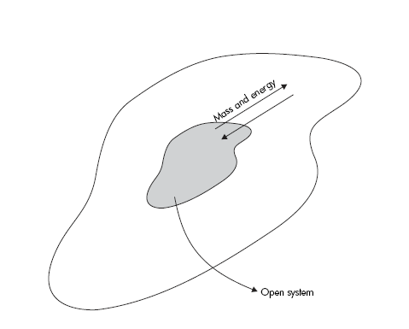
The Types of a SYSTEM
A system is called open (control volume) when it exchanges matter and energy with its surroundings. In the atmosphere all systems are more or less open.
Examples of open systems are:
A glass of water with no lid, allowing evaporation into the air above it.
An internal combustion engine, since it gains matter through the intake valves and loses matter through the exhaust manifold.
In an open system mass and energy can be exchanged with its environment.
Notes:
Matter is easy to understand and includes atoms, ions, electrons, etc.

Slide 9
The Types of a SYSTEM
A closed system is a system that does not exchange matter with its surroundings. In this case, the system is always composed of the same point masses (a point-mass refers to a very small object, for example a molecule).
Examples would be:
A glass of water with a lid.
A sealed soda can.
The inside of a ThermosTM bottle with the top screwed on.
The entire Universe (as far as we know).
A system is defined as closed when it exchanges energy but not matter with its environment, and as isolated if it exchanges neither mass nor energy.
Riddles
What is the Matter?
In a closed system, is there an energy exchange?
Notes:
Matter is easy to understand and includes atoms, ions, electrons, etc.

Slide 10
The Types of a SYSTEM
in atmospheric thermodynamics, we assume that most systems are closed, when the interactions associated with open systems can be neglected. This is approximately true in the following cases.
  (a) The system is large enough to ignore mixing with its surroundings at the boundaries, ex., a large cumulonimbus cloud may be considered as a closed system but a small cumulus may not.
  (b) The system is part of a larger homogeneous system. In this case mixing does not significantly change its composition.
A system is called isolated when it exchanges neither matter nor energy with its surroundings. Examples would be:
  The inside of a Thermos bottle with the top screwed on (assuming it was perfectly insulated).
  The entire Universe (as far as we know).

Slide 11
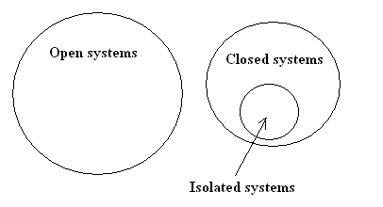
Some Notes
The set of all open systems does not intersect the set of all closed systems.
Every system is either open or it is closed.
The set of all isolated systems is a subset of the set of all closed systems.
Any isolated system is also a closed system, but a closed system is not necessarily an isolated system.
An open system cannot be an isolated system.
Any matter or energy that is not part of the system is considered to be part of the surroundings or environment.

Slide 12
Riddles
To a thermodynamic system two ‘things’ may be added/removed:
energy (in the form of heat &/or work) and matter, What are the type of a system in the following examples(open, closed or isolated)?
an open cup to which we can add water.
cool a closed water bottle in fridge.
A closed vacuum ‘thermos’ flask.
Notes:
To a thermodynamic system two ‘things’ may be added/removed:
➢ energy (in the form of heat &/or work) ➢ matter.
An open system is one to which you can add/remove matter (e.g. a open beaker to which we can add water). When you add matter- you also end up adding heat (which is contained in that matter).
A system to which you cannot add matter is called closed.
Though you cannot add/remove matter to a closed system, you can still add/remove heat (you can cool a closed water bottle in fridge).
A system to which neither matter nor heat can be added/removed is called isolated.
A closed vacuum ‘thermos’ flask can be considered as isolated.

Slide 13
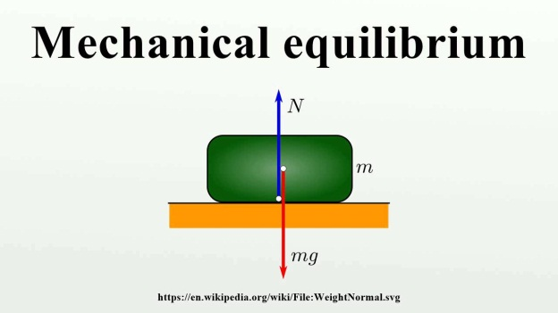
Thermodynamic Equilibrium
An equilibrium state is defined as a state in which the system’s properties, so long as the external conditions (surroundings) remain unchanged, do not change in time (no spontaneous changes). For example, a gas enclosed in a container of constant volume is in equilibrium if its pressure is constant throughout and its temperature is equal to that of the surroundings. There are three types of equilibrium:
Mechanical equilibrium – This means there are no unbalanced forces, so that neither the system, nor any part of the system, undergoes accelerations. This also implies that there is no turbulence within the system.
Material equilibrium – This means that there is no net transfer of matter from one phase or component of the system to another. The concentrations of chemical species and their phases are constant with time ( i.e. phase and chemical equilibrium).

Slide 14
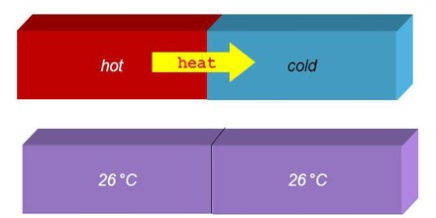
Thermodynamic Equilibrium
Thermal equilibrium – Means that the individual parts or pieces of the system would remain in the same state whether or not they were connected by a thermally conducting wall. In practicality, this means that there are no temperature gradients in the system.
A system is in thermodynamic equilibrium only if it is in mechanical, material, and thermal equilibrium.

Slide 15
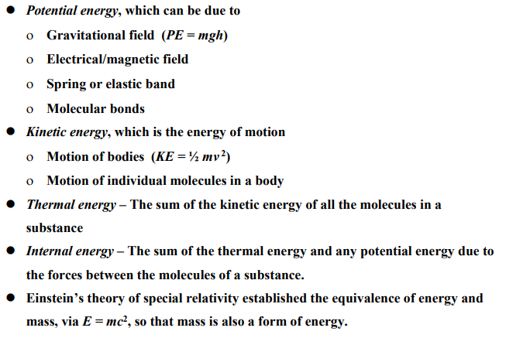
Types of Energy
Notes:
The theory of special relativity explains how space and time are linked for objects that are moving at a consistent speed in a straight line. One of its most famous aspects concerns objects moving at the speed of light.
potential energy: The energy a system has by virtue of its position; the negative of the work done in taking a system from a reference configuration, where the potential energy is assigned the value zero, to a given configuration, with no change in kinetic energy of the system.
internal energy : The energy of a system exclusive of its kinetic energy of mass motion and its potential energy arising from external forces.
The internal energy of a system of molecules is the sum of their translational kinetic energies, their vibrational (kinetic and potential) and rotational (kinetic) energies, and the total potential energy arising from forces between molecules. An ideal gas is defined as one for which the intermolecular potential energy is zero. The internal energy of such a gas depends only on its temperature.

Slide 16
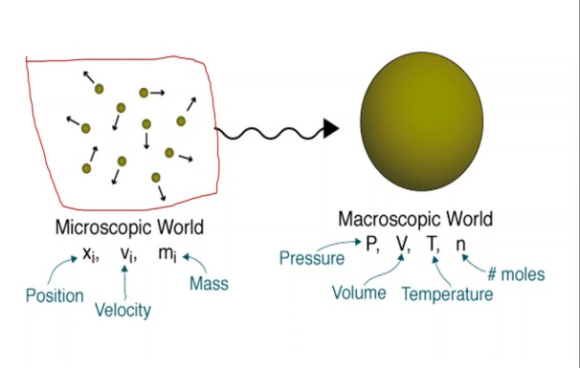
Macroscopic Vs Microscopic Approach
When a system has been chosen, the next step is to describe it in terms of quantities related to the behavior of the system or its interactions with the surrounding or both.
Microscopic approach considers the behavior of every molecule by using statistical methods.
In Macroscopic approach we are concerned with the average effects of many molecules' infractions. These effects, such as pressure and temperature, can be perceived by our senses and can be measured with instruments. This approach greatly reduces the complexity of the problem and we use this approach in this course. This is known as "Classical Thermodynamics".

Slide 17
Homogeneous and heterogeneous thermodynamic systems
A homogeneous system is defined as the one whose chemical composition and physical properties are the same in all parts of the system, or change continuously from one point to another. Example (a column of atmospheric air, which is a mixture of a number of gases, mainly nitrogen and oxygen, acted upon by the force of gravity, both the composition of the system and its physical properties will continuously change from one point to another.
A heterogeneous system is defined as one consisting of two or more homogeneous bodies. The homogeneous bodies of a heterogeneous system are referred to as phases ( i.e. The system that has more than one phase). An example of a heterogeneous system is water with ice floating in it. This system has two homogeneous bodies, water and ice. The chemical composition of the two phases is the same, but their physical properties differ drastically.

Slide 18
Phase, State and State variables
Phase: a quantity of matter that is homogeneous throughout, and Phase Boundaries: interfaces between different phases (an example of a single phase is ice. Another single phase is liquid water; a glass of ice water is a two-phase mixture with the phase boundaries at the edge of each ice cube).
State: condition described by observable macroscopic properties (state variable).
state variable: is a property of a system that depends only on the current, equilibrium state of the system and thus do not depend on the path by which the system arrived at its present state(independent of the history of the system), for example, internal energy, enthalpy, and entropy etc.

Slide 19
How to specify the state of a system thermodynamically?
The thermodynamic state of a system is defined by specifying values of a set of state variables. For fluid systems, typical properties are pressure, volume and temperature. More complex systems may require the specification of more unusual properties ( ex. the state of an electric battery requires the specification of the amount of electric charge it contains).
Since p, V, and T determine the state of the system, they must be connected by functional relationship f (p, V, T) = 0 which is called the equation of state.
Any other thermodynamic variables that depend on the state defined by the two independent state variables are called state functions. State functions are thus dependent variables and state variables are independent variables.

Slide 20
Extensive versus, Intensive variables
An intensive property is one that does not depend on how much substance is present. Temperature is an example of an intensive property. If two identical masses are at the same temperature and are added together, the temperature remains the same even though the mass is doubled.
An extensive property depends on how much substance is present. Internal energy is an example of an extensive property. If the two identical masses are added together there is twice as much internal energy.

Slide 21
Extensive versus, Intensive variables
There are two ways to convert an extensive property into an intensive property:
Divide by the mass. The result is a property that is normalized by the mass. We add the term specific to indicate that we’ve divided by the mass. For example, the specific internal energy u is defined as U/m.
Divide by the number of moles. The result is a property that is normalized by the number of moles present. We add the term molar specific to indicate we’ve divided by the number of moles. For example, the molar specific internal energy, u_{m}, is defined as U/n.
In general, extensive properties are denoted using upper-case letters, while intensive properties are denoted using lower-case letters. However, there are exceptions, including ONE NOTABLE EXCEPTION: Temperature is denoted using upper-case T, even though it is an intensive property.

Slide 22
TRANSFORMATIONS
A system that moves from one equilibrium state to another will experience a change in state variables.
The initial and final equilibrium states can be represented on a thermodynamic diagram.
There are an infinite number of paths on the diagram by which the system can be transformed from one equilibrium state to another. However, regardless of which path is taken, the change in the state variables will be the same between the two points.
Notes:
Note that only equilibrium states of a closed system can be represented on a 2-dimensional thermodynamic diagram. Why is this?

Slide 23


TRANSFORMATIONS
We can express this property of state variables mathematically in two ways:
  The change in any of the state variables (say U) doesn’t depend on the path of the system on a thermodynamic diagram. It only depends on the endpoints.
  The integral of a state variable around a closed path is zero.
Mathematically, this means that differentials of state variables are exact differentials.
  In order to be a state variable, the differential of the variable must be exact.
Notes:
Note that only equilibrium states of a closed system can be represented on a 2-dimensional thermodynamic diagram. Why is this?

Slide 24
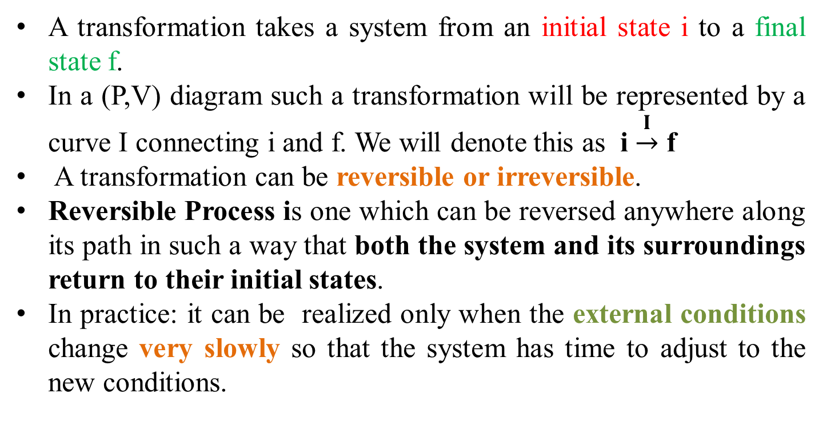
Reversible and Irreversible Process
A transformation takes a system from an initial state i to a final state f.
In a (P,V) diagram such a transformation will be represented by a curve I connecting i and f. We will denote this as i $\underset{→}{I}$ f
A transformation can be reversible or irreversible.
Reversible Process is one which can be reversed anywhere along its path in such a way that both the system and its surroundings return to their initial states.
In practice: it can be realized only when the external conditions change very slowly so that the system has time to adjust to the new conditions.

Slide 25
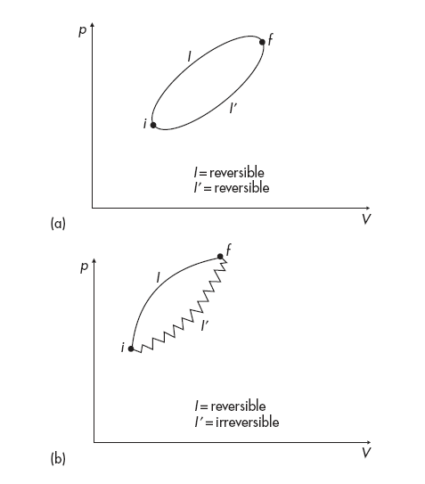
Reversible and Irreversible Process
ex., assume that our system is a gas enclosed in a container with a movable piston.
As long as the piston moves from i to f very slowly the system adjusts and all intermediate states are equilibrium states.
If a system goes from i to f reversibly, then it could go from f to i again reversibly if the same steps were followed backwards.
P1
Water at –5°C
Irreversible
Ice at –5°C
Water at –0°C
Ice at −0°C
P2
Heat
Reversible
Cool
Water at –5°C
Ice at –5°C

Slide 26
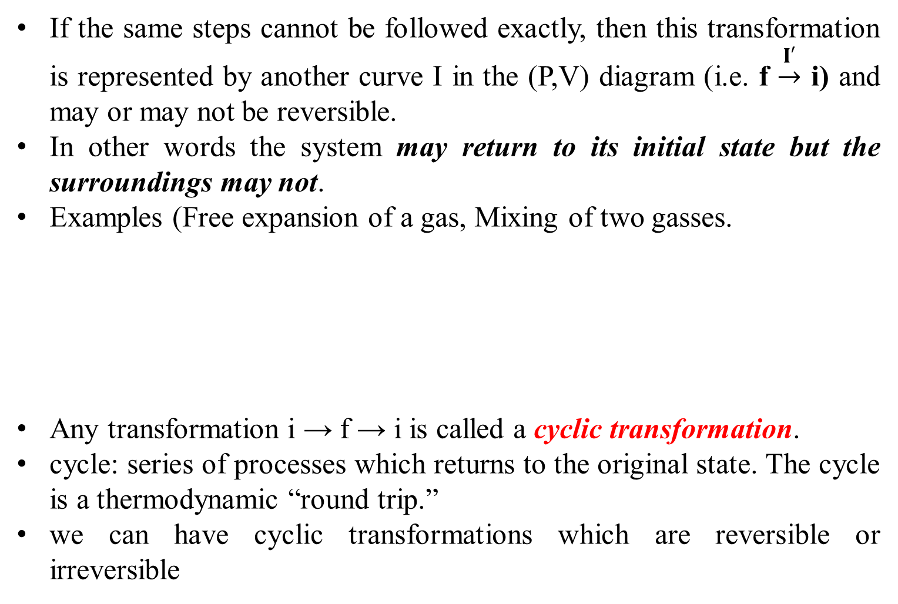
Irreversible Process
If the same steps cannot be followed exactly, then this transformation is represented by another curve I in the (P,V) diagram (i.e. f $\underset{→}{I′}$ i) and may or may not be reversible.
In other words the system may return to its initial state but the surroundings may not.
Examples (Free expansion of a gas, Mixing of two gasses.
Any transformation i → f → i is called a cyclic transformation.
cycle: series of processes which returns to the original state. The cycle is a thermodynamic “round trip.”
we can have cyclic transformations which are reversible or irreversible
Riddles
It follows that turbulent mixing in the atmosphere is a source of irreversibility, why?

Slide 27
THE END OF LECTURE TWO

