Slide 2
GENETICS is the study of inherited traits and their variation. Sometime people confuse genetics with genealogy, which considers relationships but not traits. Genetics is a life sciences. The science of heredity or genetics is the study of two contradictory aspects of nature : heredity and variation. The process of transmission of characters from one generation to next, either by gametes–sperms and ova–in sexual reproduction or by the asexual reproductive bodies in asexual reproduction, is called inheritance or heredity.

Slide 3
The science of genetics is the study of heredity which is the cause of similarities; and variation which is the cause of differences between individuals
Cells are the fundamental structural and functional units of every known living organism..

Slide 4
Instructions needed to direct activities are contained within a DNA (deoxyribonucleic acid) sequence. DNA from all organisms is made up of the same chemical units (bases) called adenine, thymine, guanine, and cytosine, abbreviated as A, T, G, and C. In complementary DNA strands, A matches with T, and C with G, to form base pairs

Slide 5
The human genome (total composition of genetic material within a cell) is packaged into larger units known as chromosomes—physically separate molecules that range in length from about 50 to 250 million base pairs. Human cells contain two sets of chromosomes, one set inherited from each parent.

Slide 6
Each cell normally contains 23 pairs of chromosomes, which consist of 22 autosomes (numbered 1 through 22) and one pair of sex chromosomes (XX or XY). However, sperm and ova normally contain half as much genetic material: only one copy of each chromosome.
Each chromosome contains many genes, the basic physical and functional units of heredity. Genes are specific sequences of bases that encode instructions for how to make proteins.

Slide 7
Cytogenetics is a field of genetics dealing with species or cell specific number of chromosomes, and their structure and characteristic segments, their functional roles, and all the differences - namely the chromosomal mutations - related to them. Chromosome mutations are changes in the structure or in the number of chromosomes, and since

Slide 8
The structure of chromosomes and genes
A chromosome is an organized structure of DNA and protein that is found in cells. A chromosome is a single piece of coiled DNA containing many genes, regulatory elements and other nucleotide sequences. Chromosomes also contain DNA-bound proteins, which serve to package the DNA and control its functions. (The word chromosome comes from the Greek chroma - color and soma - body due to their property of being very strongly stained by particular dyes.) Chromosomes vary widely between different organisms

Slide 9
Viral Chromosomes
The chromosomes of viruses are called viral chromosomes. They occur singly in a viral species and chemically may contain either DNA or RNA. The DNA containing viral chromosomes may be either of linear shape (e.g., T2, T3, T4, T5, bacteriophages) or circular shape (e.g., most animal viruses and certain bacteriophages).

Slide 10
The RNA containing viral chromosomes are composed of a linear, single-stranded RNA molecule and occur in some animal viruses (e.g., poliomyelitis virus, influenza virus, etc.); most plant viruses, (e.g., tobacco mosaic virus, TMV) and some bacteriophages

Slide 11
The prokaryotes usually consists of a single giant and circular chromosome in each of their nucloids. Each prokaryotic chromosome consists of a single circular, double-stranded DNA molecule; but has no protein and RNA around the DNA molecule like eukaryotes. Different prokaryotic species have different sizes of chromosome.

Slide 12
Eukaryotic Chromosomes
The eukaryotic chromosomes differ from the prokaryotic chromosomes in morphology, chemical composition and molecular structure. The eukaryotes (plants and animals) usually contain much more genetic informations than the viruses and prokaryotes, therefore, contain a great amount of genetic material, DNA molecule which here may not occur as a single unit, but, as many units

Slide 13
A single molecule of DNA within a chromosome may be as long as 8.5 centimeters (3.3 inches). To fit within a chromosome, the DNA molecule has to be twisted and folded into a very complex shape. Each chromosome has a constriction point called the centromere, which divides the chromosome into two sections, or “arms.” The short arm of the chromosome is labeled the “p arm.” The long arm of the chromosome is labeled the “q arm.” The location of the centromere on each chromosome gives the chromosome its characteristic shape, and can be used to help describe the location of specific genes.

Slide 14
Furthermore, cells may contain more than one type of chromosome; for example, mitochondria in most eukaryotes and chloroplasts in plants have their own small chromosomes. The following are the different types of chromosomes Morphologically l chromosome described metacentric, submetacentirc , or acrocentric

Slide 15
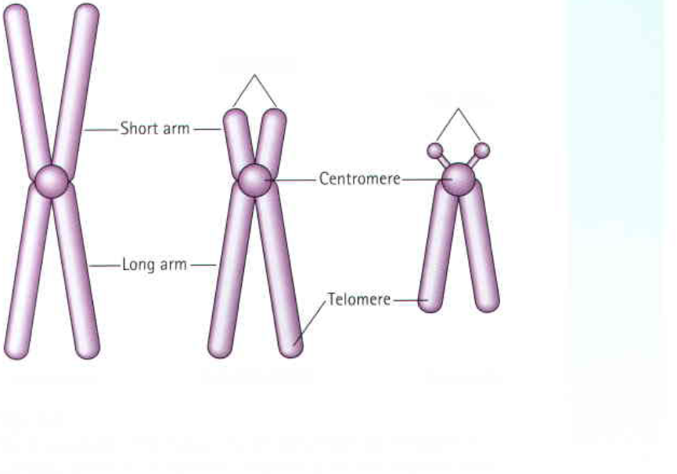
metacentric, submetacentirc , or acrocentric

Slide 16
Chemical Structure of chromatin
Chemically, the eukaryotic chromosomes are composed of
1-deoxyribonucleic acid (DNA),
2-ribonucleic acid (RNA)

Slide 17
3 - histone and non-histone proteins (The histone proteins have basic properties and have significant role in controlling or regulating the functions of chromosomal DNA. The non-histone proteins are mostly acidic and have been considered more important than histones as regulatory molecules. Some non-histone proteins also have enzymatic activities. The most important enzymatic proteins of chromosomes are phosphoproteins, DNA polymerase, RNA-polymerase, DPN-pyropbosphorylase, and nucleoside triphosphatase.
4- and certain metallic ions. (The metal ions as Ca+ and Mg+ are supposed to maintain the oragnization of chromosomes intact).

Slide 18
Euchromatin: The lightly-stained regions in chromosome when stained with basic dyes are called euchromatin and contain single-copy of genetically-active DNA.
The extent of chromatin condensation varies during the life cycle of the cell and plays an important role in regulating gene expression. In the interphase of cell cycle the chromatin are decondensed and known as euchromatin leading to gene transcription and DNA replication.

Slide 19
Heterochromatin: The word heterochromatin was coined by Emil Heitz based on cytological observations. They are highly condensed and ordered areas in nucleosomal arrays. About 10% of interphase chromatin is called heterochromatin and is in a very highly condensed state that resembles the chromatin of cells undergoing mitosis

Slide 20
They contain a high density of repetitive DNA found at centromeres and telomeres form heterochromatin.
Heterochromatin are of two types, the constitutive and facultative heterochromatin. The regions that remain condensed throughout the cell cycle are called constitutive heterochromatin whereas the regions where heterochromatin condensation state can change are known as facultative.

Slide 21
An example of facultative heterochromatin is the Barr body, which can be seen in interphase cells from females, which is the inactive X
Q1 / Compare between the heterochromatin and euchromatin

Slide 22
DNA Packaging
A-Long sequence of DNA must be stored within the geometry of a nucleus human chromosome 22, (48 million bp Extends to length of ~1.5 cm) Measures 2 m in mitosis Packaging ratio on the level of 10⁴ in mitosis
B-Packaging ratio ~500 in interphase•
C- Packaged DNA must provide controlled access to regions required for gene expression.
The first level of packing
Winding of DNA around a protein core to produce a "bead-like" structure called a nucleosome.( nucleosome is a structure unit of chromosome ) This structure is invariant in both the euchromatin and heterochromatin of all chromosomes. The protein core is composed of 8 histone proteins, two each of H2A, H2B, H3 and H4. Histone H1 forms the linker between to nucleosomes. 146 bp of DNA is wrapped around each nucleosome.

Slide 23
2-The second level of packing Coiling of beads in a helical structure called the 30 nm fiber that is found in both interphase chromatin and mitotic chromosomes. Coiling of beads in a helical structure called the 30 nm fiber that is found in both interphase chromatin and mitotic chromosomes.

Slide 24
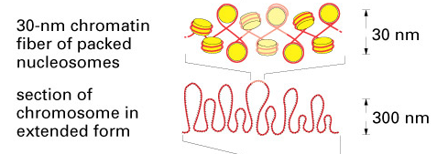
2-The second level of packing Coiling of beads in a helical structure called the 30 nm fiber that is found in both interphase chromatin and mitotic chromosomes. Coiling of beads in a helical structure called the 30 nm fiber that is found in both interphase chromatin and mitotic chromosomes.

Slide 25
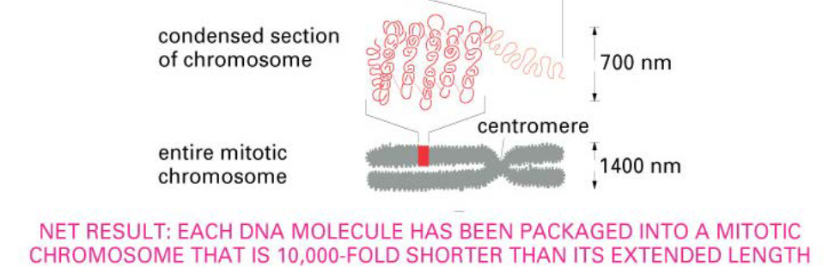
3-The final level of packing :the fiber organized in loops, scaffolds and domains that give a final packing ratio That give final package ratio about 1000 in interphase chromosome and about 10,000 in mitotic chromosome The final level of packaging is characterized by 700 nm structure seen in the

Slide 26
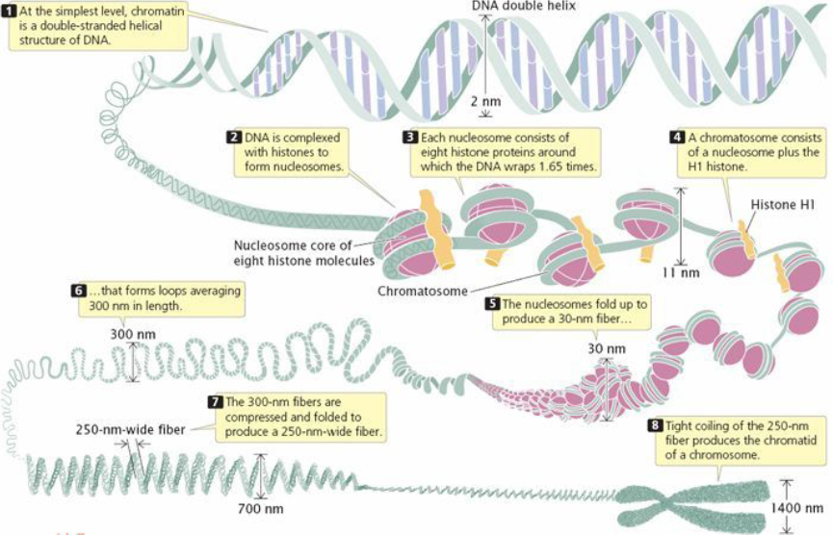

Slide 27
