Slide 1
by Fatima Mohammad & Rand Modher
dielectric

Slide 2
DIELECTRIC Building simple atom Interpretation of dielectric Electric Dipole Moment The polarization Condenser Capacity Definition of condenser capacity Types of dielectric breakdown voltage
Index

Slide 3
DIELECTRIC
Is a material that passes through the electric field, but it is not necessarily connected to the electrical current
while insulator "is used to prevent the passage of electricity through it
What distinguishes these materials because they are not connected, that the electrons are not free movement as they are in the metals conductive.

Slide 4
Building simple atom
the material consists of atoms The distance between them .each atom consists of a cloud of negatively charged electrons and a nucleus with positive electrical charge at the center of the negative cloud. the charge of the positive nucleus and the charge of cloud are composed of the negative electrons thus producing the neutral atom.

Slide 5
because of the large distance between the atoms in the insulating material and bond between electrons and nuclei .it is difficult to transfer electrons from one atom to another when the impact of an electric field outside it.

Slide 6
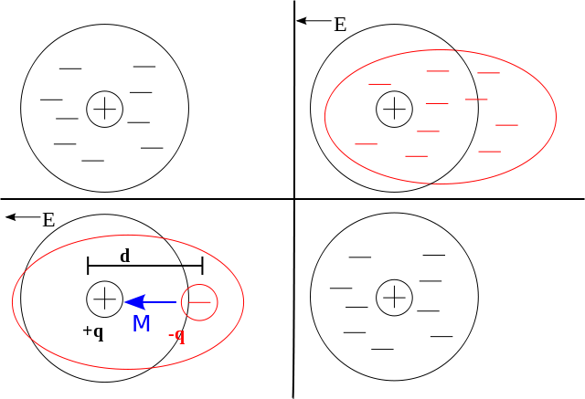
Effect of electric field on one atom

Slide 7
Interpretation of dielectric
that the electrons can not flow from one atom to another under the influence of the external electric field.
Which can be represented by two electrodes, one negative and the other positive charge, and do not move electrons between the atoms, that is, do not allow the passage of electric current.

Slide 8
Under the influence of the external electric field, only the shape of the cloud of electrons disappears for each atom, as is evident in the form, instead of the spherical cloud becoming an oval shape.

Slide 9
Electric Dipole Moment
The Dipolar moment consists of two equal loads in quantity and different in the signal
The bipolar moment is defined by the
p = q d relationship
where d is the vector of the distance between the two charges

Slide 10
The polarization
It is defined as the Electric Dipole Moment to the unit of volumes of matter by assuming that the number of particles in the volume unit is N

Slide 11
The polarization
The Dipolar determination of each molecule is μ
The polarization of the material is written as follows
P =N μ

Slide 12
Condenser Capacity
The condenser consists of two parallel plates with an insulating material between them. The capacity of the capacitor is proportional to the constant value of the
C=K A ⁄d
insulation of the insulation material
K :
It represents the electrical insulation constant also called the permeability of the insulating medium
A:The space of each plates
d:The distance between them

Slide 13
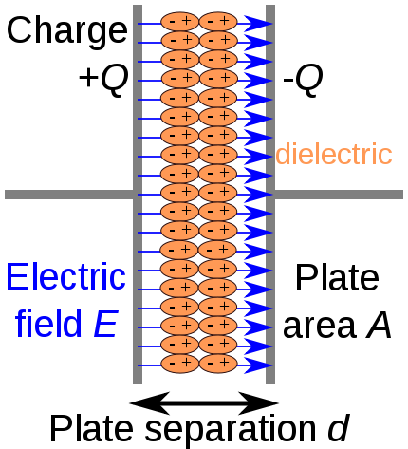
Condenser

Slide 14
Definition of condenser capacity:
Expanded capacity = charge Coulomb voltage difference between the ends of the expanded volt.
C = Q/V
Where: Q charge coulomb
v Volt voltage

Slide 15
المكثف

Slide 16
Different forms of Condenser

Slide 17
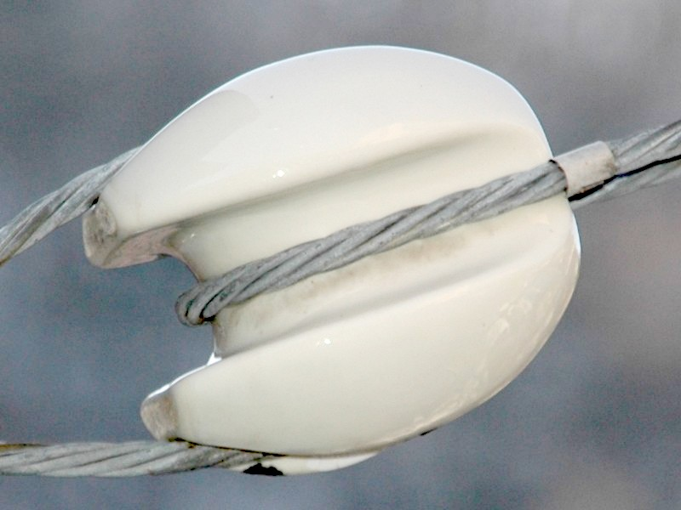
Types of dielectric
1.Insulators racking

Slide 18
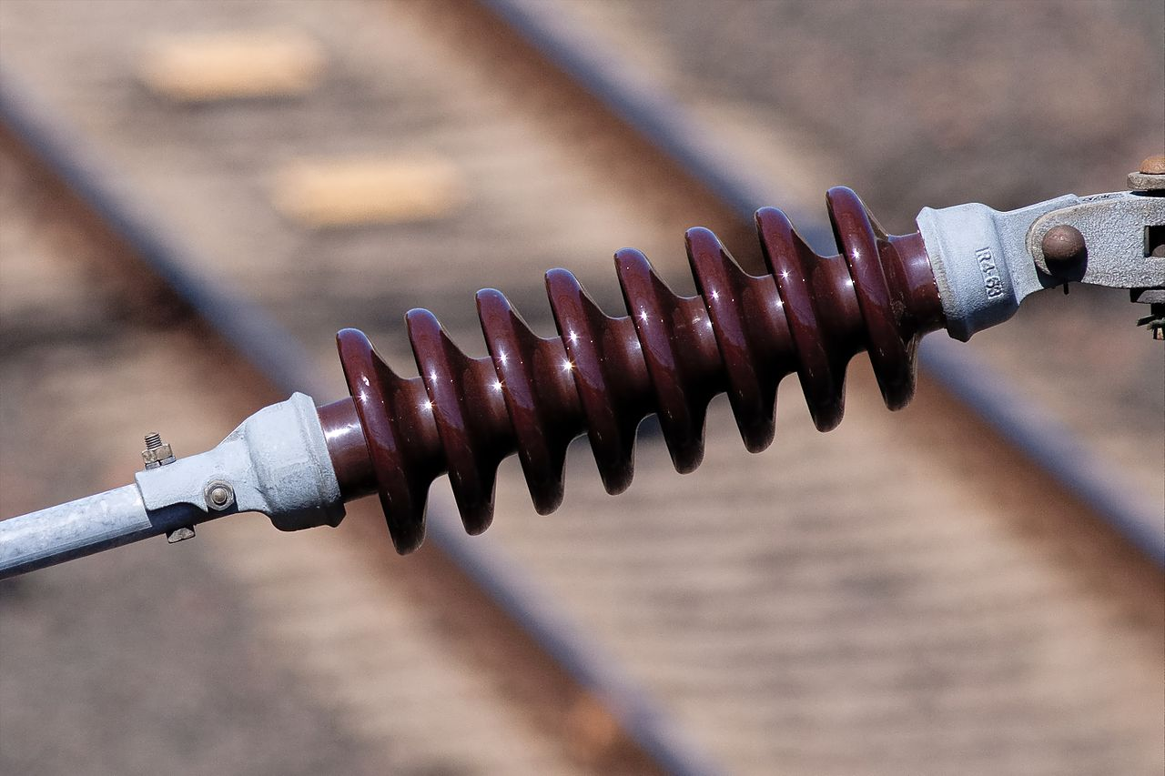
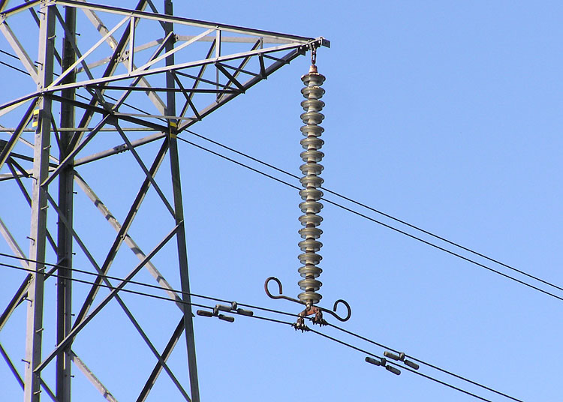
2.Cuneiform dielectric
3.Insulators of suspension

Slide 19
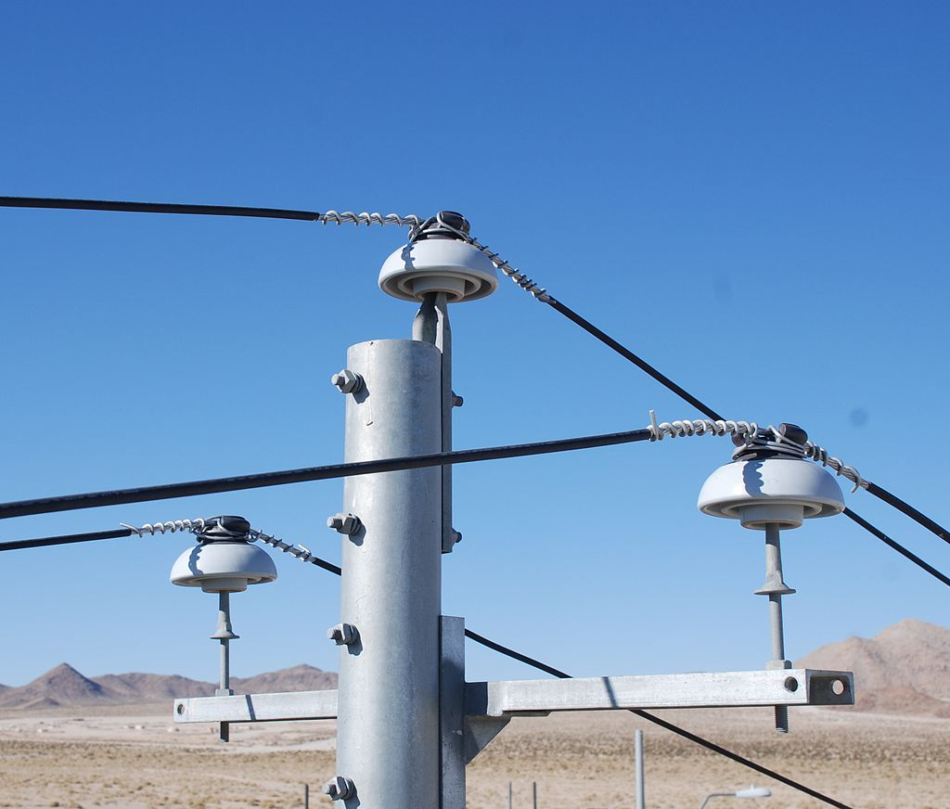
4. insulators support
4

Slide 20
breakdown voltage
In electricity and physics is the least voltage on an electrical insulator to become a conductor of the current
The breakdown voltage is one of the properties of an electrical insulator

Slide 21
It is not completely stable because it depends on the structure of the material and its impurities and defects, there is a possibility of collapse at a particular effort.

Slide 22
Solids : In the solid material, an infiltrator is an easy way to pass a current when the voltage is placed on it
Gases and Vacuum: Electric discharge in gas The gases act as a good electrical insulator under normal conditions of pressure and temperature. It needs regular electrical efforts to get out of the insulation

Slide 23
Uses dielectric
1. in many types use electrical and
electronic equipment
2.Metal wires and wire bundles that connect electricity from power to homes and offices are covered with insulating materials to prevent leakages and protect people.
3.They are also used in electrical capacitors to increase their ability to store electrical charge.
plants

